Slide 1
YE2 – YE3 distance
Manual measurements
The expected values obtained from a few manual measurements and drawings have been presented.
We were waiting for the discs to close to obtain the values from the IR sensors.
The values obtained from the IR sensors were 10 - 40mm out from what had been estimated.
Decision to go to a manual measurement at numerous points around periphery of the discs.

Slide 2
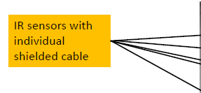
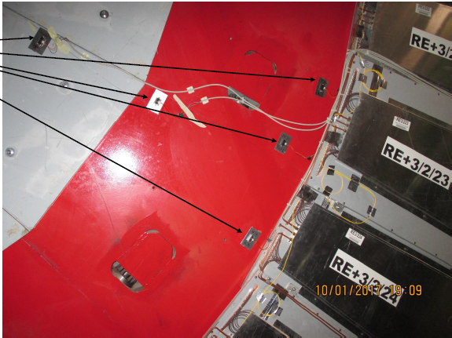
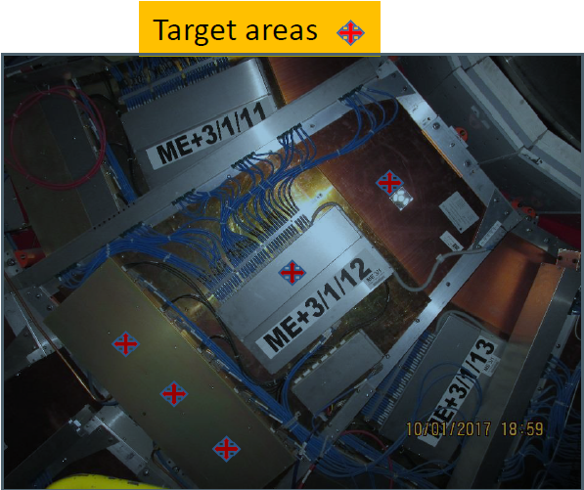
Results from IR - sensors
* IR sensors was installed in 10th of January 2017
Results will be come later

Slide 3
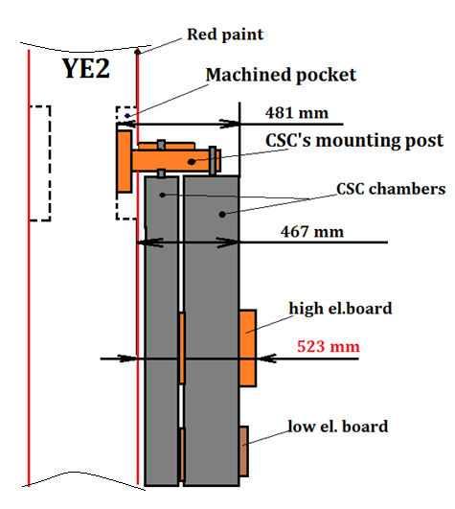
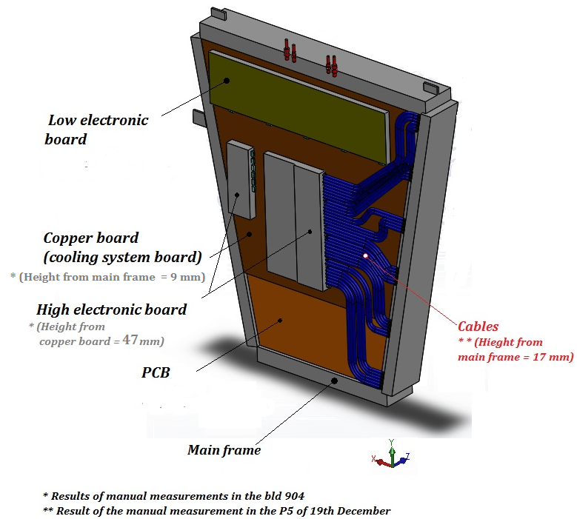
Results from manual measurements
Principle scheme of the manual measurements in the CSC chamber
Nuances of the CSC chamber design

Slide 4
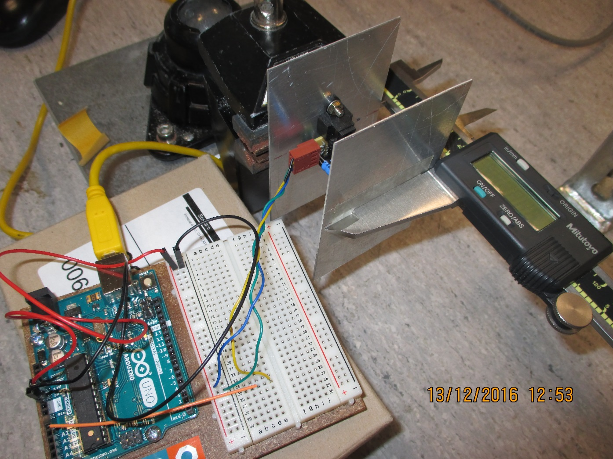
Values from IR
Calibration in 904. later calibrated with full length cables

Slide 5
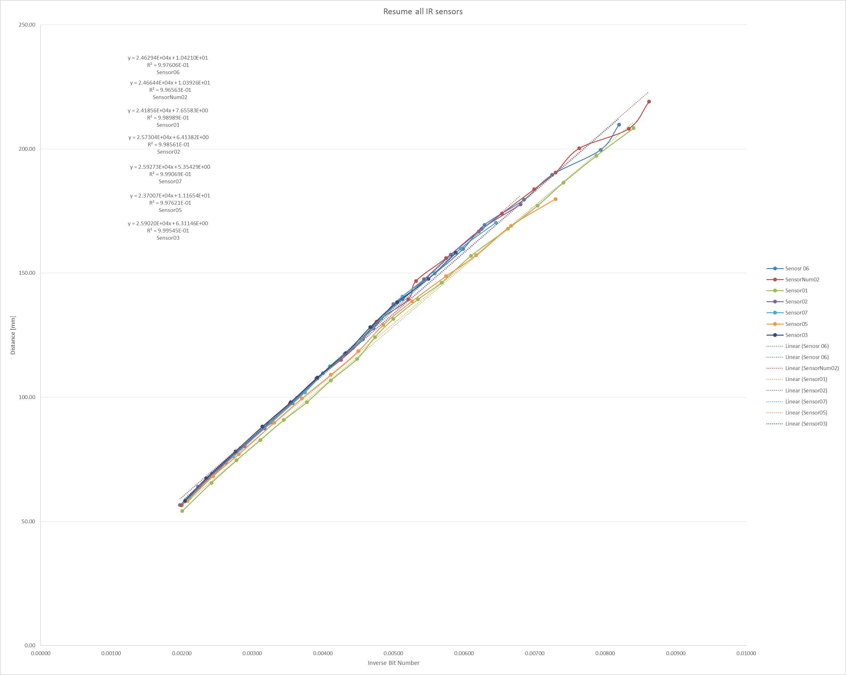
Individual calibration curves
Required range
Resolution better than 1mm. Between the closed discs the values were very stable, oscillating between only 2 bits.

Slide 6
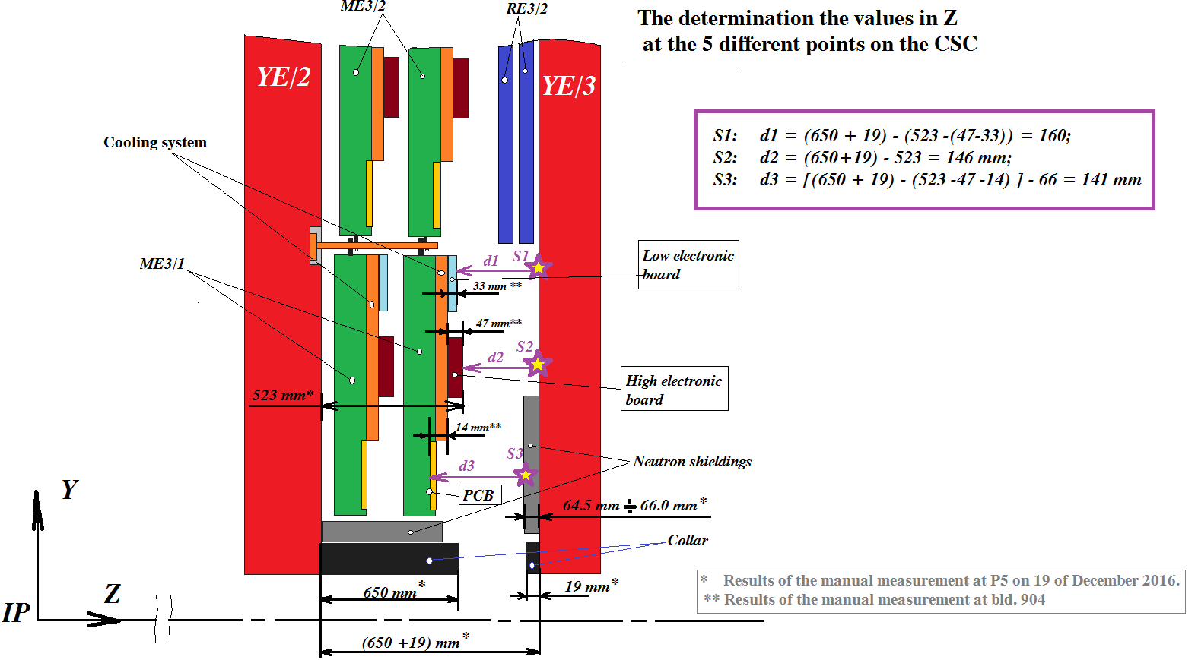
200.8mm
201.8mm
197.8mm
167.1mm
151mm
Values obtained from IR sensors in Red
467 mm (from YE2 to edge CSC) + 31 (LEB) + 14 (height difference between HEB and LEB) = 512 mm
S1: d1 = 670 – (467+31) = 172 mm
S2: d2 = 670 – 512 = 158 mm
S3: d3 = 670 – 467 - 66 = 137 mm
RPC space over the N. Shield
158 mm – 66 mm = 92
Value “Z” between CSC and RE3/1 will be
92 - (5+25+5+25) = 32 mm. - clearance between CSCs and RE3/1

Slide 7
Values taken on outer “R” at 3 different locations on both –Z and +Z on 25 April 2017. Discs closed.
178-174mm
Mean 176mm
145-145mm
486mm
14mm
ME3/2
RPC space
176 - 14 = 162mm
Drawings = 146mm
RE3/2
YE2
YE3
RPC space over the N. Shield
162 – 66 = 96mm
Standard RPC 29mm gives 68mm with mounting brackets. Leaving a generous clearance to CSCs of 28mm.
Was 88mm from drawings.
668-672mm
Mean 670mm

Slide 8
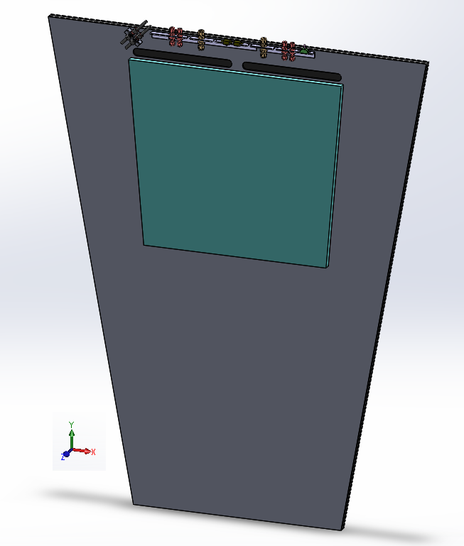
1. FEB cover up to PP and wider to adjacent chamber.
FEB
YE2
ME3/1
YE3
RE 3/1

Slide 9
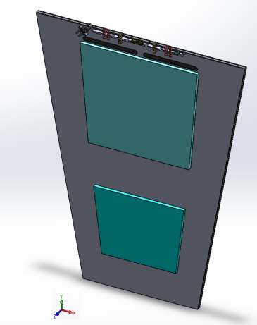
2. Additional FEB cover at low R
3. Provocative visible FEB cover that does not have a co planar interface with the CSC !
FEB
FEB
FEBs
ME3/1
YE2
YE2
ME3/1
YE3
YE3
RE 3/1
RE 3/1
96 mm
140 mm
N
N
66+5+20

Slide 10
Conclusion
The IR measurements are way away from basic drawing values.
Manual measurements are reliable both at inner and outer radii !
We appear to have > 10mm more Z space.
Now we are confident in our values we go back to IO to come to a common agreement. Already talked with Boki.

