Slide 1
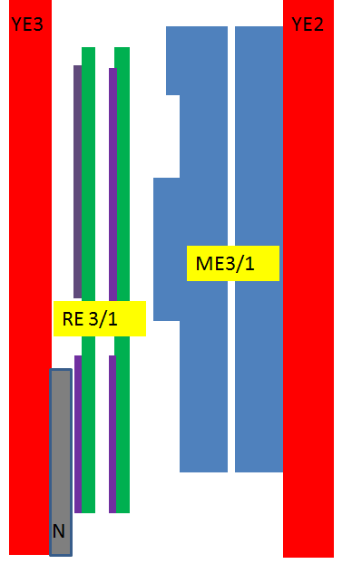
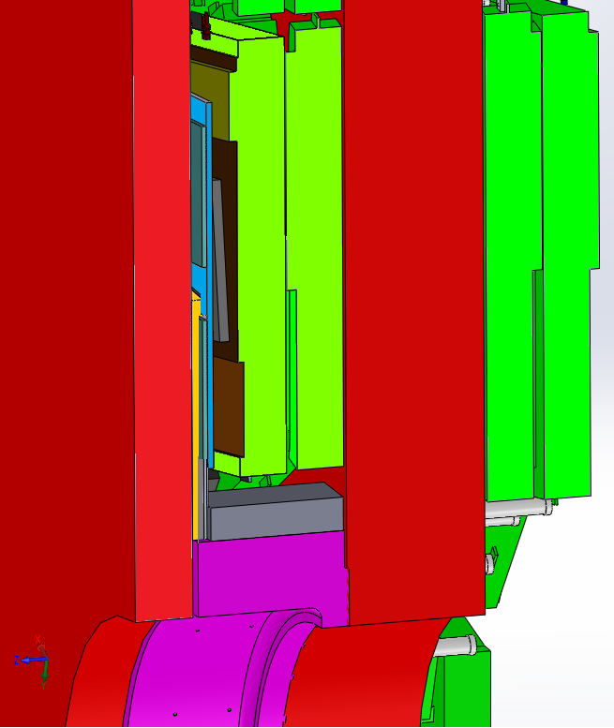
Cross section YE3 and YE2
RPC RE3/1 chambers
Principle scheme
CSC, Highest Electronics Cover
FEB
YE3
YE2
36 mm
between RE3/1 and CSC (high electronics board)
RE 3/1
ME3/1
FEB
CSC, Highest Electronics Cover
FEB
Neutron shield.
670 mm
between YE2 and YE3
96 mm
between CSC (high electronics board) and N.Sield.

Slide 2
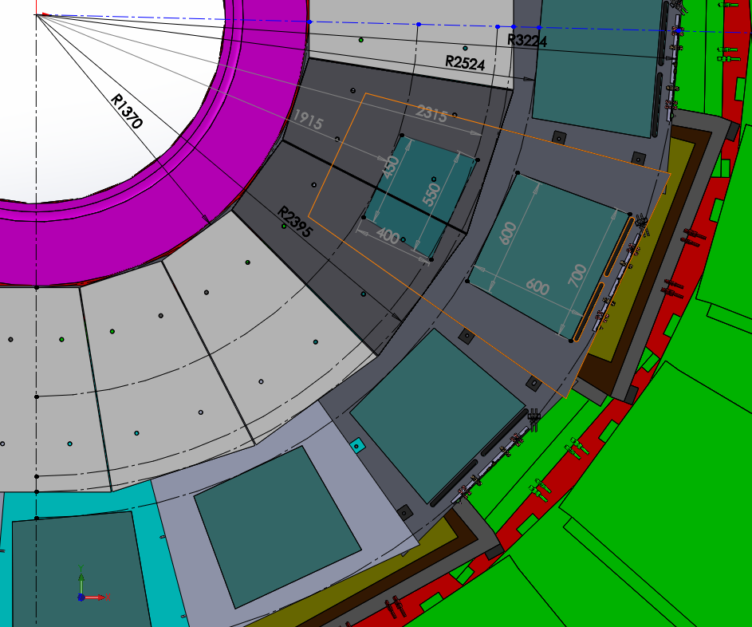
Ri 1664 mm
FEB
731 mm
1560 mm
FEB
RE3/1
“on”
Neutron Shielding
1025 mm
RE3/1
“off”

Slide 3
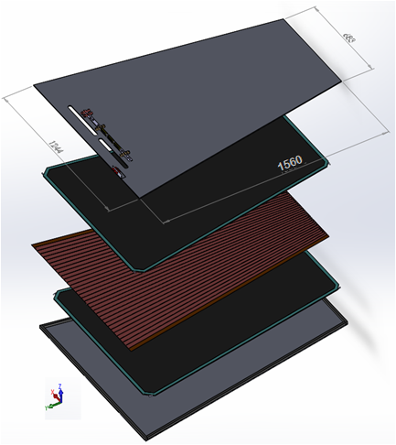
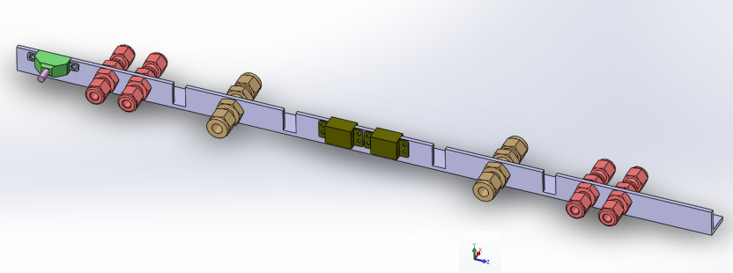
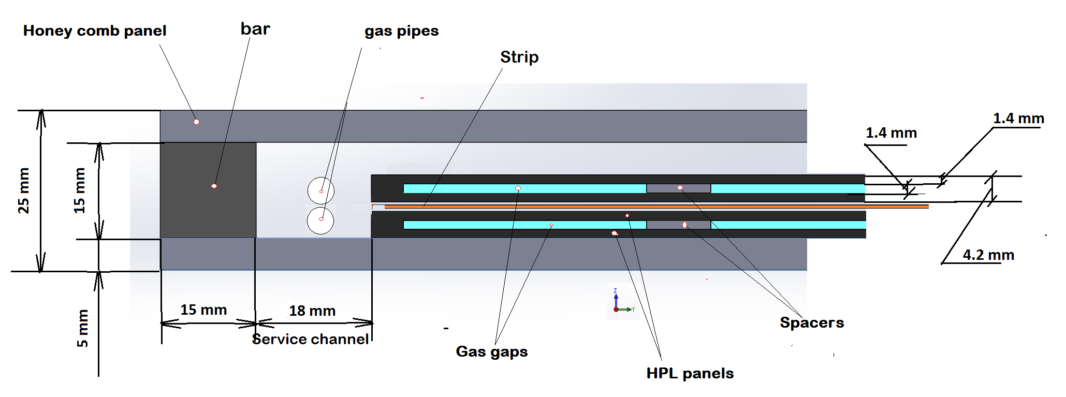
Design RPC RE3/1 and RE4/1 chambers
Double gap RPC chamber
Design Patch panel connections for RE3/1
Flat cable connectors
LV power connector
Cooling
connections
Gas connections
Thickness RPC chamber is of 25 mm!
Cross section of double gap RPC chamber

Slide 4
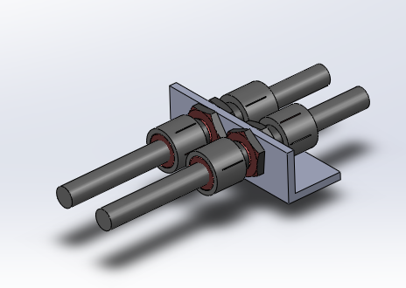
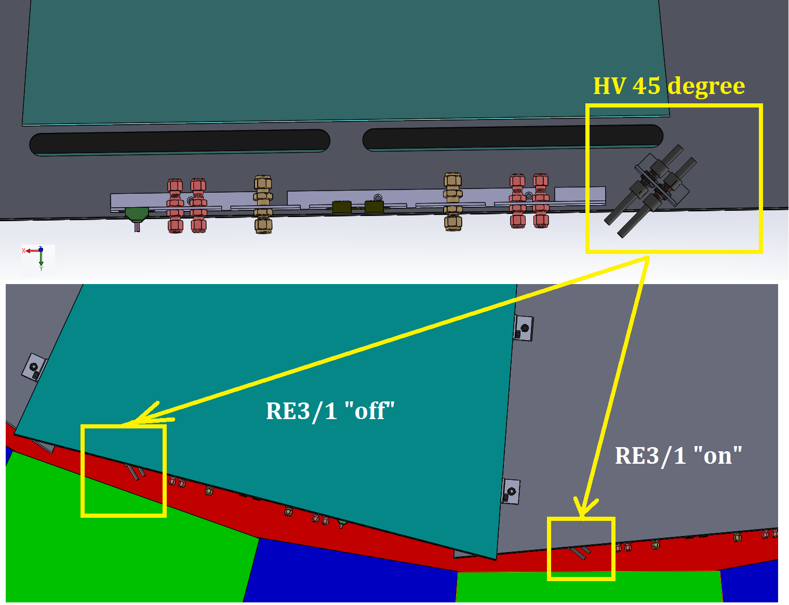
HV connectors
FEB
PP

Slide 5
Available value “Z” space for RPC RE4/1 chambers
Name of methods to determine the value “Z" | Distance between YE/ 4 and YE/3, mm | Thickness ME4/1 package, mm | Thickness neutron shielding, mm | Distance between YE/ 4 and ME4, mm
Main drawing of the CMS (3D model) | 655 | 504 | 63 | 151
Available value “Z” will be about (655-504-63) = 88 ± 1 mm
BUT
88 ± 1 mm is not enough space for RE4/1 RPC chambers with overlapping!
Because (88 ± 1) – ( 20 + 25+ 5 +25 + 8) = 5 ± 1 mm,
where
The space between ME4/1 and RE4/1 should be a minimum of 20 mm;
Thicknesses of the RE4/1 “on” yoke and “off” yoke is 25 mm;
The value gap is 5 mm;
Thickness Alu mounting plates is 8 mm.
Thus, we have the available space for RE4/1 chambers without overlapping!

Slide 6
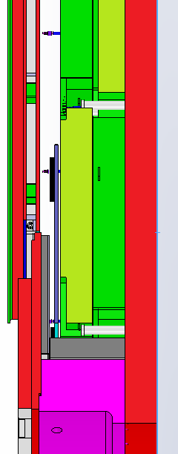
Cross section YE3 and YE4
YE4
YE3
20 mm!!!
Clearance between ME4/1 and RE4/1
504 mm
RE 4/1
FEB
23 mm
between FEB and N.shield
ME4/1
88 mm
between ME4/1 and N.shield.
63 mm
thickness N. shield.
655 mm
between YE3 and YE4

Slide 7
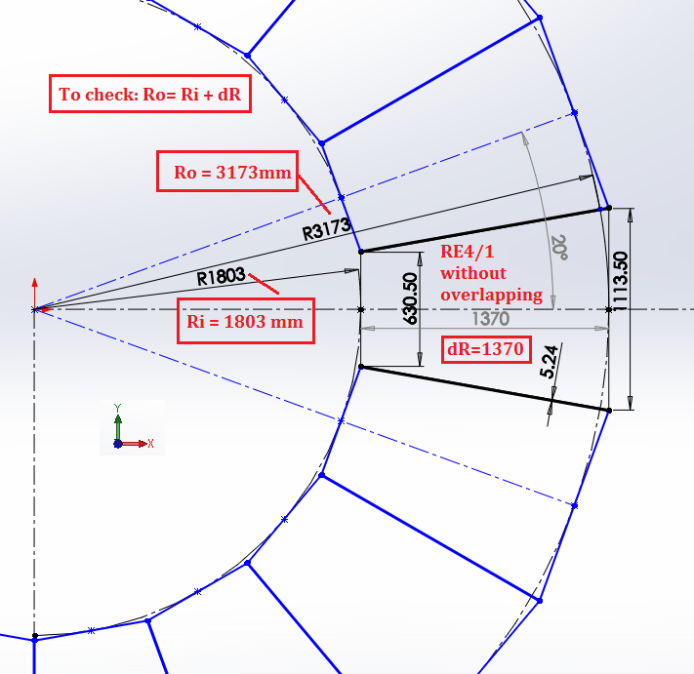
Dimensions of RE41 chambers without overlapping

