Slide 1
Main results received during the EYETS16 for the RE3/1 and RE4/1 envelope
Elena Voevodina, Ian Crotty, Salvatore Buontempo
30/05/2017

Slide 2
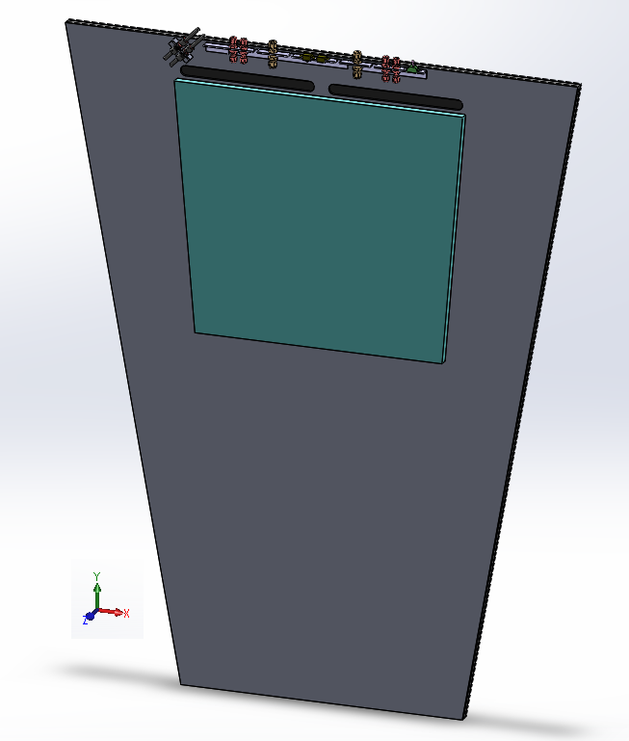
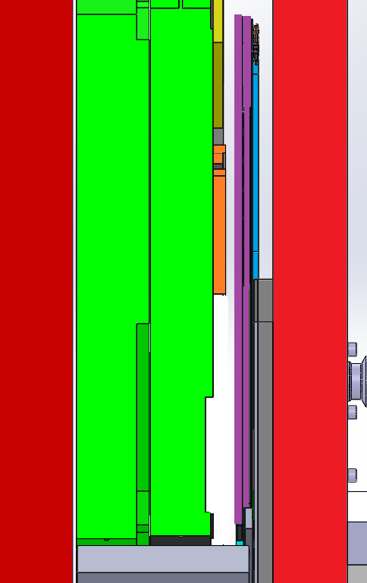
FEB in high R
FEB cover up to PP
Cross section X
FEB
YE2
YE3
RE 3/1
HEB
FEB
ME3/1
96 mm (IO)
between ME3/1 (HEB) and N. Shield
Neutron shield.
140 mm
between ME3/1 (PCB) and N. Shield
670 mm
between YE2 and YE3

Slide 3
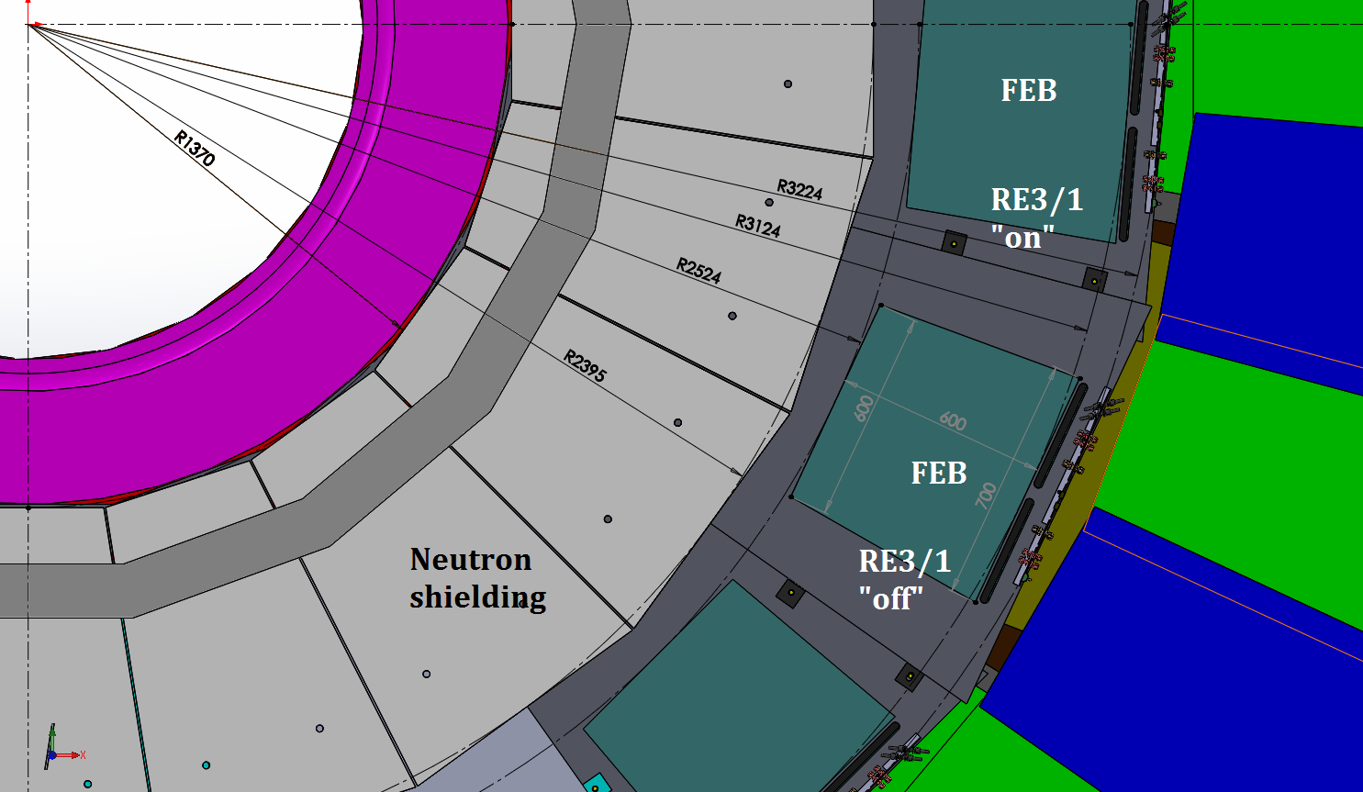
FEB in high R
Length of RPC RE3/1 chamber of 1560 mm

Slide 4
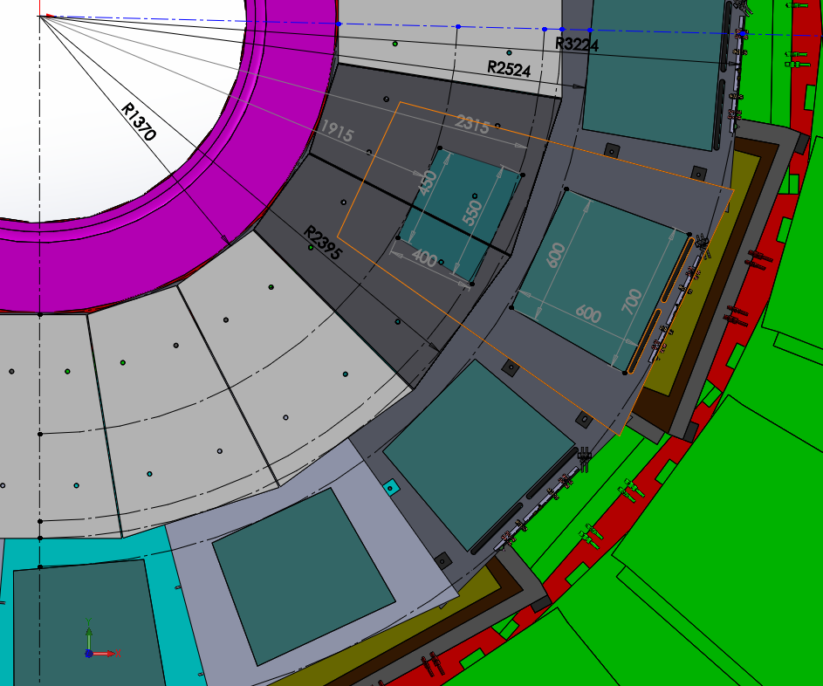
FEB in lower R
FEB
FEB
RE3/1
“on”
Neutron Shield.
Length of 1025 mm
RE3/1
“off”

Slide 5
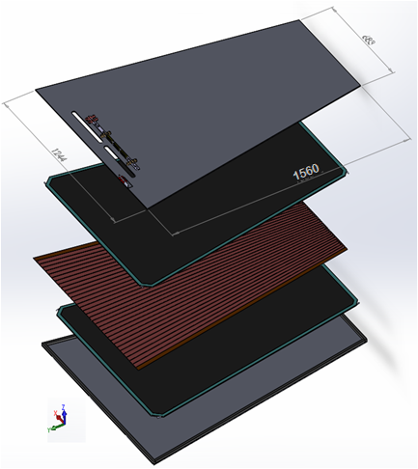
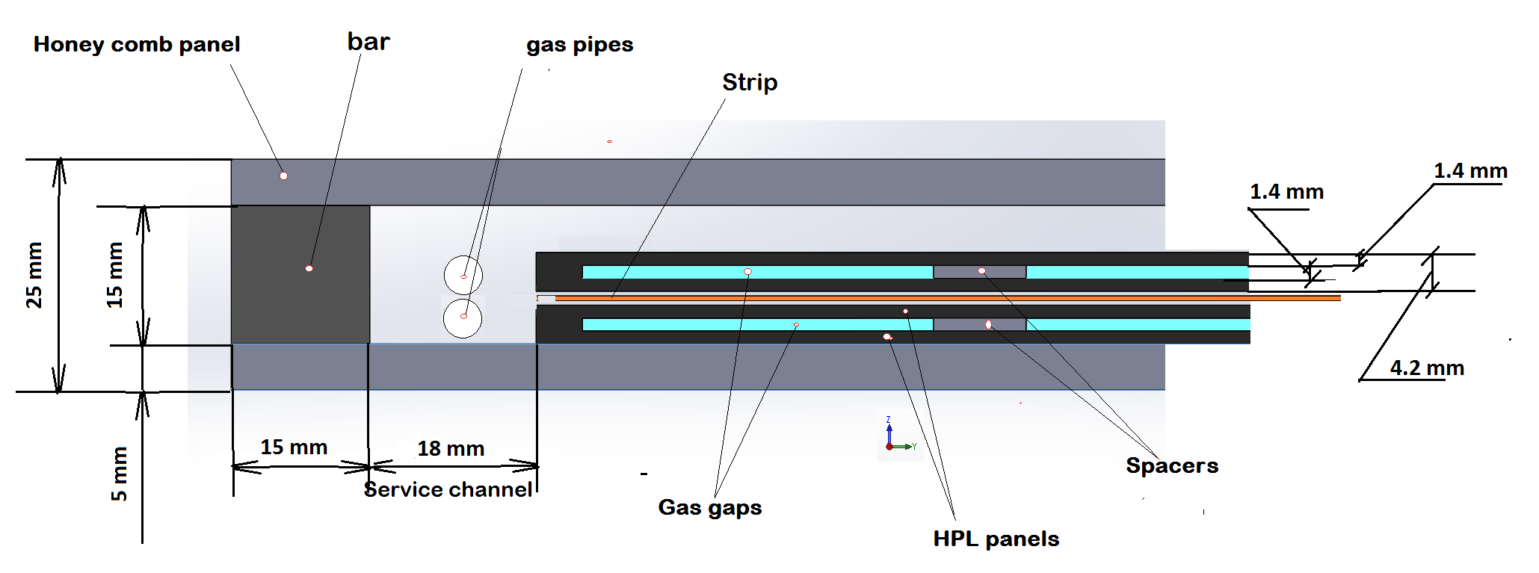
Design RE3/1 and RE4/1 RPC chambers
Double gap RPC chamber
thickness RPC chamber is 25 mm;
Cross section of double gap RPC chamber

Slide 6
Available value “Z” space for RE4/1 RPC chambers
Name of methods to determine the value “Z" | Distance between YE/ 4 and YE/3, mm | Thickness ME4/1 package, mm | Thickness neutron shielding, mm | Distance between YE/ 4 and ME4, mm
Main drawing of the CMS (3D model) | 655 | 504 | 66 | 151
Available value “Z” will be about (655-504-66) = 85 ± 1 mm
BUT
85 ± 1 mm is not enough space for RE4/1 RPC chambers with overlapping!
Because (85 ± 1) – ( 20 + 25+ 5 +25 + 8) = 3 ± 1 mm,
where
The space between ME4/1 and RE4/1 should be a minimum of 20 mm;
Thicknesses of the RE4/1 “on” yoke and “off” yoke is 25 mm;
The value gap is 5 mm;
Thickness Alu mounting plates is 8 mm.
Thus, we have the available space for RE4/1 chambers without overlapping!

Slide 7
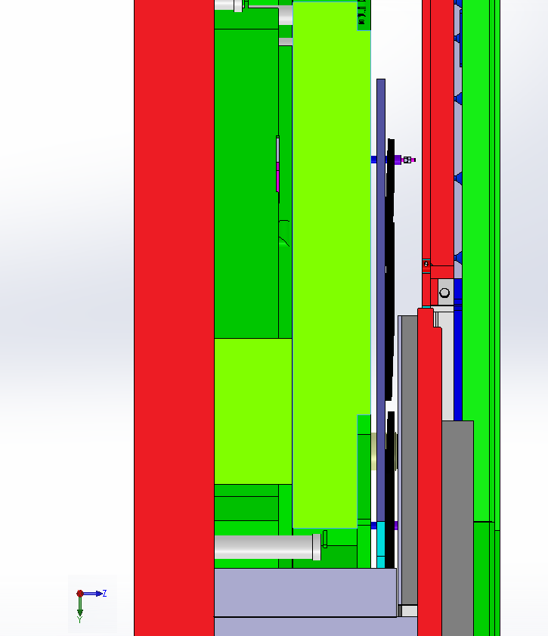
Cross section YE3 and YE4
YE3
YE4
20 mm
Clearance between ME4/1 and RE4/1
RE 4/1
504 mm
ME4/1
Neutron shield. 66 mm
655 mm

