Slide 1
Mock up for RPC RE3/1 chambers
E. Voevodina

Slide 2
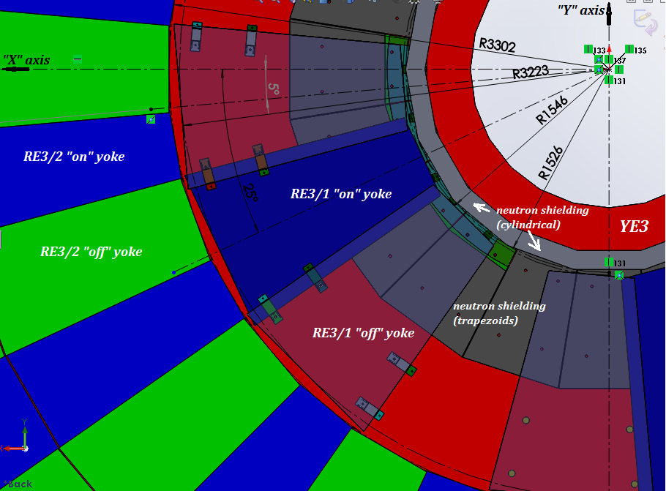
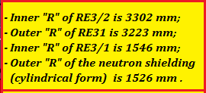
Principle scheme of the location RE3/1 chambers
1. Mounting of the RE 3/1 chambers on the YE3
1
2
Each RE3/1 chamber is fixed at six points
5
M12 mounting holes
6
4
3

Slide 3
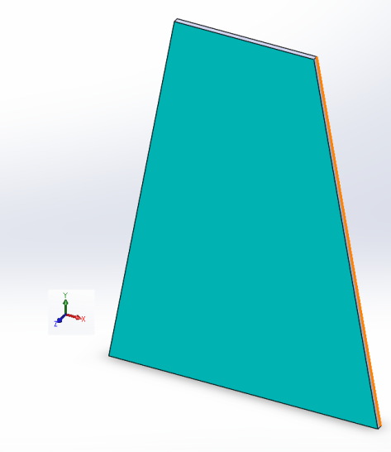
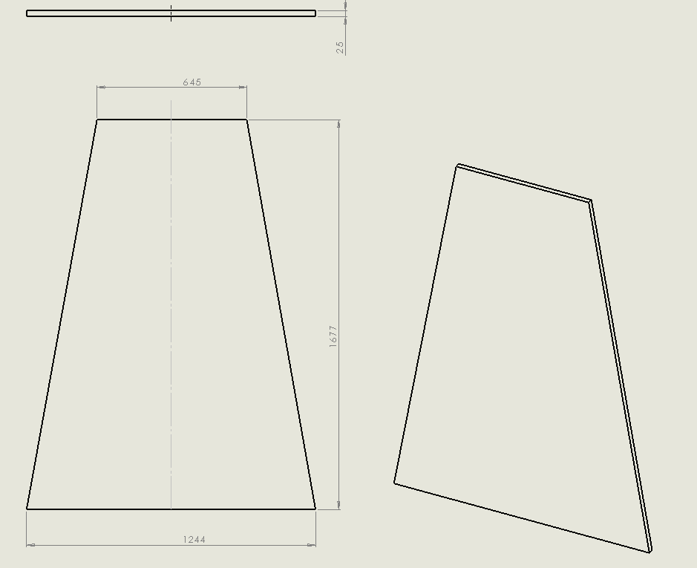
RE3/1 chambers

Slide 4
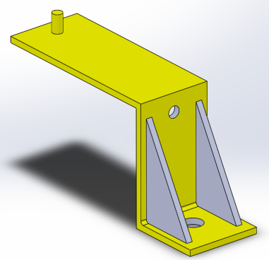
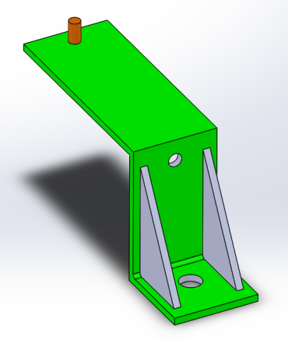
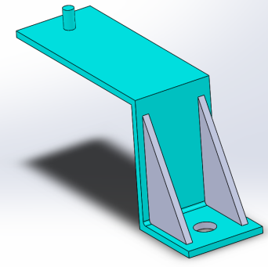
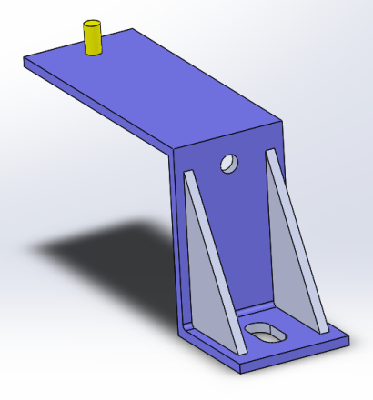
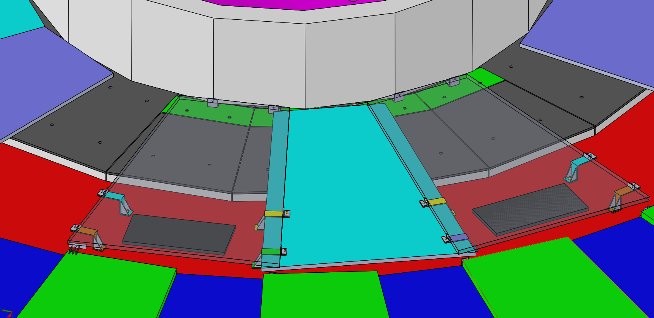
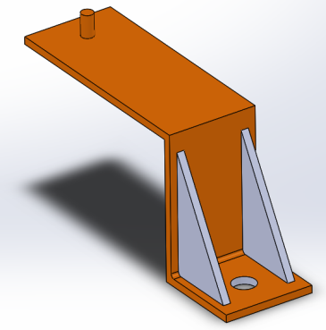
Dimensions of the mounting brackets
Diameter hole 16 mm
Diameter hole 12.5 mm
Diameter hole 16 mm
Slot
Diameter hole 12.5 mm
total number of the brackets are 8

Slide 5
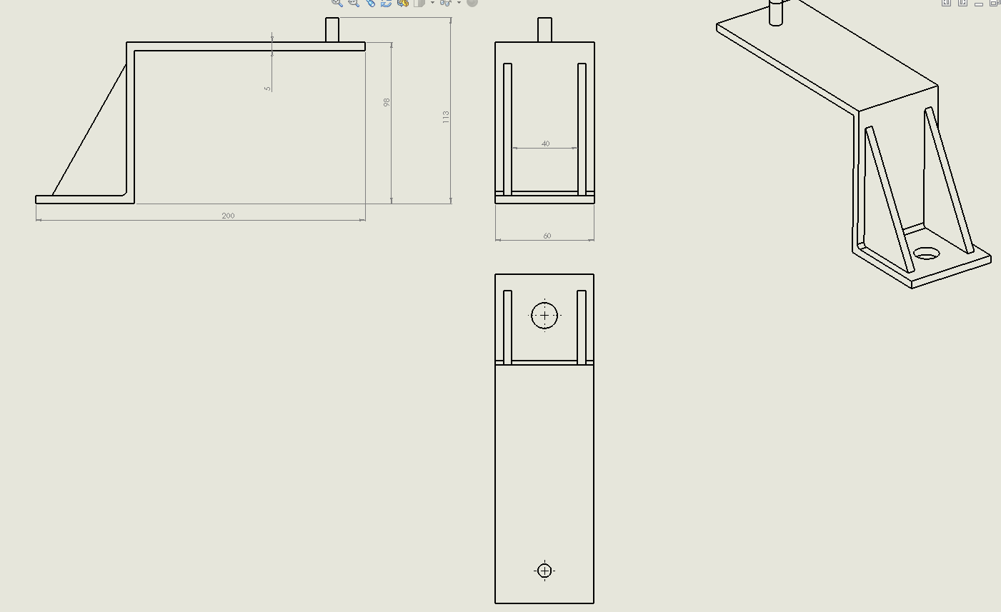
Mounting brackets dimensions
All mounting brackets have:
the similar overall dimensions;
the different holes diameter and
holes location.
Number of drawings will be 3.

Slide 6
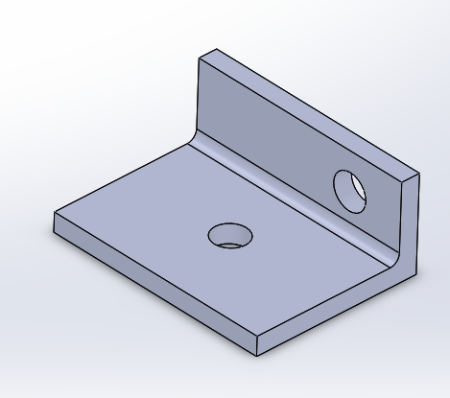
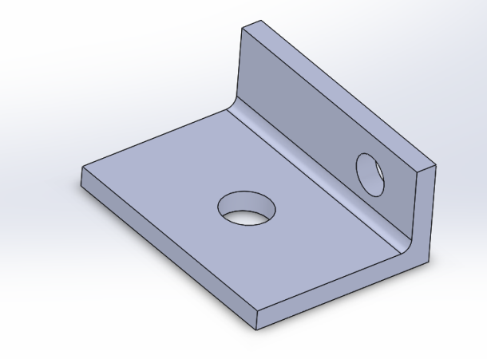
Dimensions of the mounting brackets
Diameter hole 8.5 mm
Diameter hole 12 mm
All mounting brackets have:
the similar overall dimensions;
the different holes diameter and
holes location.
total number of the brackets are 8

Slide 7
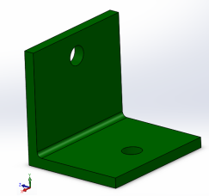
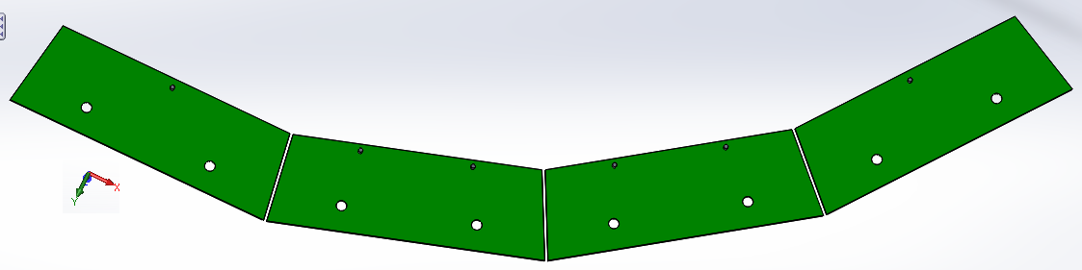
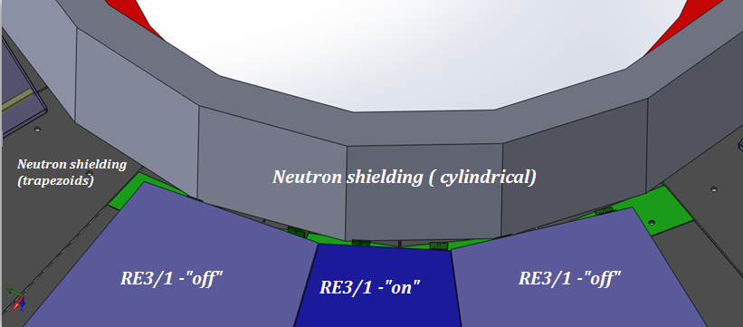
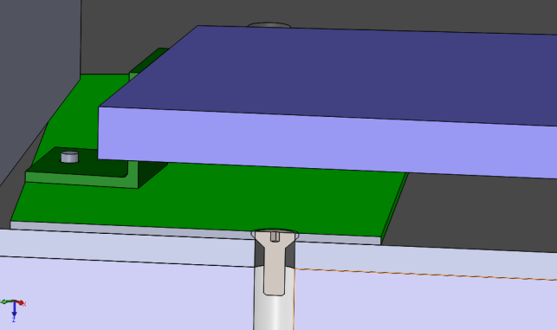
Supplementary inner “R” mounts RE3/1 chambers on the YE3
Brackets
Arc Plate for inner “R” of RE3/1
At the present time the cylindrical screws heads protrude beyond the shield.
Arc Plate for inner “R” are hidden under the RE3/1
Mounting Arc Plate on the neutron shielding
Screw with countersunk head

Slide 8
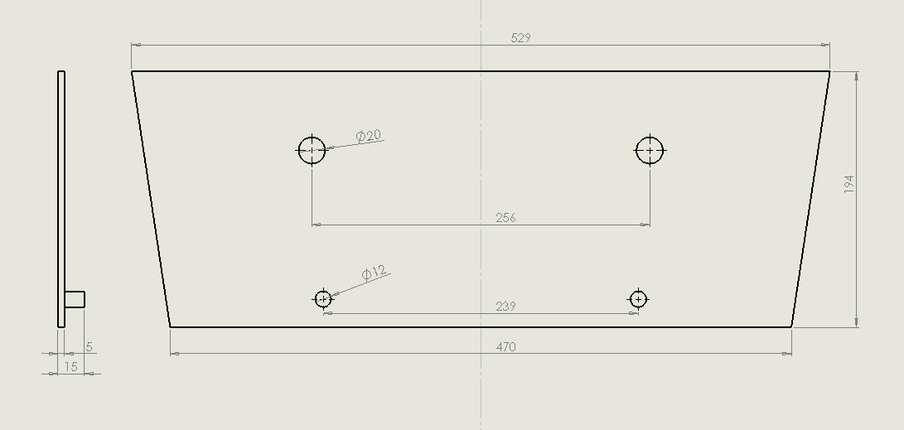
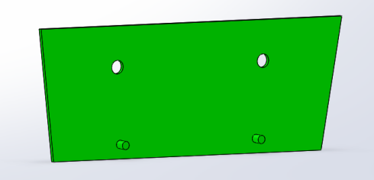
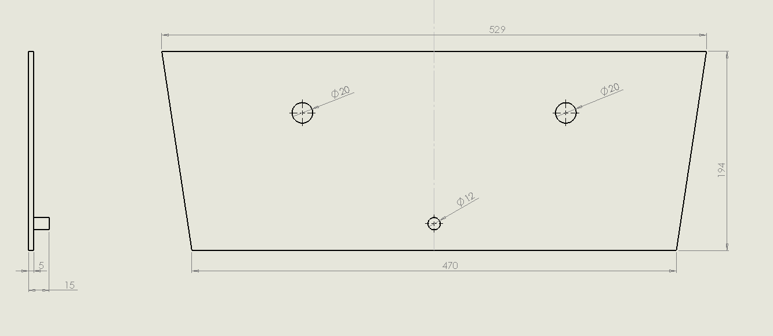
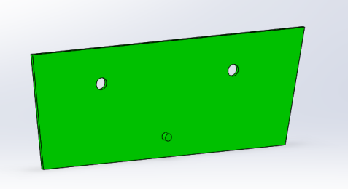
Dimensions of the mounting plates
Number of drawings are 2

Slide 9
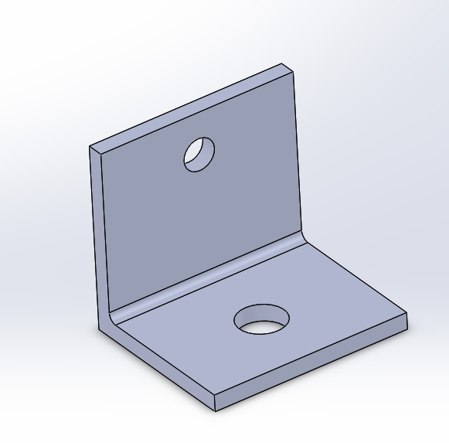
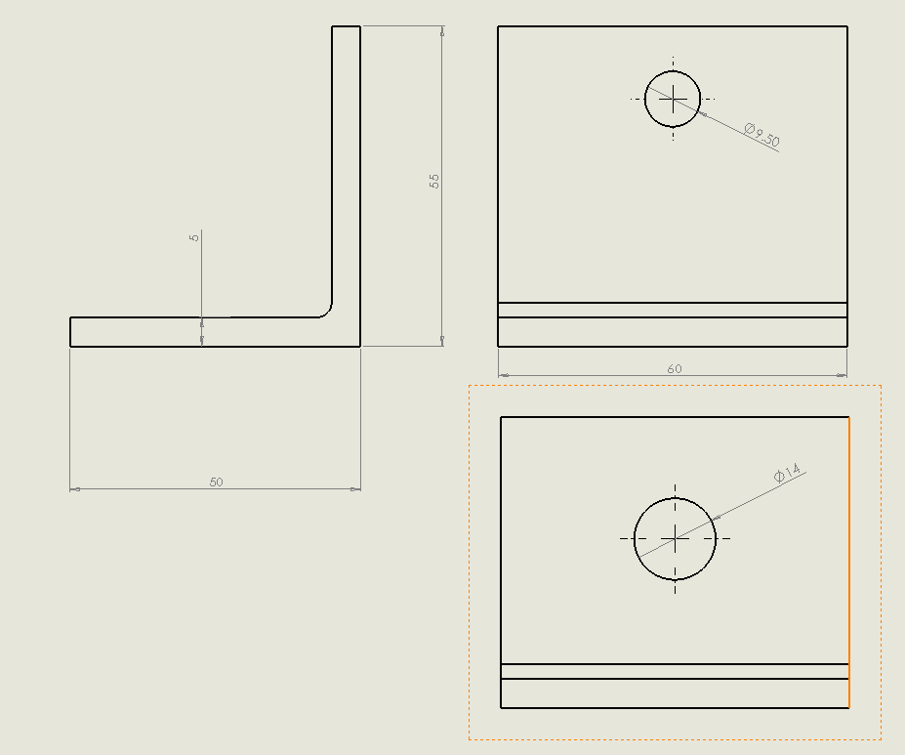
Brackets for mounting plates
the different holes location.

Slide 10
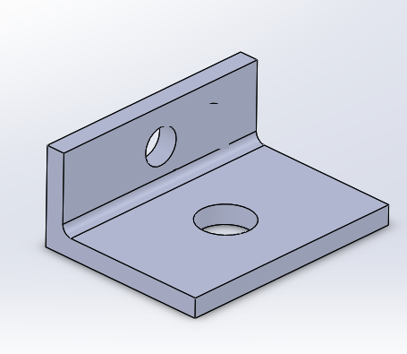
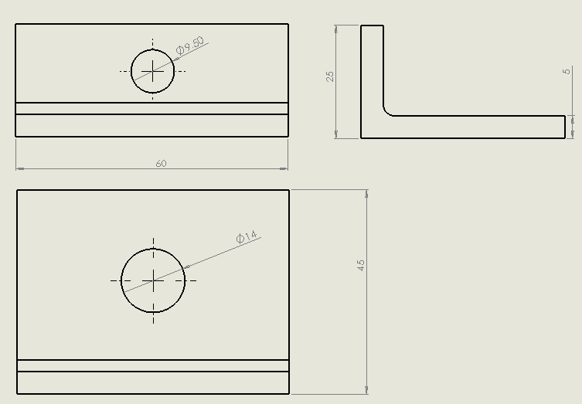
Brackets for mounting plates
the different holes location.

Slide 11
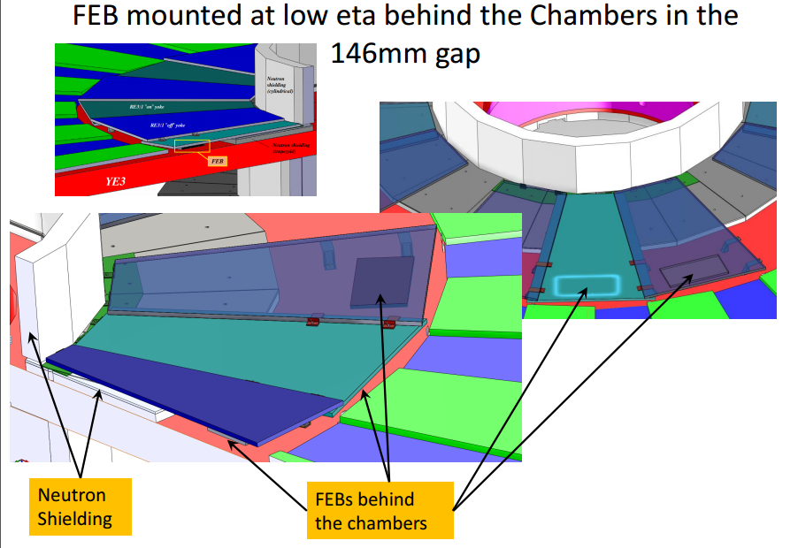

Slide 12
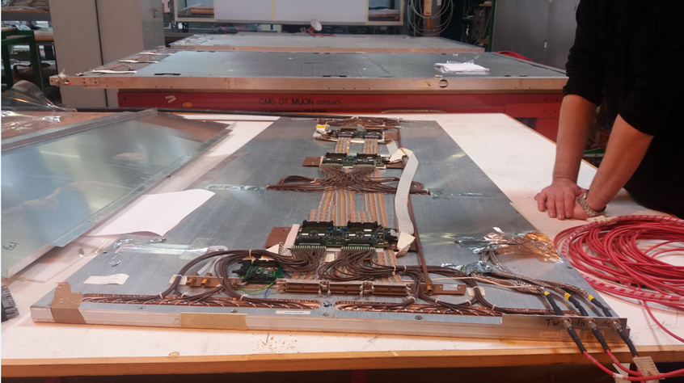
Studying of the location FEBs and connectors with cables for example of the existing RPC chambers

Slide 13
Conclusion
The restoring data after their loss were done;
all my data are located in the https://dfsweb.web.cern.ch/dfsweb/Services/DFS/DFSBrowser.aspx/Users/e/evoevodi/Public/
The dimensions of the RE3/1 chambers brackets and mounting plates for fixing were optimized ;
Production of the drawings mounting brackets and mounting plates were begun (total number of drawings will be about 10);
The studying of the location of patch panels and connectors with cables will be continue.

Slide 14
