Slide 1
Main results received during the EYETS16 for the RE3/1 and RE4/1 envelope
Elena Voevodina, Ian Crotty, Salvatore Buontempo
14/05/2017

Slide 2
Three main parameters which are determined the available “Z” space for RE3/1 RPC chambers
No. | Name of methods to determine the value “Z" | Distance between YE/2 and YE/3, mm | Thickness ME3/1 package, mm | Thickness neutron shielding, mm
1. | Main drawing of the CMS (3D model) | 655 | 504 | 63
2. | Manual measurements | 669 ± 1 | 507 ± 1 | (64.5 ÷ 66.0) ± 1
3. | Laser scan and Teodolite | 668.2 ± 3.0 | - | -
4. | IR sensors | - | - | -

Slide 3
Available value “Z” for RE3/1 RPC chambers
No. | Name of methods to determine the value "Z" | Value “Z” , mm
1. | Main drawing of the CMS (3D model) | 88.75
2. | Manual measurements | 80 ± 1
3. | Laser scan and Teodolite | 79.5 ± 3.0
4. | IR sensors | 73 ±
Available value “Z” is about 80 ± 1 mm

Slide 4
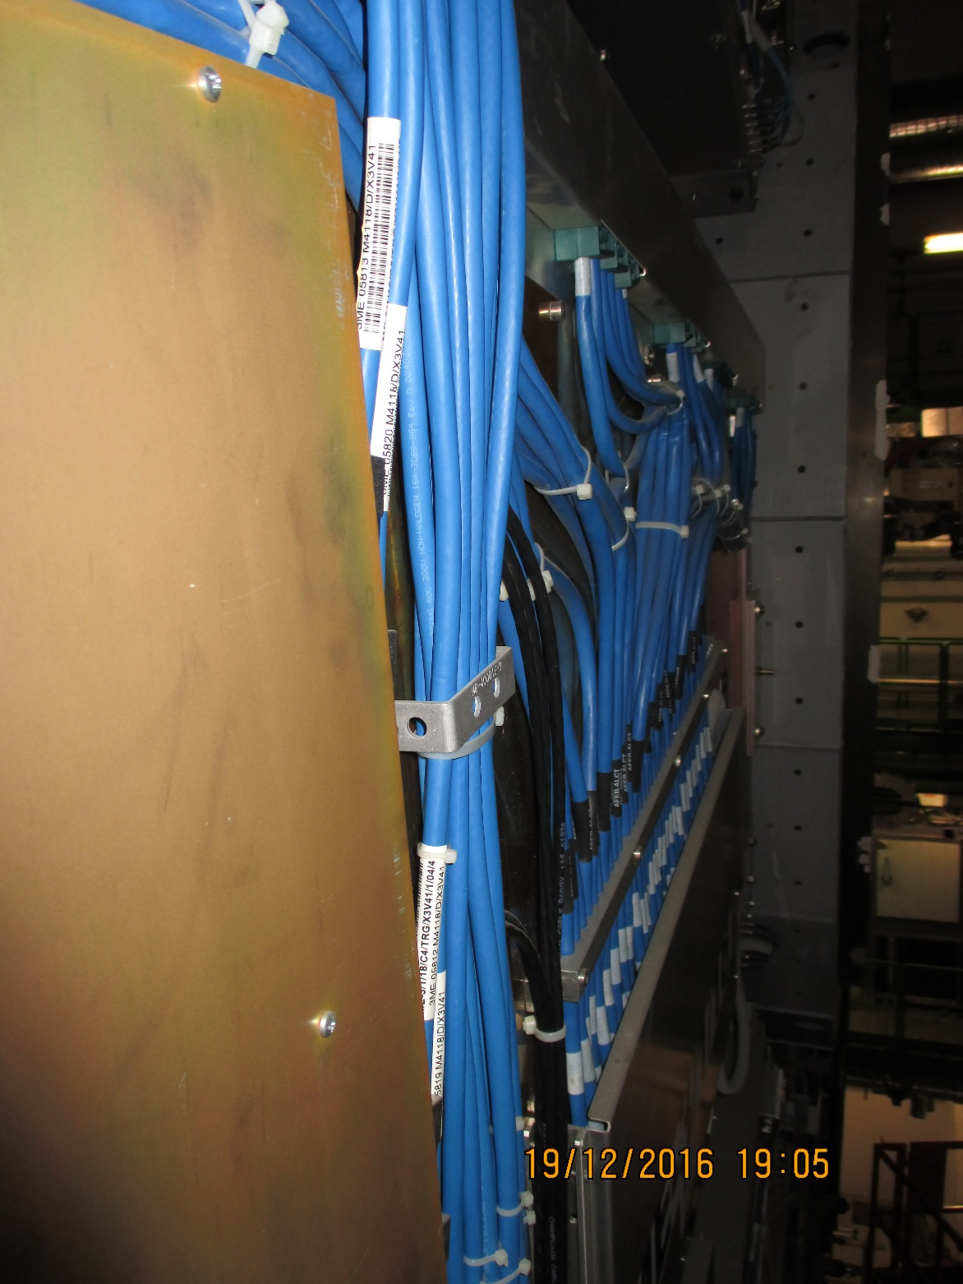
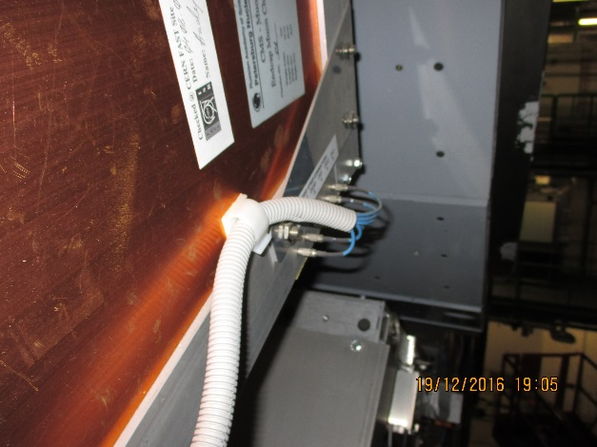
CSCs are not flat. complicate understanding
CSC chambers's features
Cables over edge of chamber cover
Front End covers at different heights
Ian Crotty, 16 Jan 2017

Slide 5
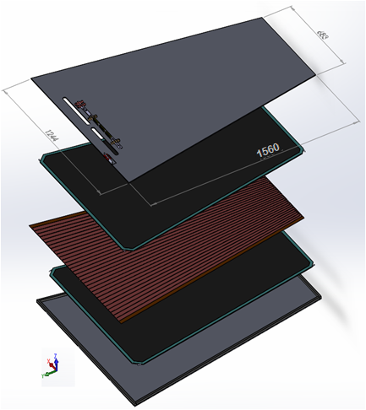
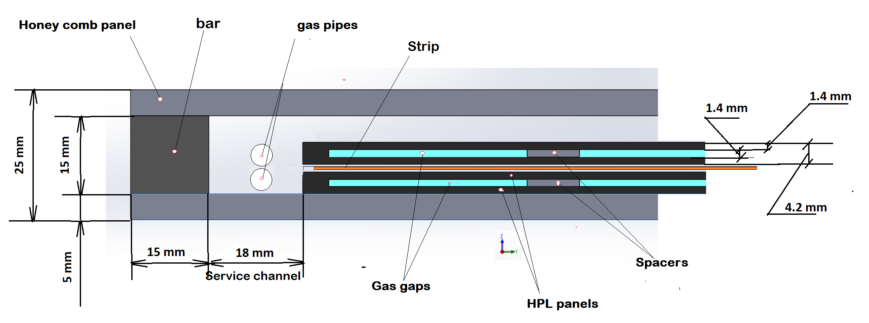
Design RE3/1 and RE4/1 RPC chambers
Double gap RPC chamber
PP under work
* Clearance between ME3/1 and RE3/1 will be
(80 ± 1 ) – (5 + 25 + 5 +25) = 20 ± 1 mm,
where
thickness RPC chamber is 25 mm;
thicknesses mounting plate and bracket are 5 mm.
Cross section of double gap RPC chamber

Slide 6
Available value “Z” space for RE4/1 RPC chambers
Name of methods to determine the value “Z" | Distance between YE/ 4 and YE/3, mm | Thickness ME4/1 package, mm | Thickness neutron shielding, mm | Distance between YE/ 4 and ME4, mm
Main drawing of the CMS (3D model) | 655 | 504 | 63 | 151
Available value “Z” will be about 83 ± 1 mm
BUT
83 ± 1 mm is not enough space for RE4/1 RPC chambers with overlap!
Because (83 ± 1) – ( 20 + 25+ 5 +25 + 8) = 0 mm,
where
The space between ME4/1 and RE4/1 should be a minimum of 20 mm;
Thicknesses of the RE4/1 “on” yoke and “off” yoke is 25 mm;
The value gap is 5 mm;
Thickness Alu mounting plates is 8 mm.
Thus, we have the available space for RE4/1 chambers without overlap!

Slide 7
Conclusion
RE3/1:
Three parameters (distance between YE3 and YE2, CSC chamber’s and neutron shielding’s thicknesses) determine the available space (Z) for future RE3/1 and RE4/1 chambers.
Four methods (main drawing of CMS experiment, manual measurement, laser scan and theodolite and IR- sensors) to determine the value “Z” were used.
After data analyses, it was found that the value “Z” is about 80+/-1 mm.
Due to the lack of space between ME3/1 and future RE3/1 chambers, FEB will be invisible (it means that FEB will be installed the space between YE3 and RE3/1).
During the work in P5 on 19 of December 2016, which was carried out within the determination of the available space for RE3/1 RPC chambers, surfaces between YE-2 and YE-3 have the following features:
        CSC chambers have the complex surface’s topology;
        Cables over edge and alignment system protrude beyond the chamber;
        Neutron shielding’s thicknesses are not constant;
        The cylindrical screws heads protrude beyond the neutron shield.
These features will affect the thickness (Z) for the future RE3/1, on selecting the technology of making and the attaching's methods.

Slide 8
Conclusion
RE4/1:
Surface between YE3 and YE4 at P5 was not opened for access. Based on the main drawing and results from RE3/1 chambers, the value “Z” for RE4/1 was studied.
Preliminary of value “Z” for RE4/1 chambers is about 80+/-1 mm.
Value “Z” is not enough to mounting RE4/1 with the overlapping.
The preliminary RE4/1 chambers ‘s design without overlapping was proposed.
In this case, FEB will be visible.
For mounting RE4/1 chambers, the mounting frames were proposed.
In summary: for better understanding of the value “Z” for RE4/1, the surface between YE3 and YE4 at P5 should be opened to access. In this case, received information would be helping for better determining of the thickness (Z) for the future RE4/1 chambers and on selecting the technology of making and the attaching's methods.

Slide 9
Backup

Slide 10
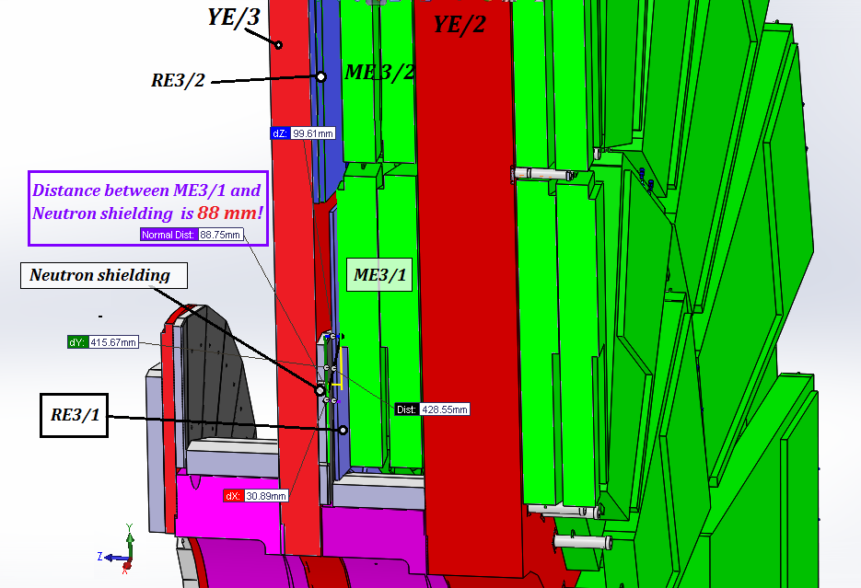
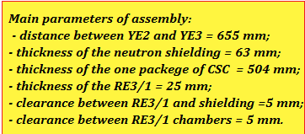
1. Main drawing of the CMS (3D model)

Slide 11
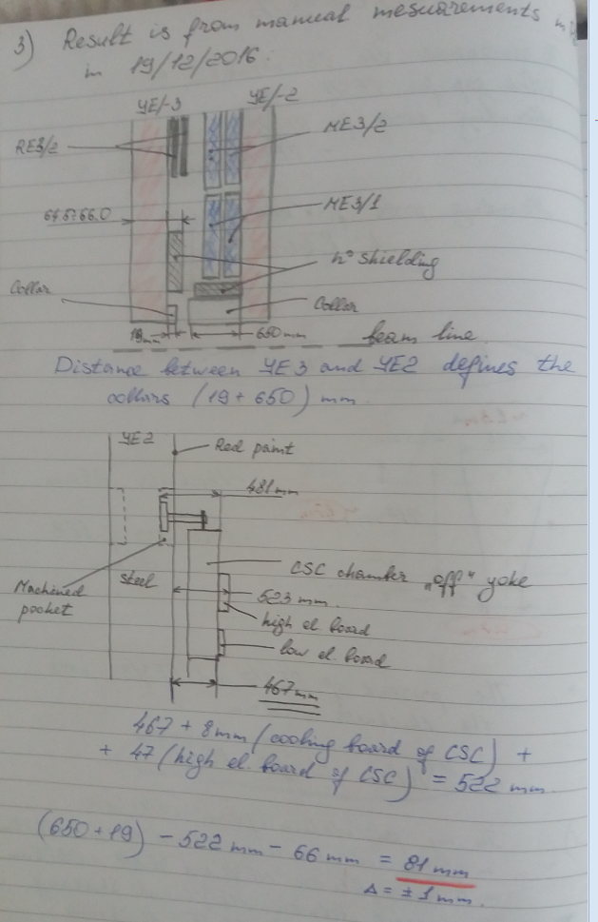
2. Manual measurements at P5 from 19 of Dec. 2016

Slide 12
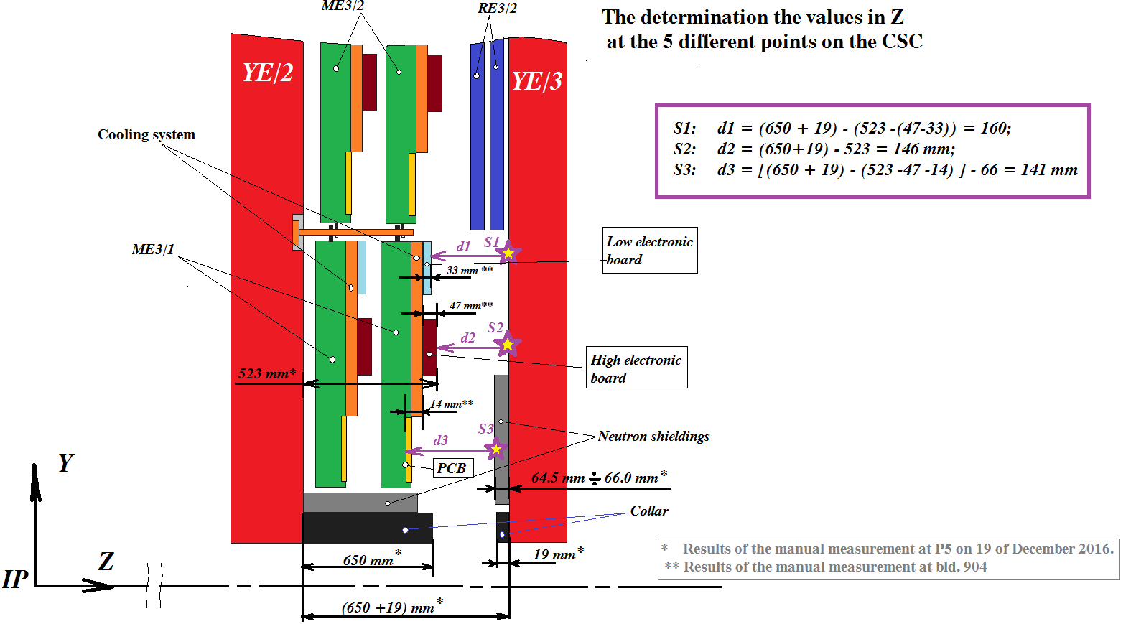
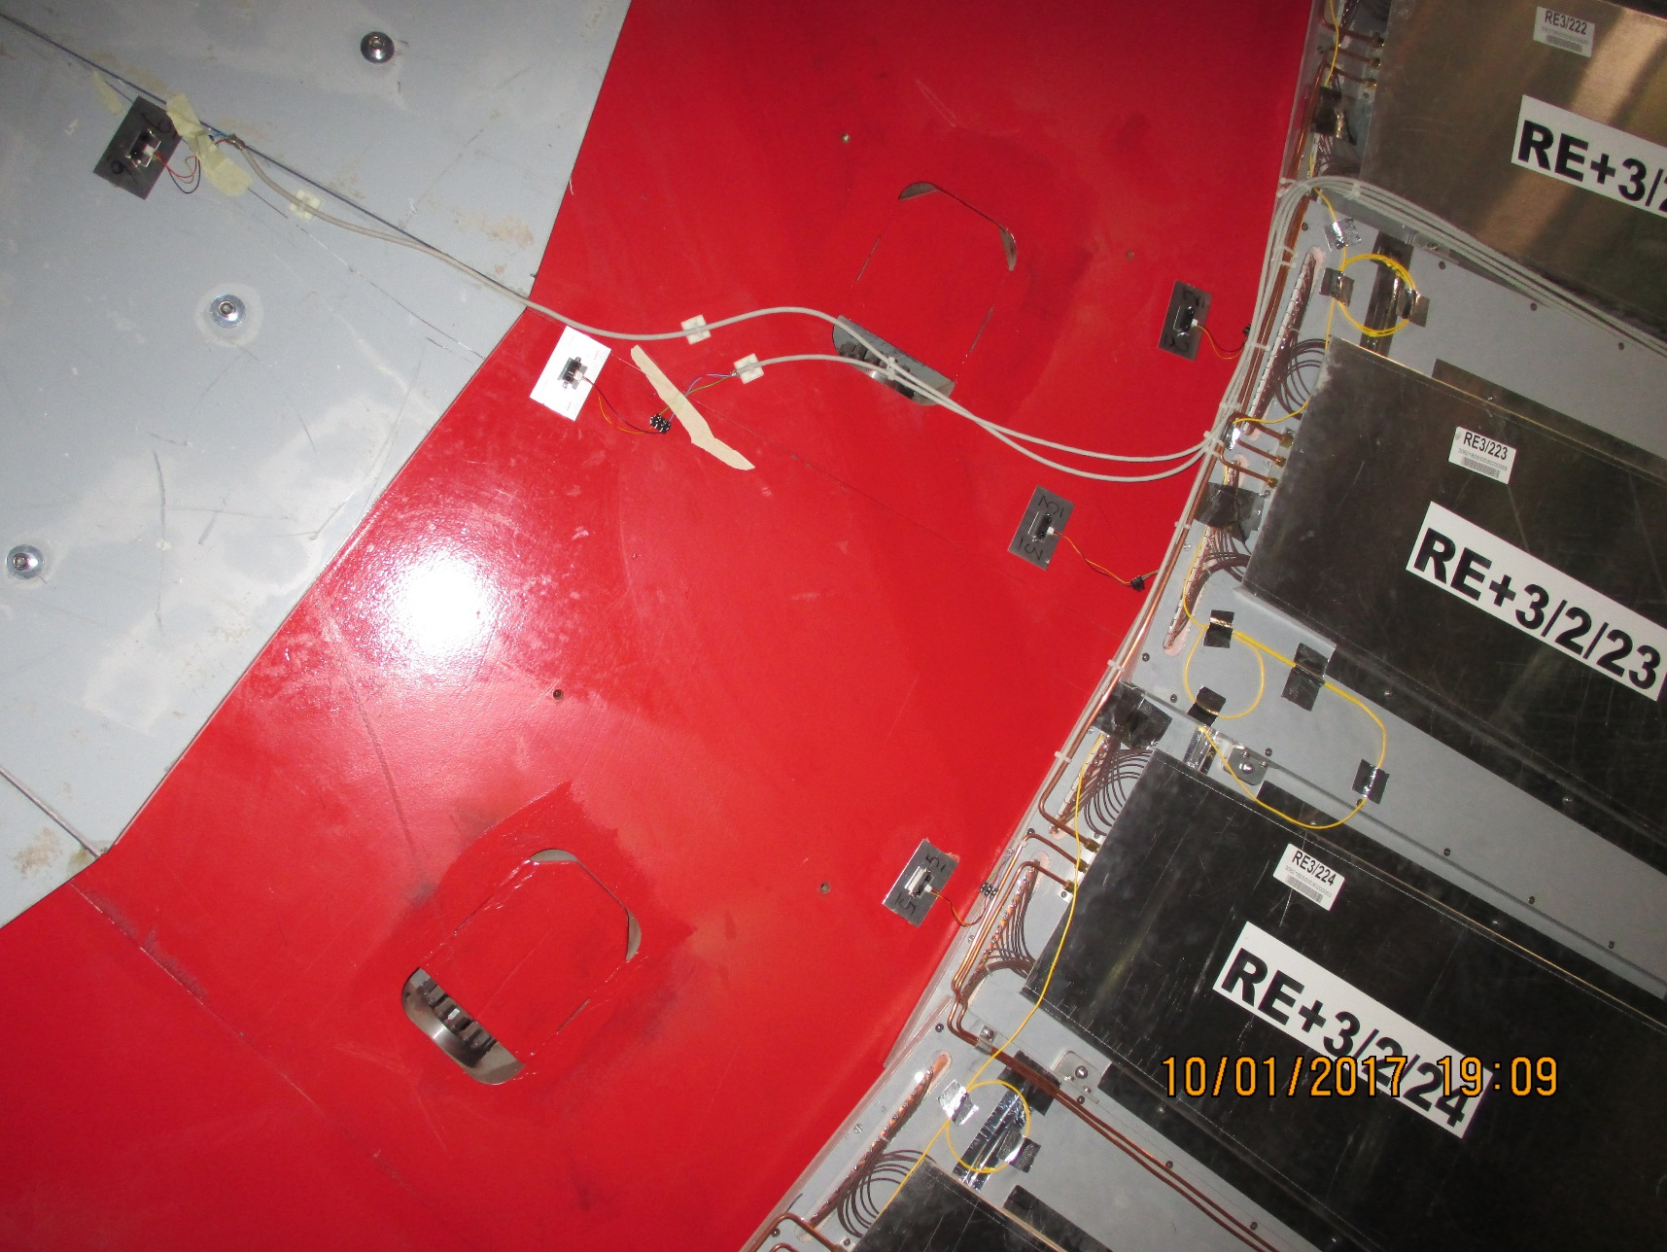
2. Manual measurements at P5 from 19 of Dec. 2016
Machined pocket
6
2
7
3
5

Slide 13
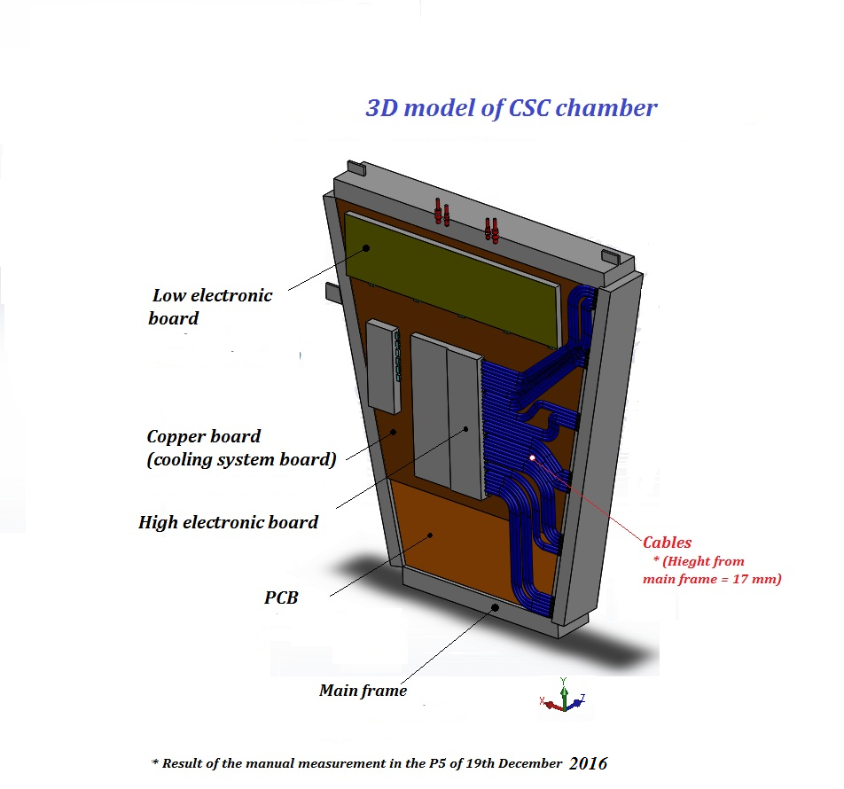
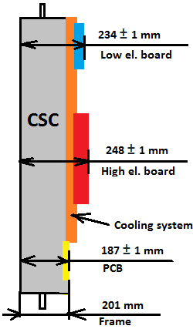
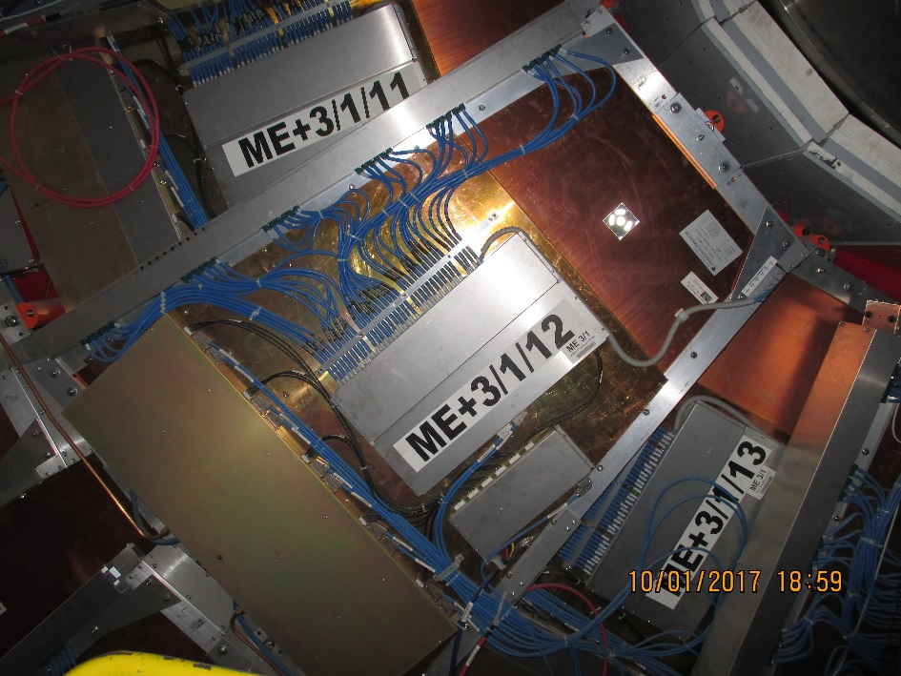
Difficult topology of CSC chamber’s surfaces
Cross section of CSC
Manual measurement at bld.904
Thus, thickness of CSC’s package = 507 ± 1 mm

Slide 14
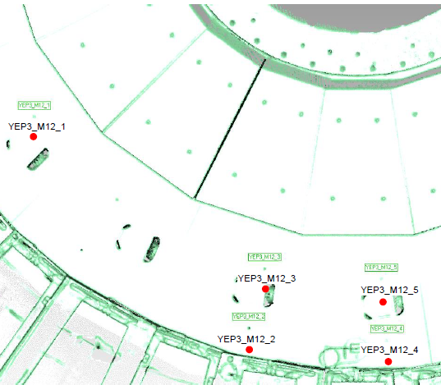
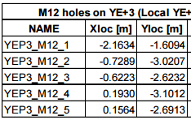
3. Laser scan and Teodolite
Surfaces between YE-2 / / YE+2 and YE-3// +3 around the CSC chambers ME/-3/1/13 // ME/+3/1/13 (below the beam pipe on far side ) have been measured;
The topology of CSC chambers is determined very good;
The average error of the best-fit is :
for YE/-2 and YE/-3 is +/-1.8 mm;
for YE/+2 and YE/+3 is +/-3.0 mm.
The maximum error is :
for YE/-2 and YE/-3 is +/-2.5 mm;
for YE/+ 2and YE/+3 is +/-3.0 mm.
The height of the collars are:
for YE/+3 is 19.6 mm; for YE/-3 is 20.4 mm;
for YE/+ 2 is 648.6 mm; for YE/- 2 red disk not measured.
These values agree with the manual measurements.
The position of five M12 holes measured in the area of YE/+3 in front of the
CSC chamber ME+3/1/13.
Inspection of the positions of the M12 holes
RPC Upgrade Workshop, 14-15 March 2017 07/19
RPC TC working meeting 7/

Slide 15
4. IR – sensors
(preliminary results)
Machined pocket
S3
S1
S2
6
2
7
3
5

Slide 16
4. IR - sensors
Results
Sensor # | Calc Dist | Calc Dist
 | [mm] | [mm]
 | min | max
03 | 171.6 | 172.0
02 | 175.9 | 174.8
06 | 126.6 | 125.8
05 | 177.4 | 175.9
07 | 140.3 | 139.3
* During analysis data took into account the CSC package's thickness which was equal to 509 ±1 mm
Comparison
 | Preliminary results | IR - sensors
 | mm] | mm]
S1 | 160±1 | 174.6
S2 | 146±1 | 139.8
S3 | 141±1 | 126.2
S3
S2
S1
6
2
Target areas
7
3
5

Slide 17
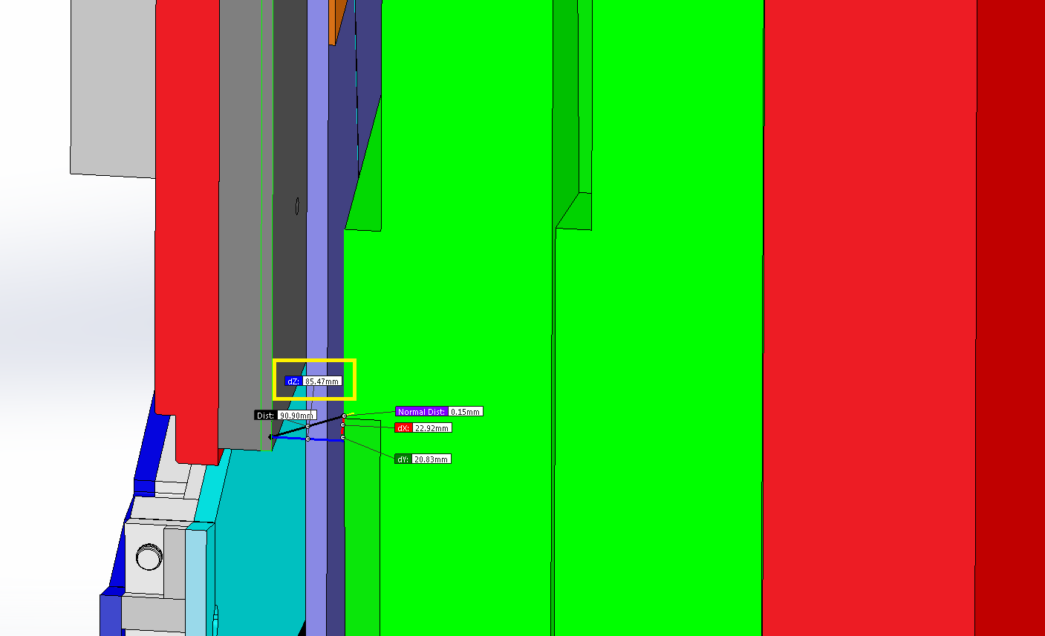
Studies of the value “Z” for RE4/1
Basis on the main drawing of the CMS
Shield
RE4/1
Cross section YE/4
YE/3
YE/4
85 mm !
ME4/1

Slide 18
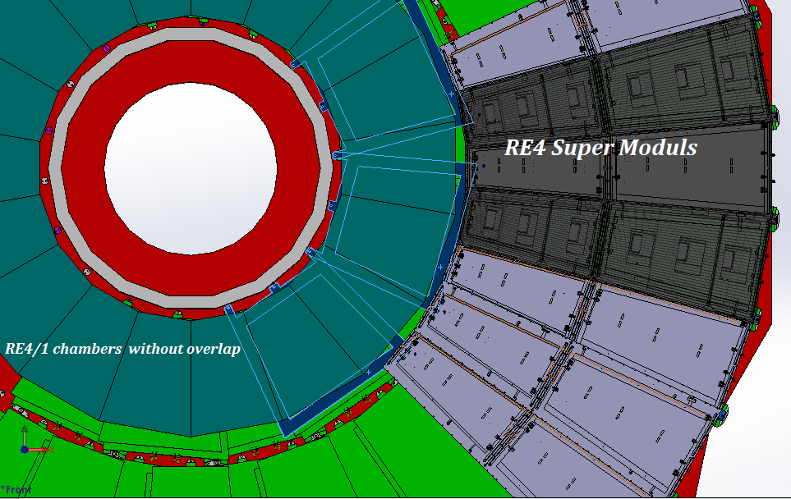
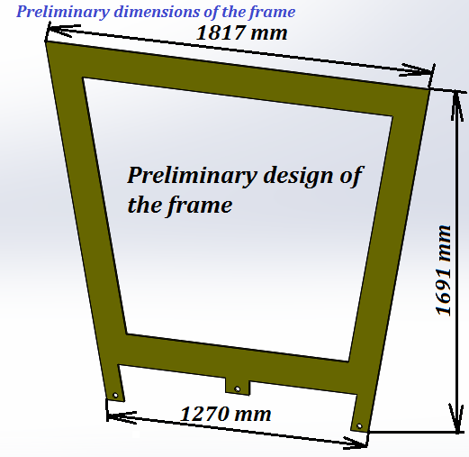
Mounting plate for RE4/1 chambers
Mounting plates
Preliminary design of the mounting plate
Thickness is 8 mm

Slide 19
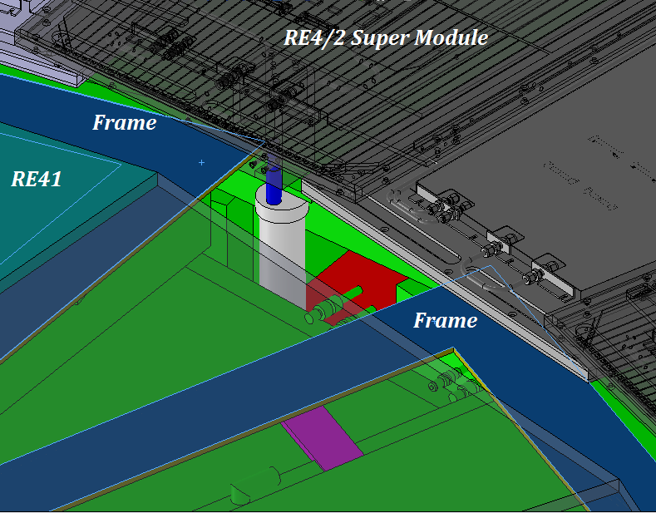
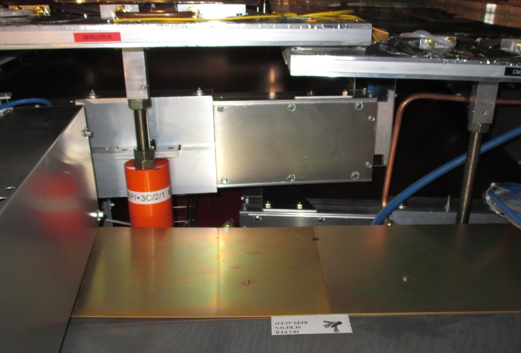
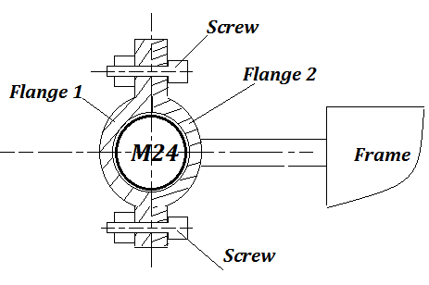
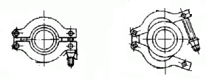
The proposed MP outer “R” M24 posts which are underneath the RE4 SMs
Two interesting questions:
How to mount the frame using the mounting positions M24?
How to attach the RE4/1 chambers on the frames?
Mounting posts M24
Area of mounting
Principle scheme
Or another version
Flange
M24
Screw

Slide 20
