Slide 1
Cooling link to RE3/2
Ian Crotty
30 May 2017

Slide 2
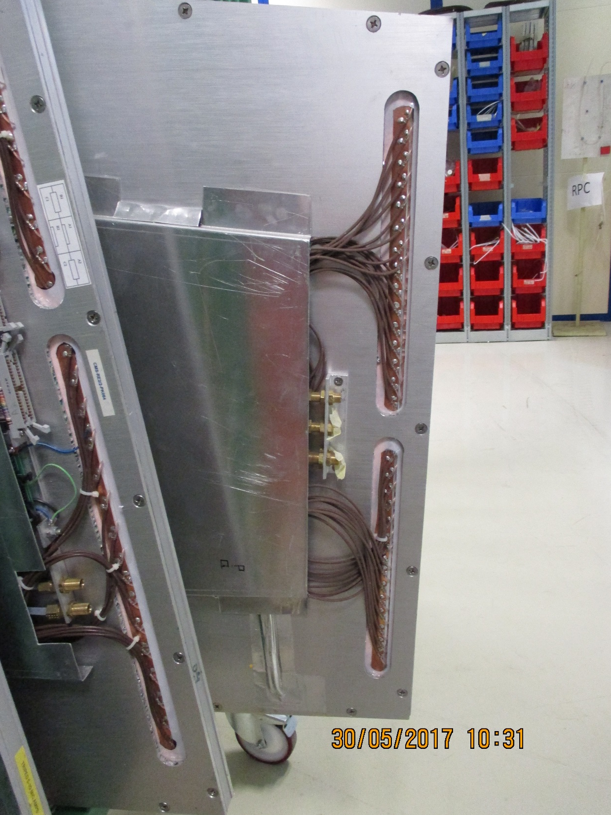
35mm
RE3/2 Cooling details at low “R”
695mm
360mm
100mm

Slide 3
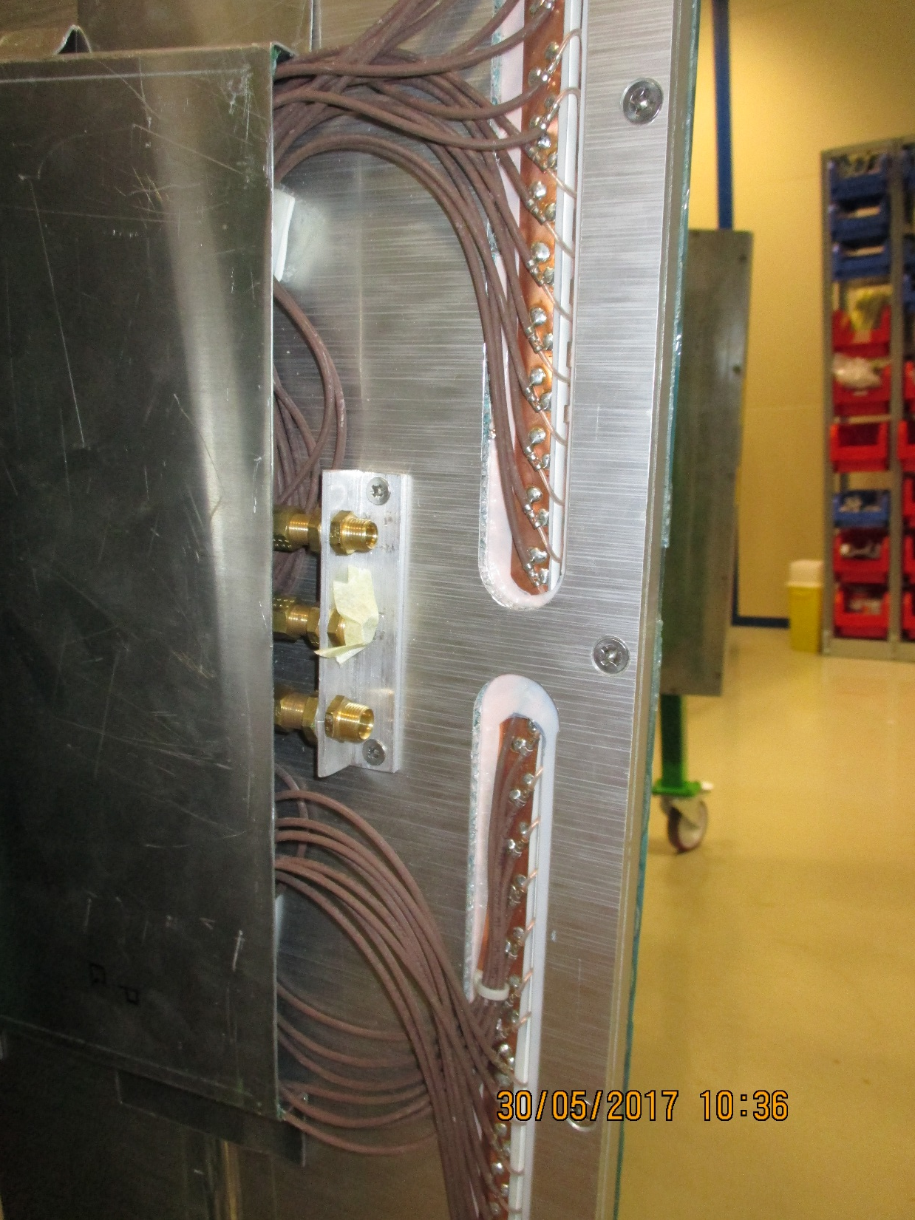
96mm
100mm

Slide 4
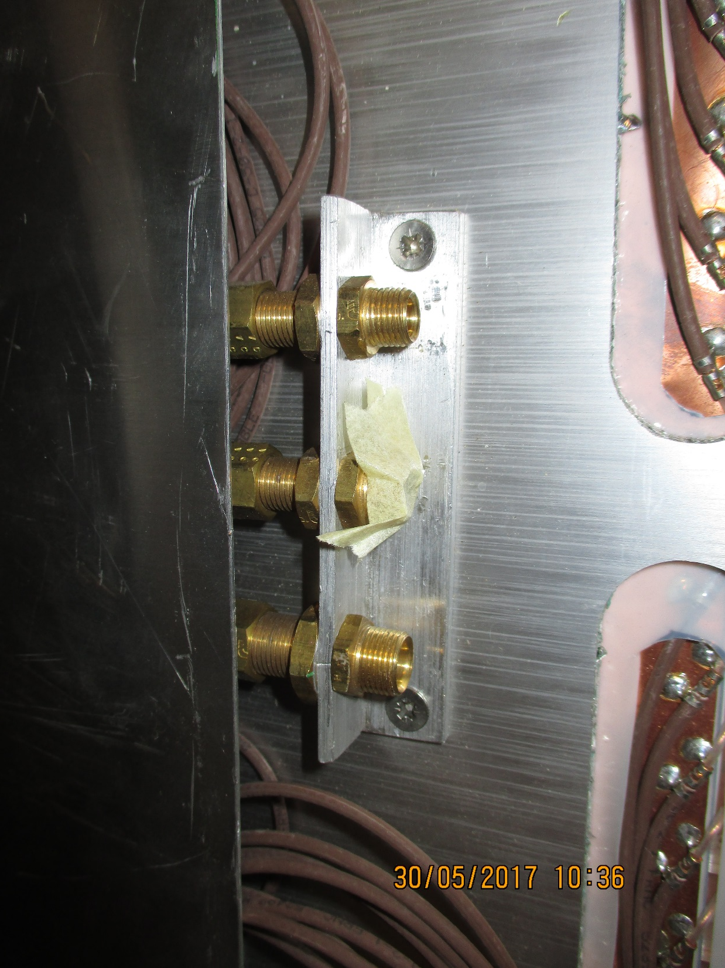
Gas Union Legris body dia 10mm
Pipe dia 6x4mm
20mm
50mm
CL
Cooling Union Legris body dia 12mm
Pipe dia 8x6mm

