Slide 1
FEB mounting, constrained mounts
Ian
June 2018

Slide 2
“When designing products that have features that need to be constrained, it’s best to figure out and implement the minimum number of constraints necessary to adequately constrain the feature “
Degrees of Freedom with respect to ……. DoF
Doff Vertical
DoF Horizontal wrt
Dof Phi
Pick-up strip panel PUSP
Front End Board FEB
Honeycomb Panel HCP
Copper cooling plate CCP

Slide 3
Constraint and degrees of Freedom
DoF CCP to FEB >1.0mm
CCP
± 0.5mm
“Phi”
FEB
± 1.5mm
CCP
HCP Mechanics
GAP
PUSP
GAP
“Z”
± 1.5mm
“0” ref
Delta R = 0
Delta Z = 0
Delta Phi = 0
HCP Mechanics
“R”

Slide 4
GEM are modifying their board design as they have been criticised during an engineering review and so will adopt flexible connections to avoid over constraint which can introduce stresses in their connectors, which are very similar to ours.
One example is the need to cut their main full length (GEB ?) board in half and join it together with another board (Opto Highbread) on top. The main board that is now split is secured to the structure of the chamber so putting a strees on the connectors linking them to the top board that links the two.

Slide 5
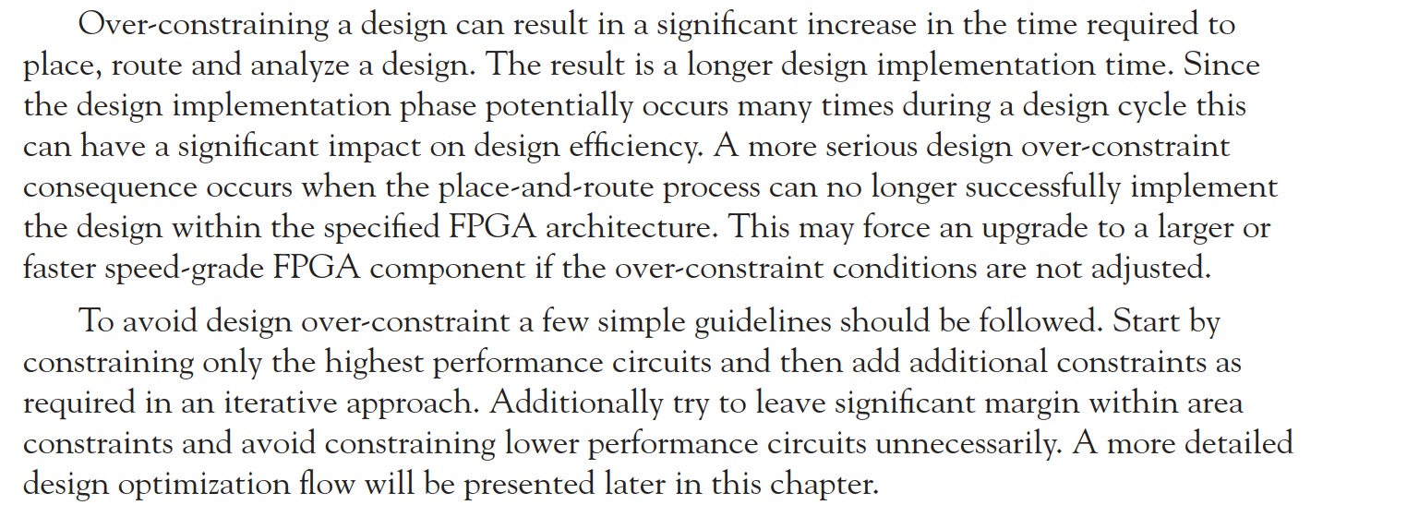
http://booksite.elsevier.com/samplechapters/9780750678667/Sample_Chapter.pdf

Slide 6
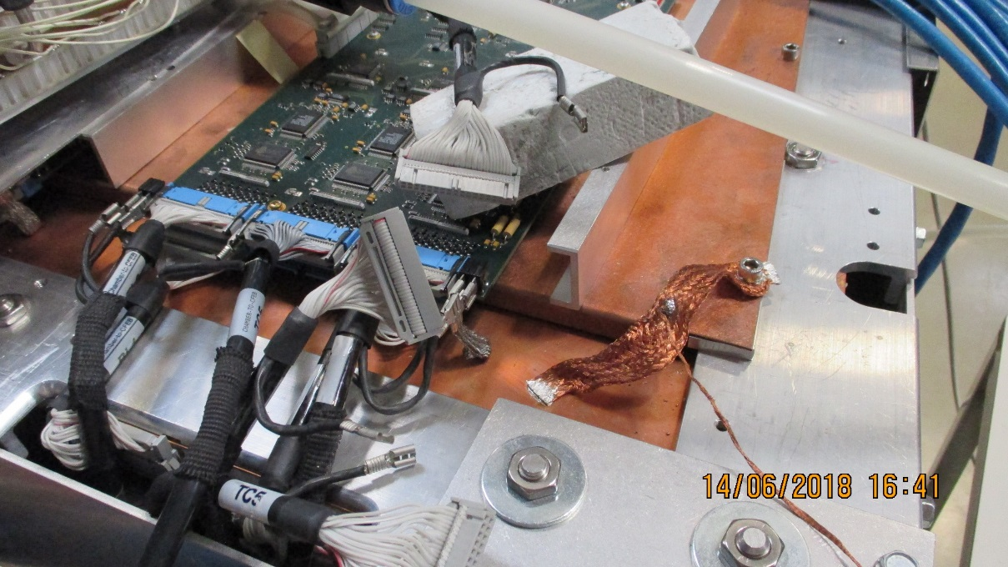
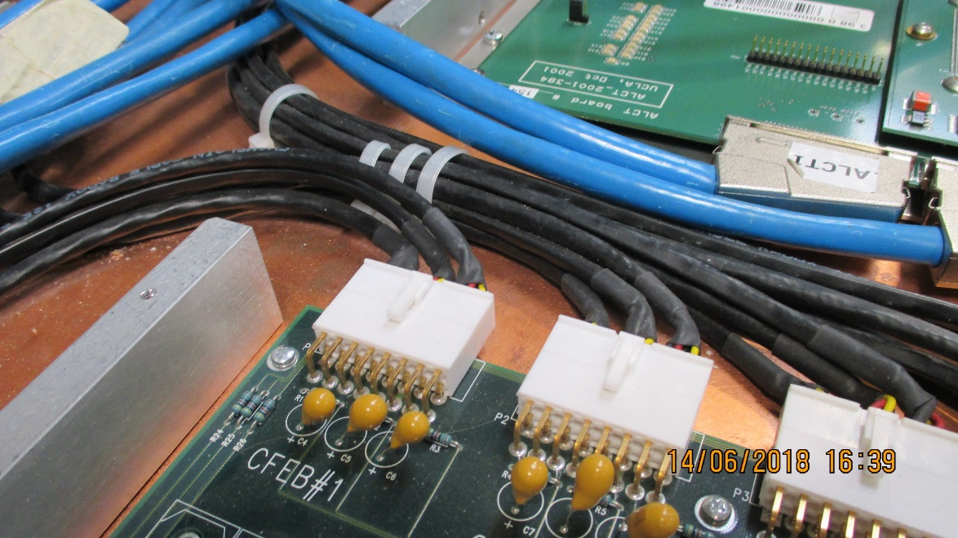
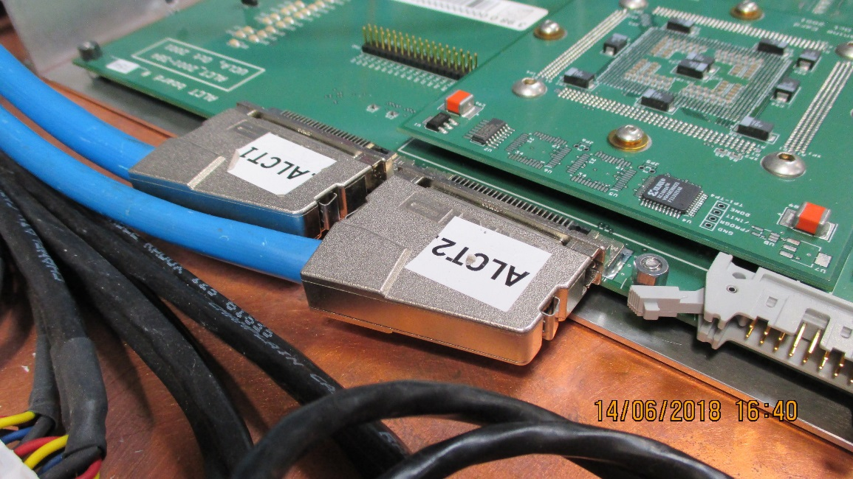
CSC cooling plate and FEBs

Slide 7
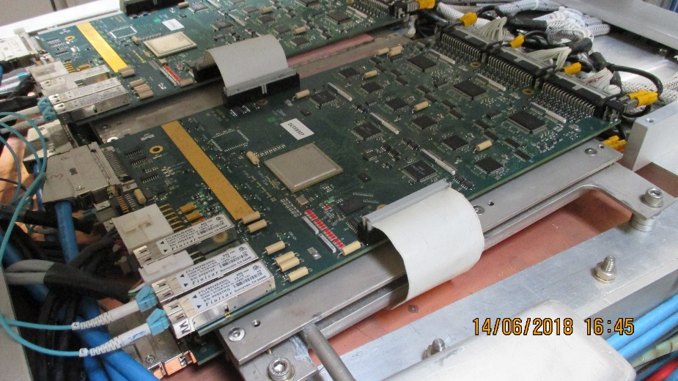
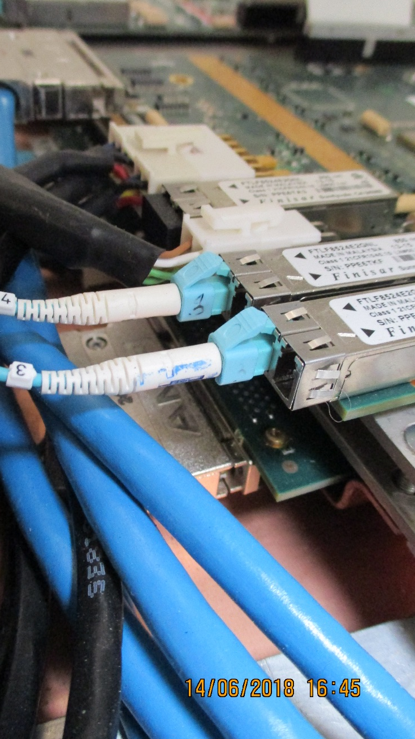
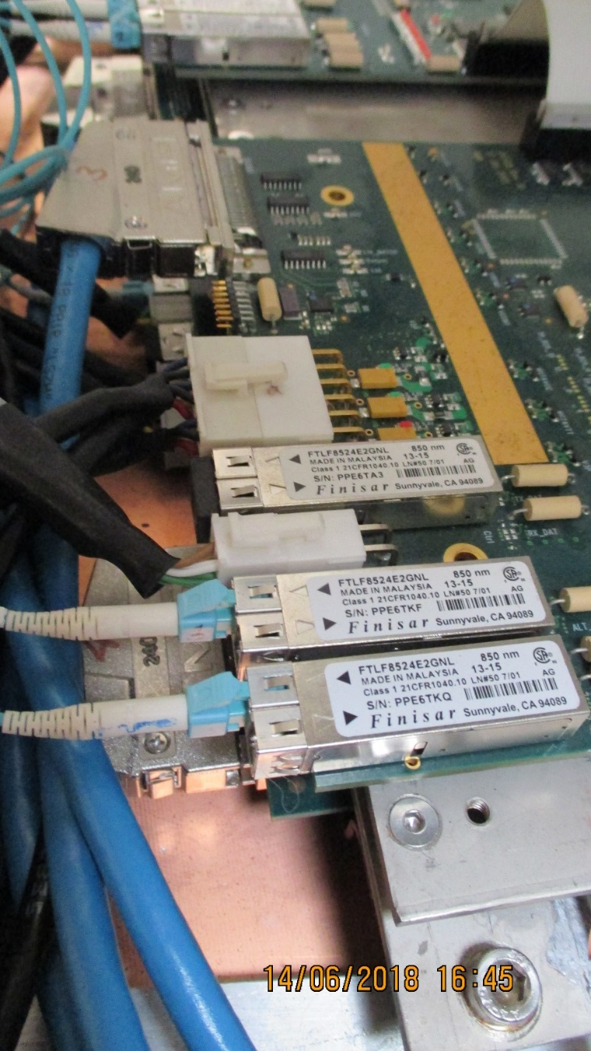
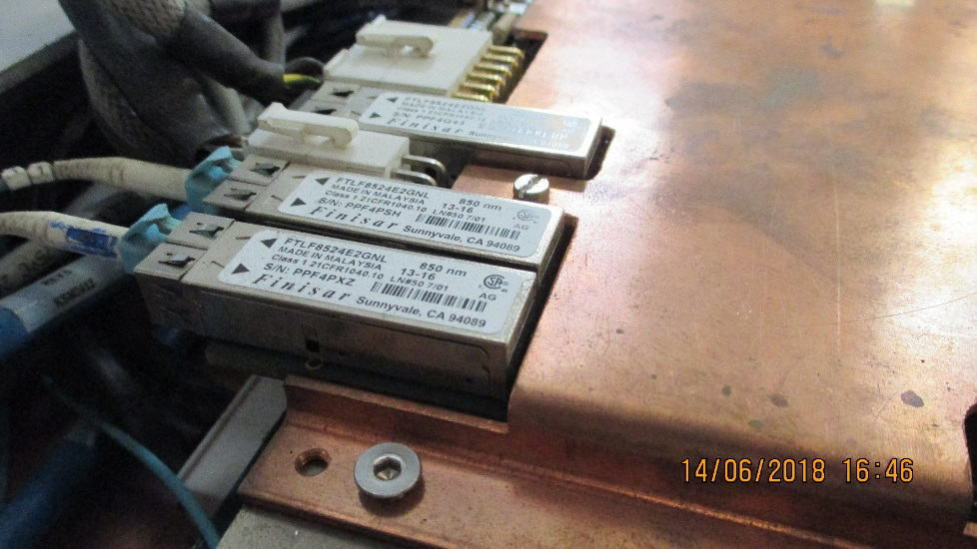
ME1/1

Slide 8
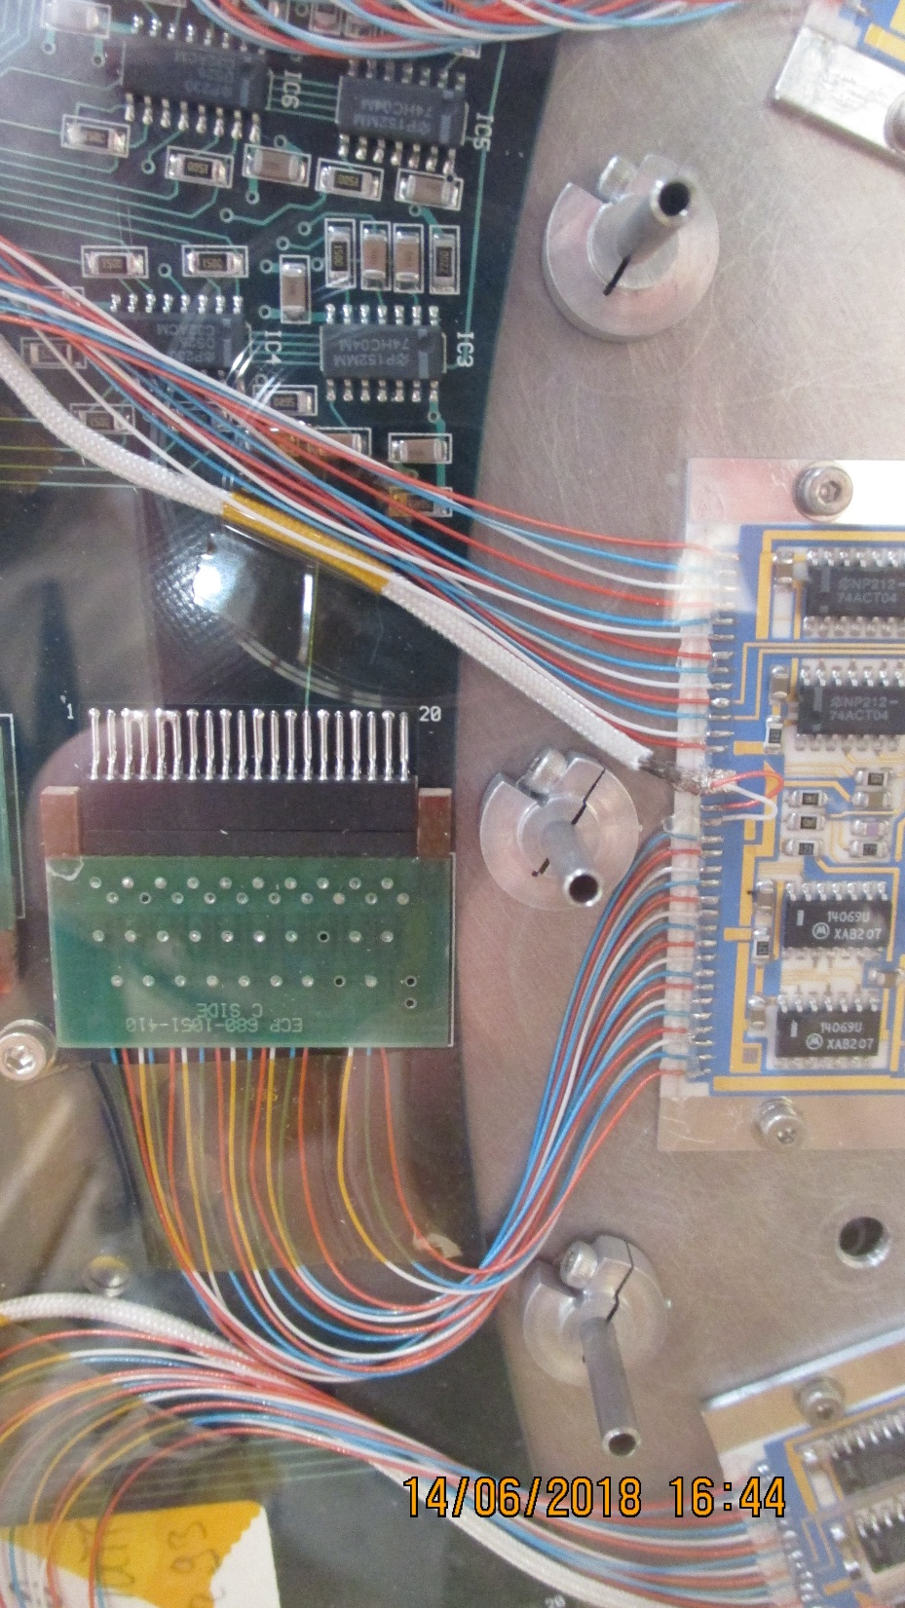
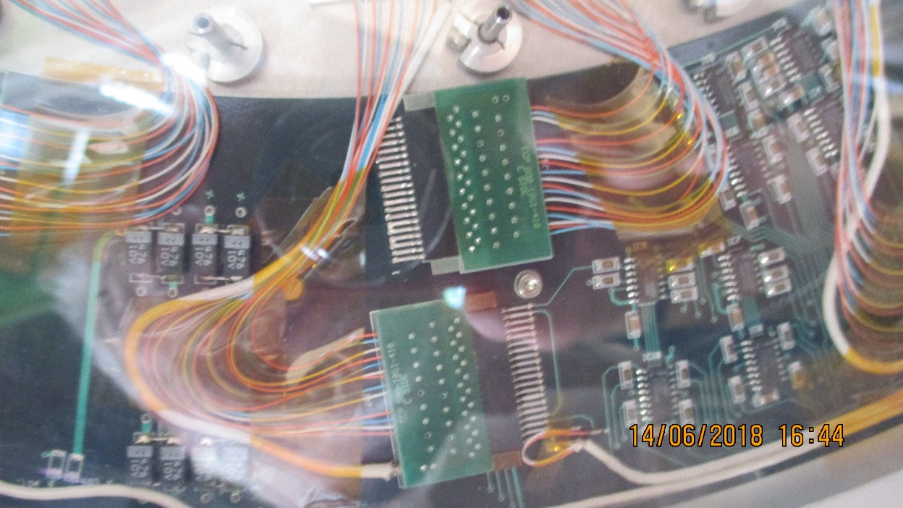
Beam Pipe detector

Slide 9
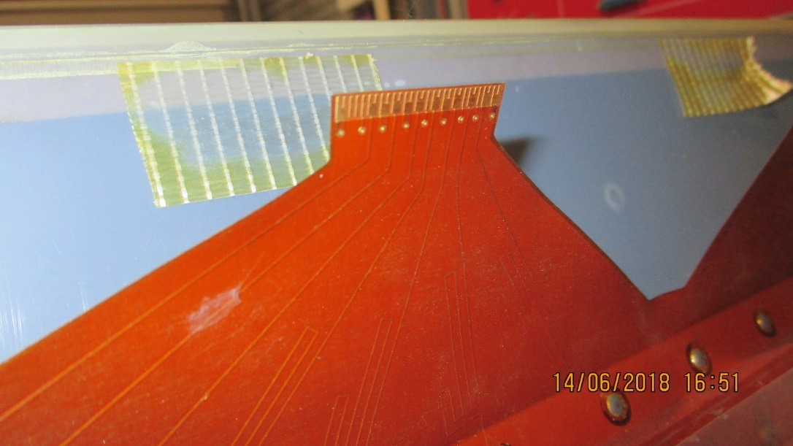
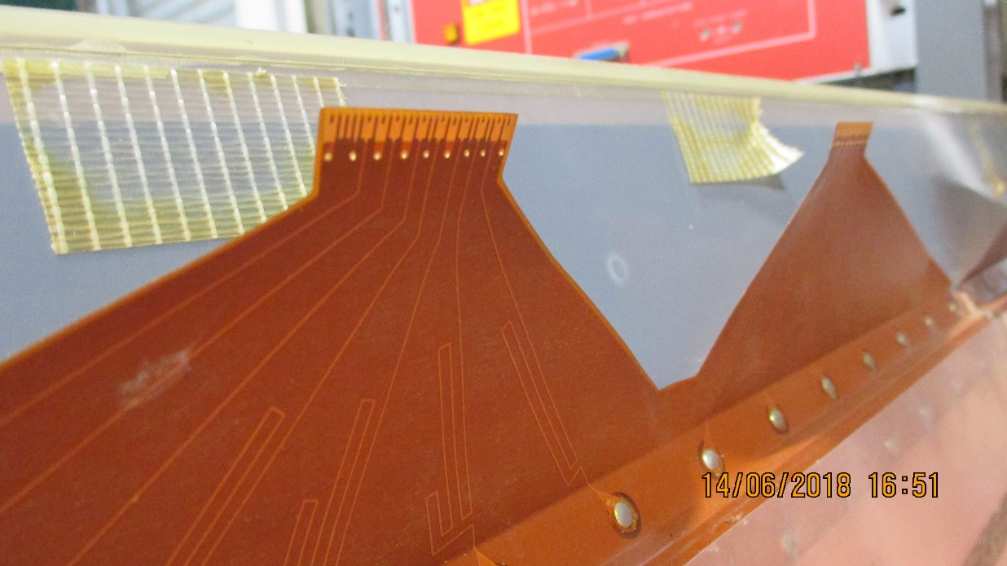
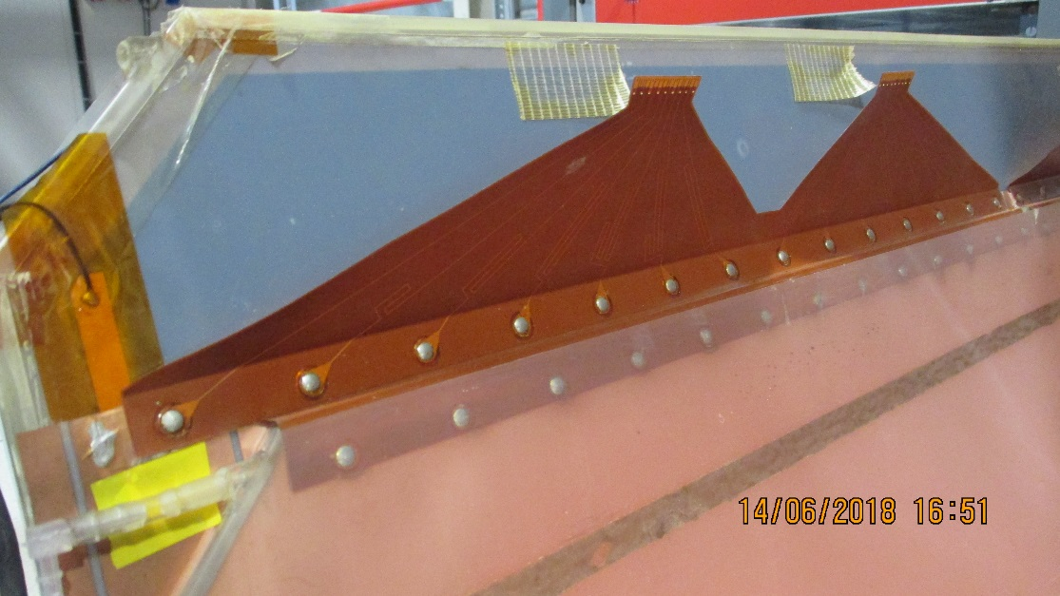
Fan out for Barrel RPC

Slide 10
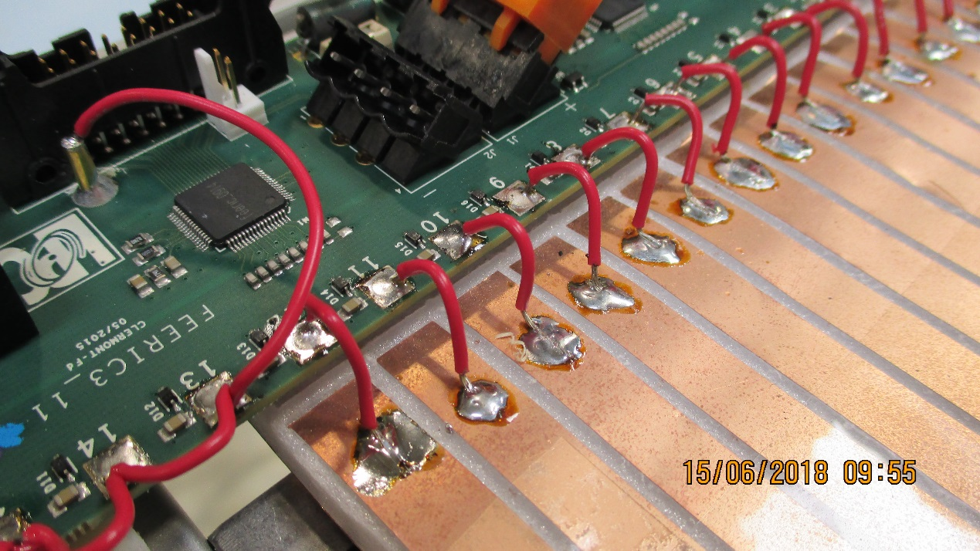
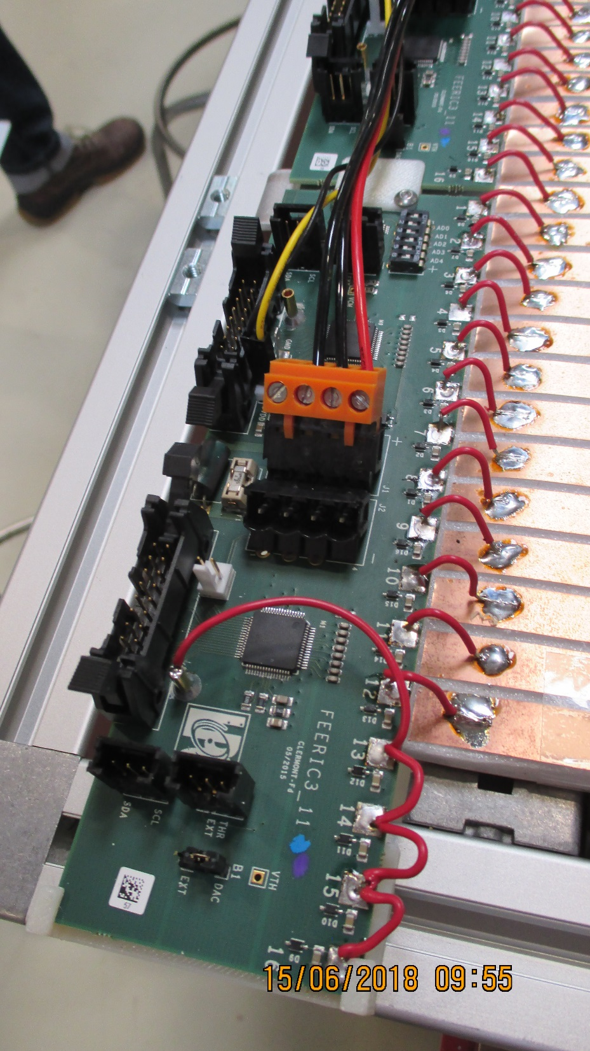
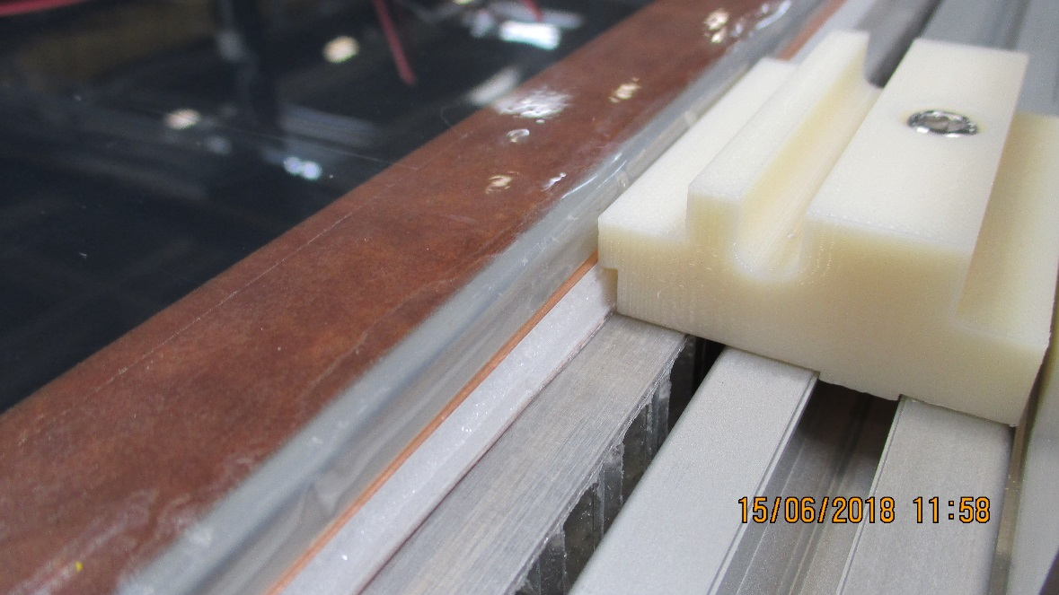
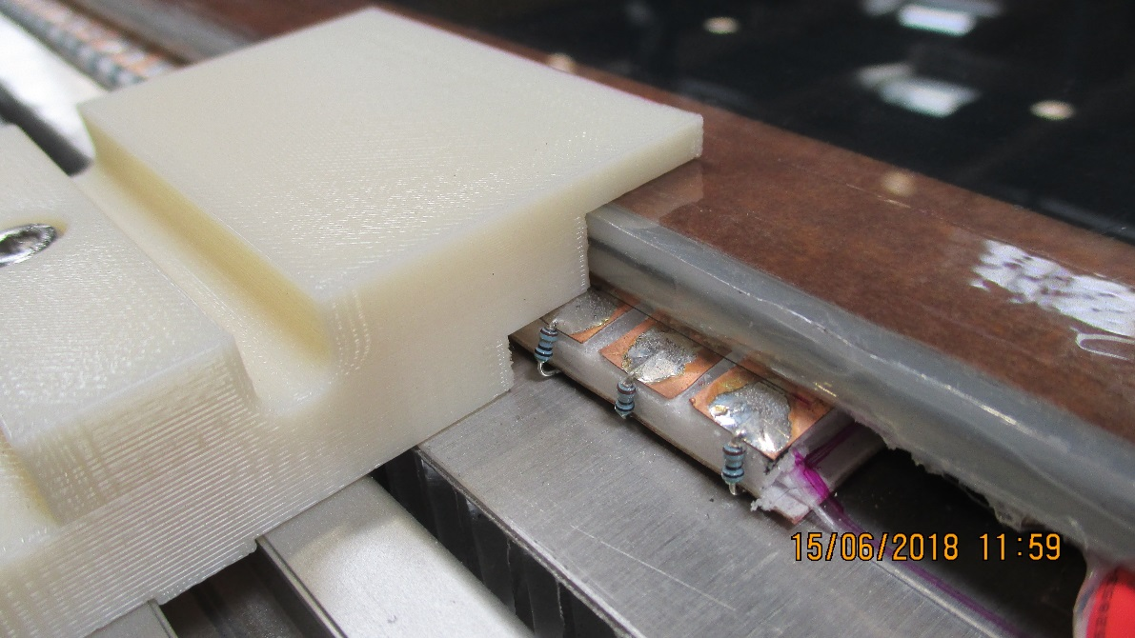
Fan out for SHIP RPCs

Slide 11
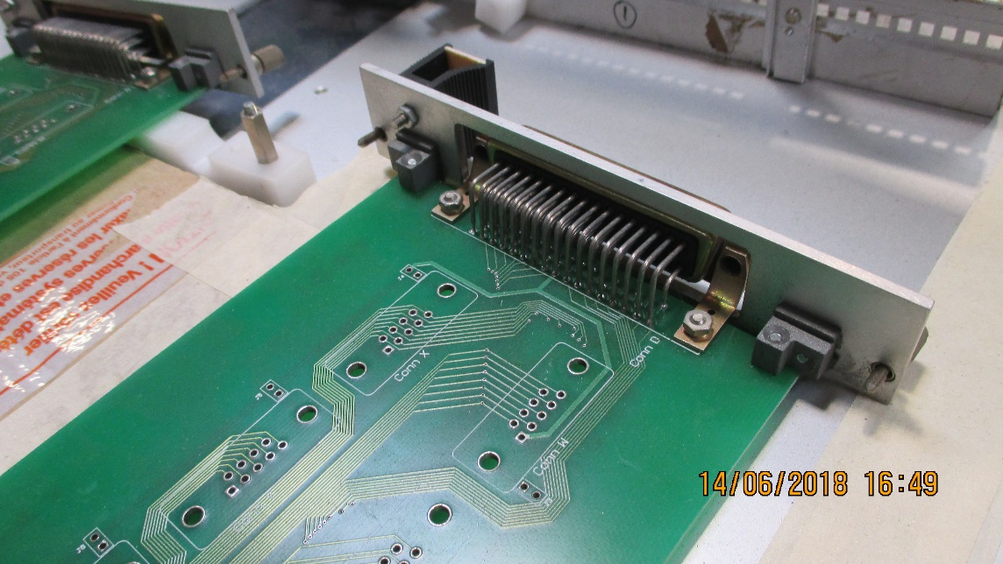
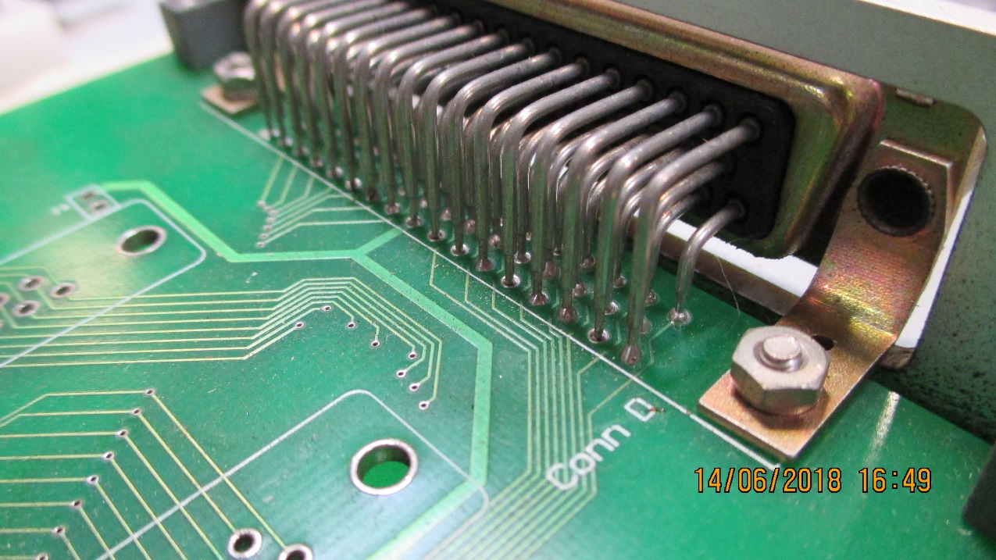
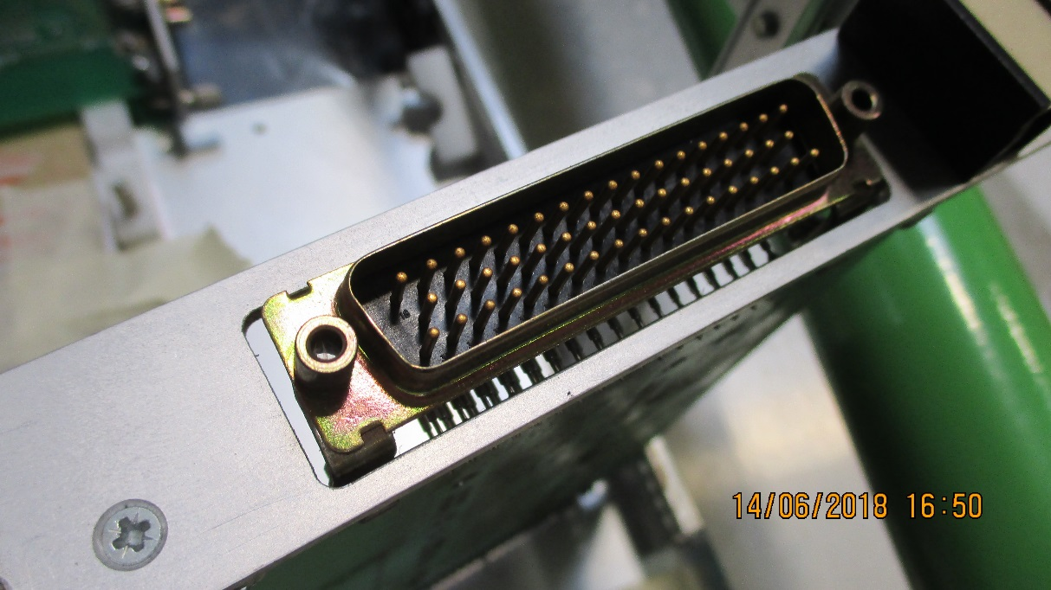

Slide 12
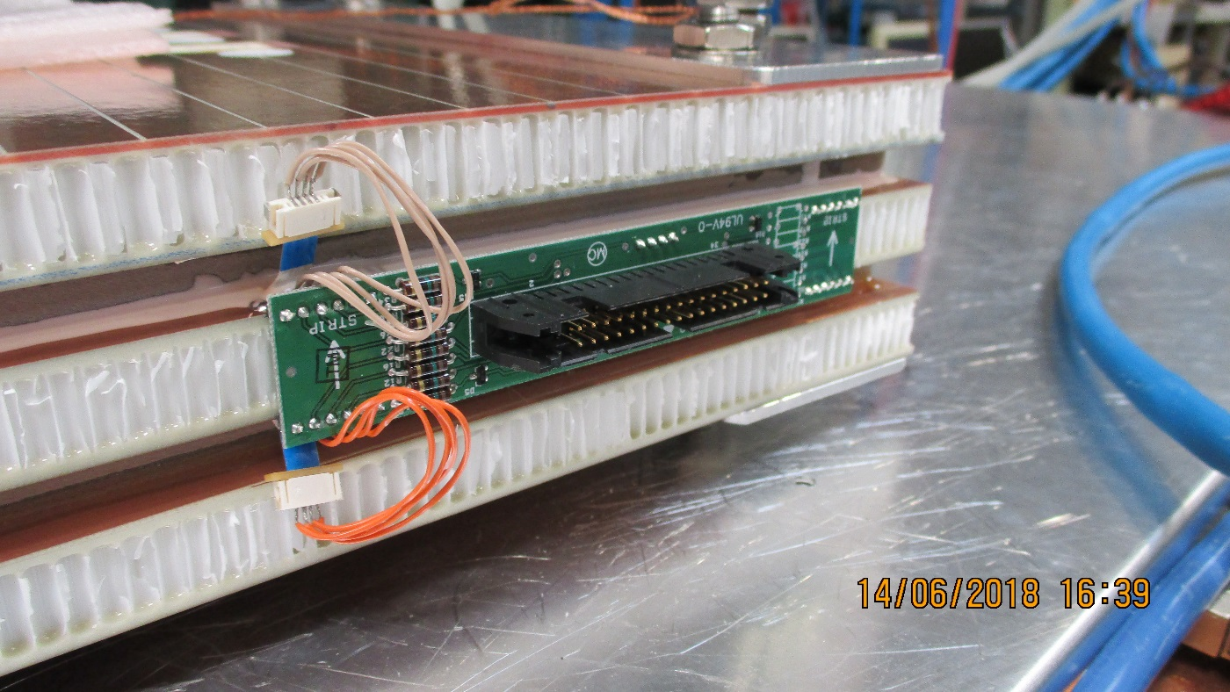
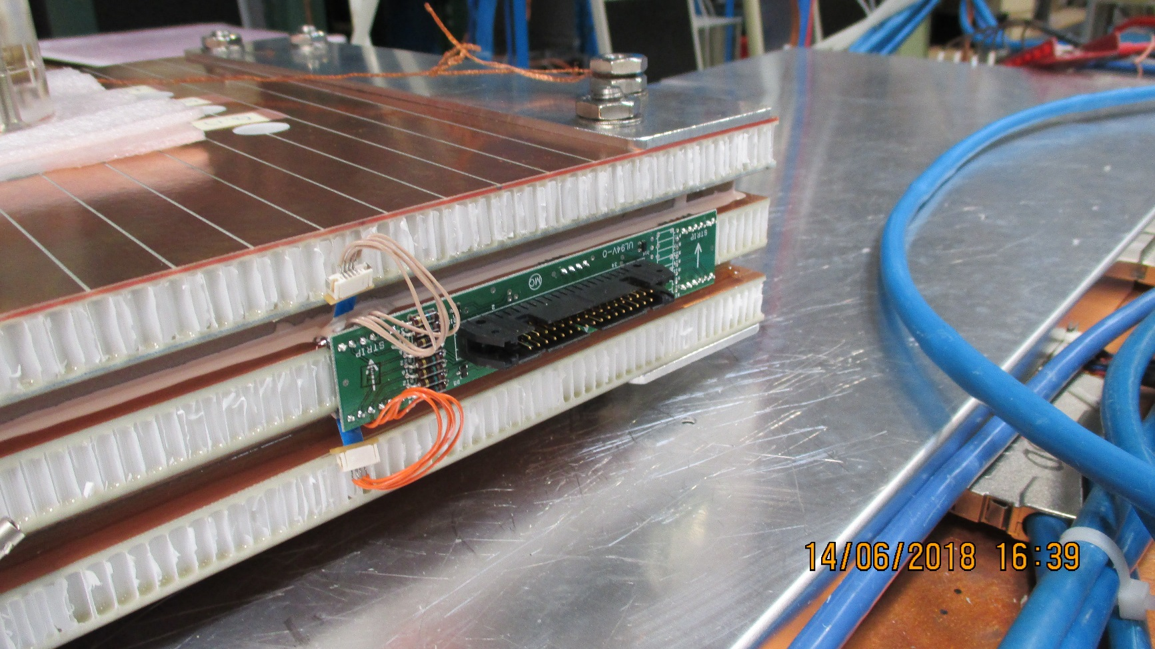
Soldered card between two Mechanical elements.
Screws retaining the HCP elements together

Slide 13
Conclusion
We can not rigidly mount the FEB to the cooling.
Limited cooling ability.
Some flexibility has to be introduced to unconstrain the system
Introduce flexible connection between the FEB and PUSP.
If retaining the “rigid” direct connect then a mechamnical mounting of the two must be introduced.

