Slide 1
HCP
CEL Components
Imad Laktineh suggestion see email is adjacent email,

Slide 2
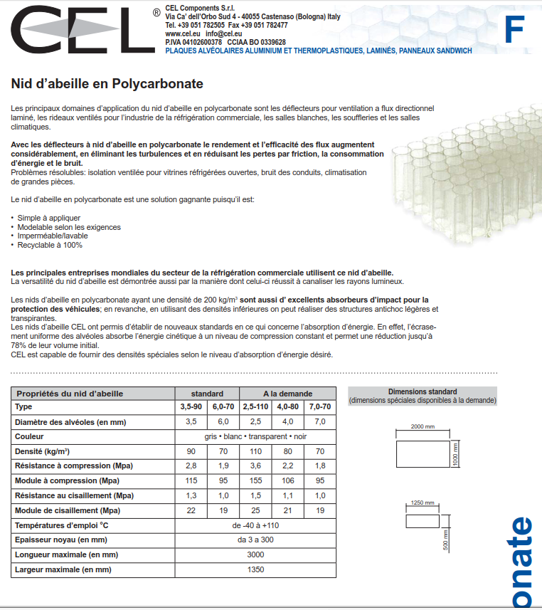
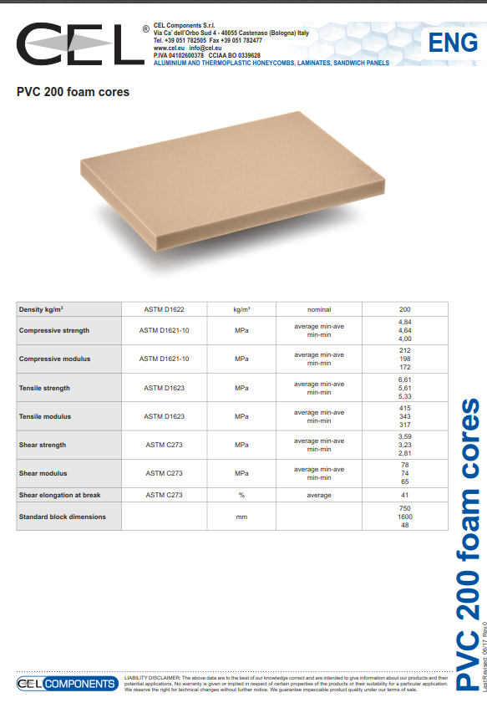
Examples of range

Slide 3
Quotation for Imad jan 2017
250 Euro for one panel 2500 x 1250 x 5mm
Transport 200Euro

Slide 4
Contacts
Alice Frascari
CEL Components Srl
Via Ca dellâOrbo Sud, 4
40055 Castenaso BO
Tel. 051782505
Fax. 051 782477
commerciale@cel.eu

Slide 5
