Slide 1
Report on 1.6mm GT RPC
Imran & Ian
11 Aug 2016

Slide 2
Genaeral Chamber condition
Gas inlet strength
First results

Slide 3
Work to be done
Gas circuit to PP
Move PP to common side so all services are on same edga
Flat cable connections to PP
Ground connection of the reference shield
Repair gas inlet

Slide 4
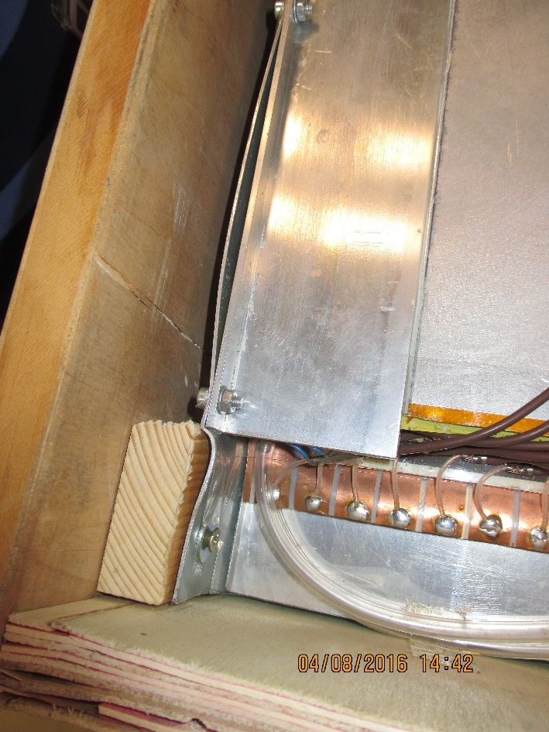
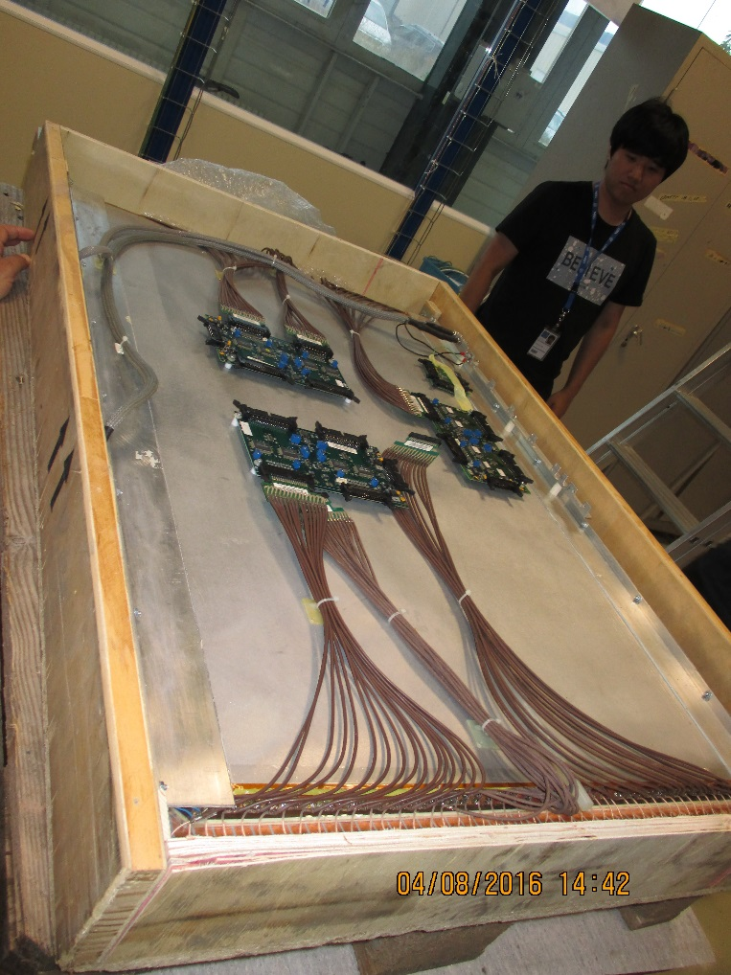
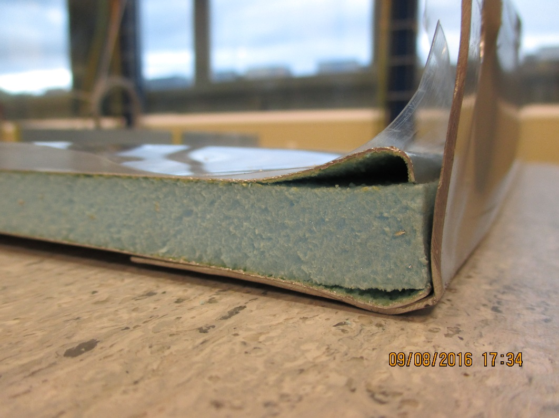
Mechanical condition

Slide 5
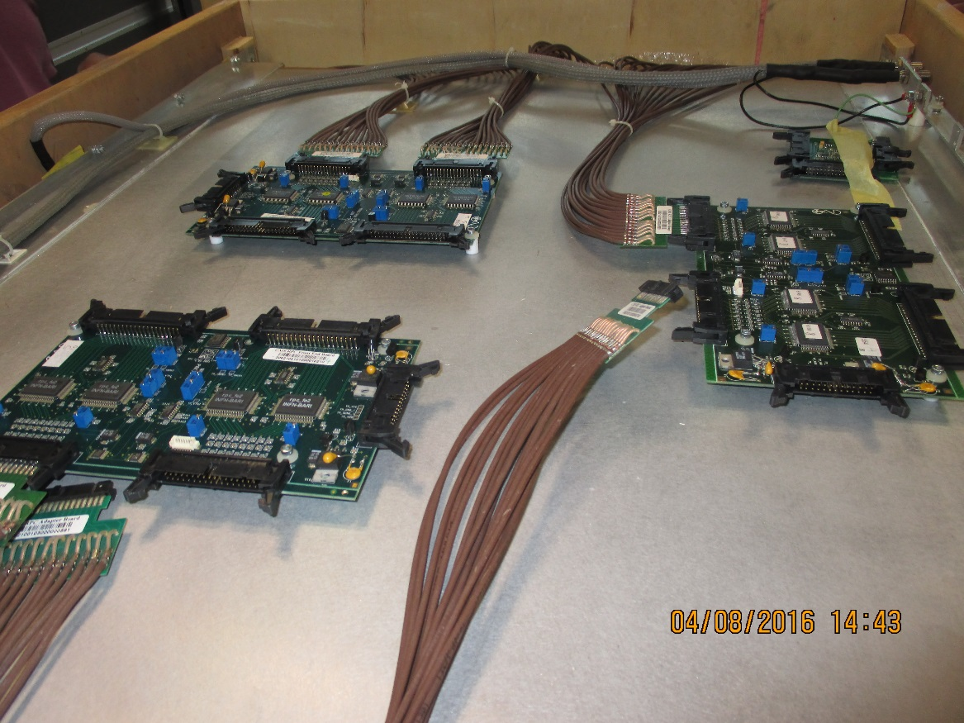
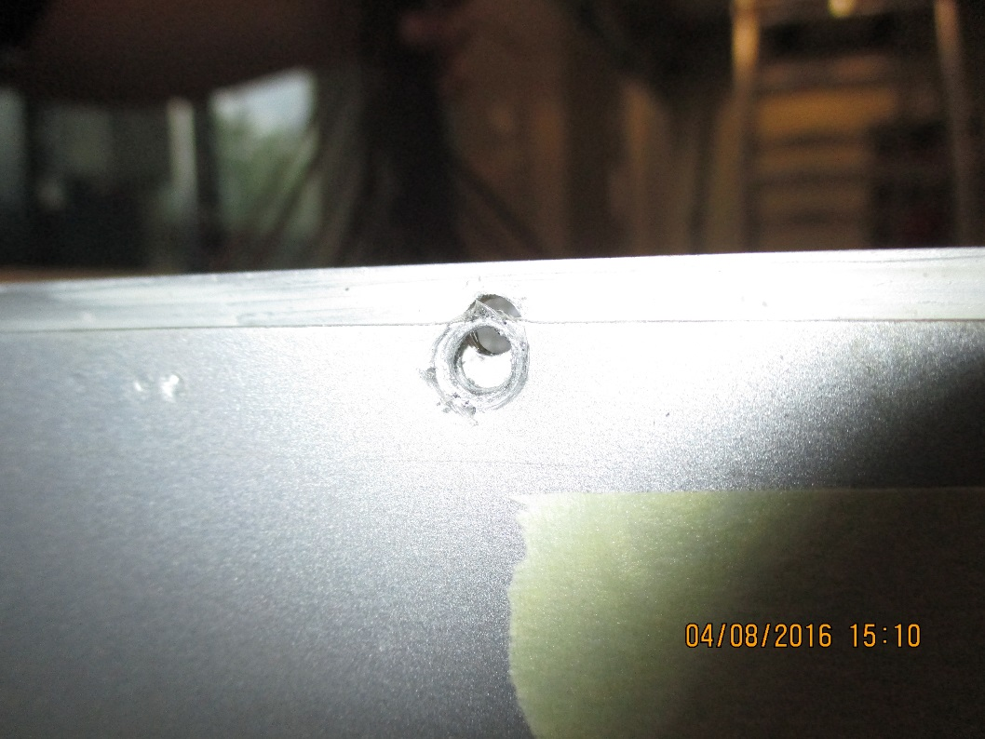
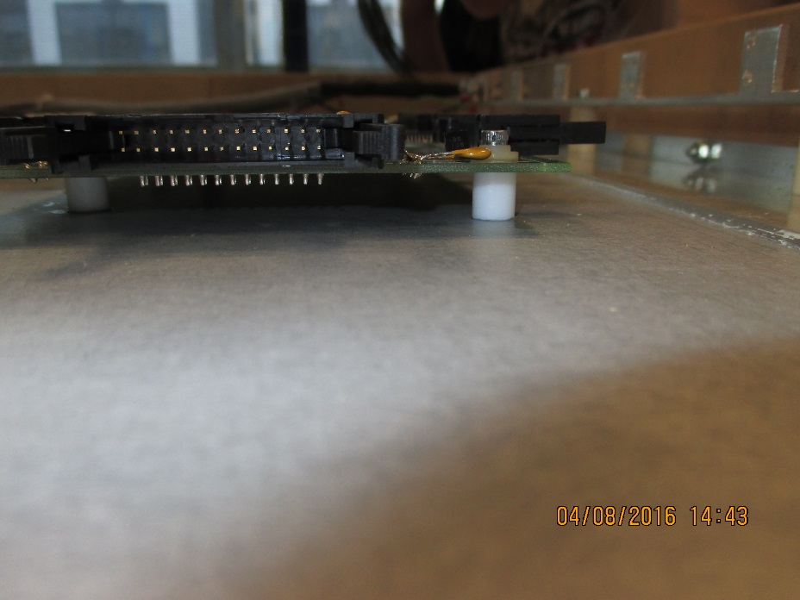
Compression of gaps
FEB distribution and mounting

Slide 6
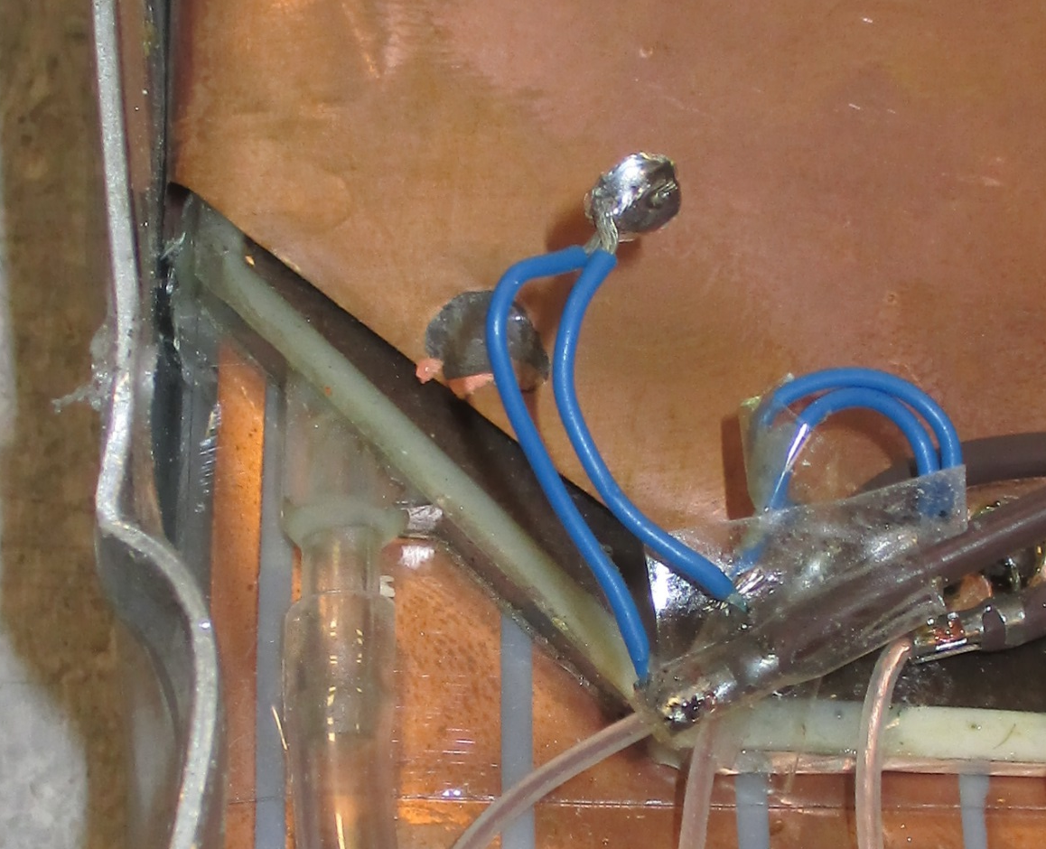

Cu/Mylar reference shield. Solder pulled off.

Slide 7
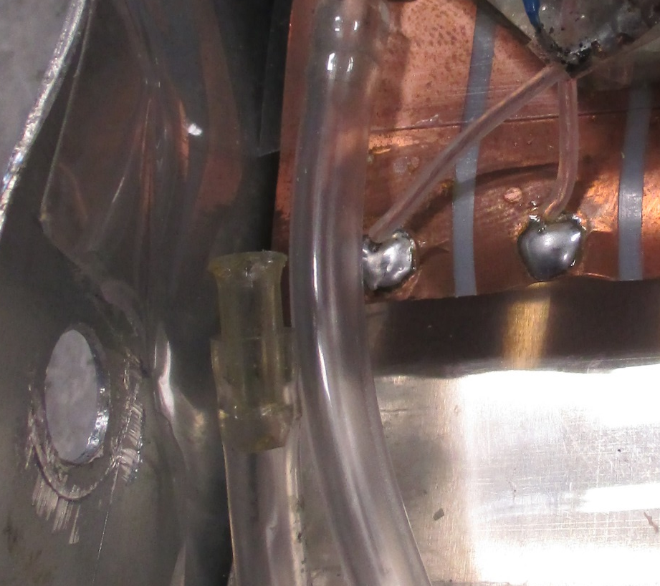
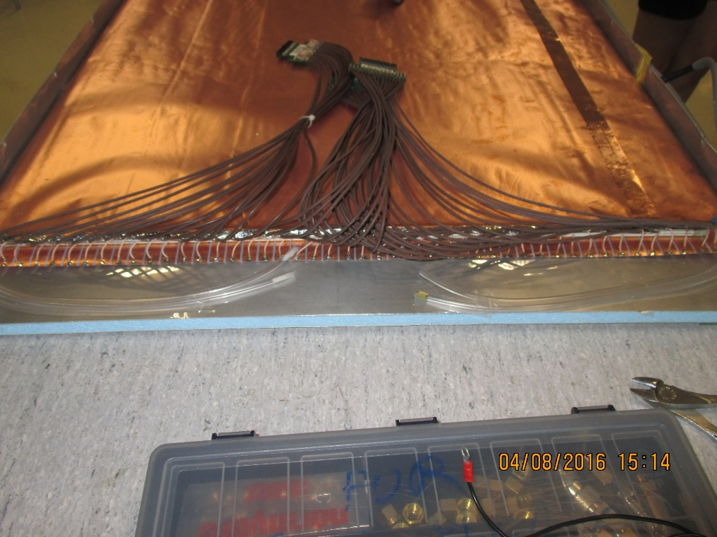

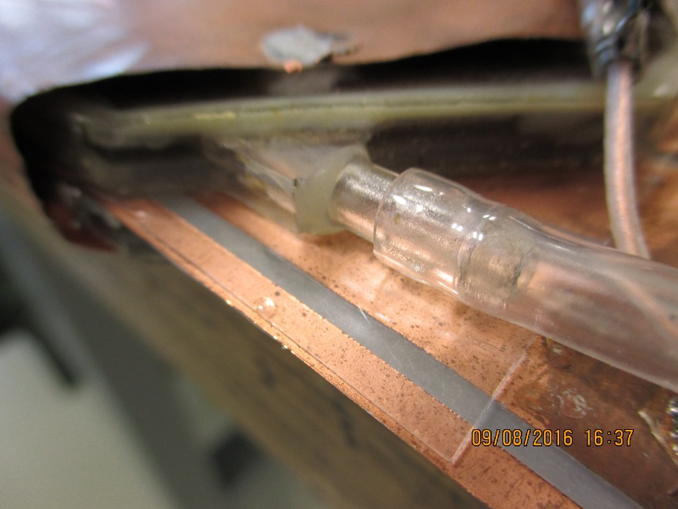
Soft gas pipes, too short to link to circuit
Broken Gas pipe

Slide 8
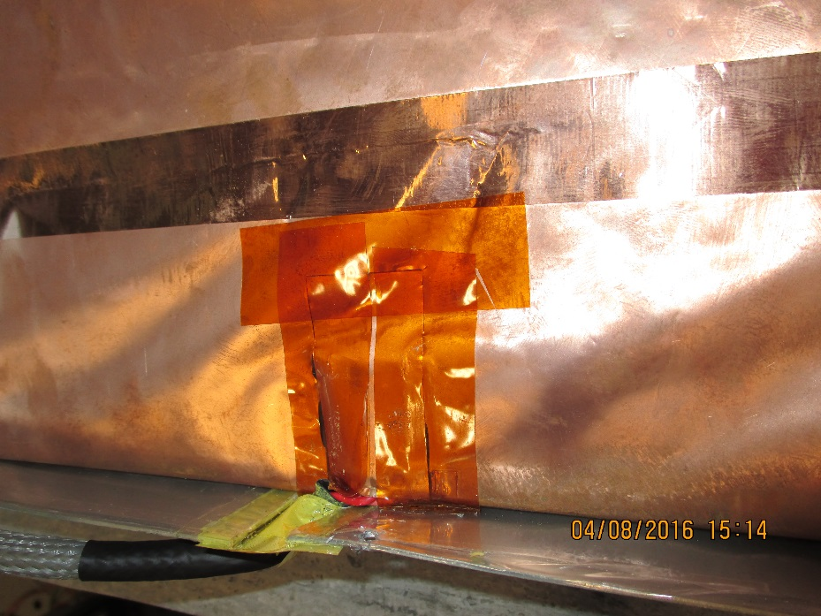
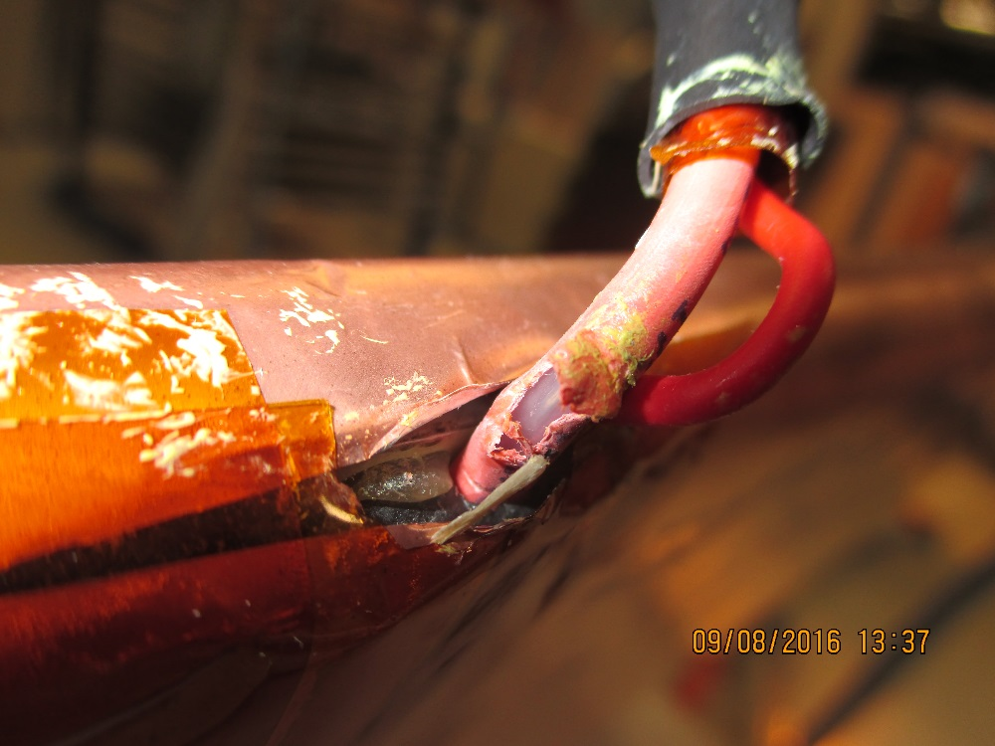
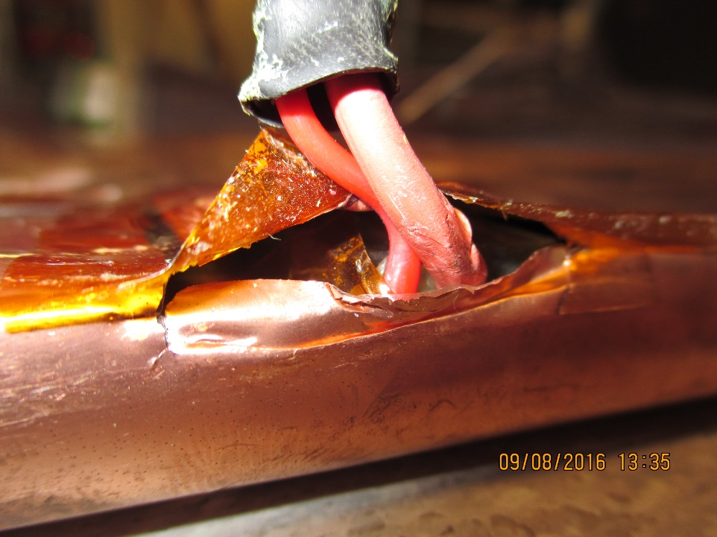
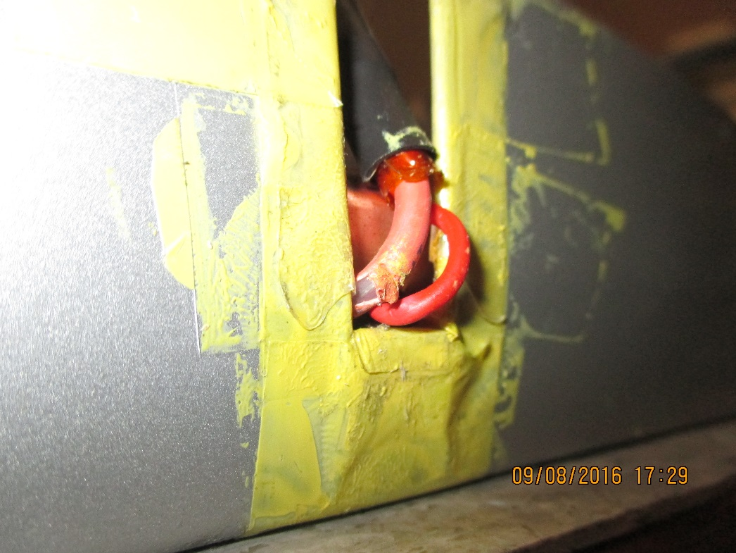
Top Gap HV cable
Bottom Gap HV cable

Slide 9
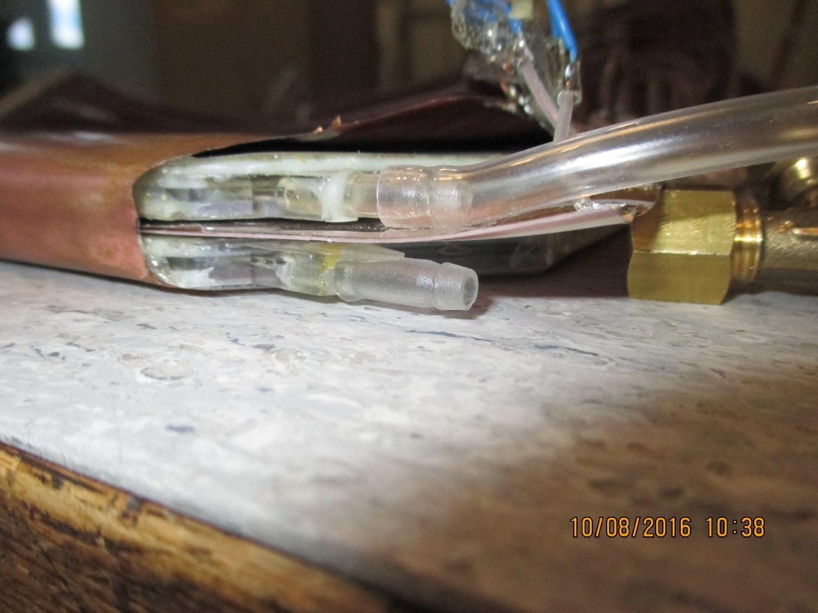
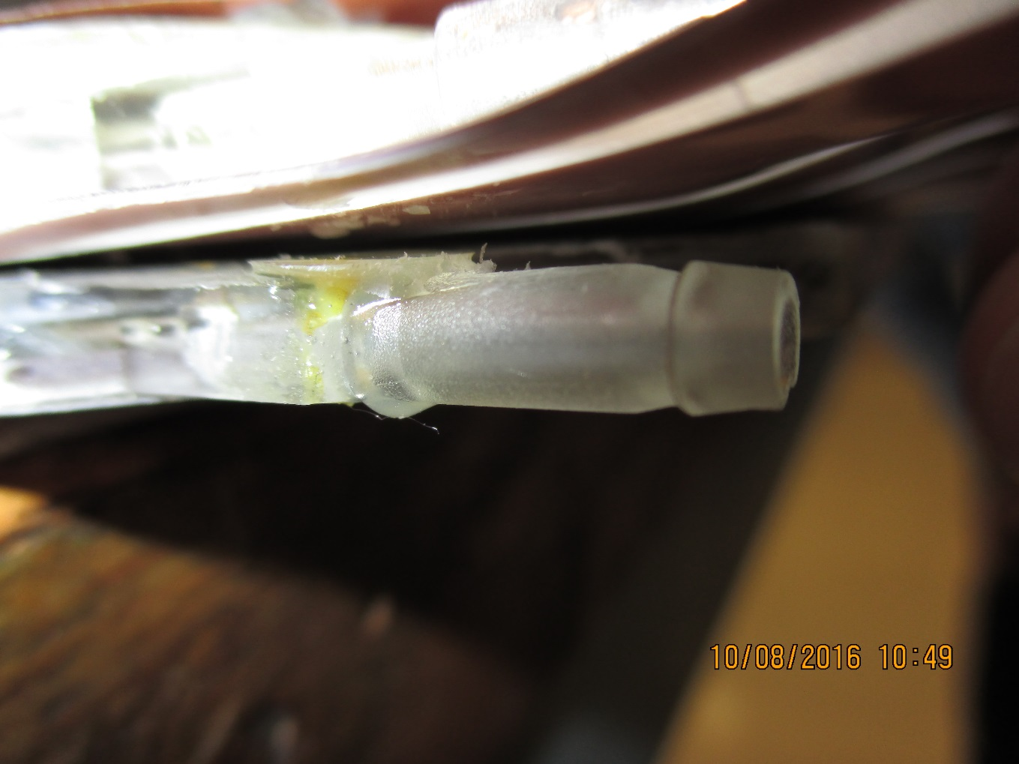
Gas inlet repaired by Naples technician
Excess epoxy cleaned back the next day

Slide 10
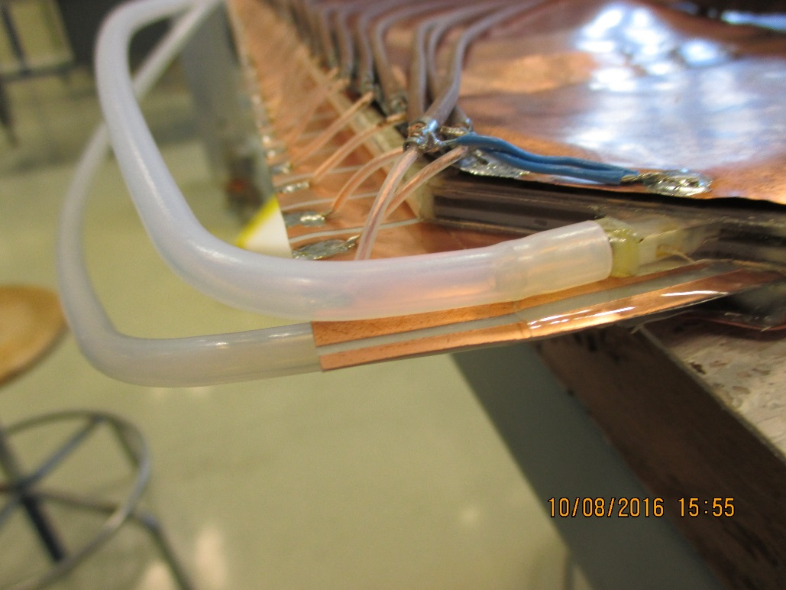
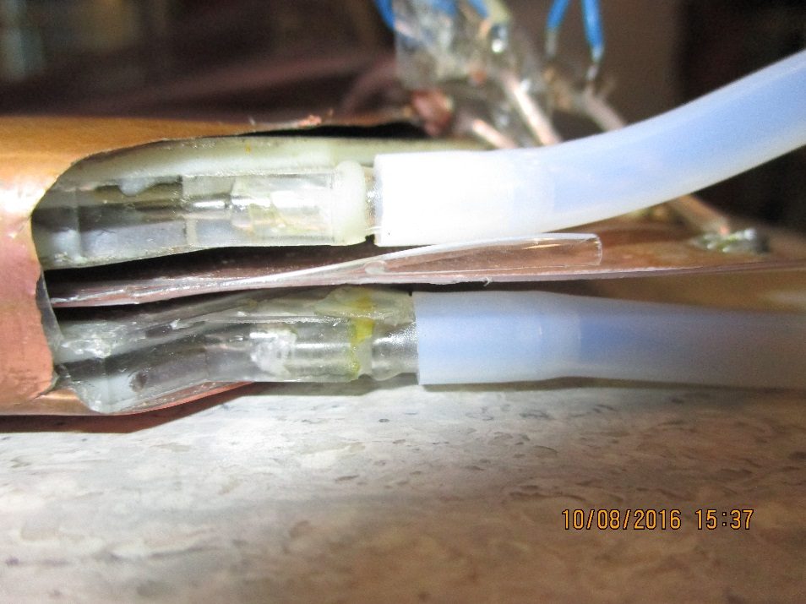
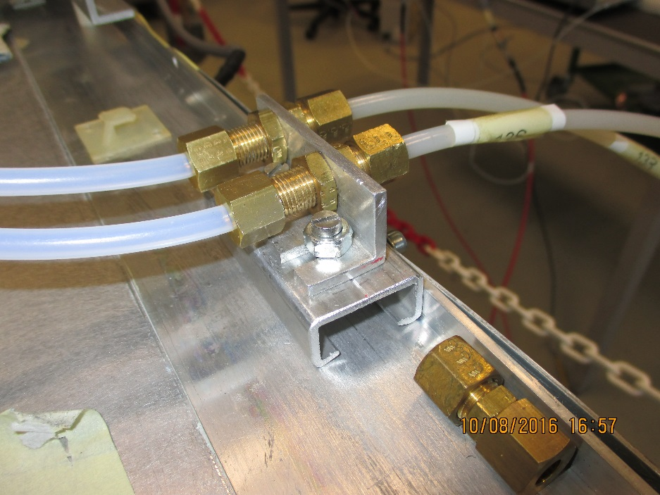
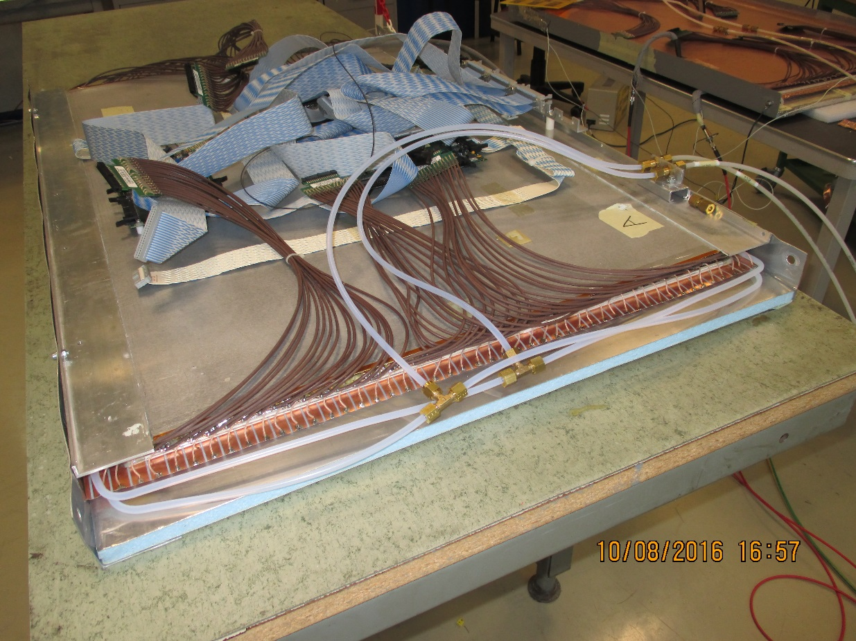
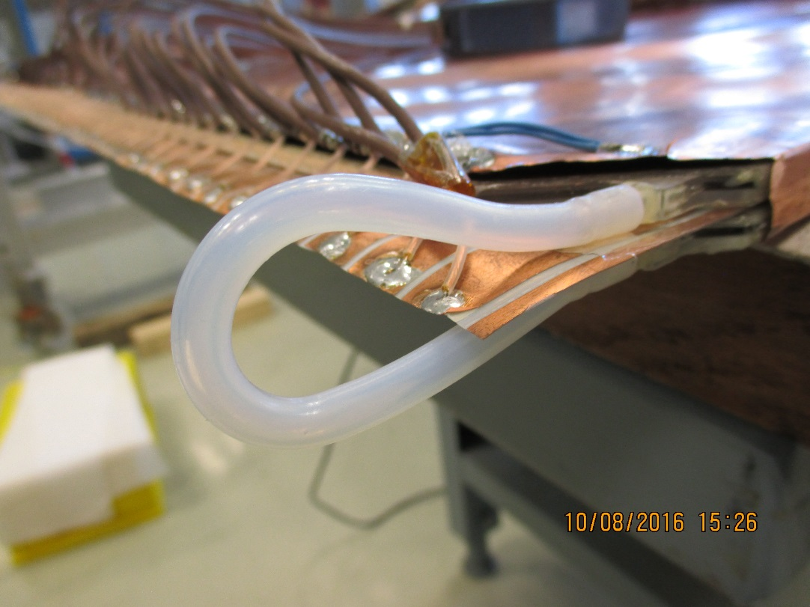
Gas circuit as installed by Imran

Slide 11
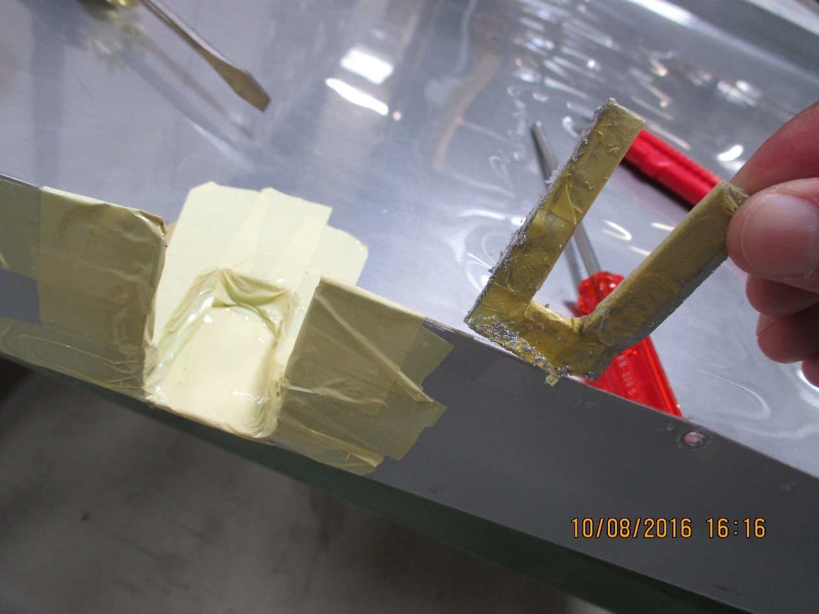
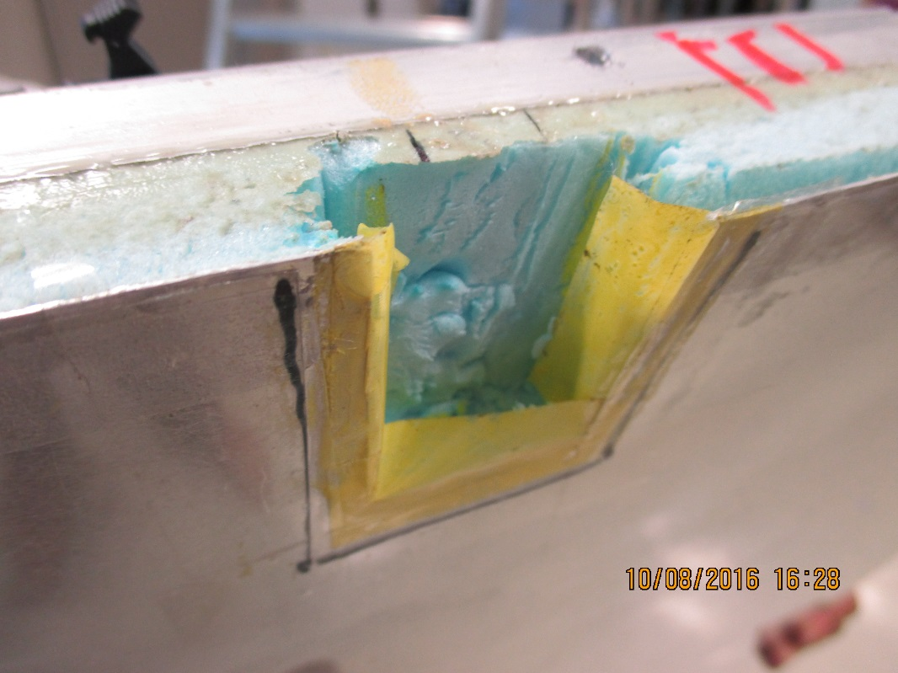
Top gap left as is
Hv cut out for Bottom gap

Slide 12
Programme to understand gas inlet strength
What are the possible fracture/load modes
Static Shear load test, with realistic load application through PELD pipe
Impulse measurement
Energy to fracture

Slide 13
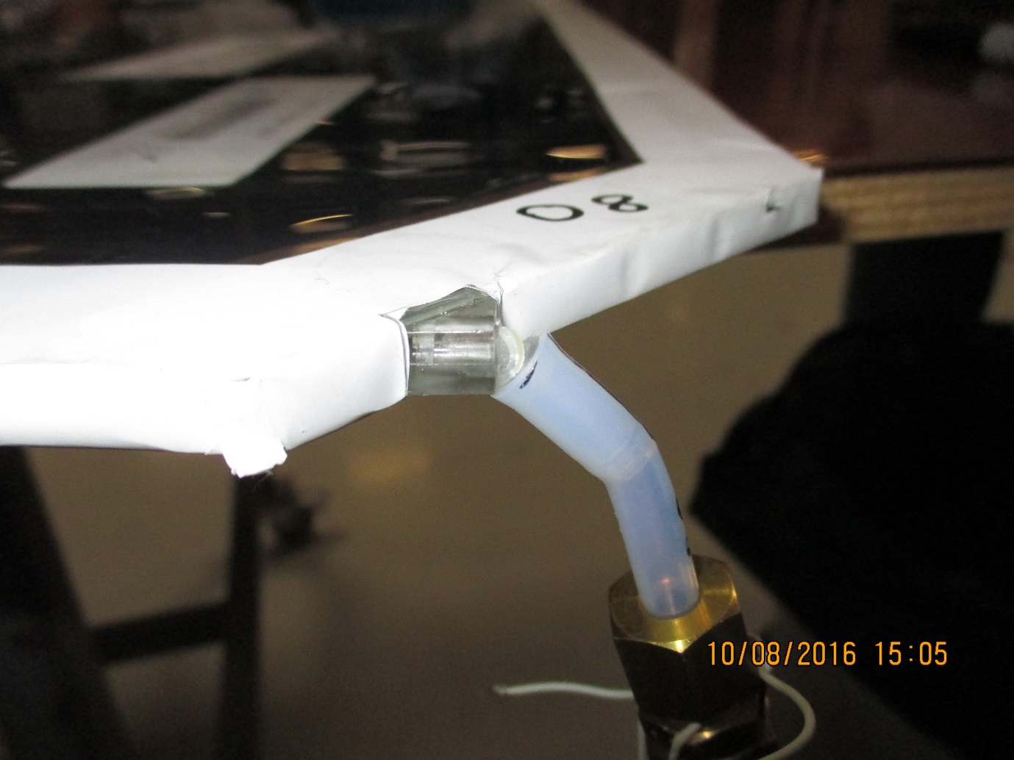
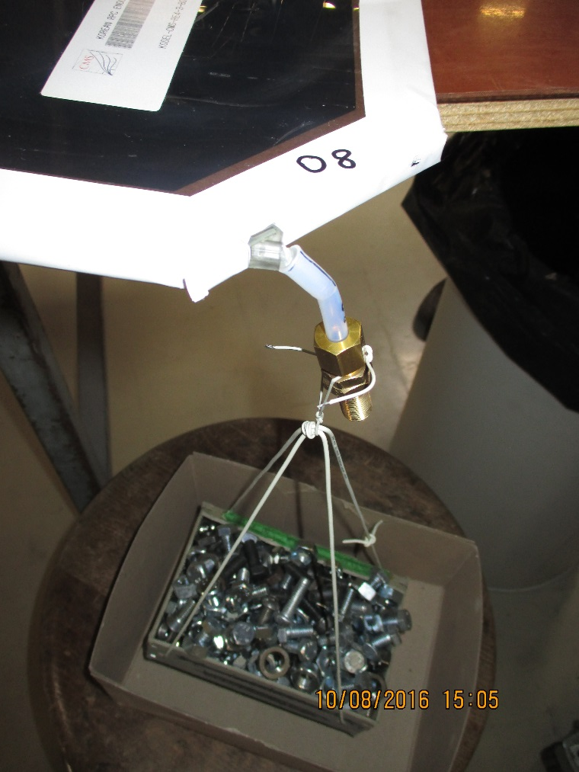
1 to 5kg load , age dependence to rupture. Results to come from Fernando

Slide 14
Conclusions
Work on gas still to be tidied
Flat cables to be remade (equal length) as the PP is on the other side
Grounding of side strips
Mounting in the Trolley

Slide 15
All material 1.6mm GT Aug 2016
http://project-cms-rpc-endcap.web.cern.ch/project-cms-rpc-endcap/rpc/UpscopeHighEta/RPCDevelopements/RE31and41/ProtoGTNov2015/ProtoGT4Aug2016/

