Slide 1
The ideal chamber, at least in terms of signal
Ideas taken from K.S. Lee and developed
Ian April 2018

Slide 2
The impedance of trapezoidal pick up strips is not constant along the length, this causes ………………
Solution put the ground plane at the correct distance form the strip along the full length of the strip.
The use of the ground plane at the optimum distance from the pick-up strip to define the strip impedance for good signal reception at the FEB
Use the construction mechanics as part of the ground plane.

Slide 3
Strip is fixed distance from the Back plane or ground plane so for

Slide 6
ATLAS FE
This should occupy 30mm at the end of the strips

Slide 7
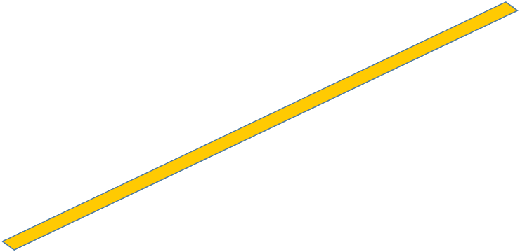
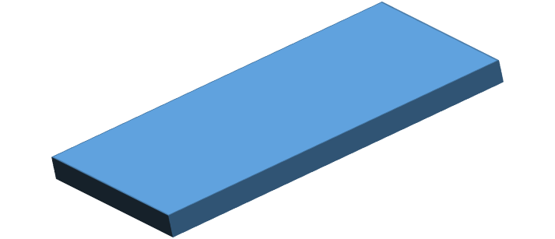

Slide 8
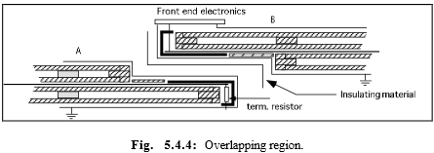
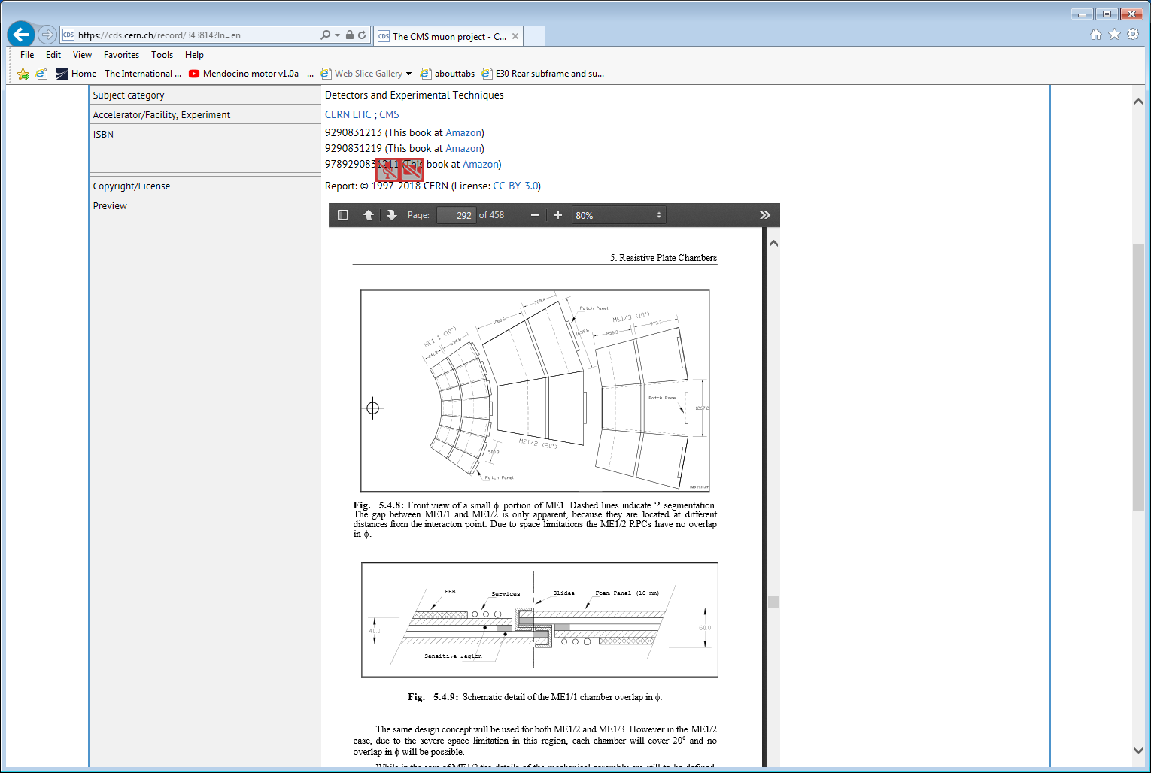
Overlap of the new 060418 chamber design with x2 gaps each with its own “X” and “Y” read out planes. This package is in excess of the 25mm available and so will not nominally fit with overlapped chambers.
Diagram taken from the Muon TDR 1997
ME1/1 refers to RE1/1 during these early days
An optimistic 68mm total for overlapped chambers was given with 10mm for FEB space rather than the 20mm used finally. !

Slide 9
CMS Muon TDR 1997. Same constraints and similar solutions
https://cds.cern.ch/record/343814?ln=en

Slide 10
Orientation nomenclature for discussion
This is the CMS configuration with “Y” equal to “R”
Y
X

Slide 11
Conclusion
More brain storming with convergence

