Slide 1
HCP small proto Panel
Ian
06.04.18
16.04.18

Slide 2
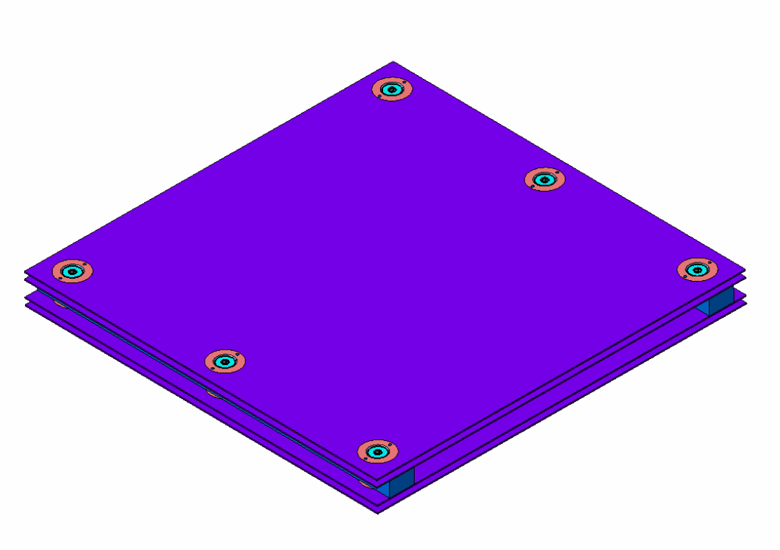
First attempt to build a Honeycomb panel (HCP) with inserts.
In house design of inserts.
Recovered HCP panels from P5
Samvel Martirosyan ( IO) drawings
Mechanics prepared by Russian team at P5

Slide 3
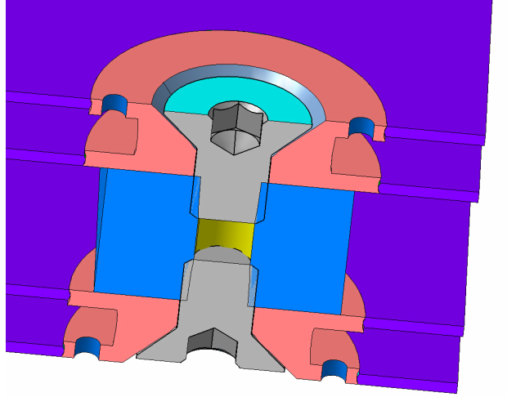
Insert Design , first version
Injection and air extraction orifice
Counter sunk screws flush or undercut with external HCP surface

Slide 4
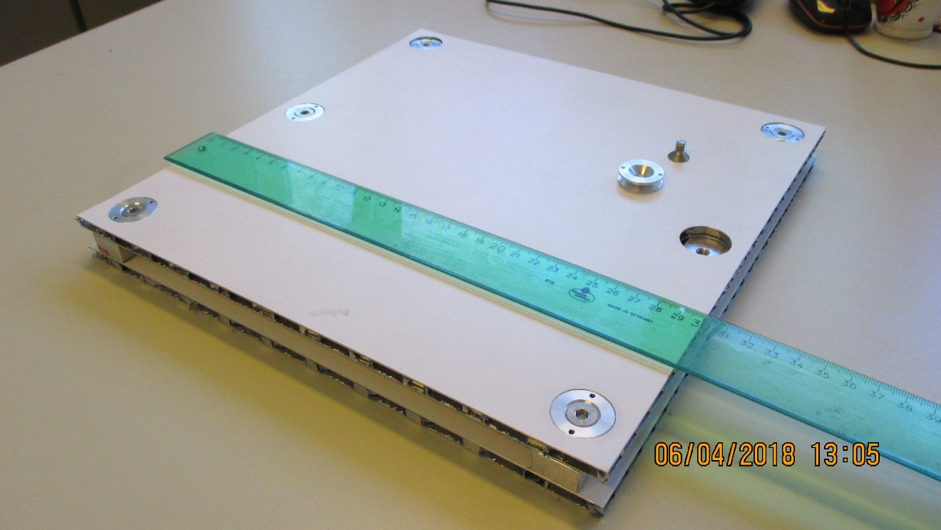
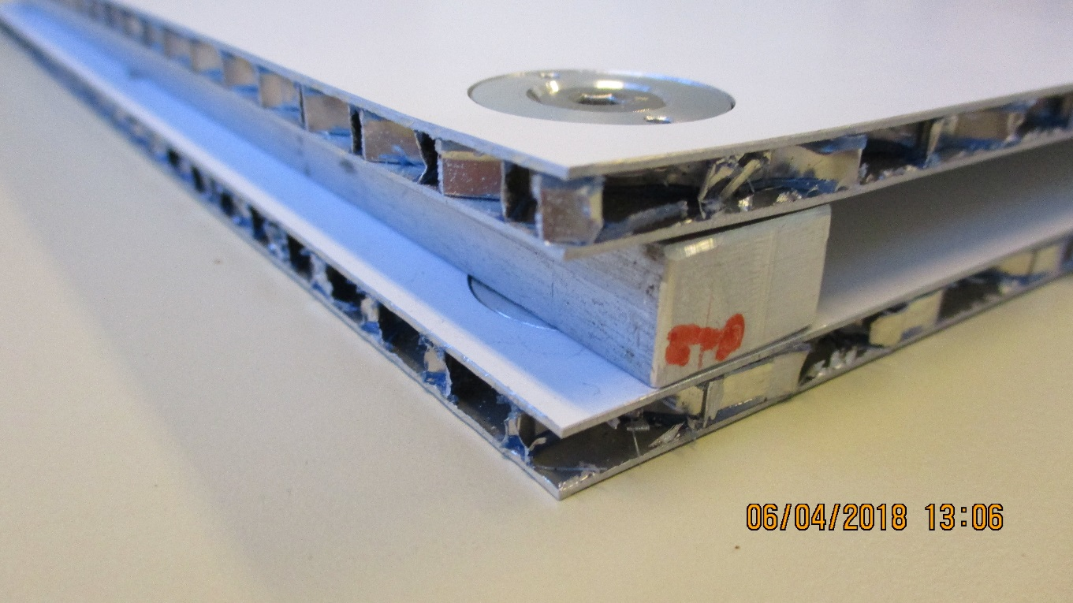
Panel before Bonding of inserts

Slide 5
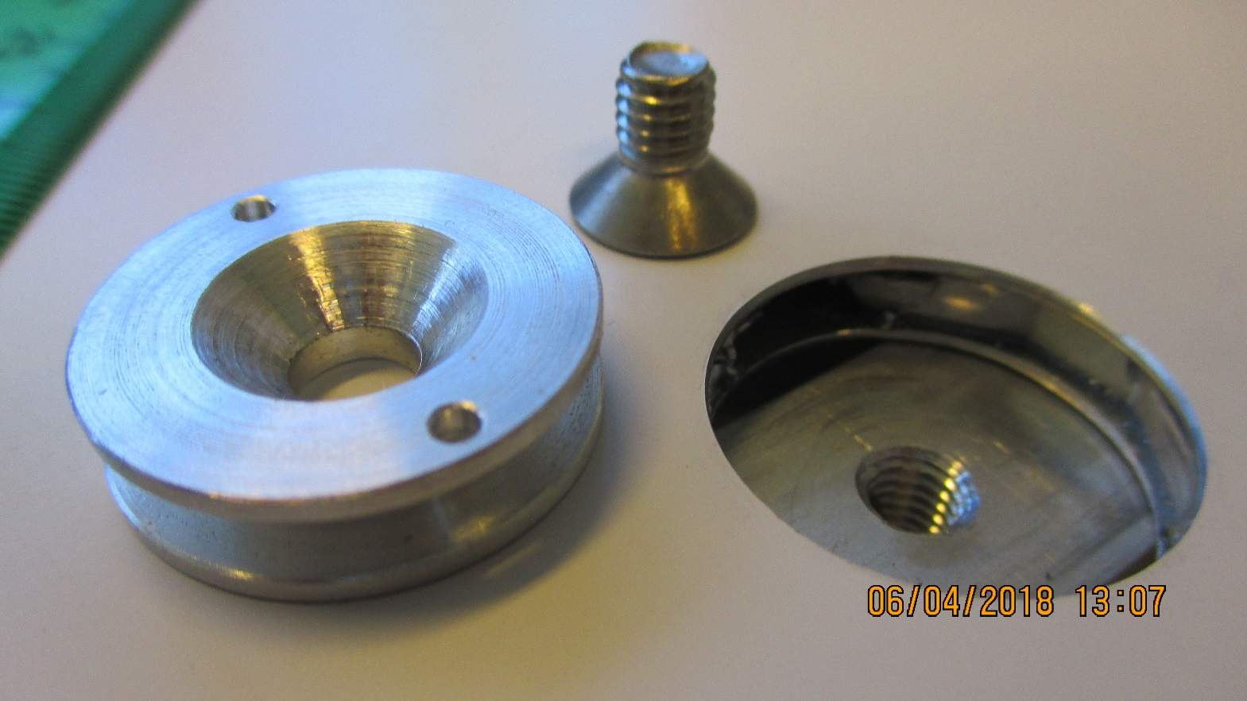
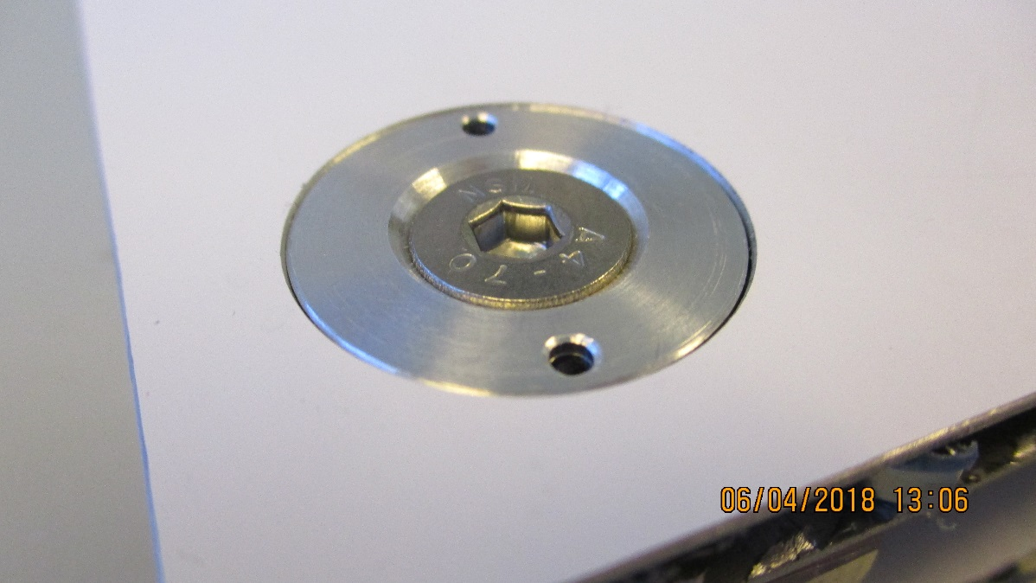
Inserts optimised for strength in compression so that high tightening torque can be applied to increase shear resistance during bending loads on chamber.
Tolerances on spacers and their pockets is important for bending resistance. This question will be investigated with full scale mechanic prototype.

Slide 6
Epoxy injection, Two types, two viscosities
Araldite 2011A and 2011B from CERN stores (AW106)
Resin AW 106 + hardener HV 953 U
Mixed viscosity 45000 [cP] @ 25degC Mixed viscosity 30-45 [Pas]
Stycast 2651-40 W 1 & catalyser LV23 old dated 2013 !
Mixed viscosity 2200 [cP] @ 25degC

Slide 7
Notes on the insert bonding method.
The initial inject of AW106 once mixed with the hardener was found to be difficult even after warming in hot (~60degC ) water. The hole size is 2.0mm, syringe was 20ml with 1.371mm int. dia. nozzle. In addition the distribution of the epoxy around the insert was incomplete despite warming of the panel and insert with a hot air gun.
The second attempt was made with an old tin of Stycast found in our 904 stock. Here the mixed viscosity was 20 times lower and gave good results in terms of filling. However additional problems where encountered namely as the cell size is large and the inserts are near the edge of the panel, as the design requires, the epoxy would leak out of the panel ! A temporary solution was to use hot melt adhesive which if opaque and moulded in a suitable fashion would/could be a solution. This method is used in making the gas gaps from Korea. The stycast fully polymerised despite its 5 years of age.
A suitable bonding agent must be sourced.
This brings to a head the need to solve the edge question.
In addition the use of tape to seal the bottom of the insert to the panel is not a good solution if the screws and spacer bar are used to position the insert within the thickness of the panel as the insert twists slightly during the tightening which rotates the insert and introduces wrinkles. they then allow the potting compound to spread out beyond the insert so complicating the clean up procedure and increasing the time to completion. An alternative method must be found.

Slide 8
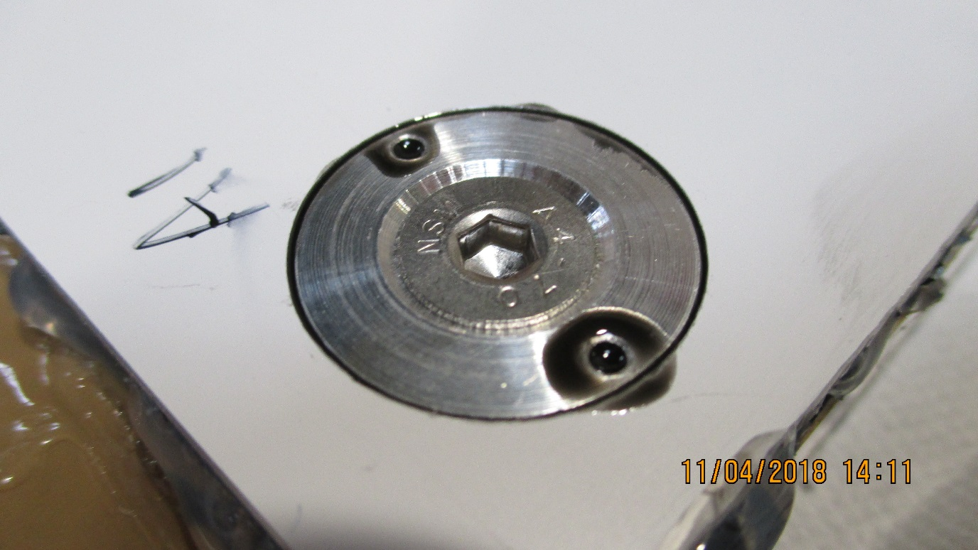
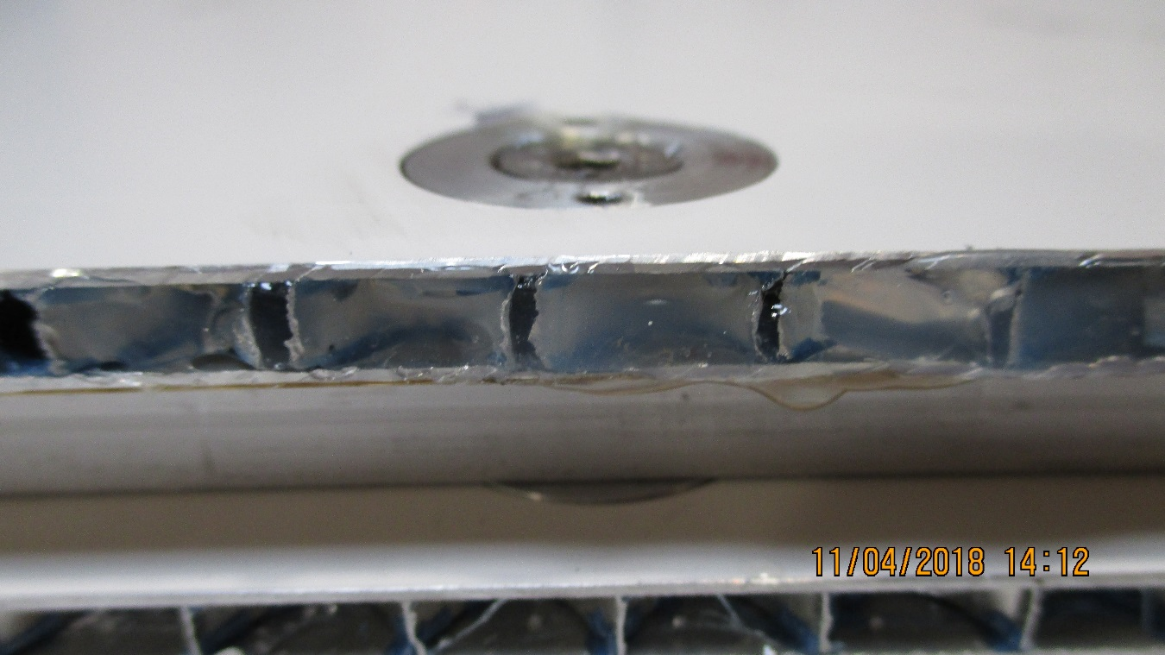
Sealing of the HCP edge to stop the epoxy leak
Finished injection with both holes full of epoxy after the bubbles have exited. The excess can be readily removed given the long operating life

Slide 9
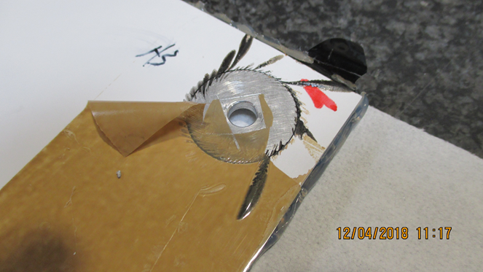
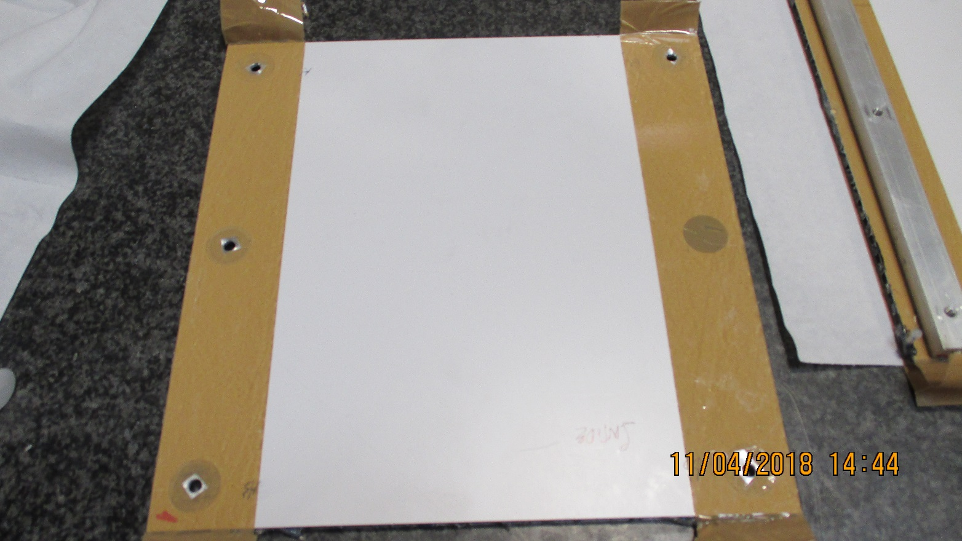
Preparing the HCP and inserts for bonding. One is left out.
An example of tape distortion and epoxy spreading below tape

Slide 10
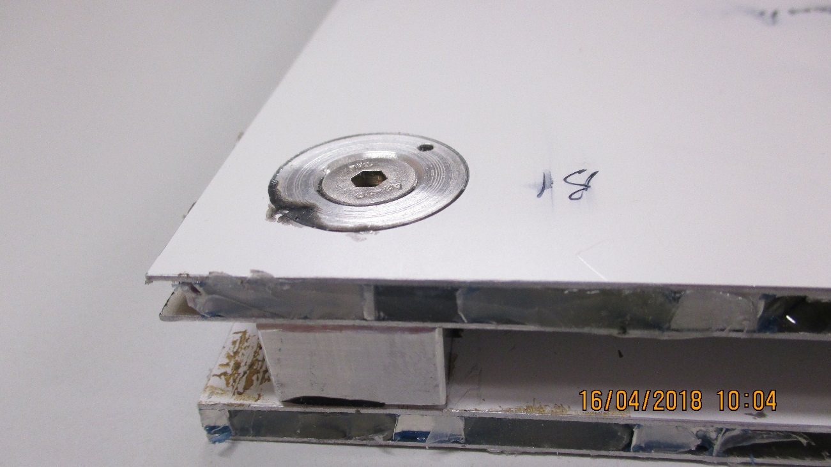
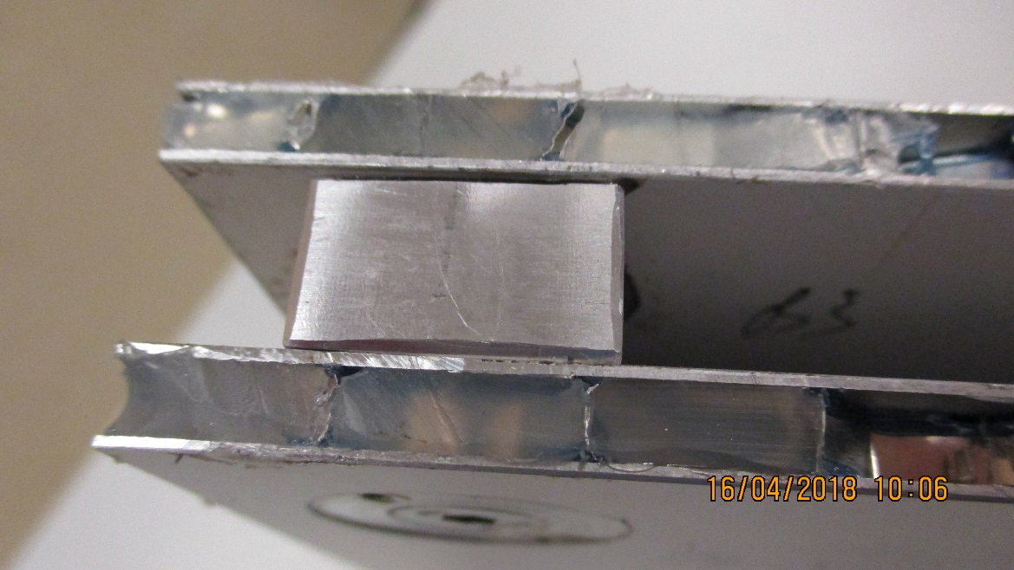
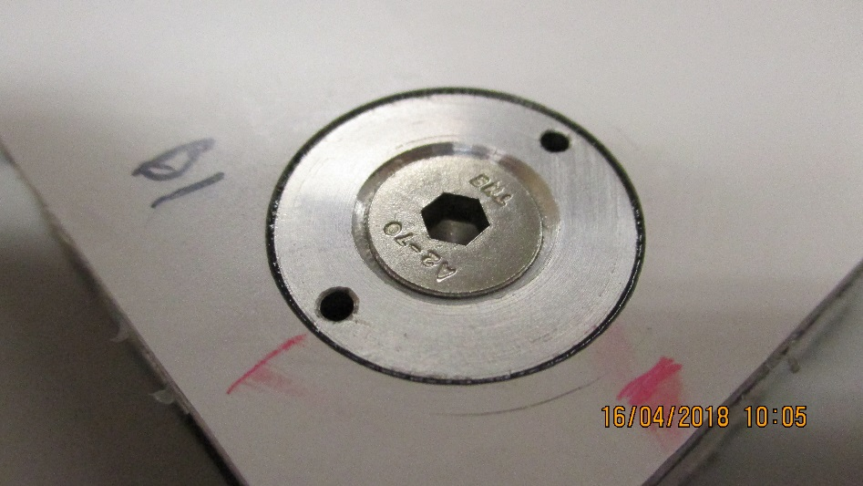
Finished after cleaning looks fine

Slide 11
Final Conclusions for the small insert prototype
The method of bonded in inserts for treaded mounting points is viable for HCP production, as known by Industry for many years.
For a full size chamber the insert position definition prier to bonding will be changed, the question of tolerances during machining. The stiffness of the panel will be influenced by the rigidity of the insert/panel bond, notably the transfer of shear load from the insert to the HCP skin.
Once all is prepared the bonding goes quickly.
A search for inserts will continue with the associated epoxy, in house is possible for small runs.
The finishing of the edges both internal and external is not yet solved.
Strength and stiffness tests will be performed on some panels, both P5 and CEL, different skins and cell size.
We are ready to make a full size mechanical mock-up of a RE3/1 chamber, to study the questions of tolerances, rigidity, weight and method.
Does this HCP production method satisfy the needs of the RE3/1 & RE4/1 project.

Slide 12
References;
Resin AW 106 + hardener HV 953 U
http://adhesive.leaderseal.com/download/TDS-A106-953(US).pdf
http://www.mouldlife.net/ekmps/shops/mouldlife/resources/Other/araldite-aw-106-hardener-hv-953-u-eur-e-1-.pdf
Stycast
Stycast 2651-40 W 1 & catalyser LV23
https://www.ellsworth.com/products/encapsulants/catalyst/henkel-loctite-catalyst-23-lv-1-lb-bottle/
Viscosity Convertion
https://www.engineeringtoolbox.com/dynamic-viscosity-d_571.html

Slide 13
This document is available here;
http://project-cms-rpc-endcap.web.cern.ch/project-cms-rpc-endcap/rpc/UpscopeHighEta/RPCDevelopements/RE31and41/Production/Components/HoneycombPanels/TestPanelsMarch2018/HCPSmallProtoPanelPartTwoApril2018.pptx

