Slide 1
HCP small proto Panel
Before bonding of Inserts
Ian
06.04.18

Slide 2
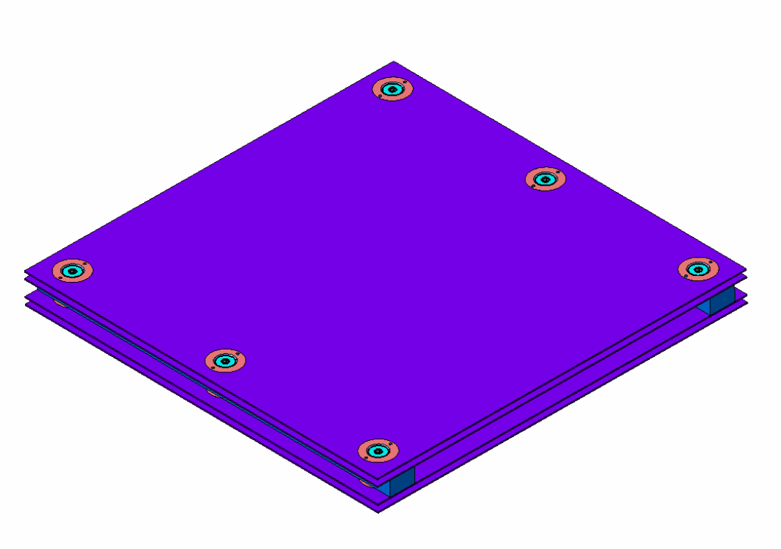
First attempt to build a Honeycomb panel (HCP) with inserts.
In house design of inserts.
Recovered HCP panels from P5
Samvel Martirosyan ( IO) drawings
Mechanics prepared by Russian team at P5

Slide 3
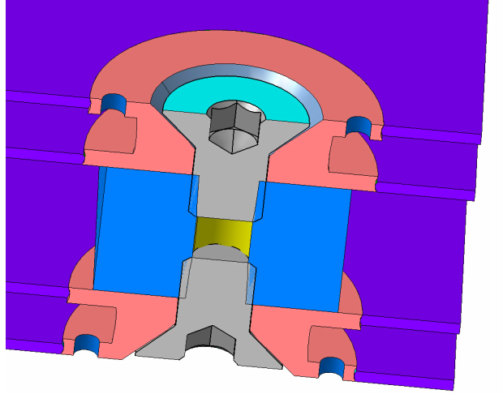
Insert Design , first version
Injection and air extraction orifice
Counter sunk screws flush or undercut with external HCP surface

Slide 4
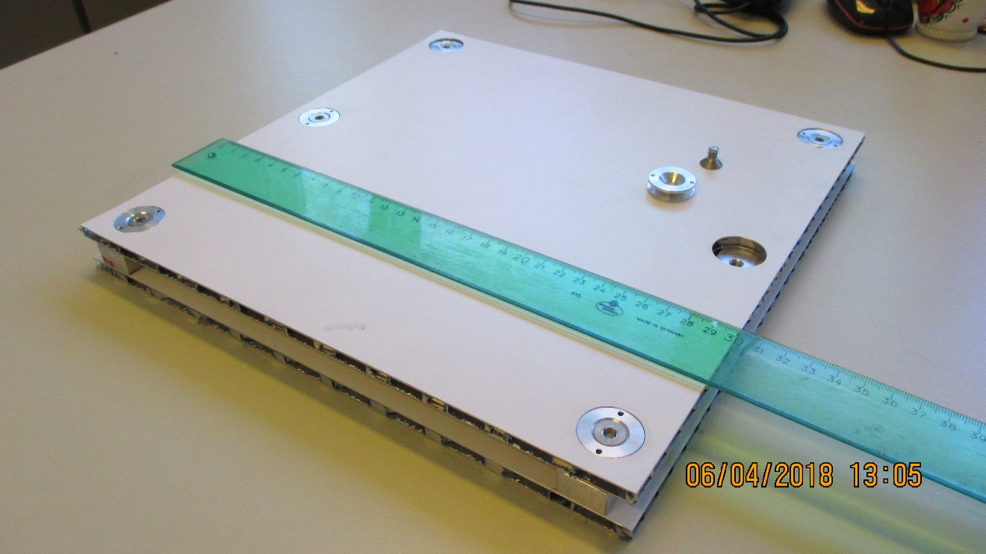
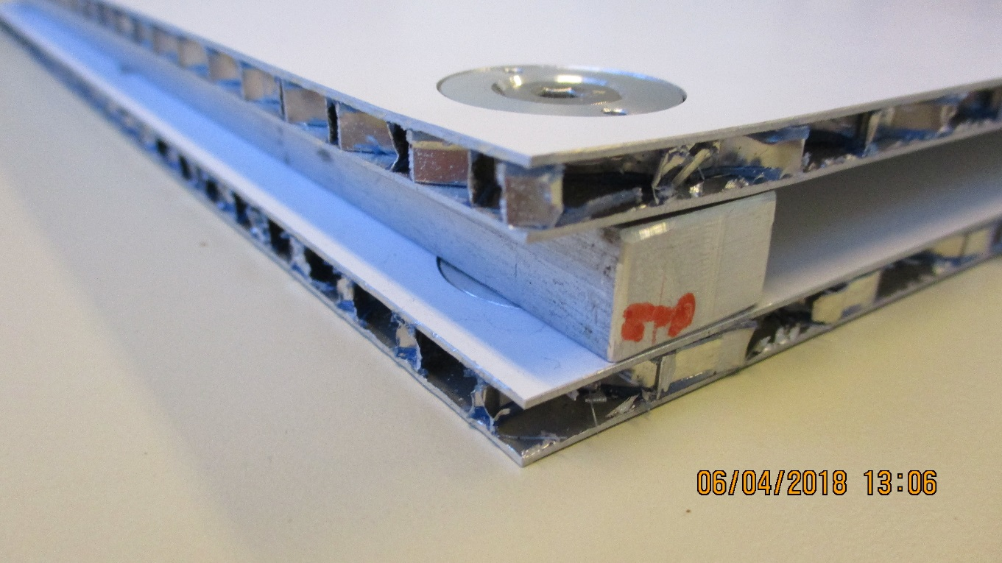
Panel before Bonding of inserts

Slide 5
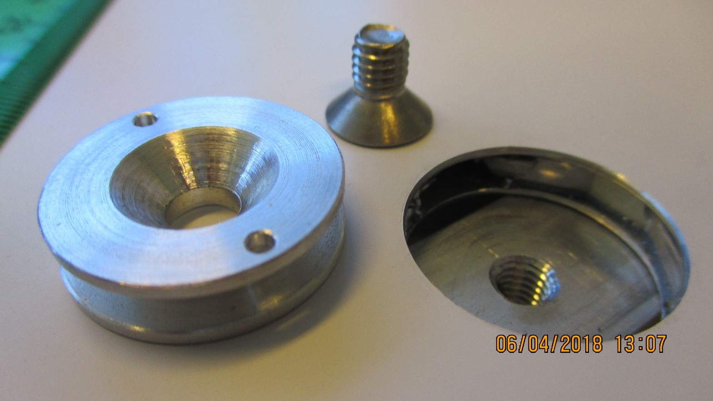
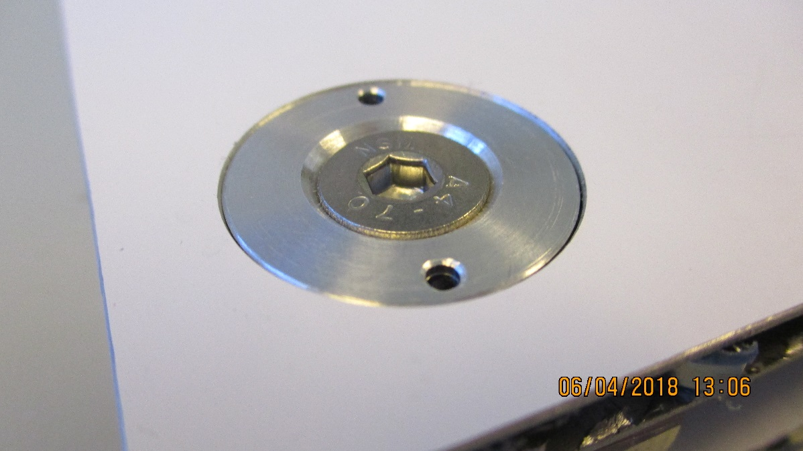
Inserts optimised for strength in compression so that high tightening loads can be applied to increase shear resistance during bending loads on chamber.
Tolerances on spacers and their pockets is important for bending resistance. This question will be investigated with full scale mechanic protype.

Slide 6
Conclusion
This works, will proceed once we have the injection tooling and epoxy.
Need to do stiffness test on HCP both recovered ones (large cells) and new delivery from Italy ( small cells).
Need to investigate edge finishing, both outer edges and slot (HV &gas) inner edges.
Will make full size chamber mechanics for investigate large machining ,1.7m, questions, tolerances and precision.
Better with supplier of inserts rather than in house design and production.
Check compatibility with original RE mechanics, stiffness, weight etc. Does this HCP production method satisfy the needs of the RE3/1 & RE4/1 project.

Slide 7
This document is available here;
http://project-cms-rpc-endcap.web.cern.ch/project-cms-rpc-endcap/rpc/UpscopeHighEta/RPCDevelopements/RE31and41/Production/Components/HoneycombPanels/TestPanelsMarch2018/HCPSmallProtoPanelApril2018.pptx

