Slide 1
HCP strength
Ian Jan 2018

Slide 2
Contents
Test old original panel from Re4 and older RE1, 2 and 3
Establish test conditions for the new HCP and QA for new supplier

Slide 3
Testing of original panel
Specification of original
Drawing
Test stand
With solid bar
Without solid bar

Slide 4
Refs
https://www.janssenprecisionengineering.com/page/beam-theory/

Slide 5
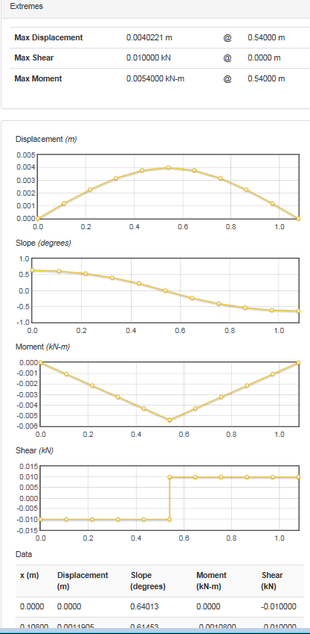
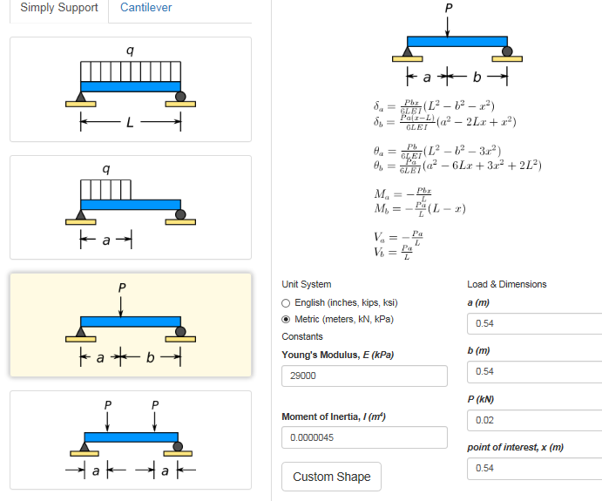
Calculator
http://www.engineeringcalculator.net/beam_calculator.html

Slide 6
Calculator
MIT
https://www.youtube.com/watch?v=q-uLJN8upWE
MIT OpenCourseWare
http://www.amesweb.info/StructuralBeamDeflection/SimpleBeamConcentratedLoadAtAnyPoint.aspx

Slide 7
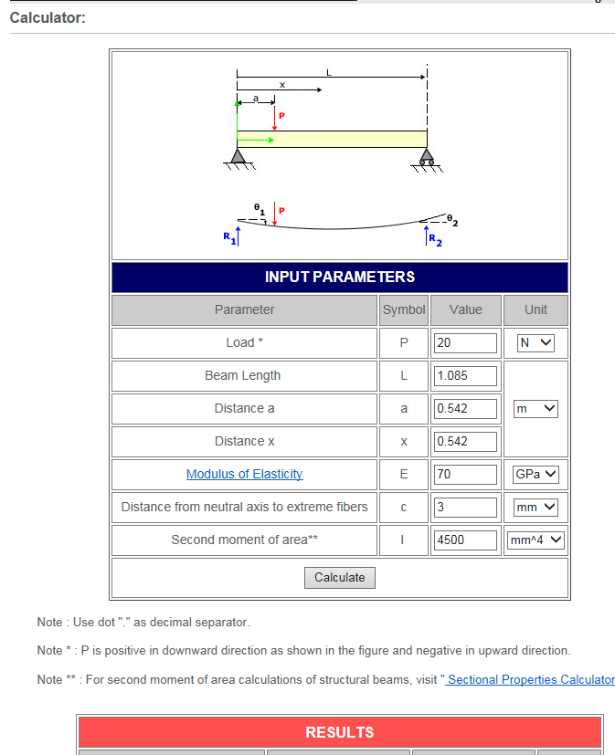
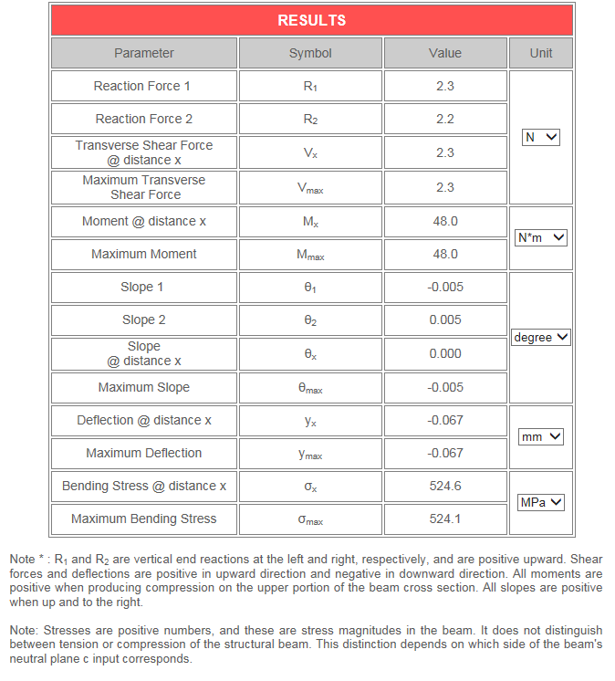
http://www.amesweb.info/StructuralBeamDeflection/SimpleBeamConcentratedLoadAtAnyPoint.aspx

Slide 8
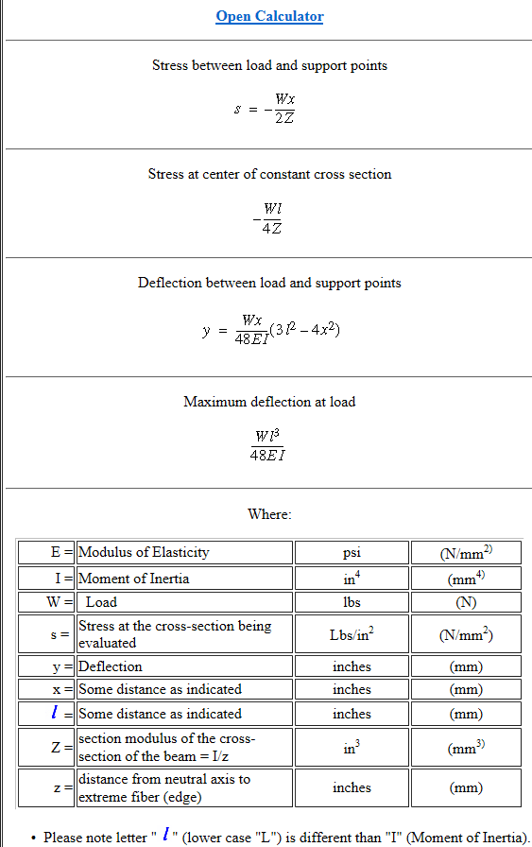
https://www.engineersedge.com/beam_bending/beam_bending2e.htm

Slide 9
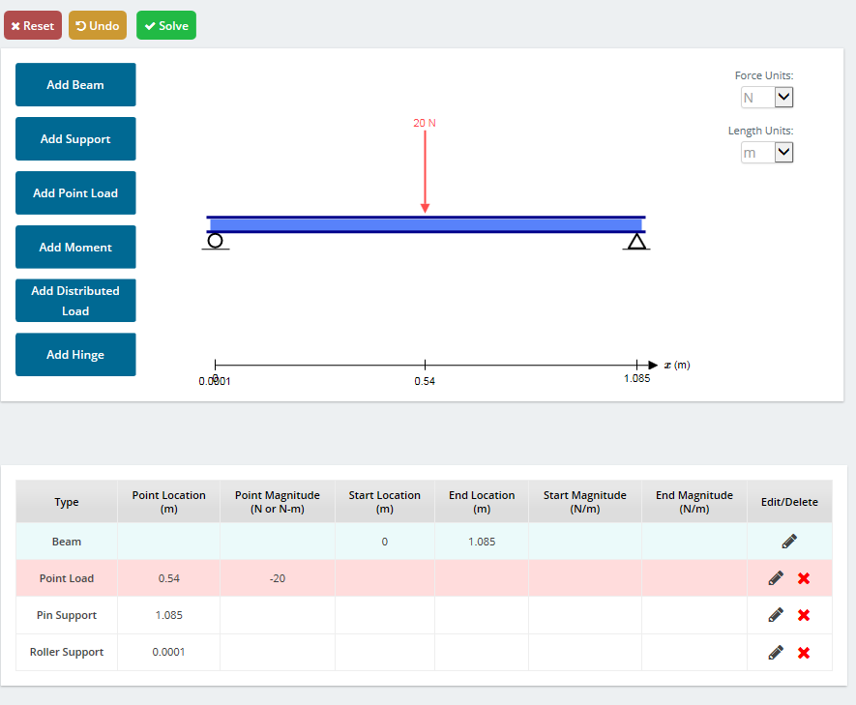
https://skyciv.com/free-beam-calculator/
Elastic deflection at mid span = 1.475mm

Slide 10
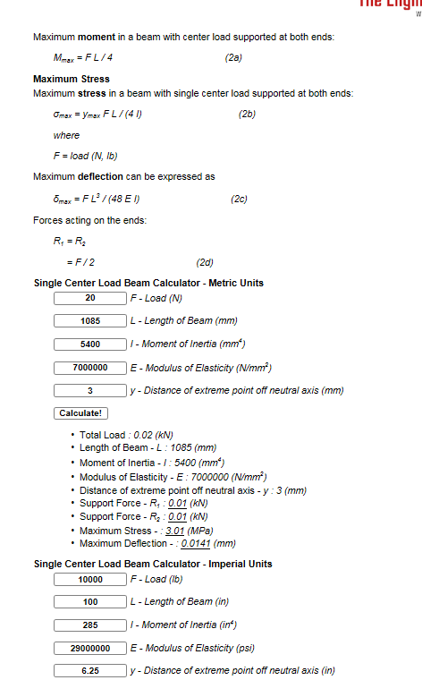
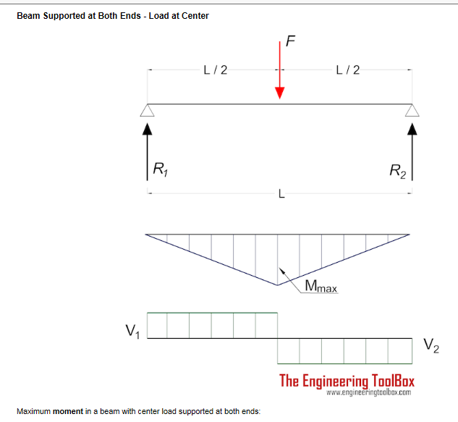
https://www.engineeringtoolbox.com/beam-stress-deflection-d_1312.html

