Slide 1
HCP Stifness caluclation
Ian and Yasser
17April 2018

Slide 4
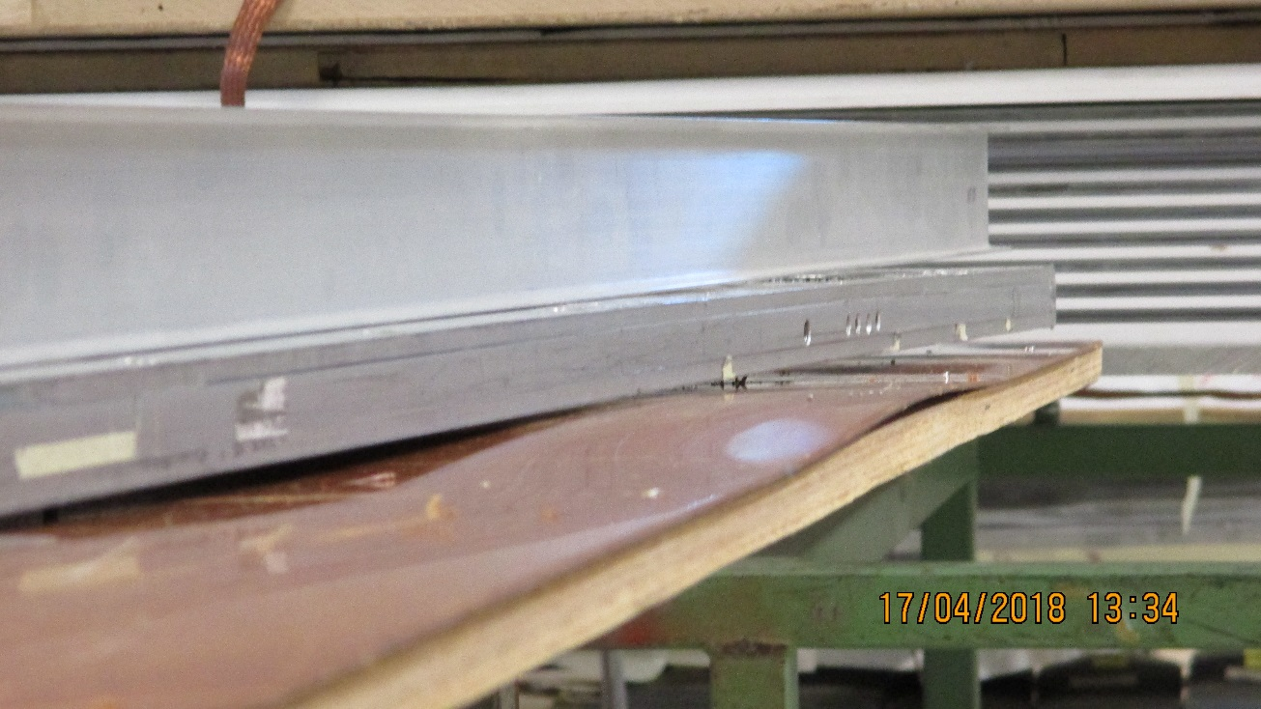
Chamber stiffness and flatness
The chamber elements are very flexible. The gaps can support minimal bending before the stress in the bonding the spacers of the gaps is compromised. The stiffness of the mechanics comes from ensuring that the top and bottom HCP are linked with a minimium of strain possible between the two. Check “ Beam Theory”.
This is attained first of all in the HCP by bonding the two skins together with a shear resistant material, the core, normally of hexagonal form, thus explaining the origine of the name “Honeycomb panel”.
Secondly the top and bottom HCP are held apart by the bars. Their role is to ensure a shear resistance between the bottom and top panel. The bars do not contribute in a significant manner to the bending rigidity of the assembly. The transmission of this strain resistance through the spacers and screws to the HCP will ensure a rigid mechanical assembly suitable to allow manipulation and mounting of the gaps within these mechanical assemblies which have become a rigid chamber assembly.
The stiffness od the insert bondingin to the HCP and the tightness of the screws must be ensured in order tto achieve the above result.
Care must be taken to assemble chambers flat.
5mm deflection over 400mm

Slide 5
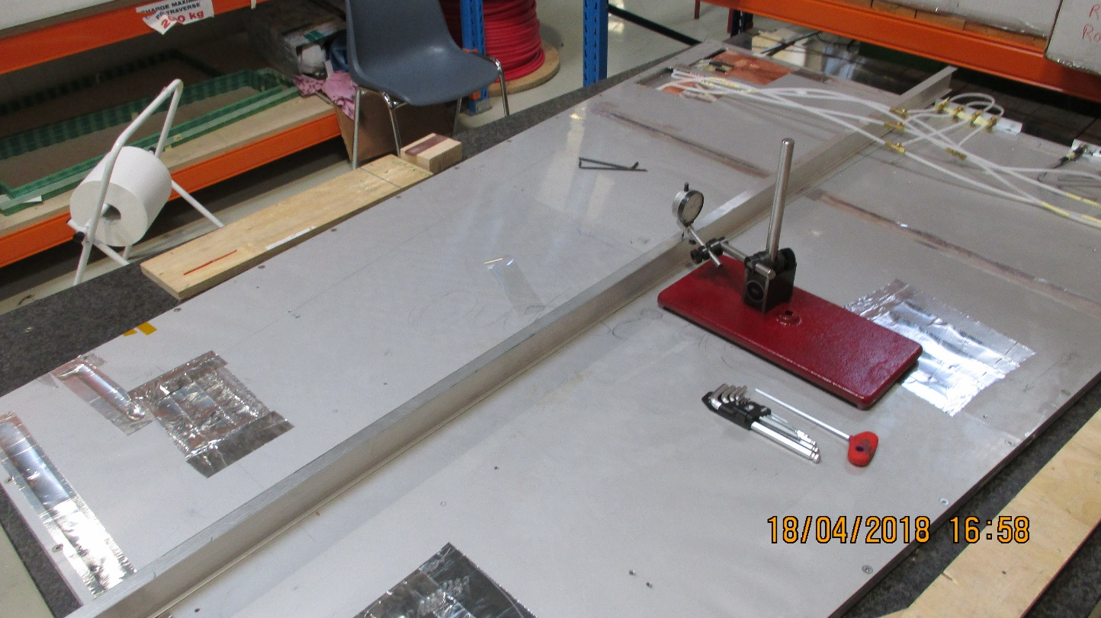
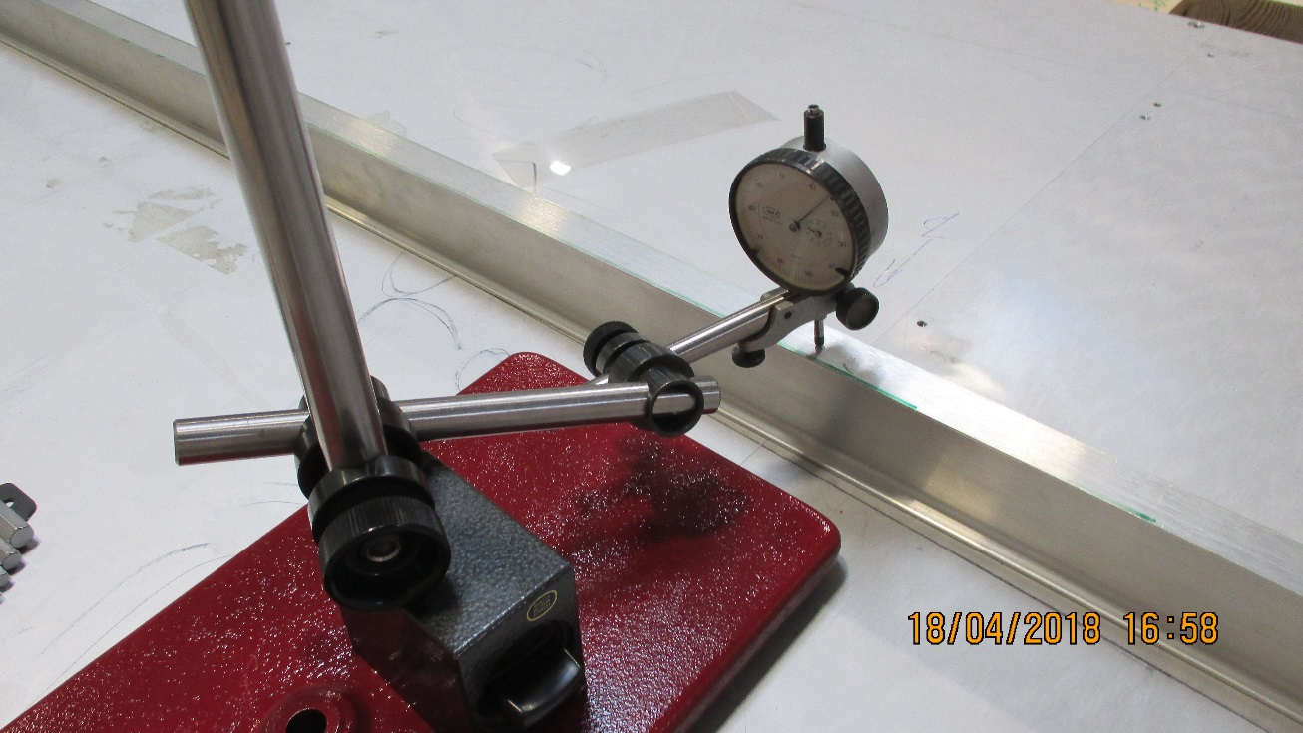
Care must be taken to assemble chambers flat.
5mm deflection over 400mm
Straight edge
Micro-meter used to measure deflection under self weight

Slide 6
Plot chamber sagitta against the distance raised of one end of full chamber

Slide 9
References
Beam Theory
http://homepages.engineering.auckland.ac.nz/~pkel015/SolidMechanicsBooks/Part_I/BookSM_Part_I/07_ElasticityApplications/07_Elasticity_Applications_04_Beam_Theory.pdf
http://web.mit.edu/16.20/homepage/7_SimpleBeamTheory/SimpleBeamTheory_files/module_7_no_solutions.pdf
HCP bending calculation
http://www.mse.mtu.edu/~drjohn/my4150/sandwich/sp1.html
http://www.mas.bg.ac.rs/_media/istrazivanje/fme/vol45/4/12_mdinulovic_et_al.pdf
The strength characteristics of aluminum honeycomb sandwich panels See the paper in this folder
https://www.researchgate.net/post/How_to_calculate_bending_stiffness_shear_stiffness_core_stresses_and_face_stresses_for_Sandwich_panel_with_a_foam_core
http://digitalcommons.calpoly.edu/cgi/viewcontent.cgi?article=1146&context=matesp
http://citeseerx.ist.psu.edu/viewdoc/download?doi=10.1.1.678.3714&rep=rep1&type=pdf
http://www.ijera.com/papers/Vol2_issue3/BK23365374.pdf
https://orbilu.uni.lu/bitstream/10993/9845/1/Paper2011_shear_ORBI.pdf

