Slide 1
High Resistant threading
Ian
29 May 2018

Slide 2
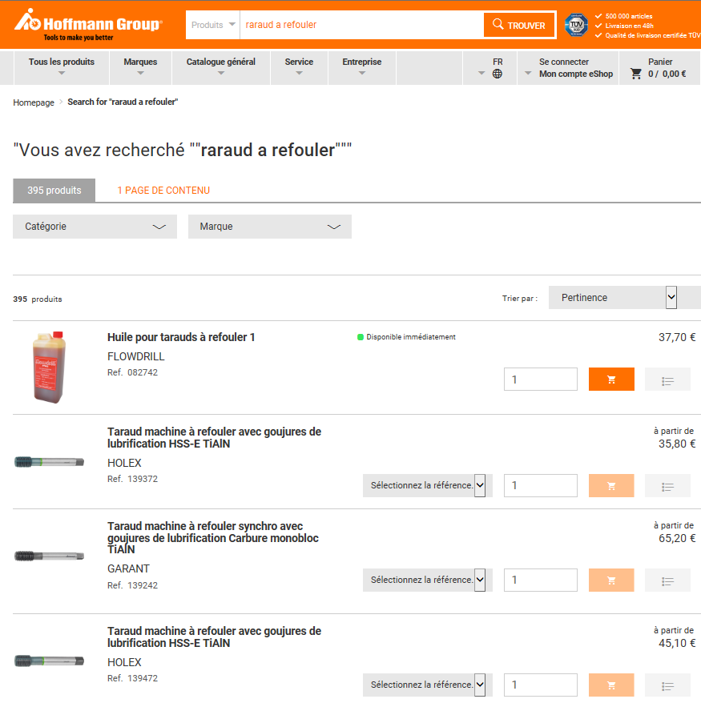
https://www.hoffmann-group.com/FR/fr/hof/search?search=raraud+a+refouler&searchterms=raraud+a+refouler%3Arelevance

Slide 3
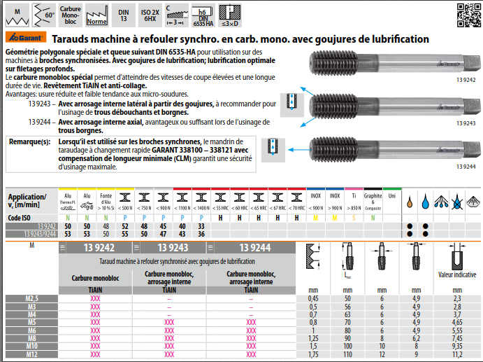
https://www.hoffmann-group.com/pdf/125/90017001_fra_fr_fre_139242_139244.pdf

Slide 4
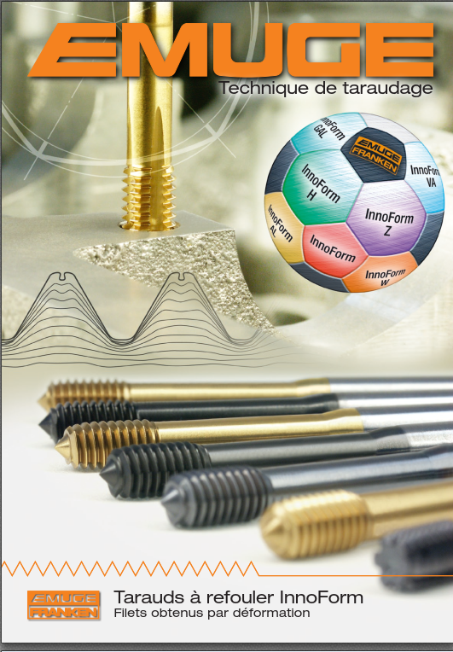
http://www.emuge-franken.fr/download/Brochure%20Tarauds%20%C3%A0%20refouler%20InnoForm%20-%20zp10019_fr.pdf

Slide 5
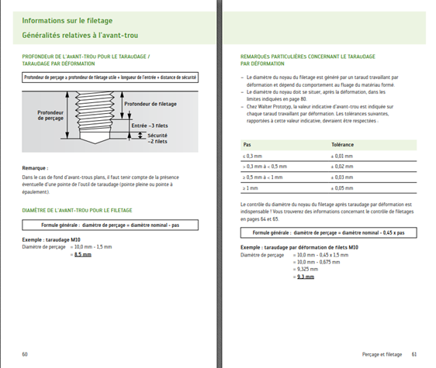
https://www.walter-tools.com/SiteCollectionDocuments/downloads/global/manuals/fr-fr/handbook-drilling-threading-2009-fr.pdf

Slide 6
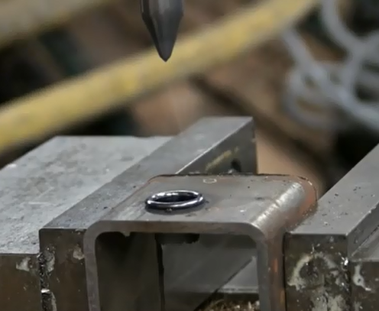
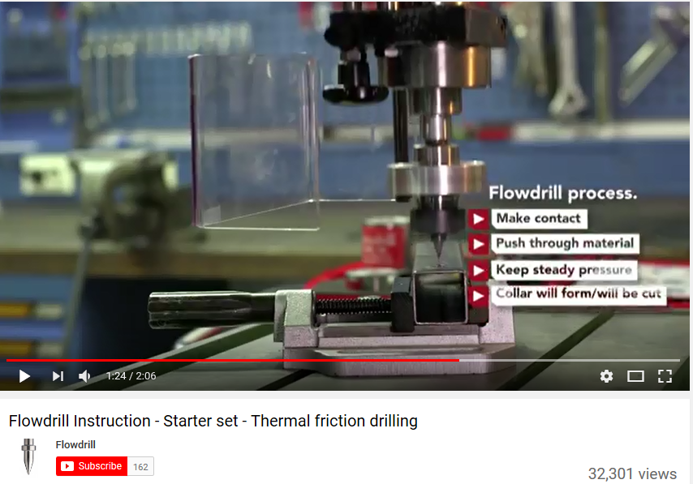
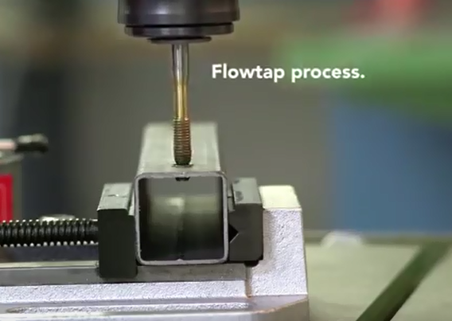
https://www.youtube.com/watch?v=HUyd5w94dHQ

Slide 7
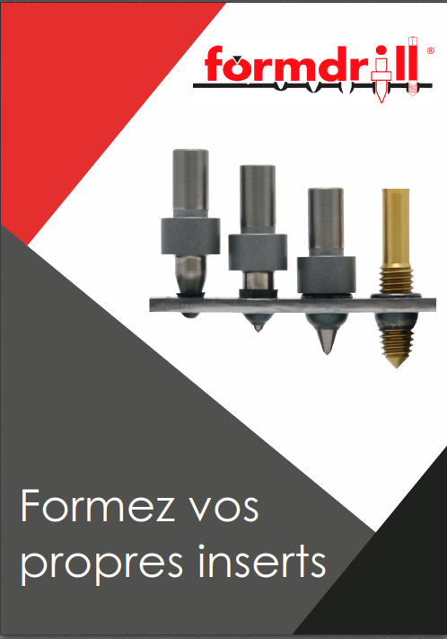
http://www.fluopercage.fr/pdf/formdrill_doc_francais.pdf

