Slide 1
HCP for R3/1 and RE4/1
Panel de panal
Ian
Jan 2018

Slide 2
Revisit the Honeycomb panel construction due to the very poor quality received from the Chinese supplier for RE4/2 and RE4/3.
Defects were the lower grad quality aluminium alloy skins . Insufficient bonding due to incomplete polymerisation of the film bonding the skins to the alu core (Cells). The resultant out-gassing caused massive delamination in zones from 20 - >60cm .
Consequences of this were the 1 year corrective work to collapse the bubbles formed by the aforementioned delamination.
Due to this lack of integrity the panel stiffness in compromised.
In addition it was not established if this outgassing is continuing causing pressure to bear on the gaps inside.

Slide 3
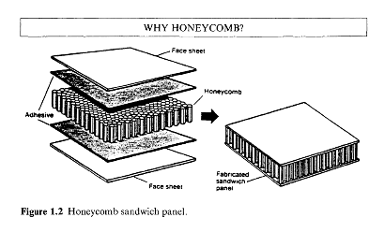

Slide 4
Approx. dimensions of RE3/1 (& RE4/1)
1.3m
Weights of panels solid and HCP
1.7m

Slide 5
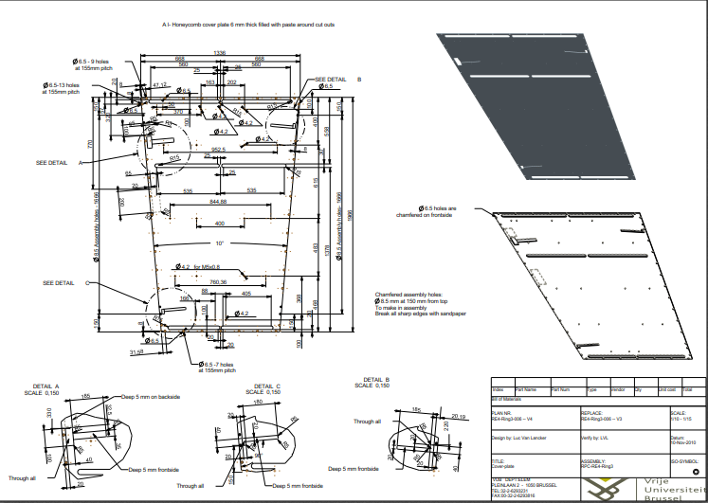
Top HCP for RE4/3 showing cut outs and chamfered through holes on the edges for clamping the structural volume.

Slide 6
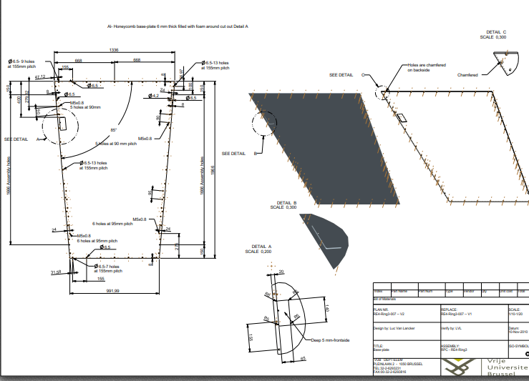

Slide 7
Characteristics of Original panels and solid Alu. Alloy
Stiffness is referred to as the Young’s Modulus (E) in units of MPa.
AW6082 Hardened and annealed E = 70 GPa
Tests from original HCP Chinese panels indicate a stiffness of ~30GPa

Slide 8
Alternative manufacture methods of Alu skinned HCP or foam cores
First scenario
Build up the panel, skins and core, as done on all RE’s. The fabrication facility has to have heated press and pre & post machining capability.
Second scenario
Procure full HCP panel , OEM panel from supplier.
Transfer to a facility that will cut to dimensions, create necessary cut-outs, insert and bond in-place dowels for threads, assembly holes and edge facings.

Slide 9
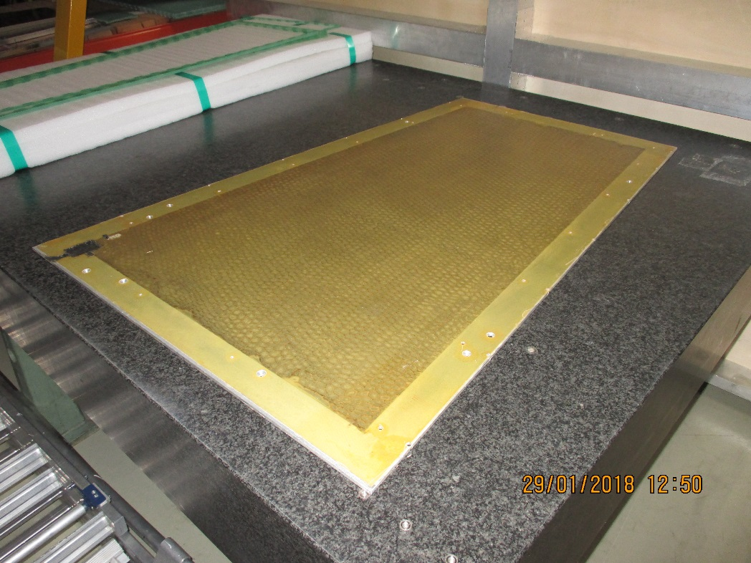
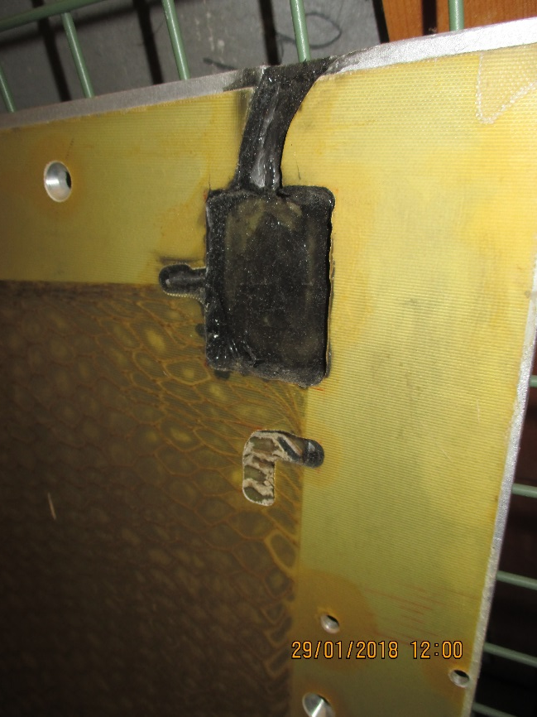
First Scenario
Individual lay-up of all the components.
Press and autoclave of consequent size.
An example of an HCP produced with limited materials and expertise at CERN

Slide 10
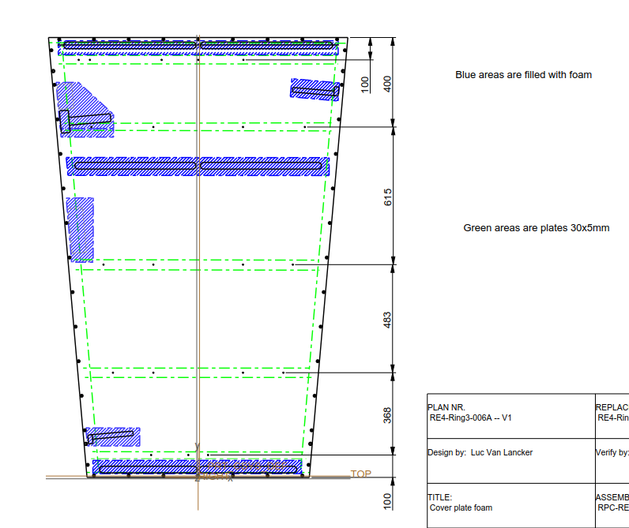
Alu bars inserted on all 4 edges
5 additional bars inserted for the cooling mounting
Foam injection for edge facings
Honeycomb cell cut to shape

Slide 11
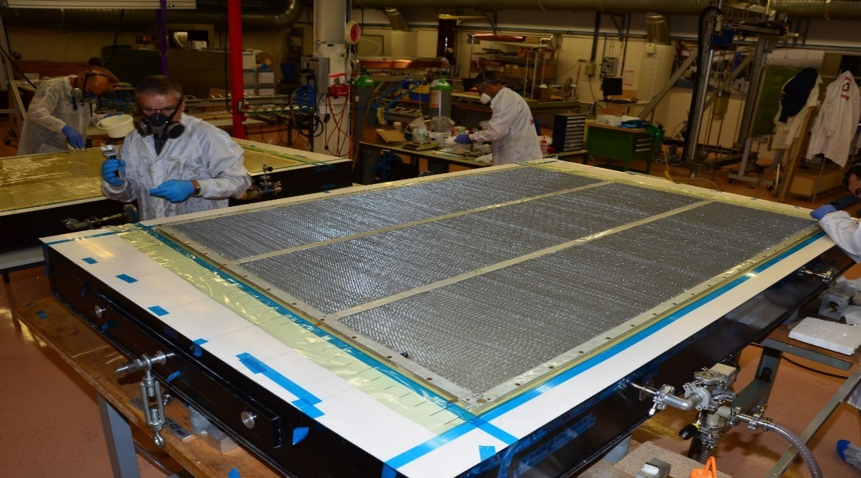
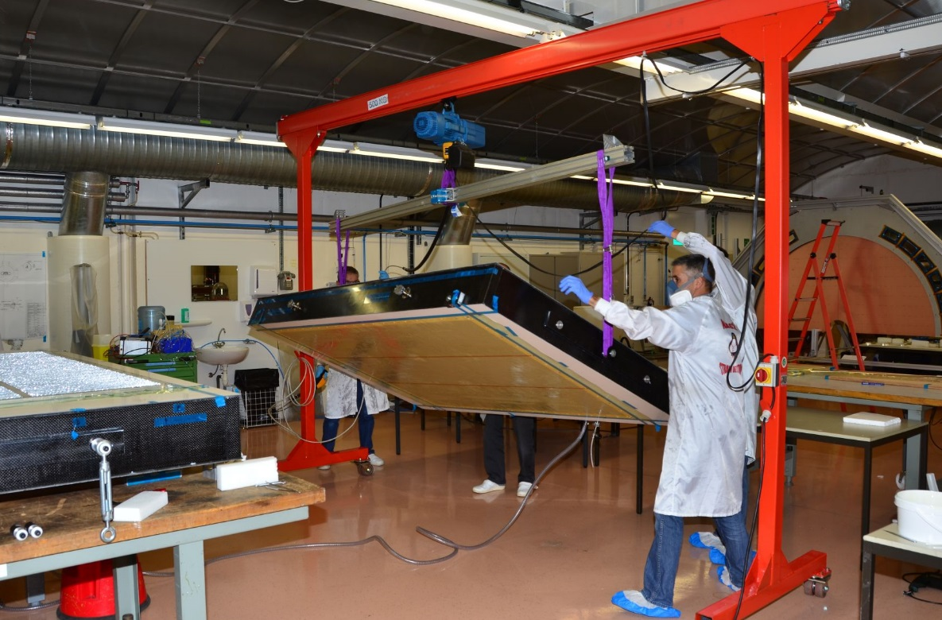
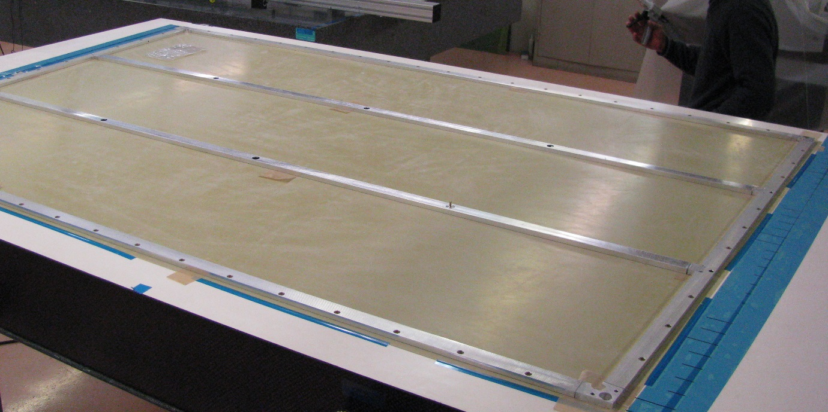
ATLAS MICROMEGAS
Module 0 Assembly procedure
drift panel assembly

Slide 12
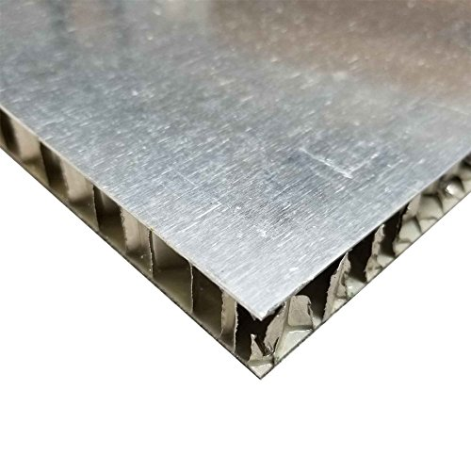
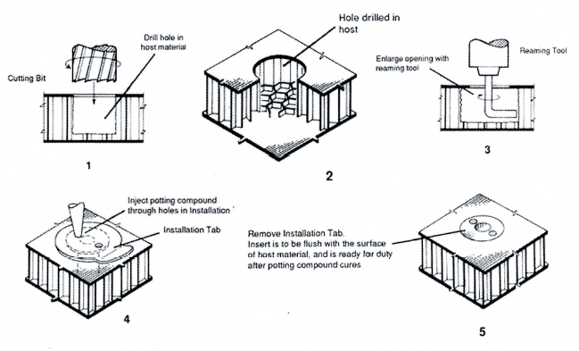
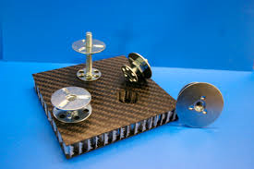
Second Scenario
Buy in OEM panel
Machining, inserts and edge facings

Slide 13
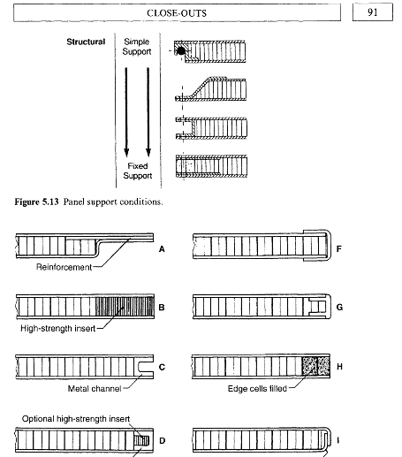
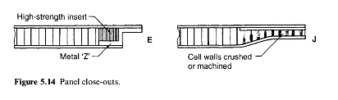
Close outs or Edge Facings
A large choice
See the book “Honeycomb Technology” by T. Bitzer, old but complete.

Slide 14
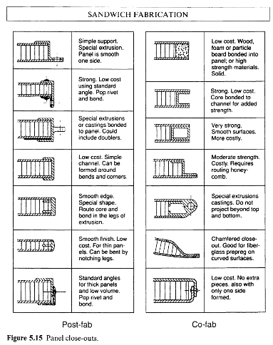
Close outs or Edge Facings

Slide 15
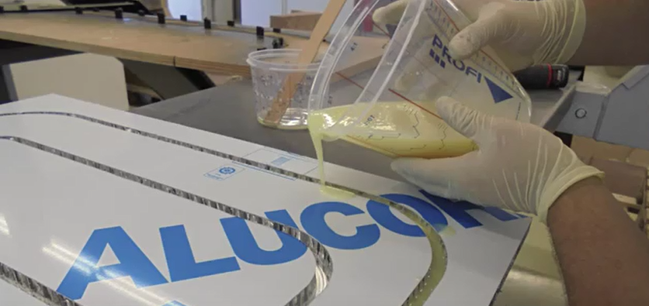
Panel edges or edge facing methods
Alucore edge prcocessing
https://www.youtube.com/watch?v=oIieqHavBBQ&spfreload=1
https://www.youtube.com/watch?v=Jnbcokk3N_A

Slide 16
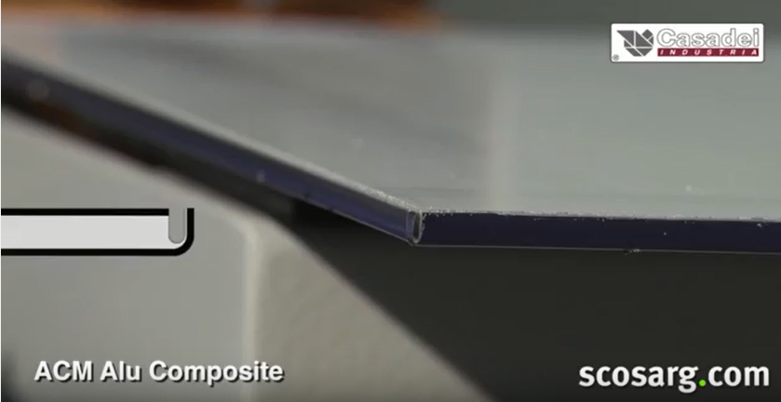
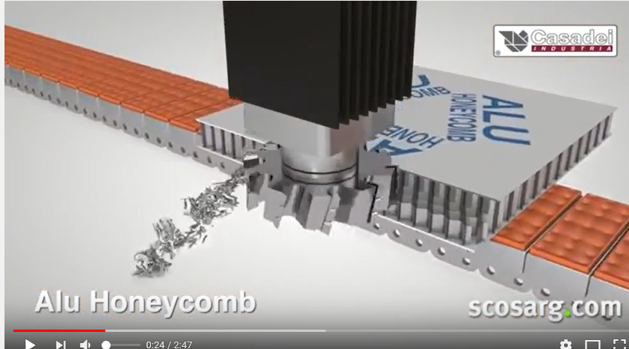
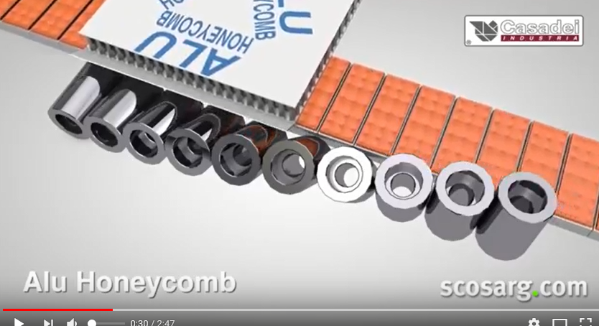
Edge Facings Methods, automated large scale production
https://www.youtube.com/watch?v=W-udub9VPxM

Slide 17
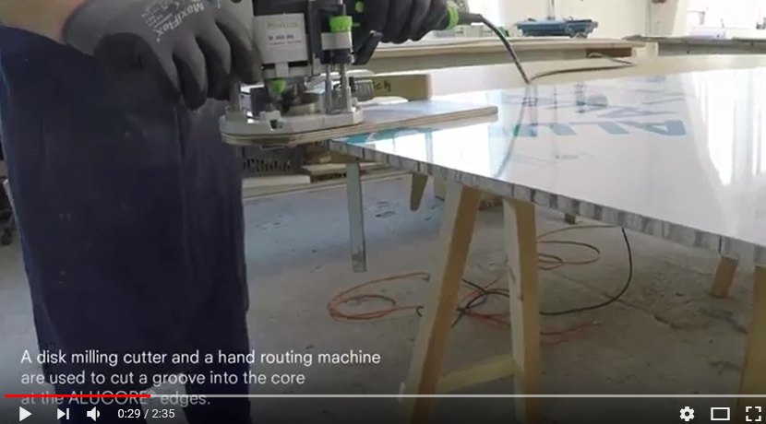
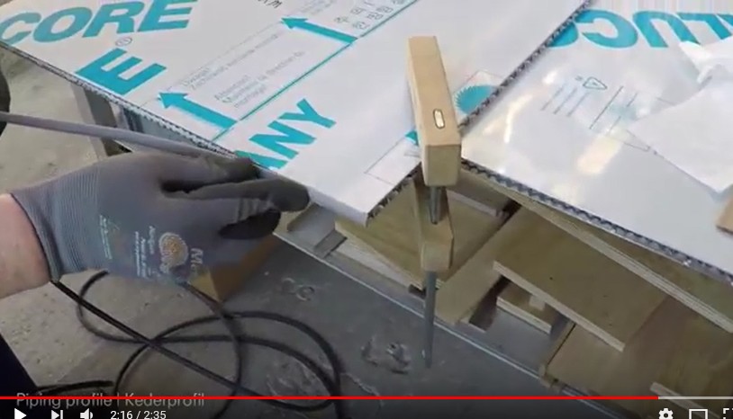
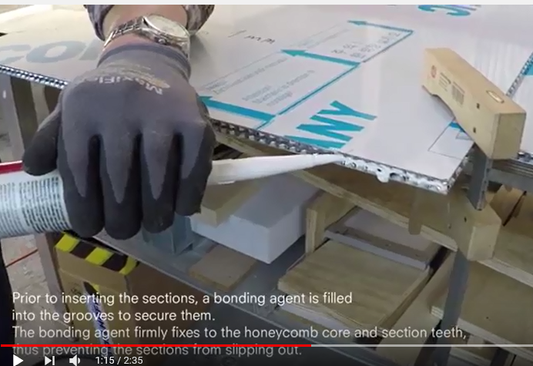
Edge Facings, small hand tool approach
https://www.youtube.com/watch?v=oIieqHavBBQ&spfreload=1

Slide 18
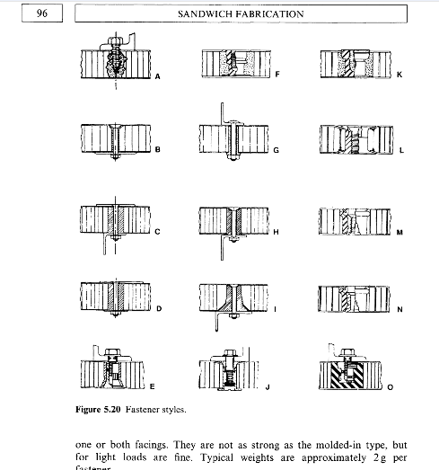
Inserts , threaded holes etc
There are also many solution that have been refined since this publication.
See the book “Honeycomb Technology” by T. Bitzer, old but complete.

Slide 19
There are many insert solutions illustrated on Youtube;
https://www.youtube.com/watch?v=NCC2TcSR4bY
https://www.youtube.com/watch?v=nyVZyc2TTAg
https://www.youtube.com/watch?v=EFZBOP-Xb64&list=PLjztg1Gd4WZRbYbiKB-c1zrLAJChPo7vH
3M inserts ?
https://www.youtube.com/watch?v=M9qkvBZwMwE

Slide 20
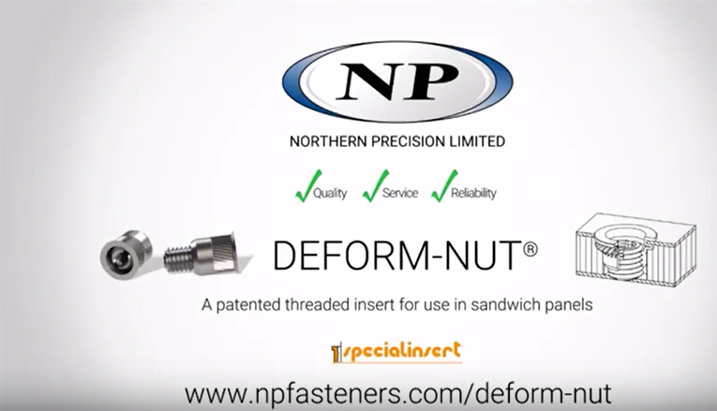
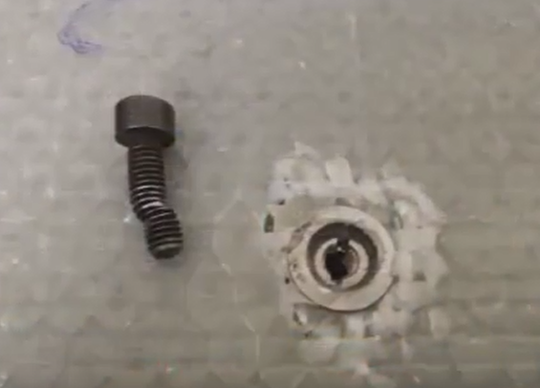
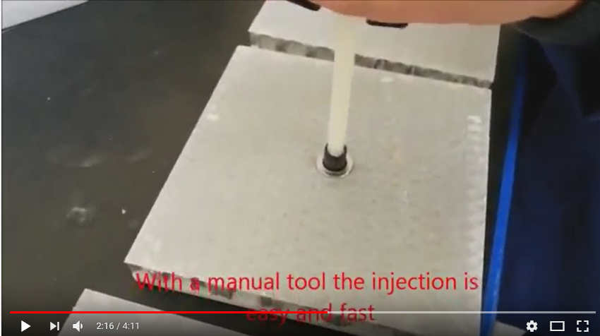
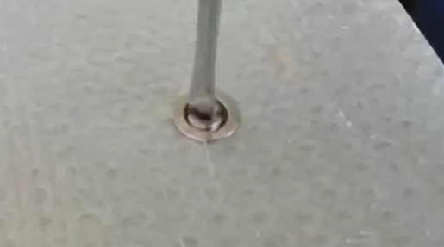
Inserts continued
NPFasteners.com/deform-nut
https://www.youtube.com/watch?v=NCC2TcSR4bY
Shear test on M6 gives 584kg to rupture !

Slide 21
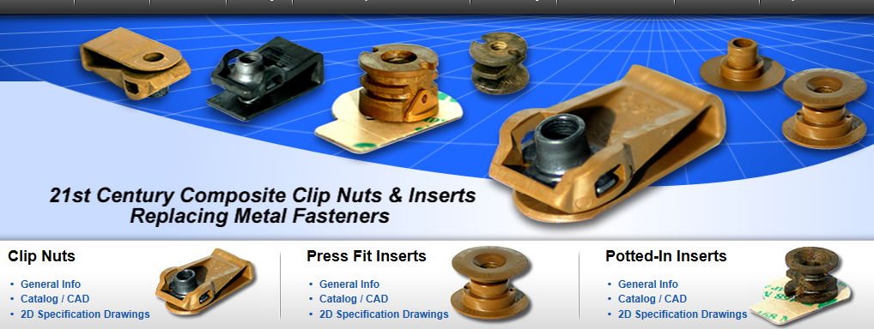
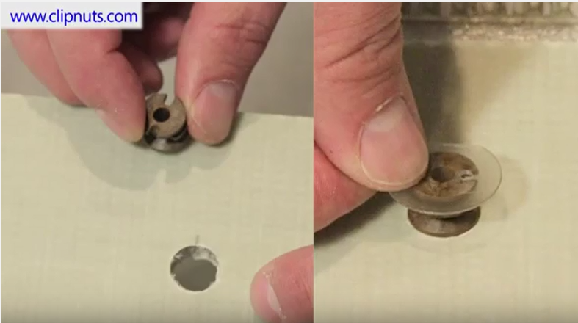
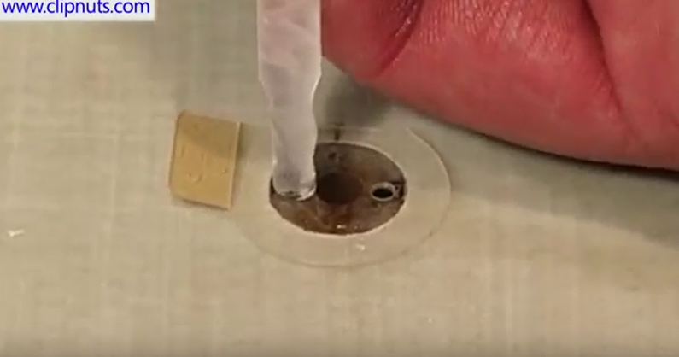
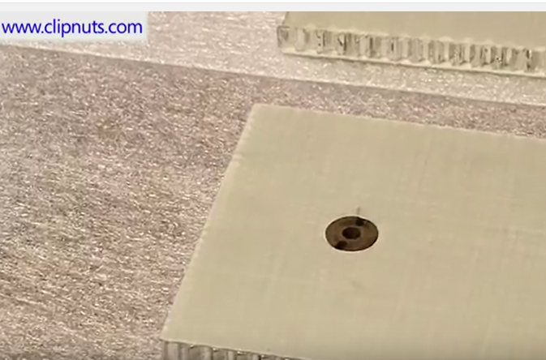
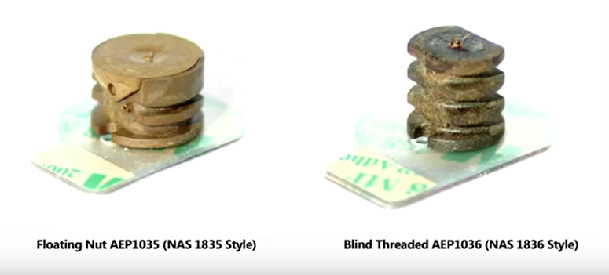
Inserts continued
https://www.clipnuts.com/products/potted-in-inserts.html
https://www.youtube.com/watch?v=M9qkvBZwMwE

Slide 22
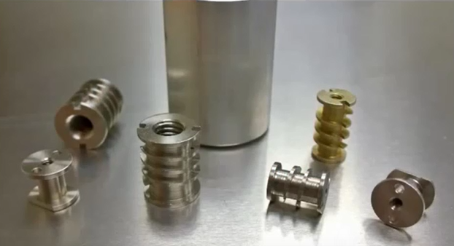
Inserts continued
https://www.clipn
https://www.youtube.com/wa
Inserts continued
www.flatironpanelproducts.com
https://www.youtube.com/watch?v=M9qkvBZwMwE

Slide 23
Panel Sources in Mexico https://www.quiminet.com/productos/panel-de-honeycomb-103806321169/proveedores.htm
GRUPO LLERANDI. BLVD ESTEBAN DE ANTUÑANO S/N ENTRE 6 Y 10 PTE Puebla, Puebla México.
http://grupollerandi.com/servicios/materiales-compuestos
Provem. AVE. DE LA TRANSFORMACION 646, PARQUE INDUSTRIAL QUERETARO QUERETARO, QUERETARO México. Paper packing material
Novapak. Alberto N. Swain No. 234 Col. Ciudad Industrial, Coahuila, Torreón C.P. 27019. México. Packing.
BASF. Insurgentes Sur No. 975 Col. Ciudad de los Deportes, Distrito Federal C.P. 03710. México
Grupo Quinzco. Monterrey 25 Col. Fraccionamiento Valle CeylánEstado de México C.P. 54150. México. Tel; 52 55 4169-6844
Aislamientos y Más. José Benitez 2186 Col. Colonia Obispado, Monterrey, Nuevo León C.P. 64040. México. Tel; 52 81 4170-8342

Slide 24
Original panel characterisation, Can we produce something similar ?
Yes of course we can Honeycomb material is used in every country around the world in the building and transport industry. The days when the scope was limited to aerospace and military have gone.

Slide 25
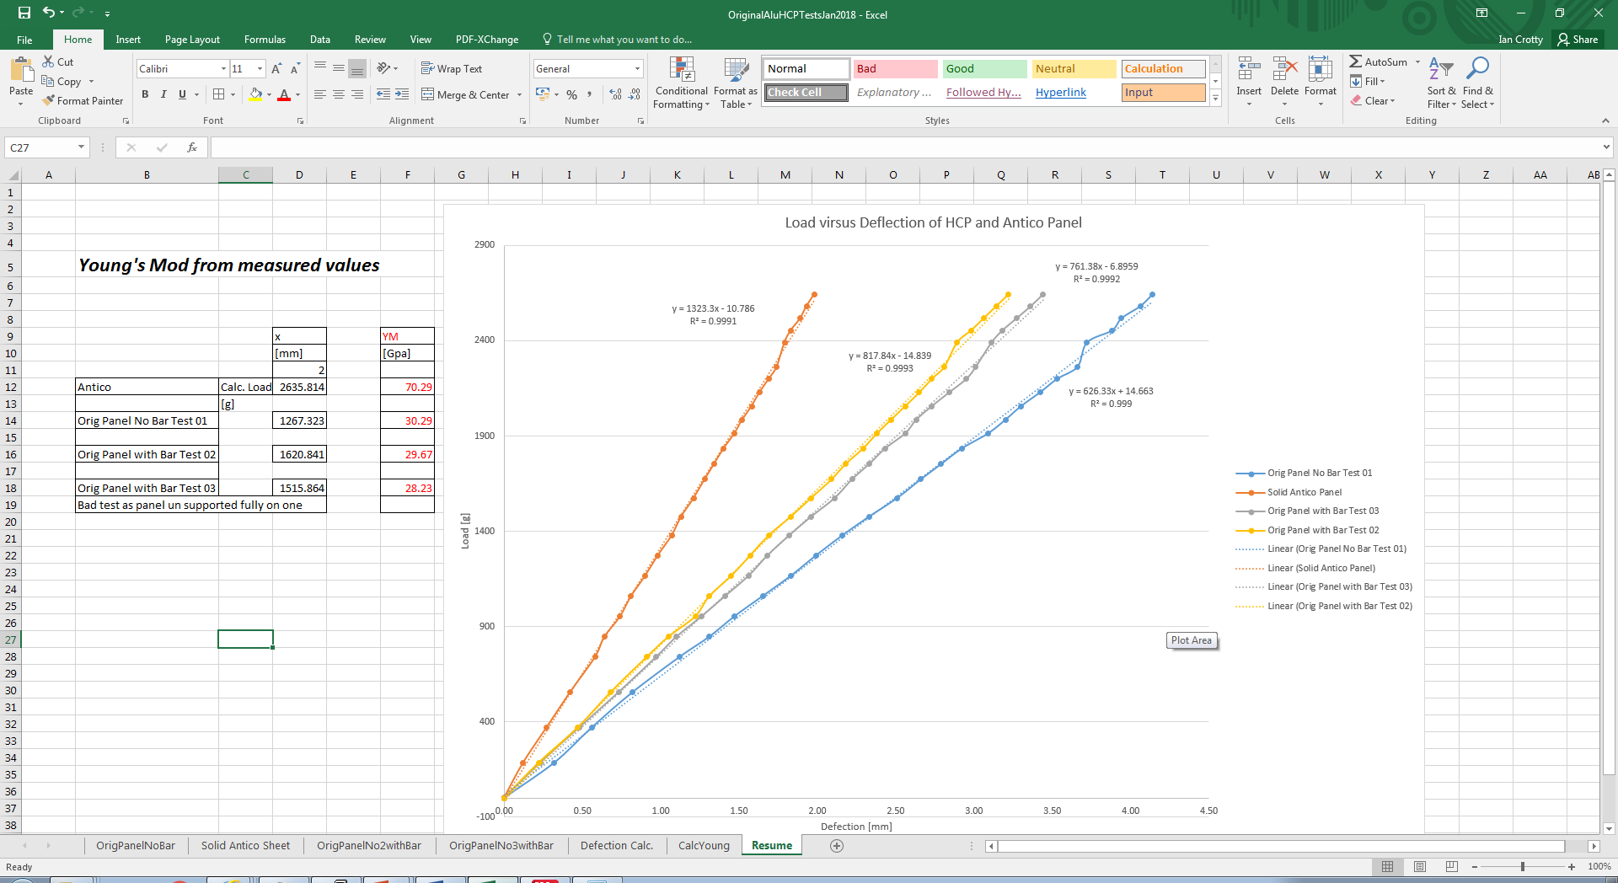
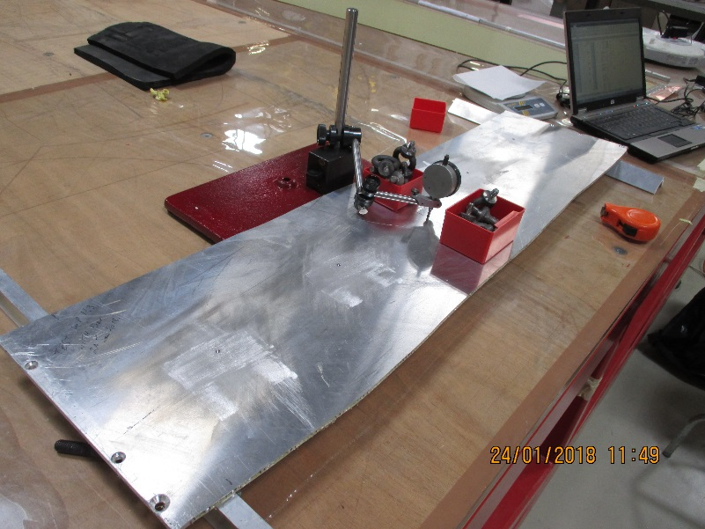
Original panel characterisation
Solid Alu panel is twice as stiff as an HCP but its weight is x4 times heavier.

Slide 26
Aluminium alloy (6mm) AW 6082 weighs 16.2kg/m2
Honey comb panel (6mm)weighs approx. 4kg/m2
RE*/3 panel weighs
RE*/2 anel weighs

Slide 27
Conclusion
It is possible to make HCP in house.
Making HCP without strict supervision is NOT a solution.
Adopting industrial practise of buying in and processing to obtain the required product IS a good solution.
Investigation of local industrial suppliers is required.
Post processing, inserts etc may be managed in house with non automated procedures.

Slide 28
Refs
Very large HCP made here at CERN
EDMS 1756235, PH/DT/CO, F. P. Gomez
Honeycomb Technology: Materials, Design, Manufacturing, Applications and Testing 1997th Edition
by T.N. Bitzer (Author)

Slide 29
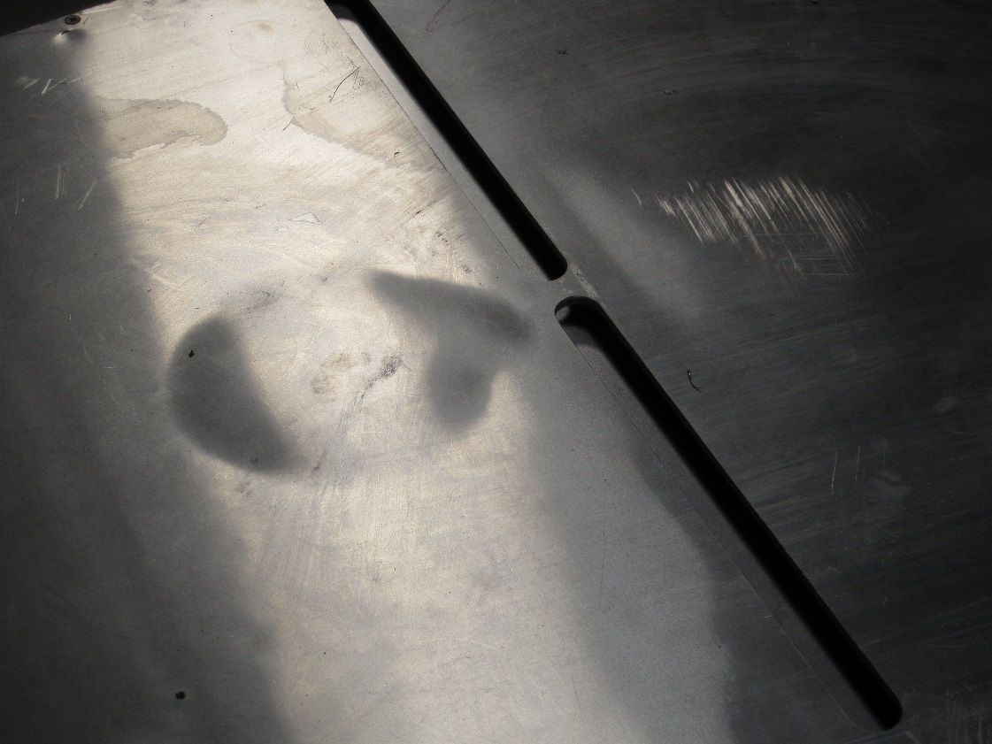
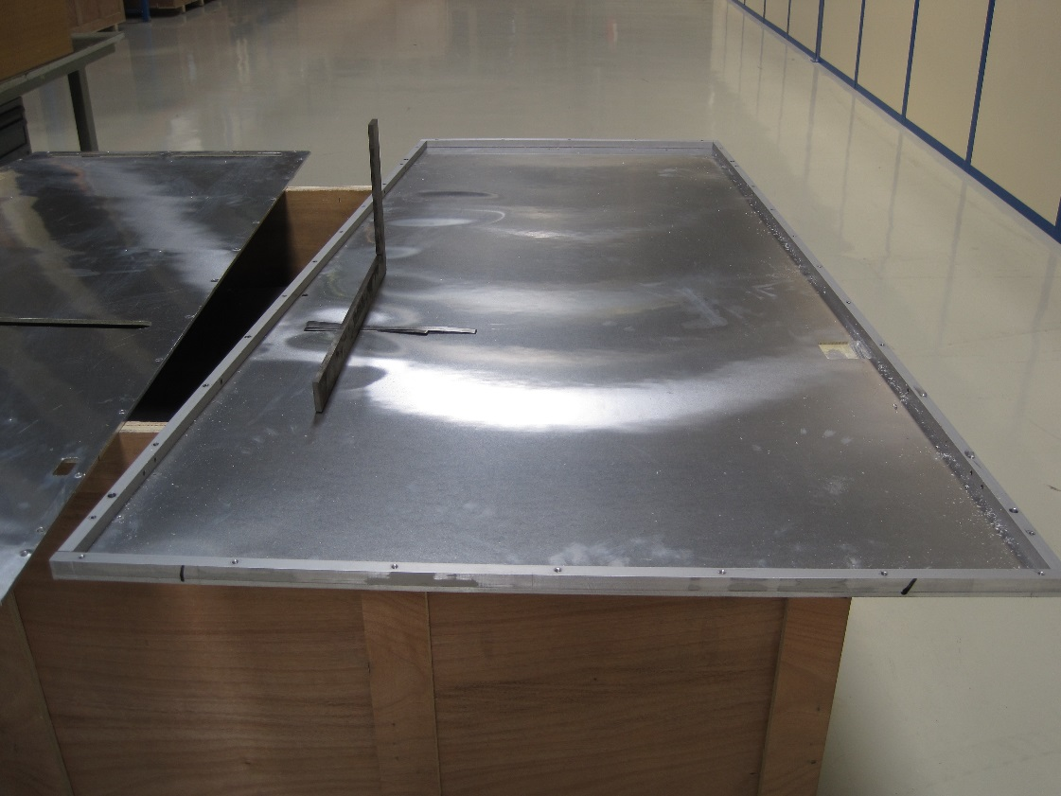
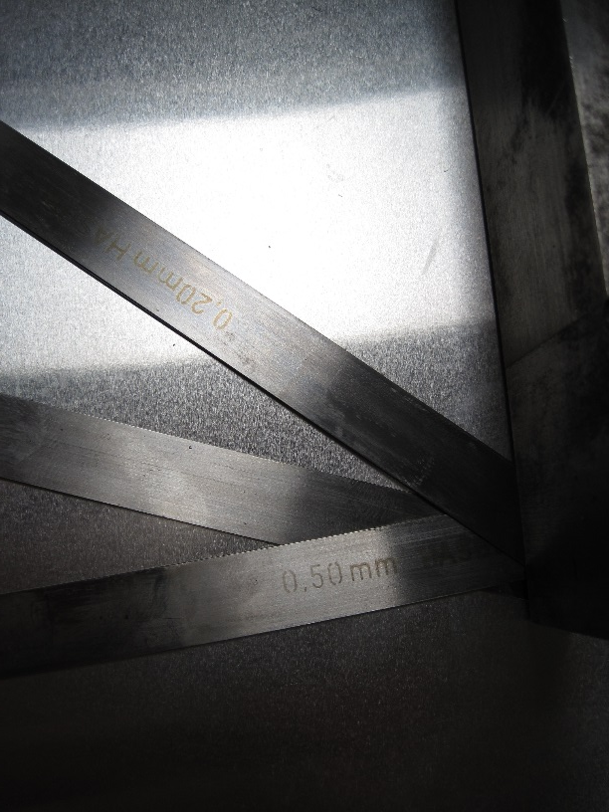
Retro fitting of HCP panels
Any changes cause problems. Bad preparation and processing causes bond failure. Pressure on the gaps is NOT good.
http://rpc-cms-re4-upscope.web.cern.ch/rpc-cms-re4-upscope/RPC/Chamber%20production/Components/Mechanics/RetroFitting/LucsDoc/CleaningRE4MechanicsV2.pdf

Slide 30
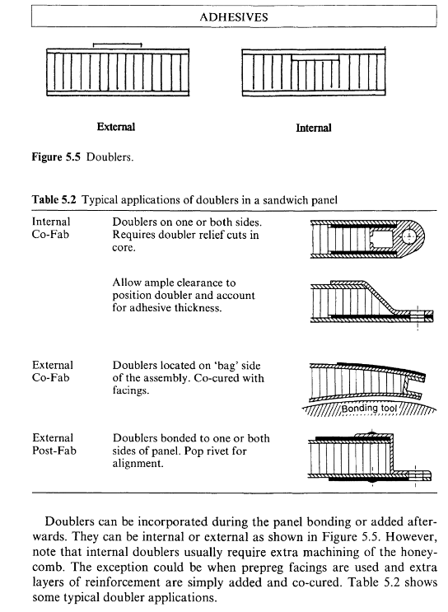

Slide 31
Aluminium HCP in UK

Slide 32
Additional types of HCP
Military faraday application made in mexico. Parker Hannifin de México S.A. de C.V. , Fluid Connectors Division, Antiguo Camino a San Lorenzo 338, Zona Industrial Toluca, Mexico
Tel; 722 275 42 00

Slide 33
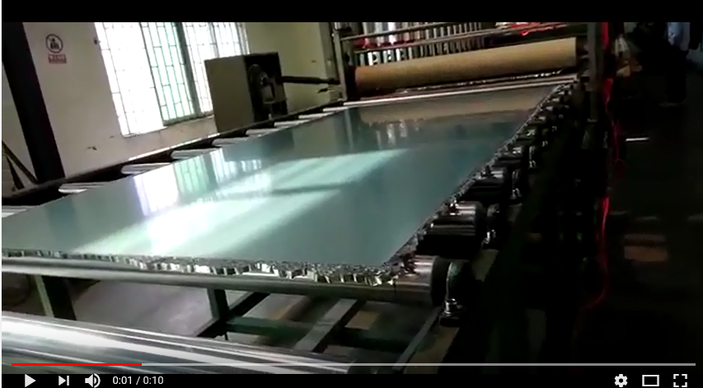
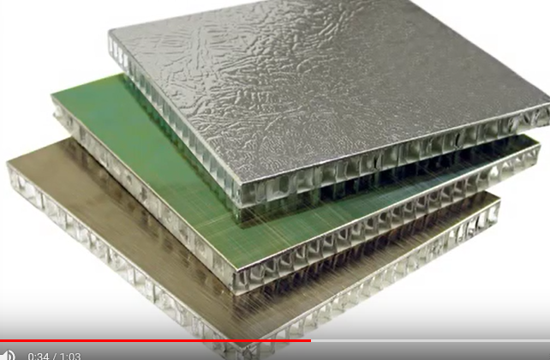
Industrial Honeycomb production
https://www.youtube.com/watch?v=V7nwcqbn4QM

Slide 34
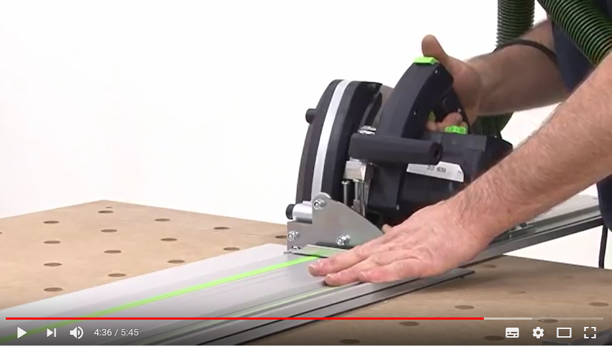
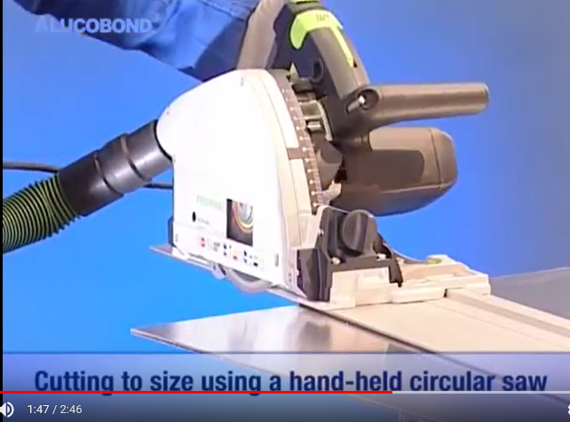
Dedicated Hand tools for cutting Composite panels
https://www.youtube.com/watch?v=GmWUftf_lm0
https://www.youtube.com/watch?v=m4AyjBfJ0k4

