Slide 1
Patch Panel Connecter System

Slide 2
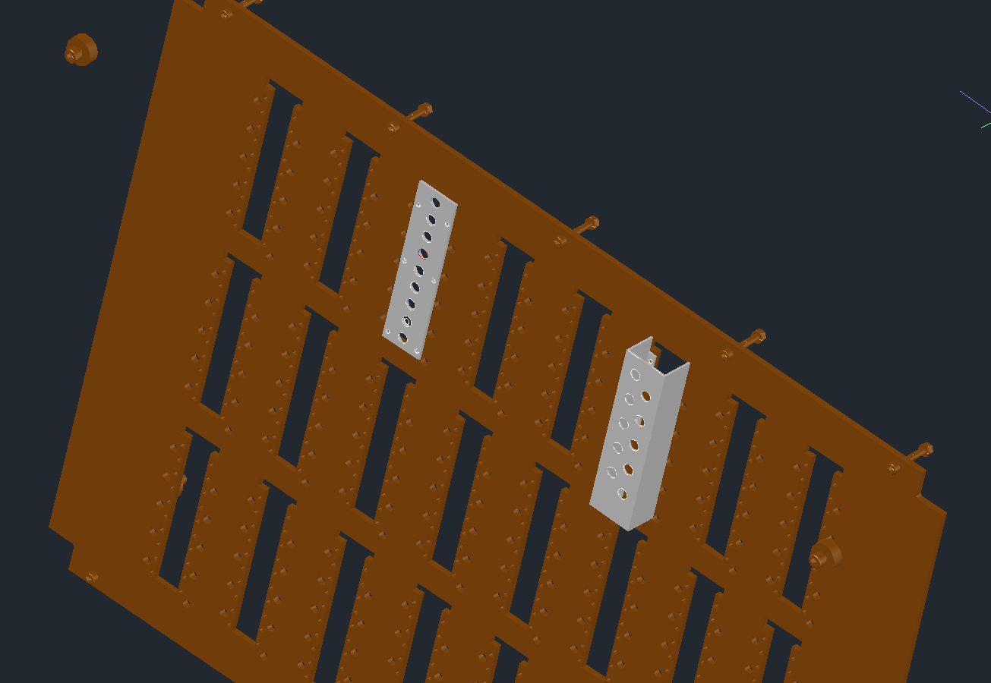
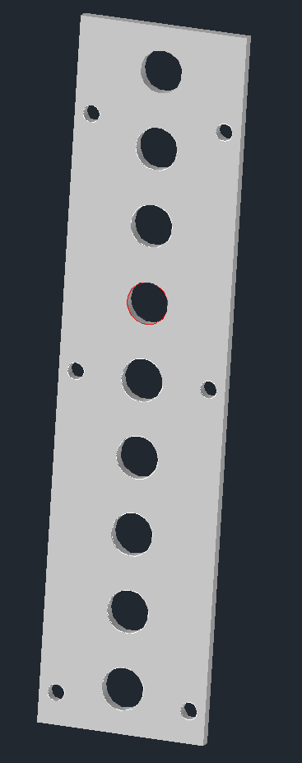
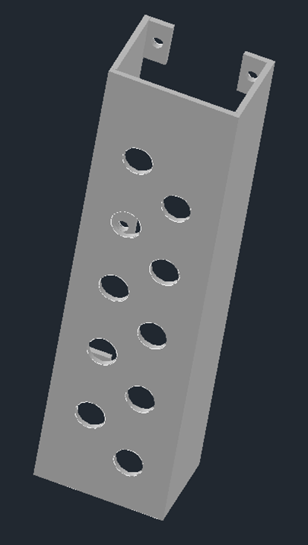
- Two systems
- The first Idea: simple plate, 9 holes (connecters).
- Second design: a U profile who can fit 10 holes.
Both idea reuse hole on the PP to fix them.
Both will probably use 2mm aluminium sheet.

Slide 3
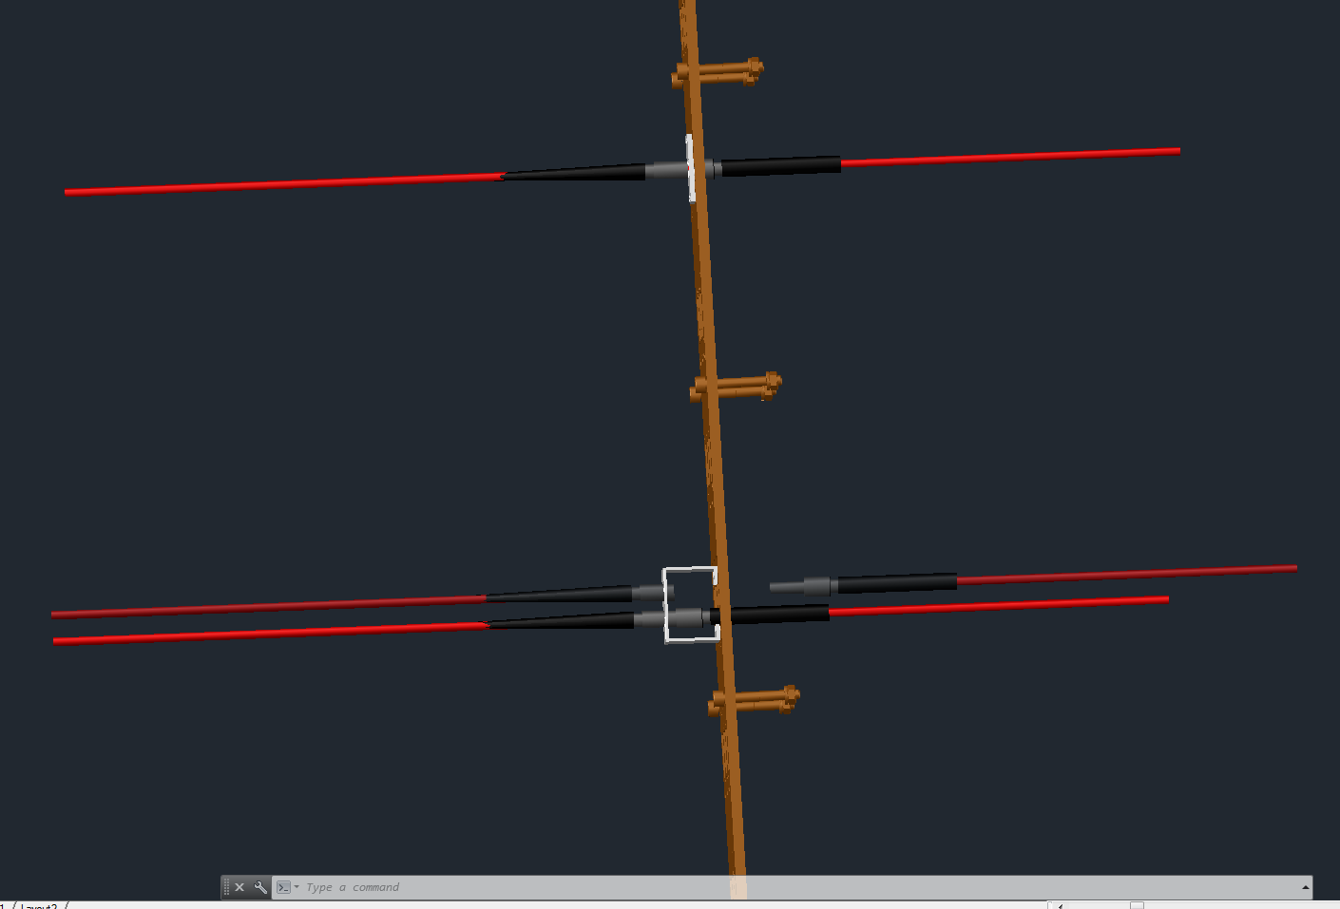
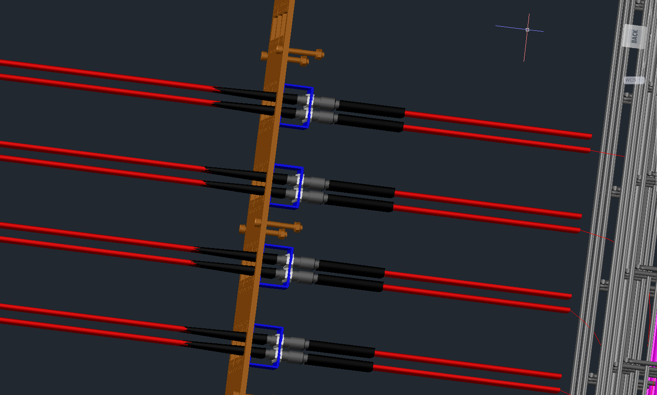
- With Cables assembly or not
- I think, with this position, it’s easier to install, but need confirmation.

Slide 4
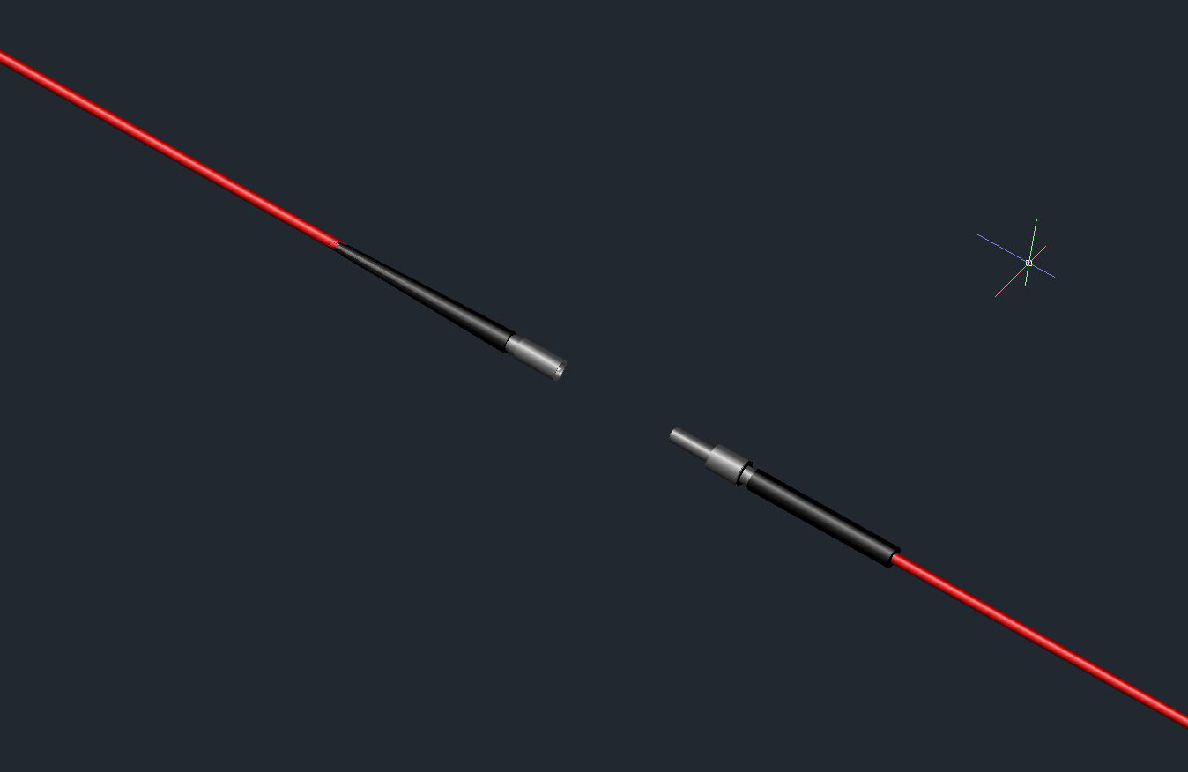
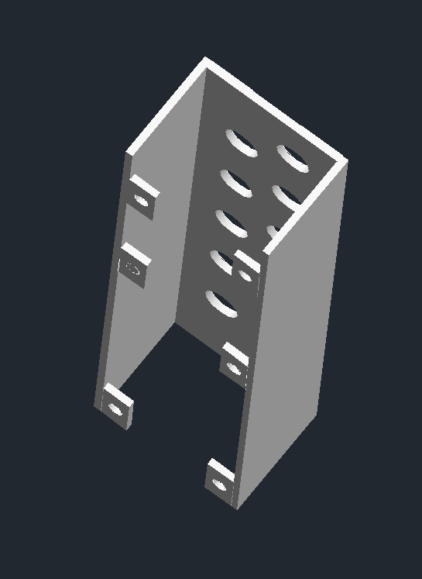
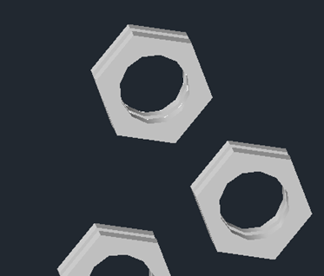
- 3D model of 5∅mm cable
Back view
- Nut of the connecter in 3D representation.

Slide 5
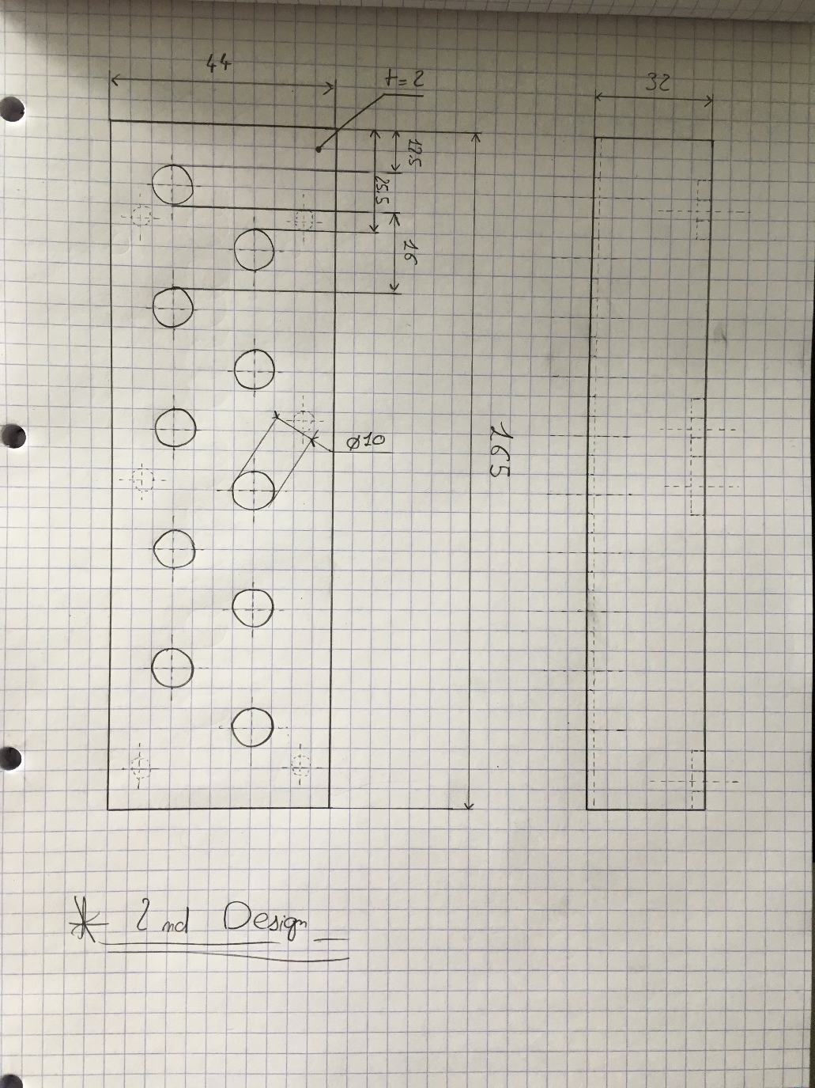
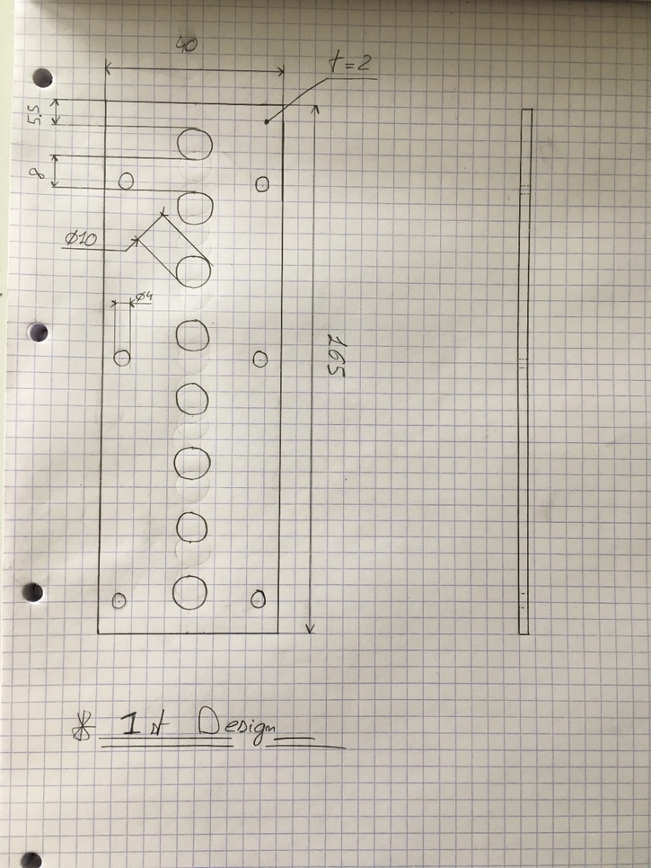
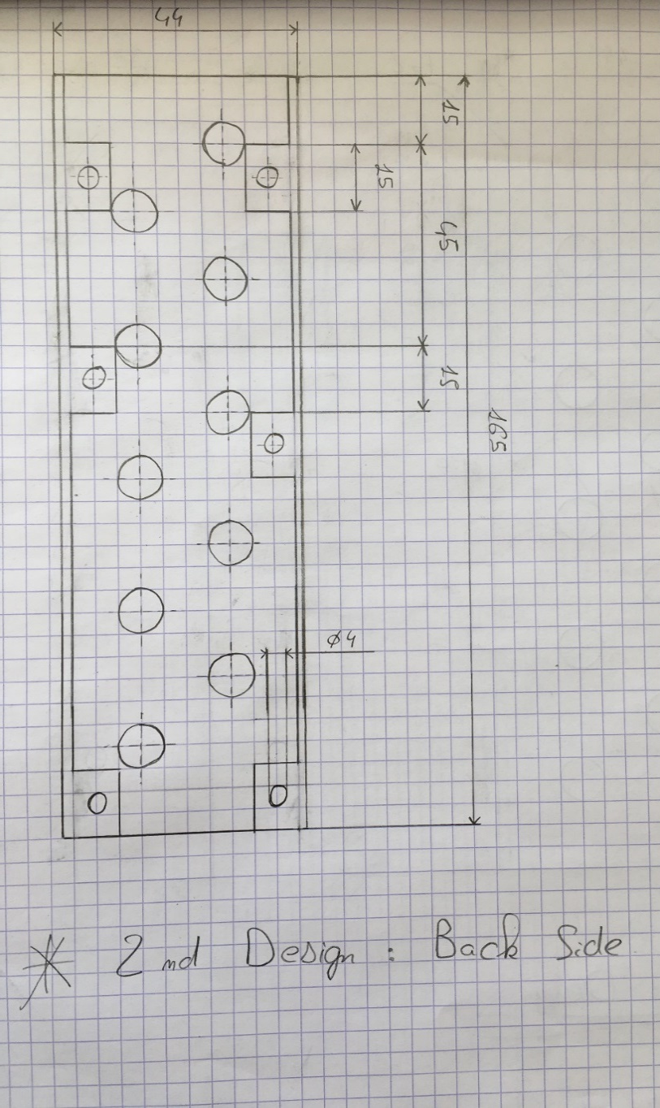
plan:

Slide 6
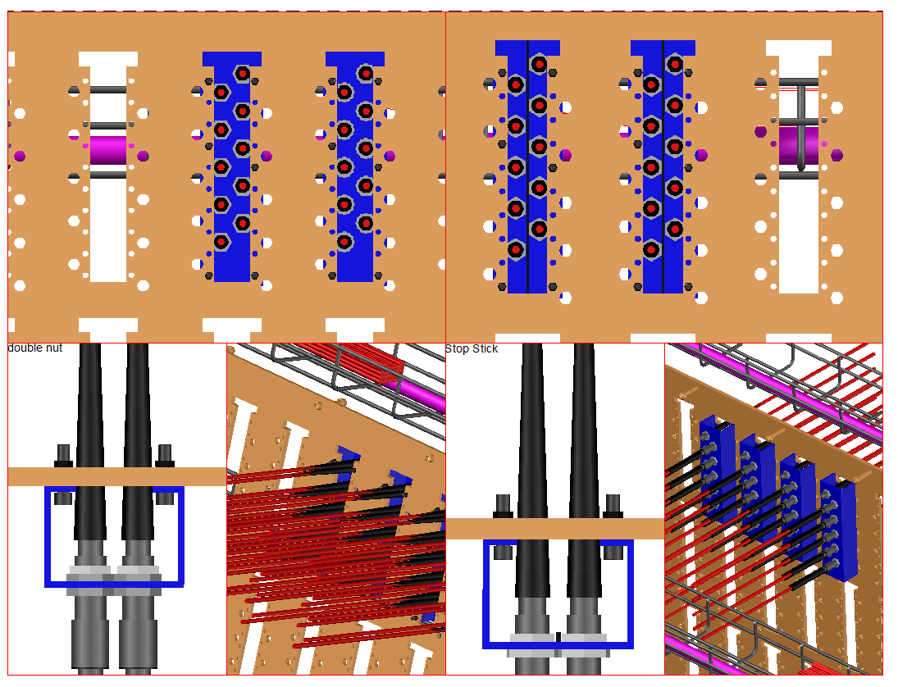
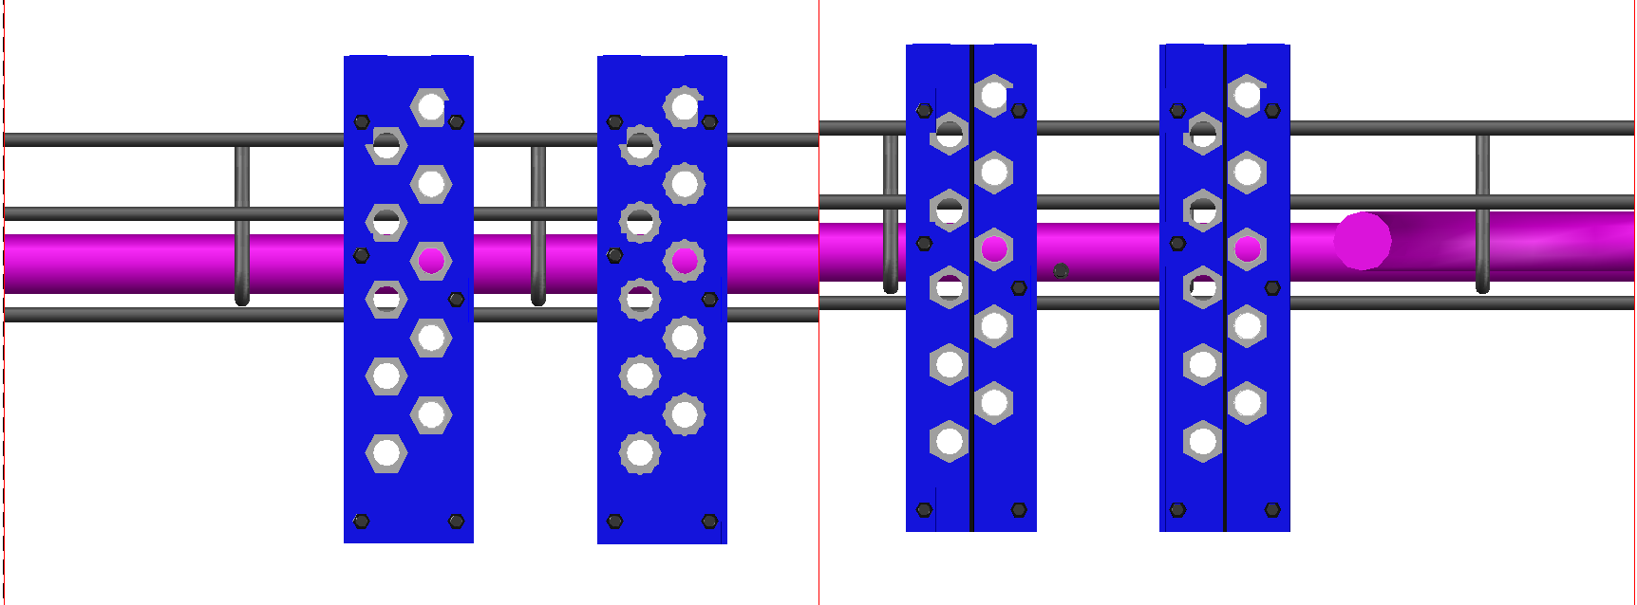
Final assembly, witch screw, nuts…

Slide 7
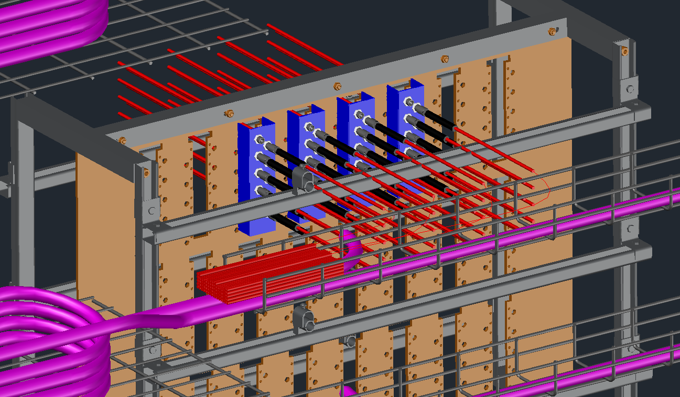
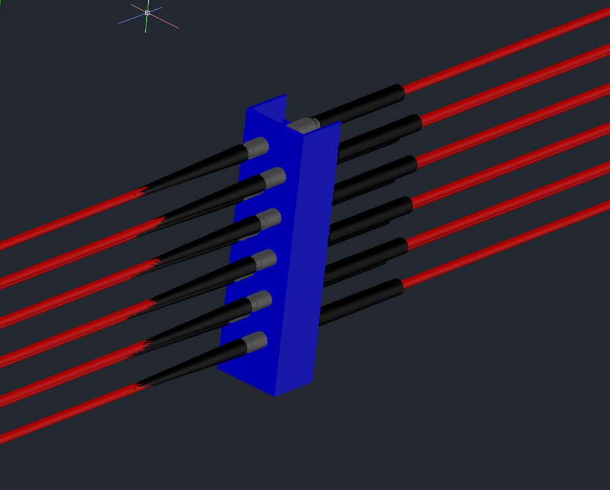
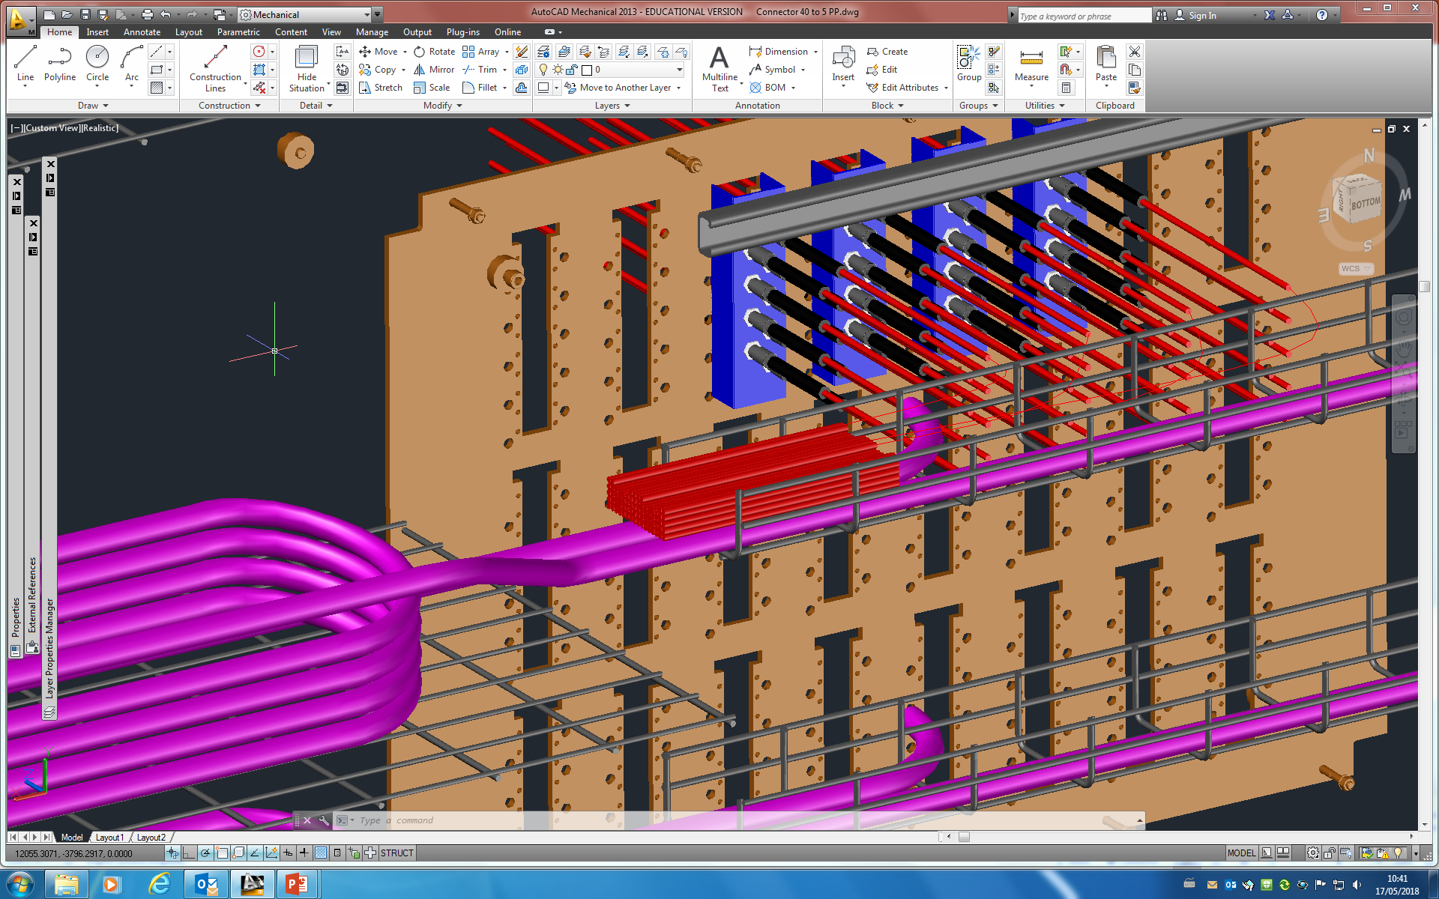
- 3D model of the adapter of ten connecters
- Position of all 40 news cables.
- Amount of cables to install in the cables rails support if there is a security length (72cables)

Slide 8
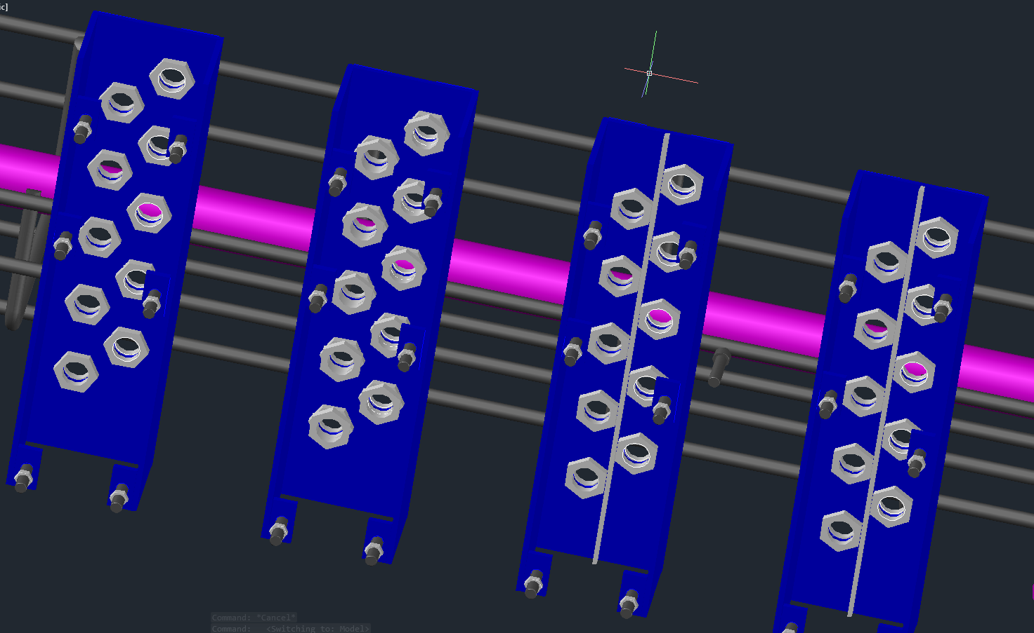
- Issue to stuck the nut, easier way to install the cables. Put narrow stick between.
- Or use double nuts to stuck each other.

Slide 9
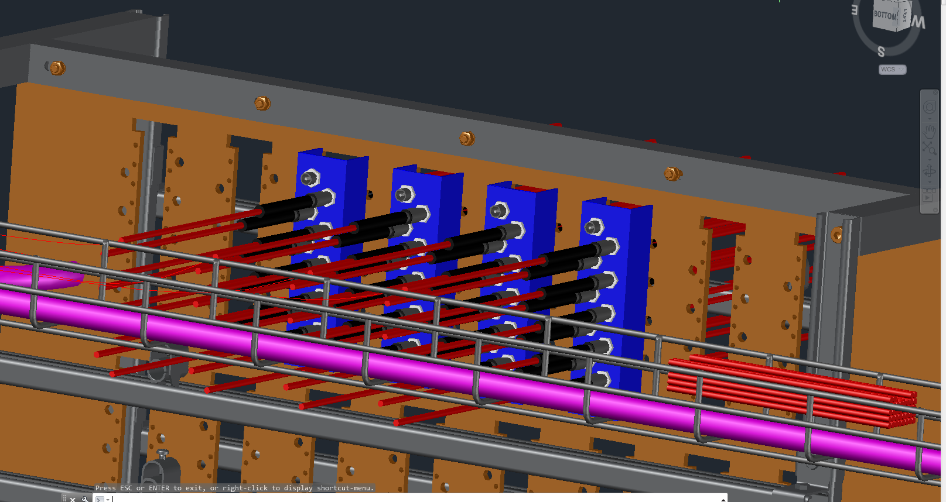
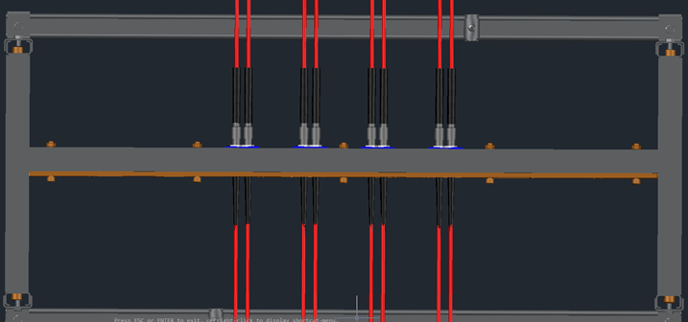
- There are 36 cables from news chambers (RE3_1 and RE4_1) and a total of 40 cables HV (2 of 40mm of 20 cables) so after the installation we will have 4 connecter empty from the chambers.
- Top view, just enough space to tighten the nut.

Slide 10
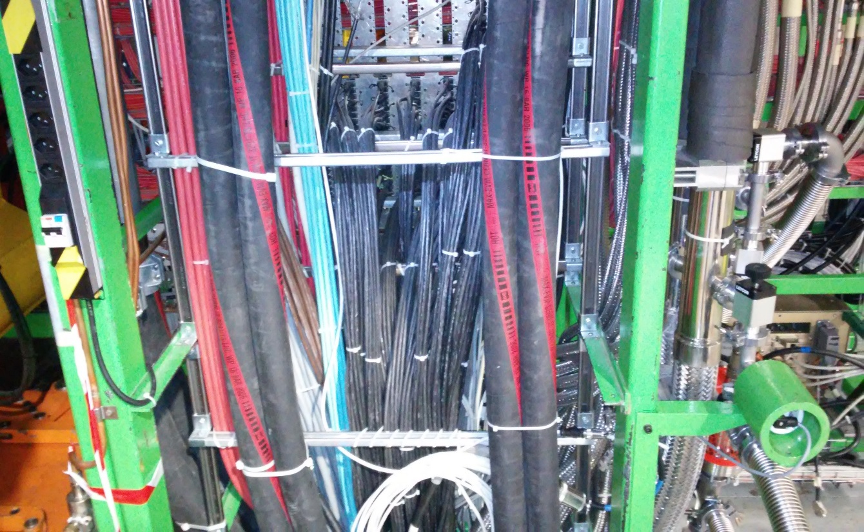
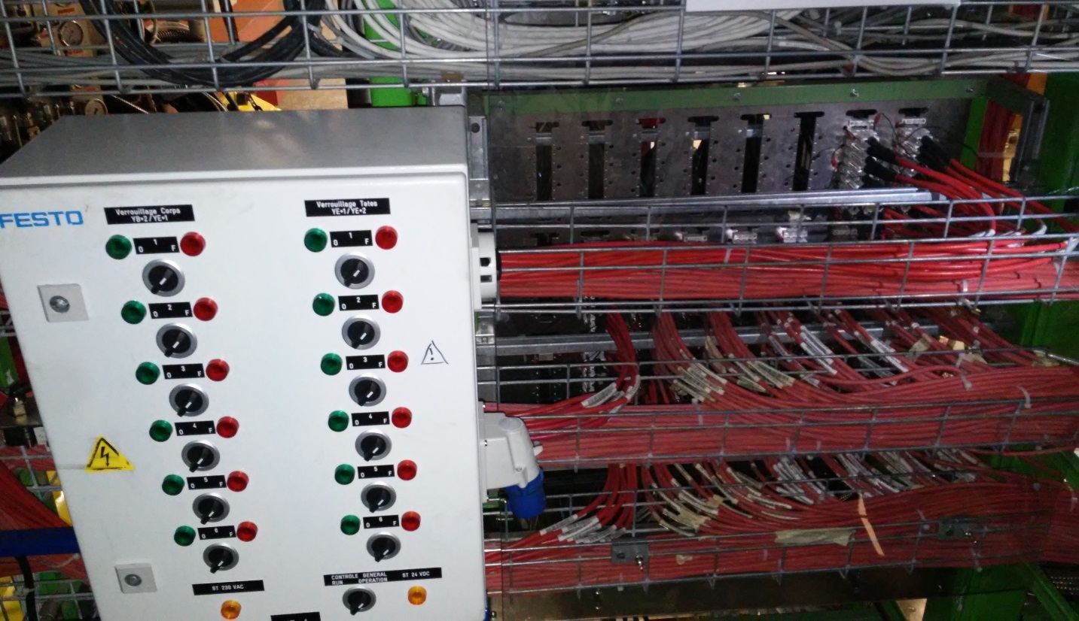
D
- From the big cable chain
- From the chamber

