Slide 1
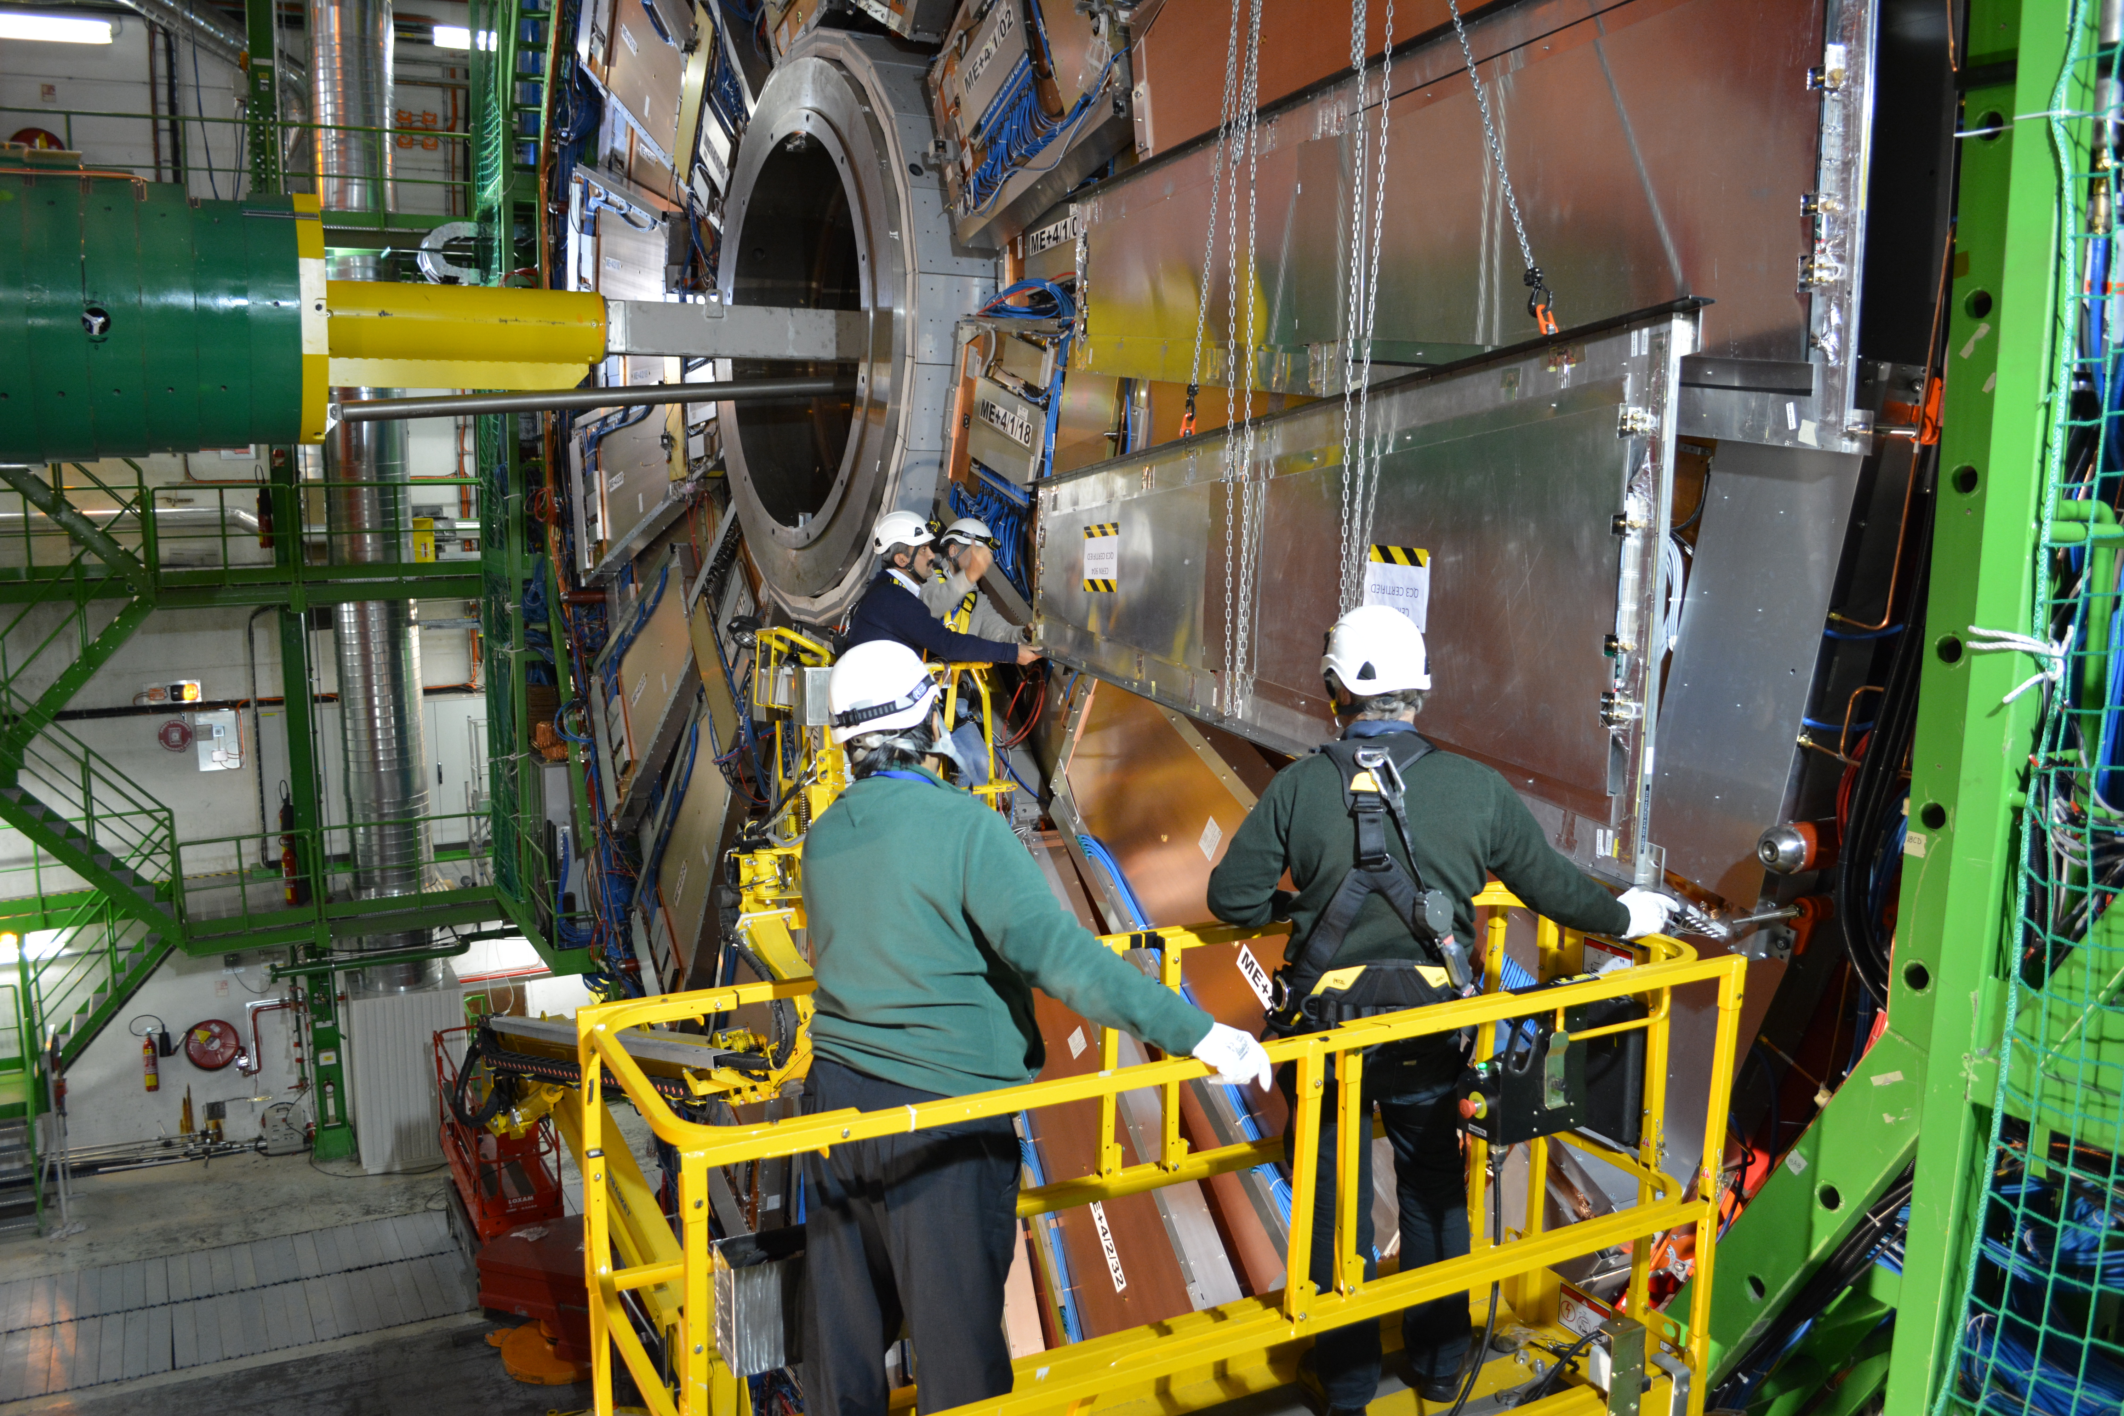
Experience from RE4-2/3
RE4-2/3 (144 Chambers) is twice the production of RE4-1/3-1 (72).
The installation negative end-cap end of December 2014.
Trial Installation 2013

Slide 2
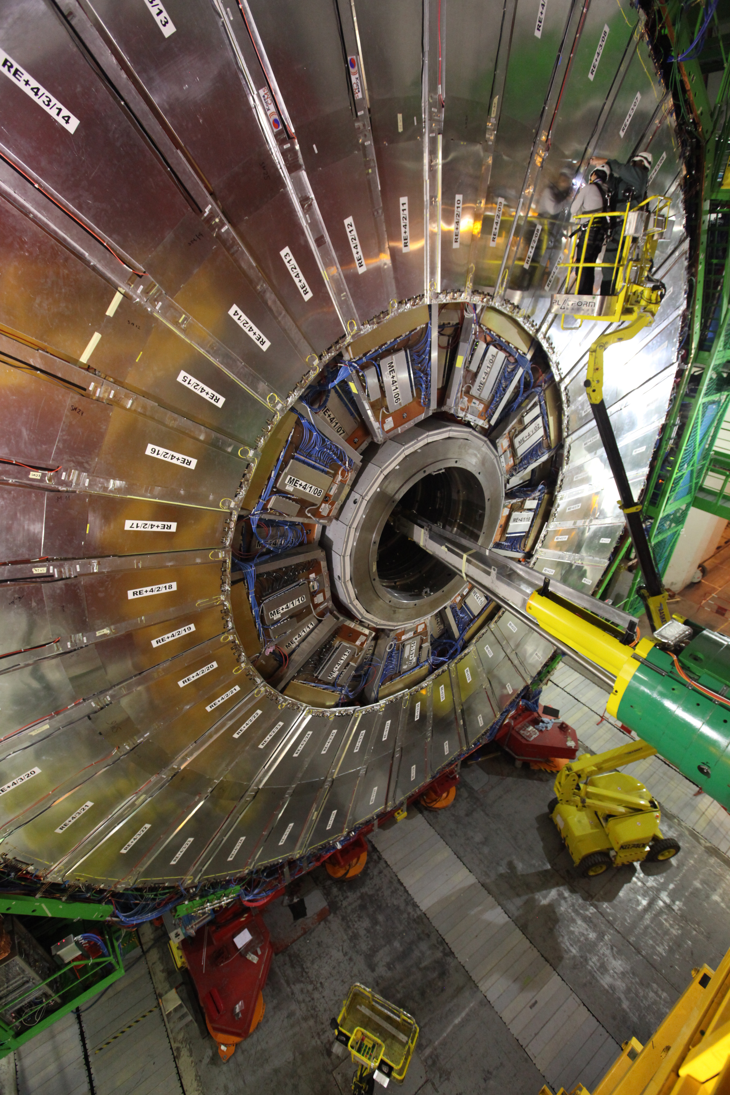
[charge 8 ]
Preliminary installation schedule
For disk of RE3/1 or RE4/1
Action | Days
Crane needed | Full time
18 (of 72) chambers installed | 3
Cable (HV/LV,Signal) | 3
Cooling and commissioning at 18 bar with gas | 4
Gas | 3
Final chamber commissioning | 7
Total installation/commissioning time
~ 3 weeks (including w.e.)
Job on different disks can be parallelised if manpower available.
Services installed during LS2 and/or EYETS
Chambers to be installed 1-2 disks during EYETS

