Slide 1
Parameter space for RE3/1 and RE4/1
Ian Crotty with Input by Boki from 904 Integration Office

Slide 2
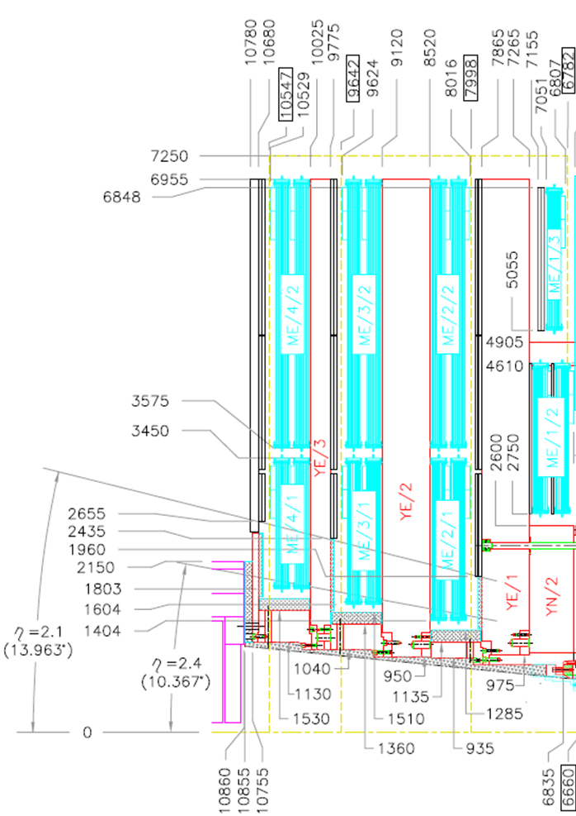
Cross-Section of CMS
RE3
RE4

Slide 3
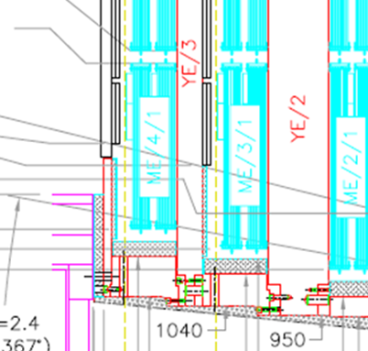
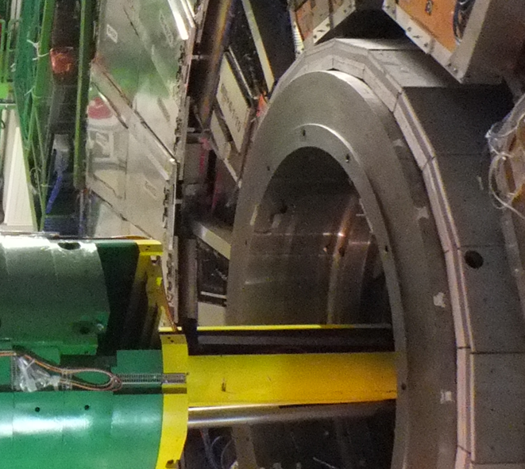
The tricky high radius mounting under the presently installed RE4/2 & RE4/3 Super Module (SM).
RE4 SMs
Short RE4/1 (2002)
CSC Mounting Posts

Slide 4
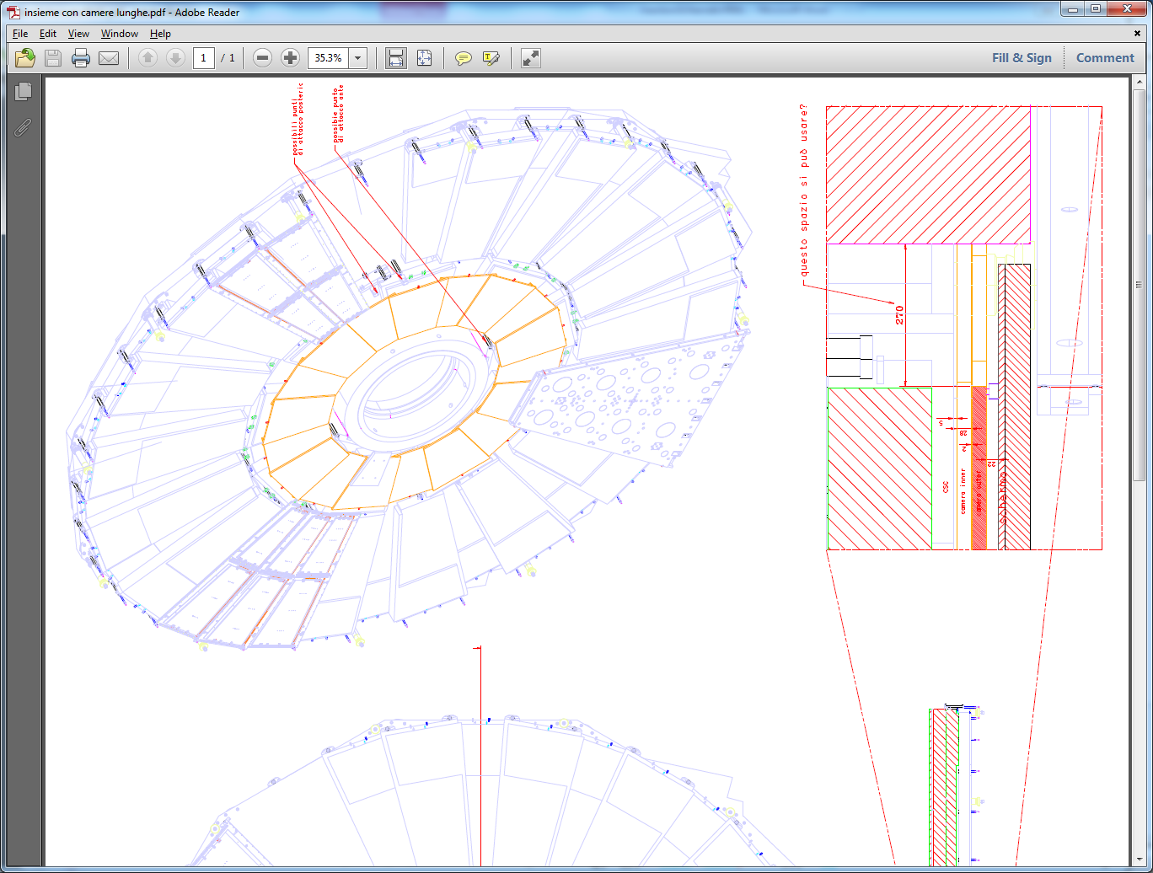
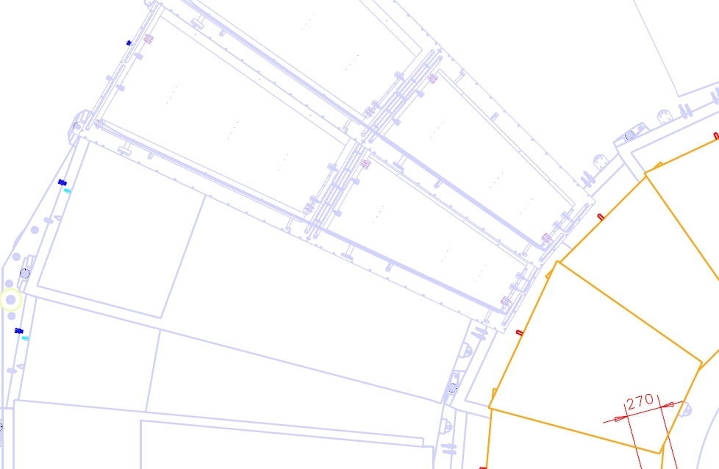
RE3/1 extended Pino & Pigi (2015
RE4 SM

Slide 5
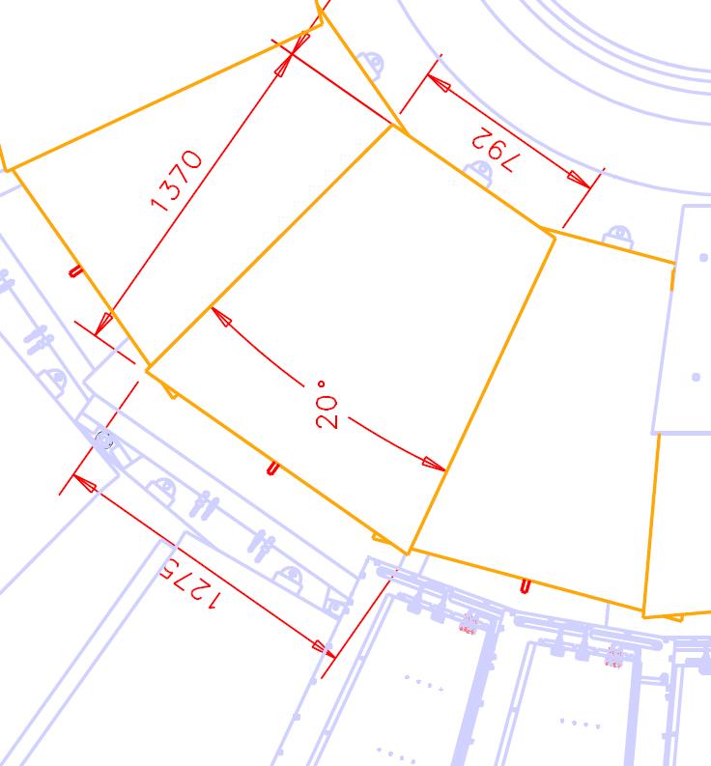
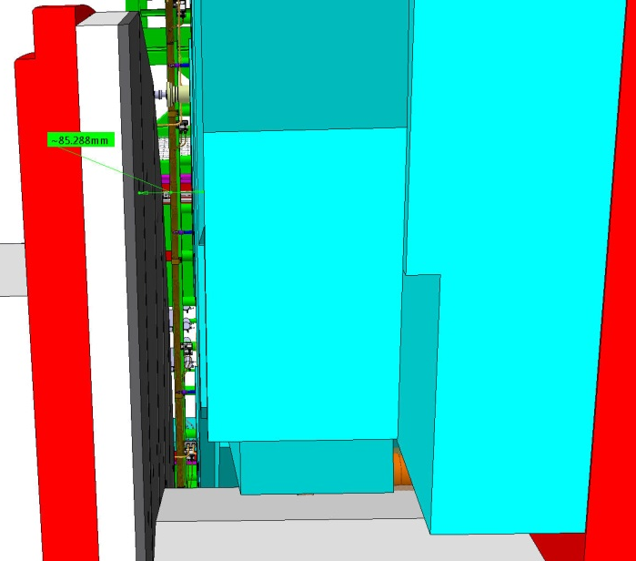
These dimensions will be verified with Integration office .
Resultant RE4/1 envelope
85mm Gap.
A model should be made and tested insitu.

Slide 6
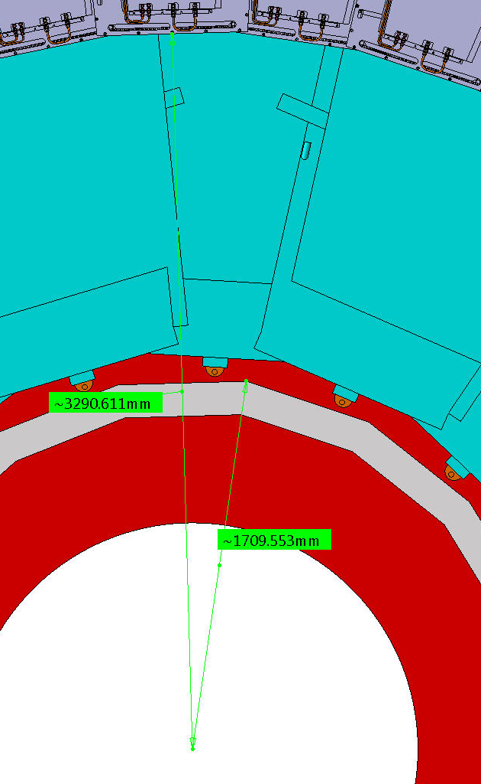
To verify the RE4/1 envelope, latest input;
Outer “R” = 3290mm
Inner “R” = 1709mm
Delta “R” = 1581mm

Slide 7
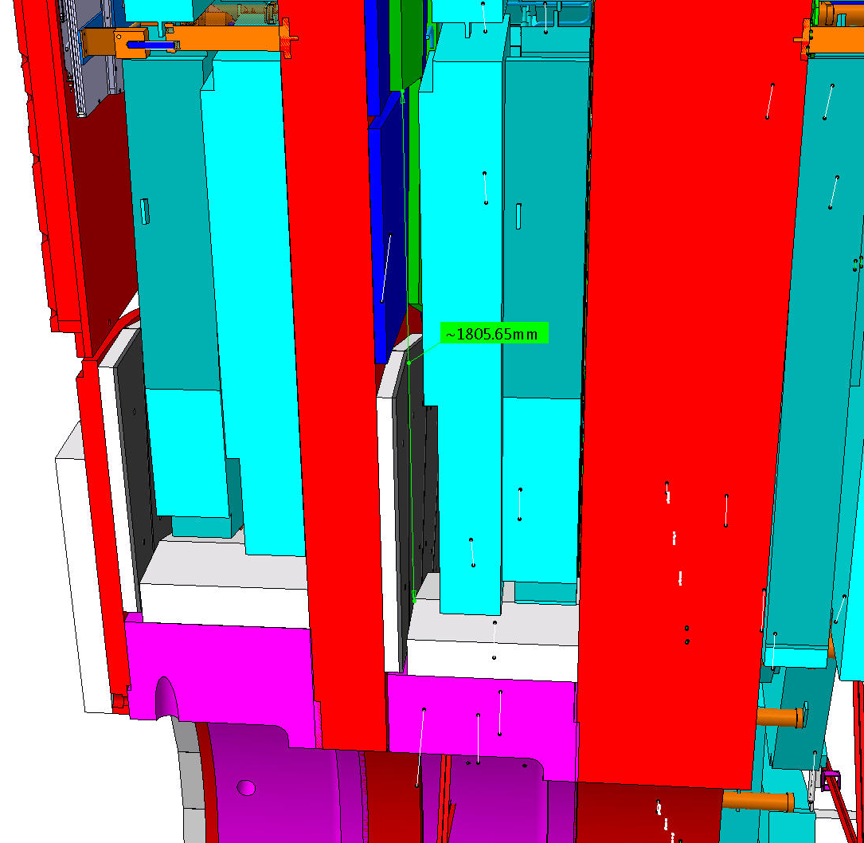
RE3/1
Basic parameters
R Outer = 3302
R Inner = 1526
Delta = 1776
This area has to be studied and an envelope produced and agreed with Integration

Slide 8
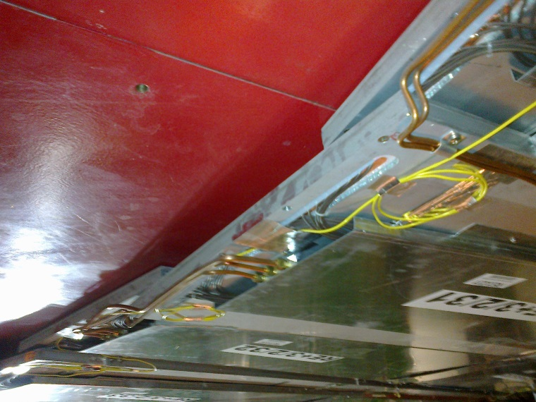
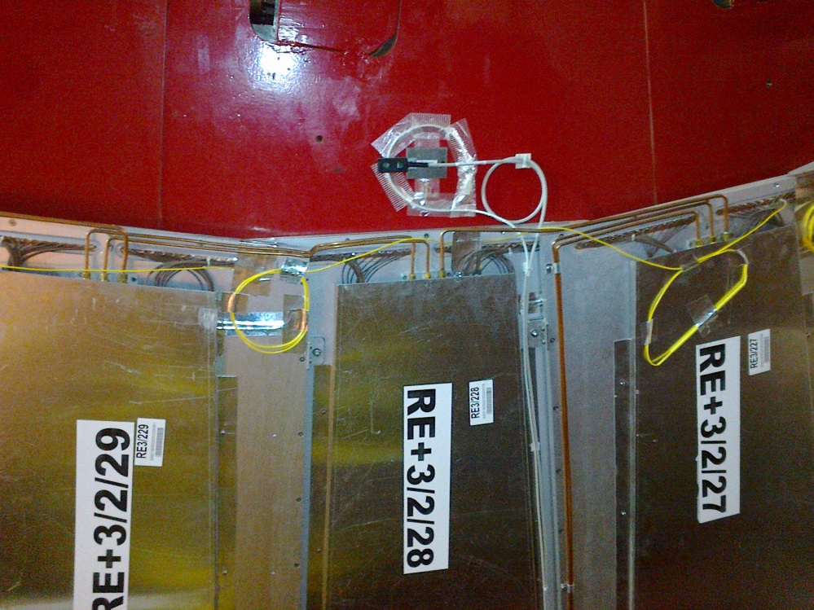
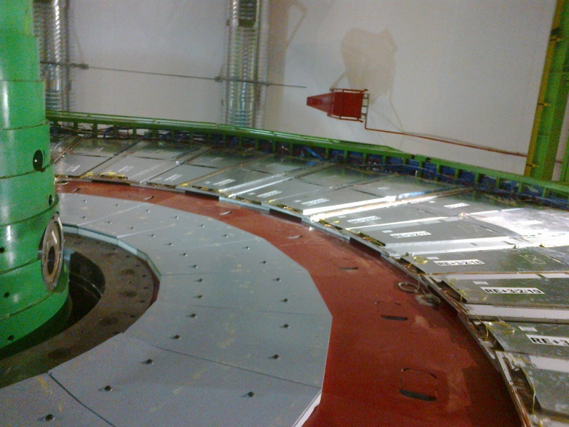
RE3/1 as built. Mounted on the Yoke. Shielding takes up significant space in “Z”
Service access to periphery ?
Services to extend to RE3/1 ?
Space to cover

Slide 9
Conclusion
Verify RE4/1 envelope
Detailed study of service space.
Produce envelope of RE3/1
Space in “Z” is small in RE3/1 when over the shielding

