Slide 1
Integration of RE3/1 and RE4/1
On behalf of the RPC community
Ian Crotty

Slide 2
Covered topics
Available envelope, coverage and Mounting schema
Installation of chambers and MP. Cable trays.
Potential conflicts with shielding, alignment & CSCs.
Heat dissipation cooling system and size present.
Service routing path, periphery, Rack space, cable chains.
Schedule
Production and Lab space person-power.
Postponed scenario LS4

Slide 3
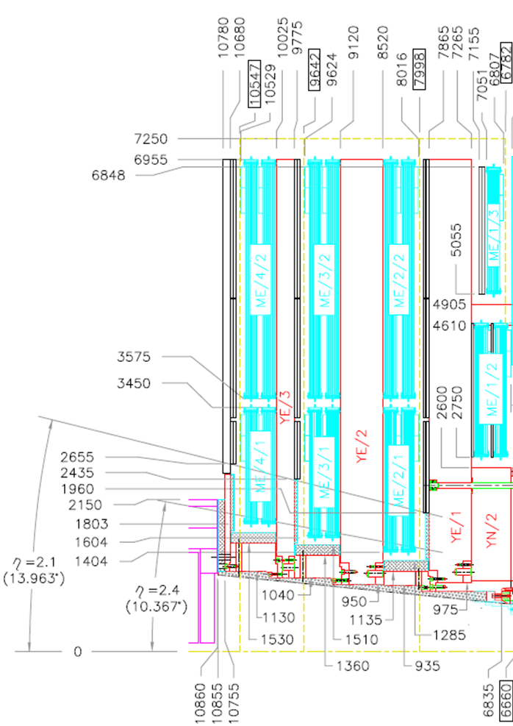
Cross Section of CMS
Installed RE3/2 &3/3
Installed RE4 SMs
Old Low Eta RE4/1
Old Low Eta RE3/1

Slide 4
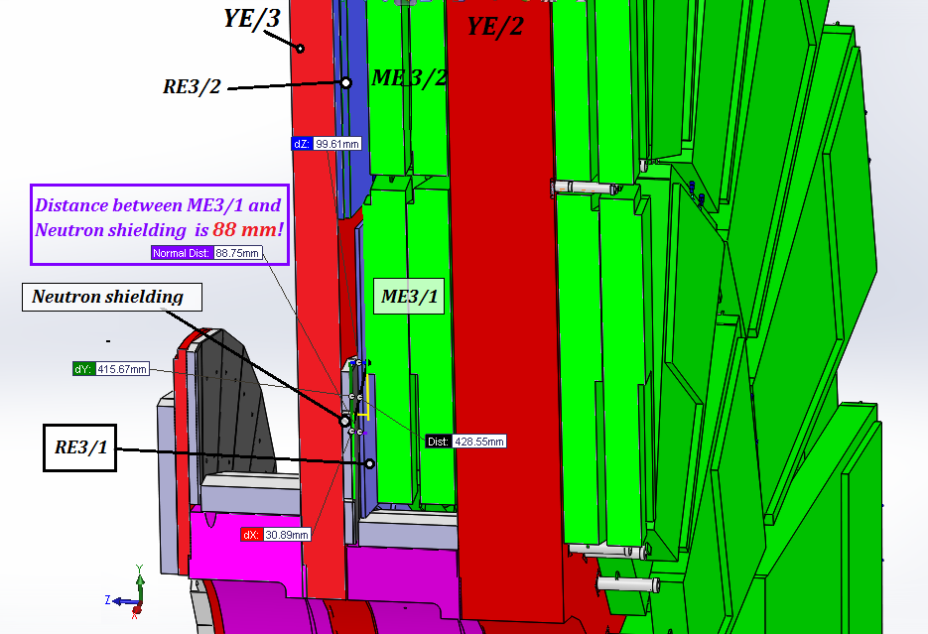
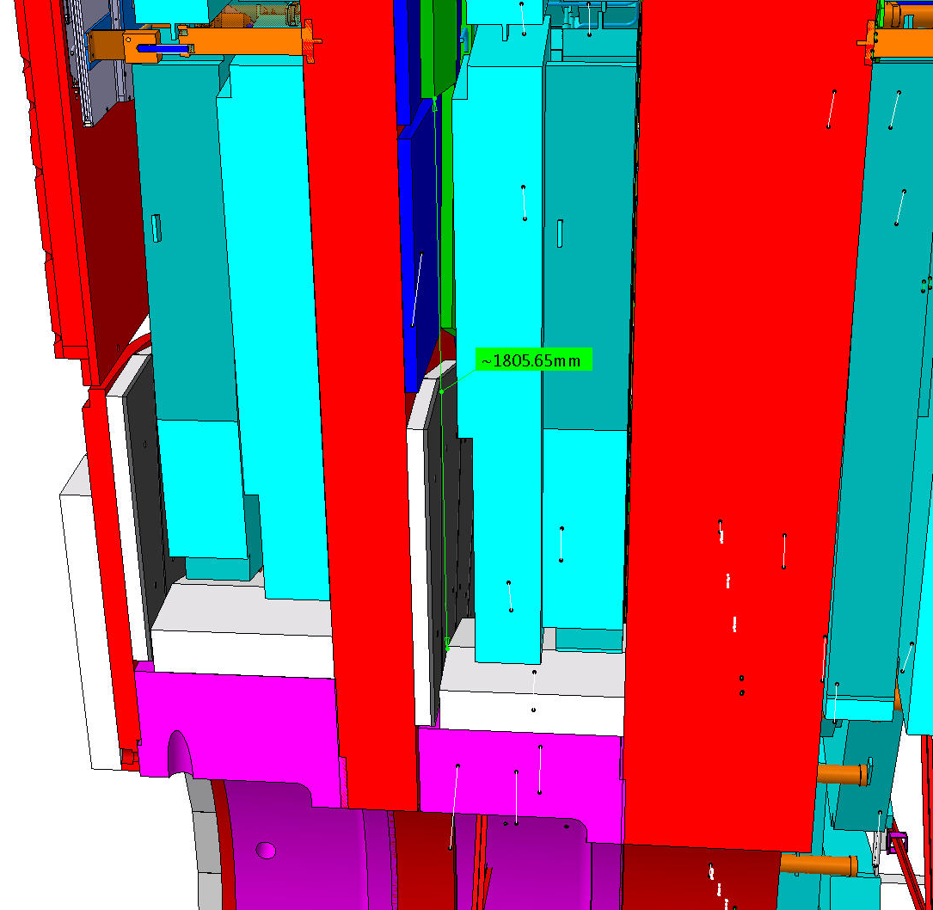
RE3/1 20deg chambers
Basic parameters
R Outer = 3302
R Inner = 1526
Delta = 1776
This area has to be studied and an envelope produced and agreed with Integration
Integration gives 88mm space in high eta region over the neutron shielding

Slide 5
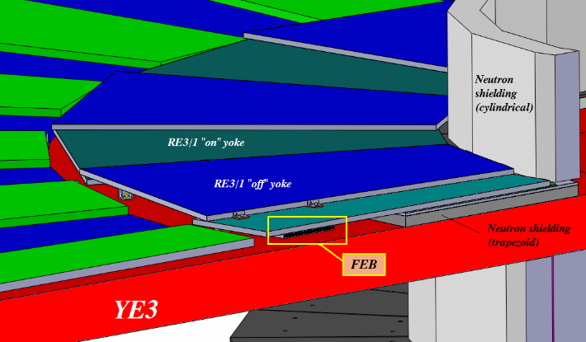
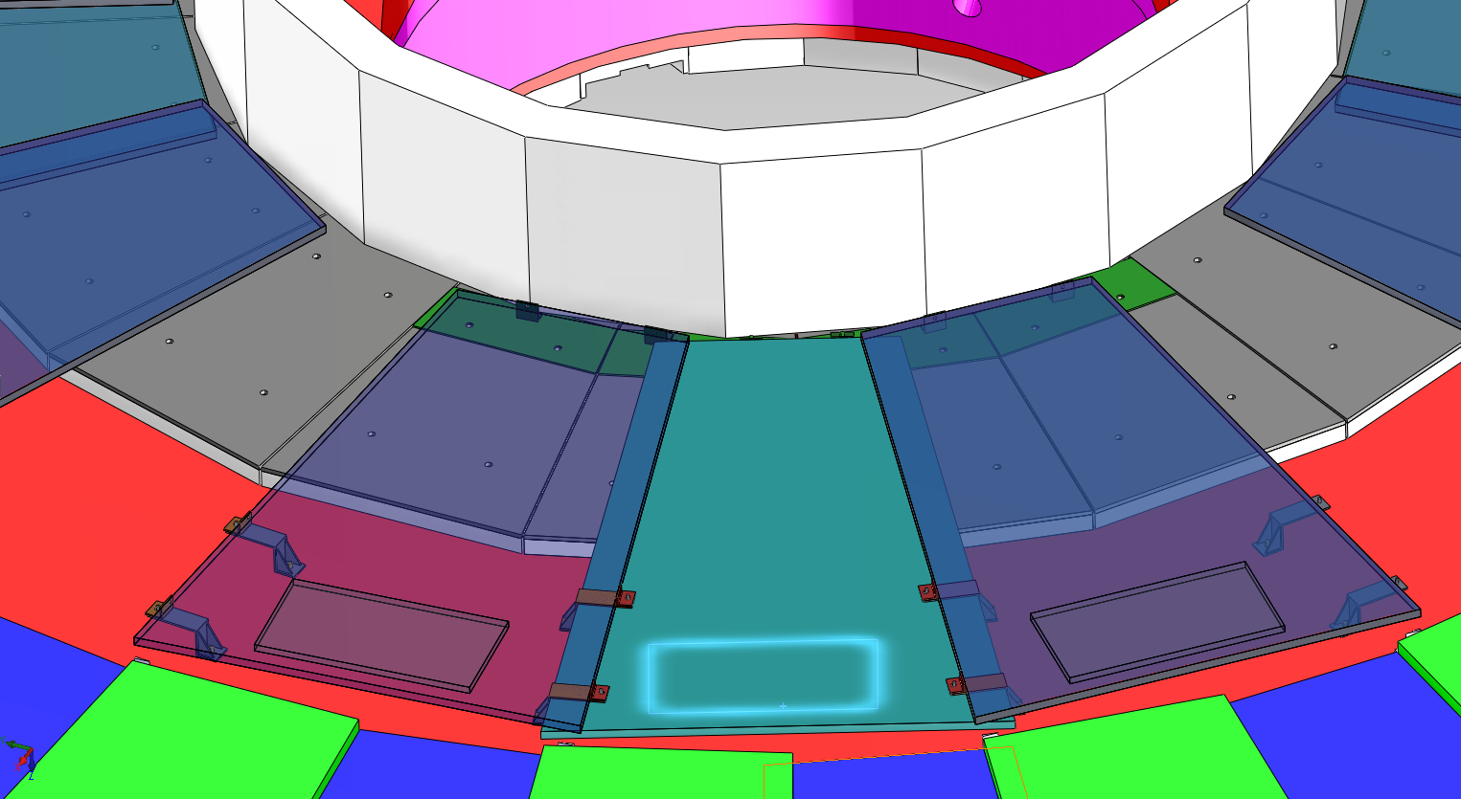
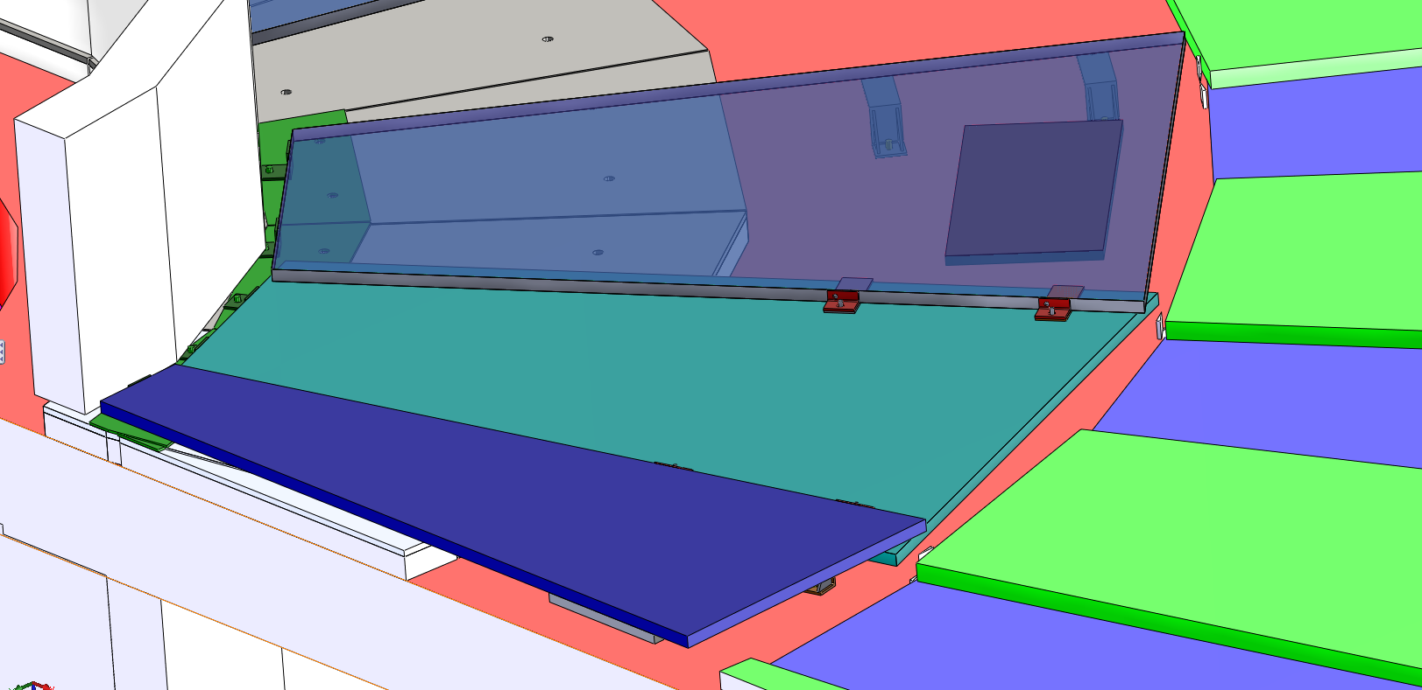
FEB mounted at low eta behind the Chambers in the 146mm gap
Neutron Shielding
FEBs behind the chambers

Slide 6
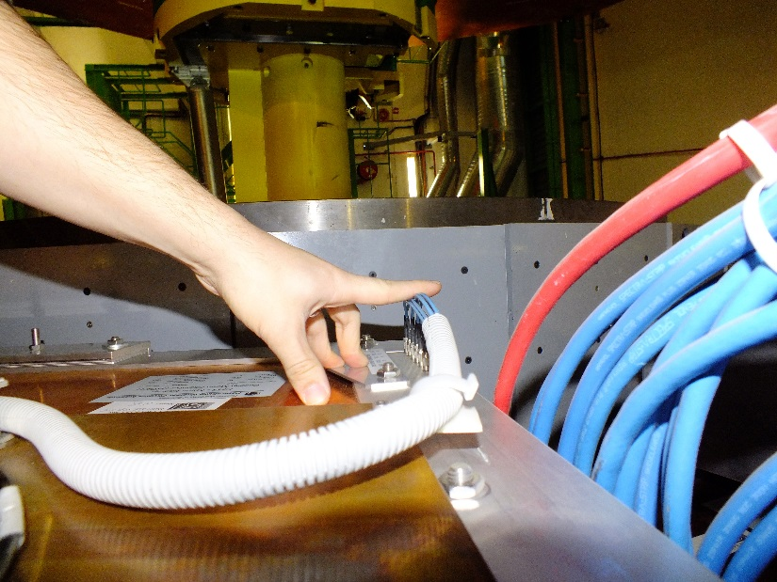
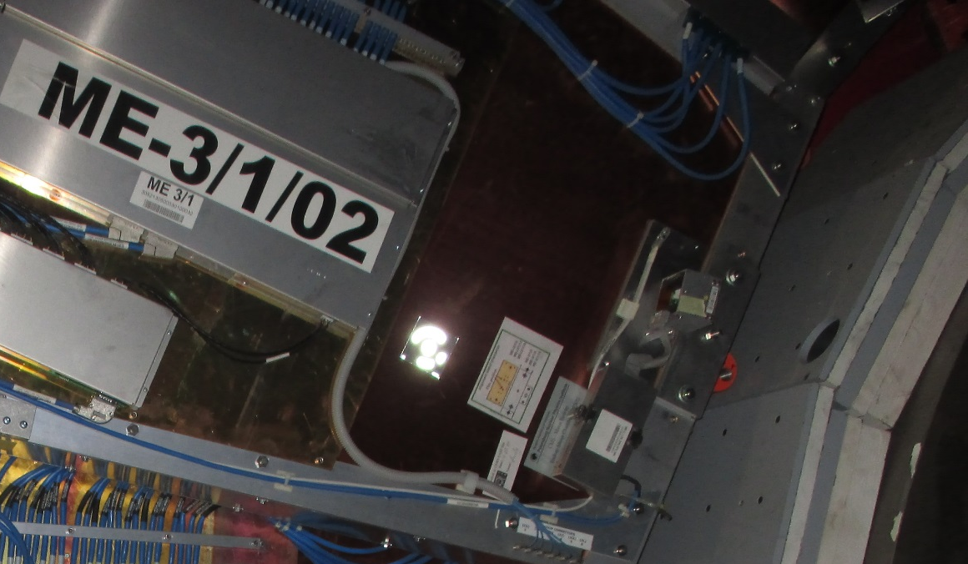
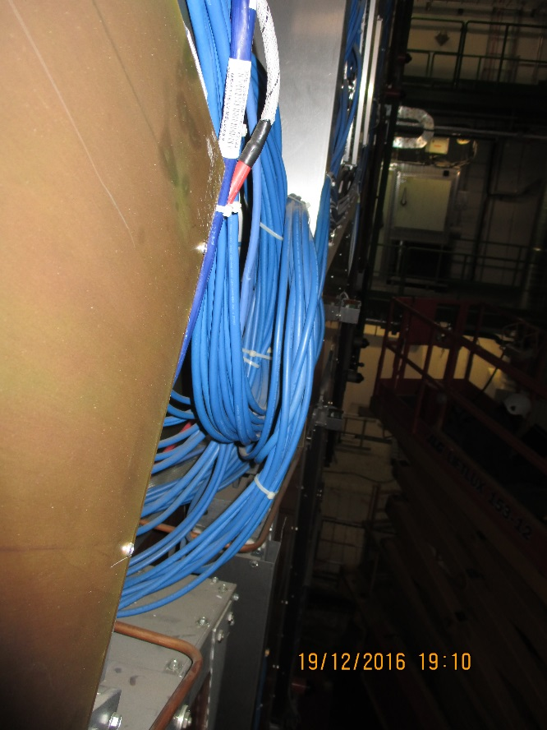
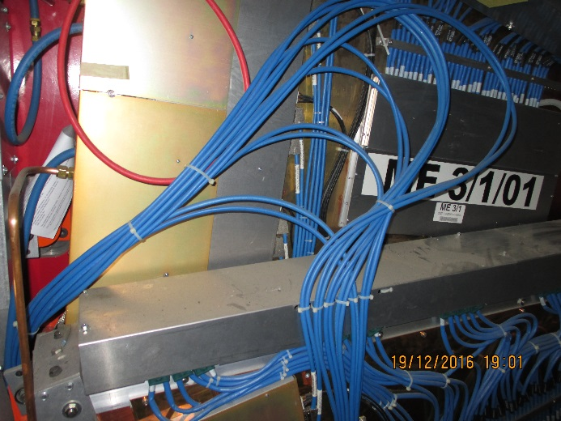
Clashes CSCs
Connectors to modify
Alignment Sensors
Check all cables lie within chamber envelope
Cable bundles to push back

Slide 7
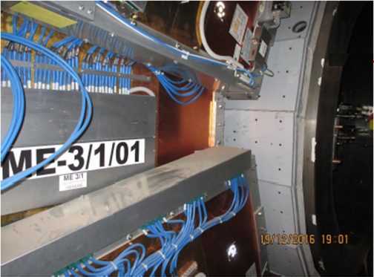
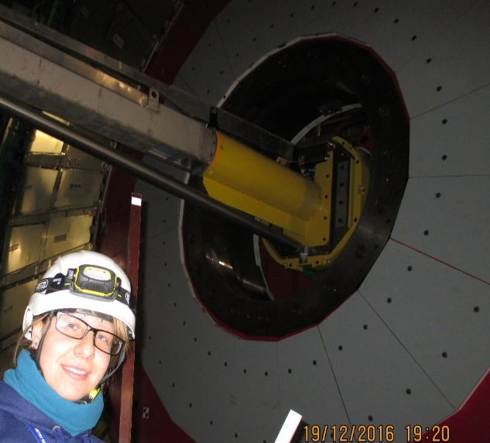
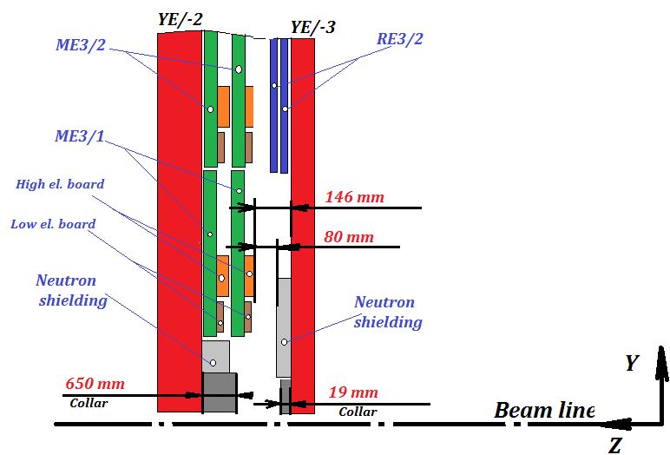
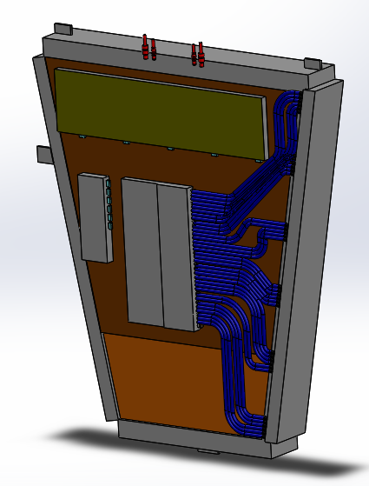
2. Manual measurements
The value "Z" for RE3/1
The value "Z" for RE3/1 from manual measurements is 80 mm!
Principle scheme for determination the value “Z ”
* The features design of the CSC chamber were taken into account.
(650+19)-523-66 =80mm
- 523 mm is CSC thickness
- 66 mm is the neutron shielding
* Manual measurements in P5 was 19 of December 2016
RPC TC working meeting 5/

Slide 8
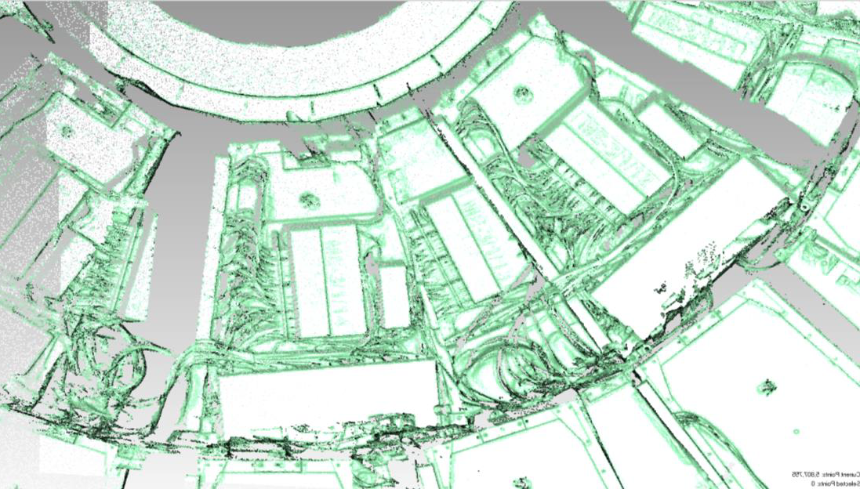
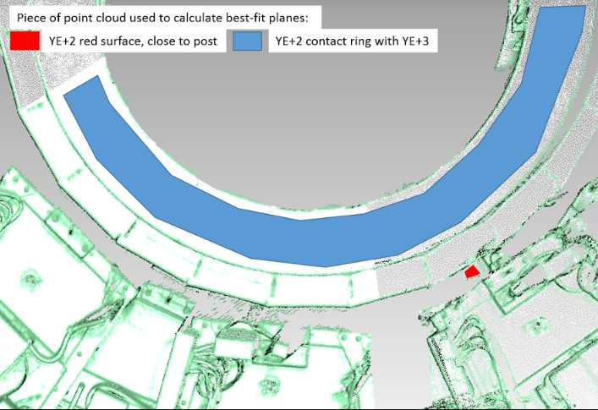
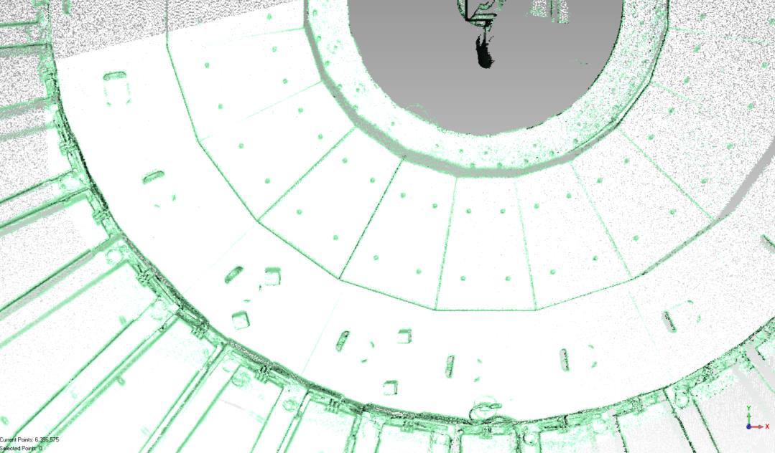
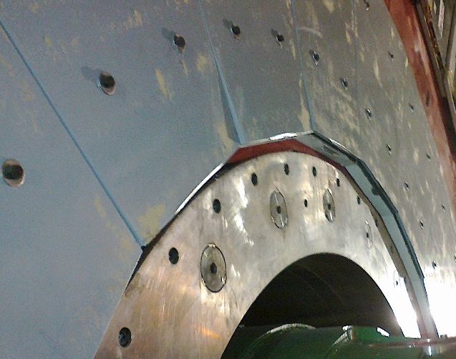
The value "Z" for RE3/1
3. Laser scanner and laser tracker
* Laser scanning in P5 was done 19 of December 2016 (for YE-2 and YE-3 around the ME-3/1/13) and 10 of January 2017 (for YE+2 and YE+3 around the ME+3/1/13)
YE/+2
Height Collar is 648. 6 mm
ME-3/1/13
YE/-3
Height Collar is 19. 6 mm
Neutron shielding
Screw heads protruding 15mm to be made flush
RE -3/2
RPC TC working meeting 6/

Slide 9
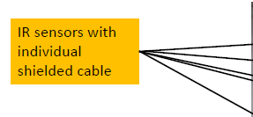
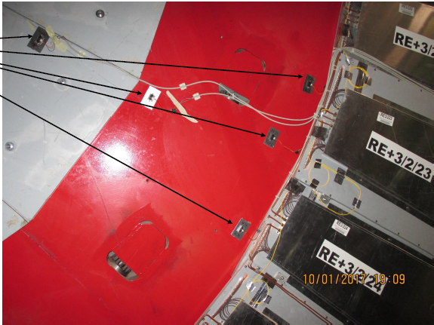
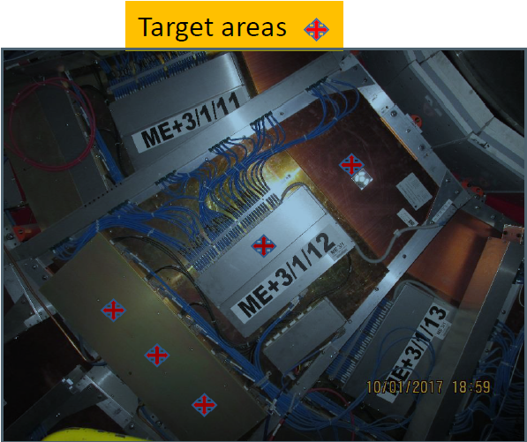
The value "Z" for RE3/1
4. IR sensors
* IR sensors were installed in 10th of January 2017
Results will be come later after closing YE/+2 and YE/+3.
RPC TC working meeting 8/

Slide 10
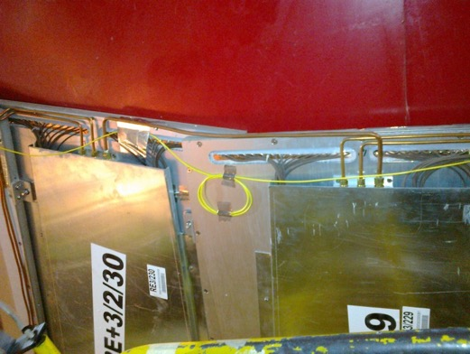
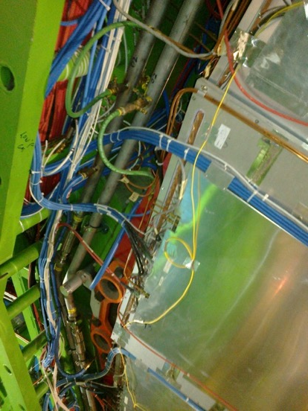
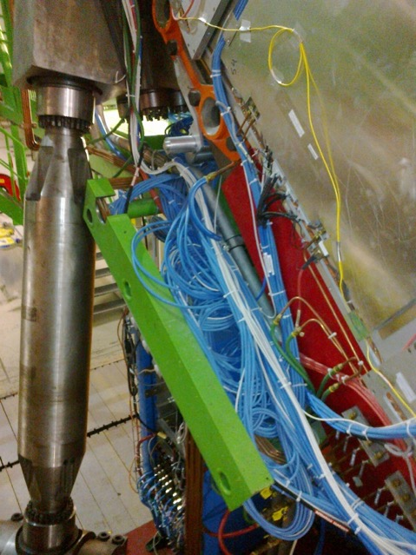
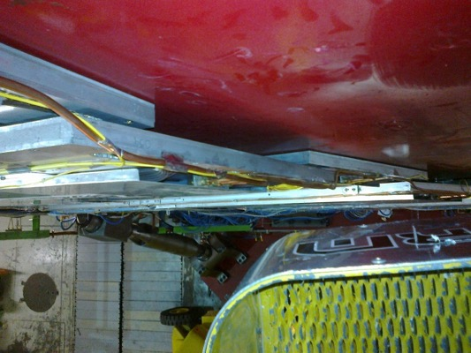
RE3/1 service passages
Space on the periphery is very limited. We will work with our CSC colleagues to optimise for the best solution
Service passage to the periphery is either on top of or under the RE3/2 & RE3/3.
Services installed before the chambers

Slide 11
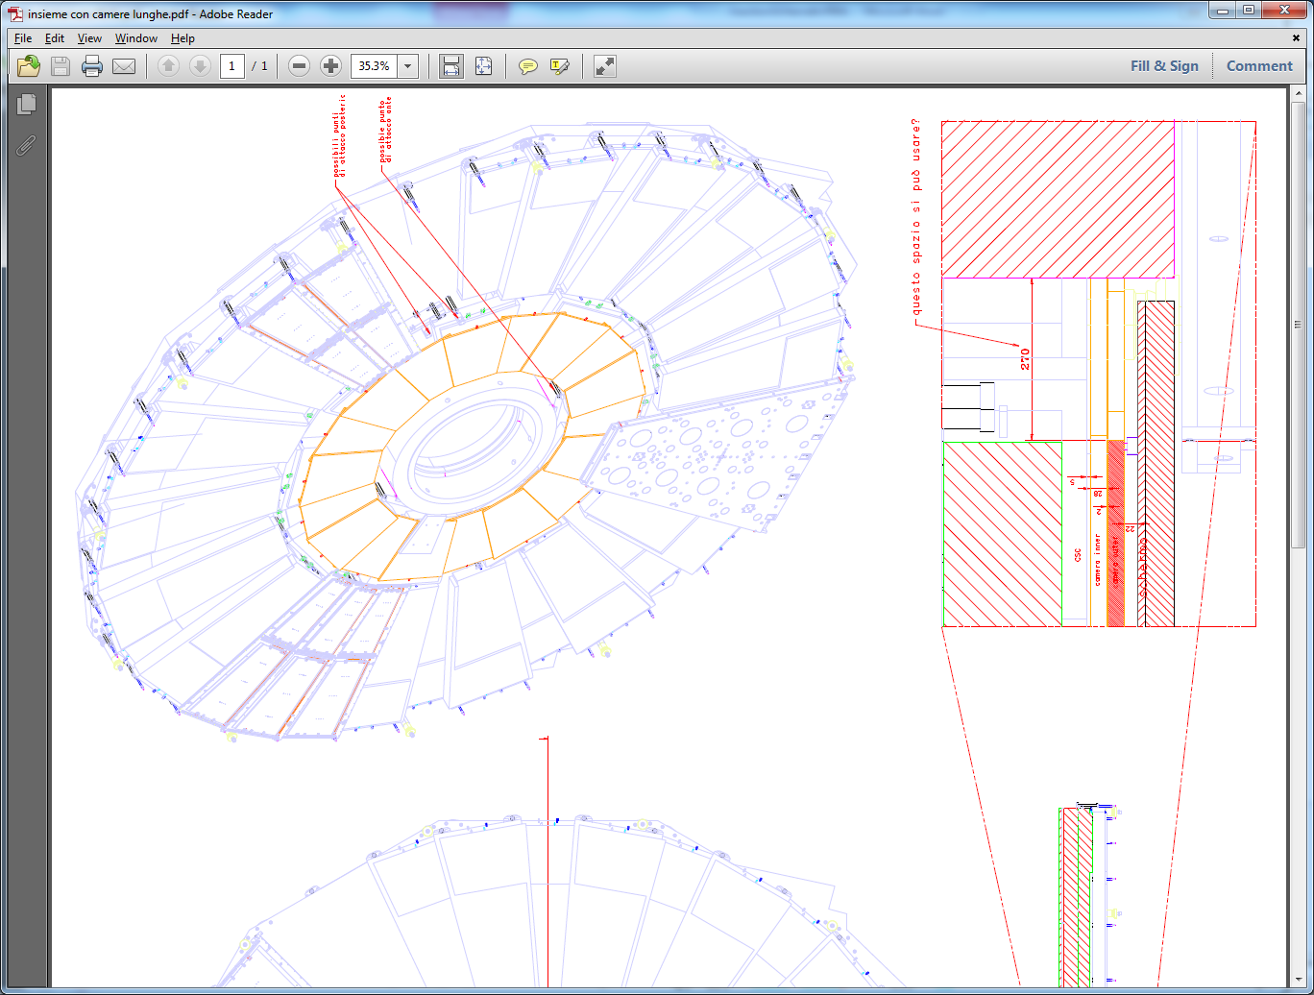
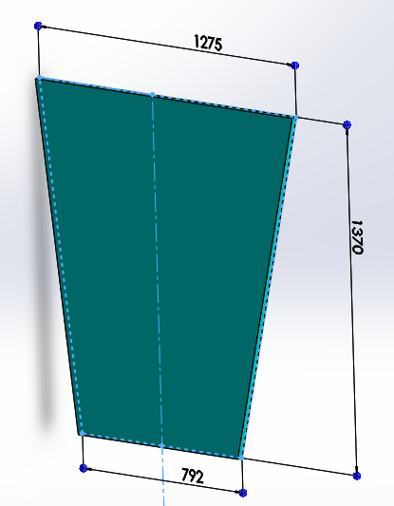
High Eta RE4/1
RE4/1 extended High eta
RE4 SM
18 chambers overlapped every 20 degrees

Slide 12
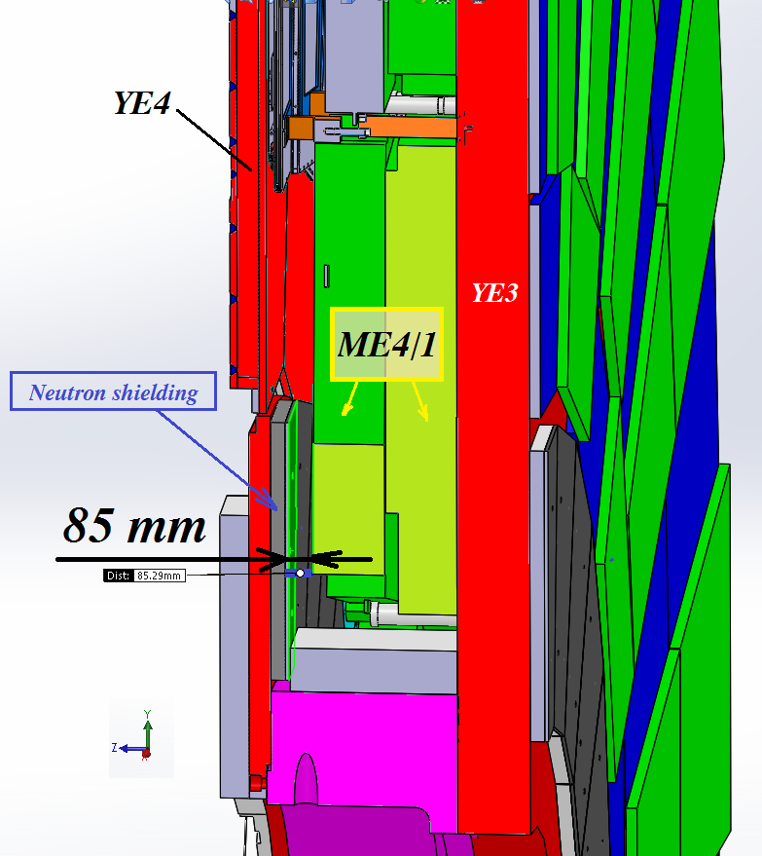
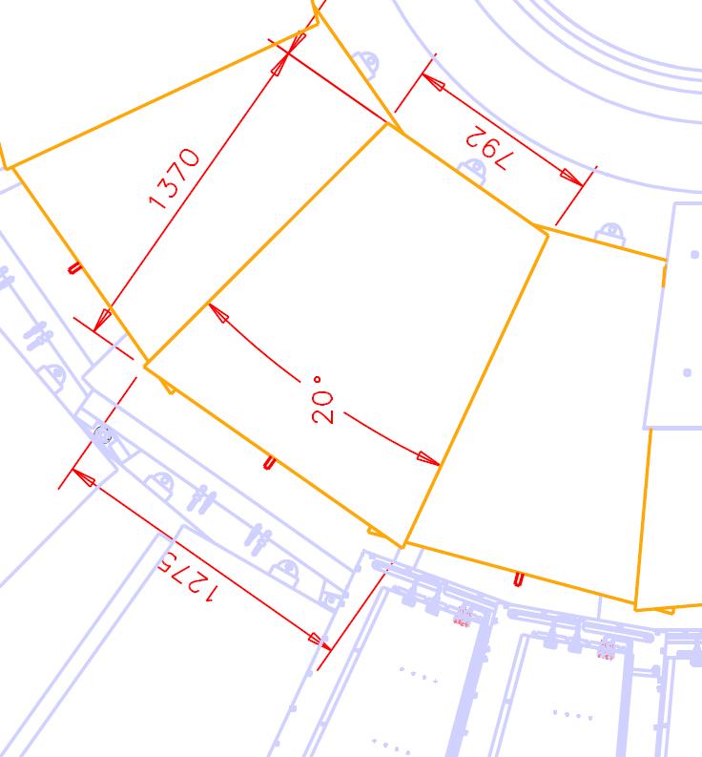
We are working with the Integration office to come to an unambiguous understanding of this volume.
RE4/1 envelope
The integration office states there is a 85mm Gap. The study done for RE3/1 will be repeated for RE4/1 gap (“Z”). We need to find some additional space to mount the chambers with overlap. Study is ongoing.

Slide 13
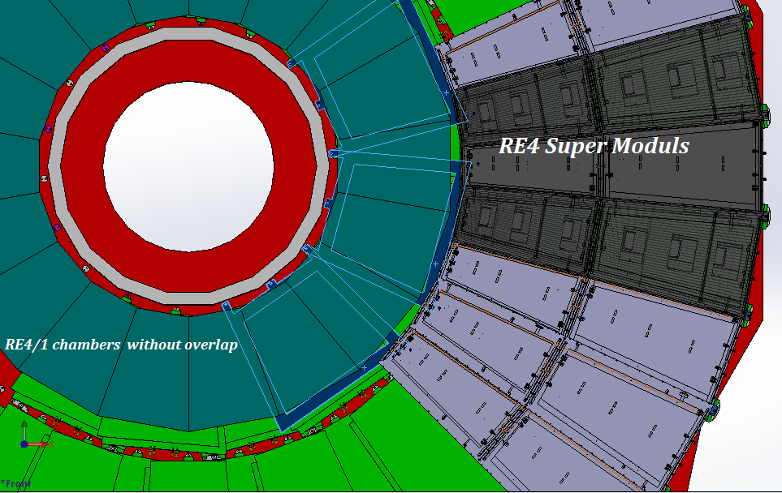
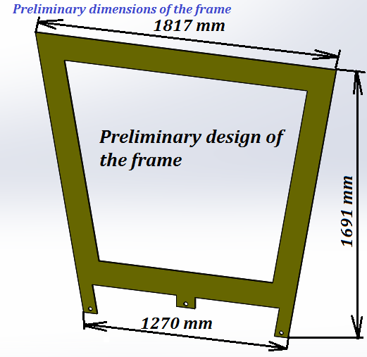
Mounting Plates (MP) for RE4/1 chambers
Mounting Plates
Mounting Plate design so far.
The MP is 30deg rather than 20deg as the chambers are in order to facilitate the high radius mounting post access.
RPC TC working meeting 13/

Slide 14
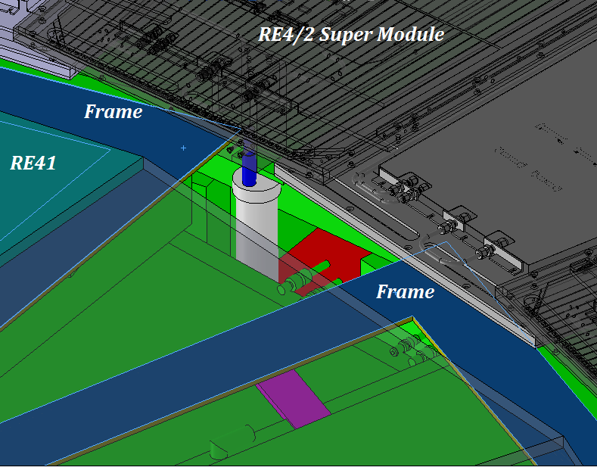
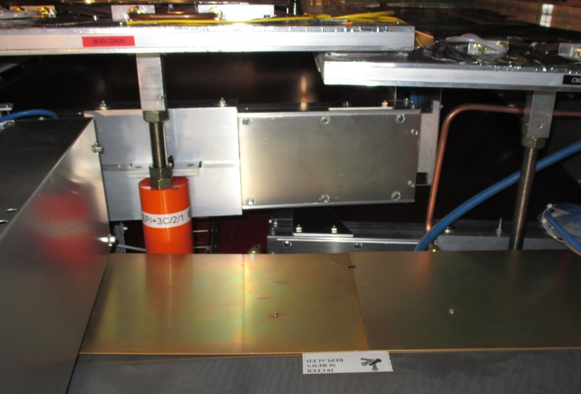
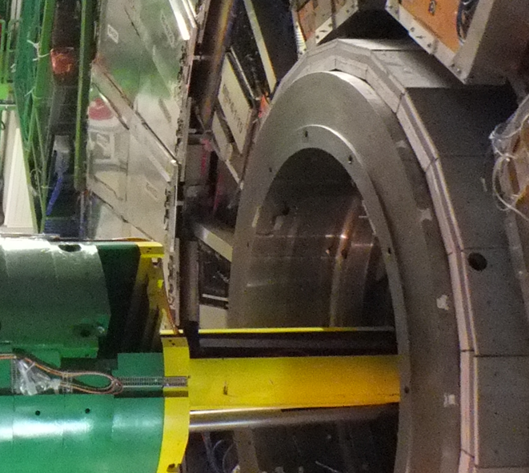
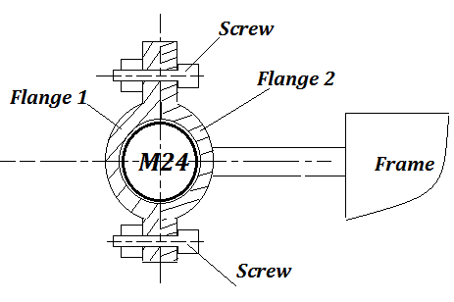
Mounting the outer radius is tricky
Schematic view of “clamp” nut
Mounting posts M24

Slide 15
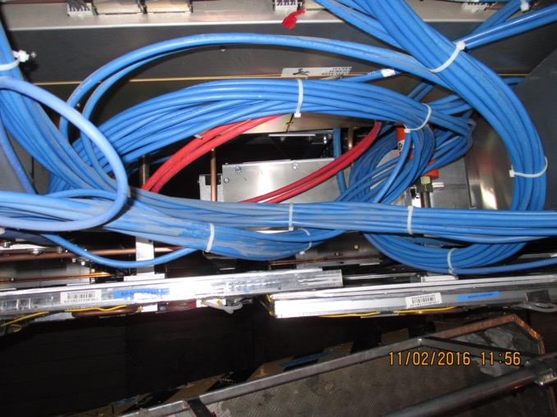
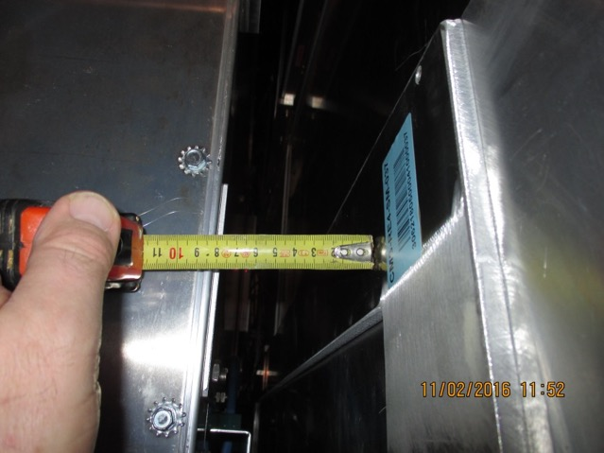
RE4/1 Service Passages
There are large passages under the CSCs that may be useful. The services will transit through flexible conduits for ease of installation. This method was verified behind the ME1/3s. Gas piping will have an alternative route, to be studied.
We will have to discuss with our CSC colleagues.

Slide 16
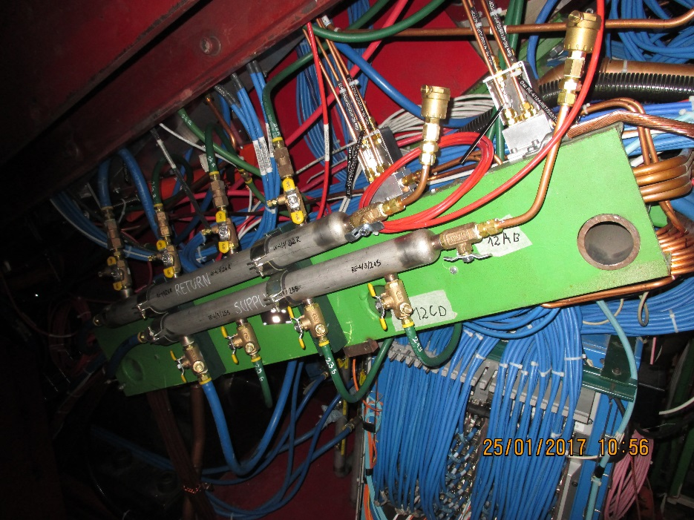
Power & Cooling
RE3/2 circuits will be extended to RE3/1.
The RE4 SMs will not be disturbed. “T”s will be added to the Mini Manifolds for RE4/1.
The power already on one YE3 is ~12kW. This 10% increase could give 0.1degC temp increase. These numbers have gone to P. Tropea for her comments.

Slide 17
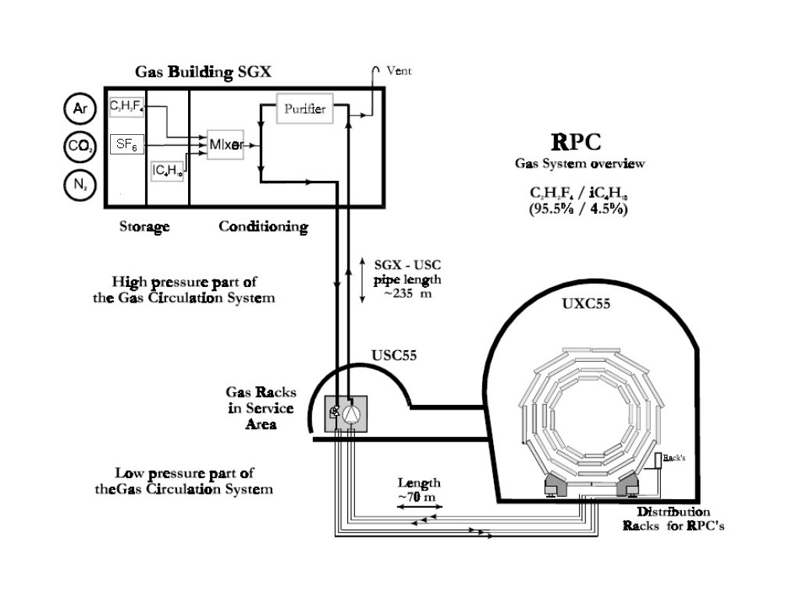
Gas system overview
Suppliers
Mixer
Humidifier
Humidity
Purifier module
Pre-distribution and pump
Final distribution

Slide 18
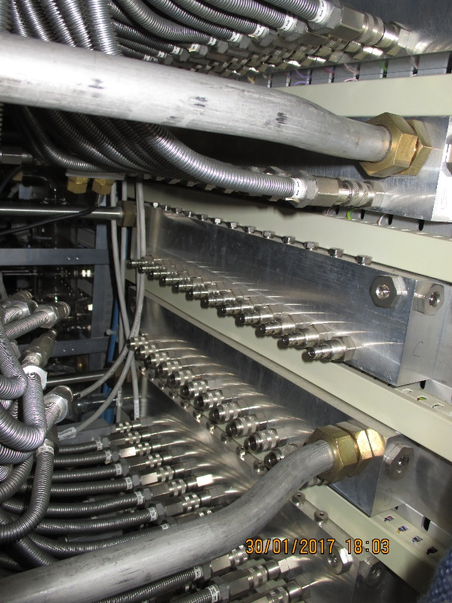
Gas
The gas system remains unchanged except for flow rate.
No additional racks are necessary as the 12 spare channels for RE3 are sufficient for the RE3/1 and RE4/1
New piping will be necessary on the RE4 side of the disc. Re piping of the original RE3/1 circuits is necessary

Slide 19
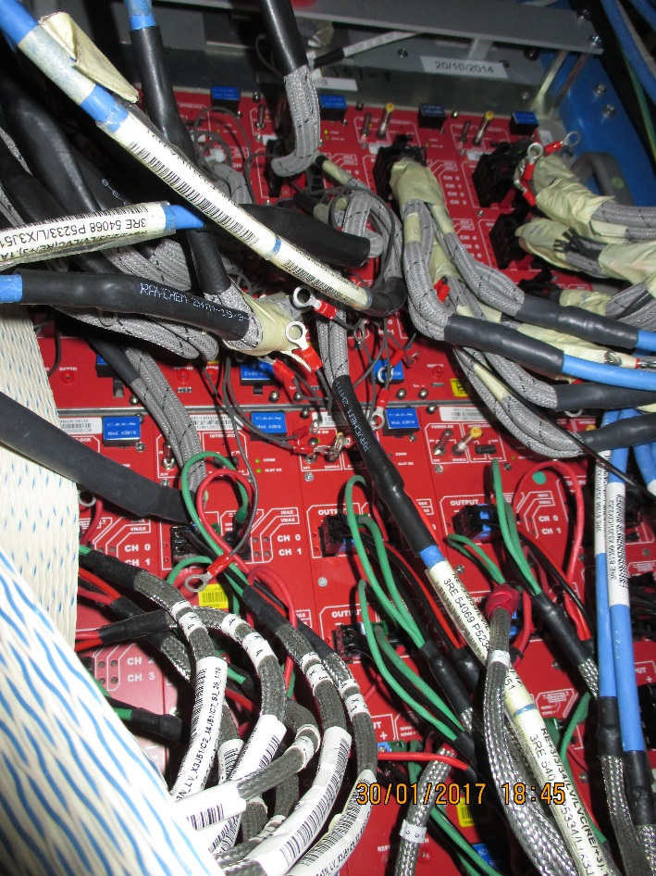
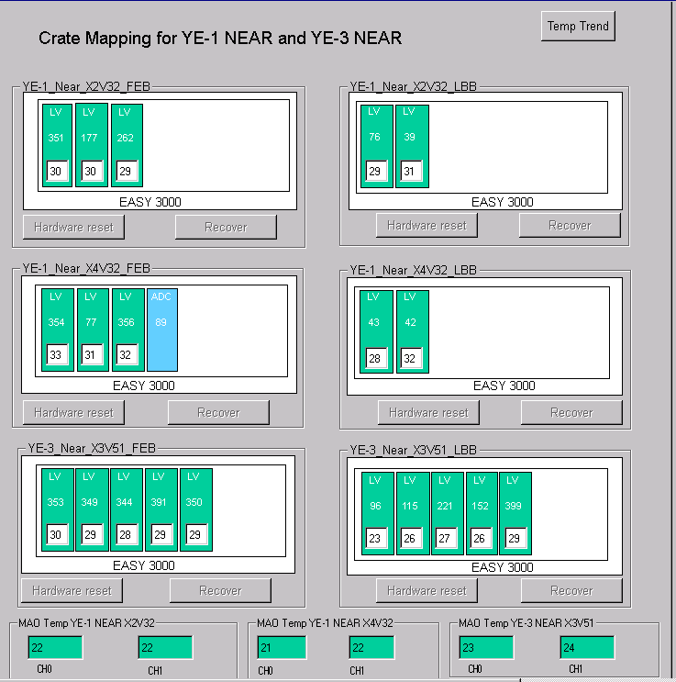
LV Power System Optimisation
for RE3/1 & RE4/1
For each end && side we would need 2 A3016 LV
boards to power the RE3/1 and RE4/1 chambers.
We should redesign the entire RPC LV system such that:
  We redistribute the LV power cables of 2 RE4 A3009 boards into the neighbouring 3 RE3 A3009 boards
then
  We will free slots for 2 A3016 boards for powering RE3/1 and RE4/1
Assuming we double connections into one board after the power
redistribution, it will still continue to work in optimal power
regime ~60% of max power.
In this scenario – no additional crates, branches and
rack space is required!
RE3
RE4
Local rerouting of present cables necessary to recover the 2 A3009s

Slide 20
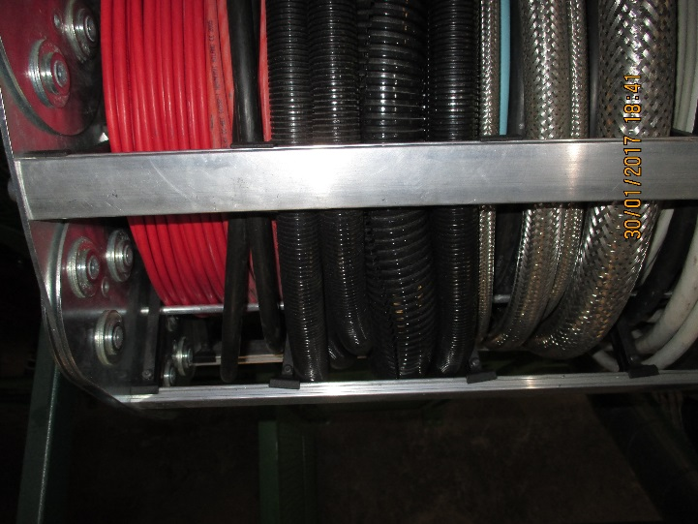
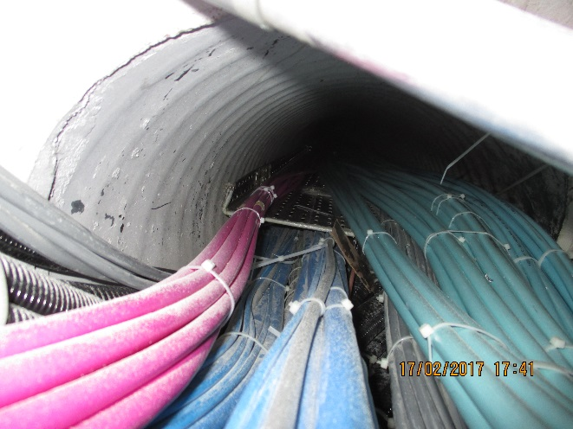
Cable Chains
  One Mini Cable Chain per Endcap
  HV cables x36 dia 6mm
  Fibre optic x1 dia 20mm
  One Main Cable Chain per Endcap
  HV cable x2 dia 38mm
  Fibre optics x2 dia20mm
Near MCC
Fibre channel between USC and UXC.

Slide 21
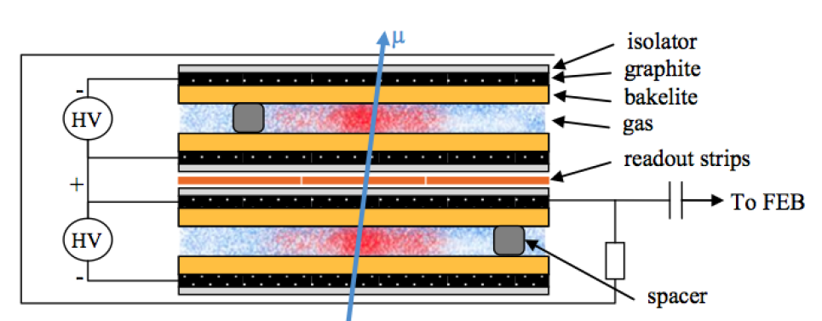
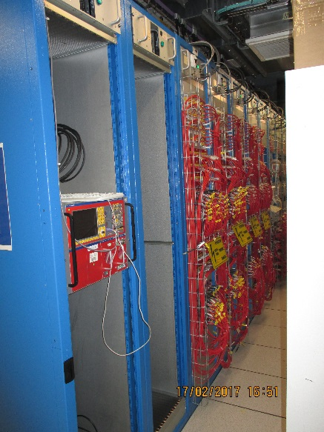
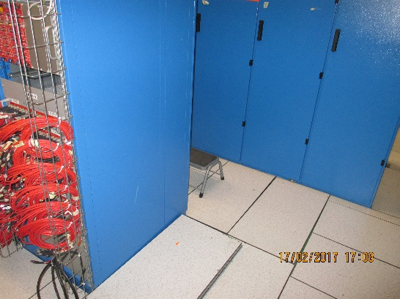
HV Power System for RE3/1 & RE4/1
Assume 20° chambers
  18 chambers per Endcap disk or 36 per station
  RE3/1 – 36 chambers
  RE4/1 – 36 chambers
Unique powering independent on detector technology
1 HV channel per chamber = 72 HV channels & 72 HV cables
  18 HV cables per disk, 36 HV cables per end
  18 HV cables in mCC per side & end
  RE3/1 & RE4/1 slots already available on X1 RE HV PP
  72 HV channels in 4 crates ➔ 18 channels (3 HV boards) per crate
  Upgrade present HV system from 4 to 6 crates in EASY chain
  More service power will be required (A3485S)
  This powering schema is valid for Double and Multigap design.
    Operational voltage
      (9000, 10000)V
      12000V negative polarity.
Require more rack space in USC. There may be some space in 2 new GEM racks and there is space at the other end of the row for 2 additional Racks.
Standard double-gap RPC

Slide 22
Very preliminary installation schedule
For each disk of RE3/1 or RE4/1
18 chambers installed in 3 days. Crane needed full time.
Cable (HV/LV,Signal) : 3 days
Cooling (including commissioning at 18 bar with gas): 4 days
Gas : 3 days
Final chamber commissioning: 1 week
Total installation/commissioning time ~ 3 weeks (including w.e.)
Services have to be installed in advance during previous LS or YETS
Job on different disks can be parallelised if manpower available.
Services can be installed during LS2 and/or YETS
Chambers can be installed 1-2 disks / YETS before LS3

Slide 23
Very preliminary production schedule
For both disks of RE3.1
36 chambers produced in external labs, delivered at CERN and
commissioned for QC4 level (long term current stability) by the end of 2021
Chambers stored in 904 lab controlled T/RH conditions (new lab in front of RPC lab or
in CSC small lab), 6 trolleys of 6 chambers each, 100 m² needed.
Installation in P5 possible in YETS 2021-22, if parallel acccess granted in -/+Z disks
The trolleys and 904 space will be reused for RE4.1
For both disks of RE4.1
36 chambers produced in external labs, delivered at CERN and
commissioned for QC4 level (long term current stability) by the end of 2022
Chambers stored in 904 lab controlled T/RH conditions (new lab in front of RPC lab or
in CSC small lab), 6 trolleys of 6 chambers each, 100 m² needed.
Installation in P5 possible in YETS 2022-23.
If RE3.1 installation postponed we will need double amount of trolleys and space in 904
Storage space and activities in 904 strongly affected by possible RE4 SM dismountling in LS2 for ME4.1 elctronic upgrade access in P5

Slide 24
Conclusion
The RE3/1 mounting is the same as RE3/2 & 3/3.
The RE4/1 mounting configuration is the same as RE4 SMs. The installation procedure is different.
The exact “Z” dimensions must be understood (spare in RE4 case)
Confirmation from TC required for cable chains and heat load.
Will the CSC alignment system be decommissioned ?
Service paths require optimisation.
USC Rack and cable paths to be defined.
Final chamber technology should comply with the above constraints.
Detailed planning for Installation and production required.

Slide 25
Additional Material

Slide 26
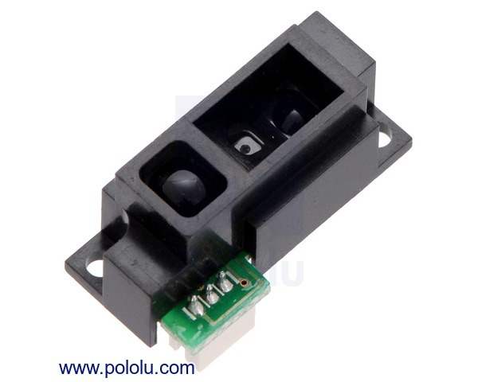
“Z” value
2 values from IO.
Will measure the distance with IR sensors installed during the EYETS.
Elements calibrated in 904
Analog Distance Sensor 2-15cm

Slide 27
LV Power System for RE3/1 & RE4/1 (II)
New/Developing RPC FE electronics
  PETIROC electronics (64 channels in the new version)
    on ASIC TDC
      Granularity: 3mm pitch, i.e. 320 strips per 20° or 640 channels (320 strips readout on both ends)
      Eta Division:1 η-partition i.e. 10 ASICs x 64 channels each = 640 channels.
      Power consumption:
        3.6 mW per channel x 640 = 2.3W per 20° chamber
        20 W on-chamber FPGA to collect the data from the ASIC.
        1 GBT optical link per chamber to transmit data to one data concentrator card per station ~1 W
    on FPGA TDC
      Granularity: 3mm pitch, i.e. 320 strips per 20° or 640 channels (320 strips readout on both ends)
      Eta Division:1 η-partition i.e. 10 ASICs x 64 channels each = 640 channels.
      Power consumption:
        80mW per channel x 640 = 51W per chamber
        20 W on-chamber FPGA to collect the data from the ASIC.
        1 GBT optical link per chamber to transmit data to one data concentrator card per station ~1 W
  In short: For one 20° chamber the consumption should be between 27 W (for the TDC embedded into PETIROC ASIC option) and 77 W (if not embedded), therefore the integral consumption per disk will be between 526 W and 1426 W and the total consumption should be between 2.1 kW and 5.7 kW.
  Powering scheme:
      6-channel CAEN A3016 LV board, 8V / 90W max power per channel.
      2 A3016 LV channels powering three 20° chambers
      (cost and rack space saving option).
      optimal regime of operation (~70% of max power).
      optimal segmentation (1 LV board =180° phi coverage)
      ➔ 2 boards per disk ➔ 8 board in total are needed
      if TDC is on FPGA, the number of A3016 will be doubled, but the number of crates and branches will be not.
  Rack space: No space in racks X3*51. Need to find a solution!
TDC embedded into ASIC option
CAEN Equipment | Quantity
A3016 LV boards | 8
EASY3000S crates | 4
A1676A branch controllers | 2

Slide 28
LV Power System Requirements: Summary

Slide 29
HV Power System Requirements: Summary
NOT ENOUGH rack space availability for an EASY crate AND a HV distribution box in any of the HV Endcap racks:
S1H08, S1H09, S1H10, S1H11. Possible after redesigning RE4 HV Distribution boxes.
Intermediate solution with 2 crates and the end of each existing branch (1 positive & 1 negative endcap).
Ask space in rack S1H12.
Exploit other possibilities, for instance connecting 2 chambers in 1 HV channel, which would require 9 HV channels
per rack where at present there are 12 spare channels per rack. In this scenario, no new EASY crates & boards
are needed, but only a place for 2 HV distribution boxes (6U) per rack.

