Slide 1
Integration and Services
RE3/1 and RE4/1
Ian
On behalf of the RPC colleagues

Slide 2
Covered topics
Chamber Installation and Volume
Service component installation
Service routing

Slide 3
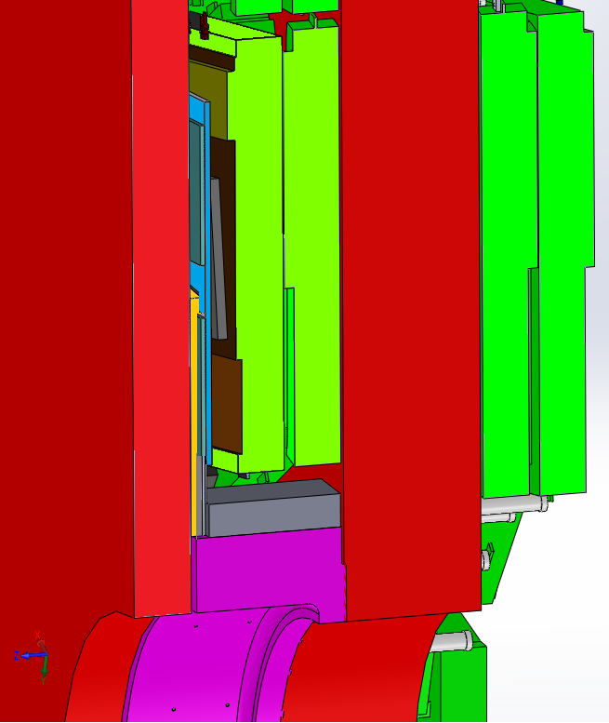
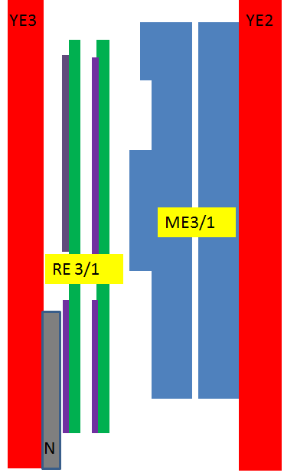
Cross section YE3 and YE2
RPC RE3/1 chambers
Principle scheme
YE3
YE2
CSC, Highest Electronics Cover
FEB
RE 3/1
ME3/1
FEB
FEBs, high R
CSC, Highest Electronics Cover
Neutron shield.
670 mm
between YE2 and YE3
96 mm
between CSC (high electronics board) and Neutron Shield.

Slide 4
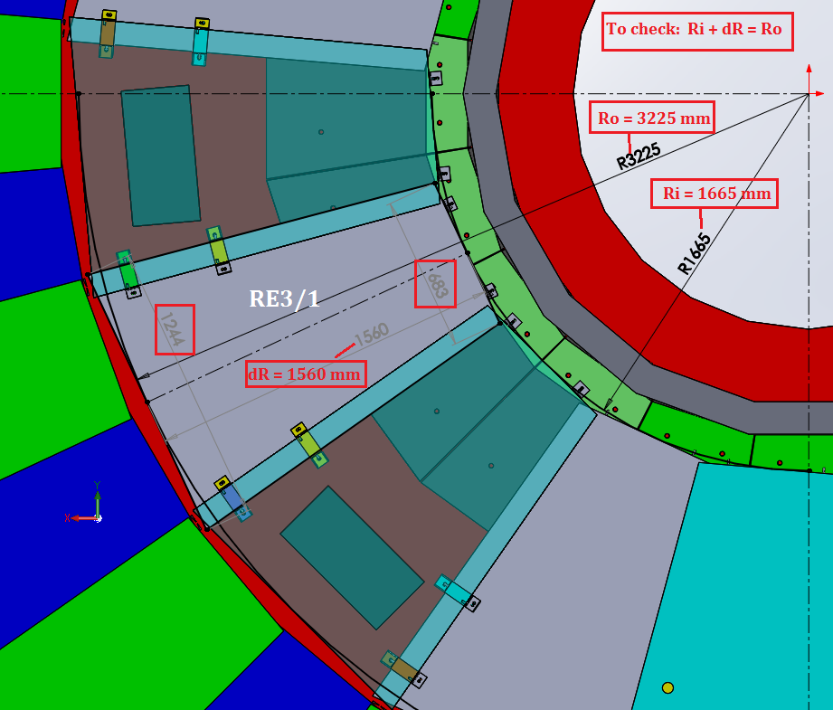
Overall Dimensions of RE3/1 with inner Mount to Neutron shielding
The inner R mount of the chamber will be made directly to the Pb layer of the Neutron Shielding
The lost coverage here will be recovered

Slide 5
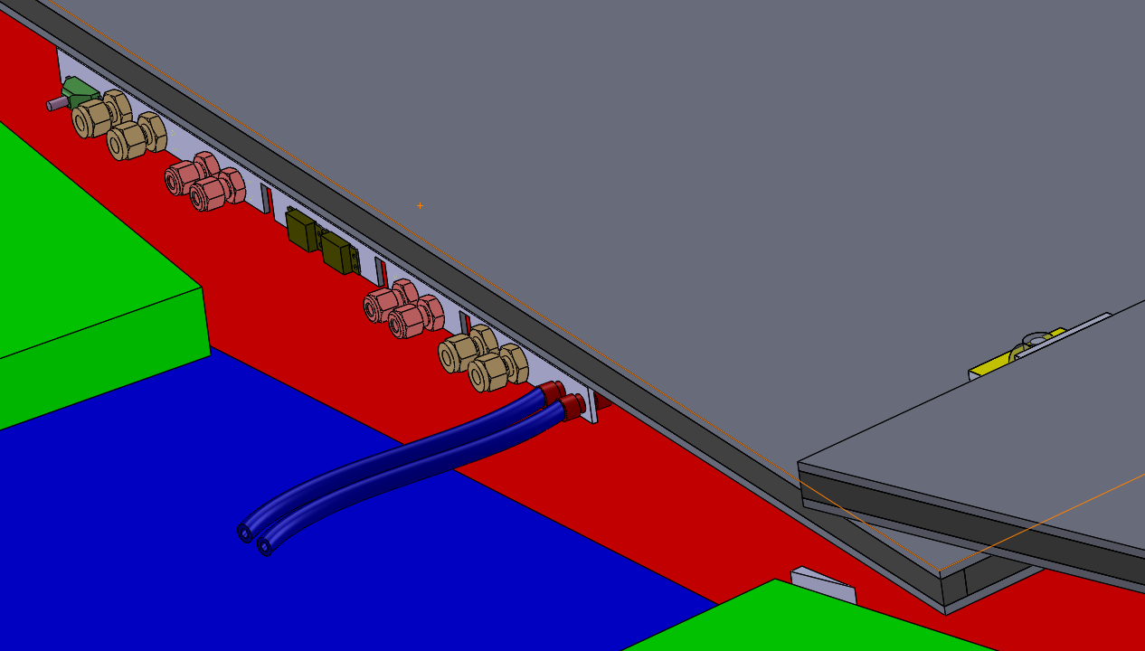
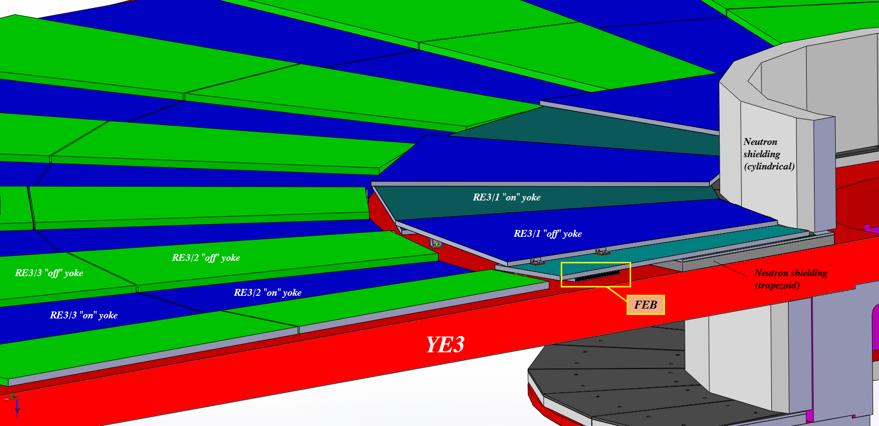
Replace with correct cable routing
Cooling will be plugged into the RE3/2 circuit by removing the link between two of the RE3/2s at their low “R”

Slide 6
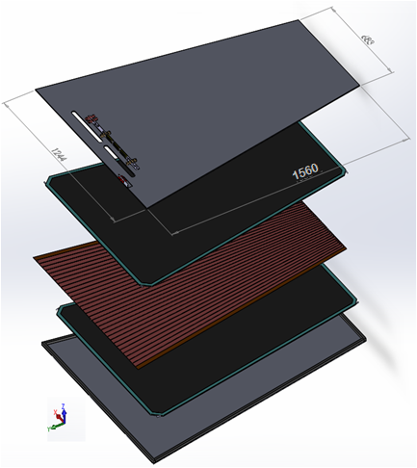
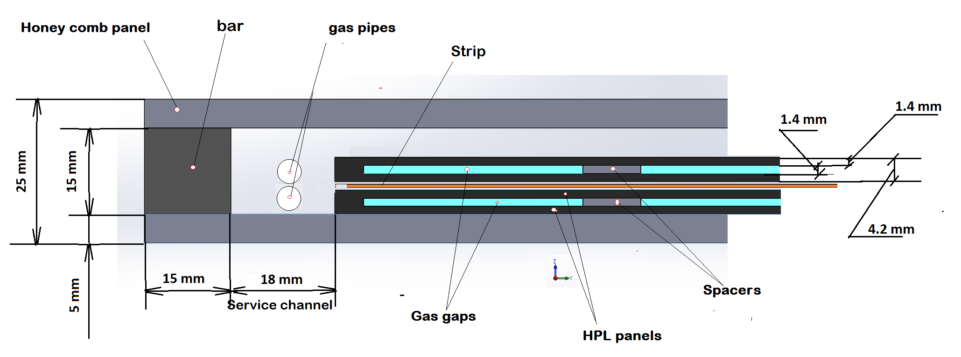
Design RE3/1 RPC chambers
Double gap RPC chamber
PP under work
Thickness RPC chamber is 25 mm;
Thicknesses honeycomb panel is 5 mm.
Cross section of double gap RPC chamber
From Kodel Beam Test design we know that the chamber will fit in this mechanics

Slide 7
RE4/1
Work on the volume definition is less developed. We have worked so far based on the IO drawings, imposing an abutted configuration.
However in situ measurements, by using the “Push-back” system, allowing access between YE3 and YE4, will give confidence in the space available. This should lead to an overlapped configuration as is in the RE3/1 case.

Slide 8
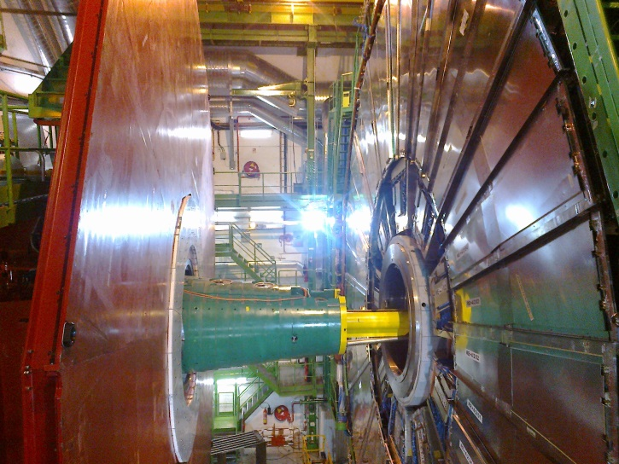
RE4/1 Mounting
Chambers to be mounted between the shielding, CSCs and RE4 SMs
Notice that the Neutron shielding (YE4) moves wrt to the future RE4/1 on the mounted on YE3.

Slide 9
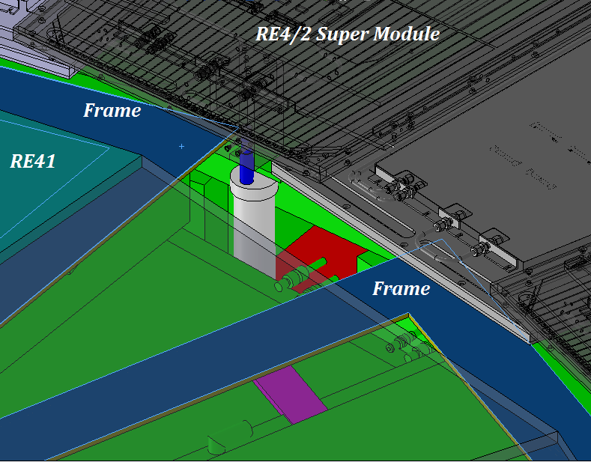
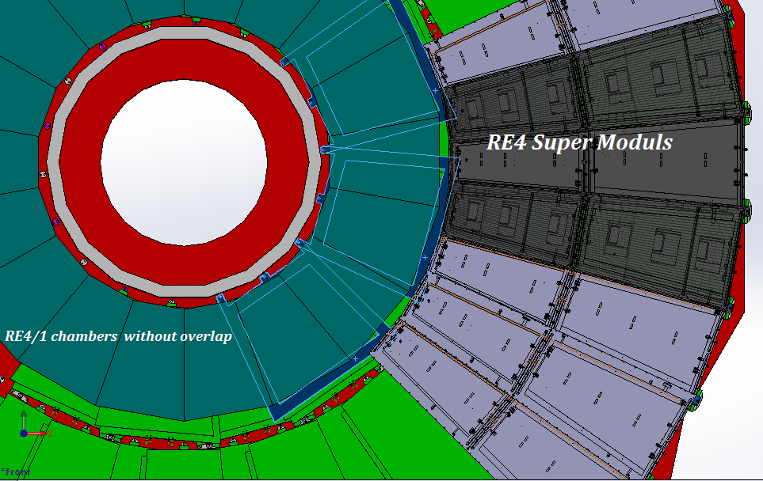
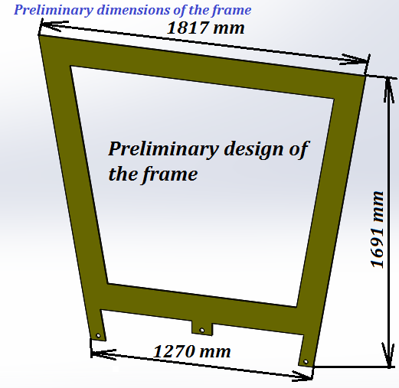
Mounting Plate (MP) for RE4/1 chambers with abutted chambers.
The MP design with overlapped chambers will require a redesign
Mounting plates
Preliminary design of the mounting plate
Thickness is 8 mm

Slide 10
Services
HV system
LV system
Fibre optics Data/trigger and DCS to USC
Cooling
Gas

Slide 11

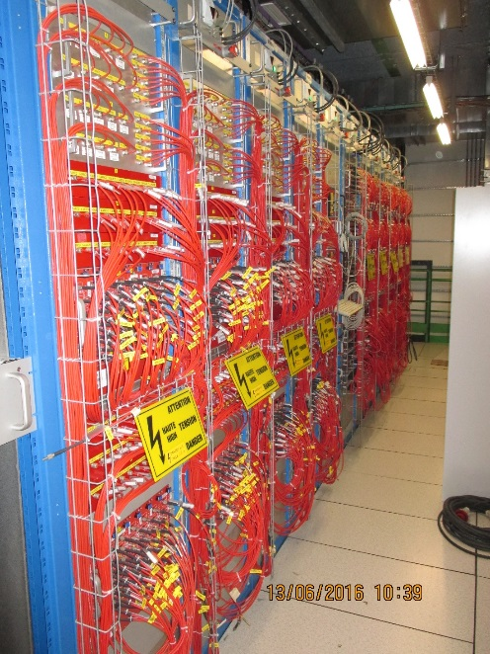
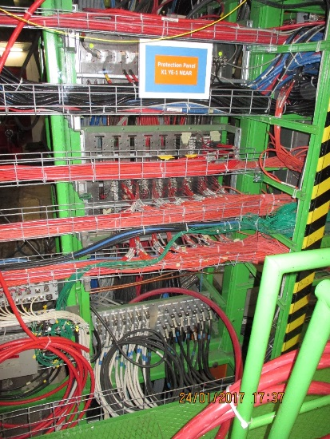


HV system
USC 55
UXC 55
x4 Easy 3000 Crates
Co-axial HV connectors through out
X72 Chambers
X4 Distribution boards
Modified PP for 72 Channels
x12 A3512N HV Boards
x8 HV Umbilical cables
There are other possible scenarios. Optimisation required

Slide 12
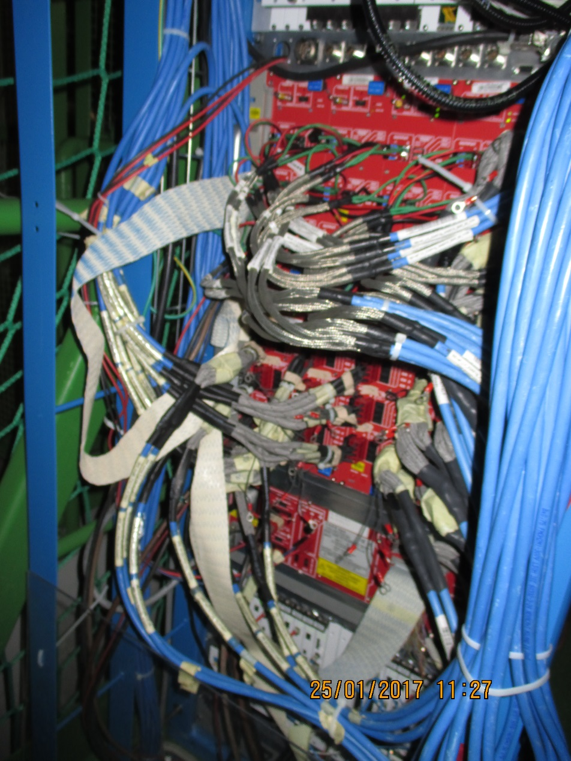
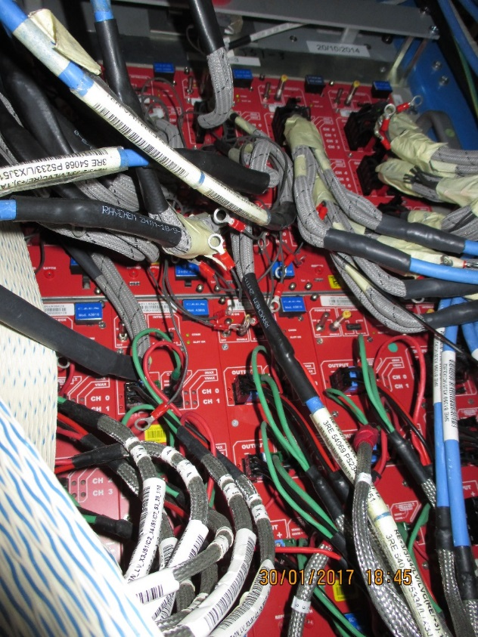
LV Power System
X3A51
LV Power for both RE4/1 and RE3/1 will be taken from the presently installed crates and modules. Re-cabling to liberate 2 modules (CAEN A3009 )will require PP/Fanout space.

Slide 13
UXC
USC
YE3
YE1
USC Racks
Mini Cable Chains
LC OF conversion to dia3mm MPO, x3/station.
YE1 PP
MPO to MPO PP
RE4/1
RE3/1
2 SFP/chamber
OF passages UXC-USC
Schematic of UXC to USC OF routing components
Main Cable Chains

Slide 14
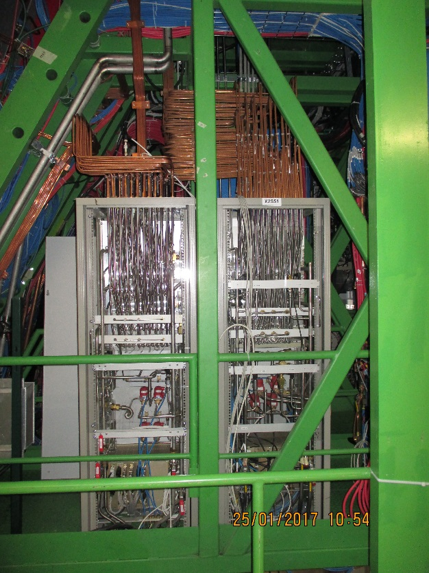
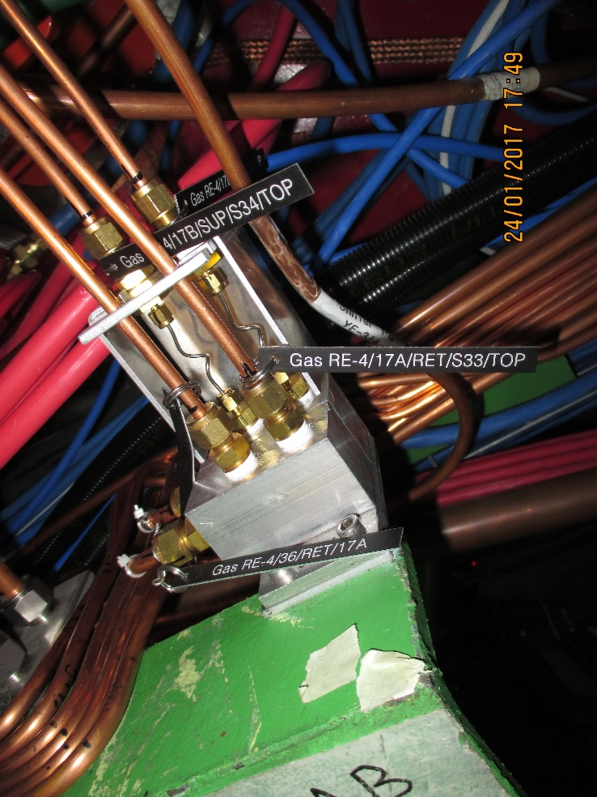
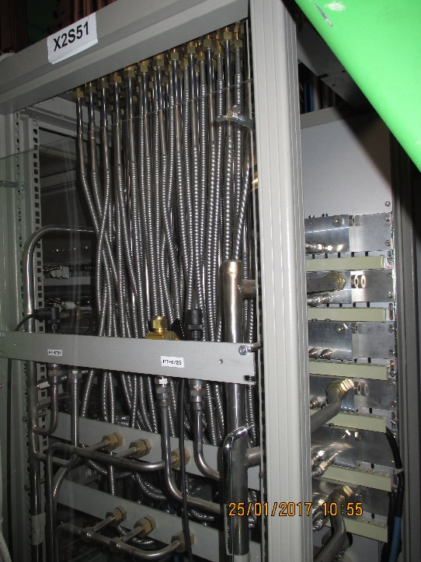
Gas system
The gas system remains un-changed in that the gas racks are not modified nor are there any additions. Re-piping of RE3 will be required.
There are 6 channels available for 1 station. Parallel gas flow is proposed for the 3 chambers fed by one channel
An example of a two channel impedance distribution for RE4 SMs. The RE3/1 and RE4/1 will require 6 channel impedance distributors.

Slide 15
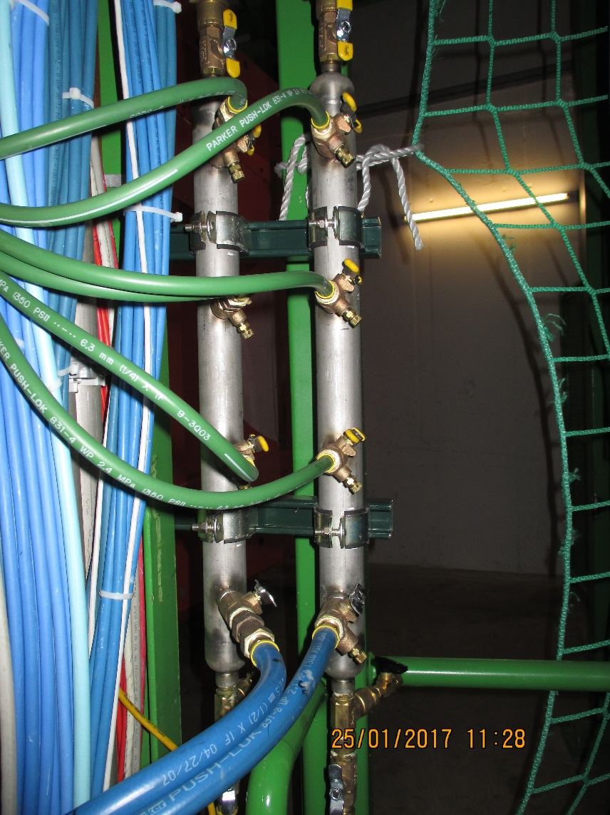
Cooling system
The power loads on the cooling system are not so large so extensions of the present system should give approx. 0.1deg C increase.
Cooling Mini Manifold for RE4/1 cooling to which “T”s and flow restrictors will be added to supply the 9 channels. Hosing from the mini manifolds directly all the way to the RE4/1 will simplify the installation.
The RE3/1 system will be a taken off from the RE3/2s, two RE3/2s for one RE3/1 using the flexible hoses.

Slide 16
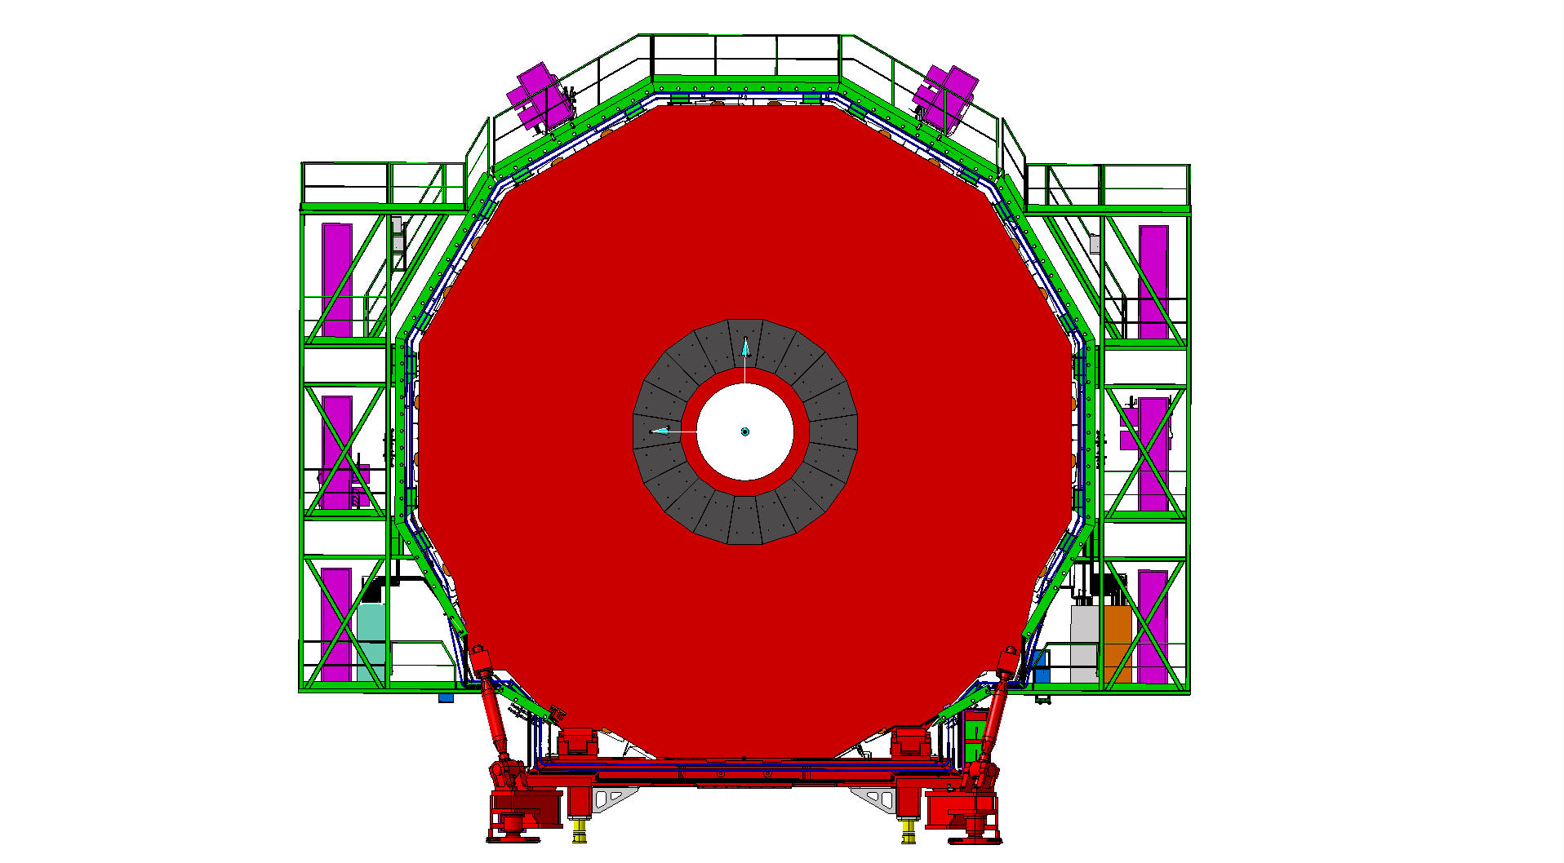
Services on YE3 serving RE3 and RE4
Mini Cable Chains for HV and OF
Mini Cable Chains for HV and OF
X3 LV racks
X3 LV racks
Space for DCC and OF Patch panels
RPC Gas Rack with spare channels

Slide 17
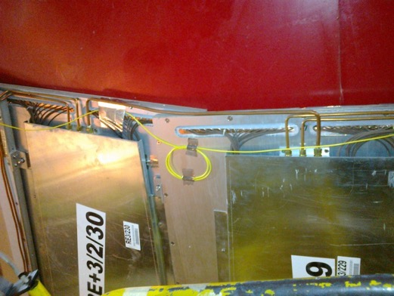
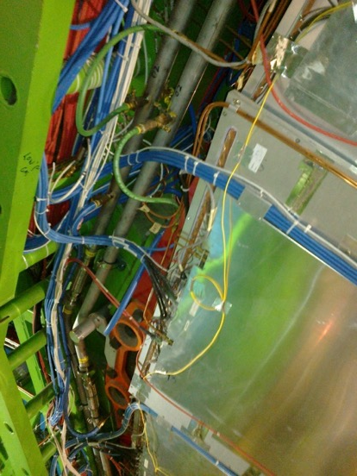
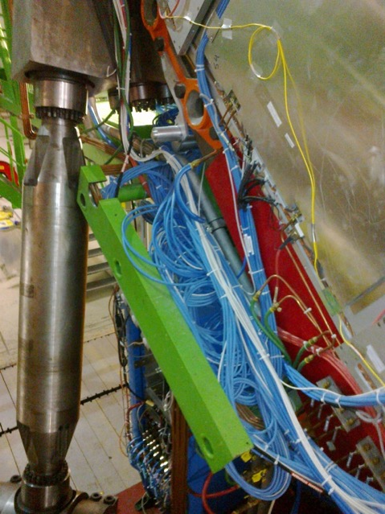
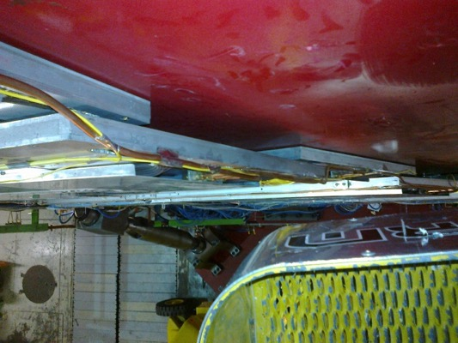
RE3/1 service passages
Space on the periphery is very limited
Service passage to the periphery is under the RE3/2 & RE3/3.

Slide 18
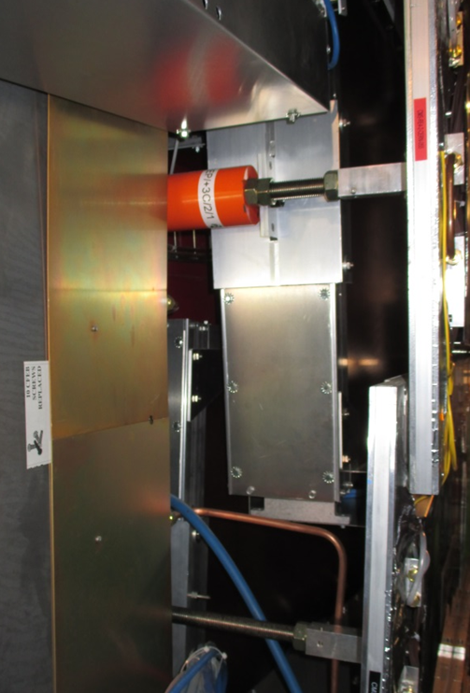
RE4/1 service passage
Service passage between RE4/2 and the ME4/2.
The problems or fears of induced noise will have to be addressed with our CSC colleagues.
ME4/2
RE4 SMs
ME4/1

Slide 19
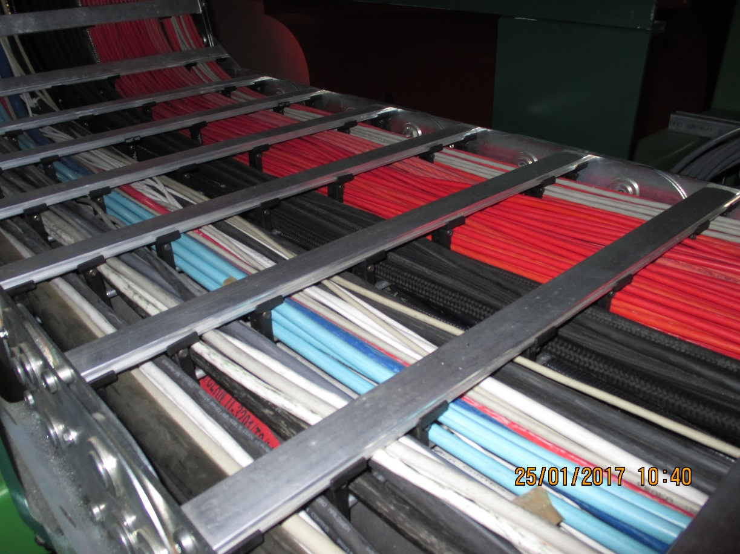
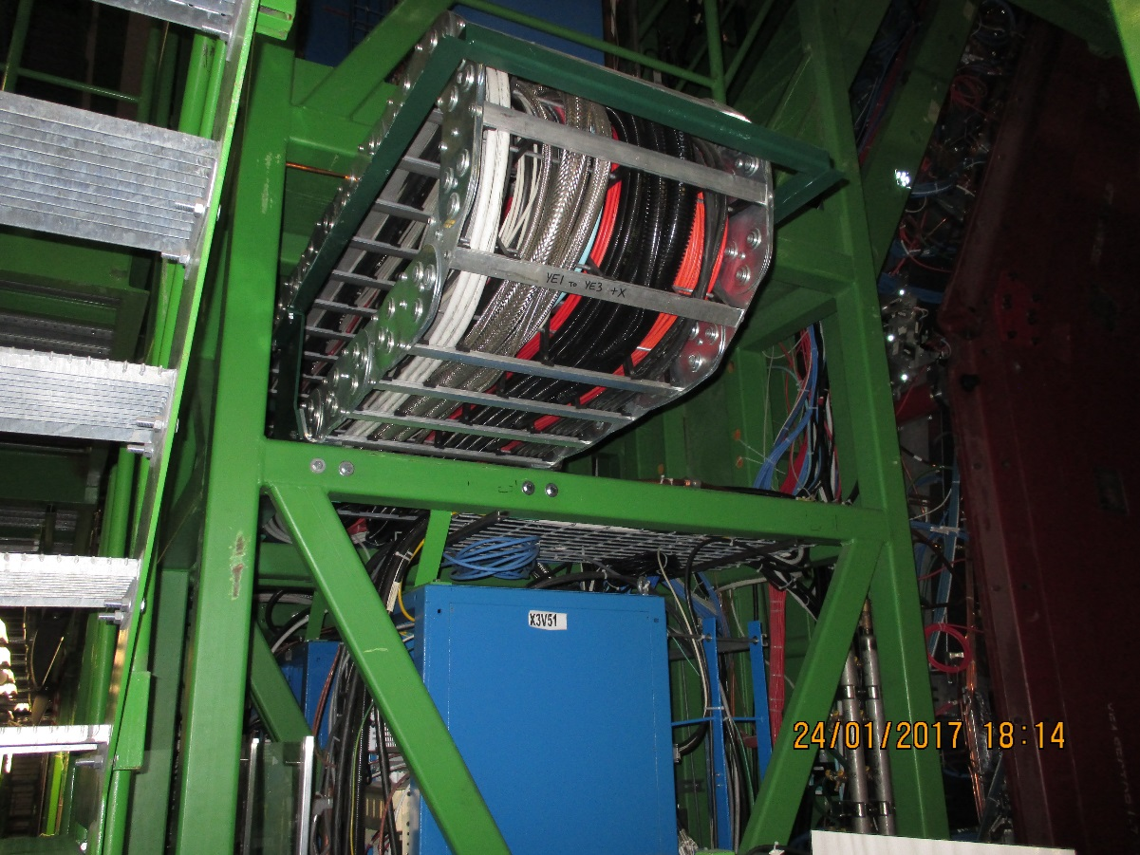
Mini Cable chains between the YE3 and YE1 and its PP are very full.
X3S51 Far
X3V51 Near, there is space for small HV cables and MPO OFs

Slide 20
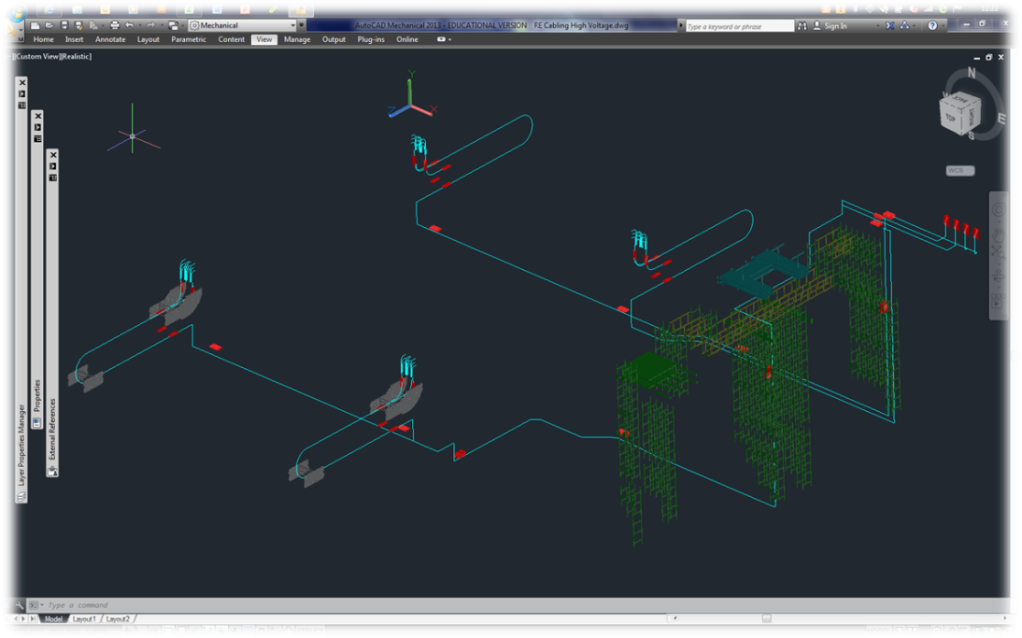
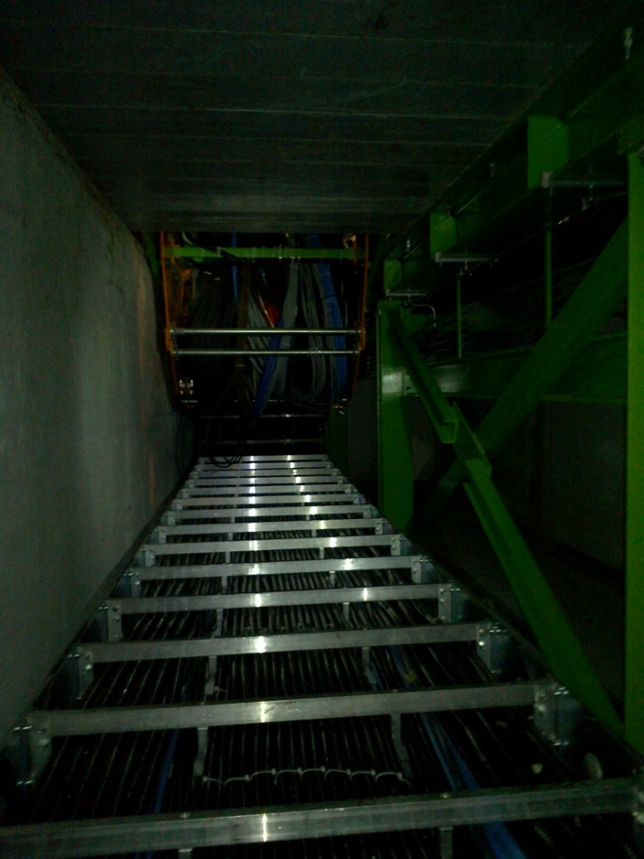
HV system routing from USC to UXC
The Main Cable chains in X0 under CMS
Routing from the USC HV racks to the YE1 PPs

Slide 22
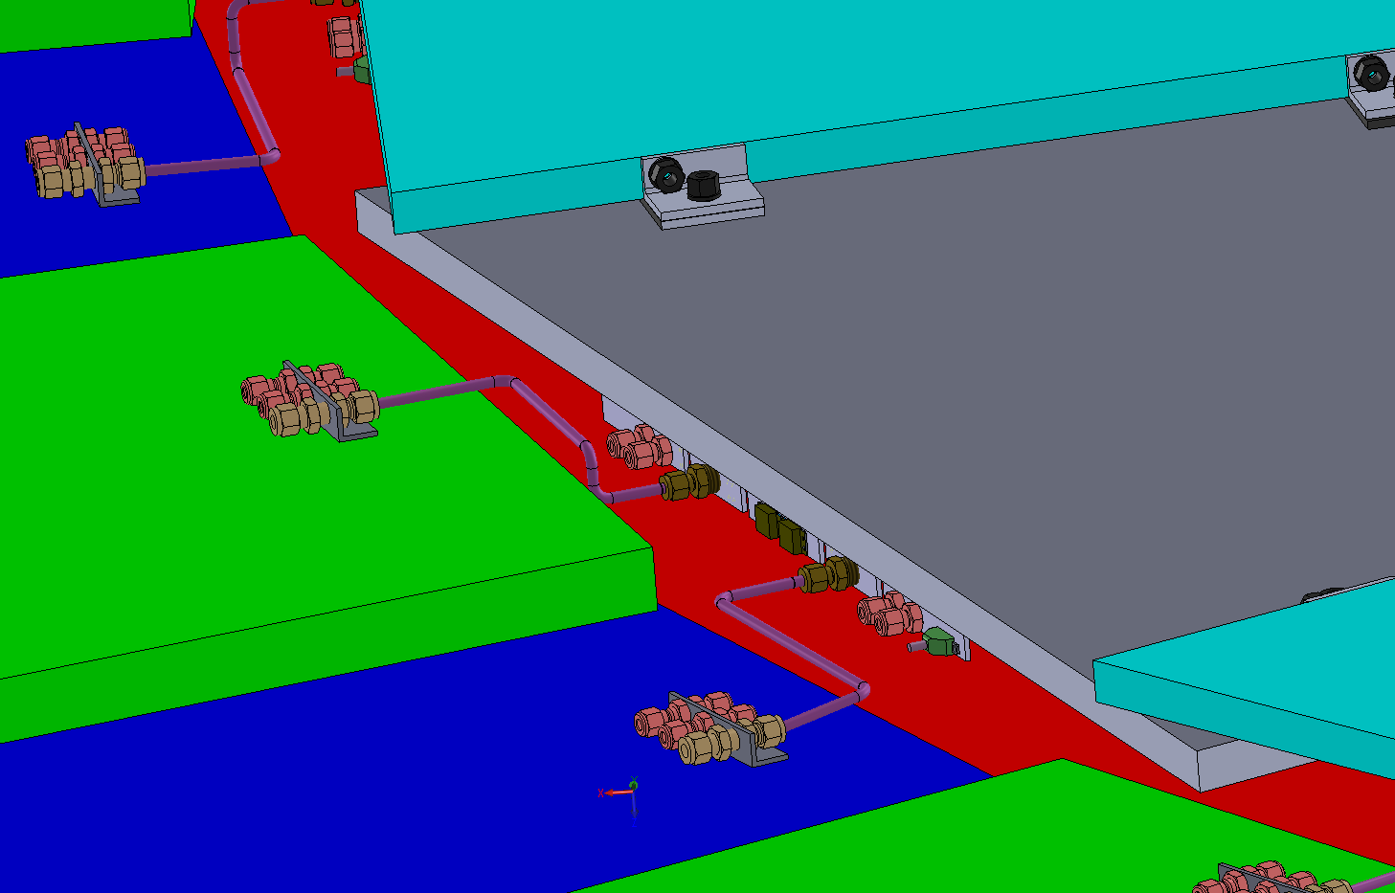
RE3/1 cooling link to RE3/2
x2 RE3/2 circuits feed x1 RE3/1 chamber
The rigid copper piping will be replaced by flexible hose links to reduce the strain on the unions.

Slide 23
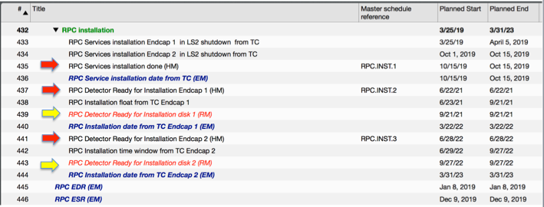
Schedule
Services will require many weeks of access on all four stations during the LS2.
Chamber installation will follow in the following YETS.
Commissioning will follow during the YETS as access is required between the Yokes.

Slide 24
Conclusions
RE3/1 integration is well understood.
RE4/1 should be overlapped once the “Z” volume is more clearly understood.
Further study of the Cable chains, gas and cooling to be carried out with Integration Office.
There are no apparent show stoppers.

Slide 25
Back up

Slide 26
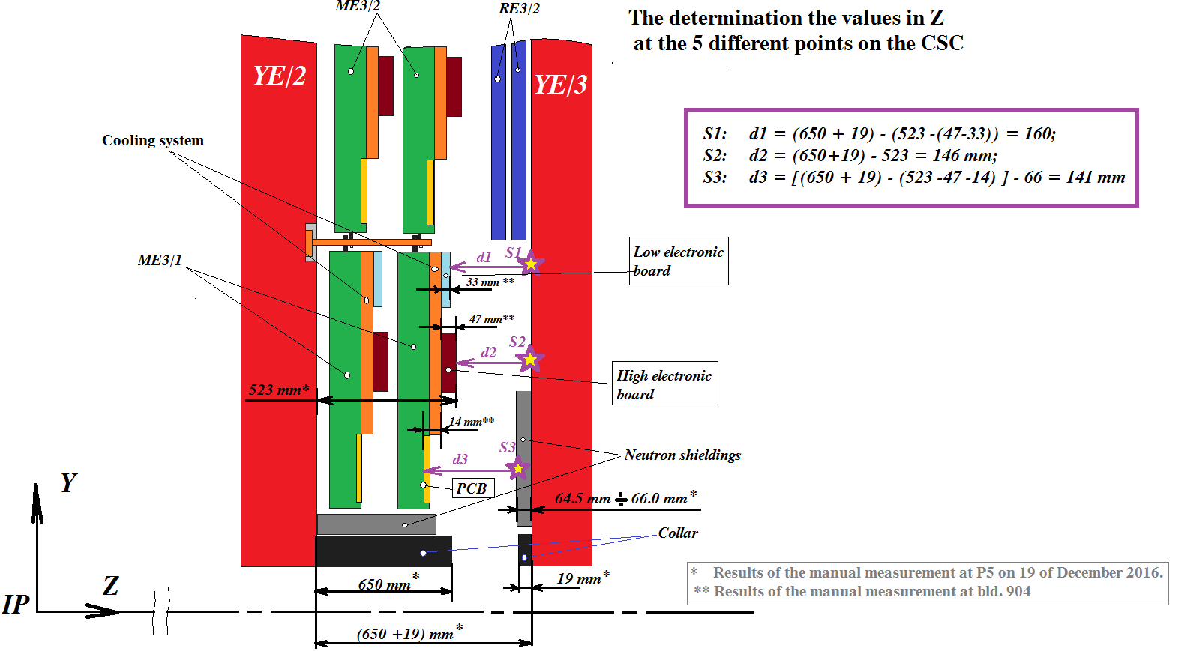
200.8mm
201.8mm
197.8mm
167.1mm
151mm
Values obtained from IR sensors in Red

Slide 27
Values taken on outer “R” at 3 different locations on both –Z and +Z on 25 April 2017. Discs closed.
178-174mm
Mean 176mm
145-145mm
14mm
ME3/2
RPC space
176 - 14 = 162mm
Drawings = 146mm
RE3/2
YE2
YE3
RPC space over the N. Shield
162 – 66 = 96mm
Standard RPC 29mm gives 68mm with mounting brackets. Leaving a generous clearance to CSCs of 28mm.
Was 88mm from drawings.
668-672mm
Mean 670mm

Slide 28
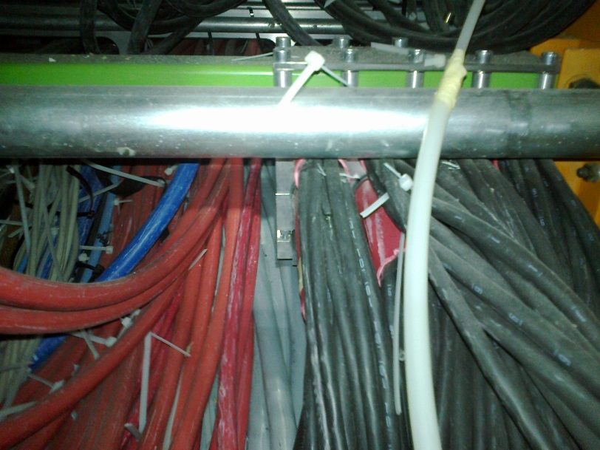

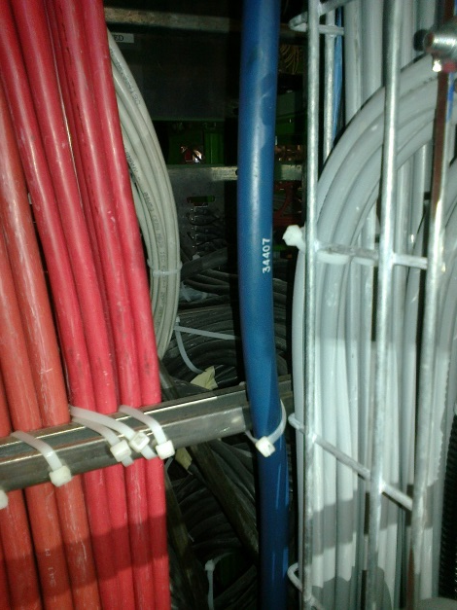
But it gets worse in the last 5% of the path length
Clamp of the Cable under PP YE1
The Main Cable chains in X0 under CMS
Access to rear of the PP

Slide 29
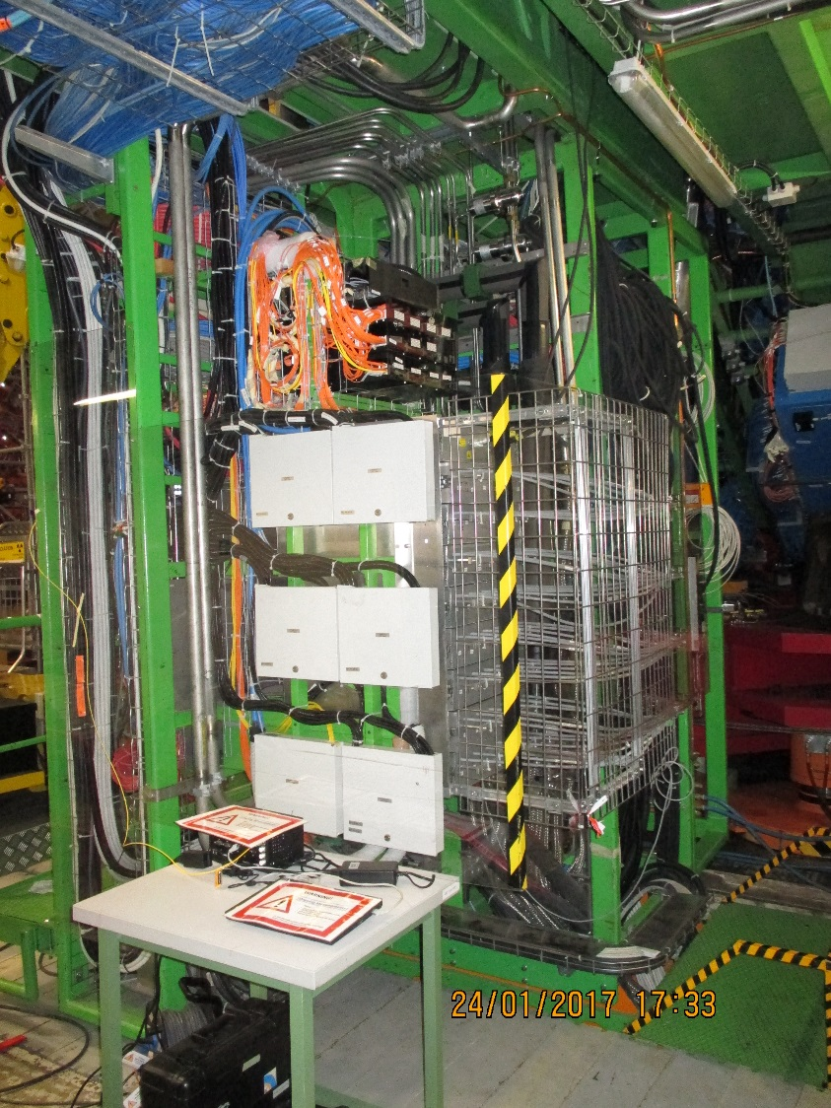
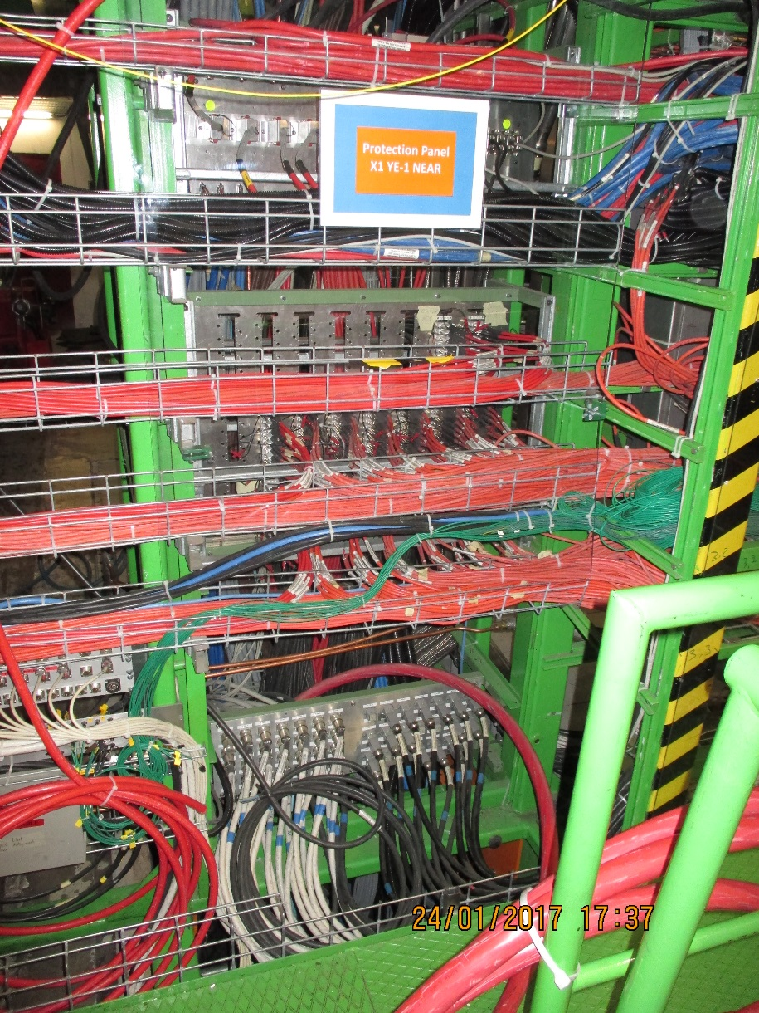
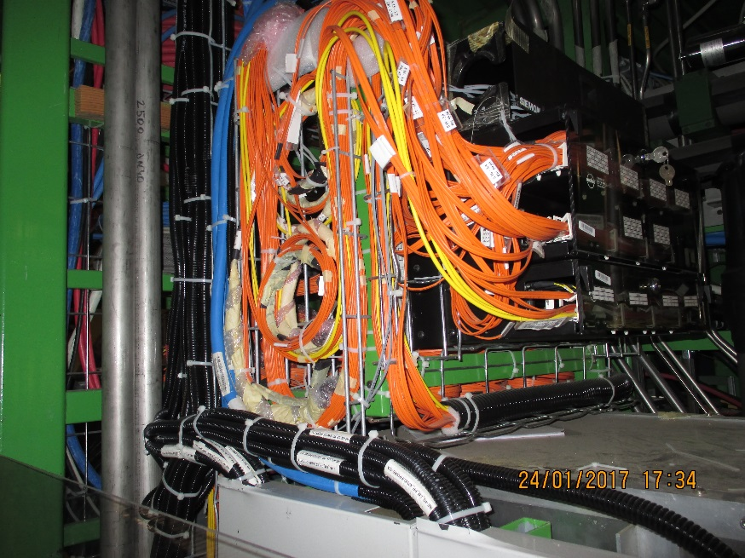
YE 1 Main Patch Panel (PP) for HV and OF
There are slots available in the HV PP sufficient for the 3 pole connectors. In the case of the coaxial option an additional PP mounted in front of the present one will be added
Present OF PP that will be needed to be able to make the junction between the MainCC and the Ofs from the MiniCC. There is limited space.

Slide 30
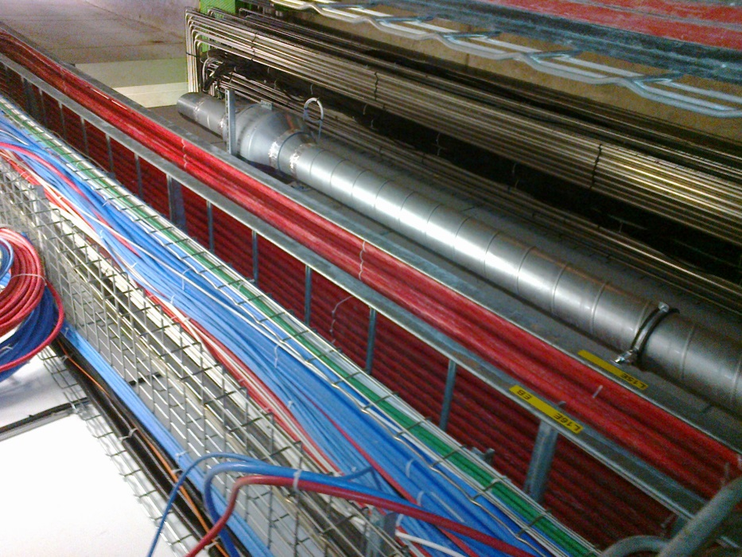
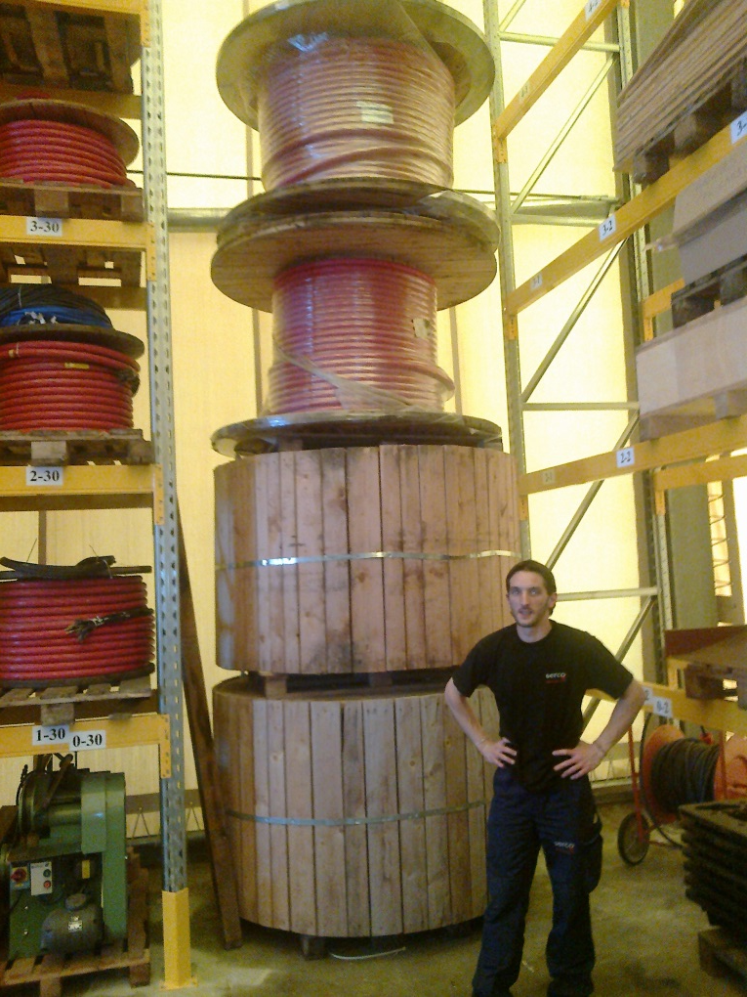
The path is clear and we already have the cable. This is a big job
Approx 1.5km
Cable length 57-90m

Slide 31
Mini Cable chain Installation and Occupation
HV Cable 2 options Original 4 conductor (2 ch dia. 7.3mm) for the 3 pole connector
USC coaxial cable (dia. 5.0mm) for “Jupiter” style connector
OF for Data/Trigger and DCS Using MPO OF requires x3 dia. 3mm fibres per station. They will be installed in a rigid conduit for protection and installation.
One conduit dia. 16mm
There is a solution for these services on the near side YE3 to YE1 mini cable chain.

