Slide 1
Chamber Design and Integration
RE3/1 and RE4/1
Elena and Ian
On behalf of the RPC colleagues

Slide 2
Covered topics
Chamber, available volume
Electronics read out volumes
Services routing

Slide 3
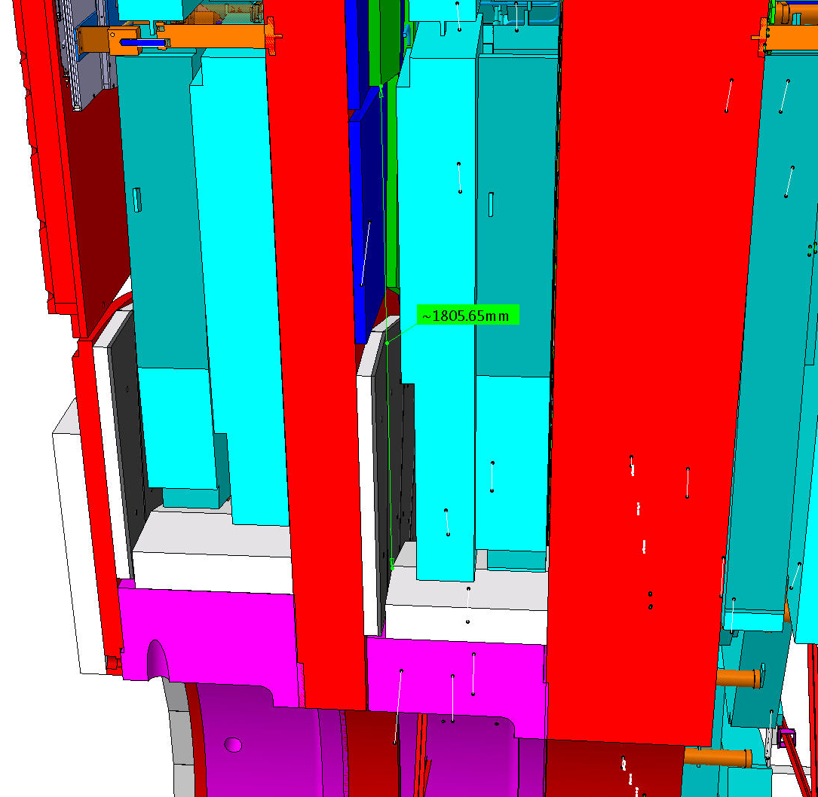
The volumes for RE3/1 and RE4/1
RE4/1
The chambers are very thin in the order of 25mm, here they are exagerated. !
The available volume dictates the design of the chamber.
RE3/1

Slide 4
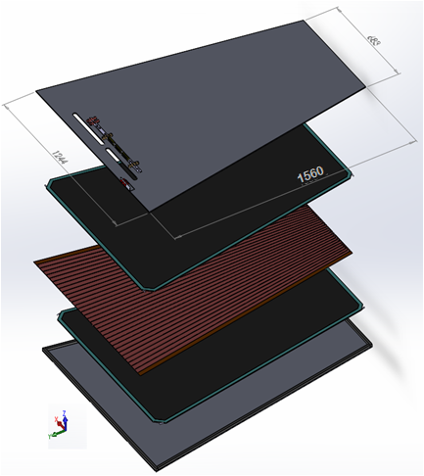
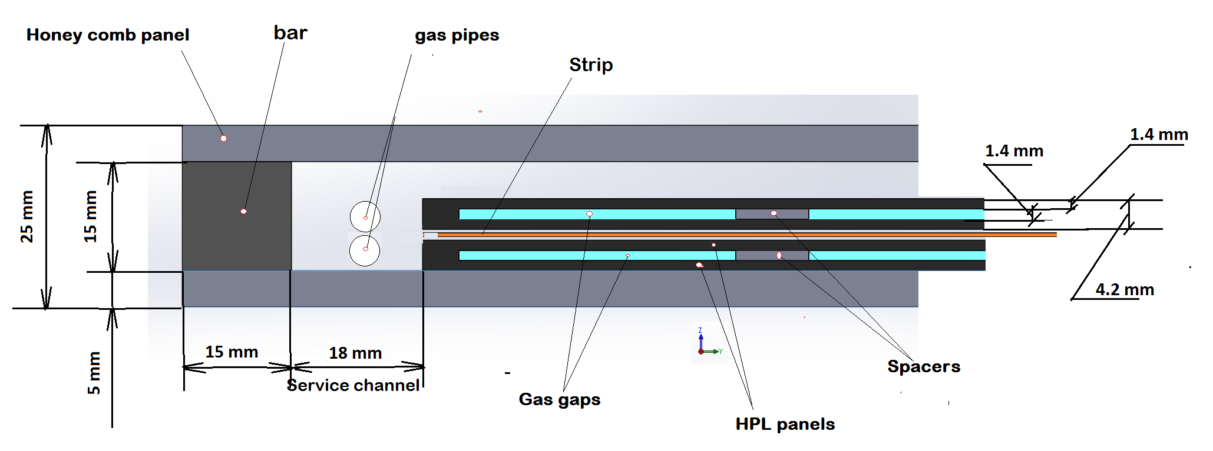
Design RE3/1 RPC chambers
Double gap RPC chamber
PP under work
* Clearance between ME3/1 and RE3/1 will be
(80 ± 1 ) – (5 + 25 + 5 +25) = 20 ± 1 mm,
where
thickness RPC chamber is 25 mm;
thicknesses honeycomb panel is 5 mm.
Cross section of double gap RPC chamber
From Kodel BT design we know that the chamber will fit in this mechanics

Slide 5
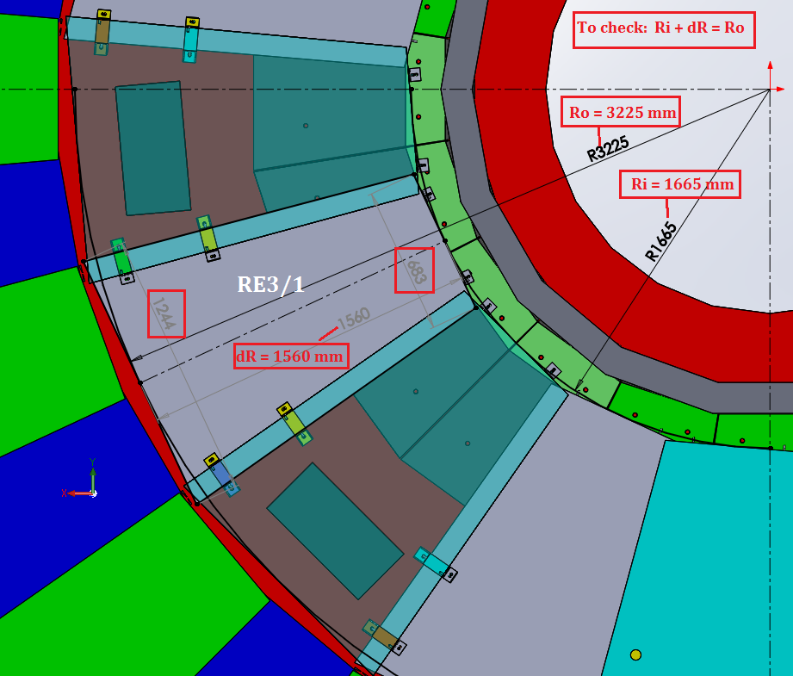
Overall Dimensions of RE3/1 with inner Mount to Neutron shielding
Lost space if the direct mount to the N. shield is retained
Development with IO will be required to increase the coverage back to the cylindrical N. shield.

Slide 6
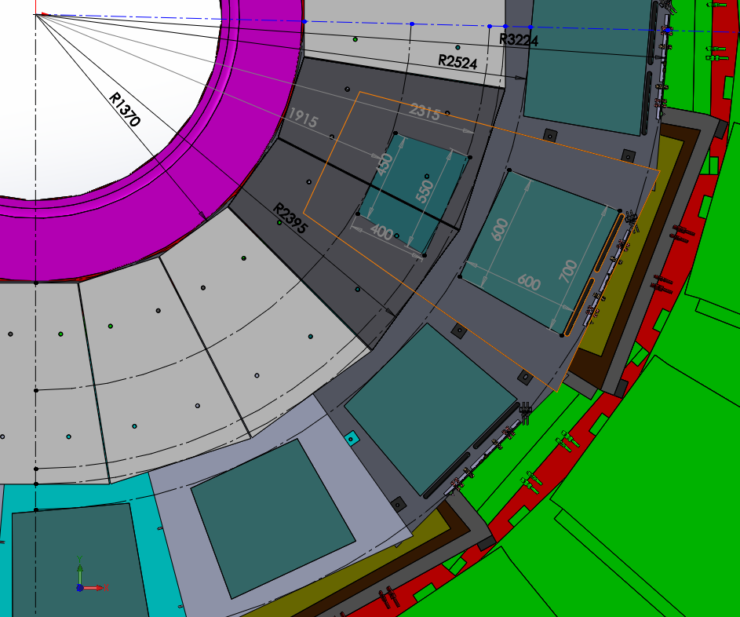
Ri 1664 mm
FEB
731 mm
1560 mm
FEB
RE3/1
“on”
Neutron Shielding
1025 mm
RE3/1
“off”

Slide 7
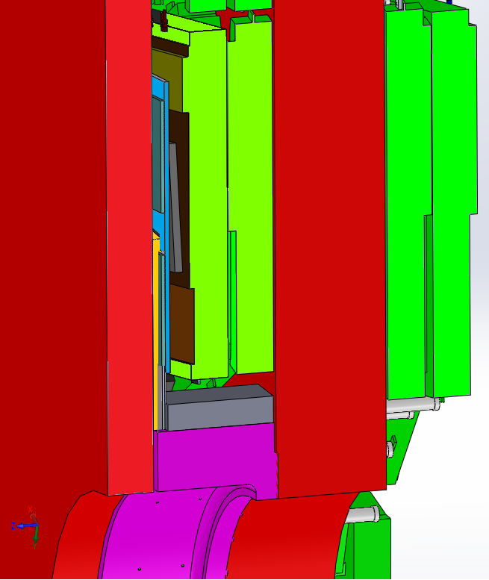
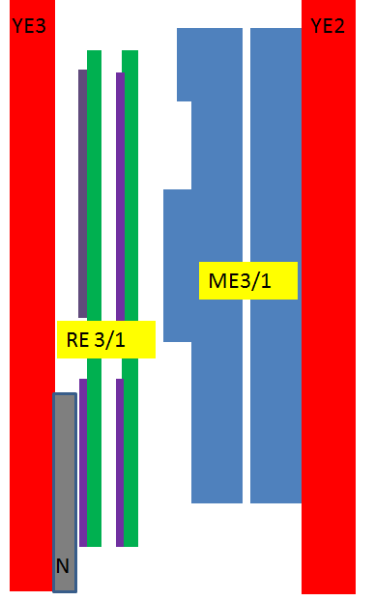
Cross section YE3 and YE2
RPC RE3/1 chambers
Principle scheme
YE3
YE2
CSC, Highest Electronics Cover
FEB
RE 3/1
26 mm
between RE3/1 and CSC (high electronics board)
ME3/1
FEB
CSC, Highest Electronics Cover
FEBs, high and low R
Neutron shield.
670 mm
between YE2 and YE3
96 mm
between CSC (high electronics board) and N.Sield.

Slide 8
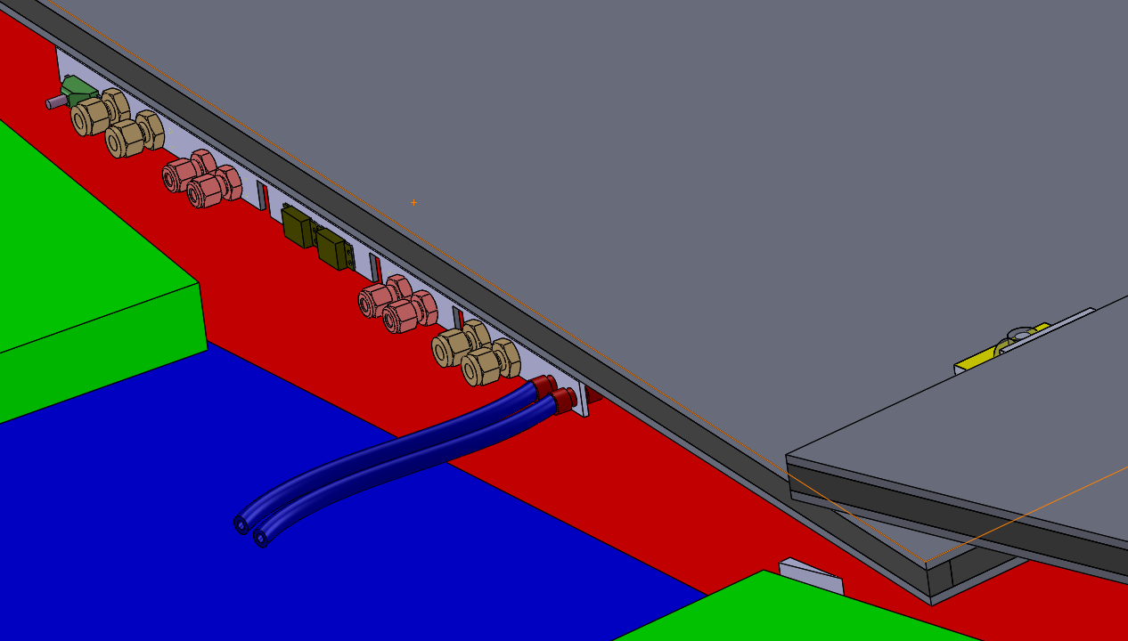
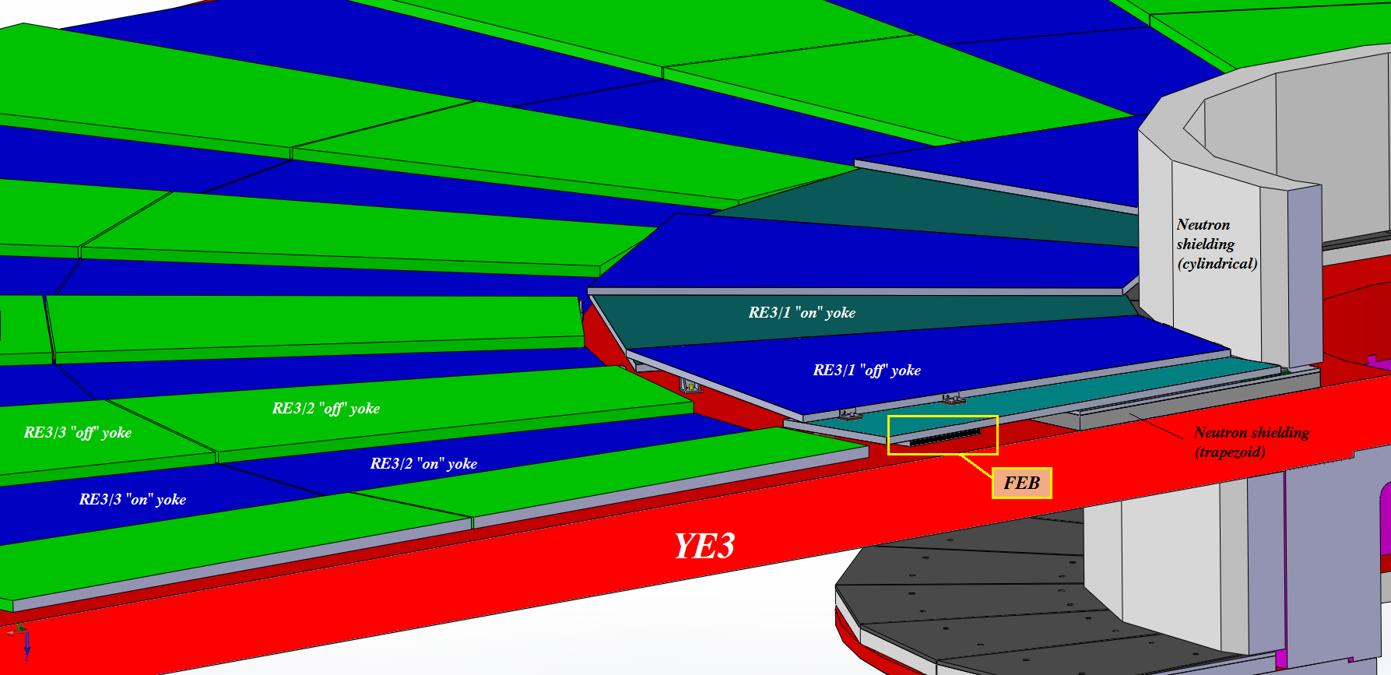
Cooling will be plugged into the RE3/2 circuit by removing the link between two of the Re3/2s at their low “R”

Slide 9
RE4/1
Work on the volume definition is far less developed. We have worked so far based on the IO drawings, imposing an abutted configuration.
Today we have the results of the manual measurements made on the yokes on 25 April 2017.
The layout will now be studied with overlap as in the RE3/1 case.

Slide 10
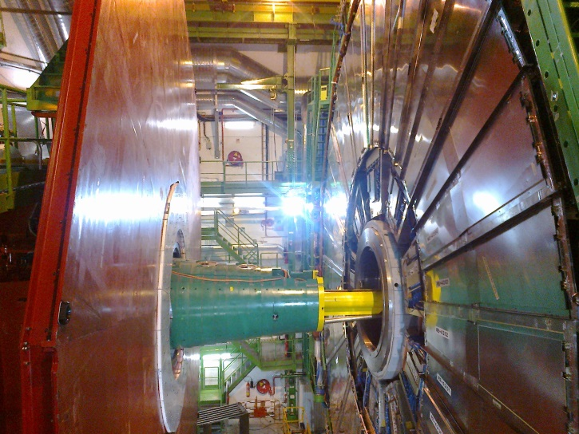
RE4/1 Mounting
Chambers to be mounted between the shielding, CSCs and RE4 SMs
Notice that the Neutron shielding (YE4) moves wrt to the future RE4/1 on the mounted on YE3.

Slide 11
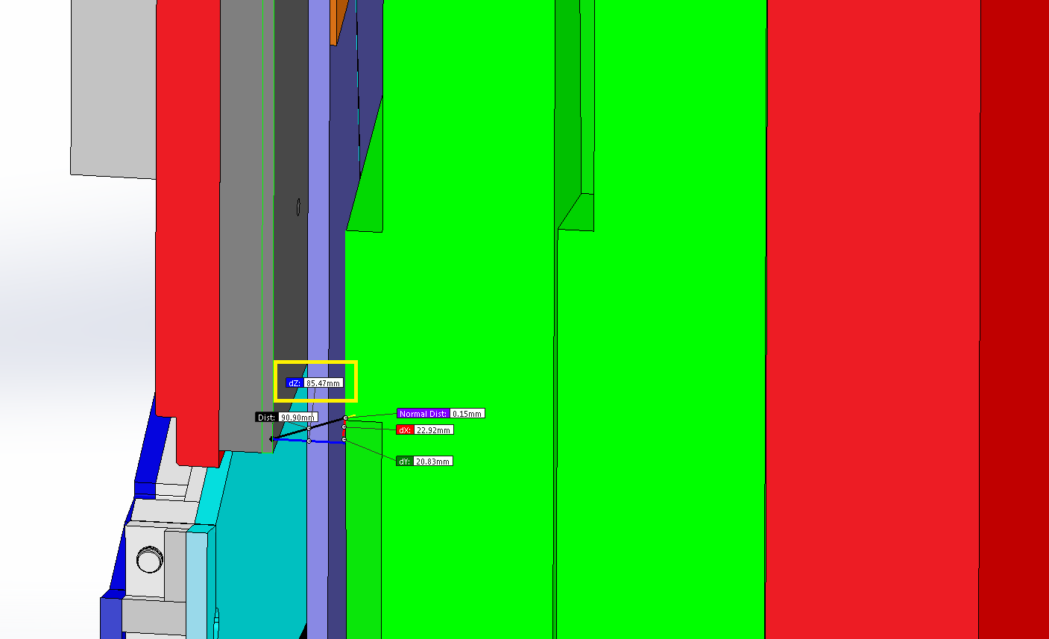
Studies of the value “Z” for RE4/1
Basis on the main drawing of the CMS
Shield
RE4/1
Cross section YE/4
YE/3
YE/4
This smaller Z value will be evaluated to find space that will allow an overlap configuration
85 mm !
ME4/1

Slide 12
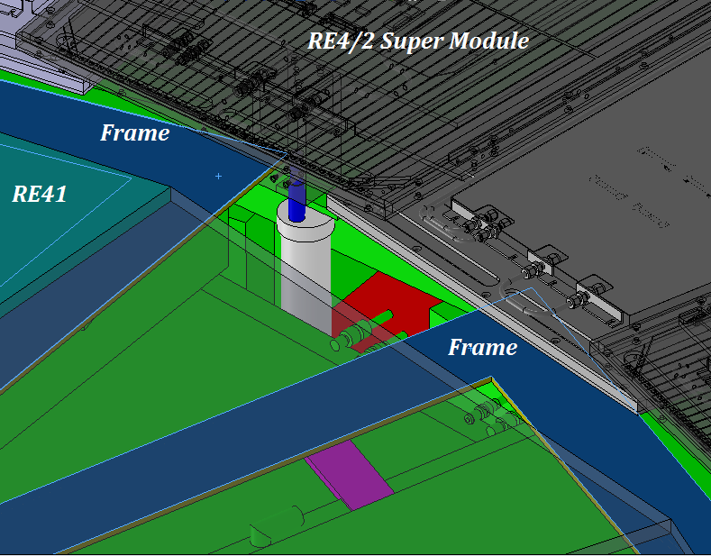
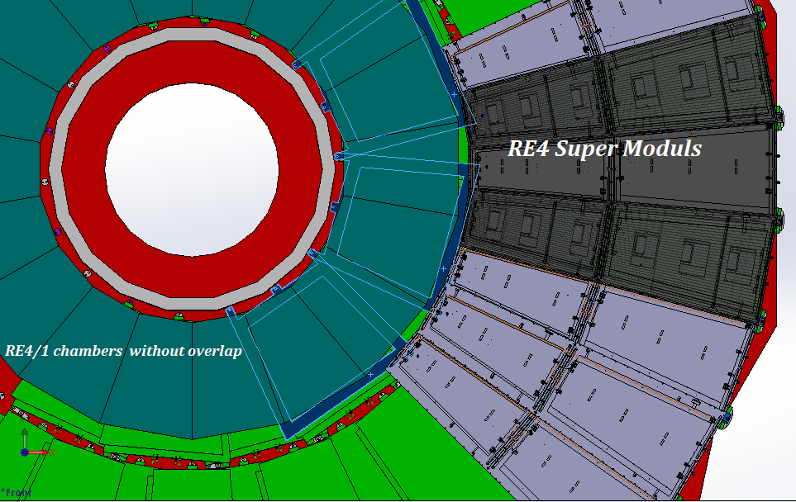
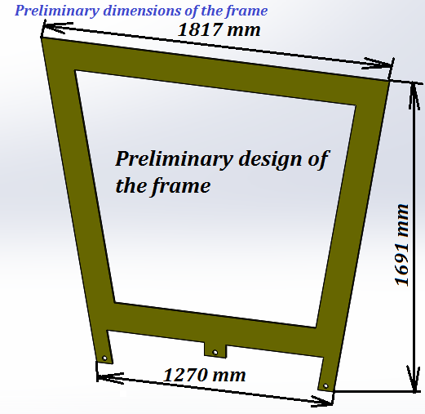
Mounting Plate (MP) for RE4/1 chambers with abutted chambers.
The MP design with overlapped chambers will require more work
Mounting plates
Preliminary design of the mounting plate
Thickness is 8 mm

Slide 13
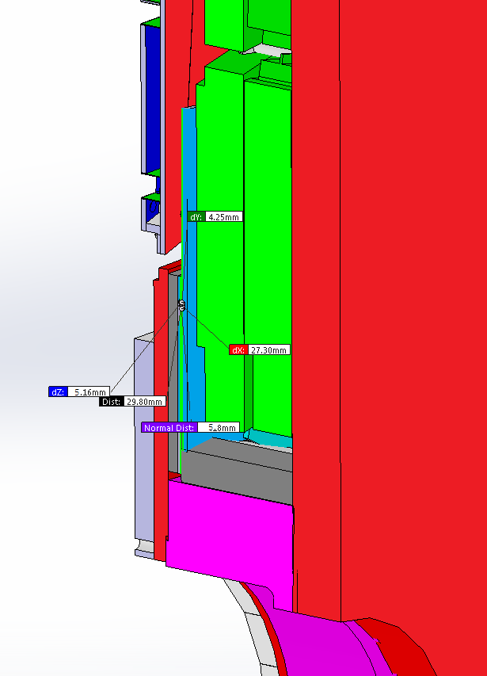
We are working on the space available. Not yet cleat but looks good as we have gained 18mm from 650mm to 668mm. All values are nominal with no tolerance given yet.

Slide 14
Services
HV cables and connectors from USC
LV Power from X2 crates on near and far side
Fibre optics Data/trigger and DCS to USC
Cooling
Gas
HV Systyem
LV System
Invert the paths and the components

Slide 15
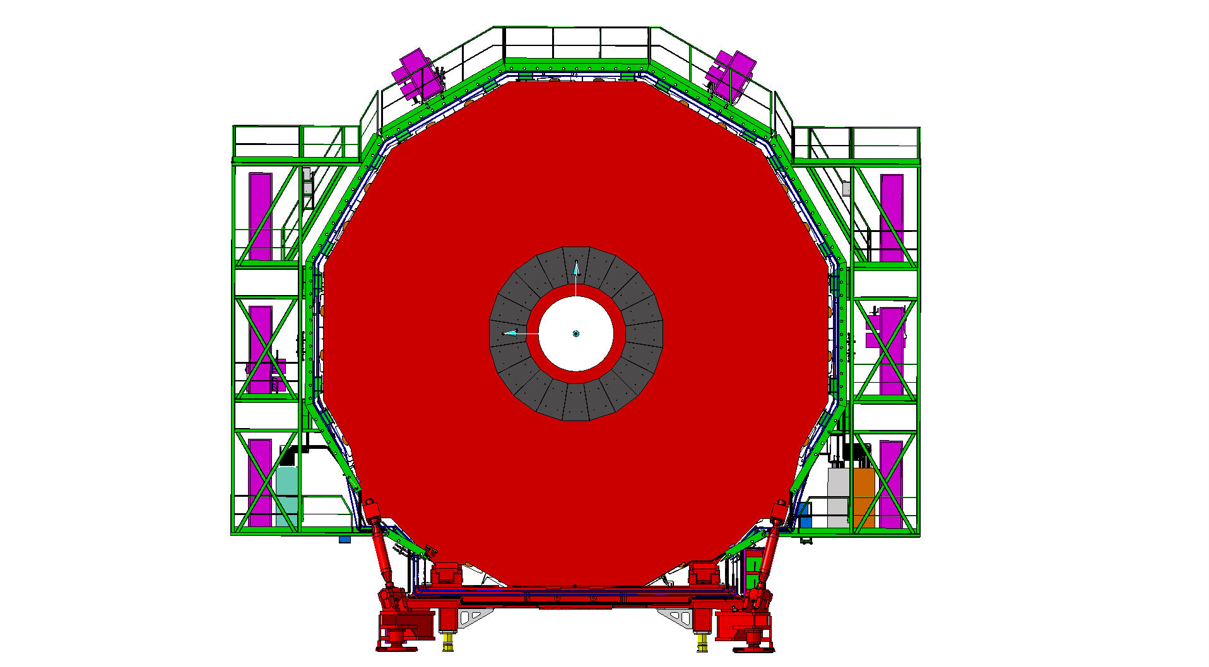
Services on YE3 serving RE3 and RE4
Mini Cable Chains for HV and OF
Mini Cable Chains for HV and OF
LV racks
LV racks
Space for DCC and OF Patch panels
RPC Gas Rack with spare channels

Slide 16
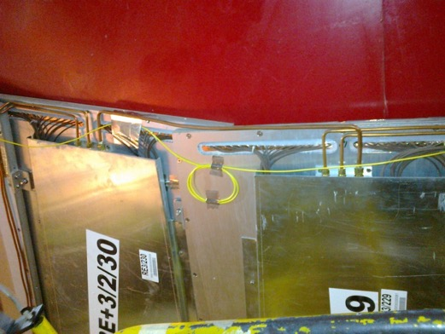
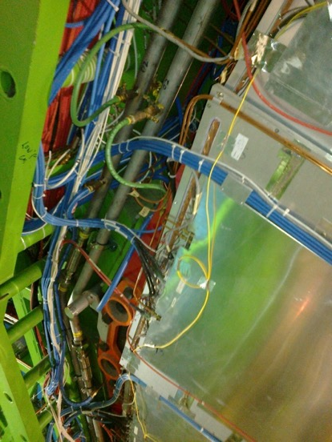
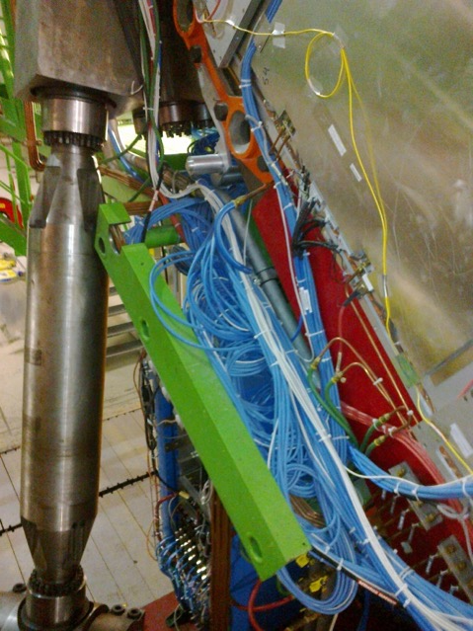
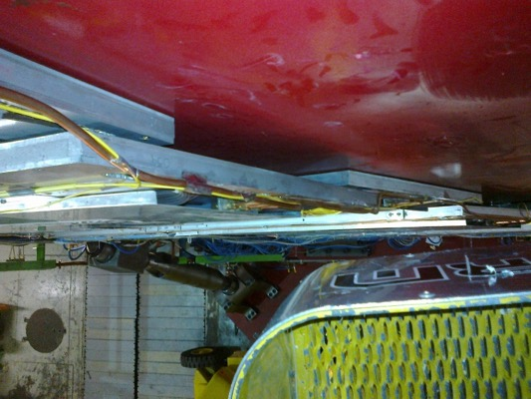
RE3/1 service passages
Space on the periphery is very limited
Service passage to the periphery is under the RE3/2 & RE3/3.

Slide 17
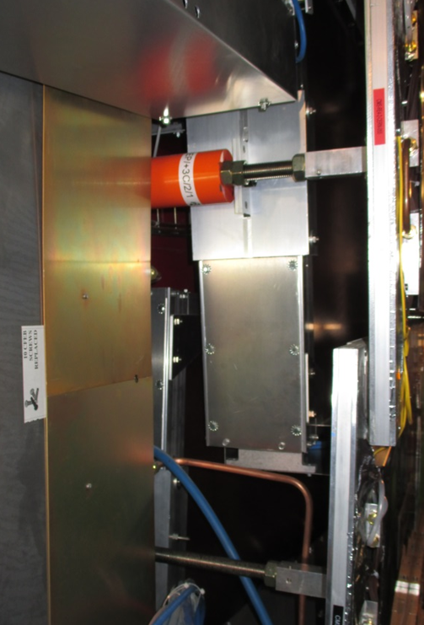
RE4/1 service passage
Service passage between RE4/2 and the ME4/2.
The problems or fears of induced noise will have to be addressed.

Slide 18
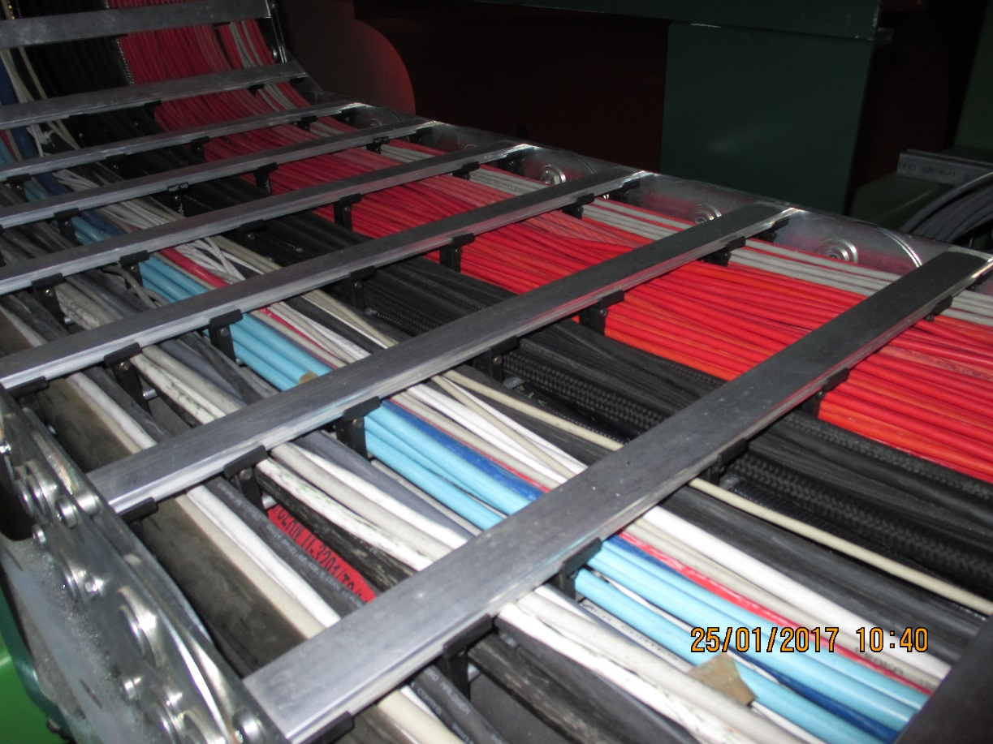
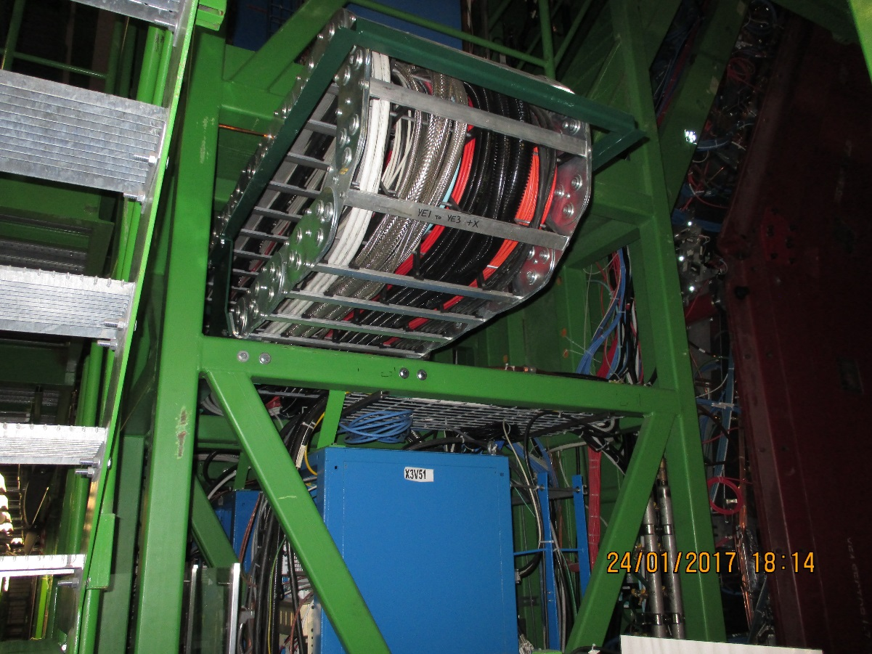
Mini Cable chains between the YE3 and YE1 and its PP are very full.
X3S51 Far
X3V51 Near, there is some space for small HV cables and some FO

Slide 19
Mini Cable chain Installation and Occupation
HV Cable 2 options Original 4 conductor (2 ch dia. 7.3mm) for the 3 pole connector = 19.2cm2
USC coaxial cable (dia. 5.0mm) for "Jupiter” style connector = 18.0cm2
OF for Data/Trigger and DCS Using MPO OF requires few dia. 3mm fibres per station. They will have to be installed in a rigid conduit for protection and installation.
One conduit dia. XXmm

Slide 20
UXC
USC
YE3
YE1
USC Racks
Mini Cable Chains
MPO OF from Chamber to USC Rack
RE4/1
RE3/1
YE1 PP
OF passages UXC-USC
Schematic of UXC to USC OF routing components
Main Cable Chains

Slide 21
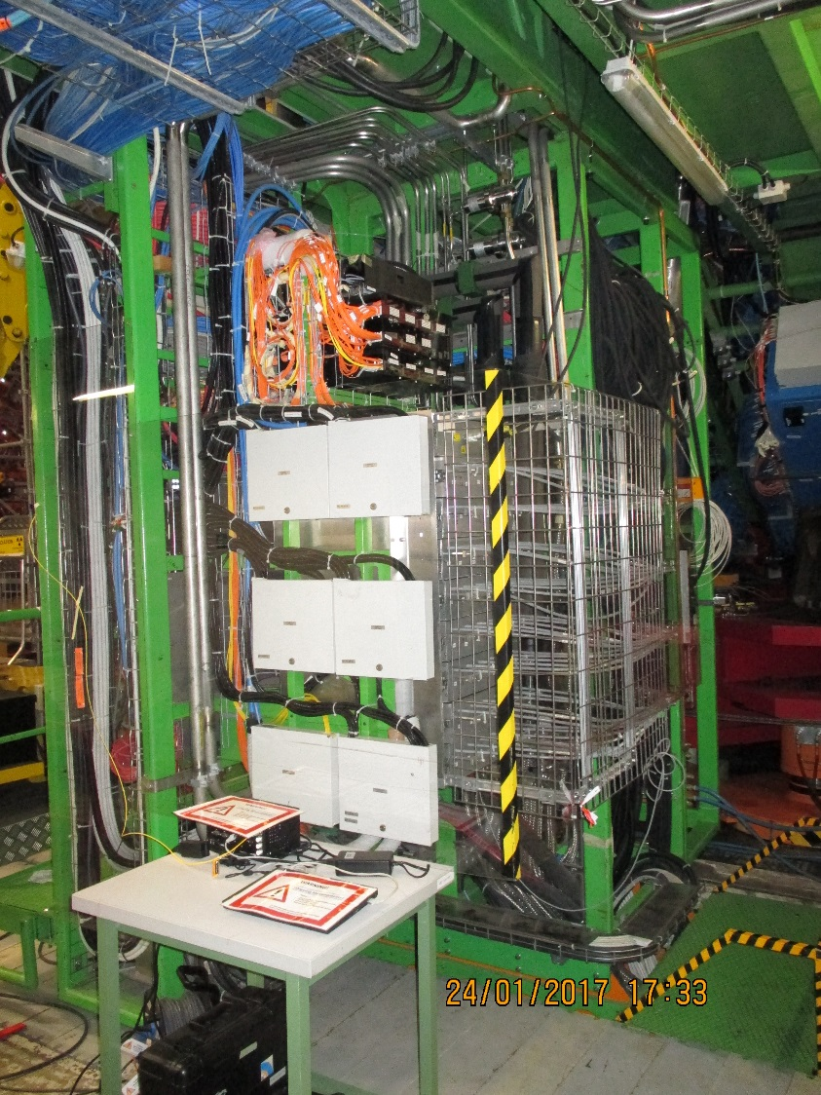
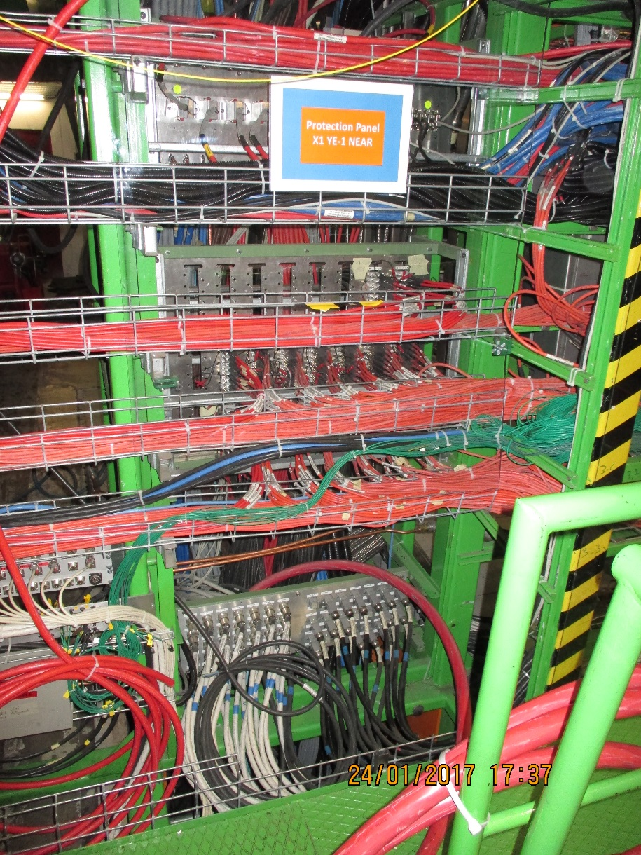
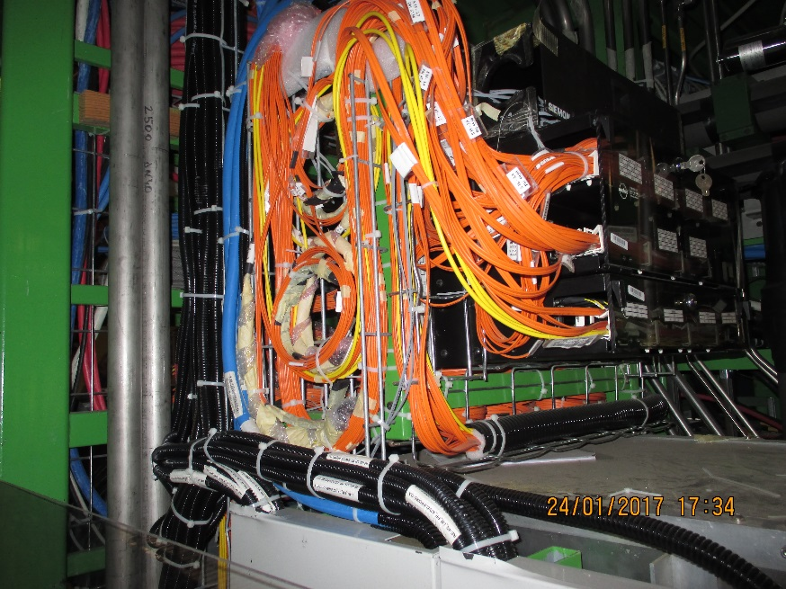
YE 1 Main Patch Panel (PP) for HV and OF
There are slots available in the HV PP sufficient for the 3 pole connectors. In the case of the coaxial option an additional PP mounted in front of the present one will be added
Present OF PP that will be needed to be able to make the junction between the MainCC and the Ofs from the MiniCC. There is limited space.

Slide 22
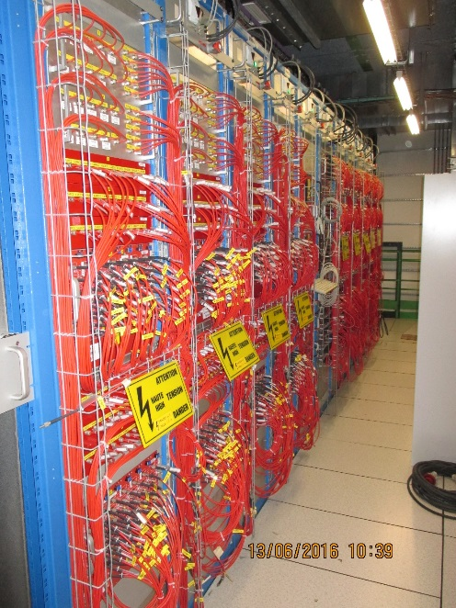

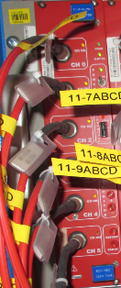
HV cables
USC
UXC
Patch panel: HV CPE Jupiter connectors female/male
On the back : male and female Jupiter connectors
YE1
HV coaxial cable : CPE Jupiter CH-side
Distribution board
HV crate
HV board
Umbilical cable : 1 big cable = 10 individual cables
Coaxial cable
Umbilical has “Jupiter” or equivalent coaxial connector throughout at each end

Slide 23
Rack use HV
Schematic
Main Frame

Slide 24
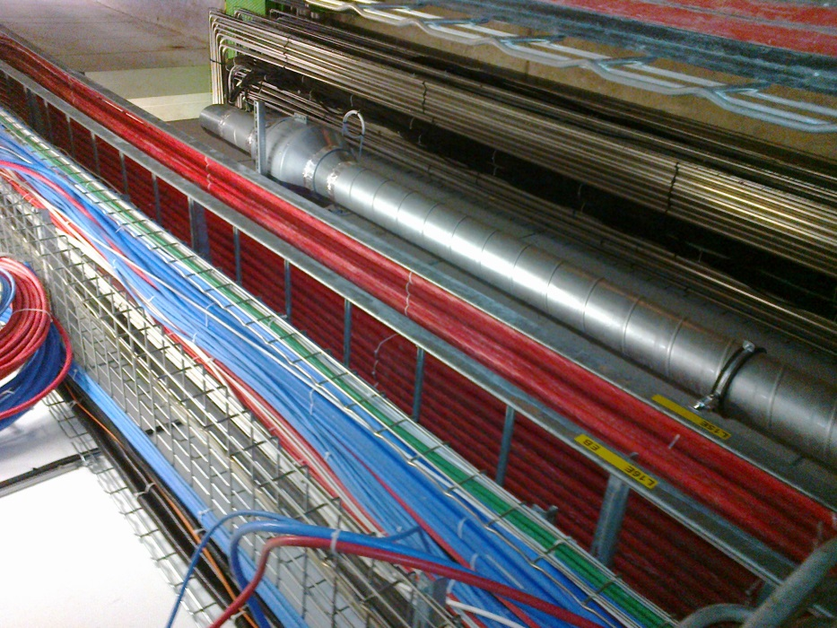
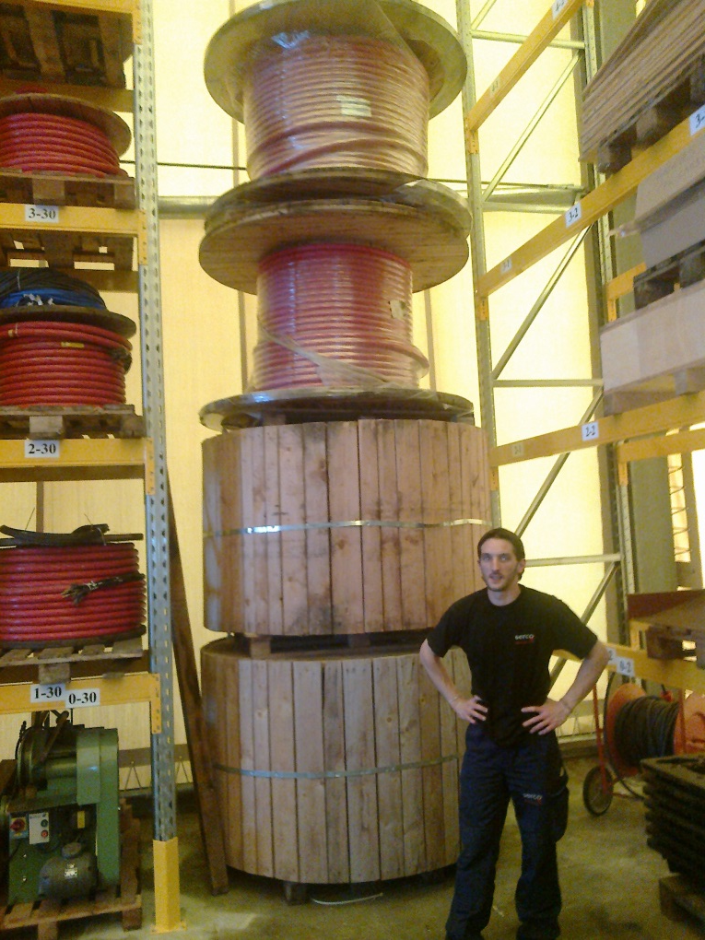
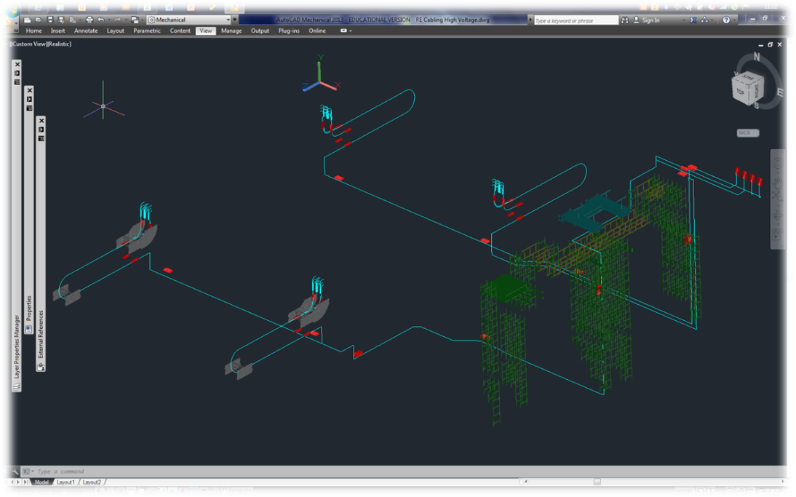
The path is clear and we already have the cable. This is a big job
Approx 1.5km
Cable length 57-90m

Slide 25
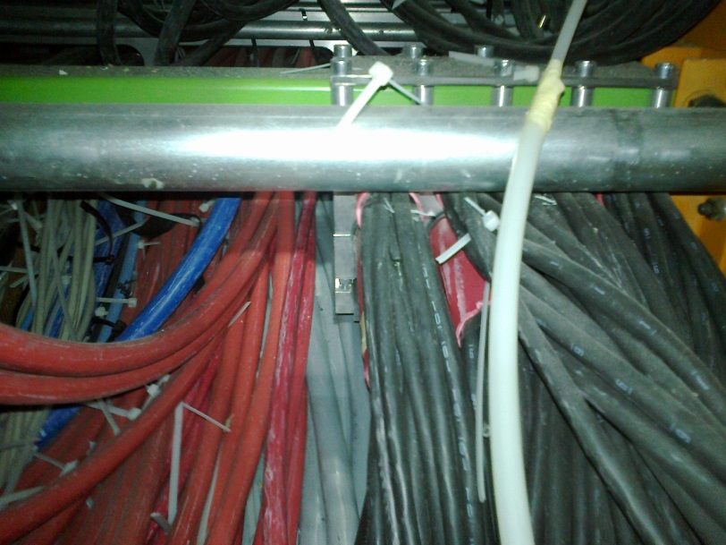
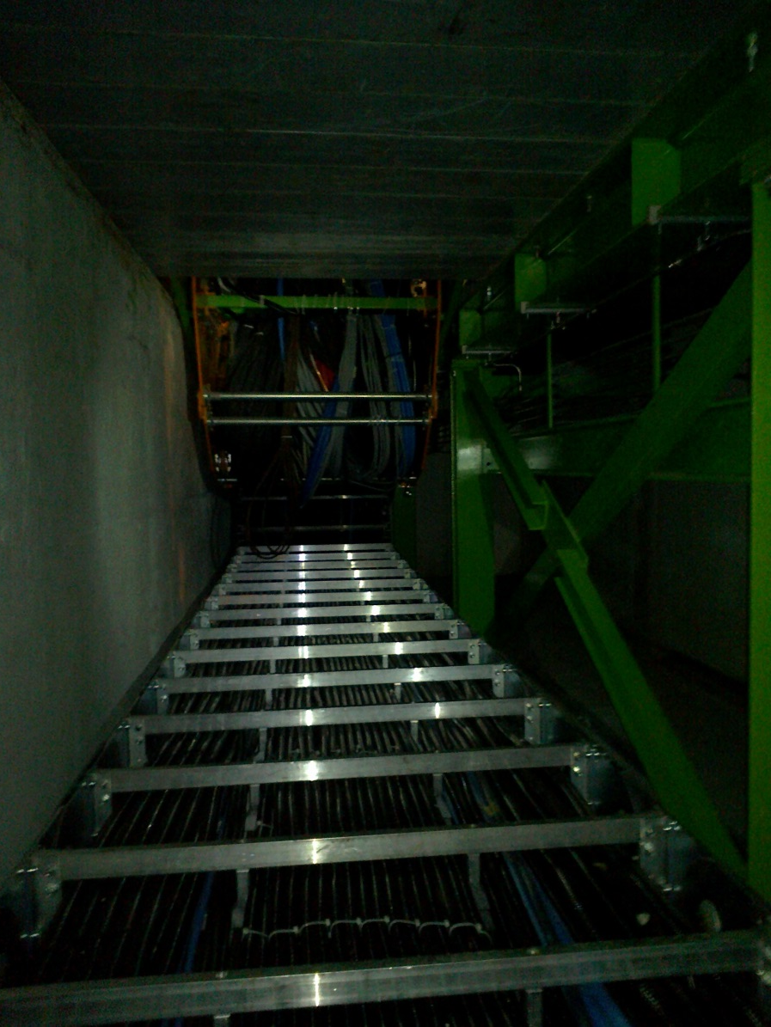
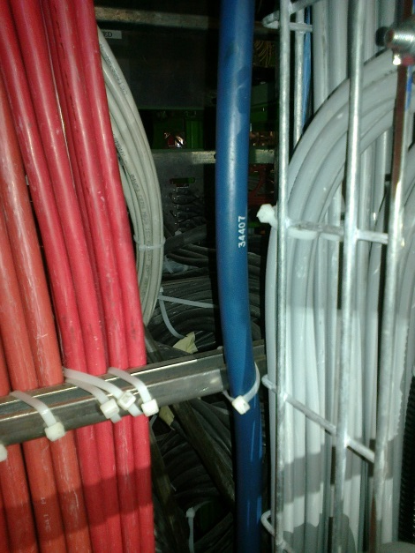
But it gets worse in the last 5% of the path length
Combine 23 – 25 slides
Positive view.
Clamp of the Cable under PP YE1
The Main Cable chains in X0 under CMS
Access to rear of the PP

Slide 26
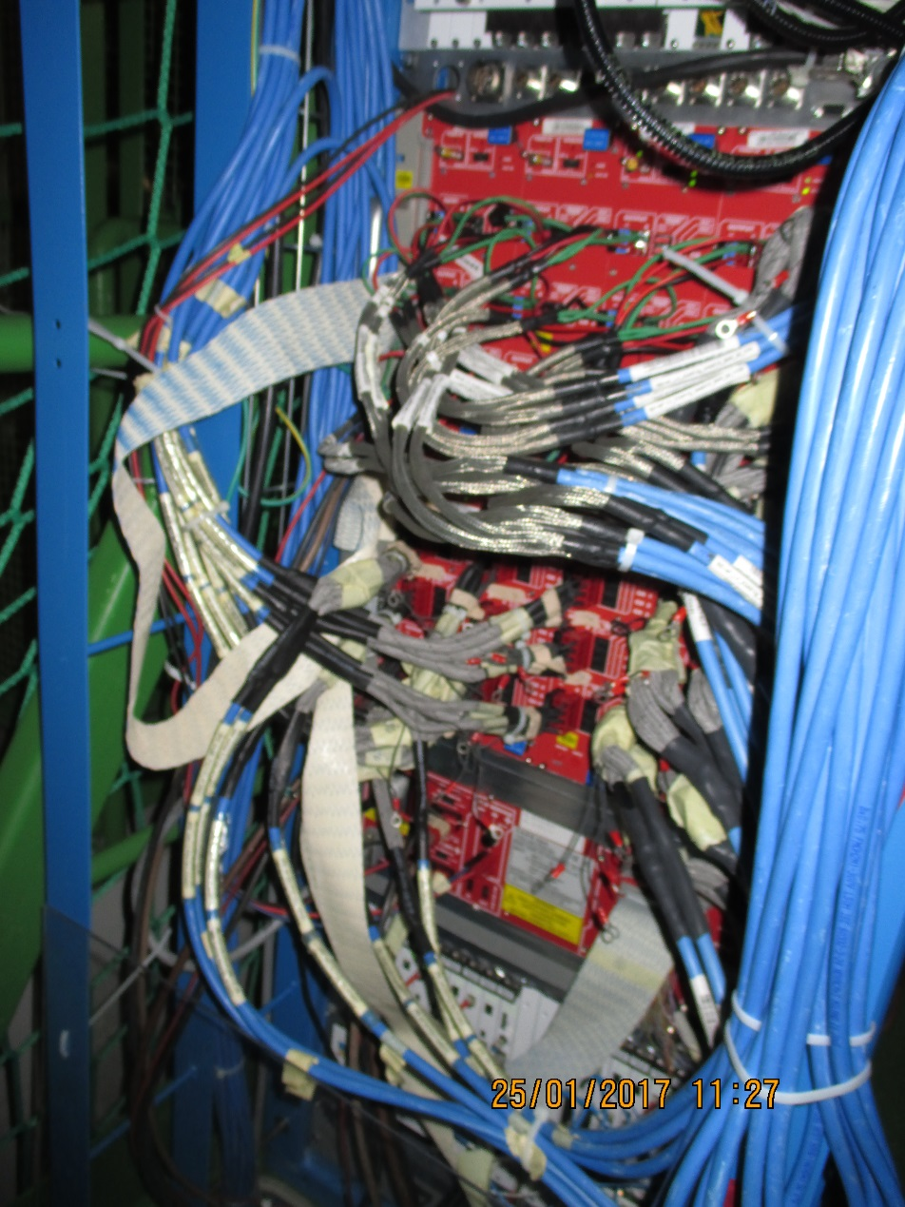
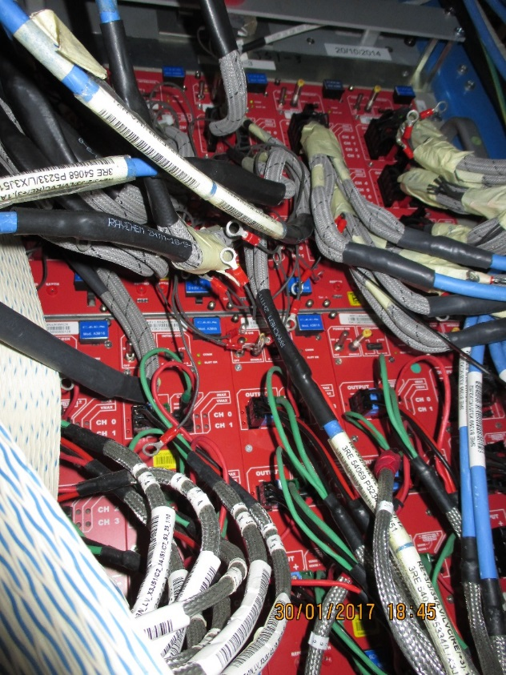
LV Power System
X3A51
LV Power for both RE4/1 and RE3/1 will be taken from the presently installed crates and modules. Re-cabling to liberate 2 modules will require PP/Fanout space
Dedicated time slot to perform this task.
Trials to be performed in 904

Slide 27
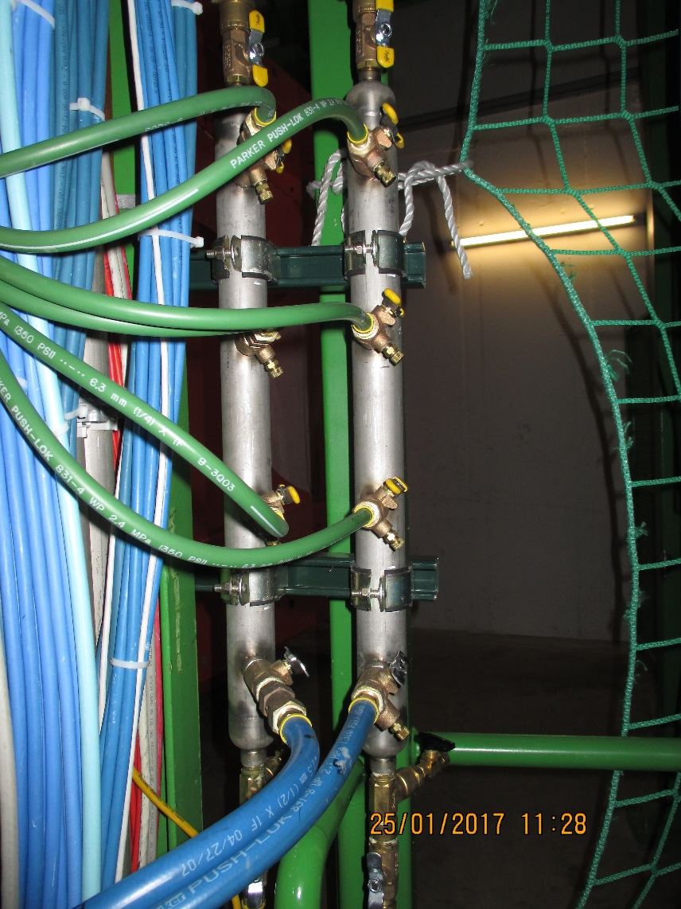
Cooling system
The power loads on the cooling system are not so large so extensions of the present system should give approx. 0.1deg C increase for YE3.
Details to be discussed with CMS cooling team
Cooling Mini Manifold for RE4/1 cooling to which “T”s and flow restrictors will be added to supply the 9 channels. Hosing from the mini manifolds directly all the way to the RE4/1 will simplify the installation.
The RE3/1 system will be a taken off from the RE3/2s, two RE3/2s for one RE3/1 using the flexible hoses as shown opposite.

Slide 28
RE4/1 Mini manifold schematic
Mini Manifold
RE4/1

Slide 29
RE3/1 cooling link to RE3/2
Drawing of the 20deg link
Flexible hose links to reduce the strain on the unions

Slide 30
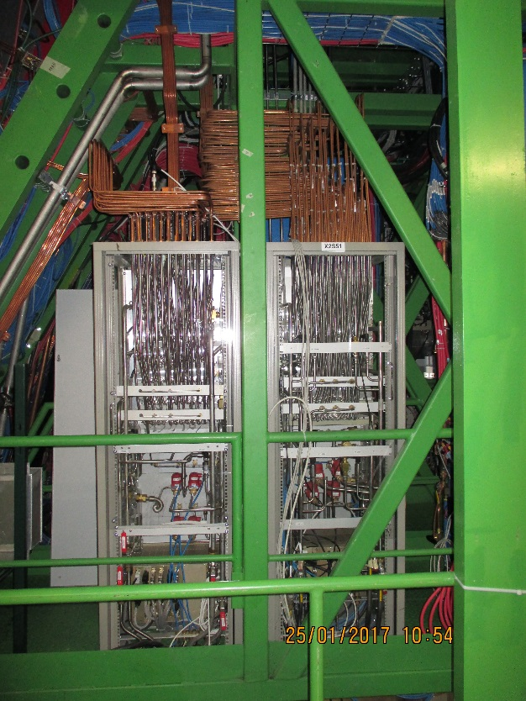
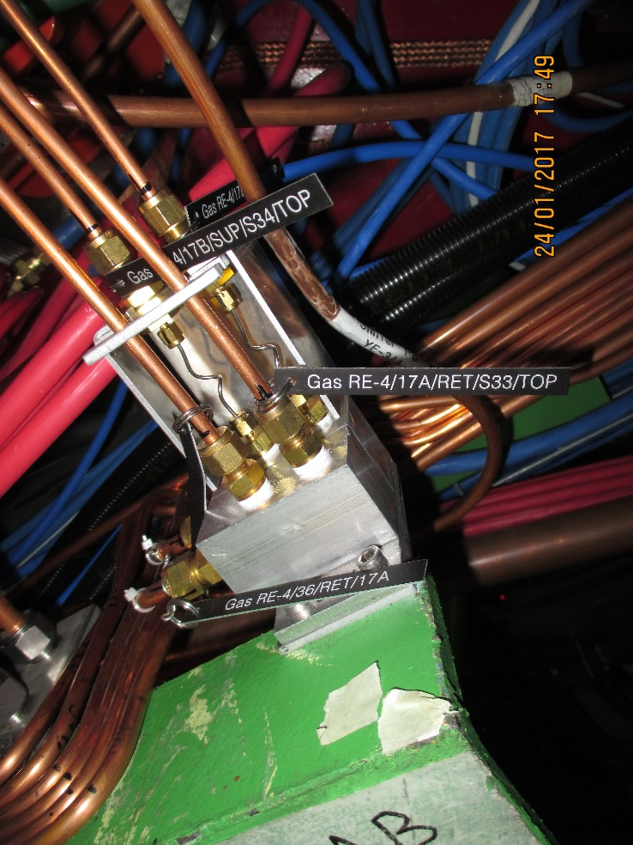
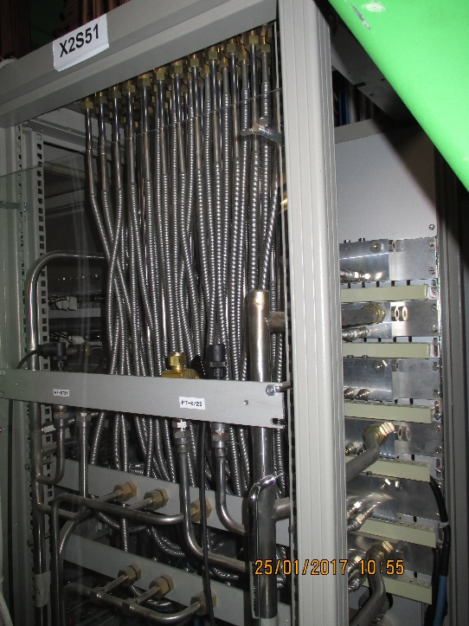
Gas system
The gas system remains un-changed in that the gas racks not modified nor are there any additions. Re-piping of RE3 will be required.
Given the few, 6, channels available for 1 station parallel gas flow is proposed for both the 3 channels on one channel and also the top and bottom gaps.
There are 6 channels to be distributed in parallel flow to each chamber
The impact on the use of Ecogas is considered minimal
An example of a two channel impedance distribution for RE4 SMs. For RE3/1 and RE4/1 will require 3 or 6 channel impedance distributors. These are Alu enclosures with unions and SS piping, not rocket science ! But they take space on the periphery.

Slide 31
Schematic of the Gas distribution
6 channel Impedance
Put in spare slides
Return collector

Slide 32
Conclusions
RE3/1 is well on the way.
RE4/1 volume is less well defined, to be worked/studied if possible
in situ
We will have to work hard to ensure that IO allows the HV cables and FOs to pass through the Mini and Main Cable chains.
The gas system distribution from the Gas rack will need detail conception and design.
Concerns of the occupation/installation in the Cable chains.

Slide 33
New Conclusions
RE3/1 integration is well understood.
RE4/1 should be overlapped once the “Z” volume is more cl;early understood.
Further study of the Cable chains, gas and cooling to be carried out with Integration Office.
There are no apparent show stoppers.

Slide 34
All drawings and numerous slides are done by Elena.
She has to continue as this is the development phase and the detailing will follow as the final design is approached. Continual changes will be made as we move along this path.

Slide 35
Back up

Slide 36
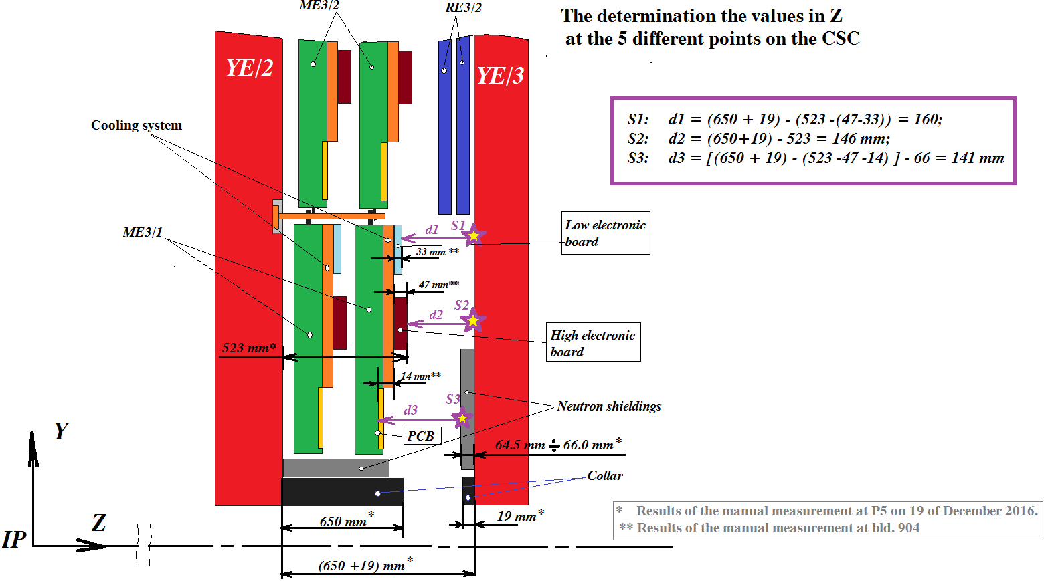
200.8mm
201.8mm
197.8mm
167.1mm
151mm
Values obtained from IR sensors in Red

Slide 37
Values taken on outer “R” at 3 different locations on both –Z and +Z on 25 April 2017. Discs closed.
178-174mm
Mean 176mm
145-145mm
14mm
ME3/2
RPC space
176 - 14 = 162mm
Drawings = 146mm
RE3/2
YE2
YE3
RPC space over the N. Shield
162 – 66 = 96mm
Standard RPC 29mm gives 68mm with mounting brackets. Leaving a generous clearance to CSCs of 28mm.
Was 88mm from drawings.
668-672mm
Mean 670mm

