Slide 1
Muon system requests for
YETS 2016-2017
M. Ignatenko (UCLA)
on behalf of CMS muon system
CMS TC workshop
Best-Western hotel
October 21, 2016

Slide 2
Main objectives
GE-11 slice test – has been scrutinized in the recent TC review.
ME11 interventions - 3w (why, where, when)
YB2 DT/RPC repairs - in background of main activities
YE1 CSC/RPC repairs - in background of main activities
YE CSC/RPC repairs during CMS closing –
in background of main activities
Improving CMS radiation shielding
RE31 mockups installation test
USC work requests

Slide 3
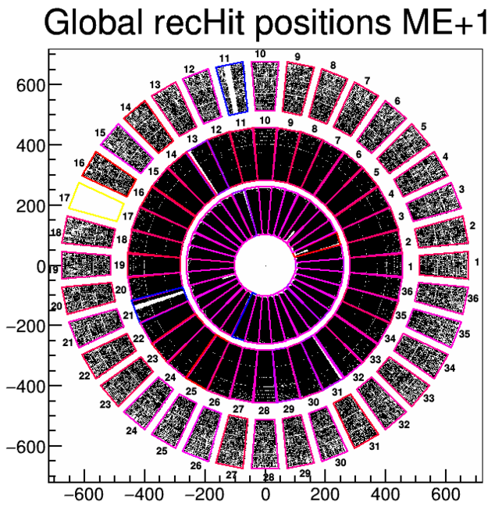
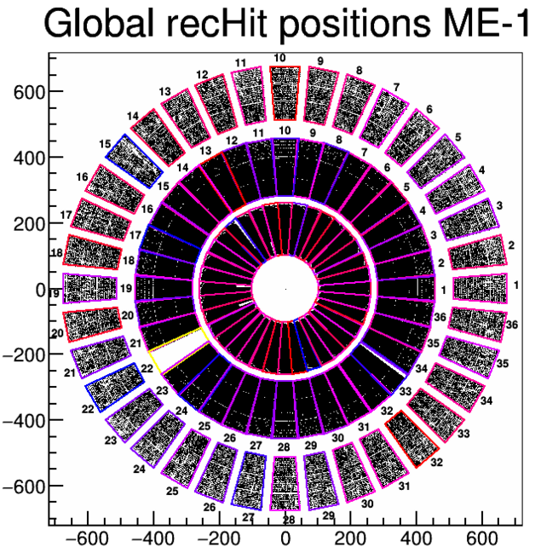
ME11 interventions
In terms of trigger and readout efficiency me11 are still OK.
Why interventions are needed?
1. Because CSC has met a problem of updating DCFEB EPROMs (firmware,
configuration parameters).
No problems of downloading FPGA. No problem of reloaded FPGA from working
EPROMs.
CSC experts need that boards on a test bench.
2. Me11 copper tube joints of cooling system are potential source of a water leak.
A procedure has been develop to reinforce cooper tube joints by radiation hard
epoxy compound. CSC wants to start using it.

Slide 4
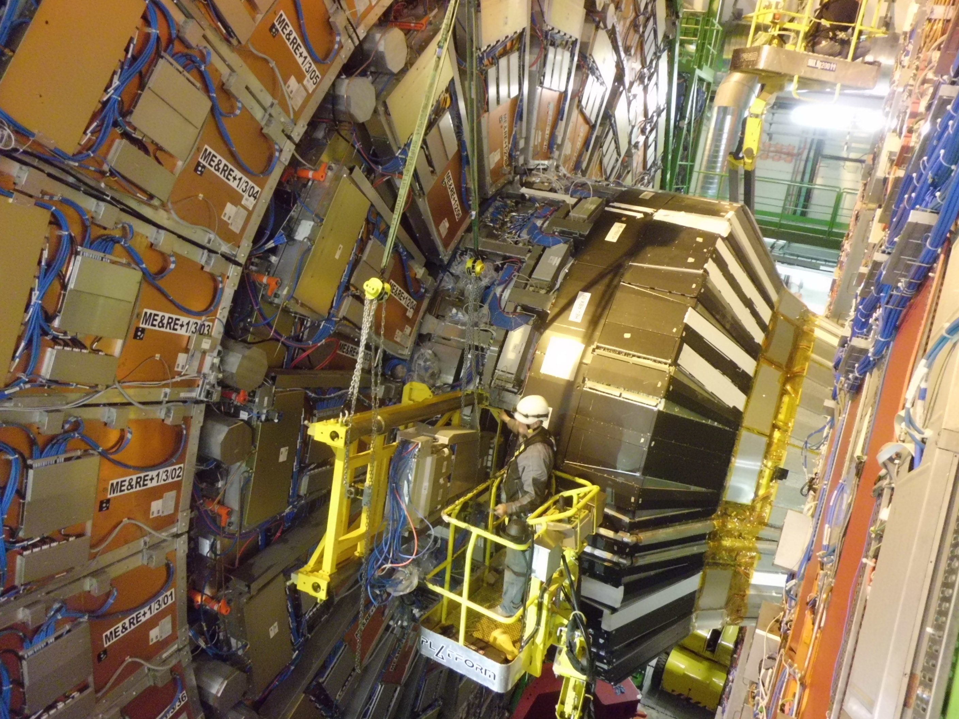
Where?
There are 3 me+11 with DCFEB EPROM problem and 2 me-11
me+1/1/03 (2 DCFEBs), me+1/1/06, me+1/1/25, me-1/1/12, me-1/1/14.
CSC hopes that problematic board replacement and reinforcing of the cooling cooper pipe joints could be done without taken me11 down.
However: in case of a problem (water or gas leak test failed,
problem with board readout) we need reserved time for a chamber re-extraction and fixing the problem.

Slide 5
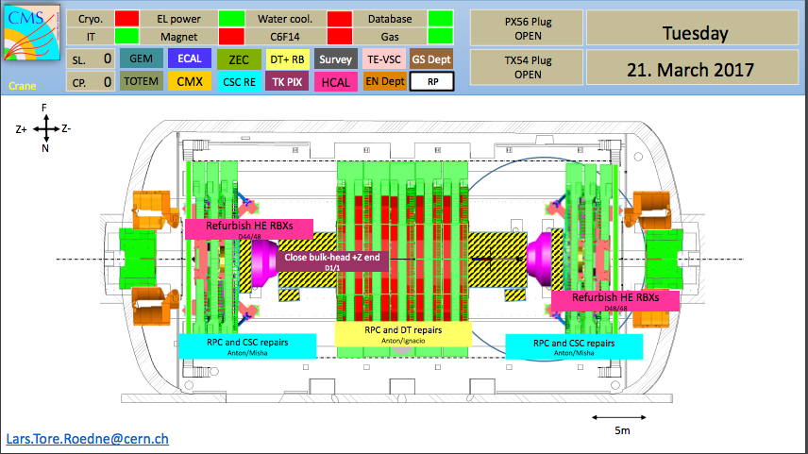
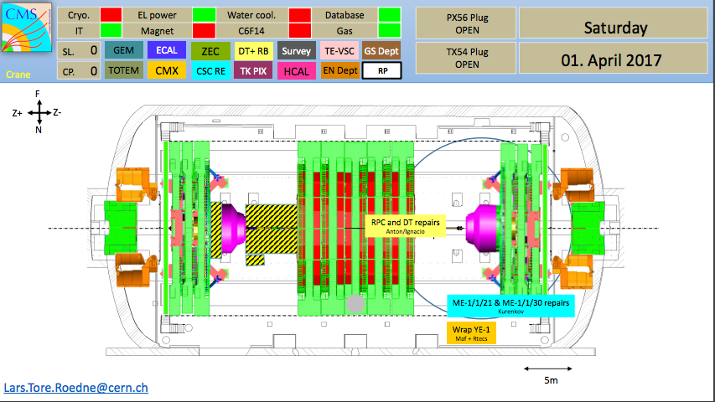
When?
Possible time windows:
Dec.21 - as soon as YE-1 nose wrap-up is removed (me-1/1/12,14).
Jan. 06-07 – in parallel with GE-11 installation (me-1/1/12, 14).
Mar. 22-29 - HE- refurbishing is over, heavy lifting not started yet (me-1/1/21).
Apr. 01-04 – HE+ refurbishing is over, heavy lifting not started yet
(me+1/1/03, 06, 25)

Slide 6
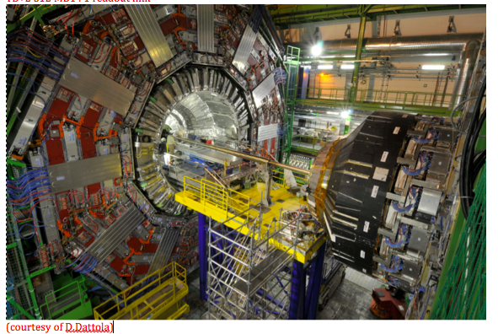
YB+/-2 repairs
DT and RPC have requested to do a few repairs (miniCrates, HV, LV, gas leaks).
From the CMS experience in the past (LS1) it is possible to do some interventions without interference with the major operation in and next to the vacuum tank.
Scissor-lifts on both sides of YB+/-2 wheels are needed.
Some requests include partial extraction of DT/RPC sandwich (~90 cm).
That work need survey (photogrammetry after installation back) and a crane.
The time window has not been defined yet.
The time estimate ~ 2-3 weeks of
expert work.
Some help from Bulgarian tech team will be useful.
List of interventions is in the backup slides.

Slide 7
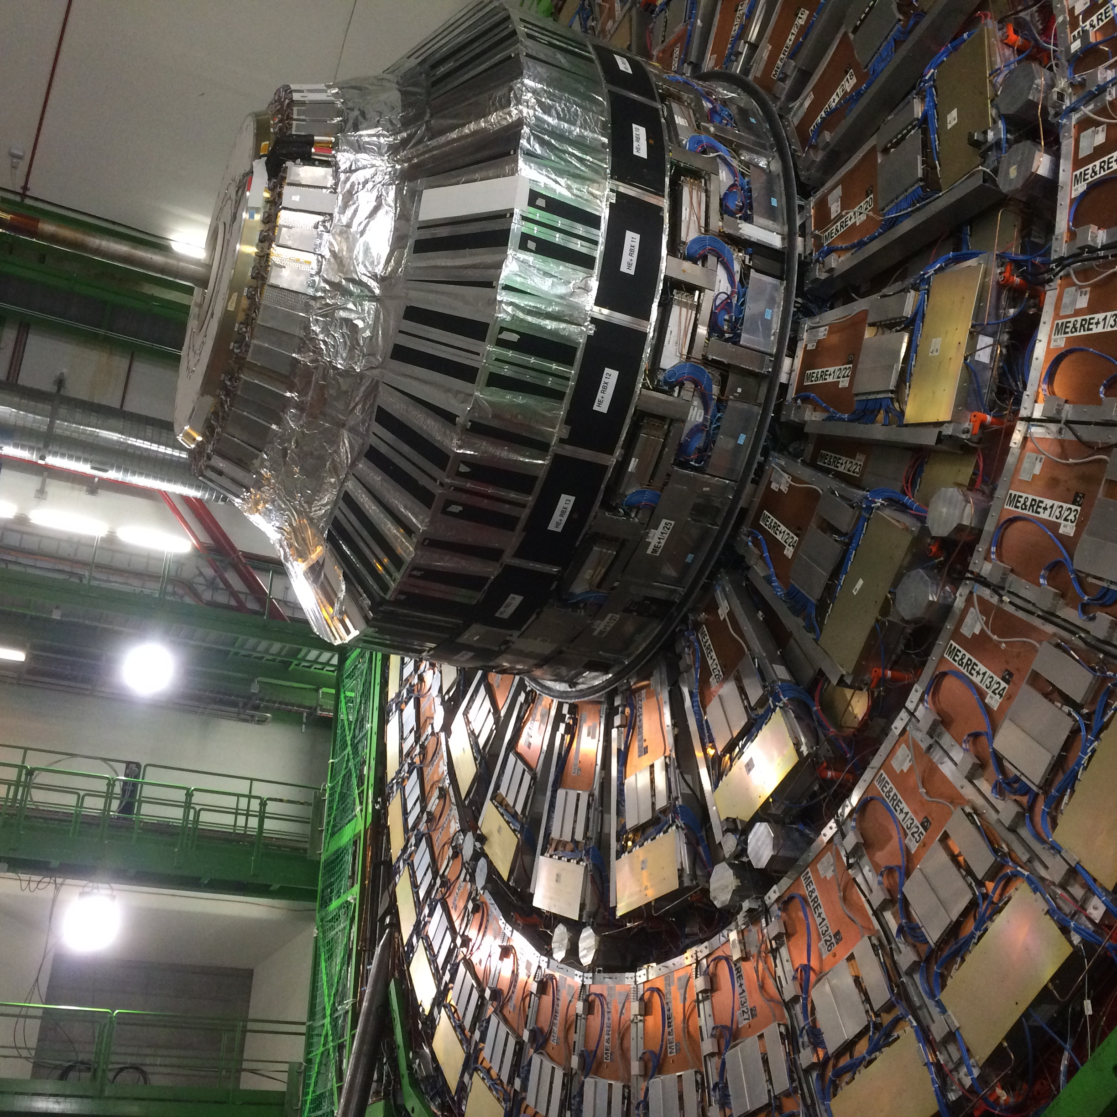
Repairs on YE1 disks
CSC and RPC need to do some repairs on YE+/-1 disks.
CSC has 3 problem:
1. Me+1/3/17 lost LV. In worst scenario a LV connector replacement is needed.
2. Me+1/1/13 and me+1/1/26 have unstable optical links with peripheral crates.
Cleaning and reseating optical connectors are needed.
No chamber extractions.
RPC need to do LV and HV repairs on 4 chambers:
1. Re+1/3/25 – LV
2. Re+1/2/13 – HV
3. Re-1/2/29 - HV
4. Re-1/3/17 - HV
The work will be done in a few days without any
destructions of HE refurbishing.
A cherry-picker is needed near both YE+1 and YE-1.
Some work can be done from scaffolding around YE1
noses.

Slide 8
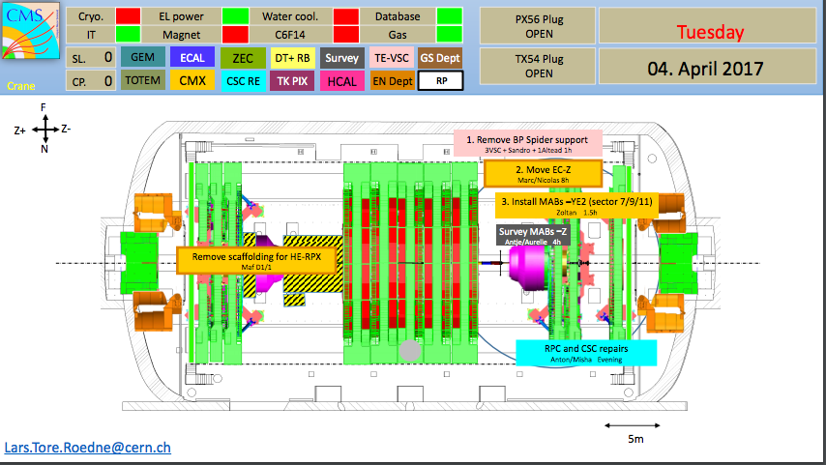
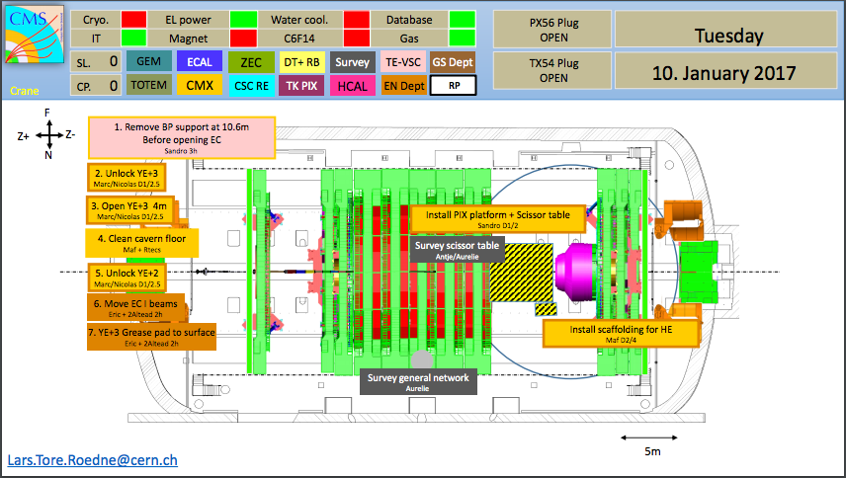
CSC and RPC repairs on YE disks
CSC/RPC request 3 interventions:
1. YE-2 – YE-3 3 m gap, evening of Apr.04
repairs of me-3/2/30, me-3/2/16, me-3/2/24
repairs of re-3/2/35 and re-3/3/35
2. YE-1 – YE-2 3 m gap, evening of Apr.05.
repairs of me-2/1/03 LV
3. YE+1 –YE+2 3 m gap, evening of Apr.11
repairs of me+2/2/29, me+2/2/14, me+2/2/02
RPC request - RE3/1 mockup installation test on evening of Jan.10

Slide 9
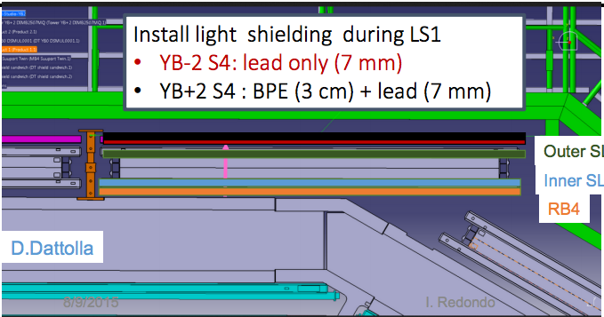
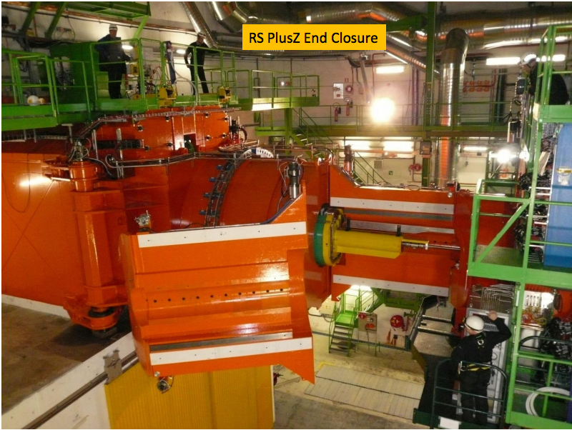
Radiation shielding
YB2 (sector4) a new improved radiation shielding.
The installation can be done in any
CMS configuration.
Improvement of efficiency of rotating shielding:
1. What can be done based on
alignment measurement results?
2. Installation of steel and borated
polyethylene bars on –z end to
make a shielding symmetrical.

Slide 10
USC work
Installation of the GE1/1 power supplies an
readout electronics (approved).
  HV power mainframes (S1H12)
  Optical patch-panel and uTCA crate (S2E01)
Refurbishing of DT HV system.
Space for cleaning of the HV module in the USC (S1) required.
Replacement of CAEN mainframe fan bins.
Storage area in USC required.
Refurbishment of RE HV system:
Installation of a second 48 DV power supply (CAEN A3485S).
Time frame - January – February 2017.

