Slide 1
Chamber Design and Integration RE3/1 and RE4/1
Elena and Ian

Slide 2
Covered topics
Available Volume
Electronics read out volumes
Services routing

Slide 3
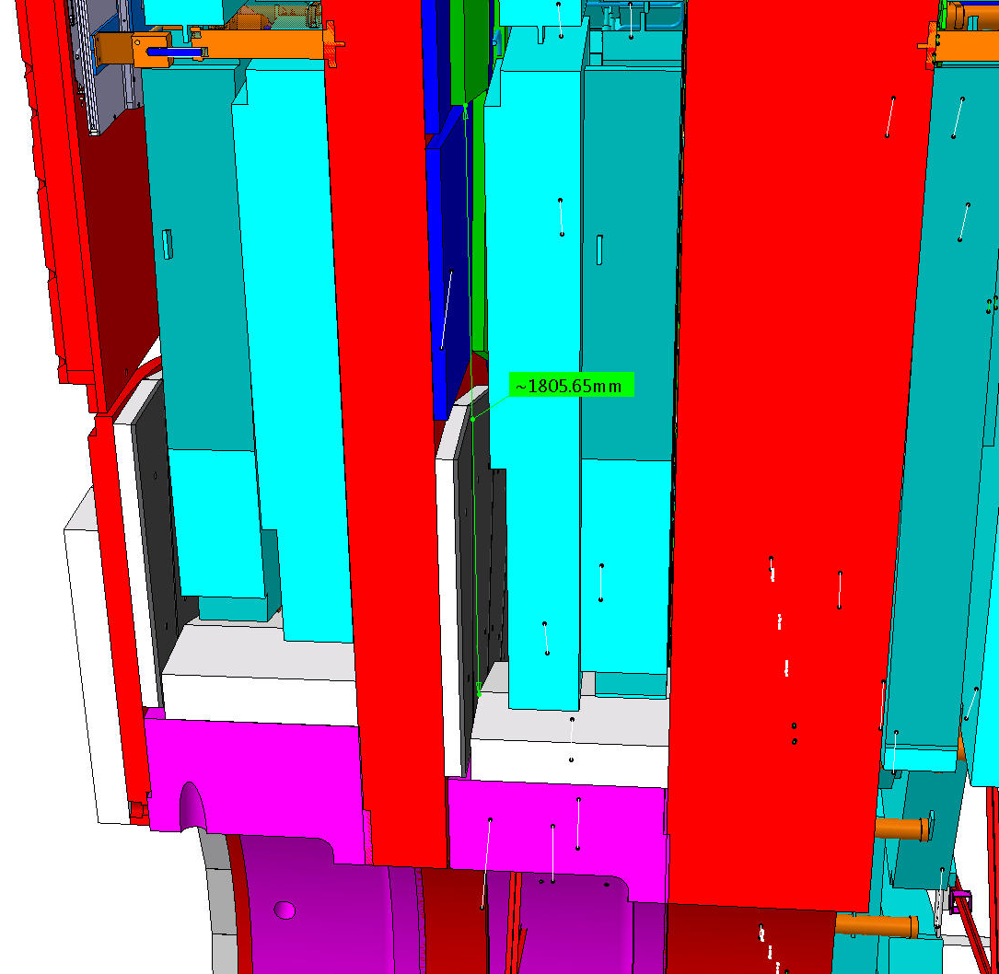
The volumes for RE3/1 and RE4/1
RE4/1
The chambers are very thin in the order of 25mm, here they are exagerated. !
The available volume dictates the design of the chamber.
RE3/1

Slide 4
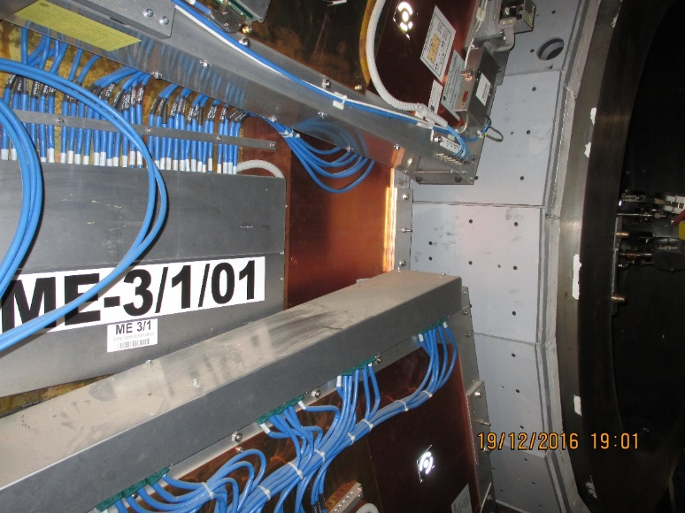
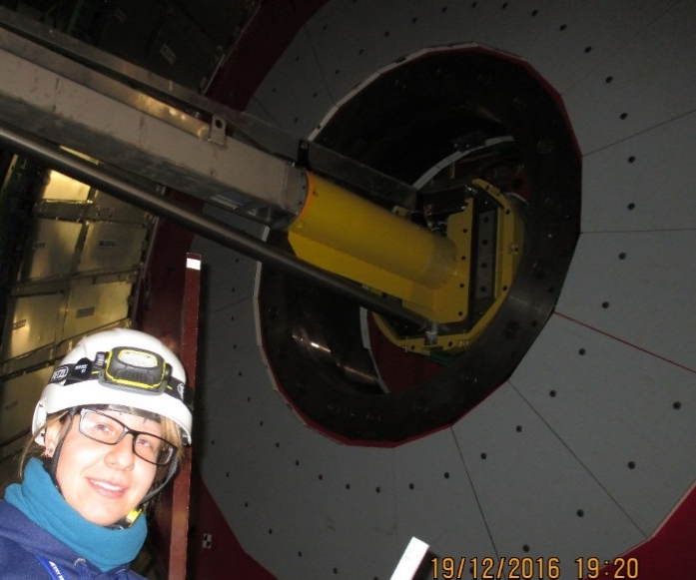
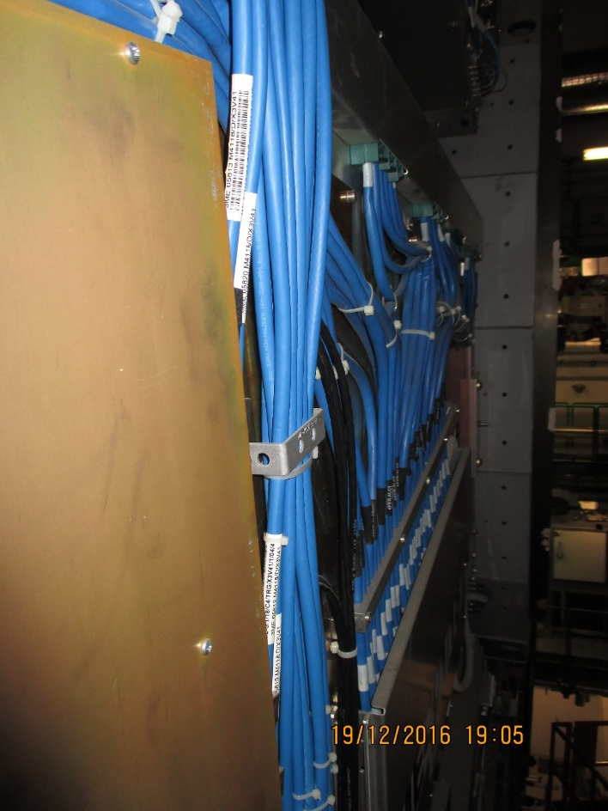
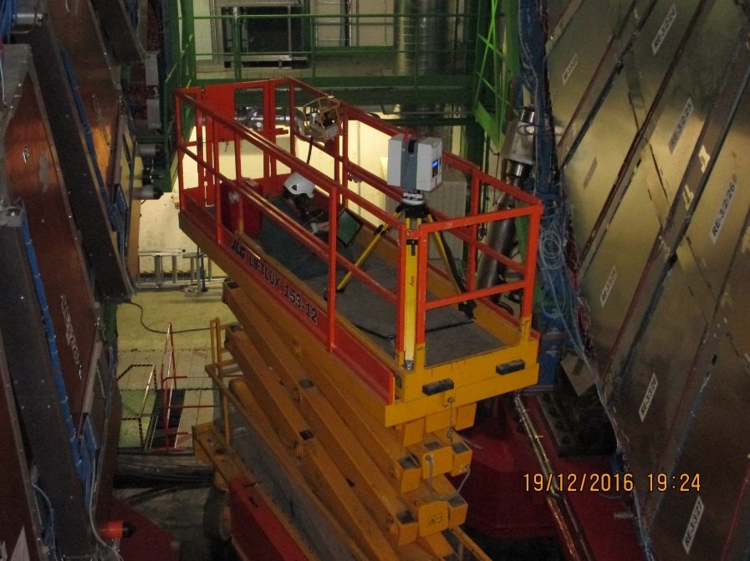
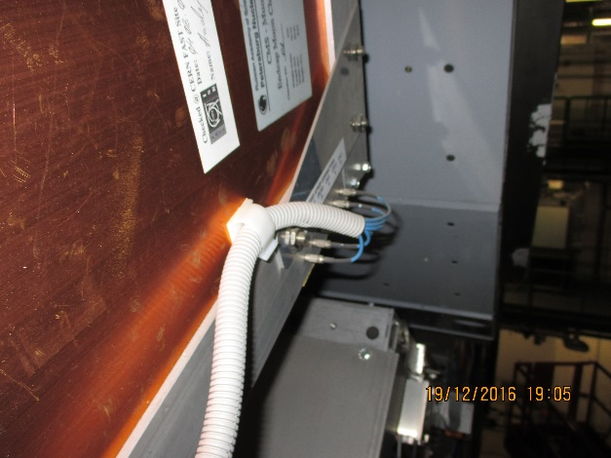
A lot of work has been done to establish the volume available in “as Built” terms.

Slide 5
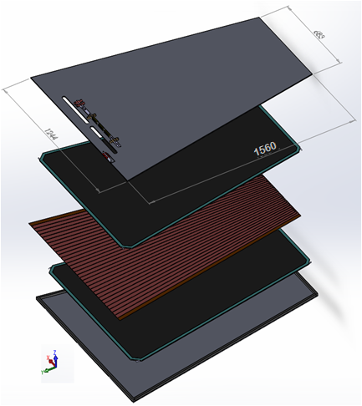
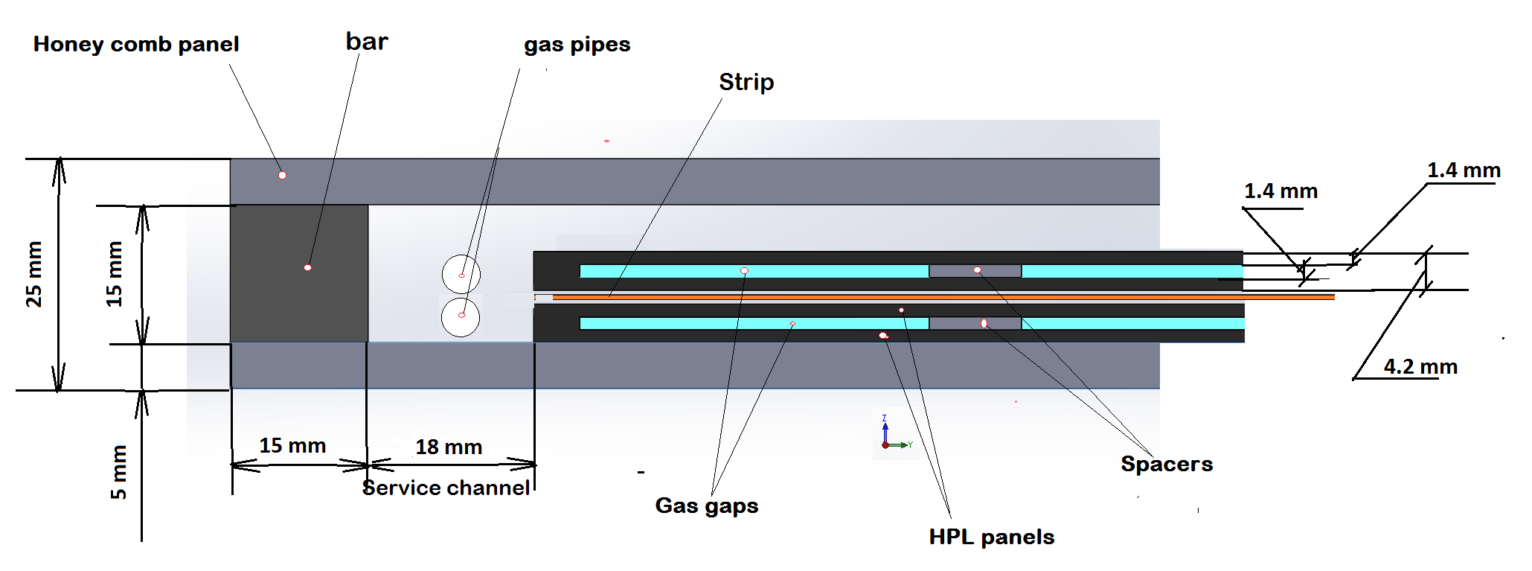
Design RE3/1 RPC chambers
Double gap RPC chamber
PP under work
* Clearance between ME3/1 and RE3/1 will be
(80 ± 1 ) – (5 + 25 + 5 +25) = 20 ± 1 mm,
where
thickness RPC chamber is 25 mm;
thicknesses honeycomb panel is 5 mm.
Cross section of double gap RPC chamber
From Kodel BT design we know that the chamber will fit in this mechanics

Slide 6
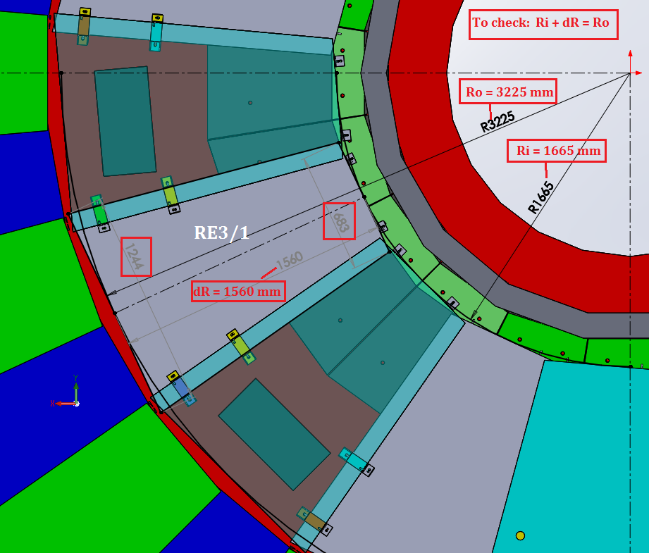
Overall Dimensions of RE3/1 with inner Mount to Neutron shielding
Lost space if the direct mount to the N. shield is retained
Development with IO will be required to increase the coverage back to the cylindrical N. shield.

Slide 7
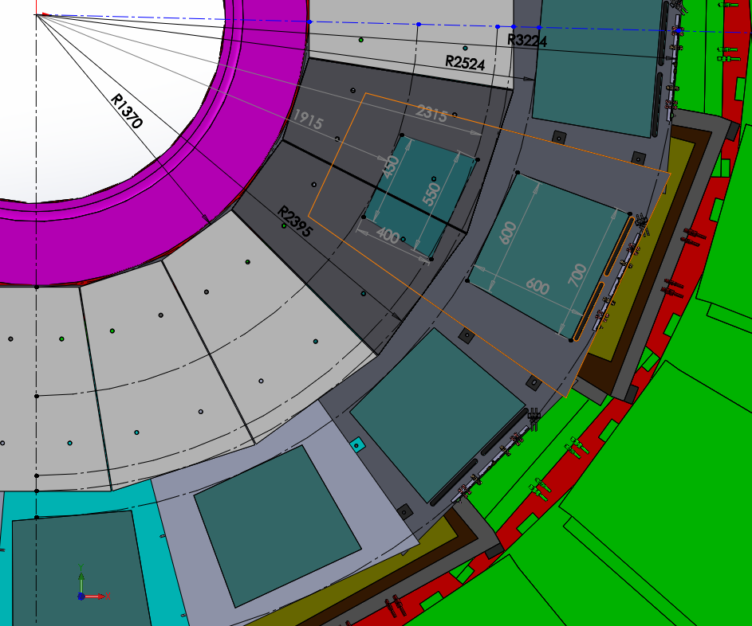
Ri 1664 mm
FEB
731 mm
1560 mm
FEB
RE3/1
“on”
Neutron Shielding
1025 mm
RE3/1
“off”

Slide 8
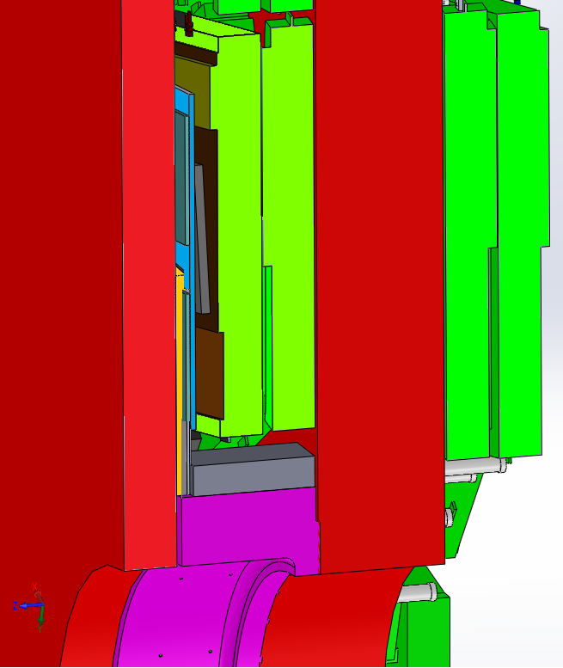
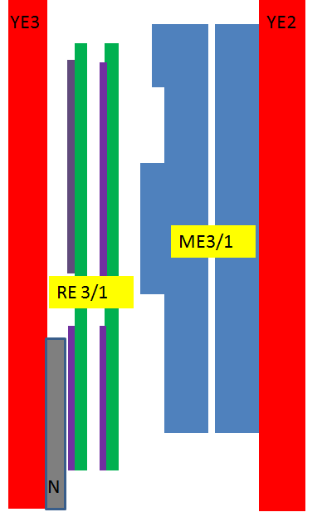
Cross section YE3 and YE2
RPC RE3/1 chambers
Principle scheme
YE3
YE2
CSC, Highest Electronics Cover
FEB
RE 3/1
26 mm
between RE3/1 and CSC (high electronics board)
ME3/1
FEB
CSC, Highest Electronics Cover
FEBs, high and low R
Neutron shield.
670 mm
between YE2 and YE3
96 mm
between CSC (high electronics board) and N.Sield.

Slide 9
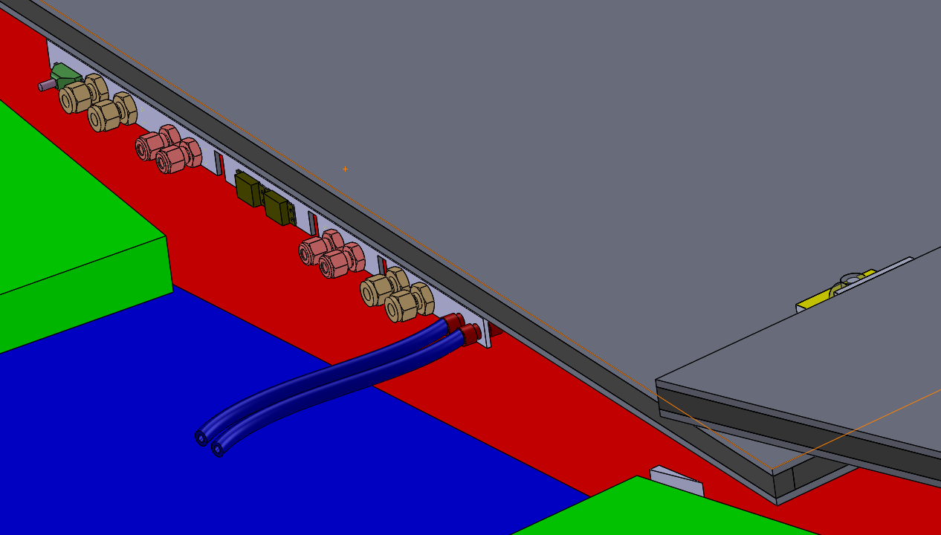
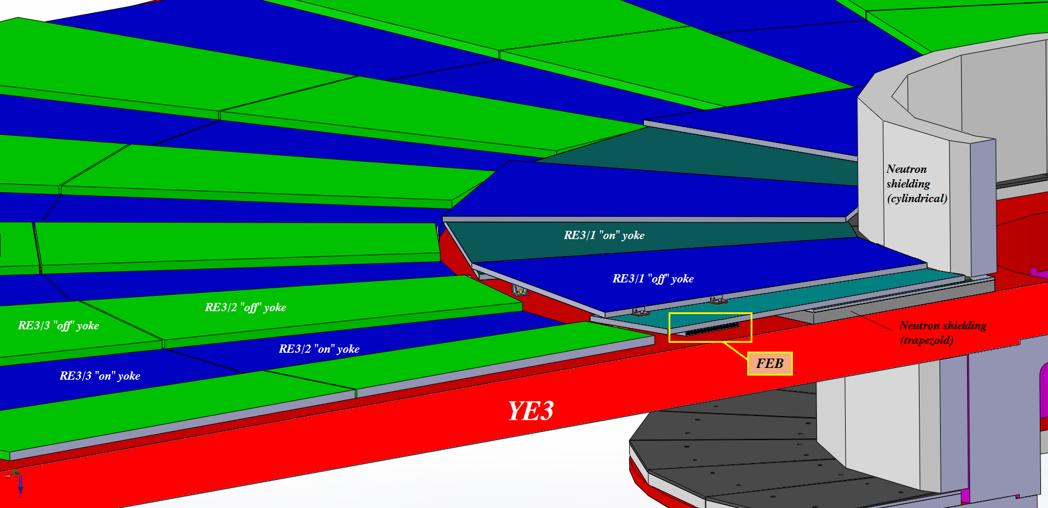
Cooling will be plugged into the RE3/2 circuit by removing the link between two of the Re3/2s at their low “R”

Slide 10
RE4/1
Work on the volume definition is far less developed. We have worked so far based on the IO drawings, imposing an abutted configuration.
Today we have the results of the manual measurements made on the yokes on 25 April 2017.
The layout will now be studied with overlap as in the RE3/1 case.

Slide 11
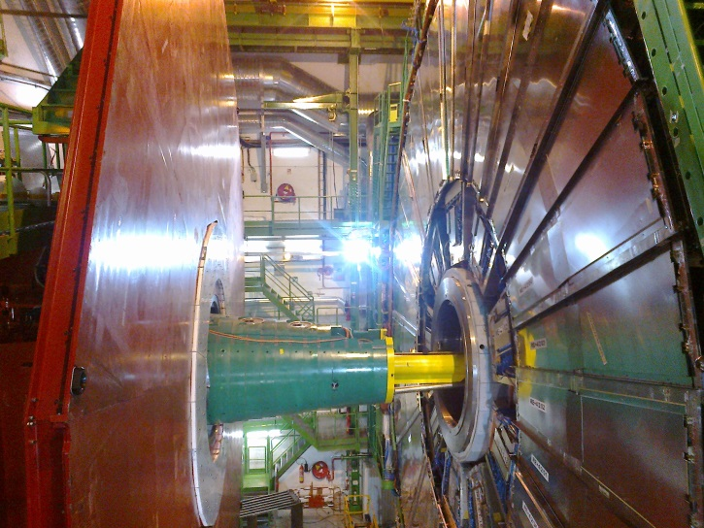
RE4/1 Mounting
Chambers to be mounted between the shielding, CSCs and RE4 SMs
Notice that the Neutron shielding (YE4) moves wrt to the future RE4/1 on the mounted on YE3.

Slide 12
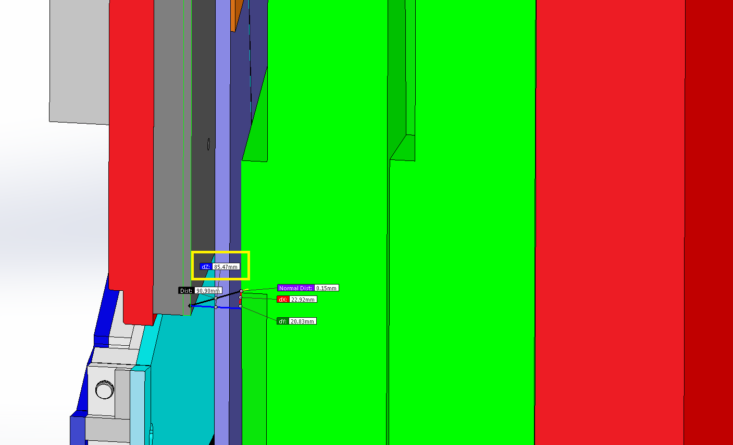
Studies of the value “Z” for RE4/1
Basis on the main drawing of the CMS
Shield
RE4/1
Cross section YE/4
YE/3
YE/4
This smaller Z value will be evaluated to find space that will allow an overlap configuration
85 mm !
ME4/1

Slide 13
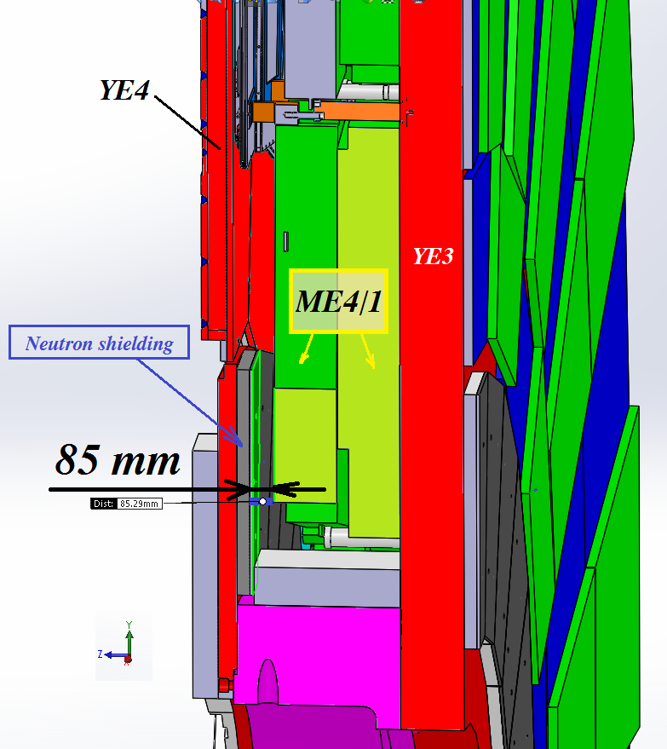
Shield
RE4/1
85 mm !

Slide 14
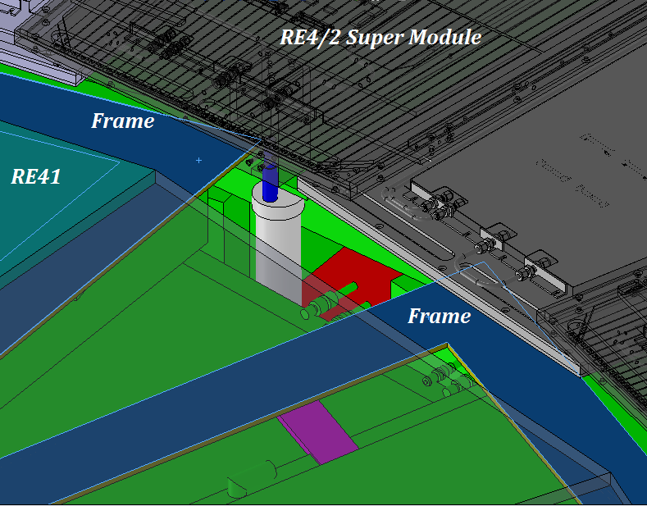
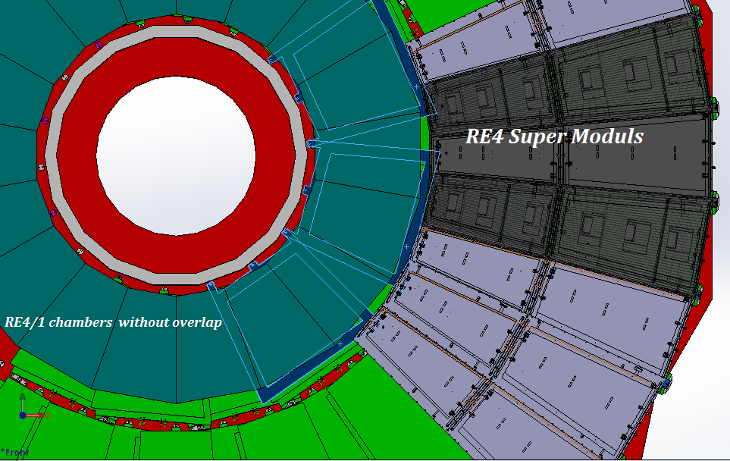
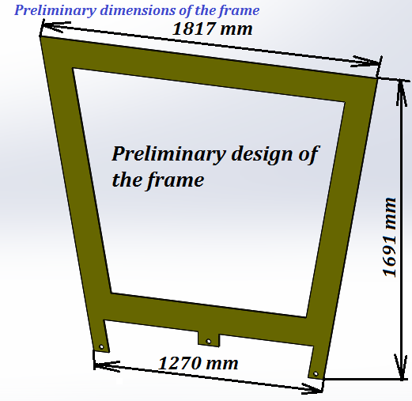
Mounting Plate (MP) for RE4/1 chambers with abutted chambers.
The MP design with overlapped chambers will require more work
Mounting plates
Preliminary design of the mounting plate
Thickness is 8 mm

Slide 15
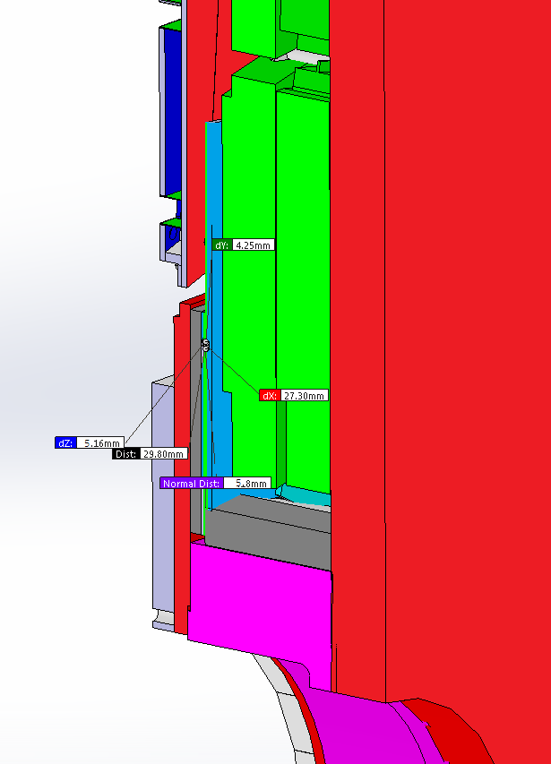
We are working on the space available. Not yet cleat but looks good as we have gained 18mm from 650mm to 668mm. All values are nominal with no tolerance given yet.

Slide 16
Services
HV cables and connectors from USC
LV Power from X2 crates on near and far side
Fibre optics Data/trigger and DCS to USC
Cooling
Gas

Slide 17
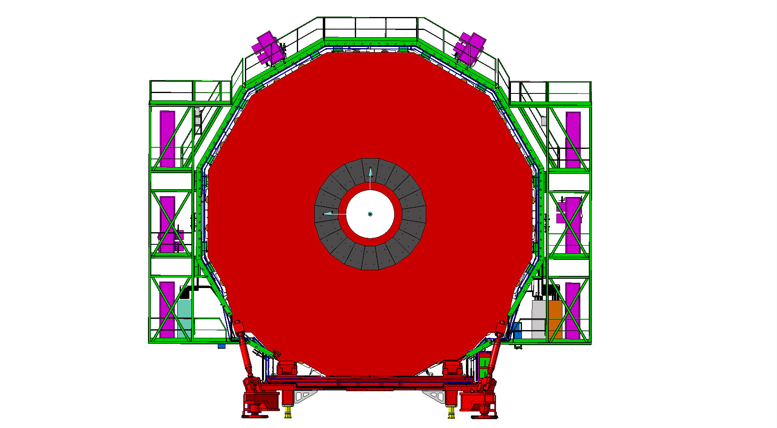
Services on YE3 serving RE3 and RE4
Mini Cable Chains for HV and OF
Mini Cable Chains for HV and OF
LV racks
LV racks
Space for DCC and OF Patch panels
RPC Gas Rack with spare channels

Slide 18
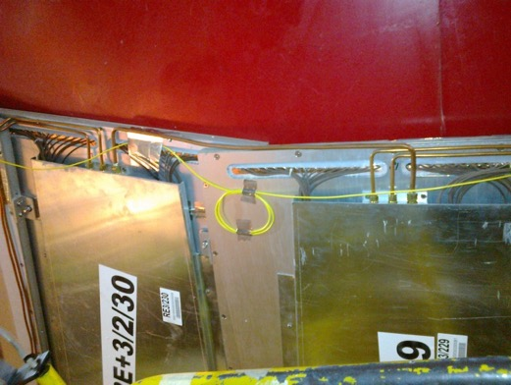
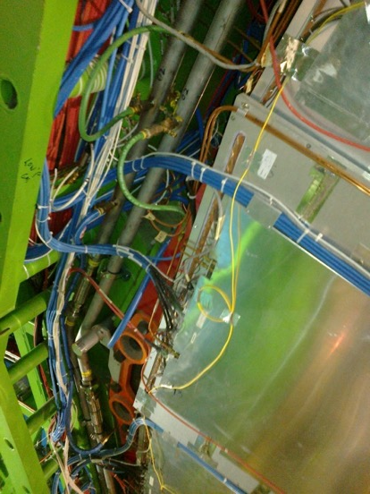
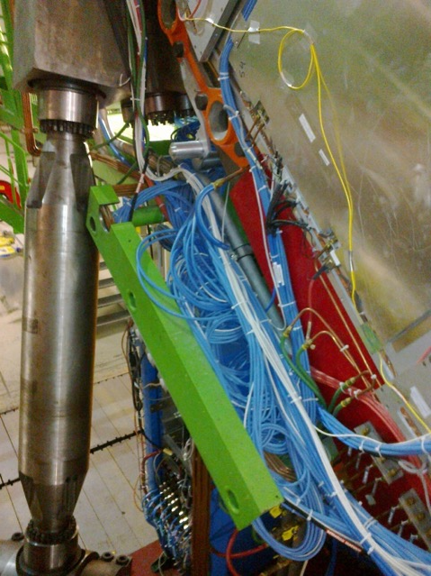
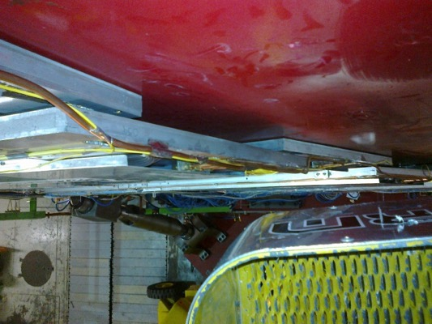
RE3/1 service passages
Space on the periphery is very limited
Service passage to the periphery is under the RE3/2 & RE3/3.

Slide 19
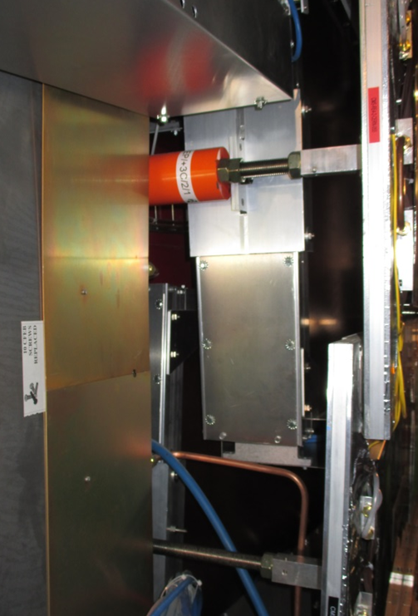
RE4/1 service passage
Service passage between RE4/2 and the ME4/2.
The problems or fears of induced noise will have to be addressed.

Slide 20
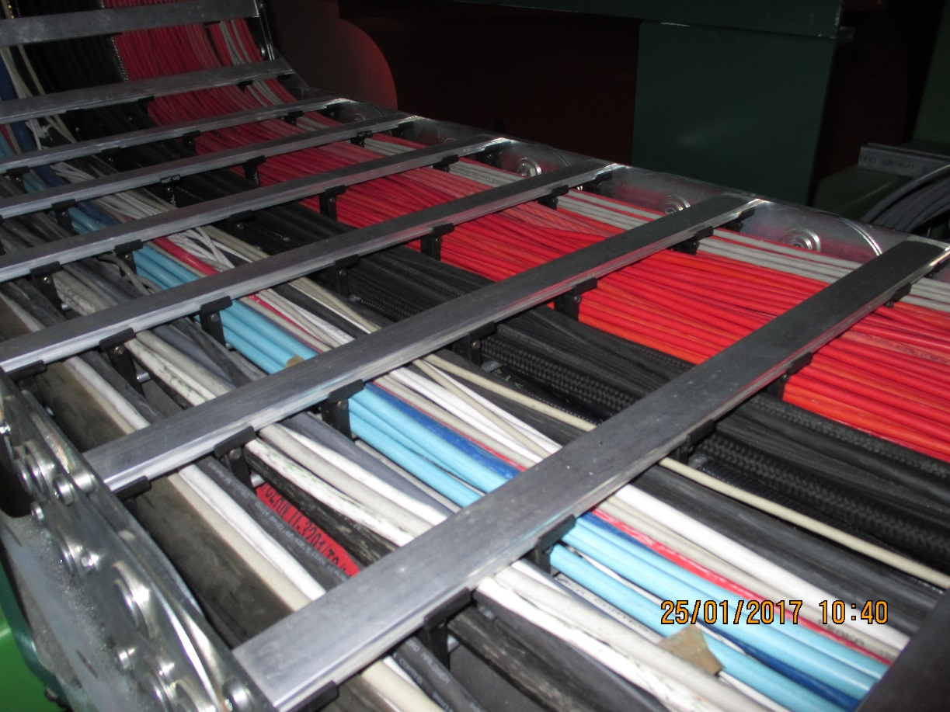
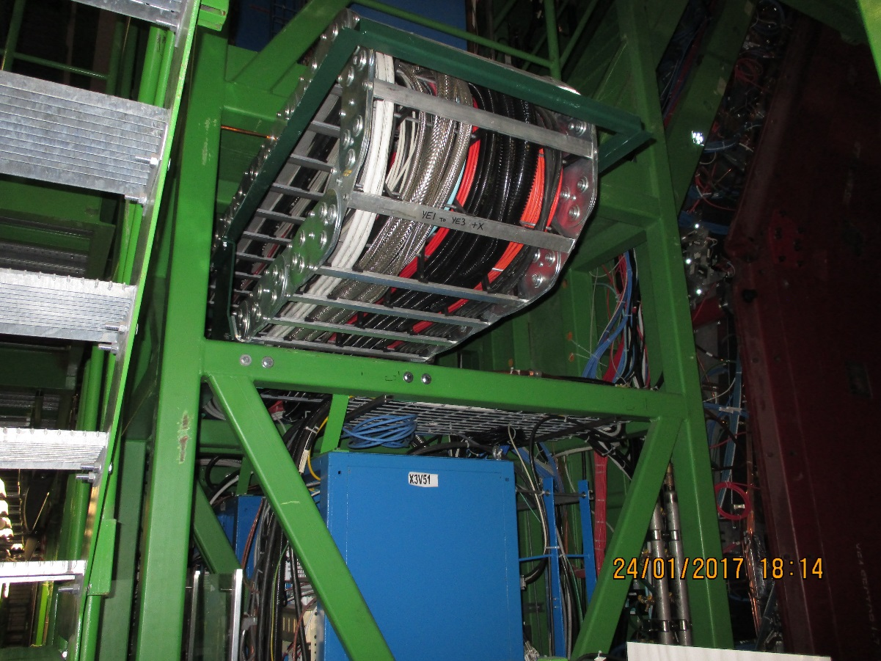
Mini Cable chains between the YE3 and YE1 and its PP are very full.
X3S51 Far
X3V51 Near, there is some space for small HV cables and some FO

Slide 21
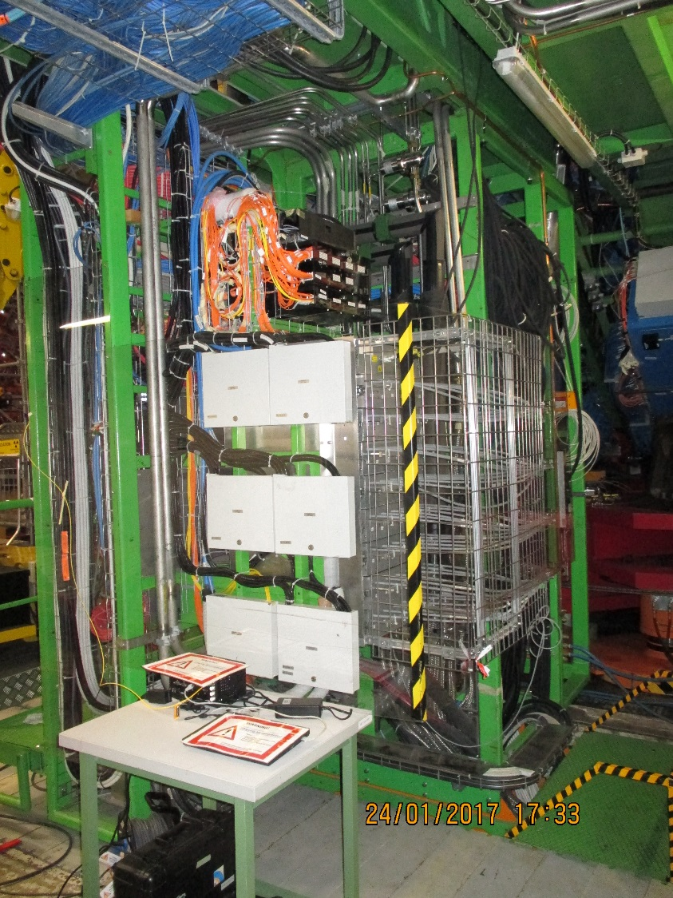
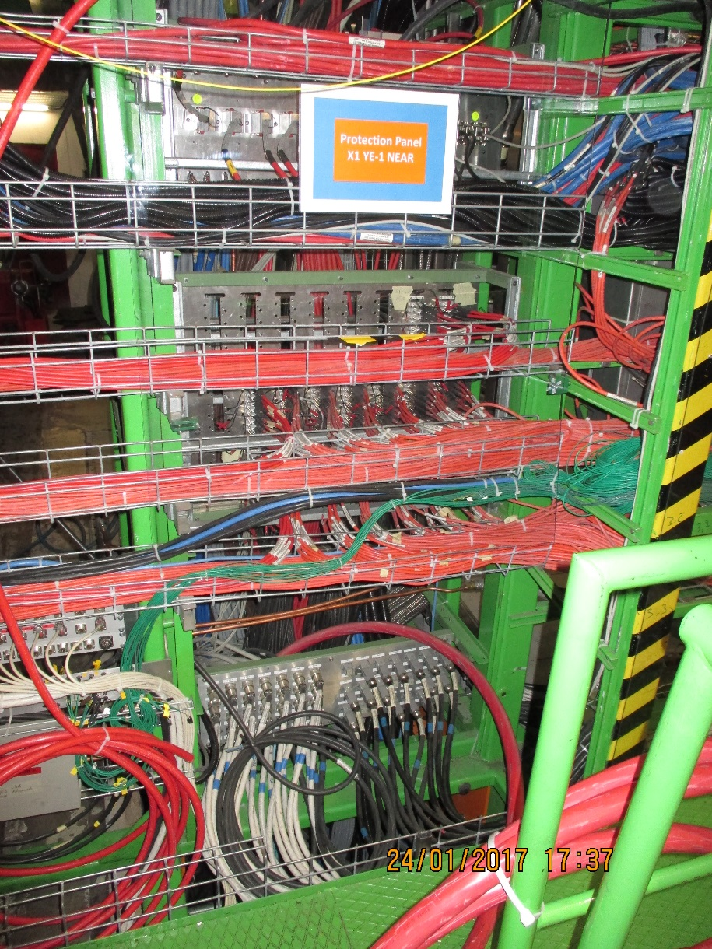
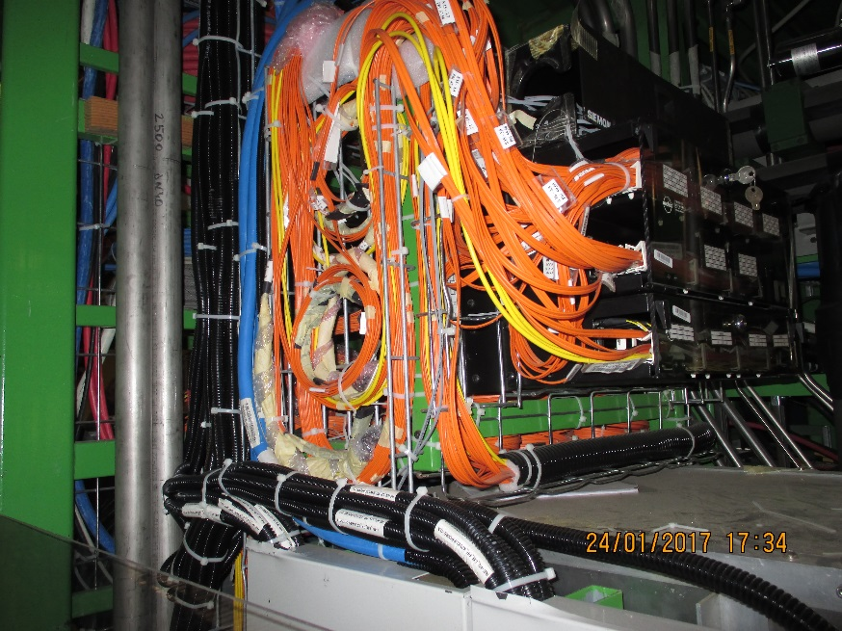
YE 1 Main Patch Panel (PP) for HV and OF

Slide 22
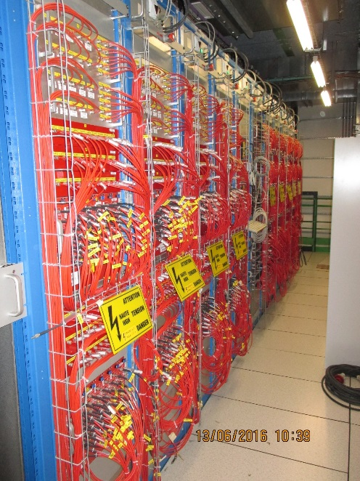

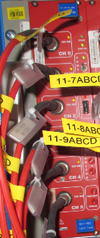
HV cables
USC
UXC
Patch panel: HV CPE Jupiter connectors female/male
On the back : male and female Jupiter connectors
YE1
HV coaxial cable : CPE Jupiter CH-side
Distribution board
HV crate
HV board
Umbilical cable : 1 big cable = 10 individual cables
Coaxial cable
Umbilical has “Jupiter” or equivalent coaxial connector throughout at each end

Slide 23
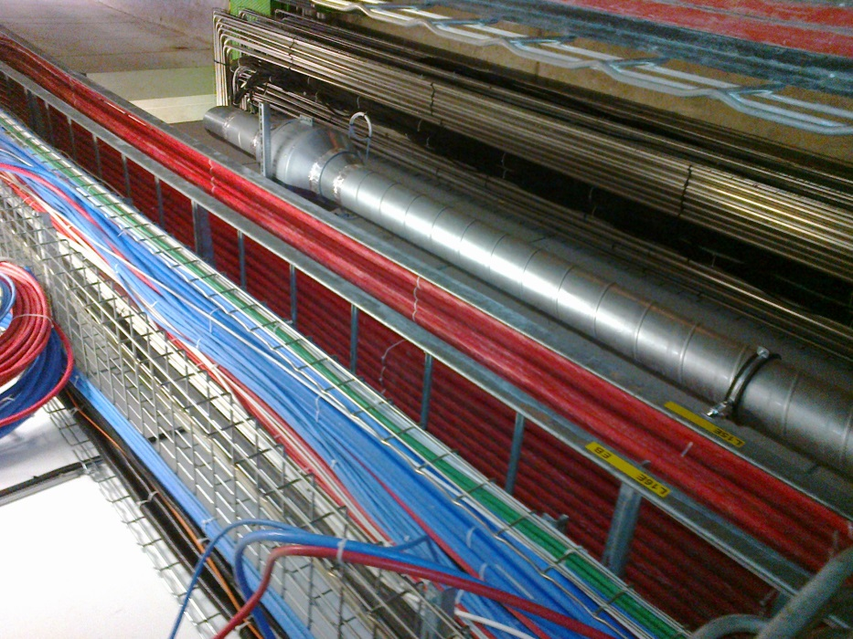
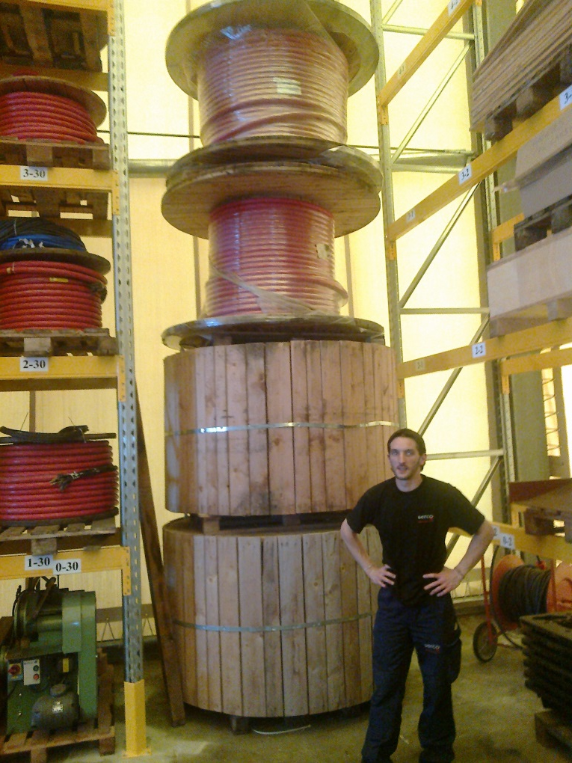
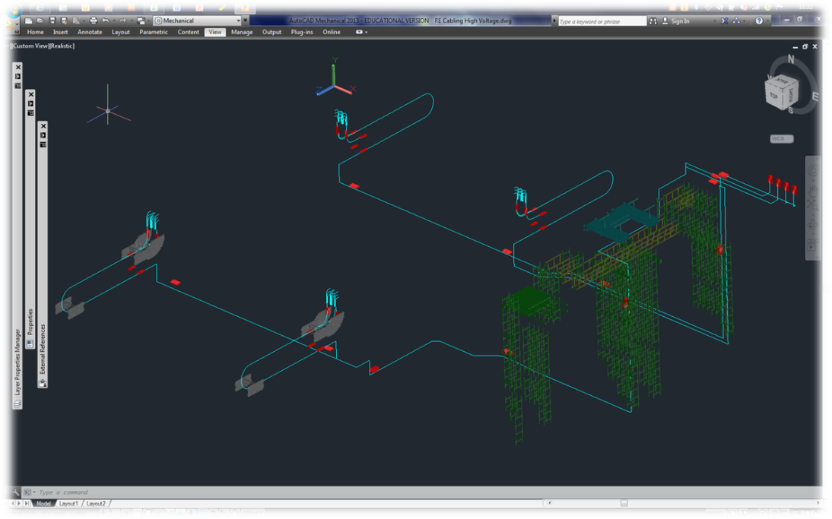
The path is clear and we have the cable. This is a big job
Approx 1.5km
Cable length 57-90m

Slide 24
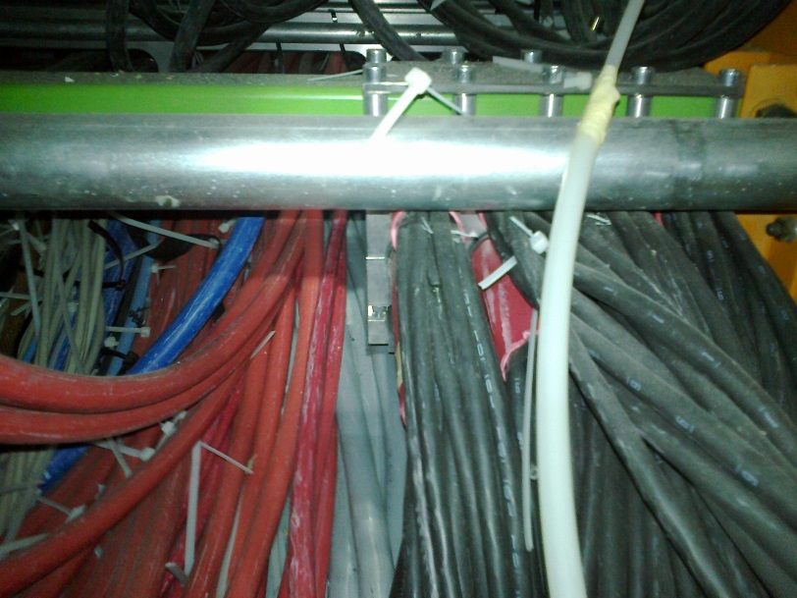
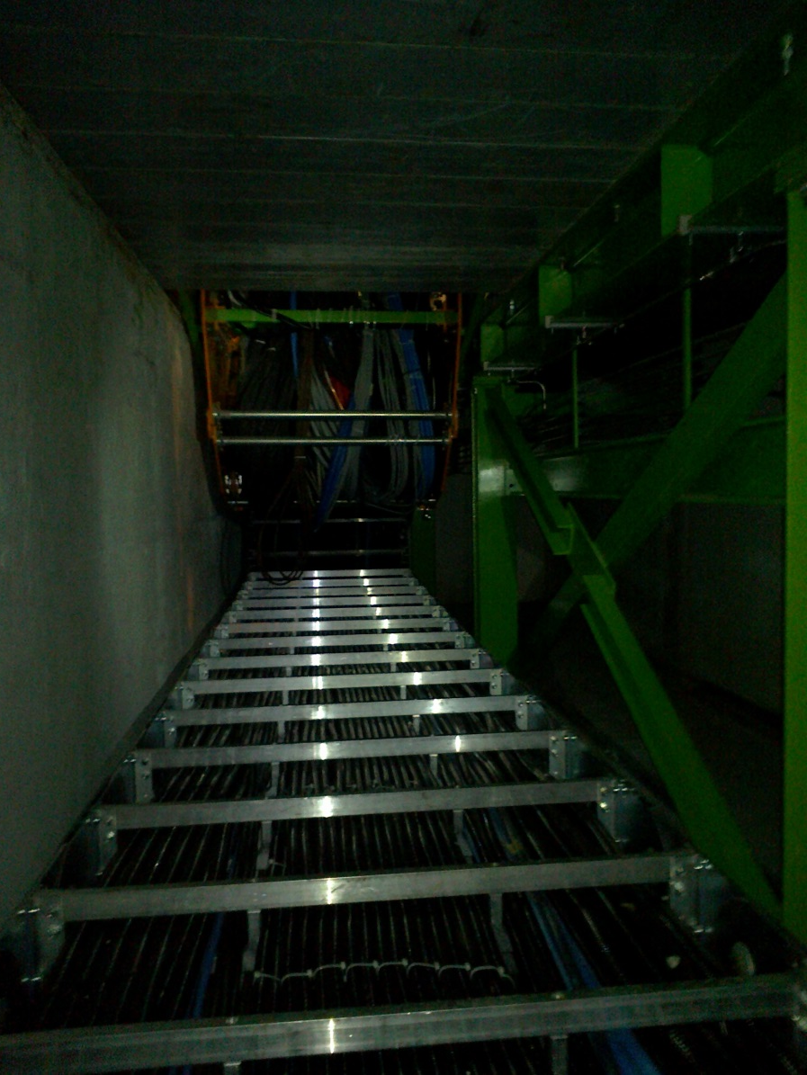
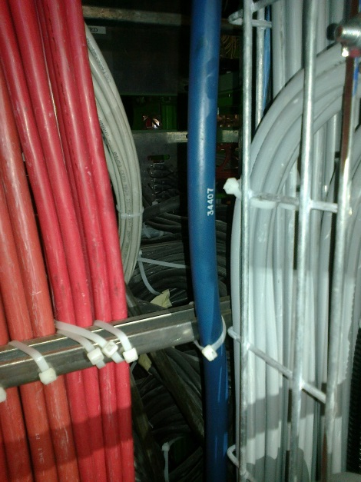
But it gets worse in the last 5% of the path length
Clamp of thee Cable under PP YE1
The Main Cable chains in X0 under CMS
Access to rear of the PP

Slide 25
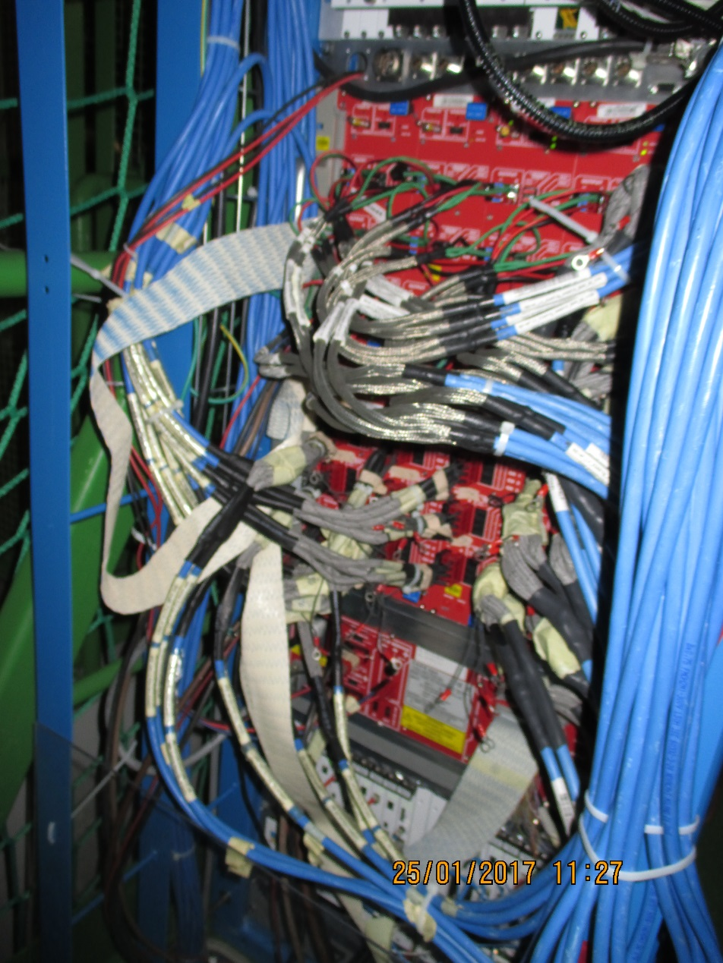
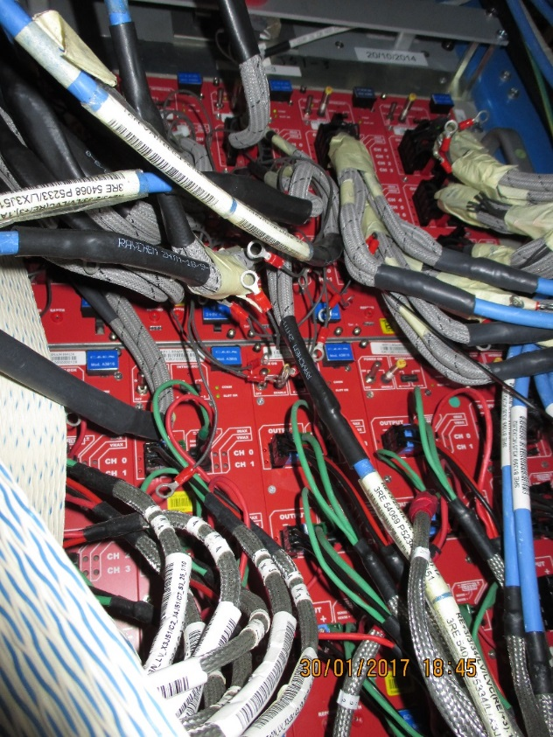
LV Power System
X3A51
LV Power for both RE4/1 and RE3/1 will be taken from the presently installed crates and modules. Re-cabling to liberate these 2 modules will require PP space

Slide 26
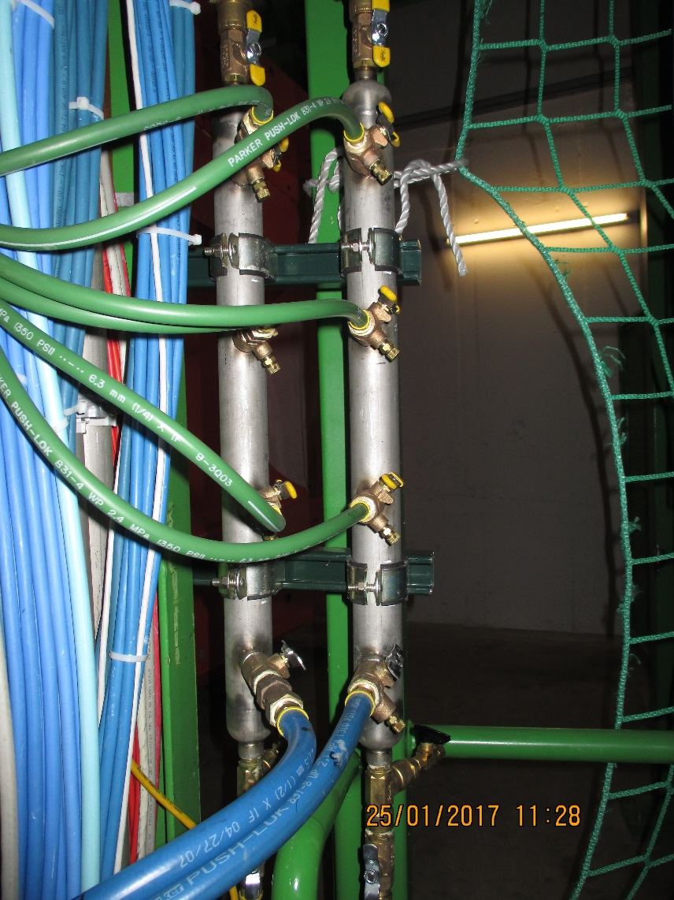
Cooling system
The power loads on the cooling system are not so large so extensions of the present system should give approx. 0.1deg C increase.
Cooling Mini Manifold for RE4/1 cooling to which “T”s and flow restrictors will be added to supply the 9 channels. Hosing from the mini manifolds directly all the way to the RE4/1 will simplify the installation.
The RE3/1 system will be a taken off from the RE3/2s, two RE3/2s for one RE3/1 using the flexible hoses as shown opposite.

Slide 27
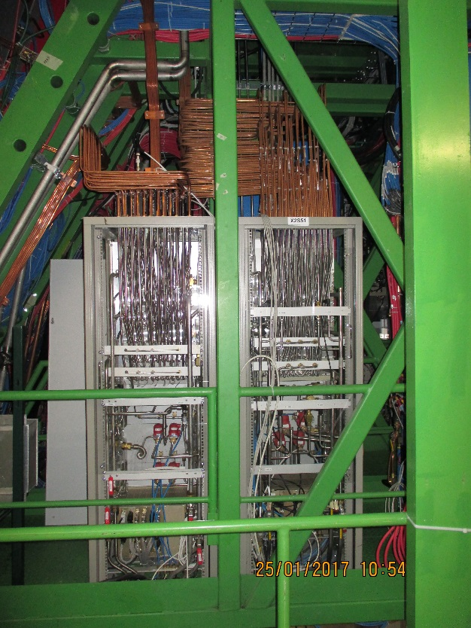
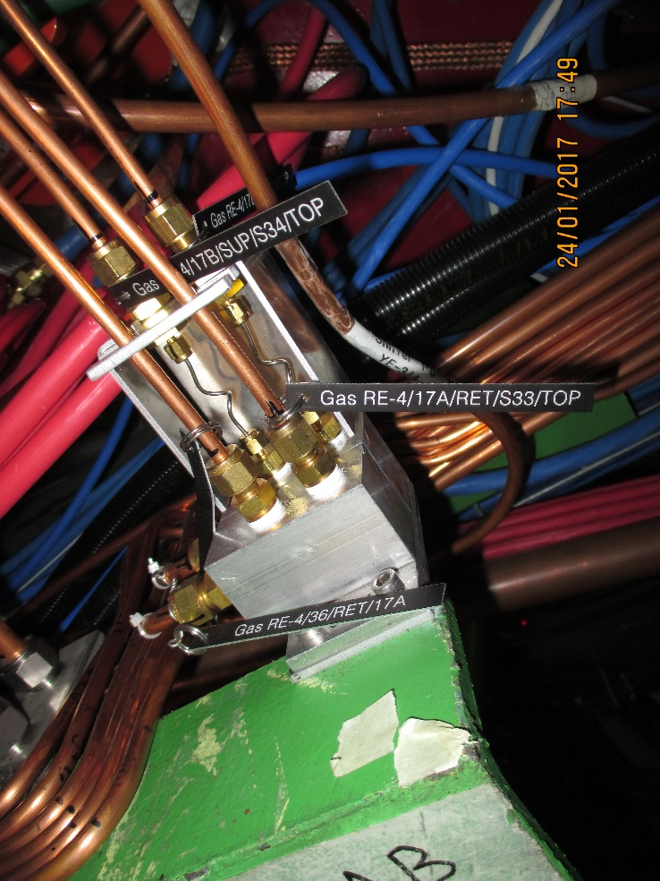
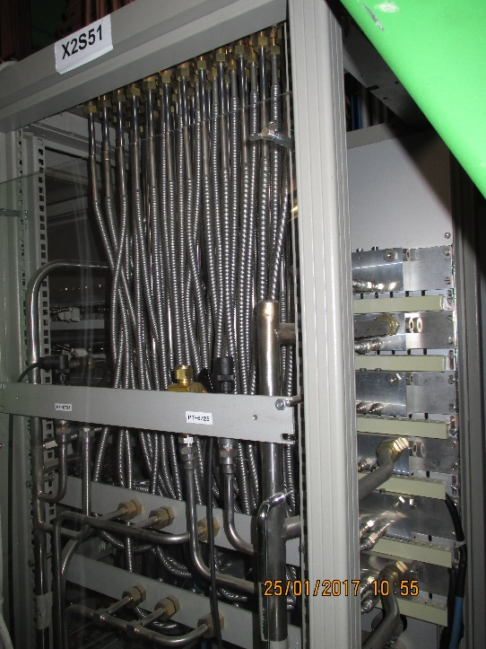
Gas system
The gas system remains un-changed in that the gas racks not modified nor are there any additions. Re-piping of RE3 will be required.
Given the few, 6, channels available for 1 station parallel gas flow is proposed for both the 3 channels on one channel and also the top and bottom gaps.
An example of a two channel impedance distribution for RE4 SMs. For RE3/1 and RE4/1 will require 3 or 6 channel impedance distributors. These are Alu enclosures with unions and SS piping, not rocket science ! But they take space on the periphery.

Slide 28
Conclusions
RE3/1 is well on the way.
Re4/1 volume is less well defined, to be worked/studied if possible insitu
We will have to work hard to ensure that IO allows the HV cables and FOs to pass through the Mini and Main Cable chains.
The gas system distribution from the Gas rack will need detail conception and design.

Slide 29
All drawings and numerous slides are done by Elena.
She has to continue as this is the development phase and the detailing will follow as the final design is approached. Continual changes will be made as we move along this path.

Slide 30
Back up

Slide 31
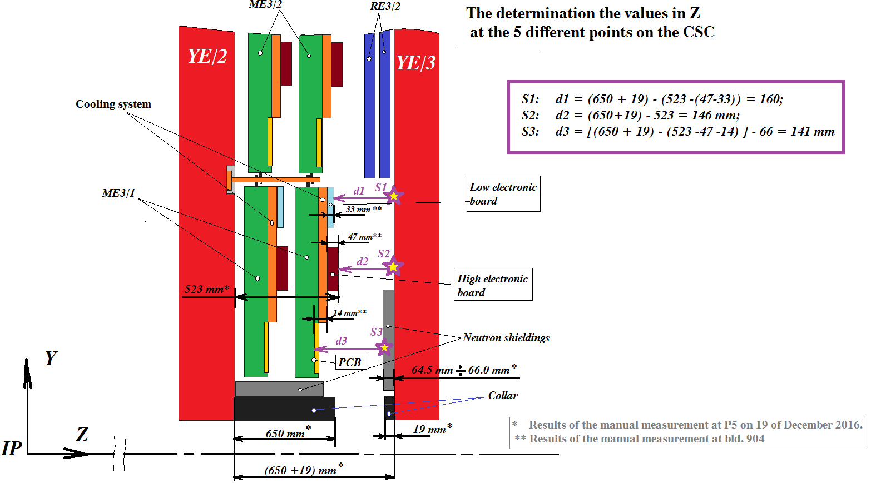
200.8mm
201.8mm
197.8mm
167.1mm
151mm
Values obtained from IR sensors in Red

Slide 32
Values taken on outer “R” at 3 different locations on both –Z and +Z on 25 April 2017. Discs closed.
178-174mm
Mean 176mm
145-145mm
14mm
ME3/2
RPC space
176 - 14 = 162mm
Drawings = 146mm
RE3/2
YE2
YE3
RPC space over the N. Shield
162 – 66 = 96mm
Standard RPC 29mm gives 68mm with mounting brackets. Leaving a generous clearance to CSCs of 28mm.
Was 88mm from drawings.
668-672mm
Mean 670mm

