Slide 1
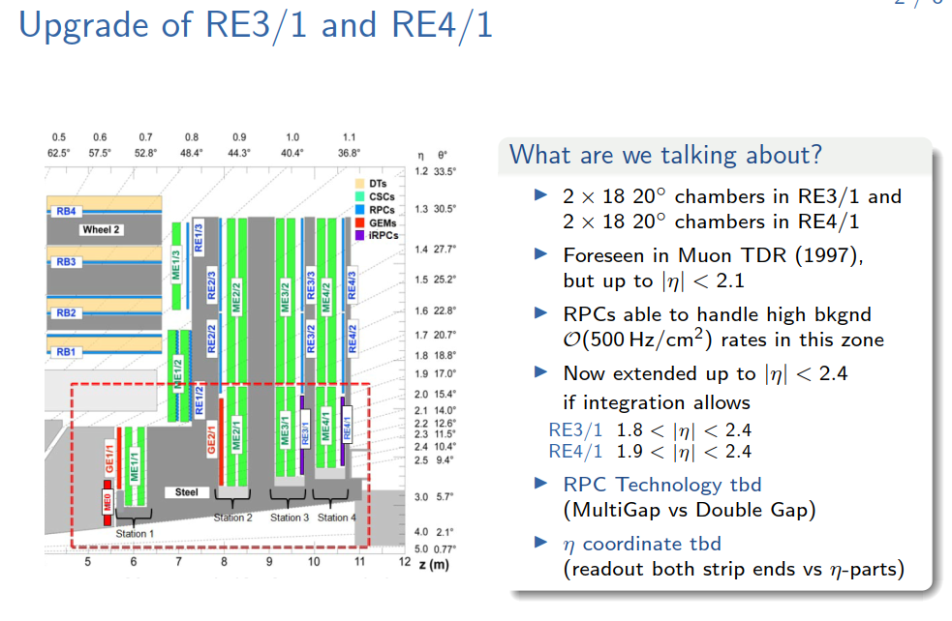
HPL DG d=1.4mm/e=1.4-1.6mm

Slide 2
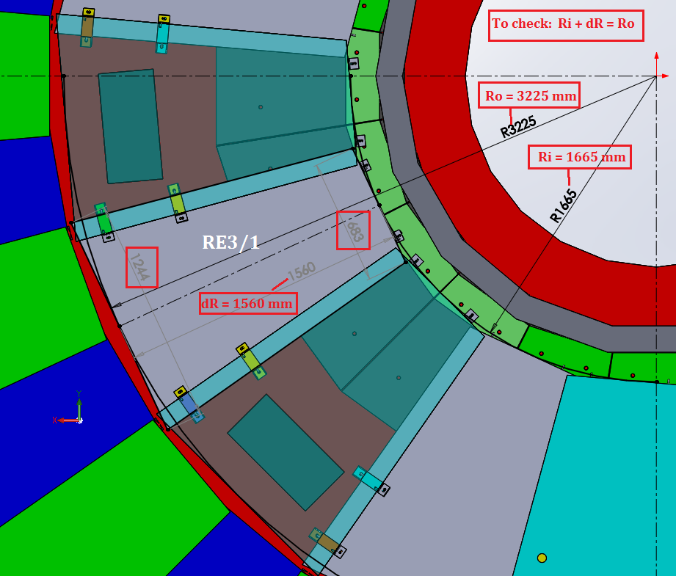
Ian Crotty
30-31/05/2017
Overall Dimensions of RE3/1 with inner Mount to Neutron shielding
Lost space if the direct mount to the N. shield is retained
Development with IO will be required to increase the coverage back to the cylindrical N. shield.

Slide 3
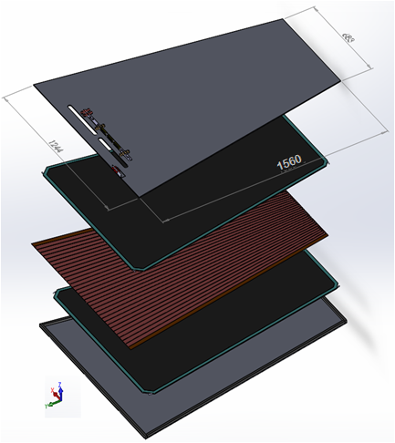
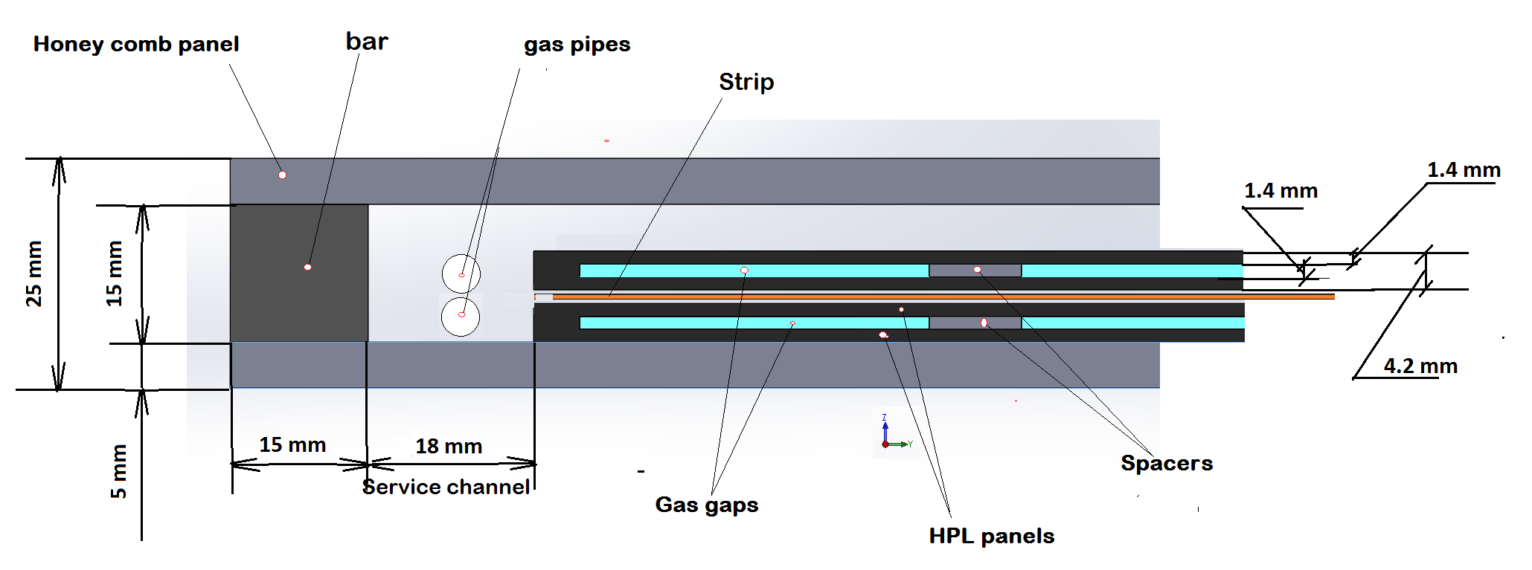
Design RE3/1 RPC chambers
Double gap RPC chamber
PP under work
* Clearance between ME3/1 and RE3/1 will be
(80 ± 1 ) – (5 + 25 + 5 +25) = 20 ± 1 mm,
where
thickness RPC chamber is 25 mm;
thicknesses honeycomb panel is 5 mm.
Ian Crotty
30-31/05/2017
Cross section of double gap RPC chamber
From Kodel BT design we know that the chamber will fit in this mechanics

Slide 4
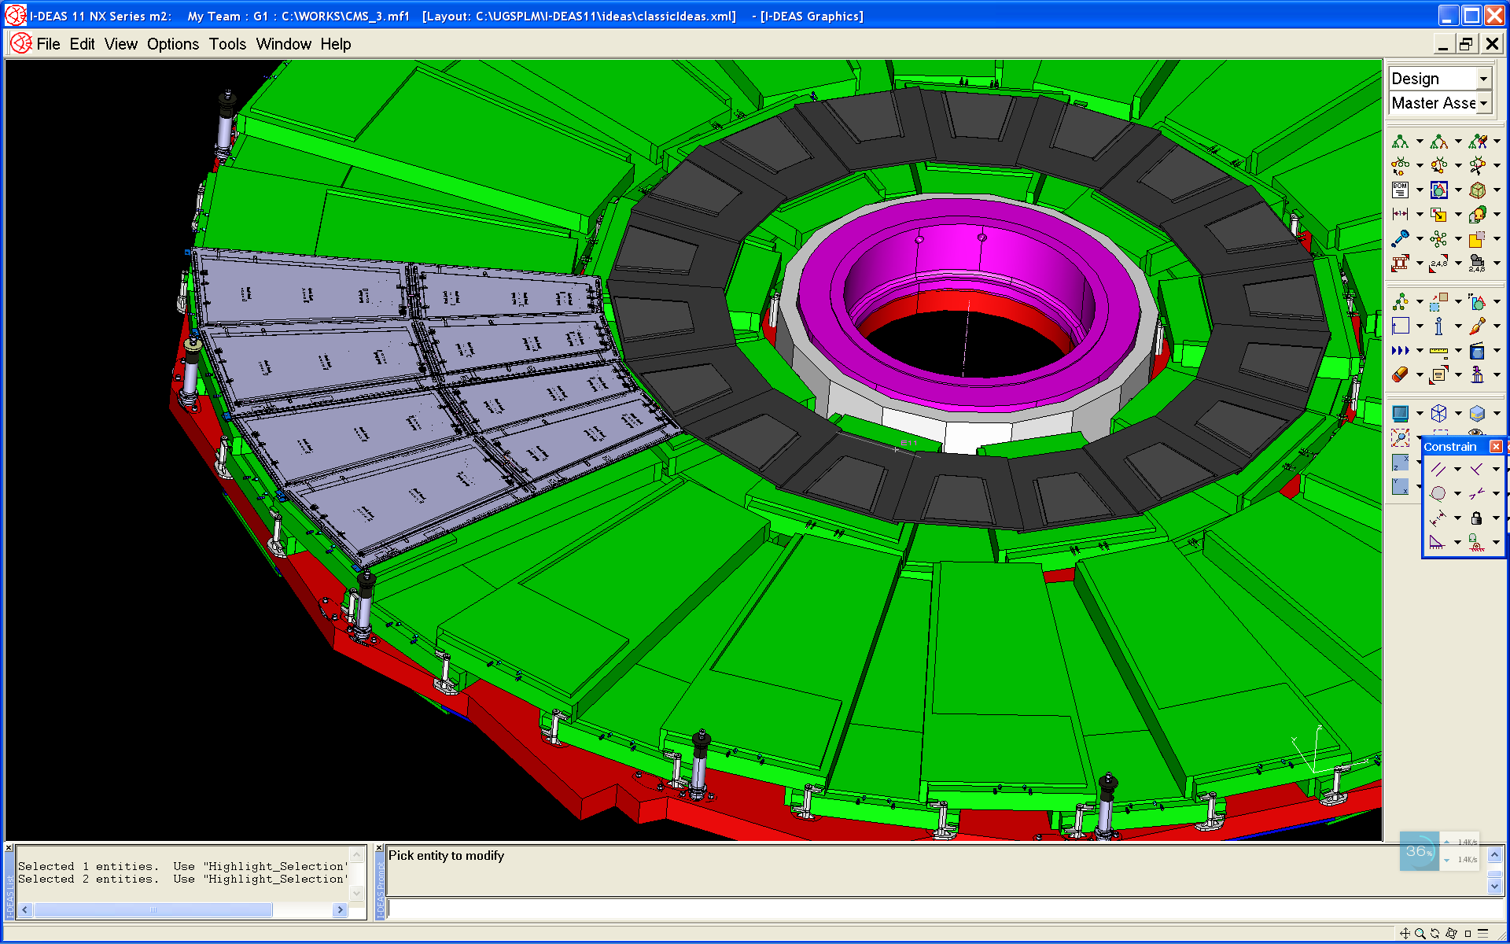
RE4-1 chambers
RE4-1
Ian Crotty
10/02/2015
RE42-3

Slide 5
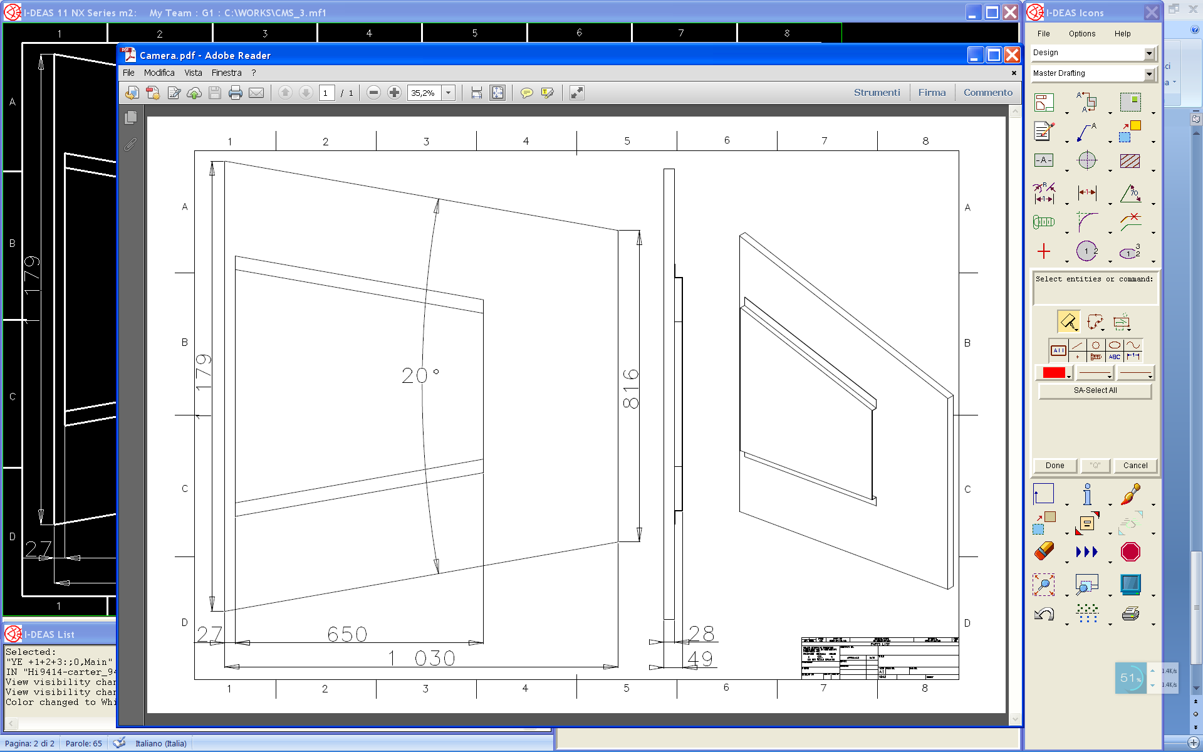
RE4-1 chamber
Ian Crotty
10/02/2015
20° chamber
Long 1030 mm
Large 1179 & 816 mm
18 top chambers
18 bottom chambers
Service Carter shorter
for space issue
70 mm thickness available

Slide 6
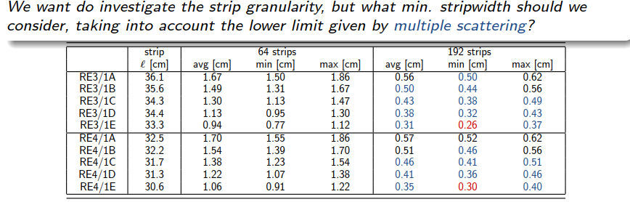
Initial TDR (2007)
|η| < 2.1 Geometry
◮ 2 rolls (η-partitions) :: A,B
◮ Δη ≈ 0.12
For the New TDR (2017)
|η| < 2.4 Geometry
◮ 5 rolls (η-partitions) :: A-E
◮ Δη ≈ 0.12 (|η| < 2.1)
◮ Δη ≈ 0.10 (|η| < 2.4)
Is it possible to keep the 5 partitions from the readout point of view ;
Strip PCBs design, FEB & cabling
Strip pitch:
96 strips / 20 degrees :
min max
Re3.1 0.52 1.24
Re4.1 0.6 1.24

Slide 7
b
RE3/1 layout
RE4/1 layout
REG1
h
REH1
a
REG2
REH2
REG3
RE3/1 & RE4/1 dimensions in CMSSW
REH3
REG4
REH4
REG5
REH5
REG1 h = 32.1 cm a = 101.36 cm b = 112.68 cm
REG2 h = 32.1 cm a = 89.68 cm b = 101.0 cm
REG3 h = 32.1 cm a = 78. cm b = 88.92 cm
REG4 h = 32.1 cm a = 66.34 cm b = 77.66 cm
REG5 h = 32.1 cm a = 54.66 cm b = 65.98 cm
REH1 h = 28.1 cm a = 104.1 cm b = 114.0 cm
REH2 h = 28.1 cm a = 93.82 cm b = 103.74 cm
REH3 h = 28.1 cm a = 83.56 cm b = 93.48 cm
REH4 h = 28.1 cm a = 73.3 cm b = 83.22 cm
REH5 h = 28.1 cm a = 63.04 cm b = 72.96 cm

Slide 8
Strips | Angle [mrad] | Width (min) [cm] | Width (max) [cm]
32 | 10.9 | 1.708 | 3.521
64 | 5.5 | 0.854 | 1.761
128 | 2.7 | 0.427 | 0.880
192 | 1.8 | 0.285 | 0.587
RE3/1

Slide 9
Strips | Angle [mrad] | Width (min) [cm] | Width (max) [cm]
32 | 10.9 | 1.658 | 3.563
64 | 5.5 | 0.829 | 1.781
128 | 2.7 | 0.414 | 0.891
192 | 1.8 | 0.276 | 0.594
RE4/1

Slide 10
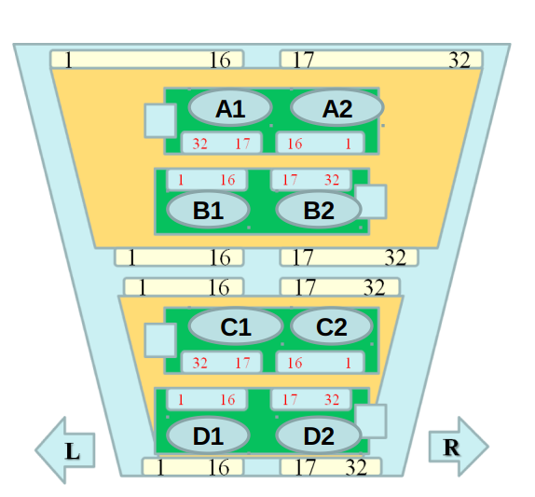
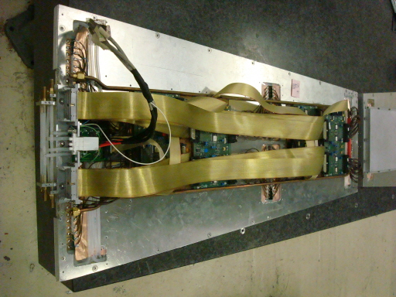
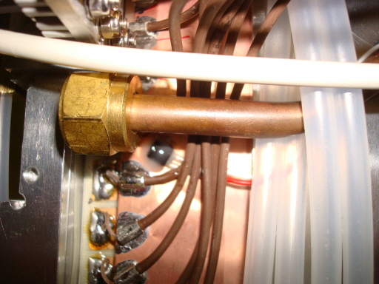
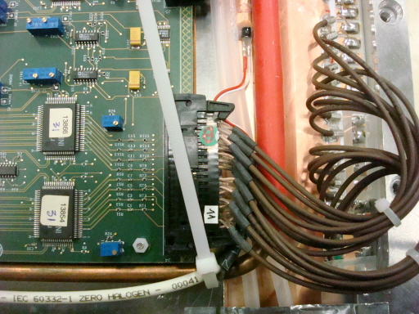
Assembly of RE1/1 chambers
KODEL, Korea university
Built 4 chambers in 2008-2009
10 degrees/4 aprtitions
Eta :1.8→2.1

