Slide 1
RE4-1 and RE3-1
Pigi, Pino Passeggio, Francesco Cassese and Ian Crotty

Slide 2
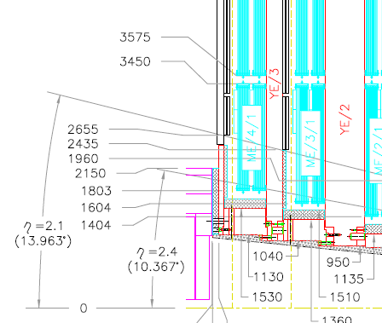
RE4/1 & RE3/1
As planned high Eta up to 2.1.
Extending to Extra High Eta
= 2.4 or 2.5

Slide 3
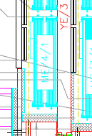
Boundries on Extra High Eta
Alignment lines
RE4/1
ETA=2.1
RE3/1
Neutron Shielding on Vertical faces of yoke
Cylindrical Neutron Shielding

Slide 4
Constraints about RE4-1
After a meeting with Andrea Gaddi and his team we agreed about few constraints:
Total thickness of the 2 layer (top and bottom) is 70 mm
  Possible increase is under study but with few caveat (alignment and shielding)
  RE4 present chamber are 50 mm (carter included)
Service carter must be shorter than the chamber (for having two superimposed layer of chambers)

Slide 5
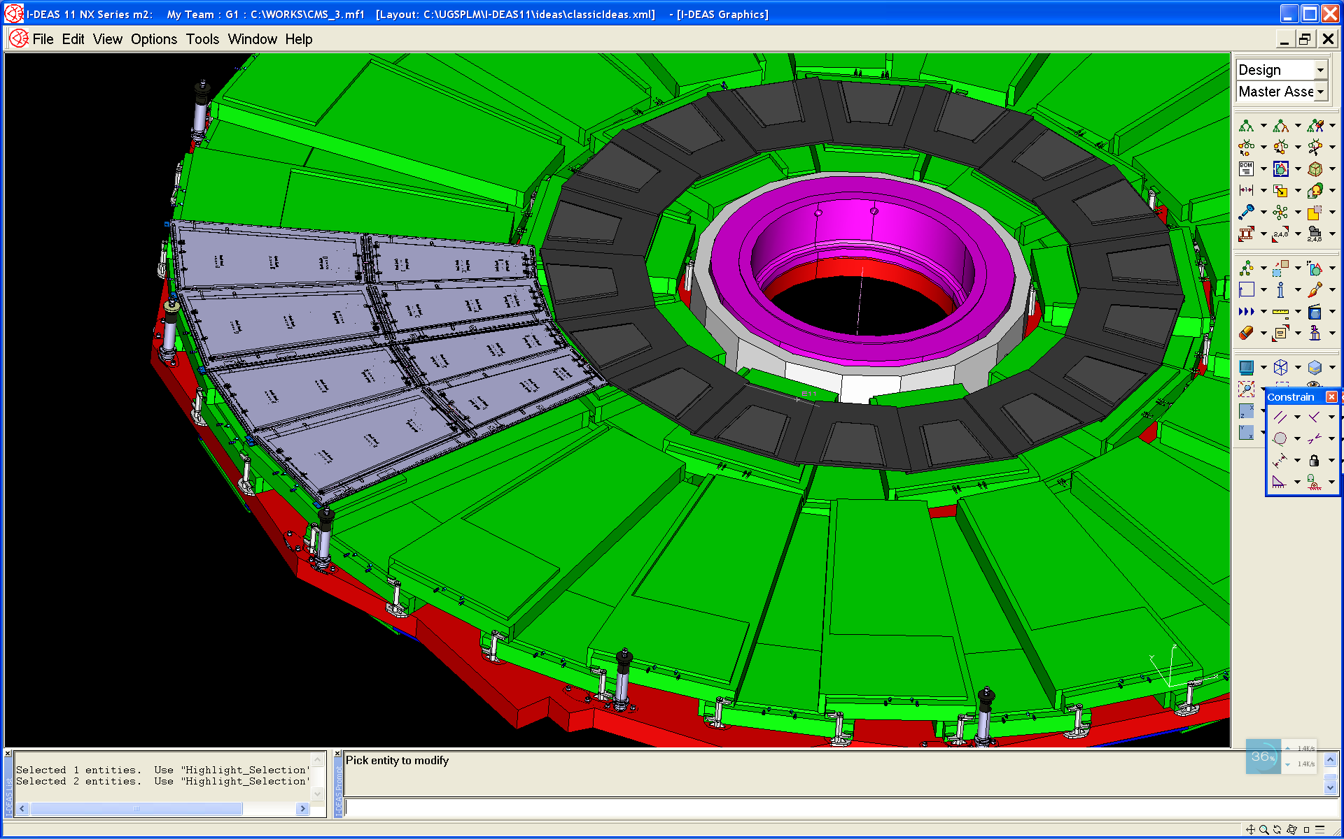
RE4-1 chambers
RE4-1
RE42-3

Slide 6
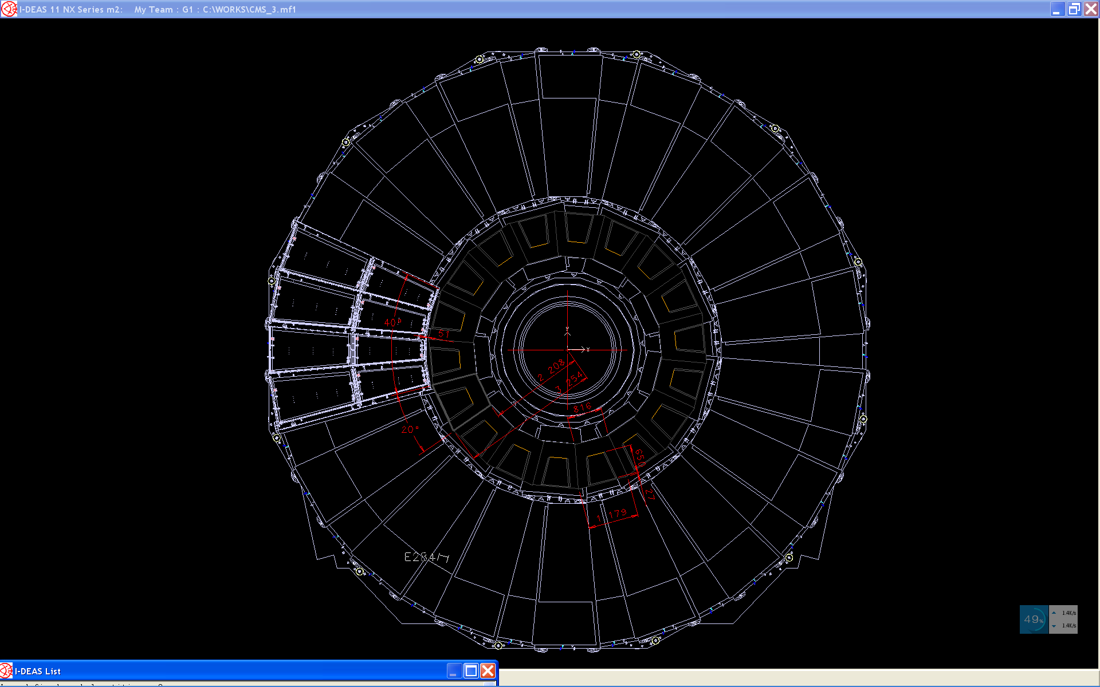

Slide 7
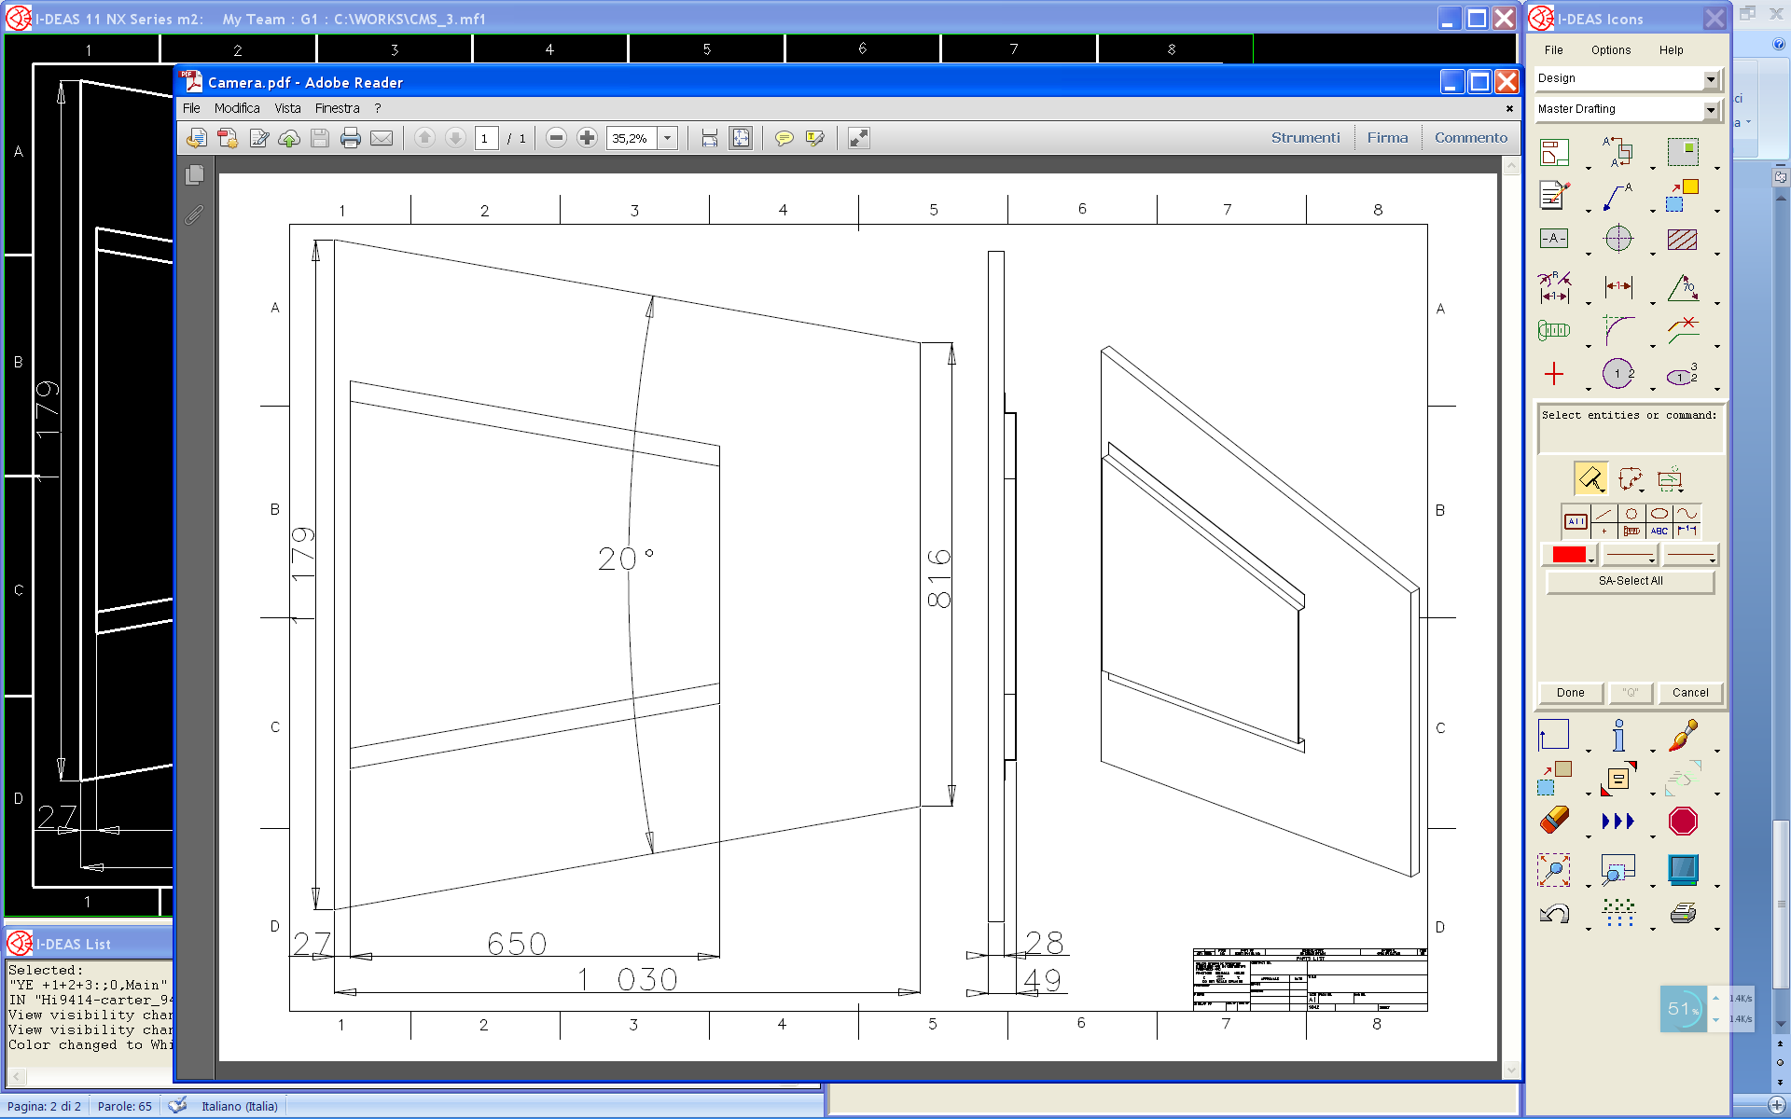
RE4-1 chamber
20° chamber
Long 1030 mm
Large 1179 & 816 mm
18 top chambers
18 bottom chambers
Service Carter shorter
for space issue
70 mm thickness available

Slide 8
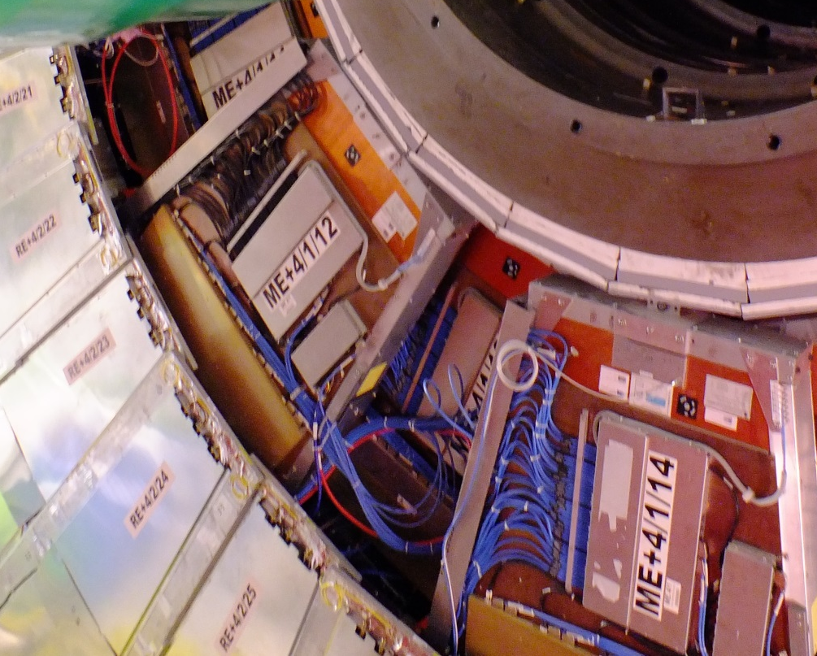
Mounting RE4/1
Outer radius mounting posts are hidden behind RE4SM

Slide 9
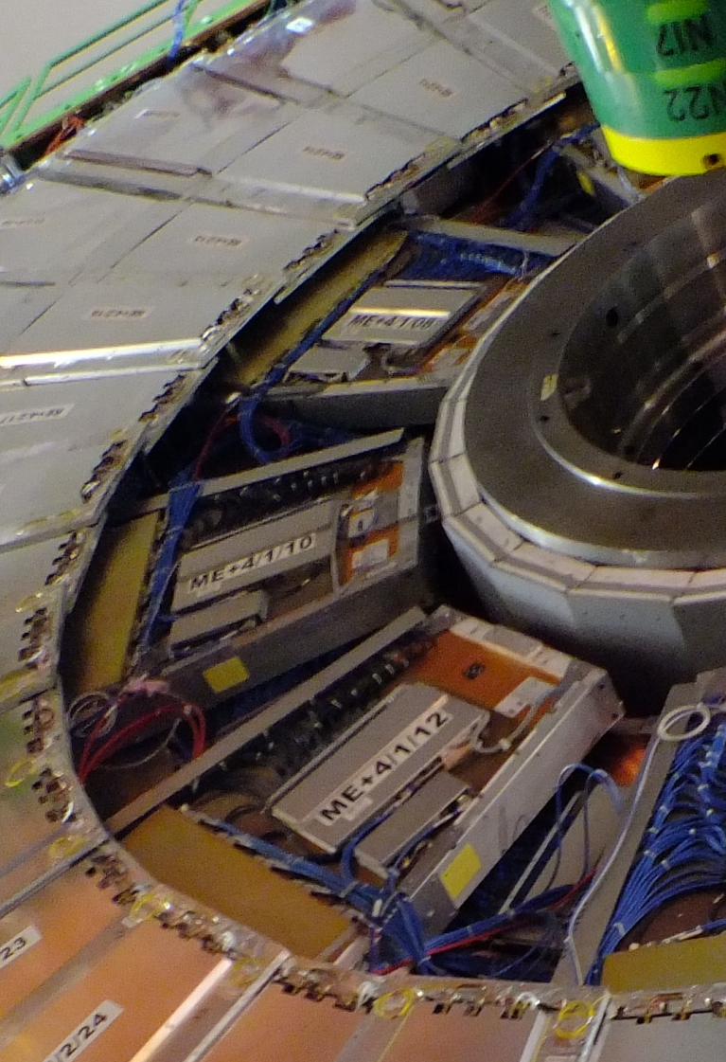
Access to Periphery
Lead cables and pipes over the top of the RPCs,
OR
Under them where the space was for the alignment system .

Slide 10
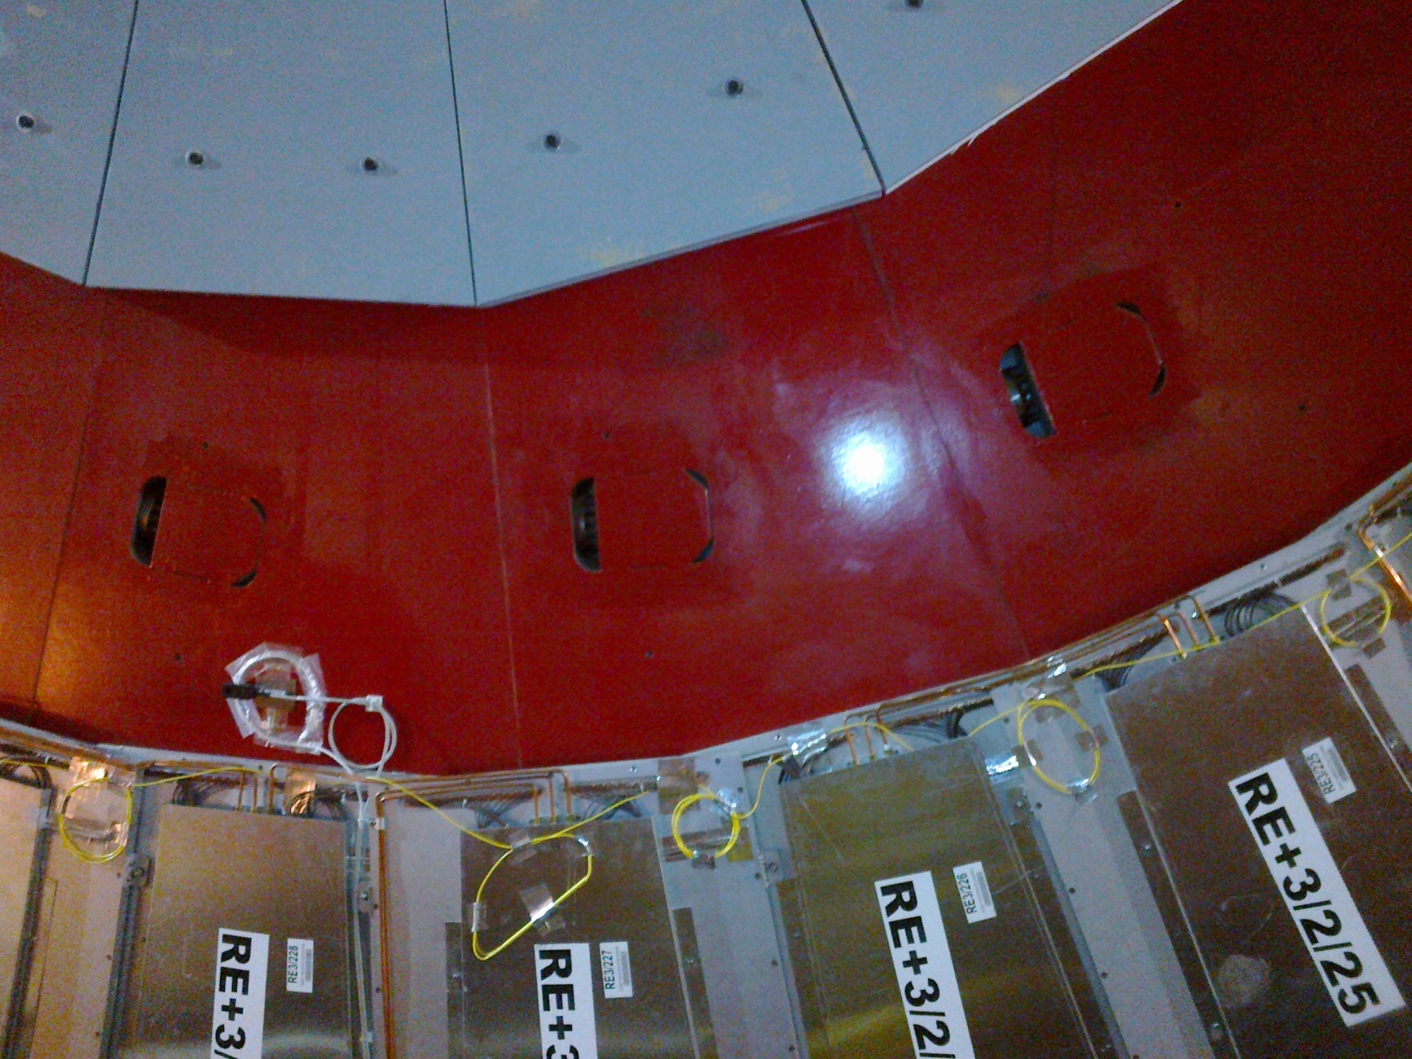
Mounting RE3/1
M12 Mounting Holes for 20deg Chambers

Slide 11
