Slide 1

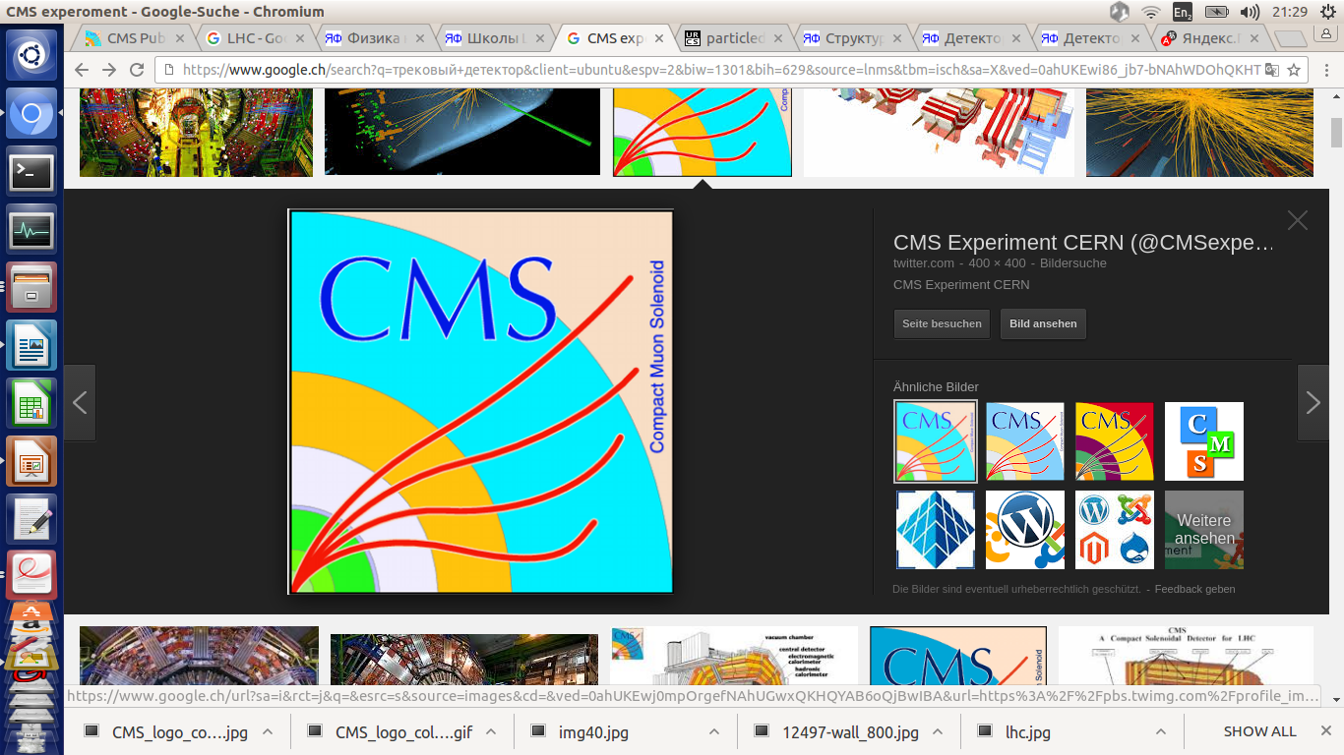


Mock-up and integration status
^{1,2} E. Voevodina, ³ I. Crotty, ^{2,3} S. Buontempo,
³B. Smiljkovic
¹ Universita Federico II di Napoli, 1-80125 Napoli,
² Istituto Nazionale di Fisica Nucleare (INFN), Sezione di Napoli,
³ European Organization for Nuclear Research, Geneva (Switzerland)
RPC Upgrade Working Meeting RPC, 21 February 2017

Slide 2
3 methods to determine the value "Z" for RE3/1
1. Survey using laser scanner and laser tracker;
2. Manual measurements;
3. IR - sensors.

Slide 3
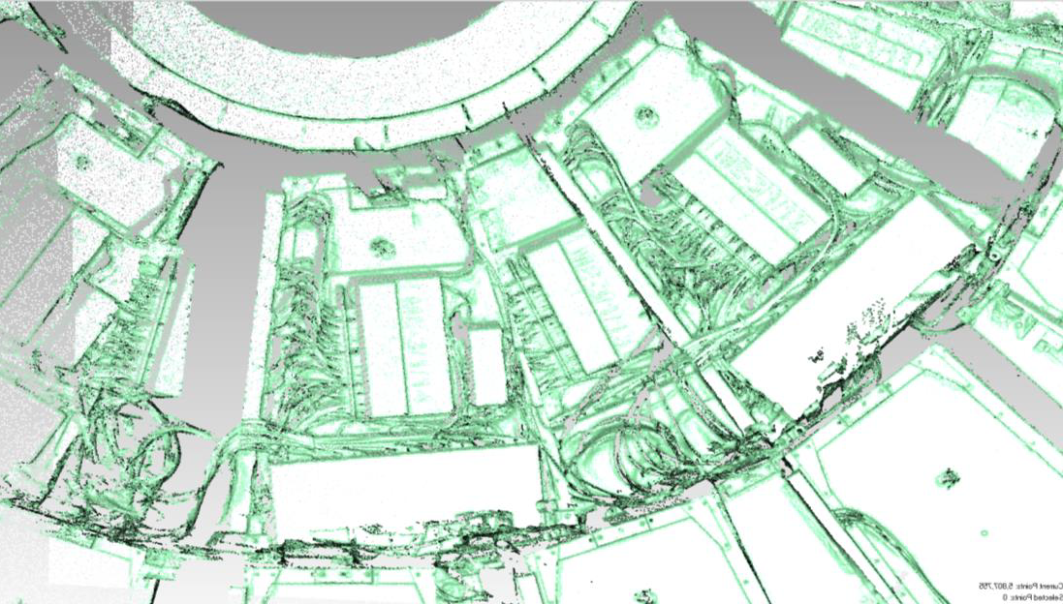
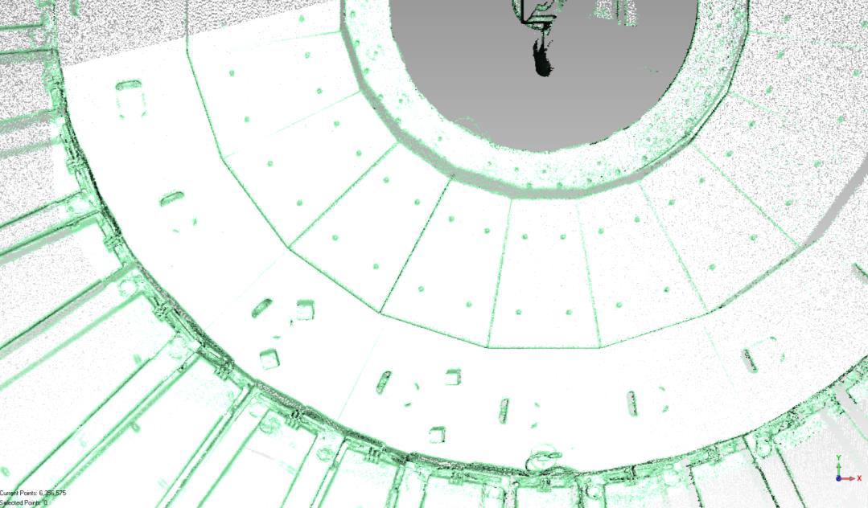
Analysis Data from Laser Scanner
19th of December 2016
Results of Scanning of Space between YE/-2 and YE/-3 for RE-3/1 in P5
ME-3/1/13
Extract of YE-2 point cloud, around CSC chamber ME-3/1/13
The average error is +/-1.8 mm;
The max. error is +/-3.0 mm
Extract of YE-3 point cloud, surface in front of CSC chamber ME-3/1/13
Neutron shielding
RE -3/2

Slide 4
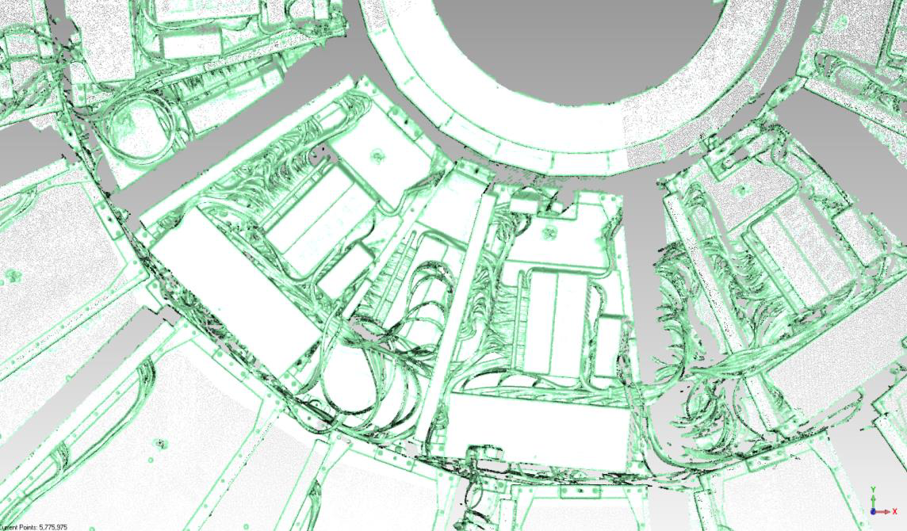
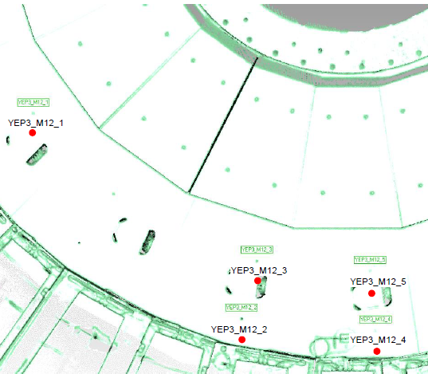
Analysis Data from Laser Scanner
10th of January 2017
Results of Scanning of Space between YE/+2 and YE/+3 for RE+3/1 in P5
Extract of YE+2 point cloud, around CSC chamber ME+3/1/13
The average error is +/-2.5 mm;
The max. error is +/-3.0 mm
Inspection of the positions of the M12 holes
Extract of YE+3 point cloud, surface in front of CSC chamber ME+3/1/13

Slide 5
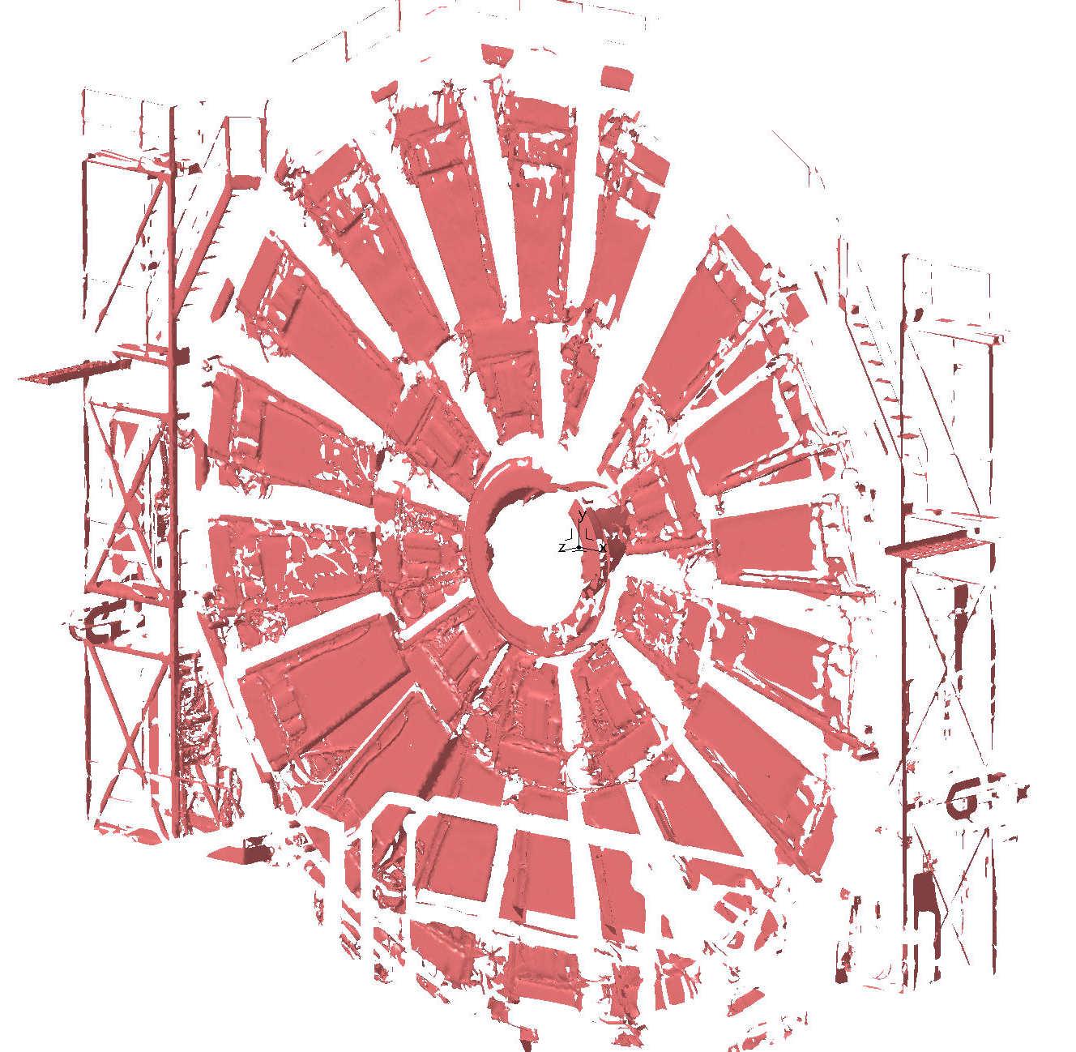
Scan
Scan YE/-2

Slide 6
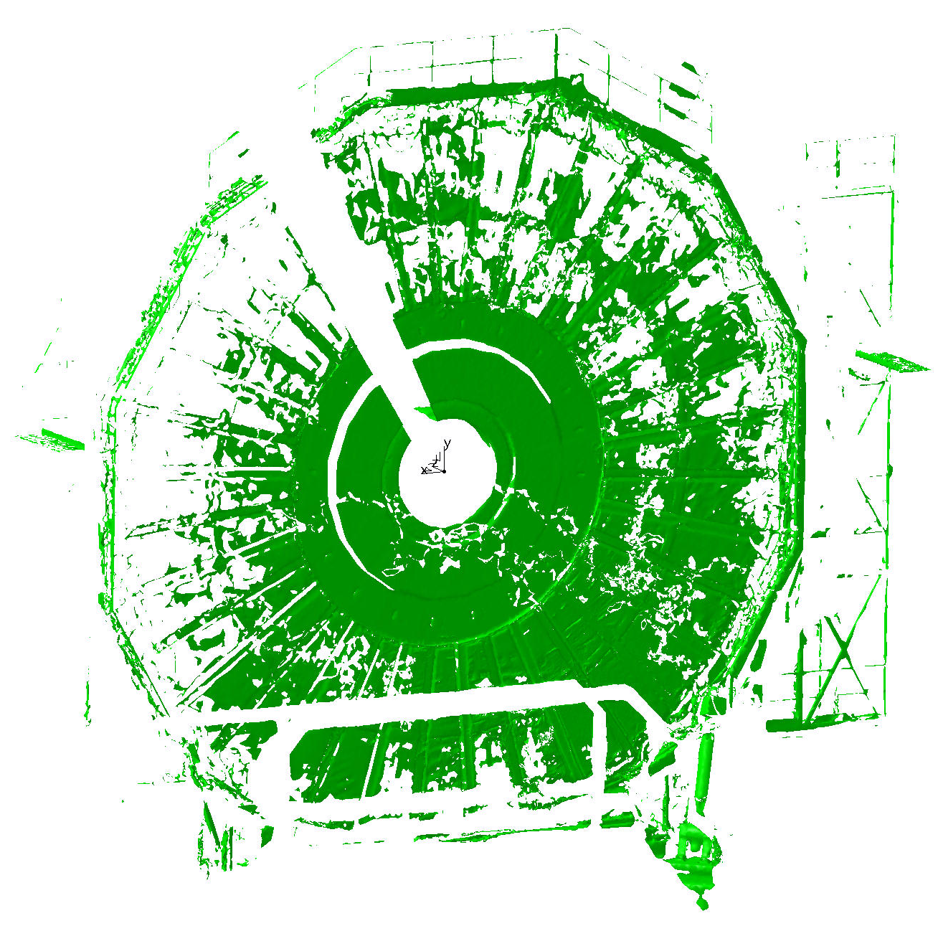
Scan YE/-3

Slide 7
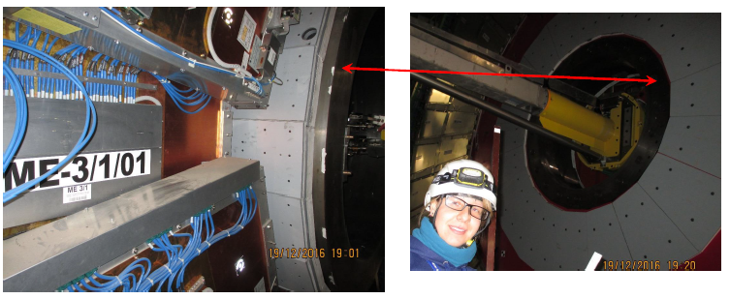
Manual measurements
YE/-2
YE/-3
Collar

Slide 8
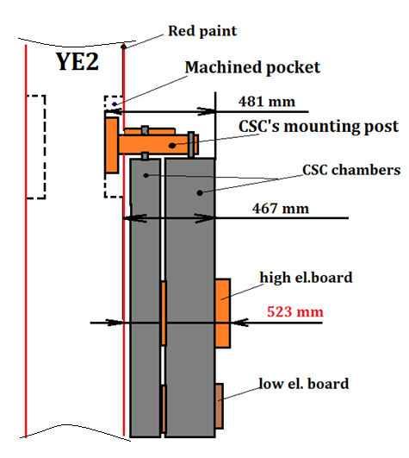
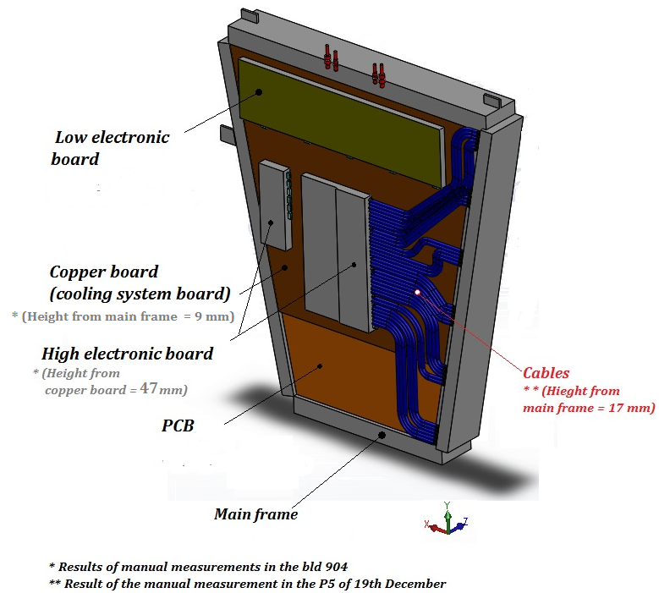
Results from manual measurements
Principle scheme of the manual measurements in the CSC chamber
Nuances of the CSC chamber design

Slide 9
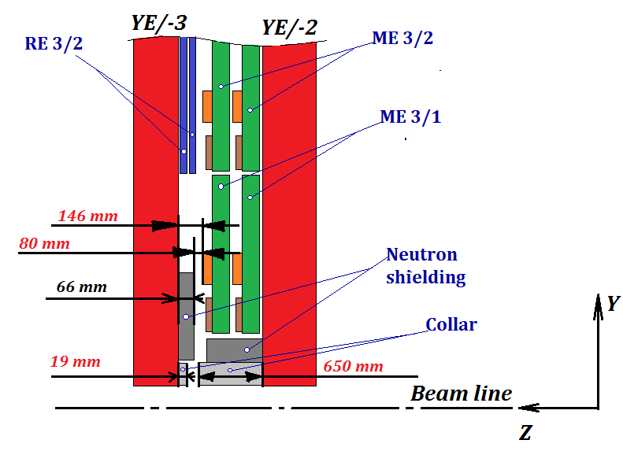
Results from manual measurements
Principle scheme of the manual measurements
Available space for RE3/1 between ME3/1 and YE3 is about 80 mm including the clearance between mobile elements

Slide 10
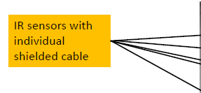
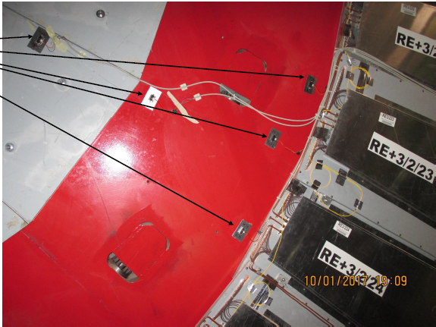
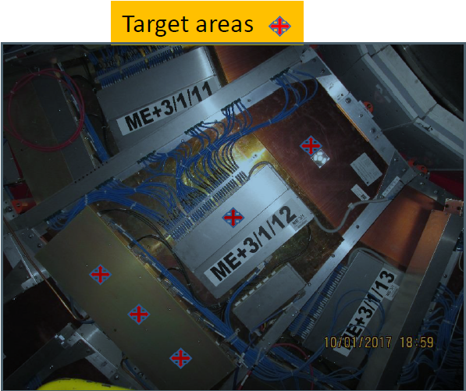
Results from IR - sensors
* IR sensors was installed in 10th of January 2017
Results will be come later

Slide 11
Conclusion
Results from available from laser scanner and manual measurements;
Discrepancy between manual measurements and 3D model / laser scan;
Laser scan will check on afternoon;
Initial results from IR- sensors will be do this week.

