Slide 1
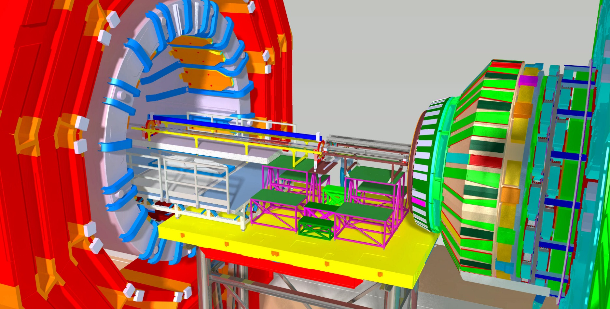
CMS Beam pipe Ph2, (v5.4.1)
Design and Installation procedure.
CMS open 10.25m (-Z, 10.4m)
Installation layout:
Platforms
Tables
tools

Slide 2
Installation drawings

Slide 3
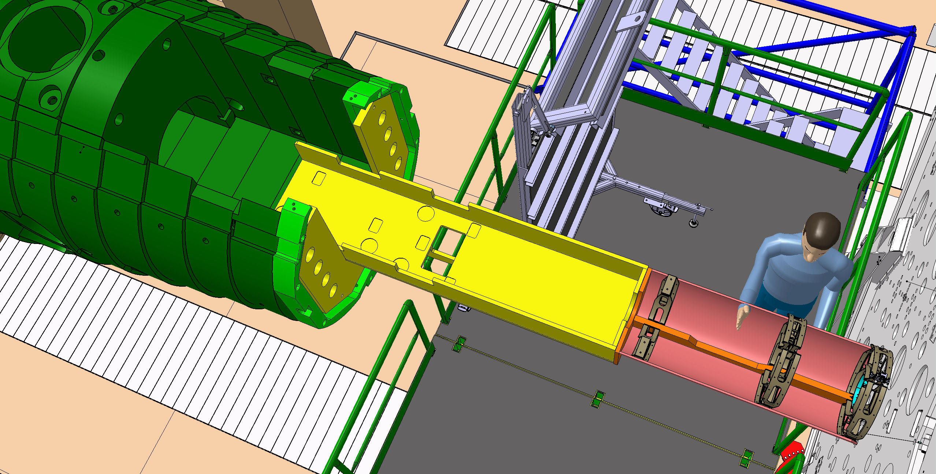
CMS Beam pipe Ph2
New FWD vac. and BP support

Slide 4
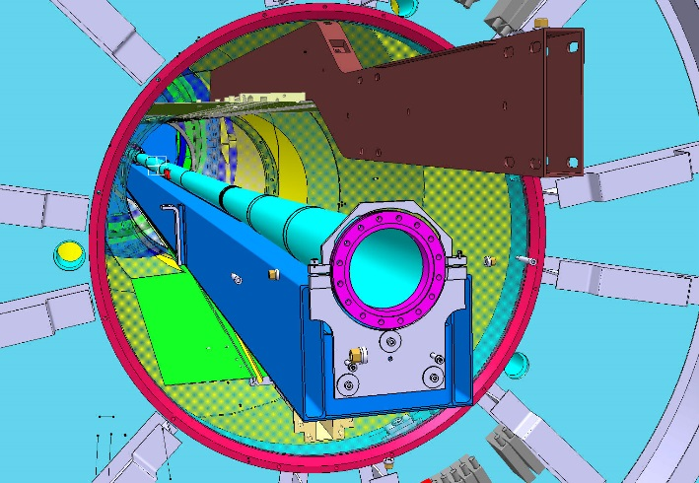
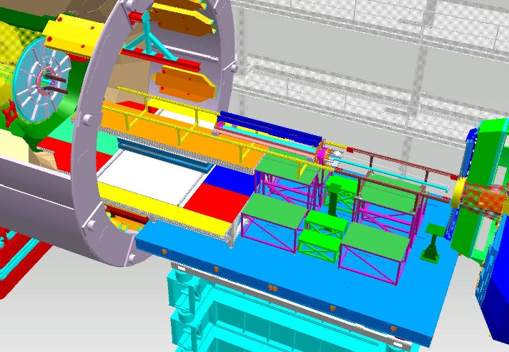
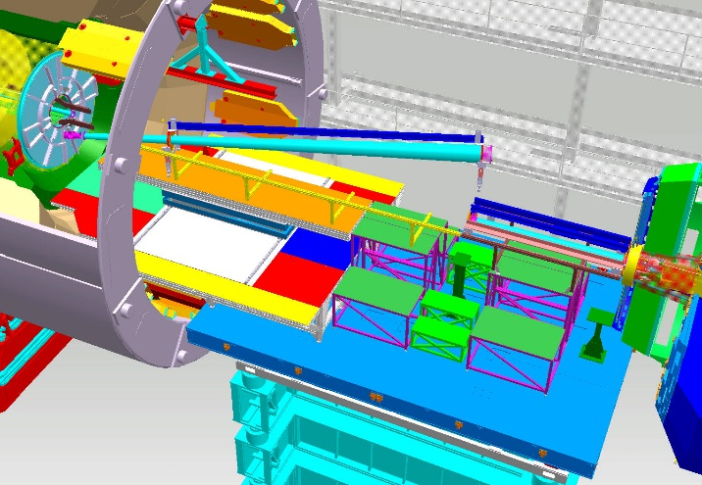
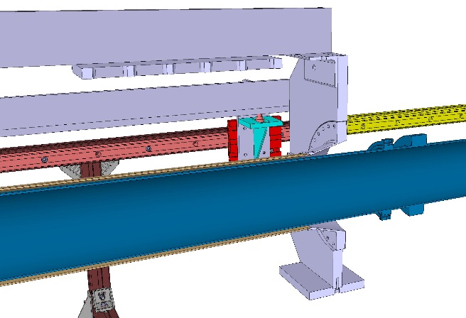
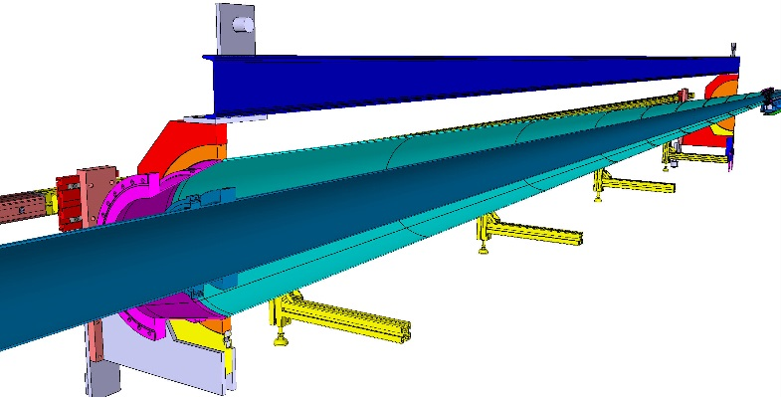
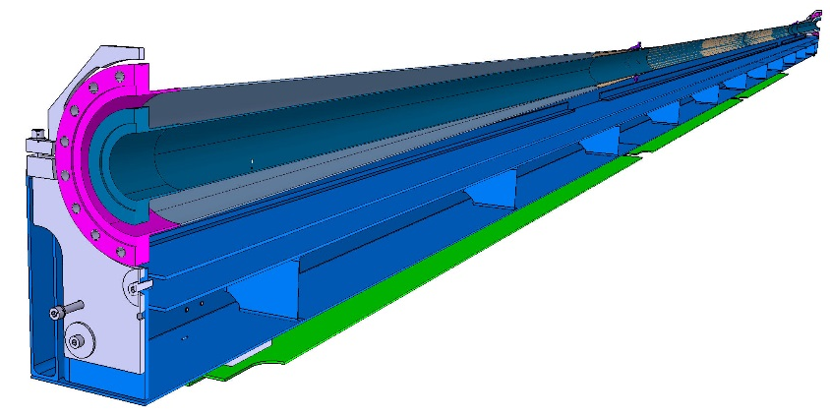
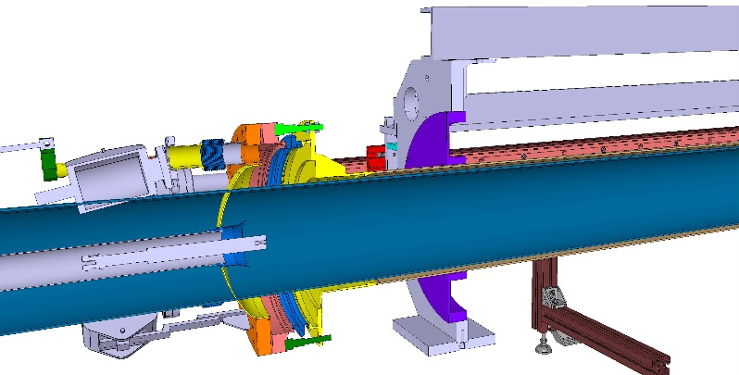
Installation procedure
Installation of the new CMS Beam pipe (v5.4.1) are based on first CMS Beam pipe installation, consider that sequences and tools could be used in the same way with certain modification and new verification.
Central Beam pipe
installation
HF&CT2 Beam pipe
installation
EndCap Beam pipe
installation

Slide 6
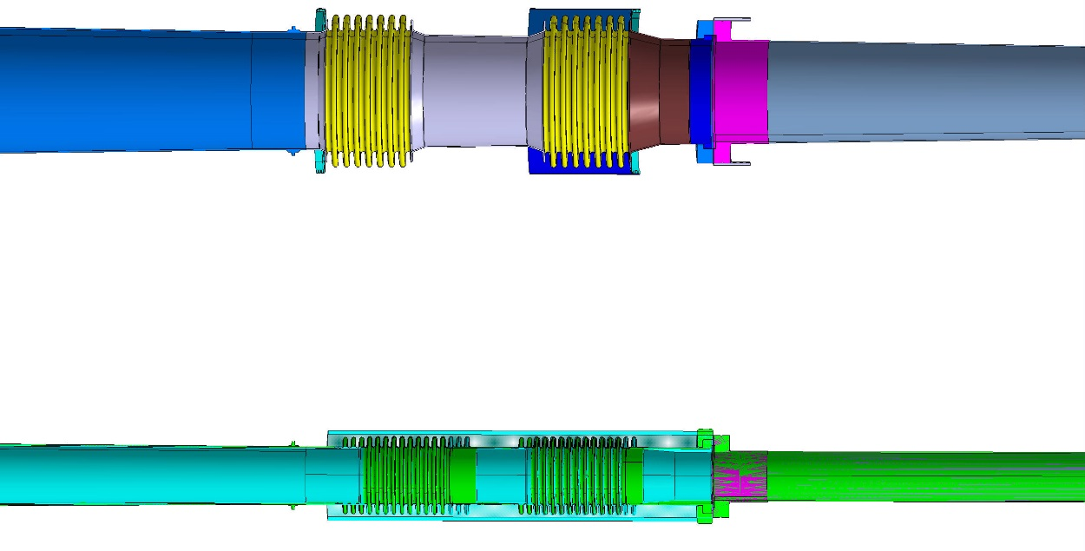
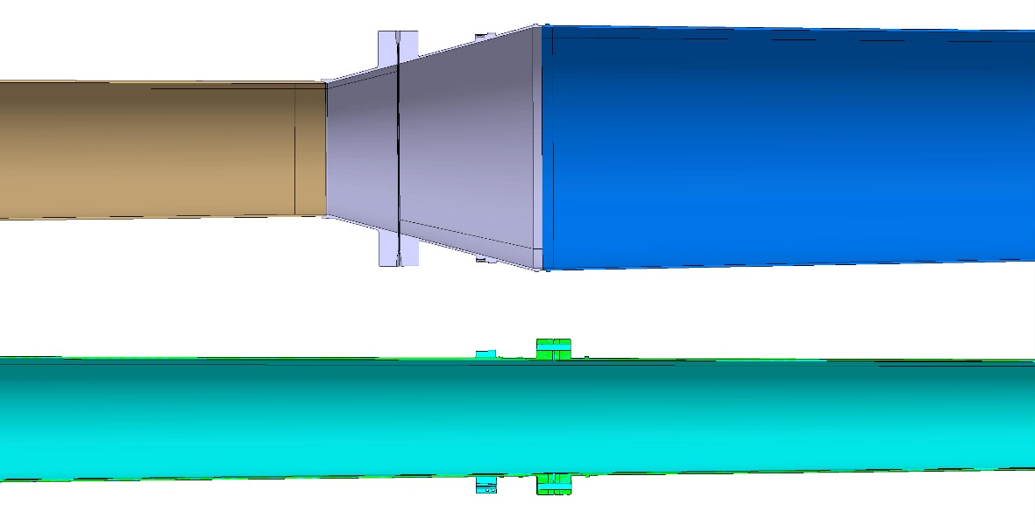
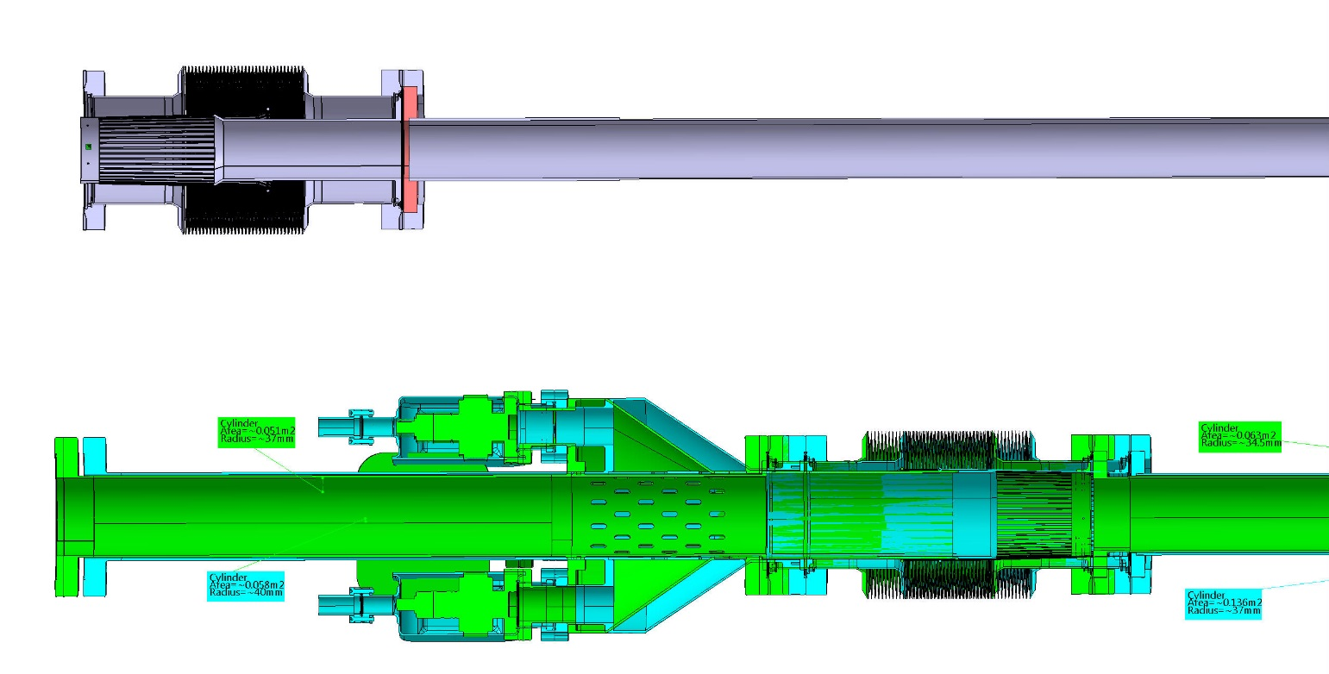
Present BP
Present BP
3D envelope
Present BP
3D model
Z position
diameter

Slide 7
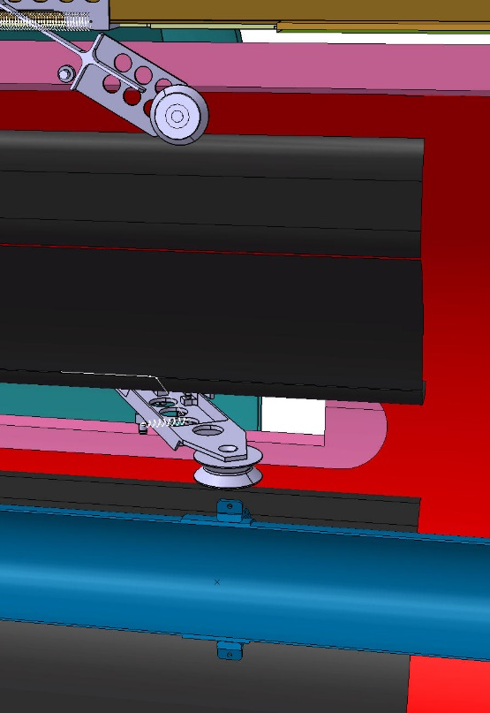
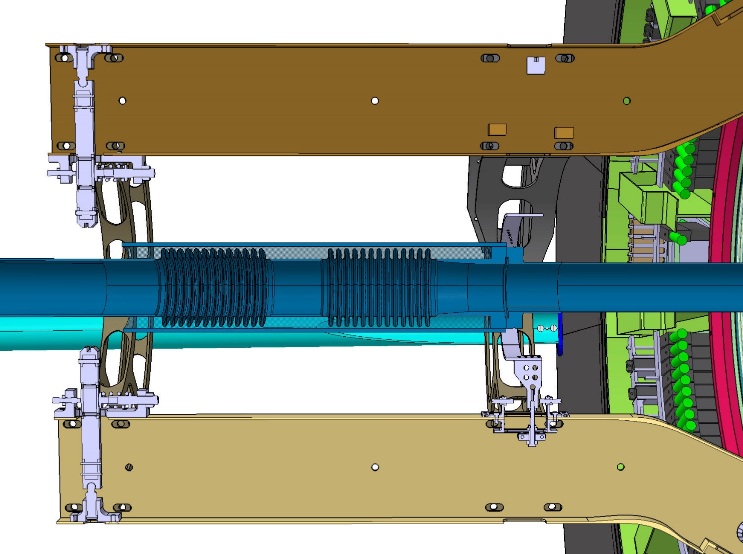
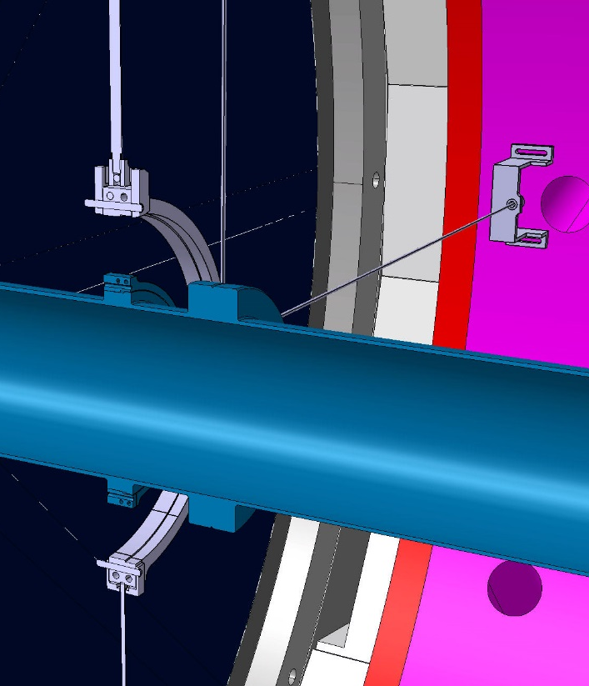
Beam pipe supports
modifications
@1630
@3200
@10700
To be modified

Slide 8
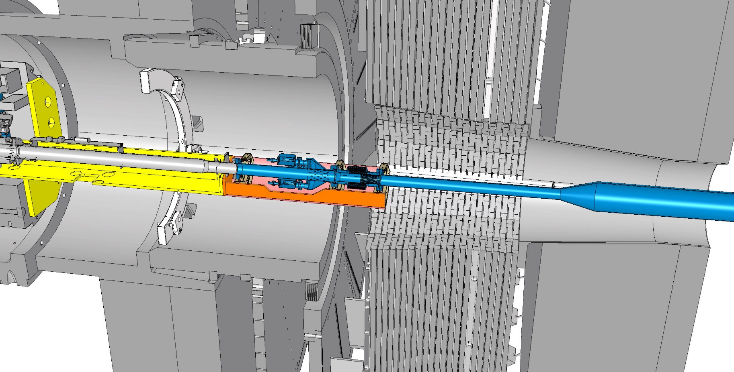
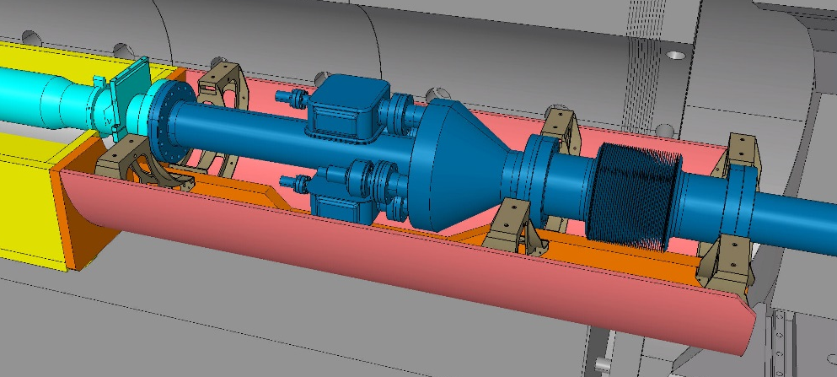
Permanent BP and pump support at 16.5m.
The Permanent BP and pump support is attached to the new forward support, for vac. equipment, installed during LS2, but compatible for LS3.
@16500
Need to support end of the CT2 pipe and pump station independently and to provide alignment.
Design of the support and alignment elements are in direct relation with the type of vacuum connections ( flange by screws, clamps or chains).

Slide 9
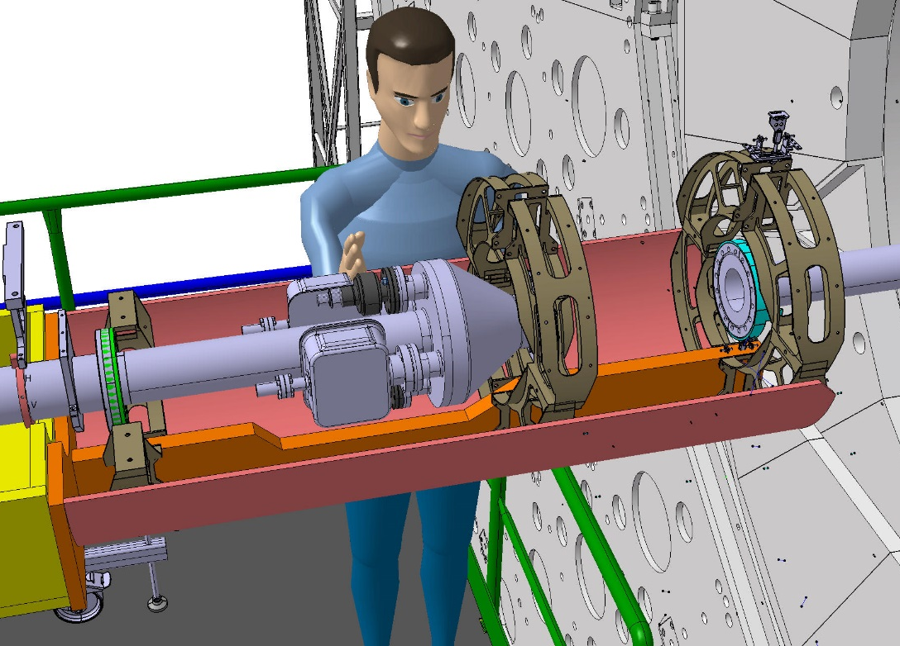
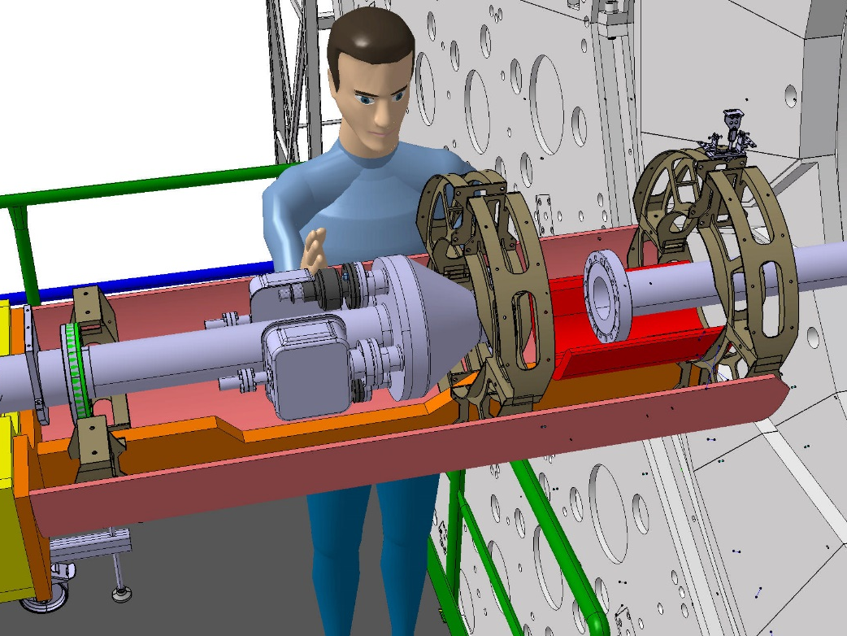
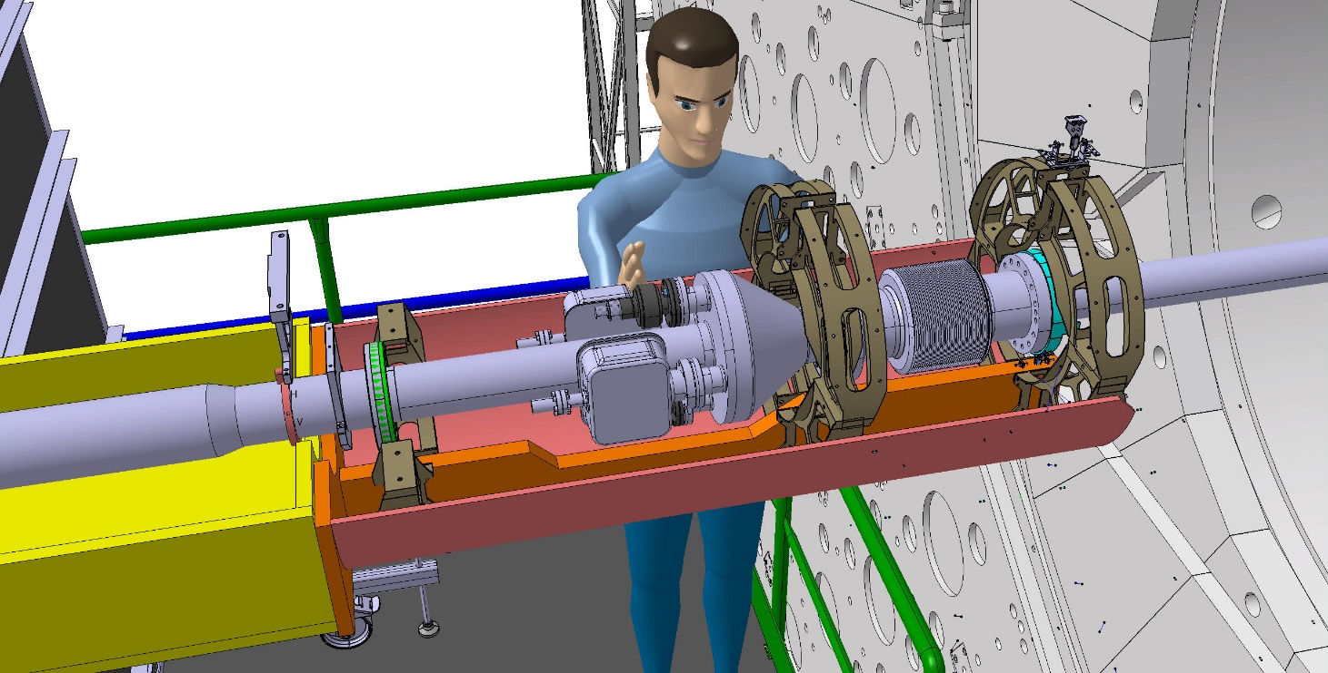

Slide 10
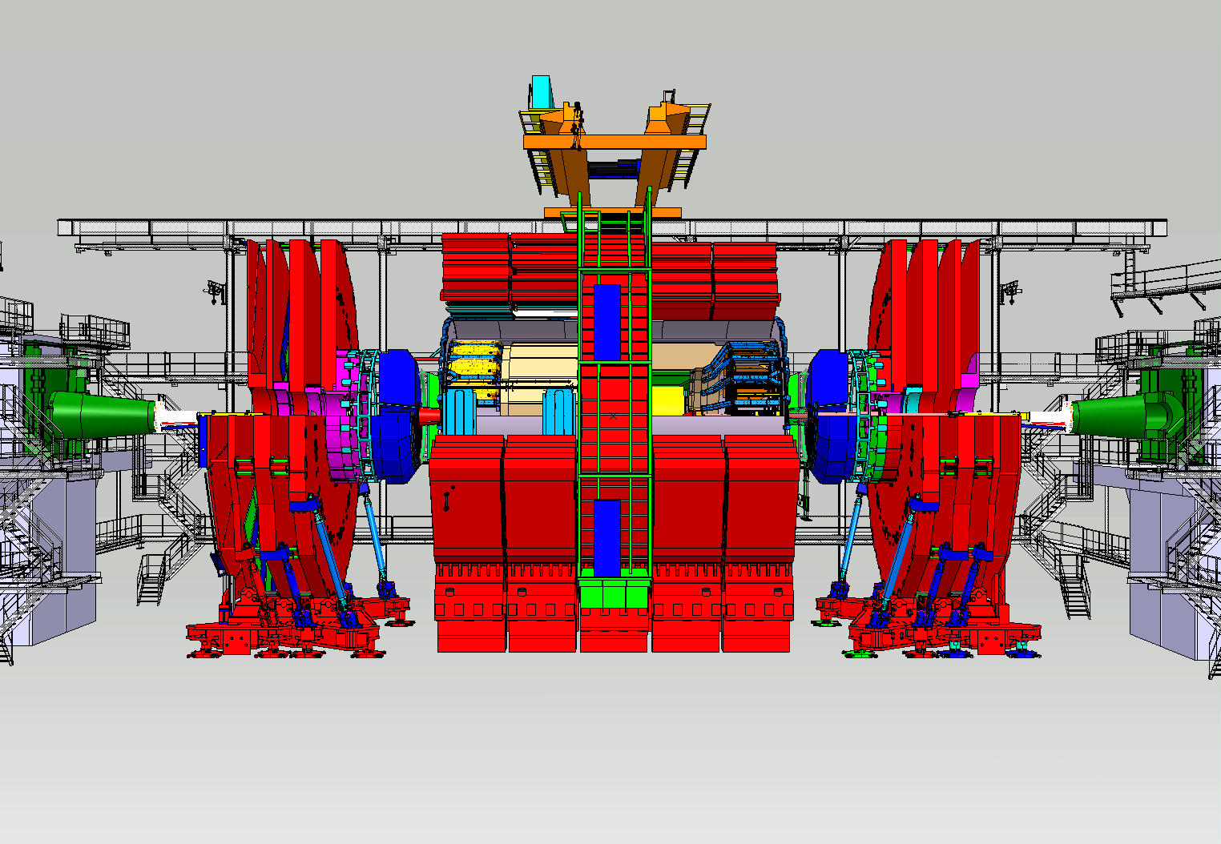
CMS open 3.74m
Bake out position

Slide 11
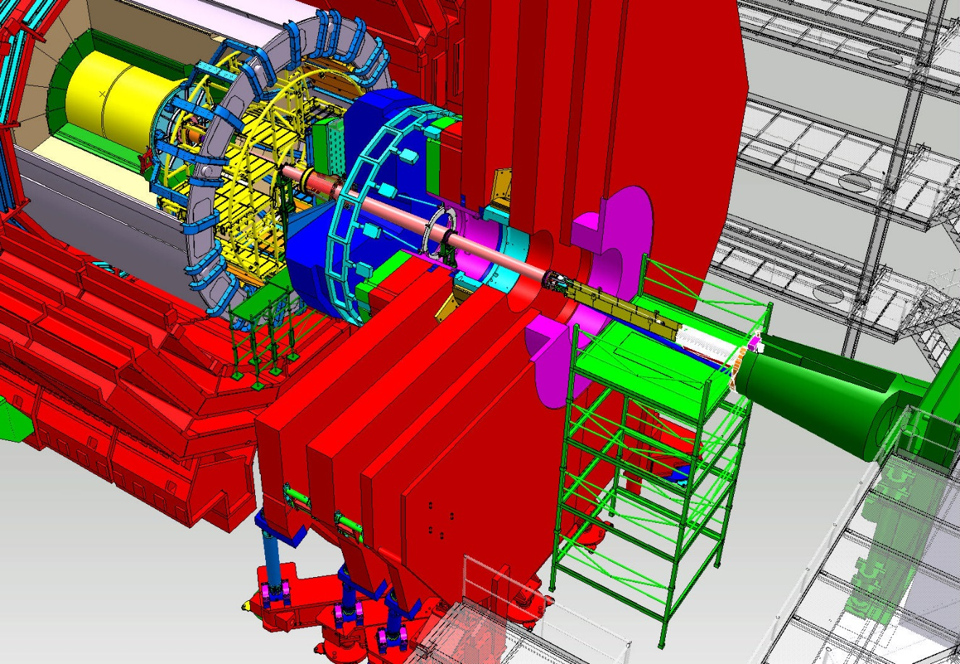
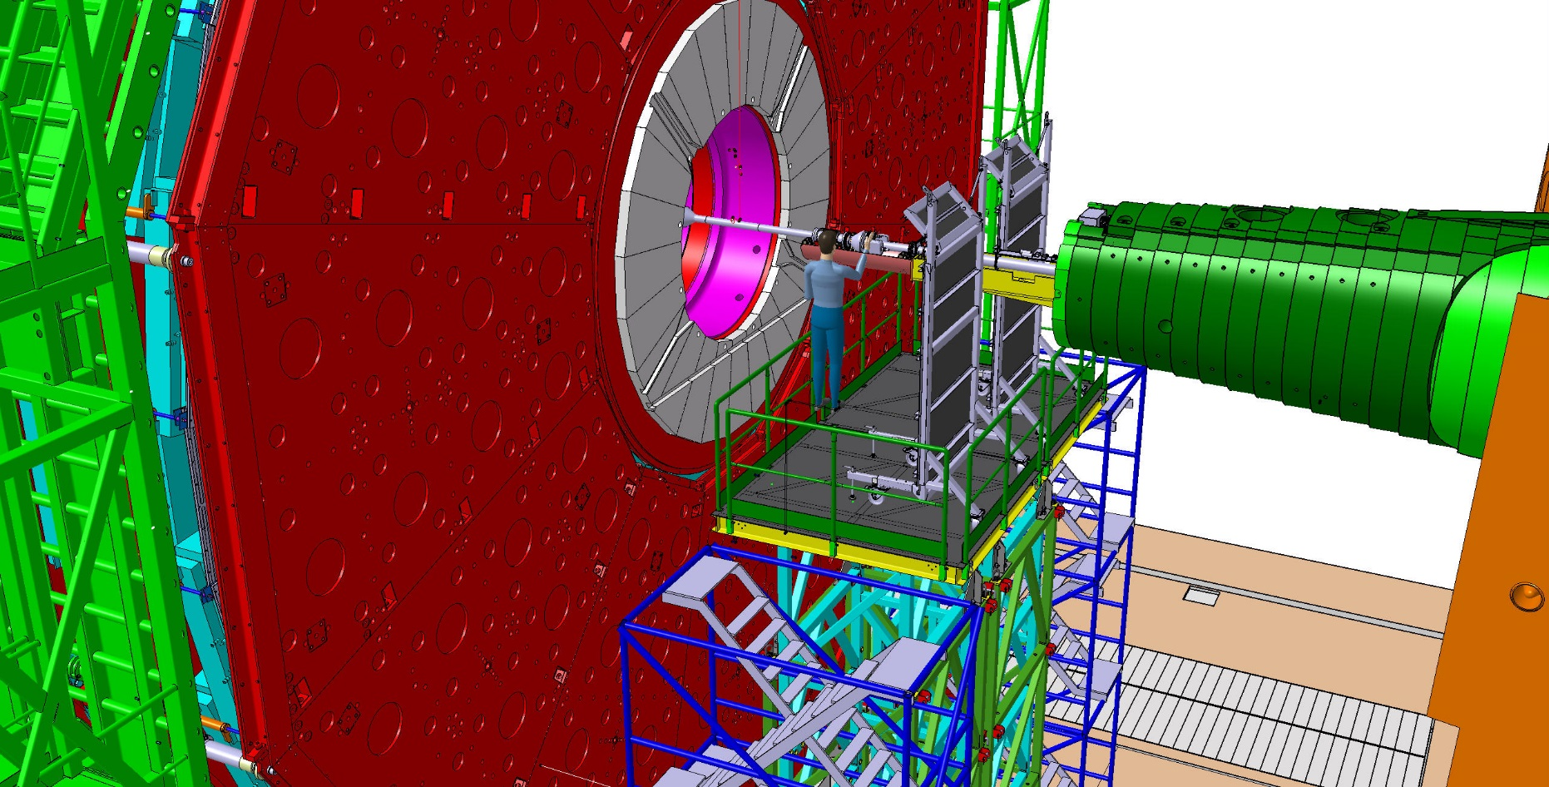
Sequence of the CMS Beam Pipe Installation
Access scaffolds
Bellow module Installation
Temporary Support inside YE1
Connection of the bake out equ.(central part)

