Slide 1
Dose Map RE3/1 & RE4/1
Ian
Dose map from S. Mallow and D. Stickland
Ivan supplied the coordinates
31 May 2021

Slide 2
RE3/1
RE4/1
R _{outer} = 3182mm
R _{outer} = 3192mm
R _{inner} = 1554mm
R _{inner} = 1811mm
Z = 9666mm
Z = 10600mm

Slide 3
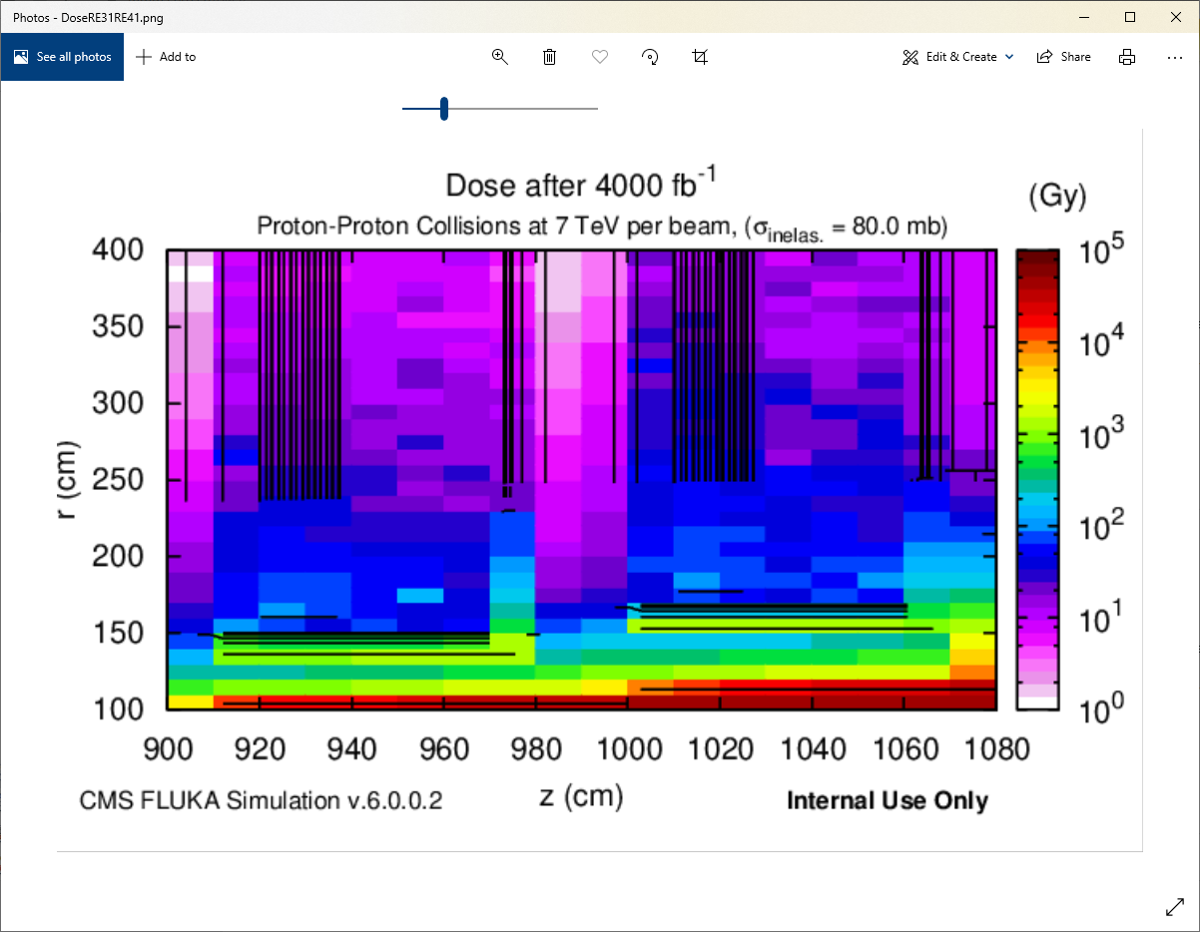

Slide 4
RE3/1 “Z”
RE4/1 “Z”
RE3&4/1
Outer R
RE4/1
Inner R
RE3/1
Inner R

Slide 5
Dose values for 4000fb^-1
A graphical interpretation
RE3/1
RE4/1
R _{outer} = 14 – 20 Gy
R _{outer} = 20 – 38 Gy
R _{inner} = 52 – 380 Gy
R _{inner} = 38 – 52 Gy
Z = 9666mm
Z = 10600mm

Slide 7
To scale ~

Slide 8
Typical values of dose for polymeres used in RPCs.
From “yellow reports” in the 90s.
Melamine 10^5 Gy
Phenolic 10^5-6 Gy
Mylar
PE 10^5 Gy
PA 6.6 cable ties 10^4-5 Gy
PEEK HV insulator & cable ties 10^6-7 Gy
PCB G10
PCB ??
Ref yellow reports;
https://cds.cern.ch/record/357576?ln=en
https://ps-irrad.web.cern.ch/assets/doc/extra/CERN_Radiation_Damage_Reports.pdf

Slide 9
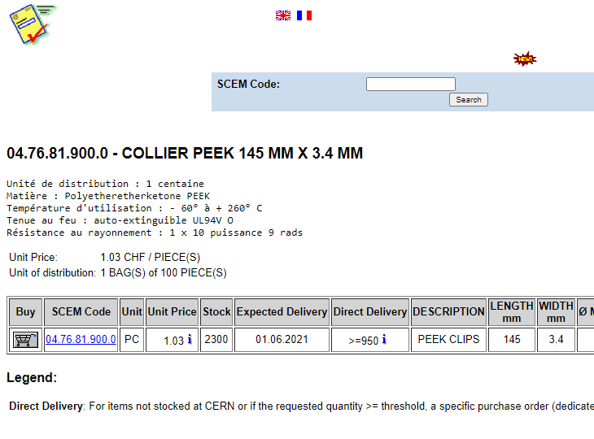
1 x 10^9 Rads equivalent to 10MGy
100Rad [rd] = 1Gray [Gy]

Slide 10
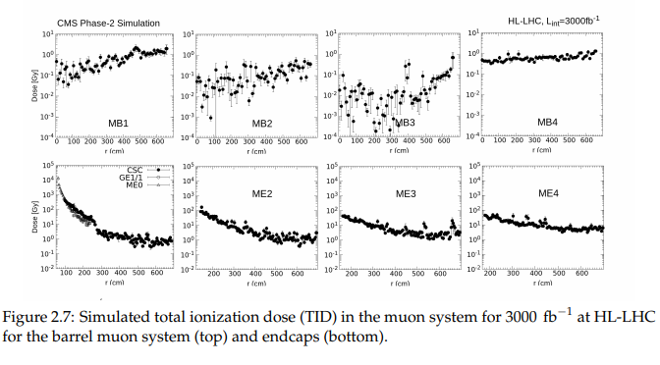
TDR for CMS Muon Upgrade 2018
https://cds.cern.ch/record/2283189/files/CMS-TDR-016.pdf p.68

Slide 11
Conclusion
PEEK is very radiation resistant and an “over the top” solution for Muon chambers.
PA is adequate in Muon chambers especially used on the lower eta areas.
It is not as good in fire but given the few grammes per chamber there is an inconsequential potential problem.
There is some form of agreement for the increase in dose from 3000fb^-1 to 4000fb^-1

