Slide 1
Information to IO for service routing and lengths
Ian Crotty
March 2018
Updated 16 April 2018

Slide 2
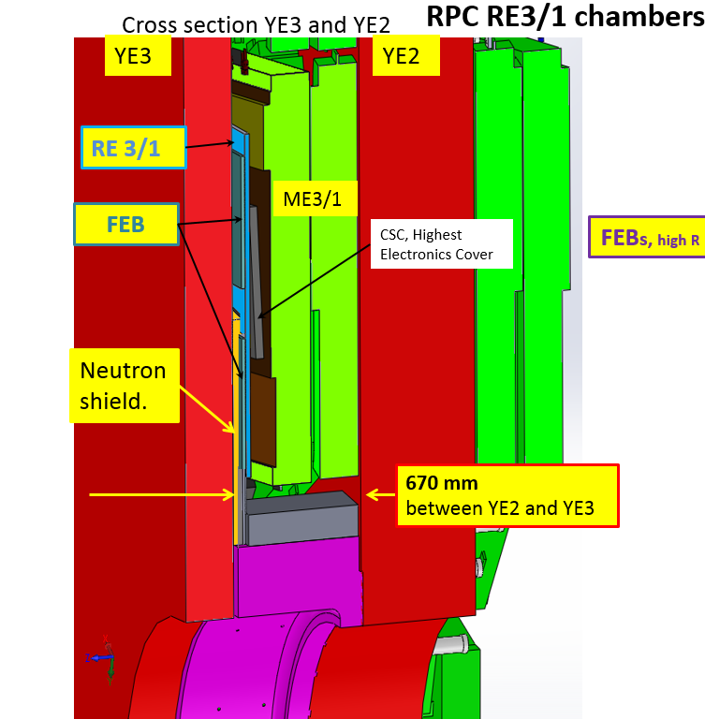
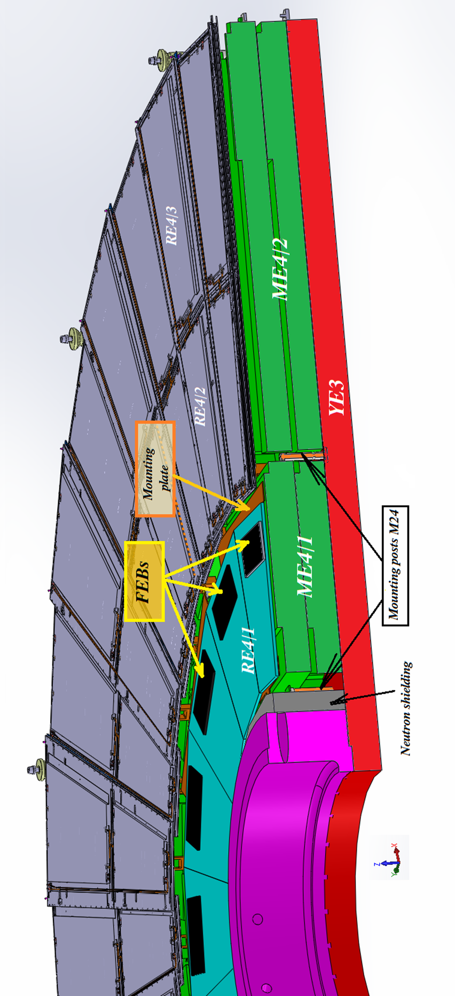
Overall View of RE3/1 and RE4/1
RE4/1 chambers

Slide 3
Optical Fibres
Schematic of layout
http://project-cms-rpc-endcap.web.cern.ch/project-cms-rpc-endcap/rpc/UpscopeHighEta/RPCDevelopements/RE31and41/Services/OpticalFibres/FibreOpticSchematicIC8June2017.pptx
Trigger crates for RPC used at present S1F01 – S1F05 and it seems the future
http://project-cms-rpc-endcap.web.cern.ch/project-cms-rpc-endcap/rpc/Services/Racks/USC/TriggerS1FtoS5F/Photos/IMG_1419.JPG
This is an unlikely possibility as it belongs to the Tracker
Photo of proposed rack S1F00;
http://project-cms-rpc-endcap.web.cern.ch/project-cms-rpcendcap/rpc/Services/Racks/USC/TriggerS1FtoS5F/Photos/IMG_1420.JPG

Slide 4
High Voltage installation
2 cables per chamber
http://project-cms-rpc-endcap.web.cern.ch/project-cms-rpc-endcap/rpc/UpscopeHighEta/RPCDevelopements/RE31and41/Services/HV/AntonDta/13April2017/HVschematicForIO19March2018.pptx
Under the first possible RPC HV rack emplacement in USC there are some steel plates, can they be moved ? Other solution are being investigated by Anton and Pigi.

Slide 5
Low Voltage
http://project-cms-rpc-endcap.web.cern.ch/project-cms-rpc-endcap/rpc/UpscopeHighEta/RPCDevelopements/RE31and41/Services/LV/Power/Anton/RPC_Upgrade_Power_System_and_Signal_Rea
dout31May2016.pptx
Page 7 is all I have.
The rack numbers are X4A51, X2J51, X2V51 and X4S51.
Assume chambers fed every 20deg with two cables of dia. 10mm

Slide 6
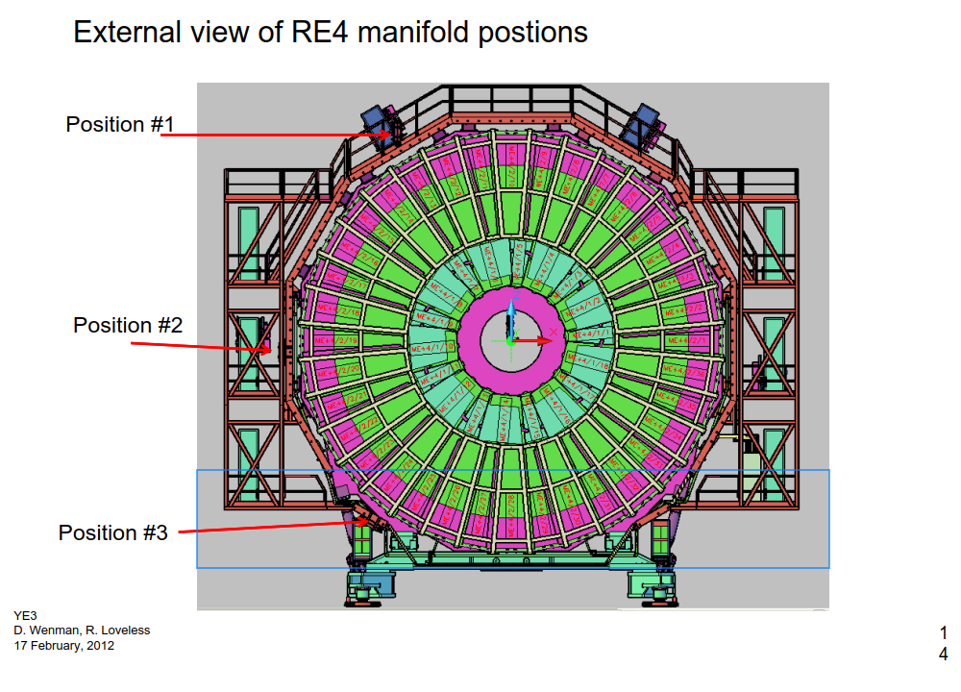
Cooling RE4/1
Cooling RE4/1
Hose lengths from xmas trees to RE4/1s

Slide 7
Email from Anton Monday .
Gas:
I still need to discuss with Aleksandar my new idea about separate manifolds inside the existing
gas racks for the upgrade chambers for the reasons discussed last time. This shuold imply one
new regulation gas rack in UGX and 2 more pipes per rack (4 in total) between UGC and UXC
I will put some details of what we can expect in the worst case.
This implies extra pipes in the YE1 PP and Mini Cable chains
The diameter of the flexible hoses is x1 of 26mm and x1 of 32mm in the each of the far Mini cable chains . The rigid SS pipes are 16 and 22mm respectively. I do not have info on the coupling diameters.

Slide 8
Conclusion
Questions please call 164414 or email without hesitation.
There are surely questions and missing information once we enter the details.

