Slide 1
Clips from GEM presentations
Antonio and Archana

Slide 2
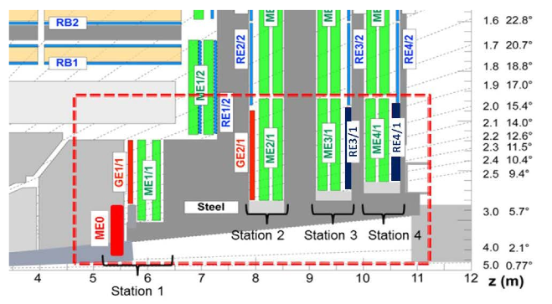
GEMs in PROPOSED MUON UPGRADE
  Sustain triggering at current thresholds up to |η|=2.4
  Increase offline muon identification coverage Maintain existing envelope; Coping with better understood backgrounds Higher instantaneous and integrated Luminosity
  Detector degradation through Phase 2 Changes to Trigger (L1 latency and rate)
LS2
2
LONGEVITY
REDUNDANCY
ETA EXTENSION
LS3
LS3
With Neutron Shielding
2

Slide 3
GE 2/1

Slide 4
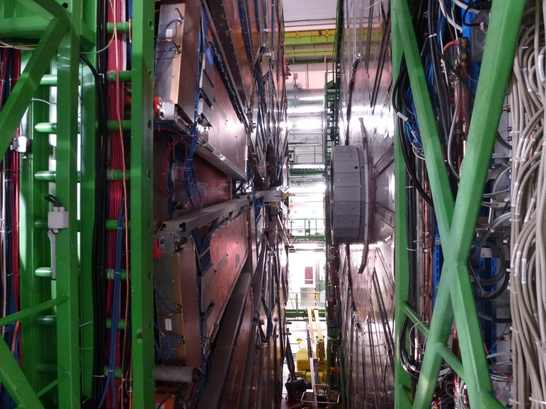
ALIGNMENT DCOPS EXPECTED TO BE REMOVED

Slide 5
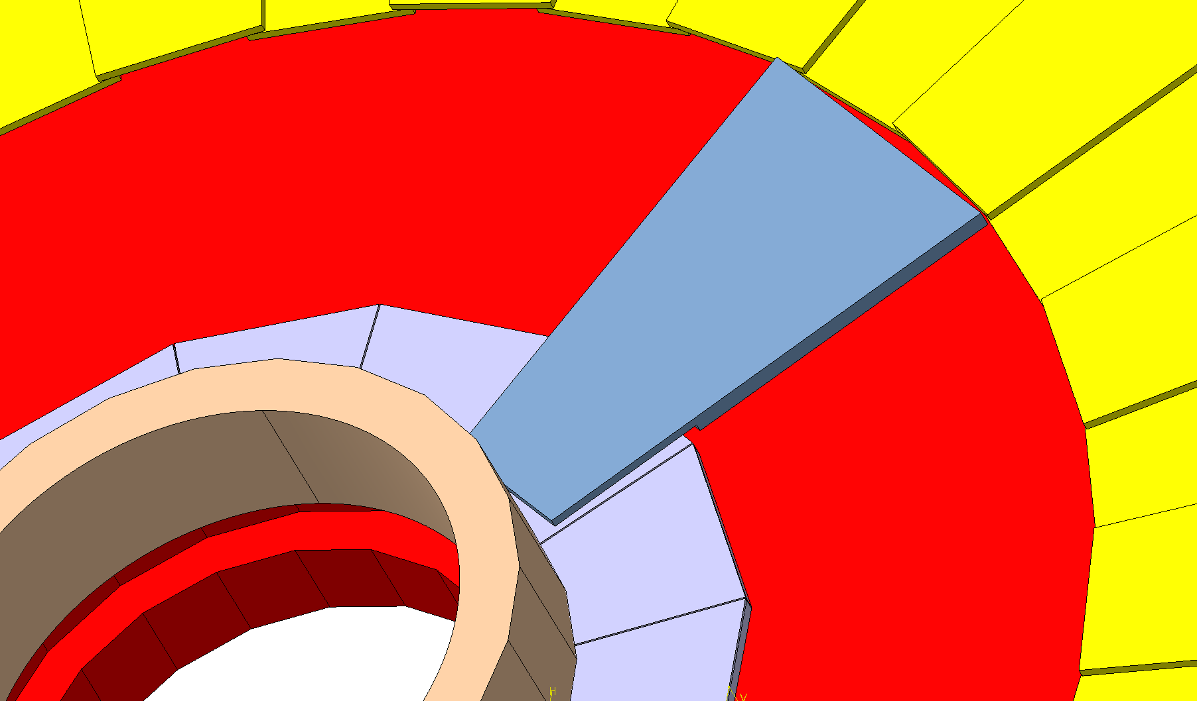
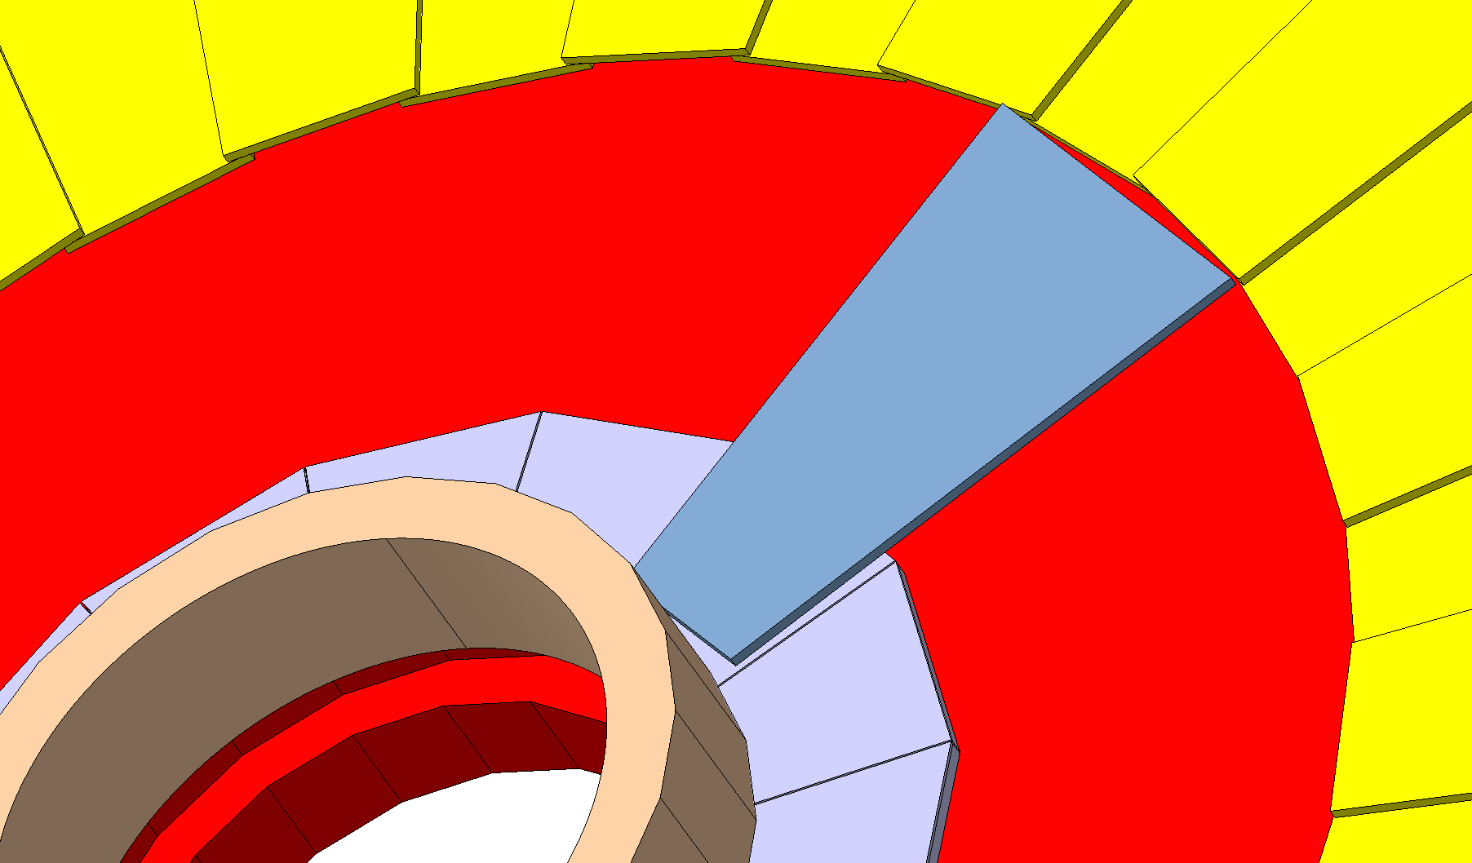
IT WILL ALLOW US MOUNTING FULLY LONG GEMs COVERING FROM 1.6 TO 2.4 ETA
✓

Slide 6
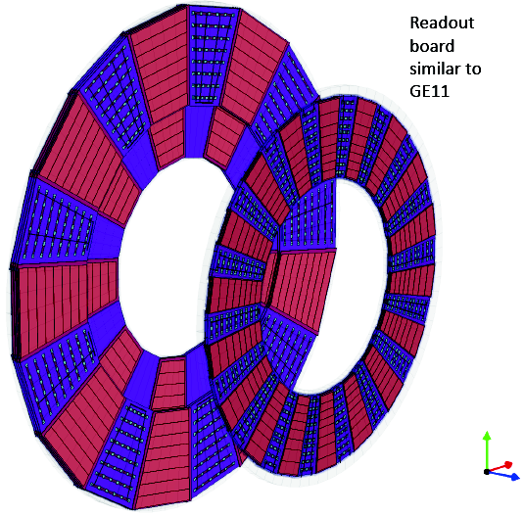
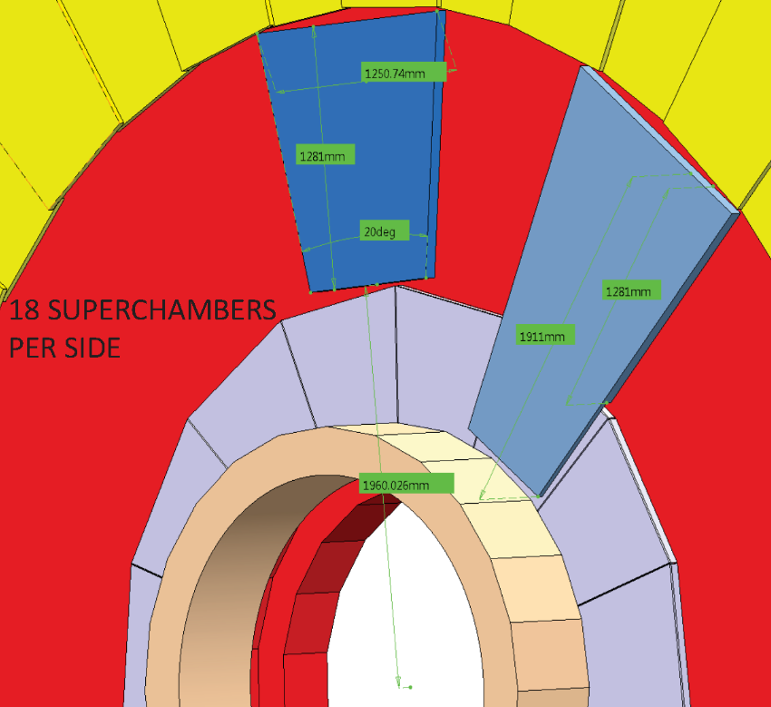
GE2/1 System
GE2/1
GE1/1
1.55 < |η| < 2.45
Each chamber spans 20°
Design on-going
Targeting two rings of double-layered triple-GEM detectors
Total foil area ~330m²

Slide 7
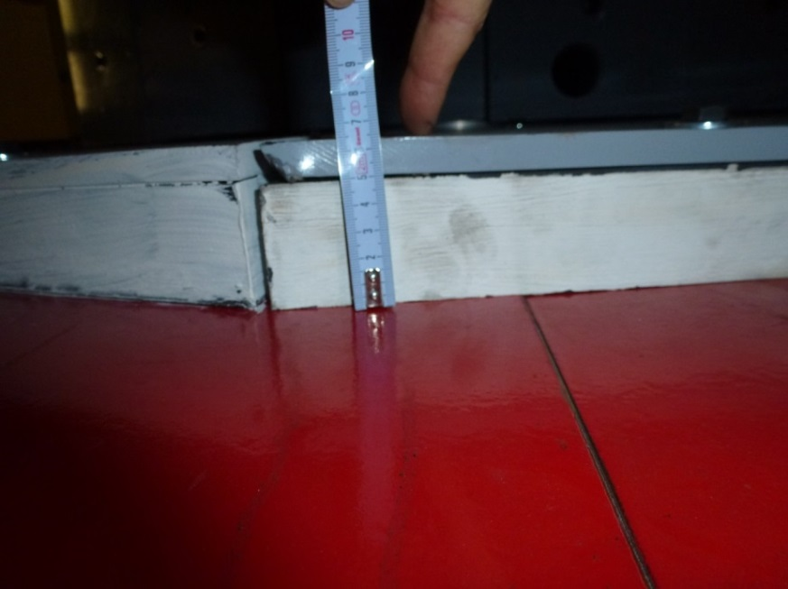
BUT WE HAVE TO DEAL WITH THE LIMITED ENVELOP
DISTANCE FROM YOKE TO CSC CHAMBERS: 147mm
SHIELDING: -65mm
GAP: 82mm
SAFETY MARGIN: -5mm
77mm
THEN, (to be confirmed by the relevant persons) CONSERVATIVE ENVELOP WITH NO DCOPS IS 77mm (for
GE 1/1 is 74mm)
DIFFICULTIES TO BE STUDIED:
COMPARED TO GE 1/1, MUCH BIGGER DIMENSION OF THE SUPERCHAMBERS (1911X1250mm)
→ NEED TO INCREASE THE THICKNESS OF THE BOX, REINFORCE THE DRIFT, ETC.?
HOW TO FIX TO THE YOKE WHILE KEEPING THE OVERLAP IN SUCH A DOUBLE SANDWICH STRUCTURE →WITH RAILS, LIKE IN GE 1/1?
Shielding 65mm

Slide 8
