Slide 1
New Detectors: Services, Integration and Installation Plan in CMS
Andrey Marinov
On behalf of the CMS Muon Collaboration

Slide 2

Forward muon system upgrade overview
RE 3/1 –RE4/1 :
Trigger and reconstruction
1.8 < |η| < 2.4
18 chambers per endcap, each chamber spans 20°
1 layer (per station) RPC-like technology
GE2/1:
ME0:
Trigger and reconstruction
1.55 < |η| < 2.45
18 staggered SC per endcap, each chamber covers 20°
2 layers of GEM-like technology
Muon tagger at highest η
each chamber spans 20°
6 layers of GEM-like technology
2

Slide 3
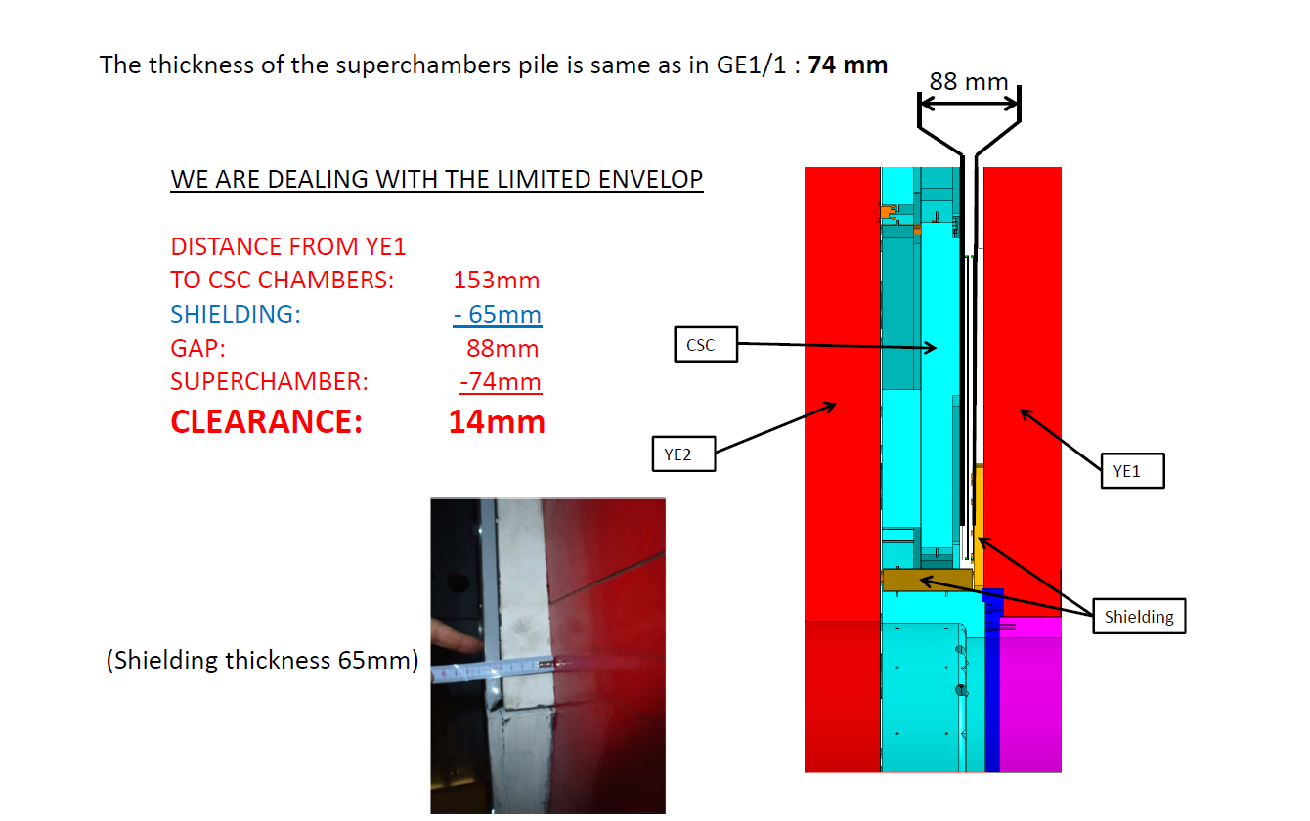
GE2/1 Envelope

Slide 4
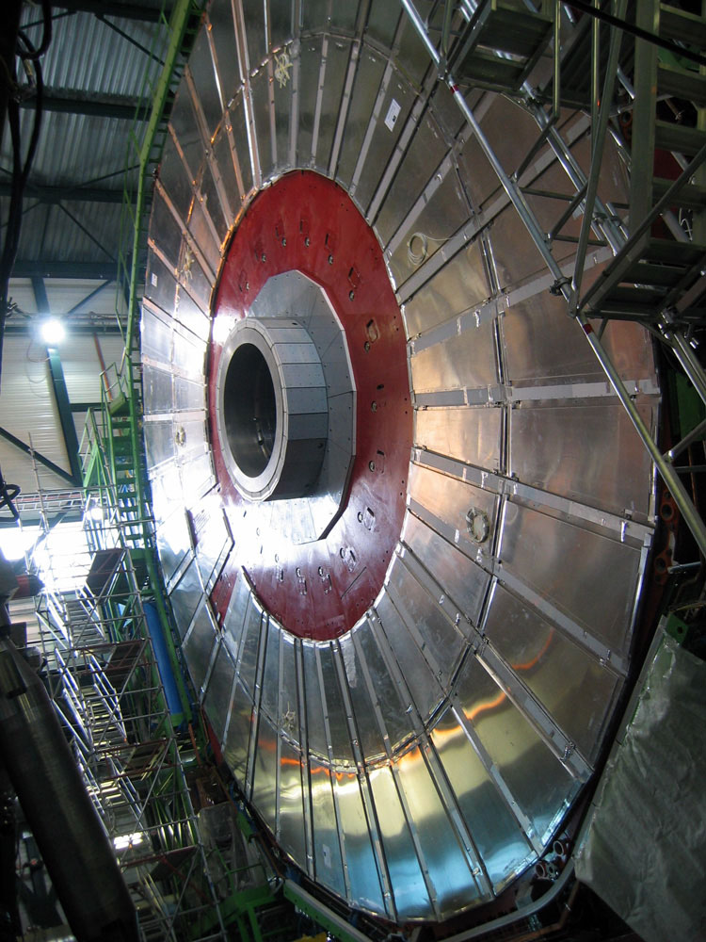
GE2/1 Services
GE2/1 will be mounted on the back of YE1, station 2. It will be installed layer by layer in order to form the super-chamber configuration
Thus all the services should be installed on YE1 to secure minimum length, and avoid the usage of the YE1-YE2 mini cable chains. LS2 is the best moment for the GE2/1 services installation
Services | Per GE2/1 Single Chamber
LV | 5V, ~15A – Based on the usage of the FEAST DCDC converters
HV | 32 channels. Divided by 4 groups of 8. Maximum potential is -4kV on the drift electrodes.
Fibers | 26 to USC plus 8 to SCS ME2/1 TMB
Gas | ArCO2 70-30% with flow 1l/h
Cooling | Water of 18C with speed of 2l/min, Δt of GE2/1 is ~2C

Slide 5
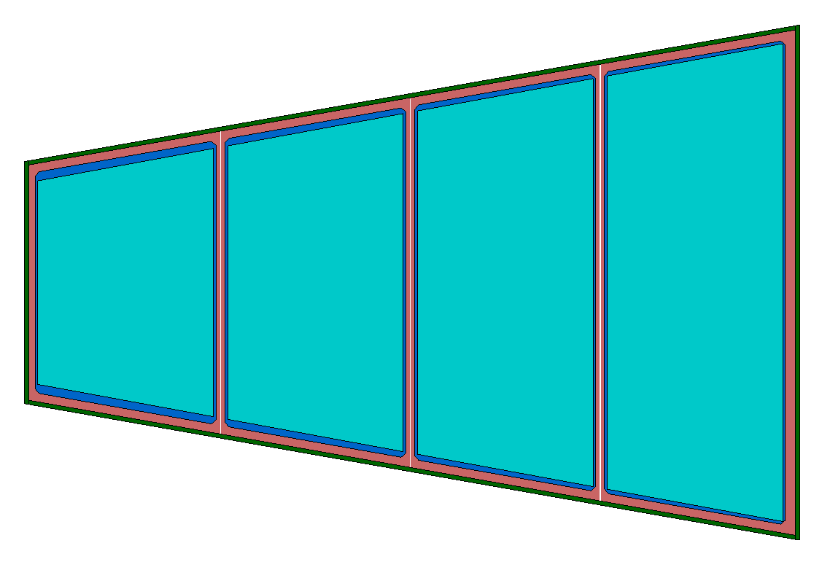
GE2/1 Single Chamber Services
HV Multi-conductor cable
LV Cable from the PS to FEAST DCDC
26 Fibers in total to USC
12 for Tracking
8 for Trigger
OH
OH
OH
OH
8 Fibers to ME2/1 TMB
Gas (Supply Return)
24 VFAT3
18 VFAT3
Cooling (Supply Return)
18 VFAT3
12 VFAT3
Optohybrid (OH) board will be specially design for GE2/1 modules. Less bandwidth and VFATs per OH compare with the GE1/1.

Slide 6
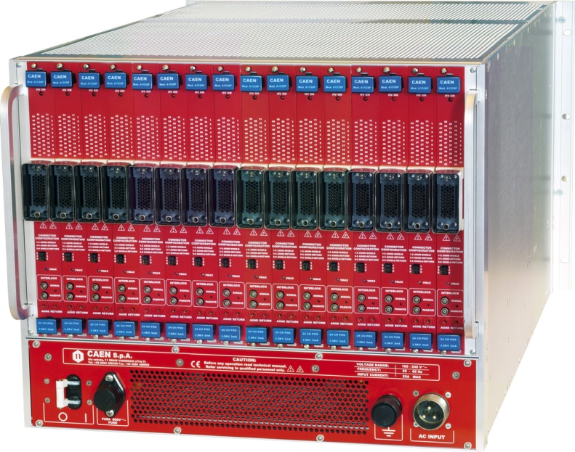
HV System for GE2/1
USC
The HV power system will be based on CAEN A1515
In total we need 5 mainframes per endcap in USC S2 level (one rack per endcap).
UXC
72 HV multiconductor cables per endcap. Each with 16 HV channels inside
All must go via the YE1’s main cable chains
It is the same HV power supply as GE1/1.
Long term maintenance will be secured by CAEN-CERN contract.
DCS software will be identical as GE1/1.

Slide 7
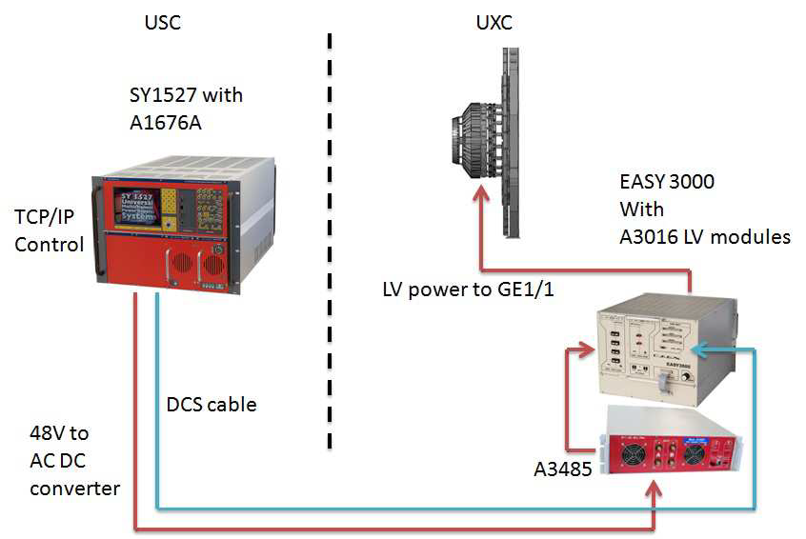
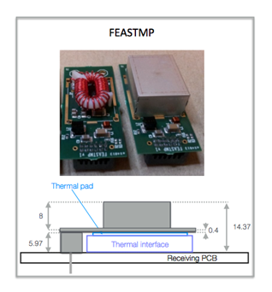
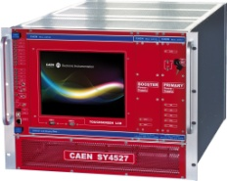
LV System for GE2/1
FEASTMP DCDC modules are developed at CERN to meet the LHC requirements
SY4527
The CERN FEASTMP DCDC converter will be integrated on the GEB boards to provide LV power for the on detector electronics – VFATs and OHs for each GE2/1 module
Less LV channels per detector
Smaller cross-section of power cables
Less power dissipation inside the detector

Slide 8
UXC Rack Space Budget for the GE2/1 LV per Endcap
EASY3000
EASY3000 with 5x A3016
6U
A3486S
3U
A3016
A3016
A3016
A3016
A3016
EASY3000
6U
30 LV channels, each module has 6 channels up to 90W per ch.
EASY3000
6U
12x A3016
4 EASY3000 crates
2x A3486S dual AC/DC converters
Total U space is 30 per endcap
A3486S
3U
EASY3000
6U
Plus Ventilation U

Slide 9
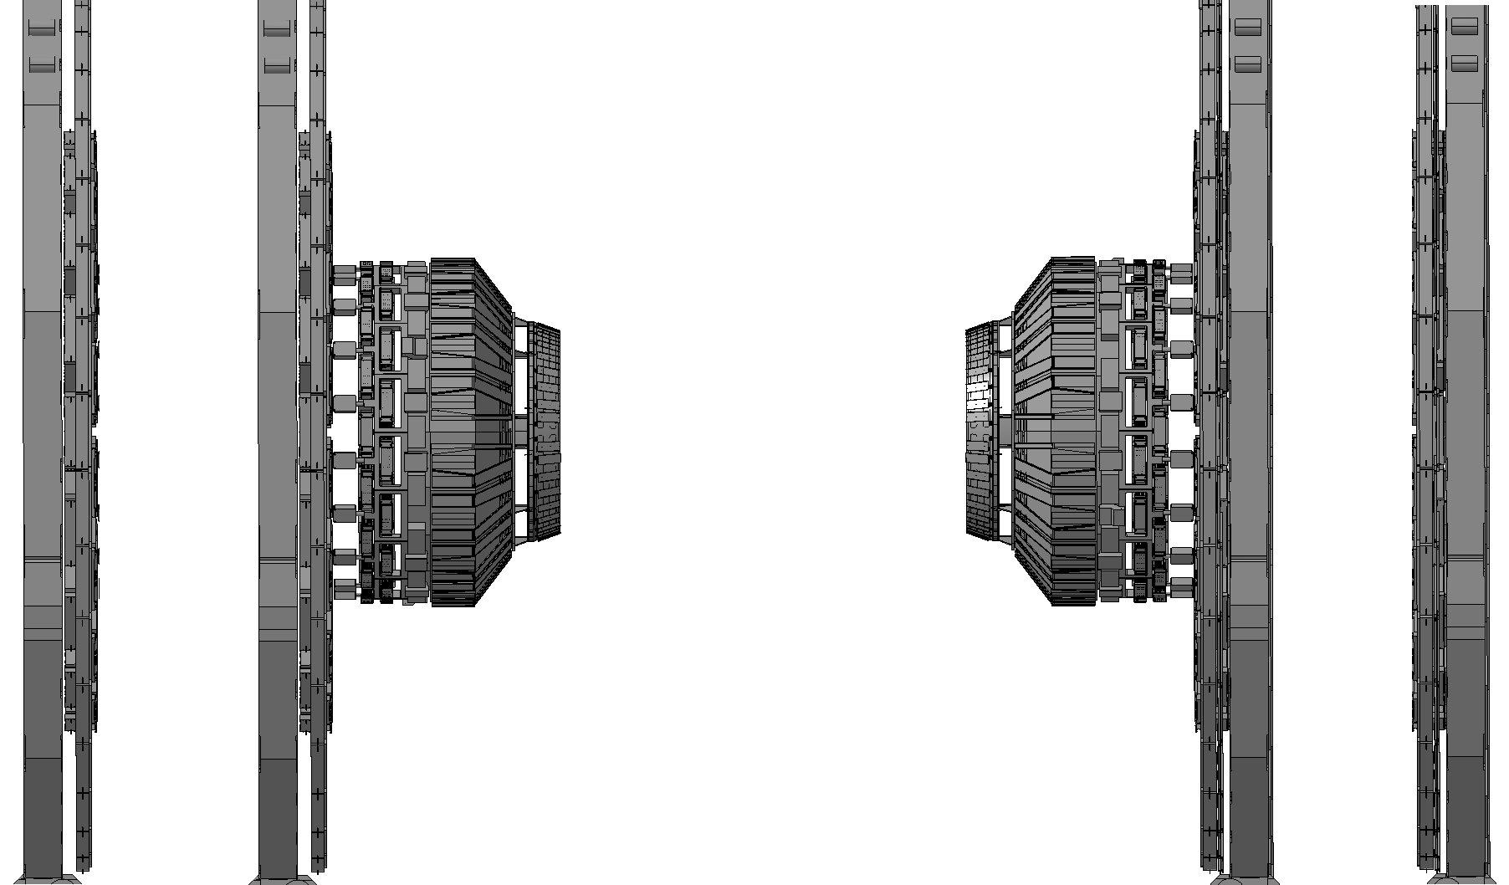
GE2/1 Fibers
YE-2
YE-1
YE+1
YE+2
ME2/1
936 fibers per endcap to USC
8x40mm duct to USC S2 per endcap
To patch them we need 40U rack space in UXC (Balcony) and 40U in USC S2 level
Mini Cable-Chain (Caterpillar)
GE2/1s
Mini Cable-Chain (Caterpillar)
In addition there are 18x16 (288) fibers from GE2/1 (YE1) to the ME2/1 TMB(YE2). The length is between 30 and 50m and must go through the mini cable chains YE1 YE2.

Slide 10
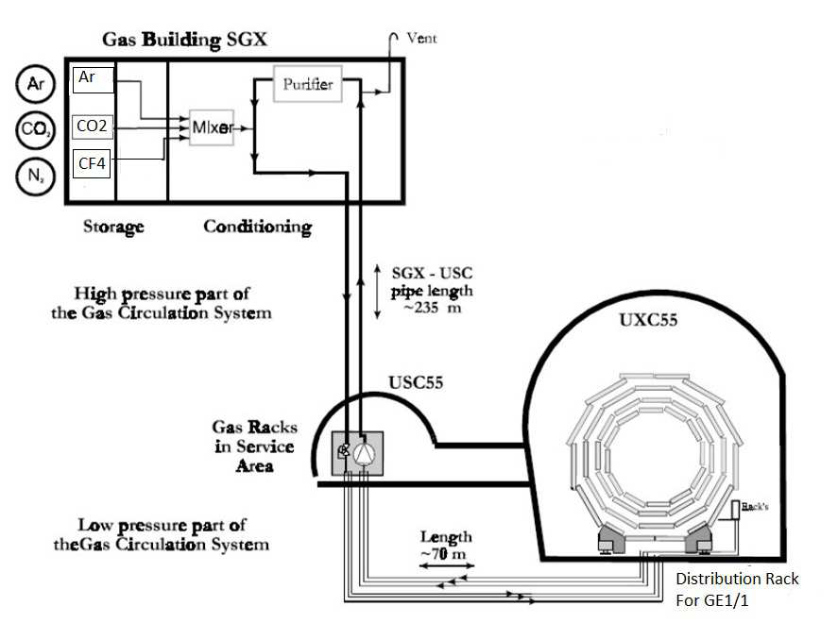
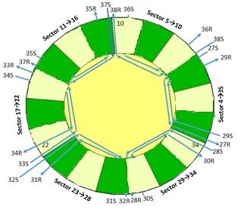
GE2/1 Gas System
We can use the same gas distribution pattern as GE1/1
Ar-CO2 70-30%
As baseline
GE2/1 distribution rack
During LS2 we have to install all the gas pipes.
3 GE2/1 super-chambers connected in serial from the 12 available flow cells

Slide 11
GE2/1 Cooling
New Cooling pipes should be placed between the RE2s the YE1 yoke. They should run from the GE2/1 patch panels to the cooling manifolds of the YE1
 | Per GE2/1 Super-Chamber
VFAT3 | 74.88W
OH | 120W
DCDC converters | 160W
 | 354.88W
Per Disk, On detector electronics 6387.84W
Power in the USC Racks per disk 3577W
Total Power per disk 9964 W

Slide 12
Proposed Alignment of GE2/1 Chambers
Two-fold chamber alignment (same as in GE1/1 and ME0):
Precisely align the Readout boards in the superchamber
Measure the strips of the Readout Boards within the frame of the chamber (defined by this step)
Locate the inter-chamber alignment sensors (technology is the same, ie Fiber Bragg Grating-based (FBG) displacement sensor that is being developped for the GE1/1)
Locate the survey target holders within this frame in order to be able to relate the two chambers in the superchamber and to be able to perform survey measurement after installation
By the observation of the FBG displacement sensor data the mutual positions (and orientations) of the (super)chambers in the GEM disk can be reconstructed → rigid disk that can either be localised by few tracks (this allows indirect tests of the track-based alignment of the disk chambers), and the disk itself can be localised within the Barrel Alignment frame with the redesigned EndCap alignment components:

Slide 13
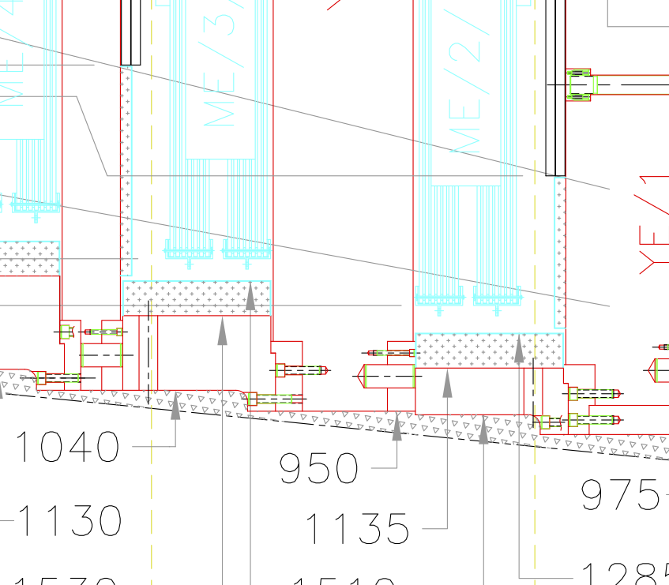
Proposed Localization of GE2/1 in Barrel System
Shielding
Existing EndCap Ali laser lines are going to be blocked by GE2/1 → redesign needed!
GE1/1 chambers
TrPlate2
TrPlate3
EndCap Ali laser lines
TrPlate1
Instead of the crossing laser lines a ‘target observing’ method is proposed. It works well in the Barrel Alignment. However instead of LEDs a high refraction index (n=2) reflective targets are to be used (good results in ISOLDE).
TrPlate4
TrPlate6
Frame
TrPlate5
Transfer lines
Glass sphere (precisely known positions!)
These radial lines can be connected with the existing “transfer Lines” connecting the two endcaps through the Barrel Alignment System
GE2/1
MAB-ring +3
MAB-ring +1
MAB-ring -1
Final Aim:
MAB-ring -3
Locate the rigid GEM disk within the Barrel frame of reference to allow studies of the tracking systematics/weak modes between the Barrel and the Endcaps

Slide 14
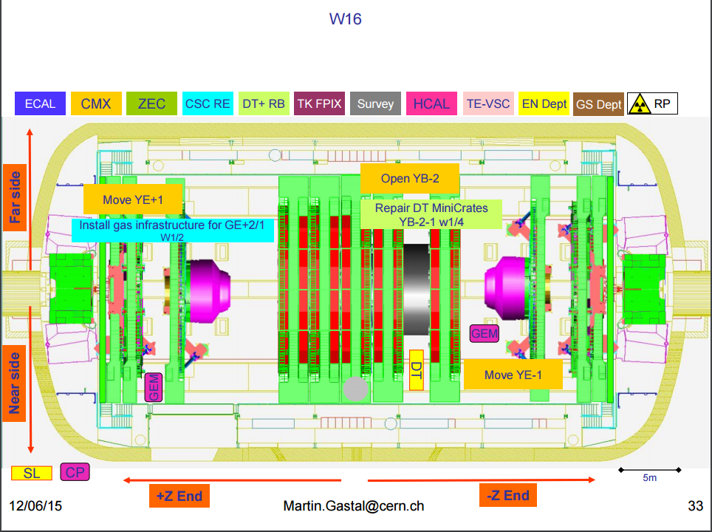
GE2/1 LS2 Schedule YE+1
We start On week 16 (end of March 2019) with the installation of the GE2/1 Pipes Gas, Cooling. Time allocated for this is 2 weeks.

Slide 15
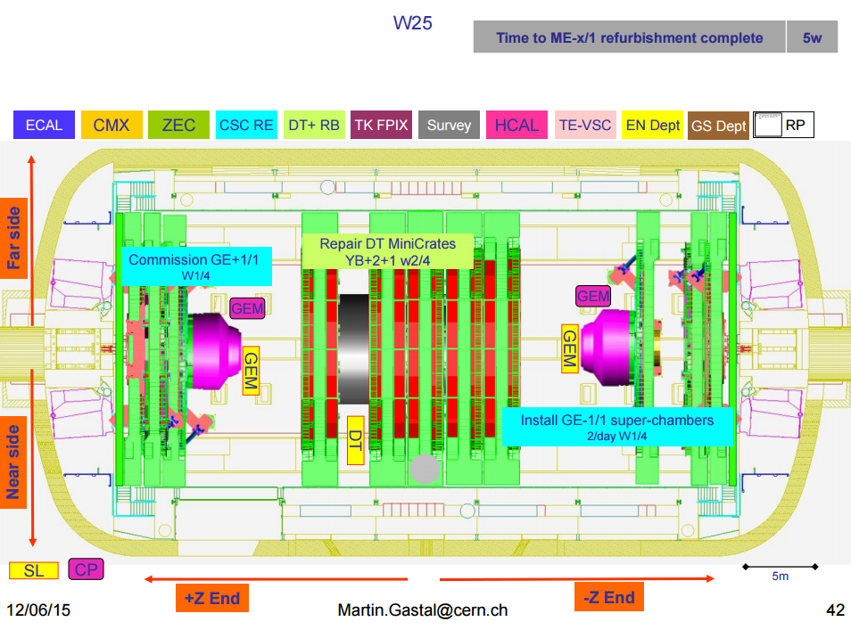
GE2/1 LS2 Schedule YE-1
We start On week 25 (beginning of May2019) with the installation of the GE2/1 Pipes Gas, Cooling. Time allocated for this is 2 weeks.

Slide 16
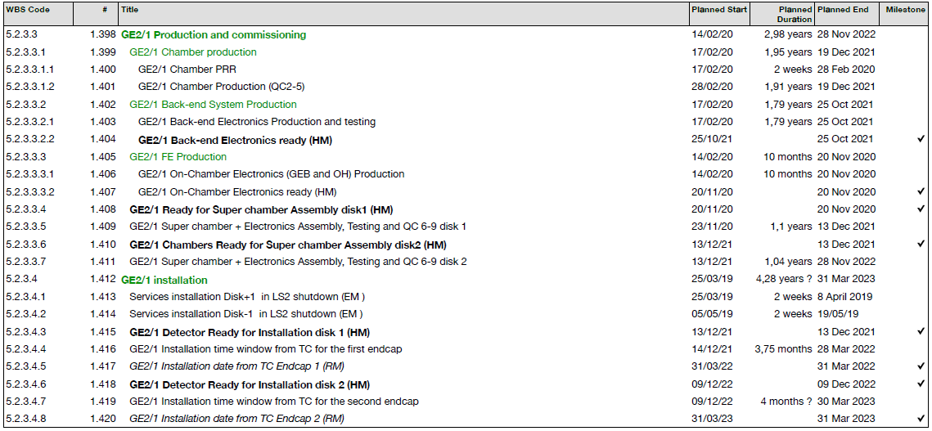
GE2/1 Schedule Proposal
The LS3 period will be mainly focused on the YE1 noses and the Barrel part of the CMS. Access to YE1 station 2 will not be in the priorities.
It is under discussion with the CMS Technical Coordinators to anticipate the GE2/1 Services installation during LS2 and to install the detectors on YETS2021/22 and YETS2022/23

Slide 17
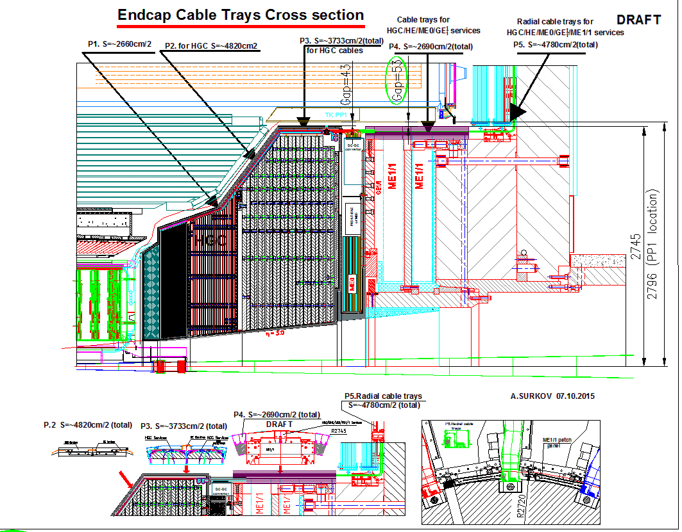
ME0

Slide 18
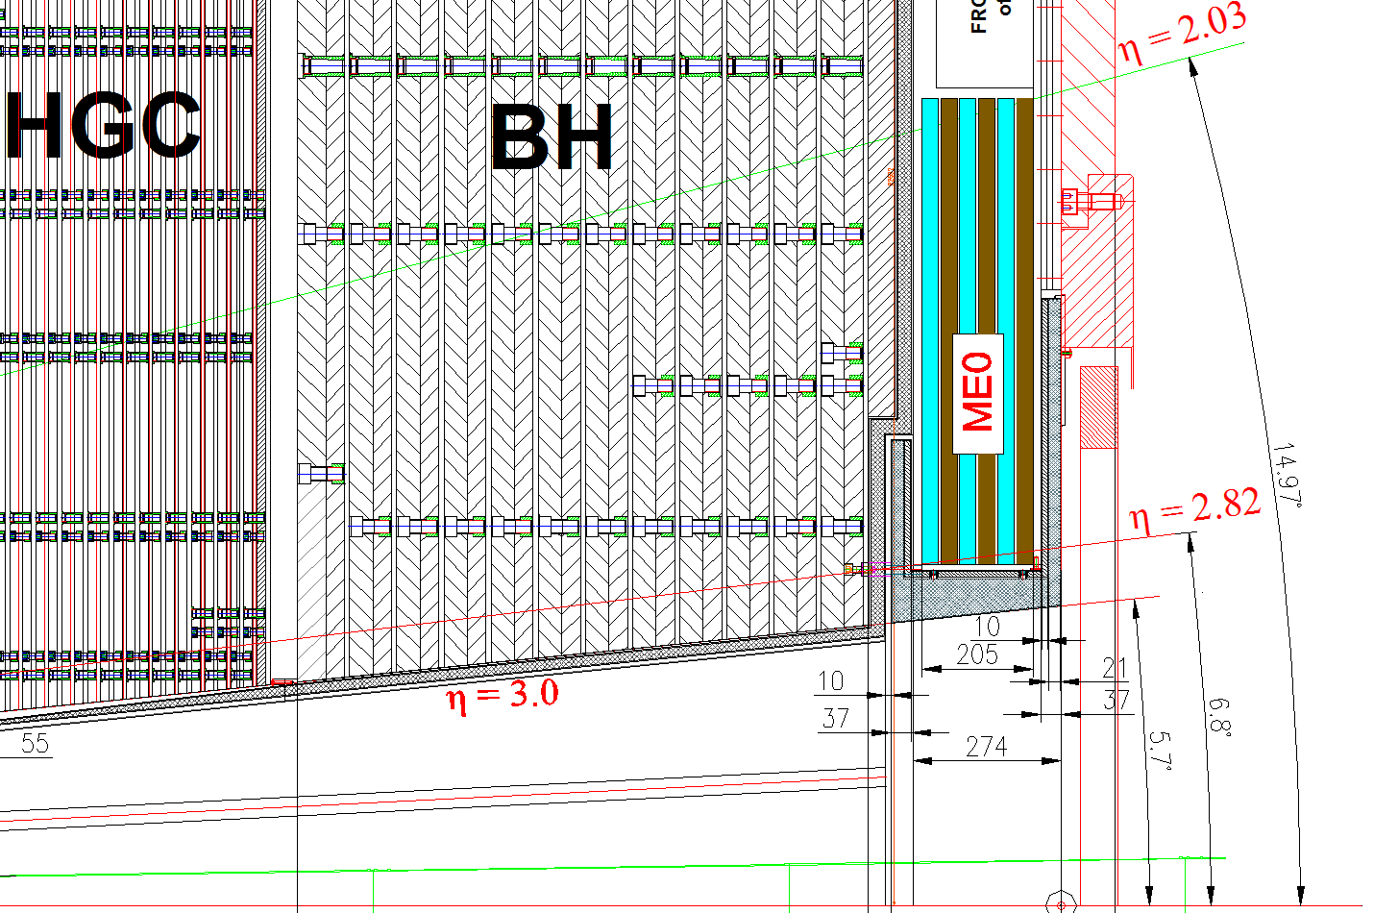
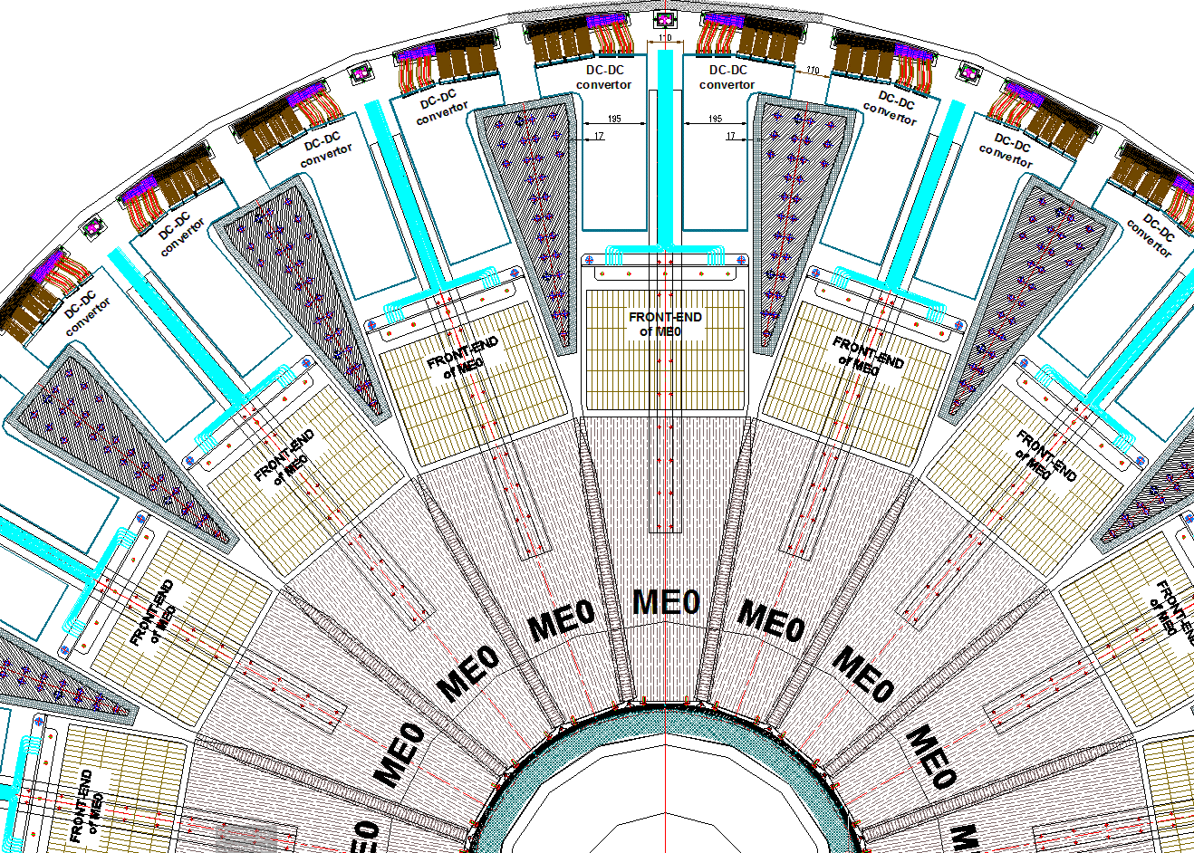
ME0

Slide 19
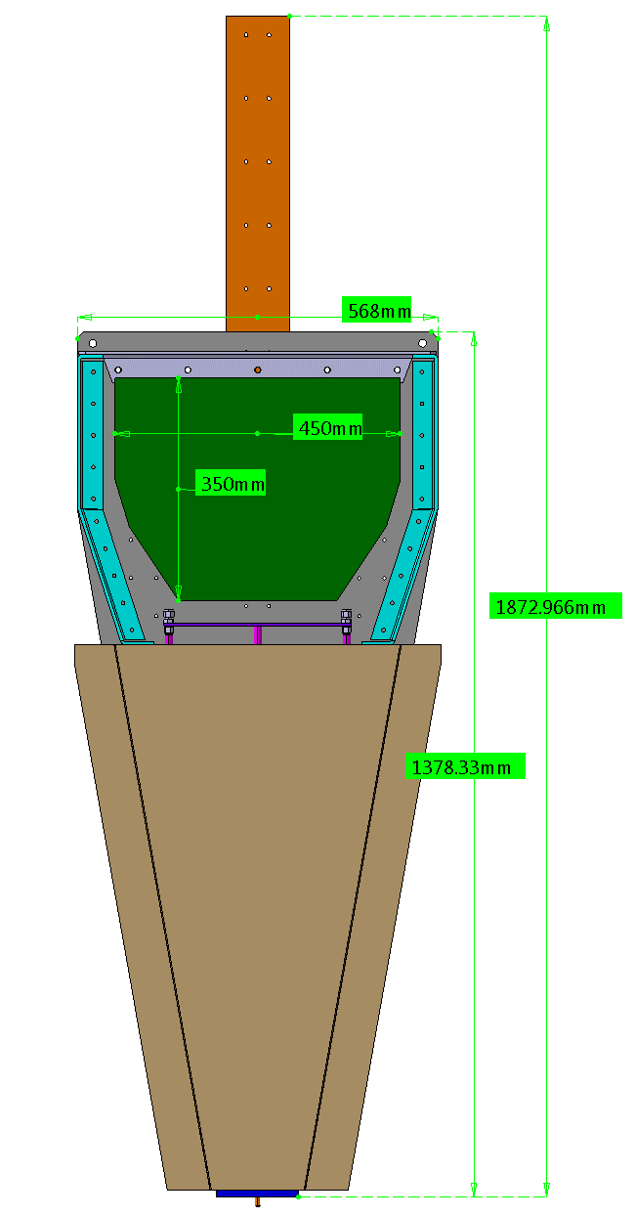
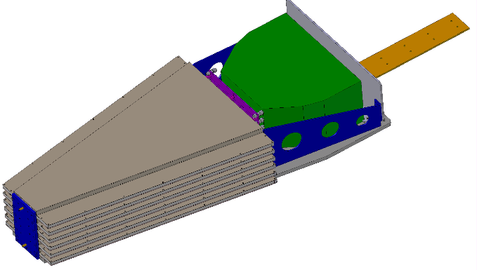
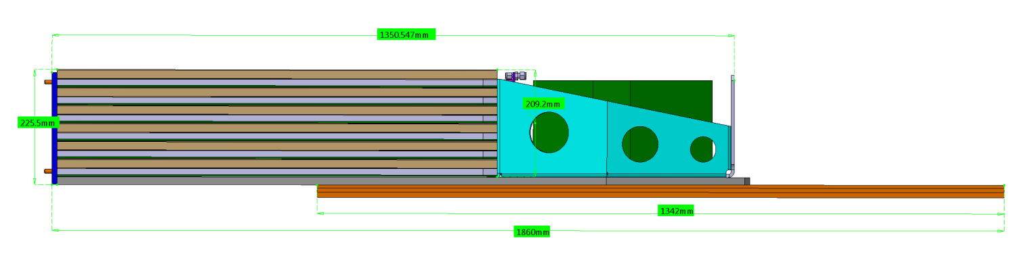
ME0
Services path
Structure of 6 layer detector.
568mm
Electronics Volume
DC/DC converter and OHs
1350.47mm
225mm
1860mm

Slide 20
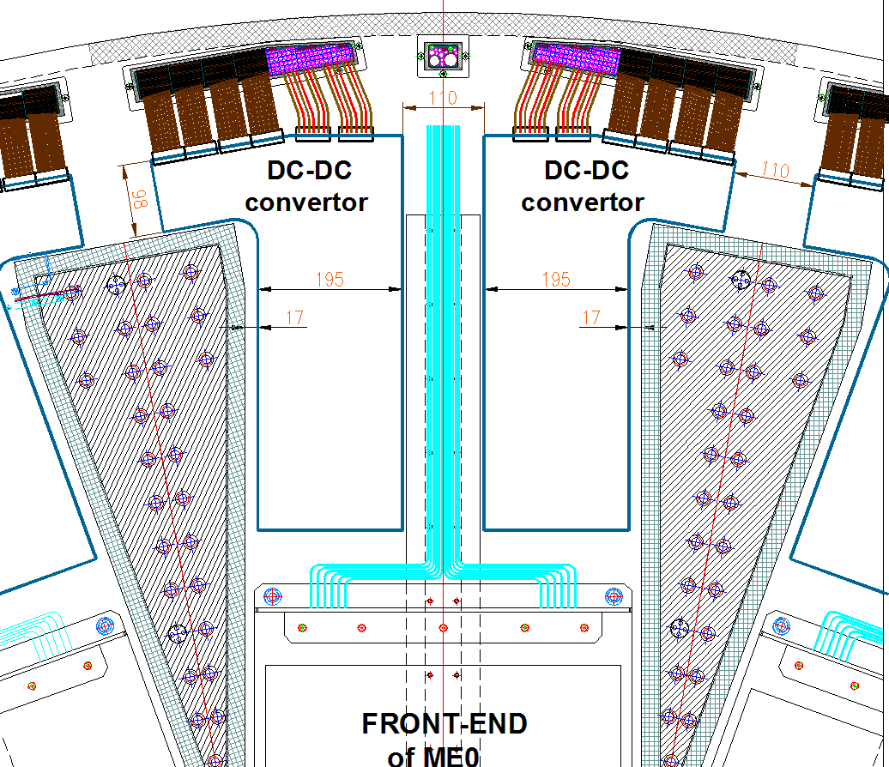
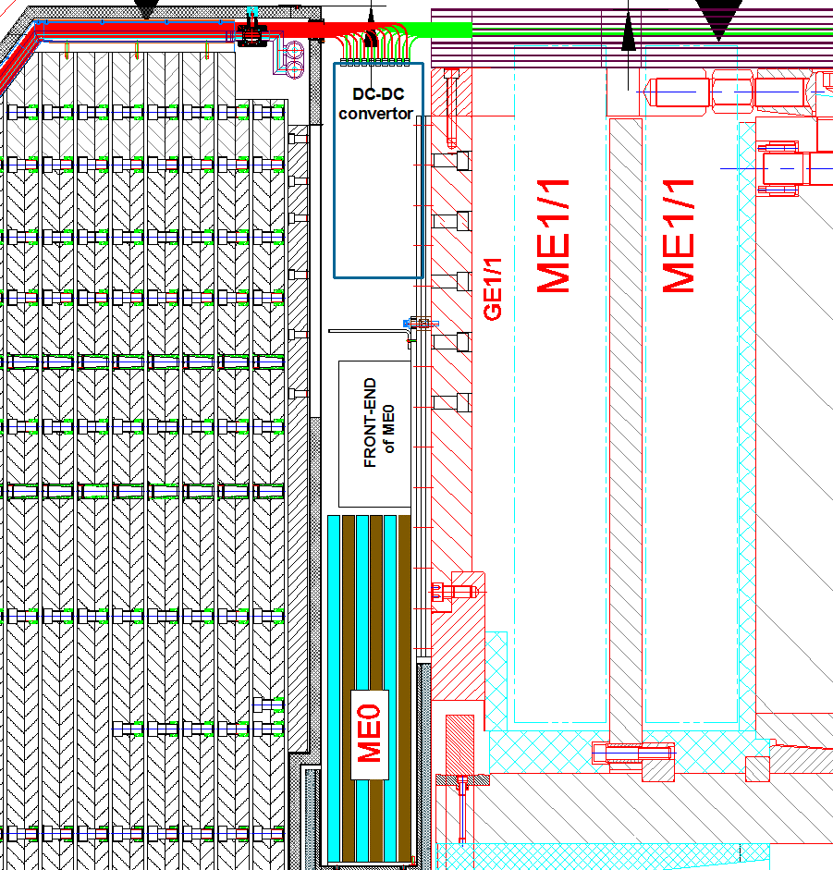
ME0 Services Envelope
6 LV cables, 6x ~10mm dia.
96 fibers for Data – 4 patch cords of 24 fibers = 4x ~12mm
HV cable 3x ~10mm
Gas pipes – Supply and Return – 2 x 6mm
Cooling pipes – 2x 10mm
BH
BH
BH
Side view

Slide 21
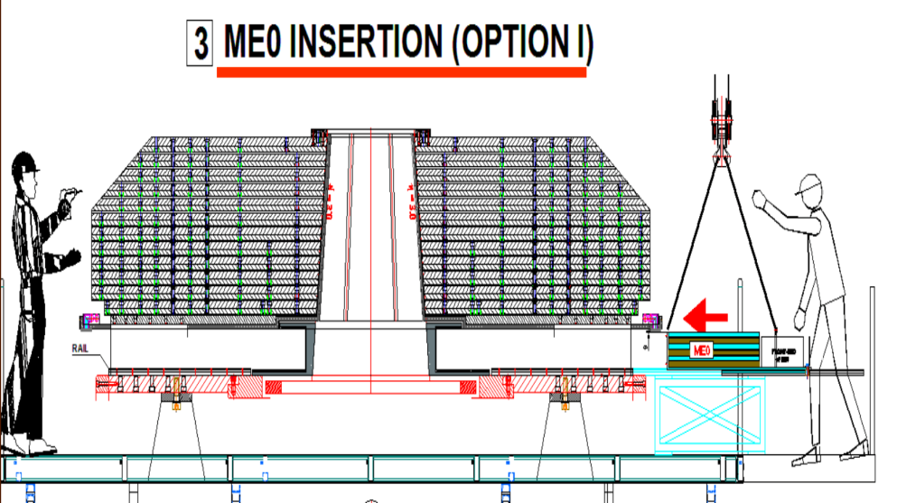
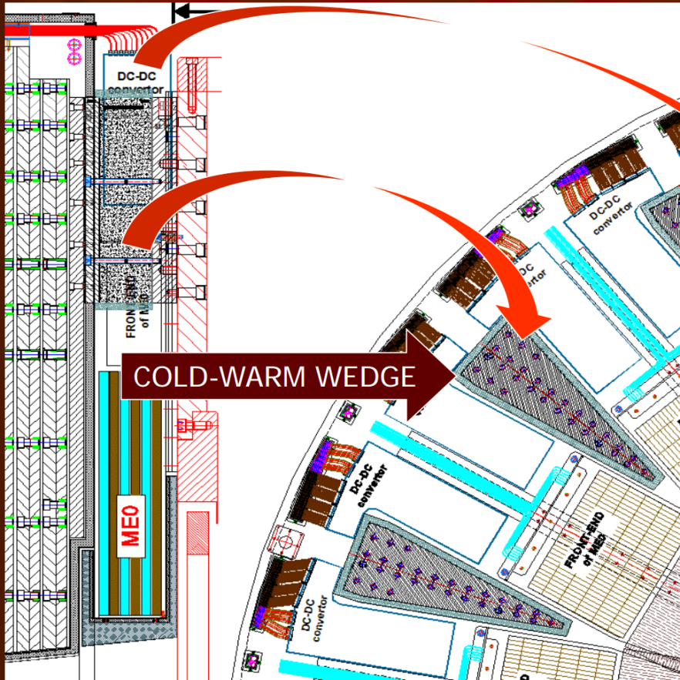
ME0 Services and integration
HGC and ME0 will be mounted in Prevessin B904 before installing in CMS.
Commissioning will be done in bd904 after insertion in HGC.
BD904
HGC
View from IP

Slide 22
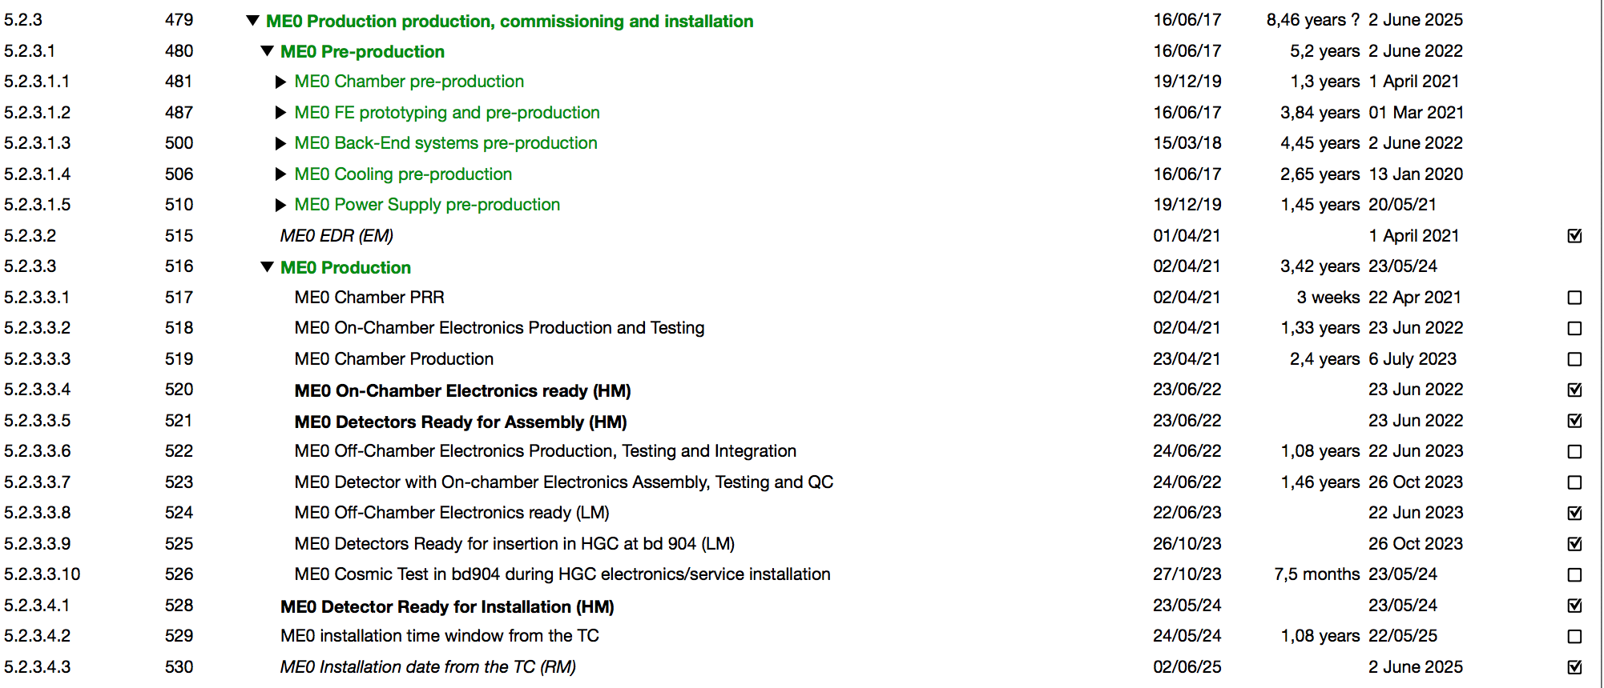
ME0 production, commissioning and installation in LS3

Slide 23
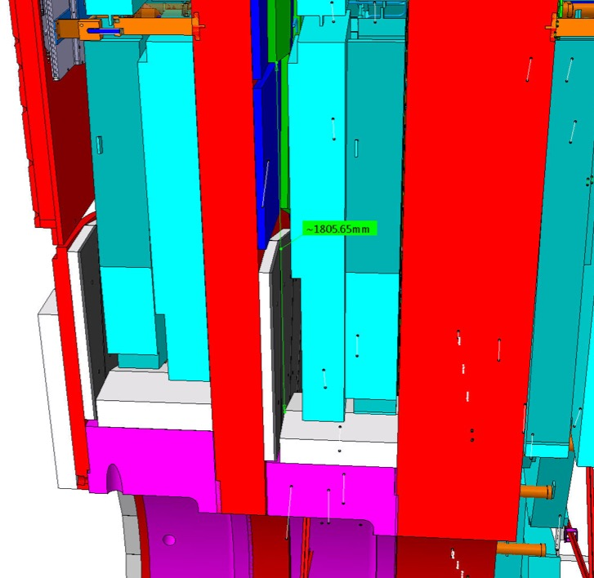
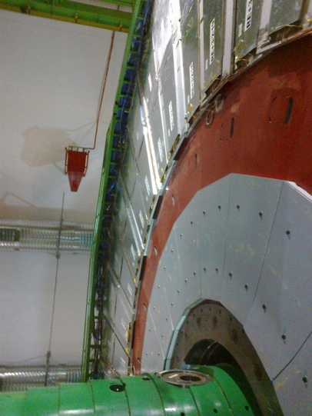
RE3/1 and 4/1 Envelopes
Dimensions are being established with the CMS Integration Office

Slide 24
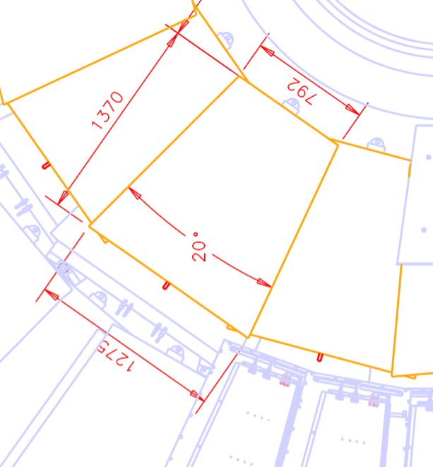
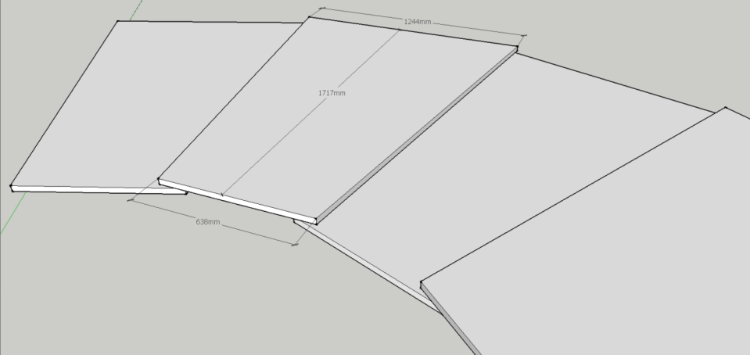
RE3/1 and RE4/1 Geometry
RE3/1
RE4/1
1244mm
1717mm
638mm
A mock-up will be tested in situ for mounting and service study during EYETS2016/17

Slide 25
RE3/1 and RE4/1 single chamber services
+
1 GBT optical link per chamber to transmit data to one data concentrator card per station
Data Concentrator Card: One card, common for one disk of 18 chambers
2 gas lines per 60° sector
12 gas flow cells per rack
UXC
USC
1 HV cable
1 Optical Link
Cooling (supply/return)
Data Concentrator Card
2 OL
1 OL for data
1 OL for trigger
18 OL
1 LV cable
Gas Up layer (supply/return)
Gas Down layer (supply/return)

Slide 26
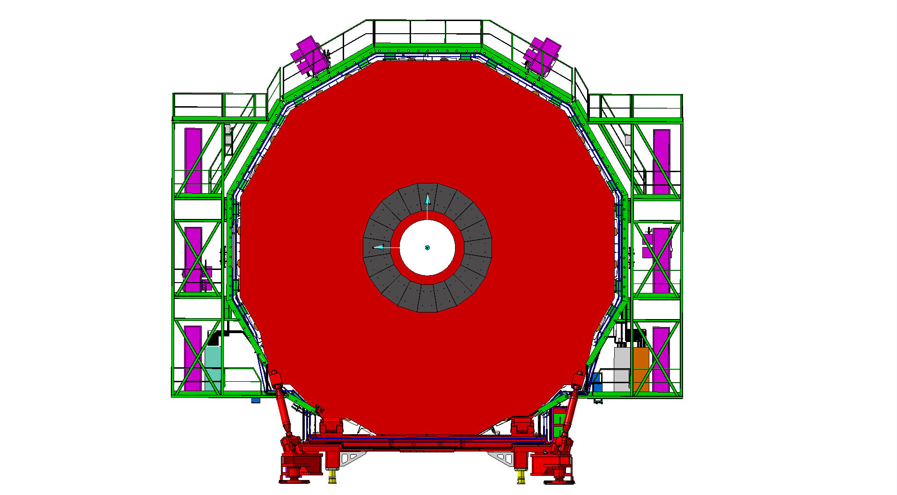
RE3 and RE4 Services on YE3
Mini Cable Chains for HV
Mini Cable Chains for HV
Near Side
Far Side
LV Easy crates
LV crates
DCC
RPC Gas Rack

Slide 27
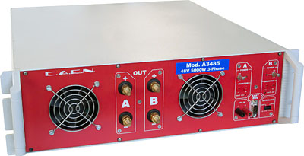
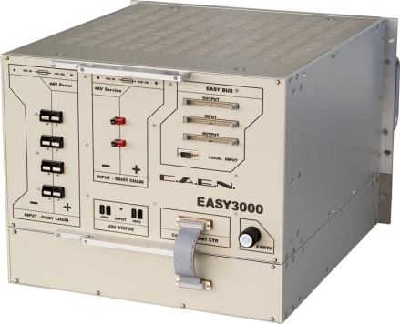
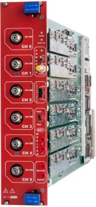
HV System for RE3/1 and RE4/1
USC
The HV power system will be based on CAEN EASY system:
SY4527 – 1 (using the existing endcap main frame)
A3485S - 2 modules
A3512N – 6 boards
UXC
A3485S
4 HV multiconductor cables per endcap. Each with 20 HV channels
All must go via the YE1’s main cable chains
A3512N
Long term maintenance will be secured by CAEN-CERN contract.
DCS software to be integrated in the RPC DCS.

Slide 28

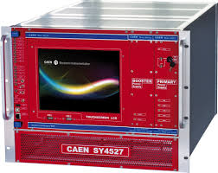
LV System for RE3/1 and RE4/1
2 A3016 LV boards per tower to power the RE3/1 and RE4/1 chambers.
6U for tower
UXC
USC
EASY3000
with A3016
SY4527 with A1676A
50p Communication bus
A3486S
48V Service power

Slide 29
RE3/1 and RE4/1 Gas and Cooling
We will use the present CMS RPC gas mixture . Installation of gas pipes to be made on the disk surface.
C2H2F4
95.2
C4H10
4.5
SF6
0.3
RE3/1 & RE4/1 Gas mixture
C2H2F4 95.2%
iso-C4H10 4.5%
SF6 0.3%
40% humidification
Cooling estimates
Distribution rack for RE3/1 and RE4/1
Per Chamber | Per Disk | Power in the UXC Racks per disk | Total Power per Disk
53W | 1.9kW | 1.6kW | 3.6kW

Slide 30
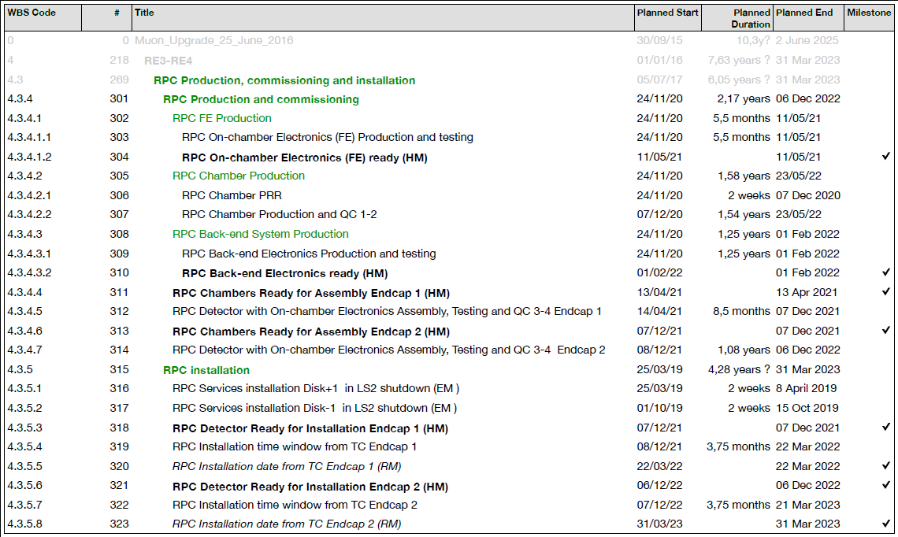
RE3/1 and RE4/1 Schedule
Services Installation during LS2
Ready for installation Endcap1
Ready for installation Endcap2

Slide 31
USC – UXC new station services summary
Sub-system | Power System Component | Total Quantity | Length/Diam. [m/mm] | Service Installation Duration | Installation LS2 Period
RPC | HV Umbilical cables | 8 | ~90/40 | 2 weeks per end | RE+: W16-17 RE-: W47-48
RPC | Gas copper pipes | 4 | ~110/12 | 1 week per end | RE+: W17 RE-: W48
GE2/1 | HV | 72 | ~100/10 | 1 week per end | GE+2/1: W16 GE-2/1: W25
GE2/1 | Optical Fibres | 1872 | ~80/40 | 2 weeks per end | GE+2/1: W16 GE-2/1: W25
GE2/1 | DCS, Alignment, Tempar | 8 | ~100/10 | 1 week per end | GE+2/1: W16 GE-2/1: W25
GE2/1 | Gas | 4 | ~110/12 | 2 weeks per end | GE+2/1: W16 GE-2/1: W25

Slide 32
RPC UXC Services
Sub-system | Power System Component | Total Quantity | Length/Diam. [m/mm] | Service Installation Duration | Installation LS2 Period
RPC | HV power cables | 72 | ~30/6 | 2 weeks per end | RE+: W18-19 RE-: W49-50
RPC | LV power cables | 72 | ~15/10 | 1 week per station & end | RE+3/1: W51 RE+4/1: W57 RE-3/1: W38 RE-4/1: W44
RPC | DCS cables | 72 | ~15/5
RPC | LVDS signal cables | 1440 | ~15/10
RPC | Supply Gas copper pipes | 24 | ~20/6 | 1 week per station & end | RE+3/1: W50 RE+4/1: W39-40 RE-3/1: W37 RE-4/1: W20-21
RPC | Return Gas copper pipes | 24 | ~20/8
RPC | Cooling | 36

Slide 33
GE2/1 UXC Services
Services | GE2/1 Chamber | GE2/1 Super-Chamber | Per Endcap | Installation LS2 Period
HV | 1 cable of 32 conductors inside | 2 cables | 36 cables | GE+2/1: W16 GE-2/1: W25
LV Up to the Periphery of the YE1 | 1 cable of 4 conductors inside | 2 | 36 | GE+2/1: W16 GE-2/1: W25
Fibers to UXC pp – toward USC S2 | 26 | 52 | 936 | GE+2/1: W16 GE-2/1: W25
Fibers to ME2/1 TMB. Vie the miniCC | 8 | 16 | 288 | GE+2/1: W16 GE-2/1: W25
Gas Daisy chain with 3 chambers | 2 | 4 | 24 pipes 12 supply and 12 return Copper pipes 8 mm external diameter | GE+2/1: W16 GE-2/1: W25
Cooling | - | 2 | 36 pipes | GE+2/1: W16 GE-2/1: W25

Slide 34
Conclusion
The services needed for the new stations are defined.
Services will be installed before and during LS2
Chambers will be installed during YETS before LS3.

Slide 35
Thank You

