Slide 1
RE3/1 & RE4/1 Parameter Space
Services
Ian Crotty
12 Feb 2014

Slide 2
CMS Parameter drawing

Slide 3
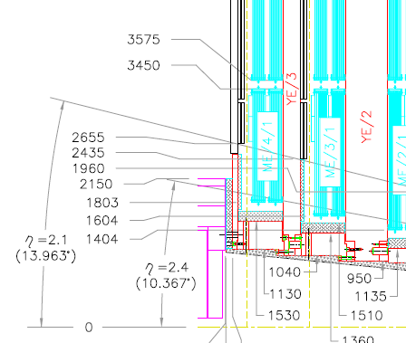
RE4/1 & RE3/1
As planned high Eta up to 2.1.
Extending to Extra High Eta
= 2.4 or 2.5

Slide 4
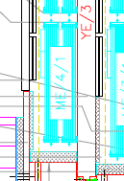
Boundries on Extra High Eta
Alignment lines
RE4/1
ETA=2.1
RE3/1
Neutron Shielding on Vertical faces of yoke
Cylindrical Neutron Shielding

Slide 5
Dimensions as per our Parameter Book
Geometrical Layout and Mechanical details of CMS
End Cap RPCs
(Version:November, 2002)
B
Ri
D
Ro
Station | Ri | Ro | A | B | C | D | Thickness | Z Position rpc Z of cu-strips
RE2/1 | 1960 | 3241 | 1301 | 1251 | 799 | 1281 | 36 | 7865-7902 7883 –7920*
RE2/2 | 3299 | 4986 | 1693 | 979 | 684 | 1687 | 36 | 7865-7902
RE2/3 | 5001 | 6955 | 1961 | 1323 | 981 | 1954 | 36 | 7865-7902
RE3/1 | 2435 | 3241 | 819 | 1251 | 966 | 806 | 36 | 9775-9738 9757-9720*
RE3/2 | 3299 | 4986 | 1693 | 979 | 684 | 1687 | 36 | 9775-9738
RE3/3 | 5001 | 6955 | 1961 | 1323 | 981 | 1954 | 36 | 9775-9738
RE4/1 | 2655 | 3241 | 595 | 1251 | 1044 | 586 | 36 | 10676-10639 10654-10621*
RE4/2 | 3299 | 4986 | 1693 | 979 | 684 | 1687 | 36 | 10676-10639
RE4/3 | 5001 | 6955 | 1961 | 1323 | 981 | 1954 | 36 | 10676-10639

Slide 6
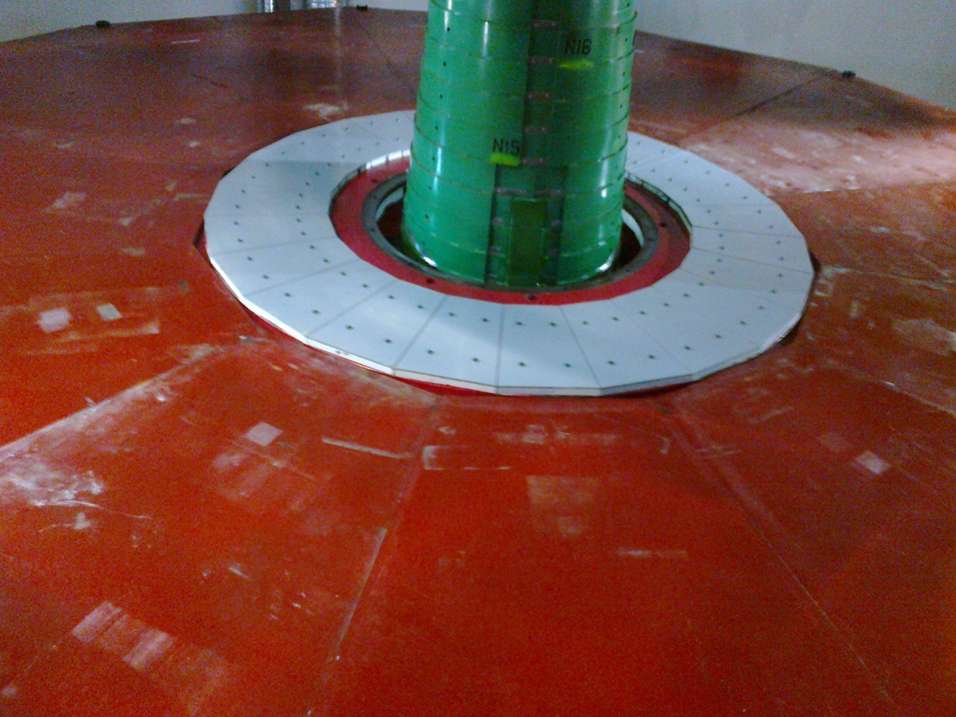
The easy solution
A flat wall YE4 to mount to
However there are no services, Gas, Rack space, Mini Cable Chains etc available on YE4. Taking services there from YE3 would require disconnects or new Mini cable chains. The former is not CMS policy.

Slide 7
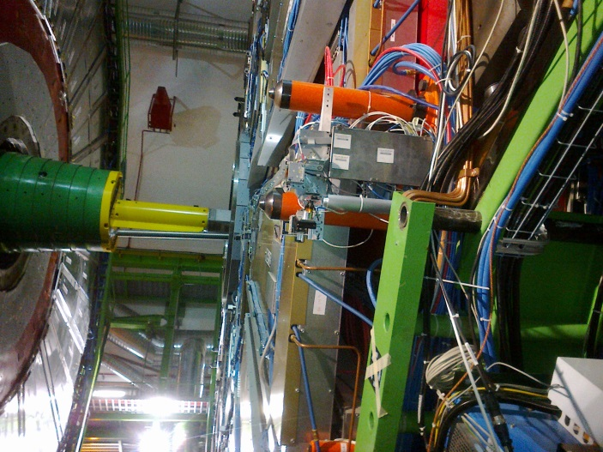
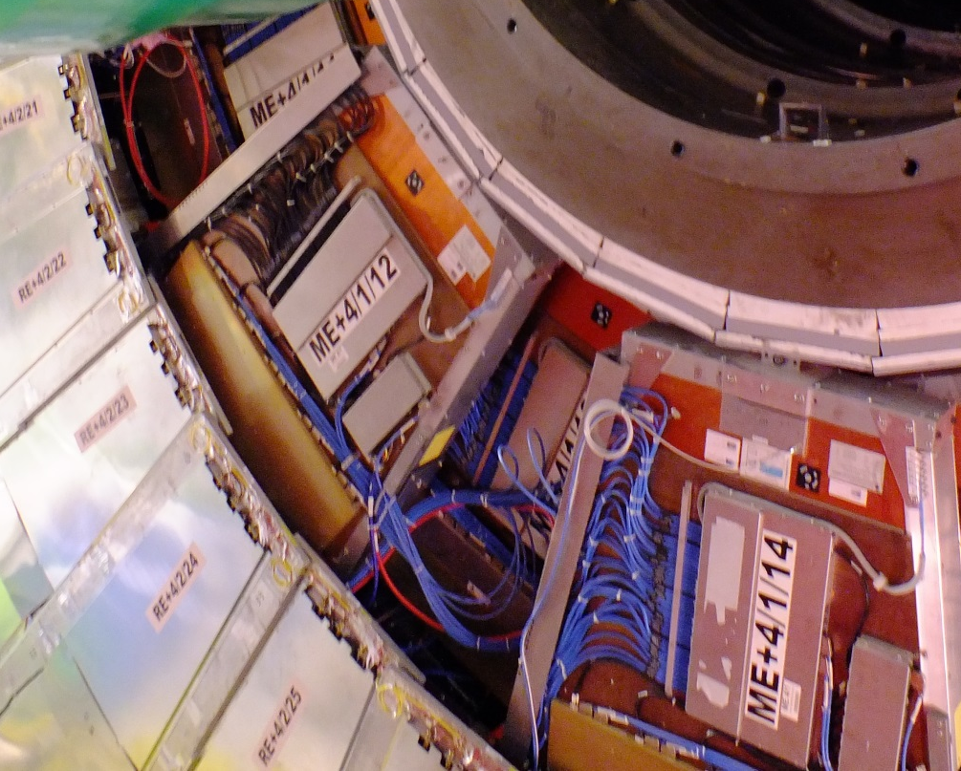
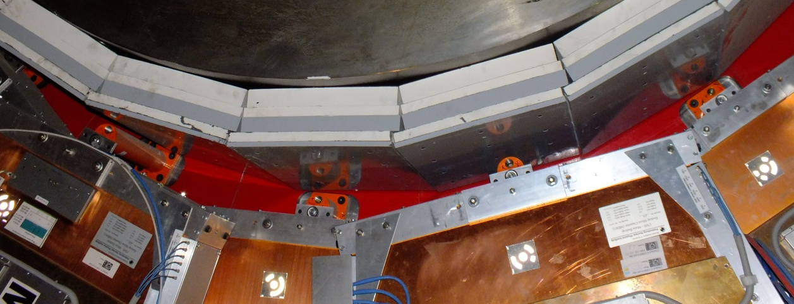
Mounting RE4/1
Outer radius mounting posts are hidden behind RE4SM
Alignment system has gone giving space ~60mm in Z
Inner radius mounts M24 every 20deg
Require a technically smart solution to fix the outer radius

Slide 8
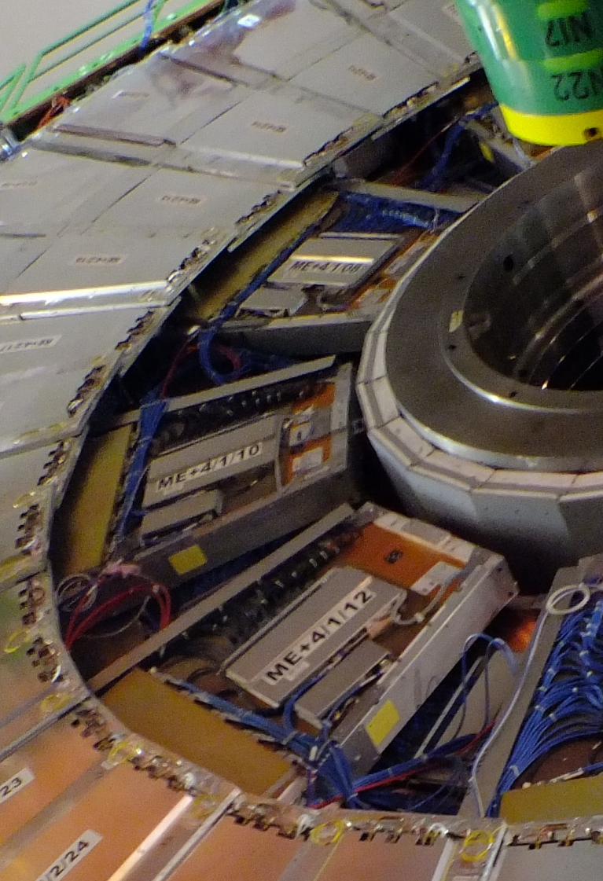
Access to Periphery
Lead cables and pipes over the top of the RPCs,
OR
Under them where the space was for the alignment system .

Slide 9
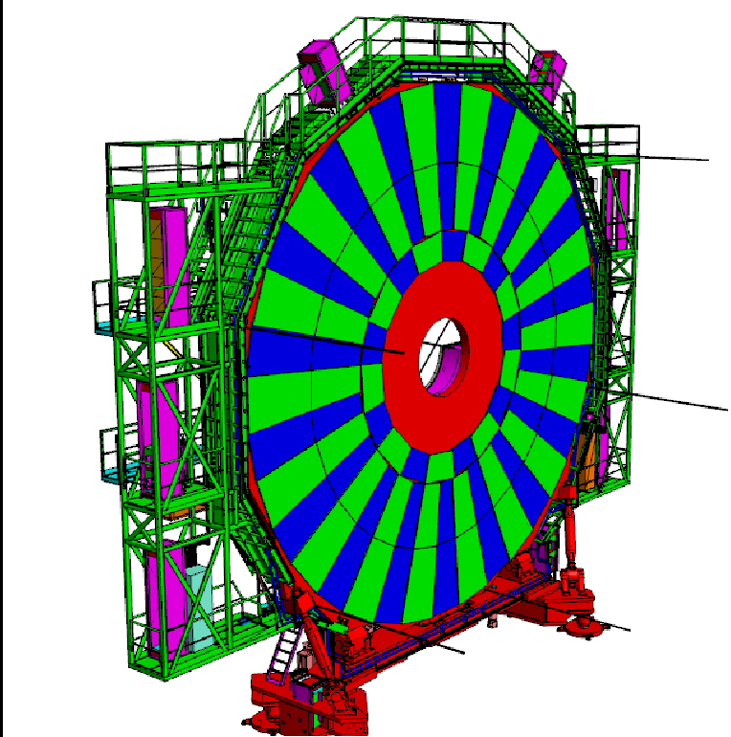
RE3/1

Slide 10
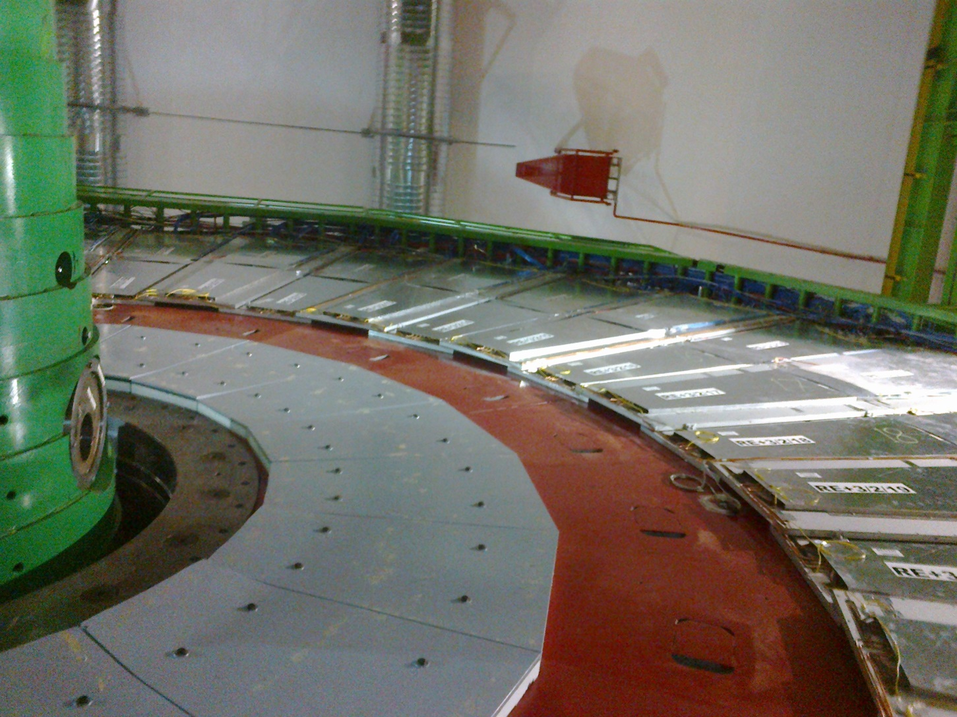
RE3/1 High Eta & Extra High Eta
RE3/1 Eta = 2.4
RE3/1 Eta=2.1

Slide 11
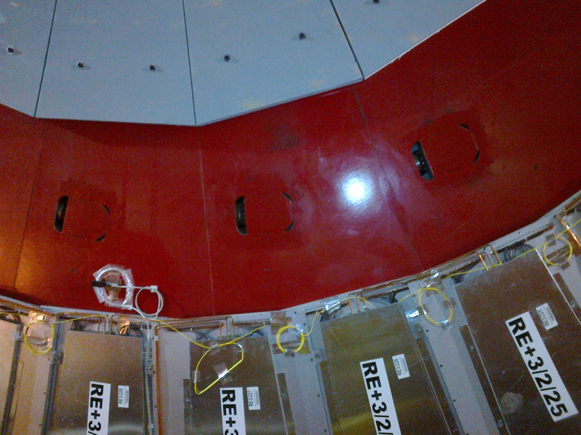
Mounting RE3/1
M12 Mounting Holes for 20deg Chambers

Slide 12
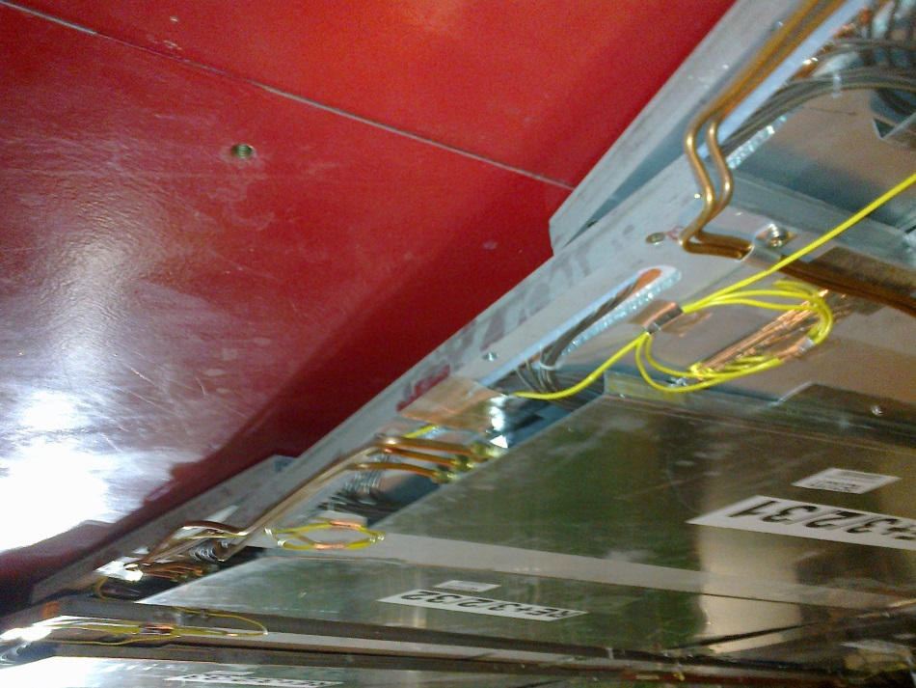
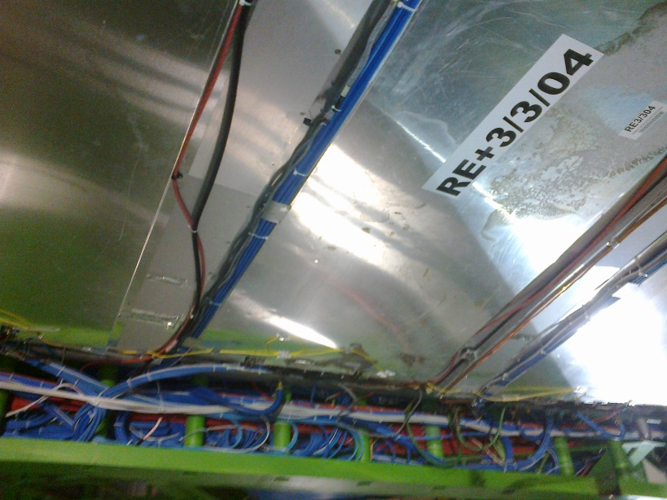
Access to Periphery
Over the top of the RPCs
Under the RE3/2 & RE3/3

Slide 13
Services
Gas rack(s)
Cooling, capacity of YE3 Manifold
Rack (LV , LBC
Cables (HV, LV Signal dcs
Access to Periphery (Green Structure)
Space in Main & Mini Cable Chains

Slide 14
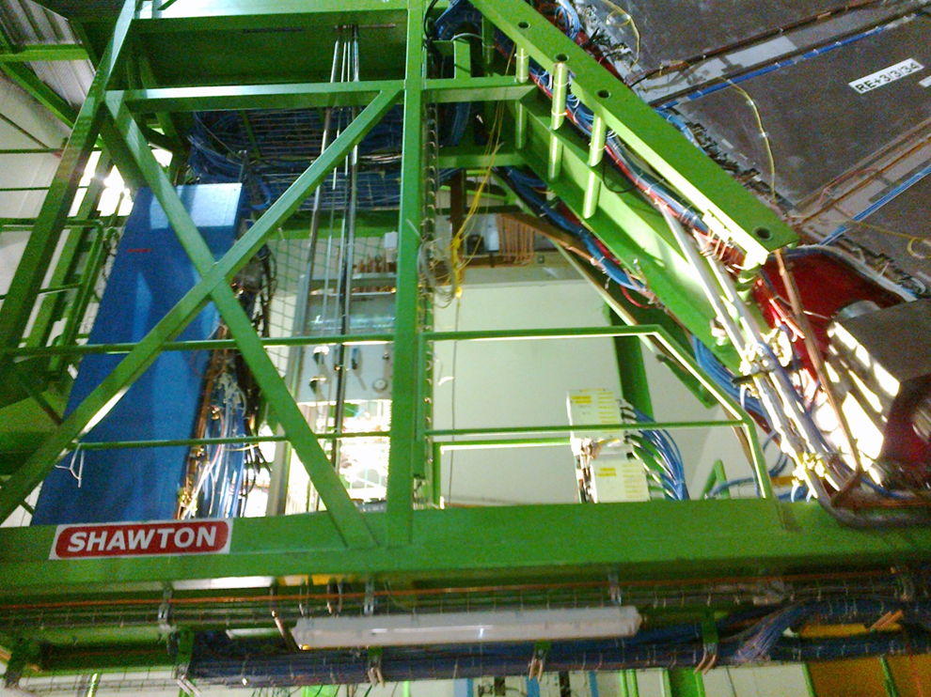
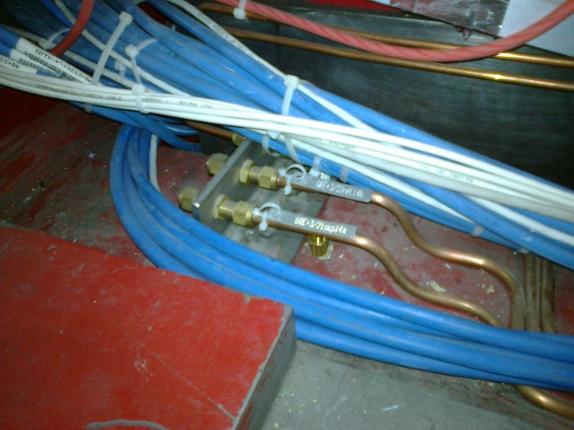
Gas rack space available on Near of YE3 suitable for both RE3/1 & 4/1 ?

Slide 15
Conclusion
The mounting of RE4/1 is tricky
The rack space for both RE4/1 & RE3/1 on the same yoke (YE3) will be difficult
Exact volumes for High ets & Extra High eta to be established with Integration 904
Iteration of chamber design and boundary conditions in P5
This doc and others are visible at;
http://project-cms-rpc-endcap.web.cern.ch/project-cms-rpc-endcap/rpc/UpscopeHighEta/Parameters/HighEtaParaSpaceRPCsIanFeb2014.pptx

Slide 16
Supplementary slides
RE2/1

Slide 17
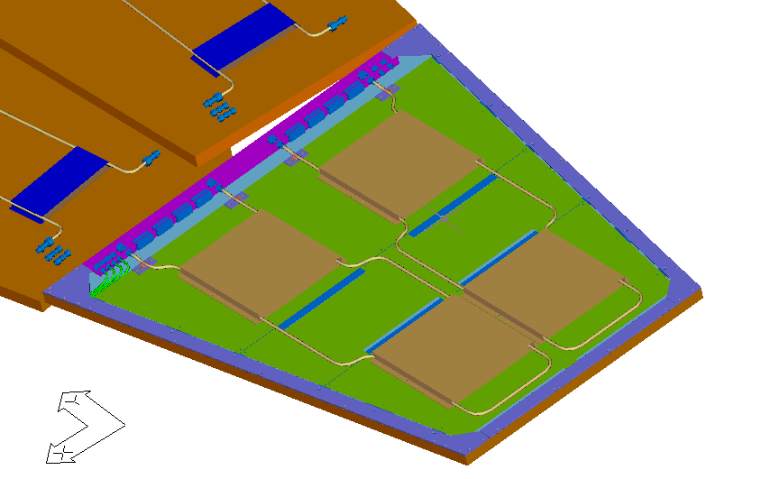
RE2/1 and its Cooling

Slide 18
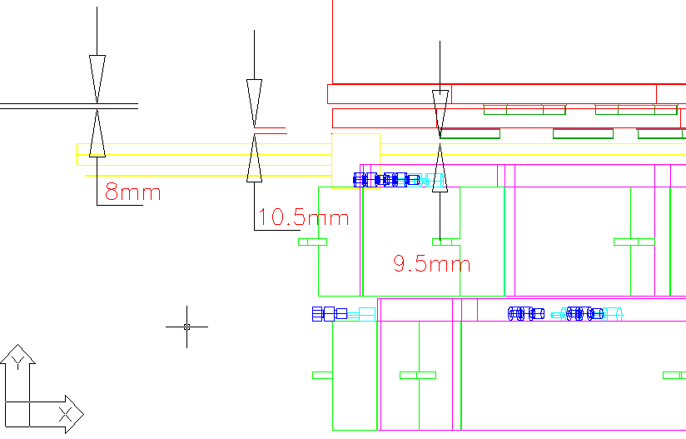
X Section of CSC-RPC interface

Slide 19
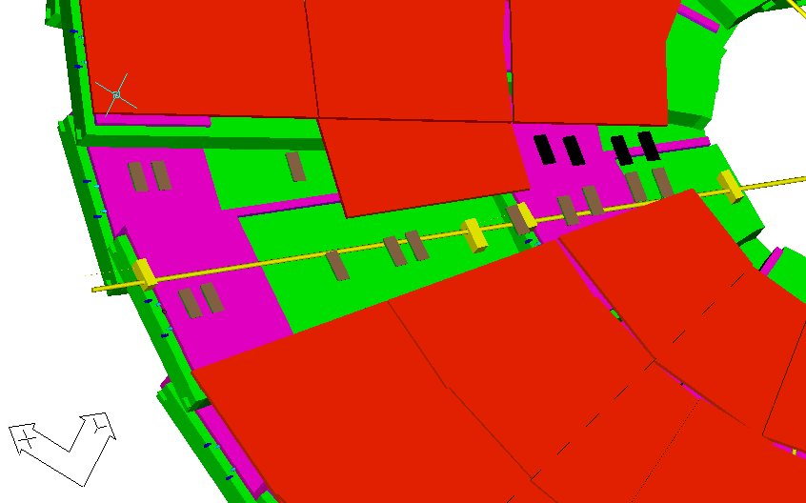
Alignment path

