Slide 1
Services and paths for
GE1/1 in CMS
Slice test & Full Installation
Ian Crotty 26 Feb 2015

Slide 2
Services and their Paths
HV
LV
Signal fibres
Alignment fibres
Gas
Cooling
Radmon

Slide 3
HV multi Channel
Channels per Superchamber
2 options CSC based system or CAEN system
USC Rack Space
UXC Rack space

Slide 4
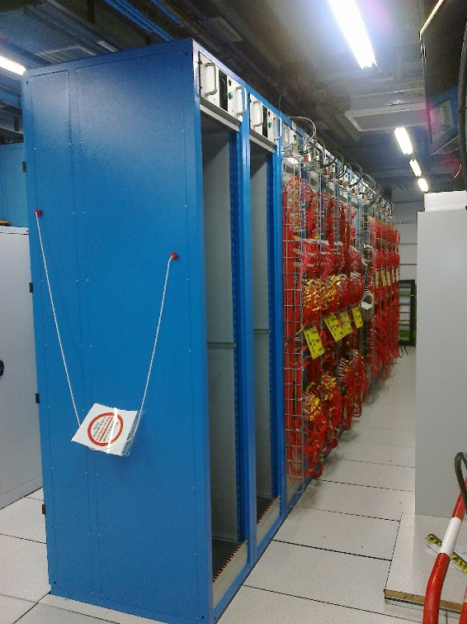
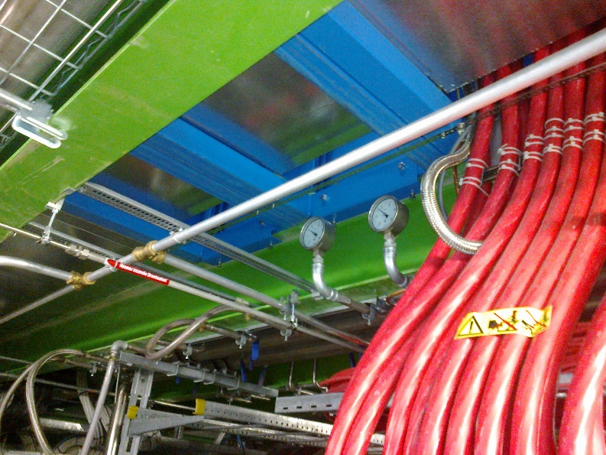
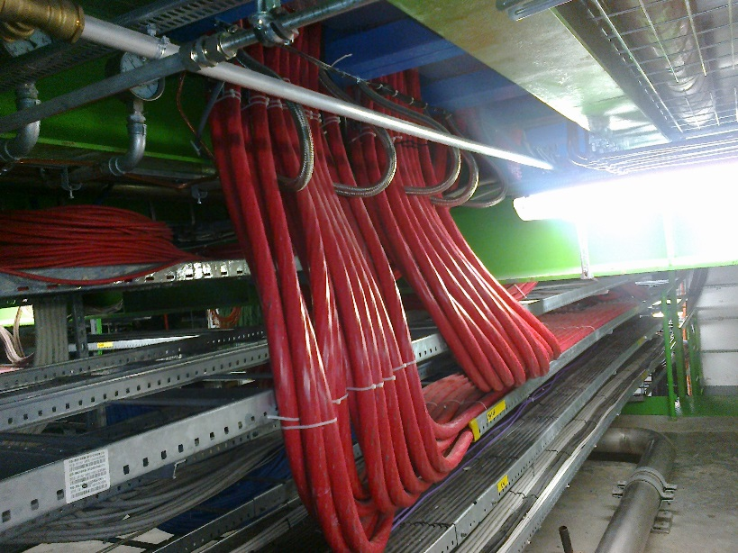
USC HV Racks
Two racks have been added, next to RPC HV system, for GE1/1
Cooling both under and in the rack are not yet done , need heat load and crate position/sizes

Slide 5
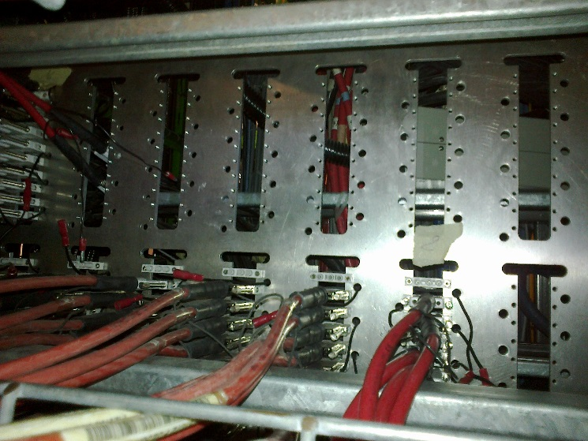
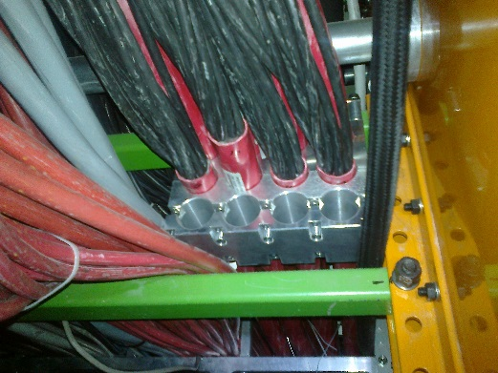
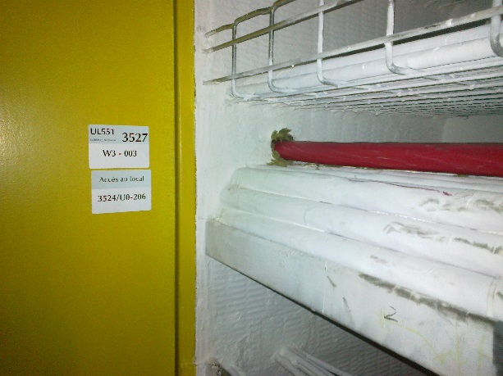
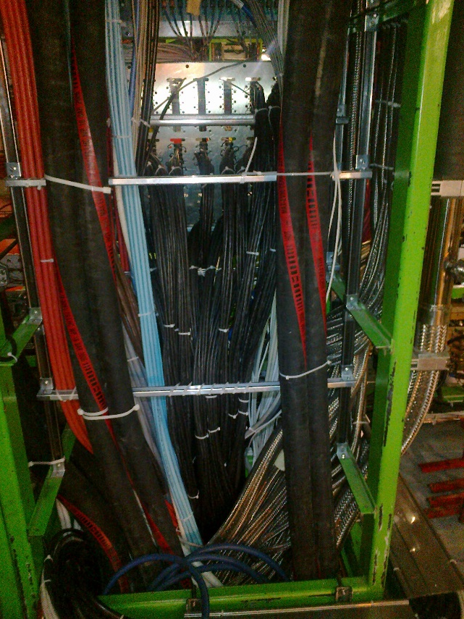
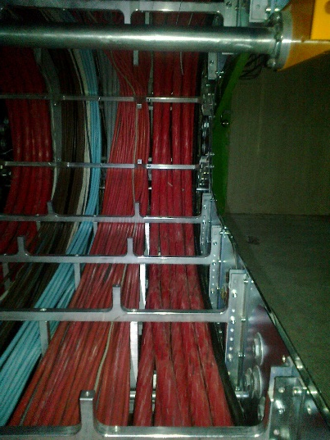
Cable chains & PP YE1
Space in RPC PP
Cable clamps under YE1 PP
New HV cable for Slice test. Fire proof passage through into basement of USC
RPC HV cables etc in Cable chain. Very difficult access.
Very little space in the YE1 PPs

Slide 6
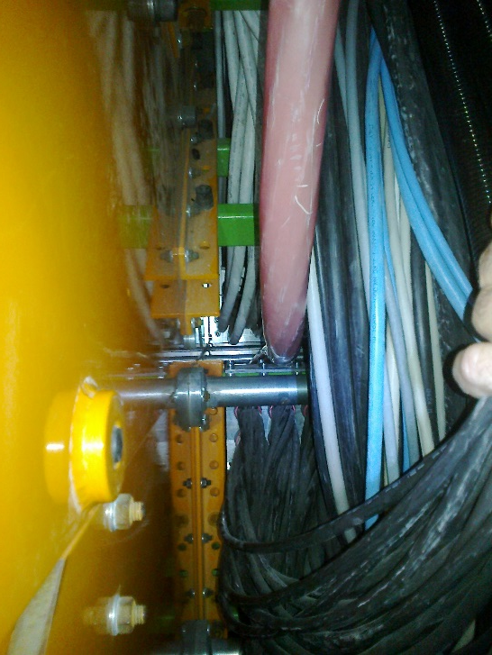
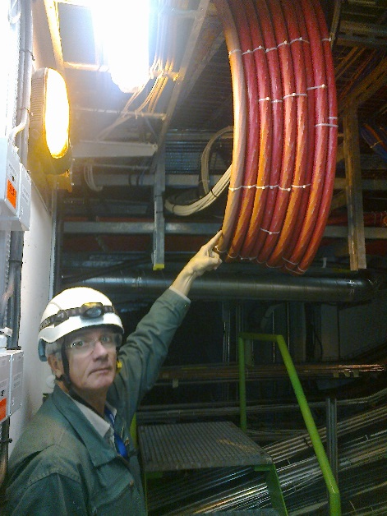
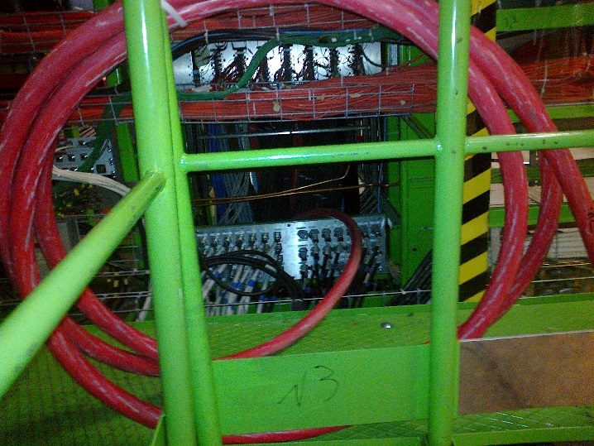
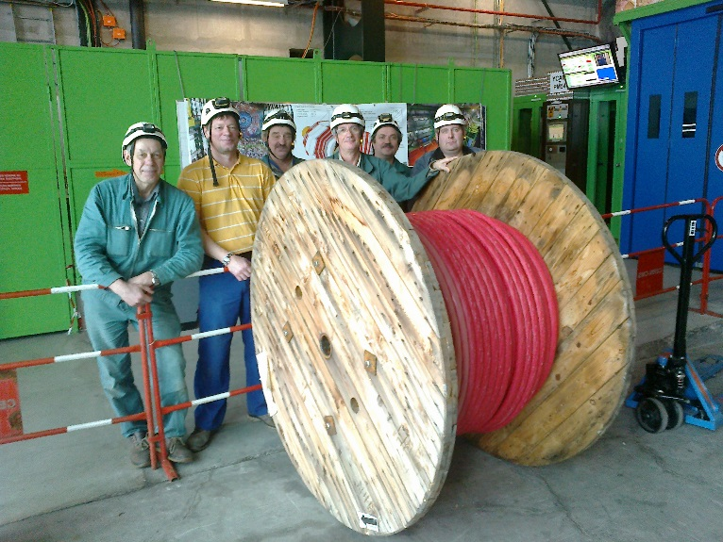
HV link from USC to UXC
Initial installation for Slice test
PP on YE-1
near
Cables for Slice test from PP to chamber are there
Need new connectors at both ends ?
A big team is necessary for one cable !

Slide 7
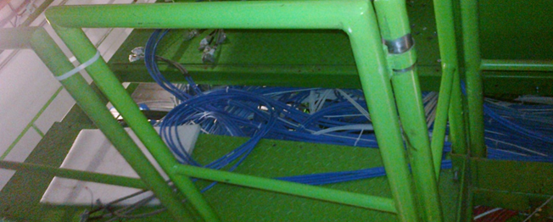
LV Rack Space on -Z
CAEN A3016 in the UXC
We have 2 rack volumes diametrically placed. They are available for GE1/1 today.
X4S33
Rack access must be studied as most x-sections are taken
GE1/1s
X2V33

Slide 8
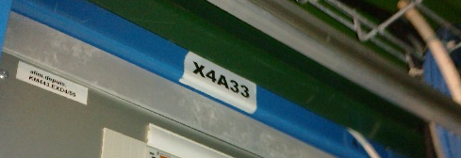
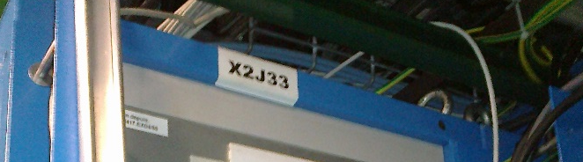
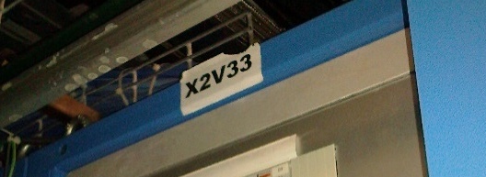
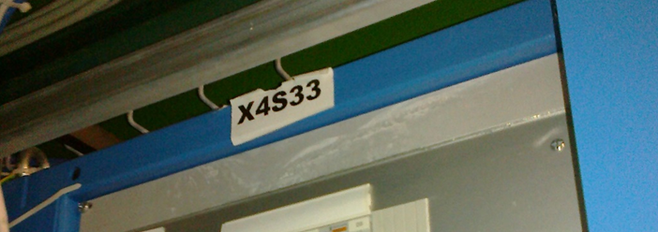
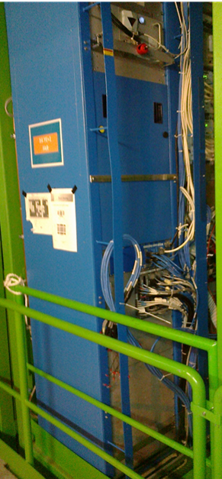
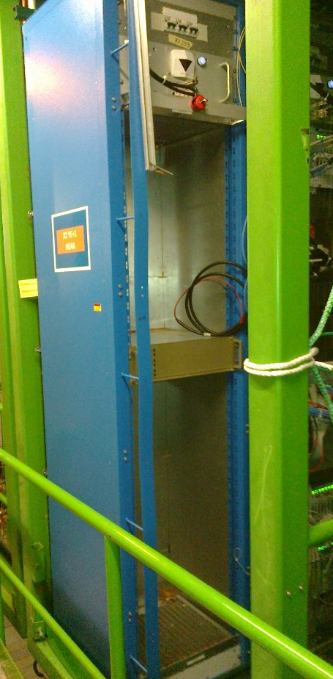
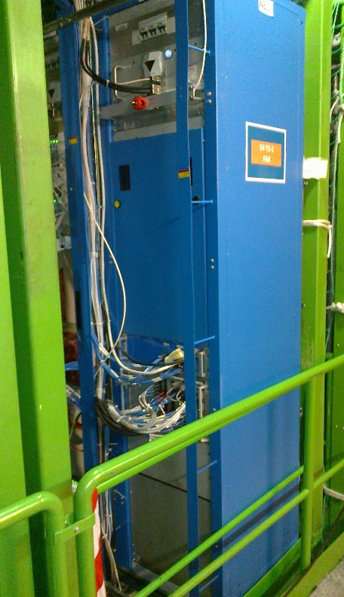
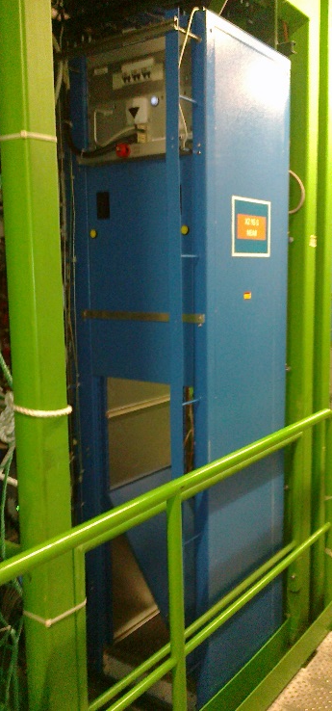
Rack space on both endcaps

Slide 9
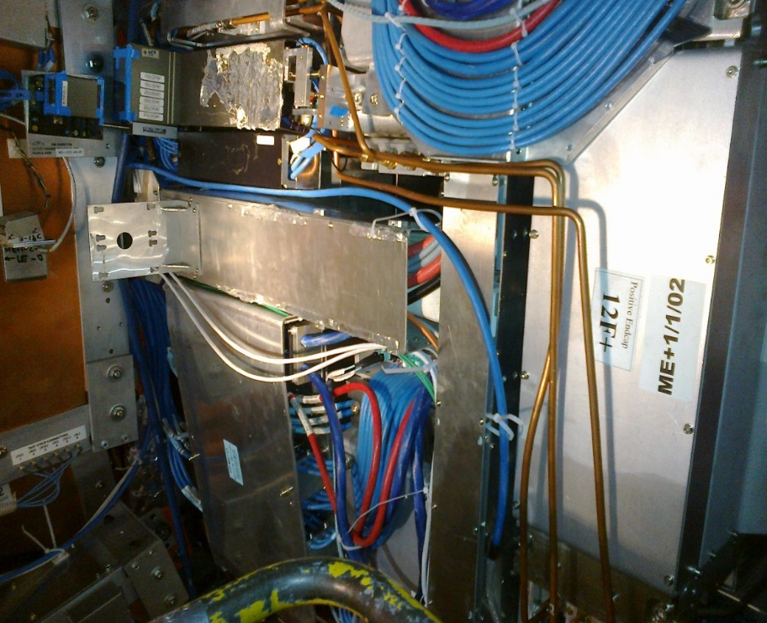
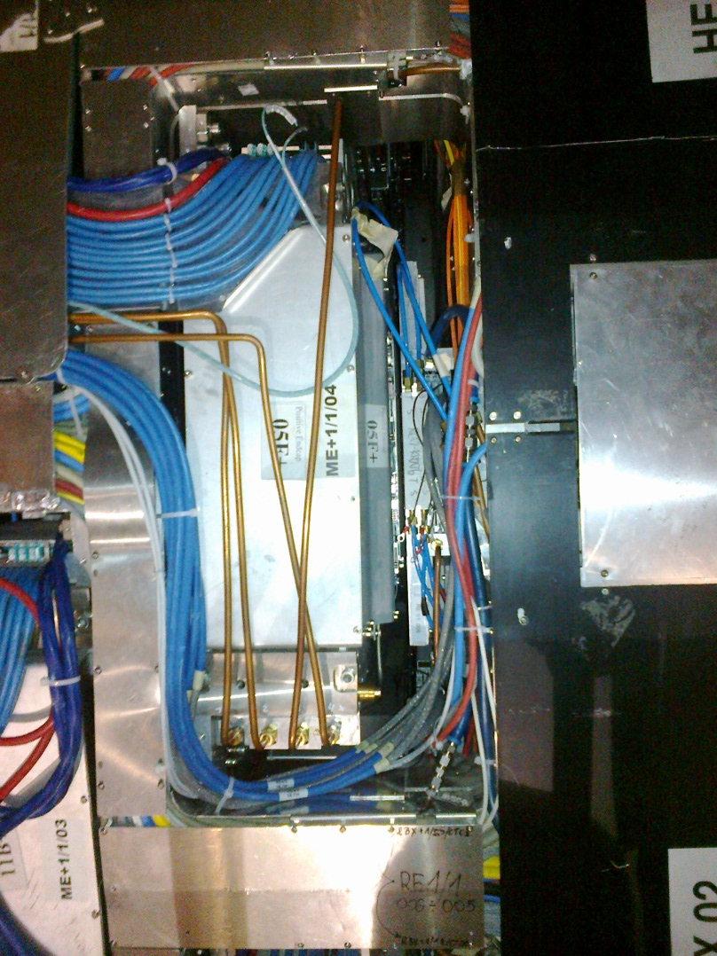
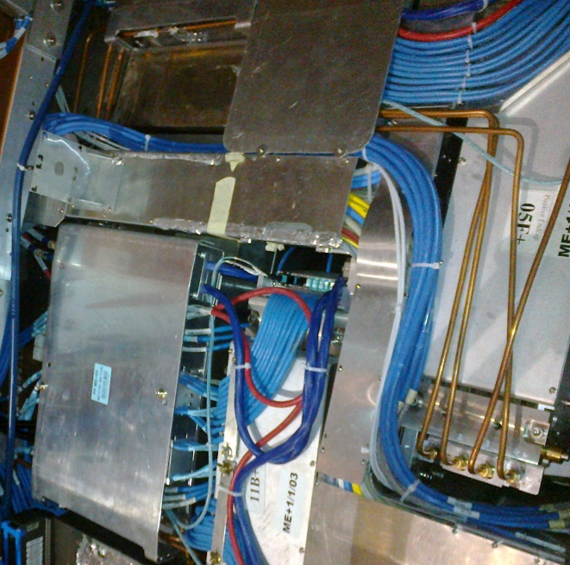
RE1/1 Cable paths over ME1/1 CSCs
8x Signal cables and 2x DCS fit readily in the x-sections
There is a distinct difference between cabling for RE1/1 and GE1/1. There are no power cables over the CSCs, they are afraid of induced noise

Slide 10
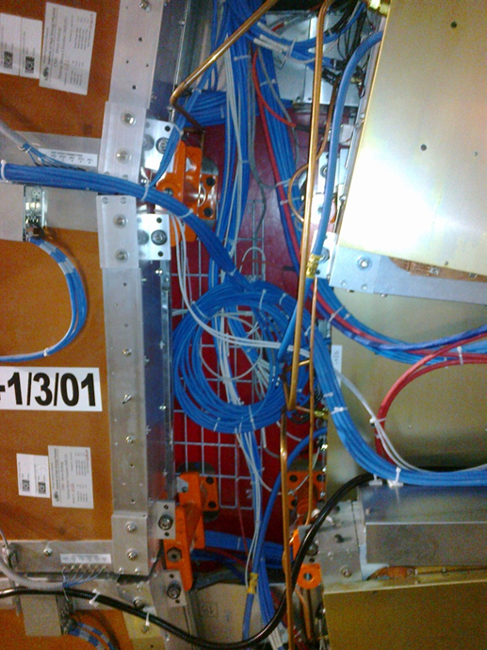
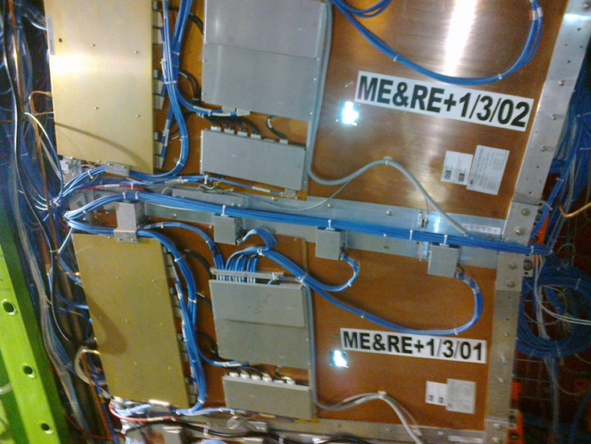
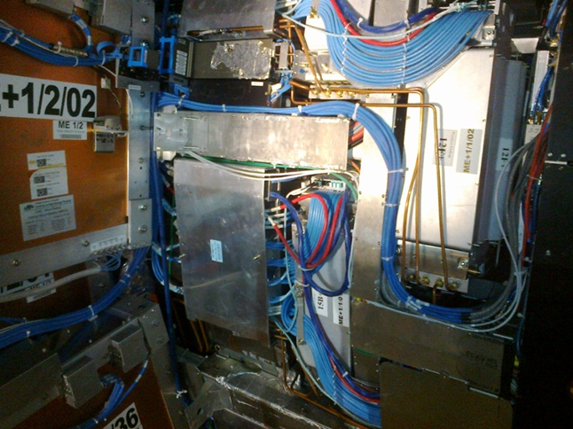
ME1/2 & ME1/3 path
Slack left in place so that MEs can me reoved without uncabling RE/GEs
Cables mounted directly onto CSC chambers, can be done in a more solid manner
Increasing Radius from HE nose to Green structure

Slide 11
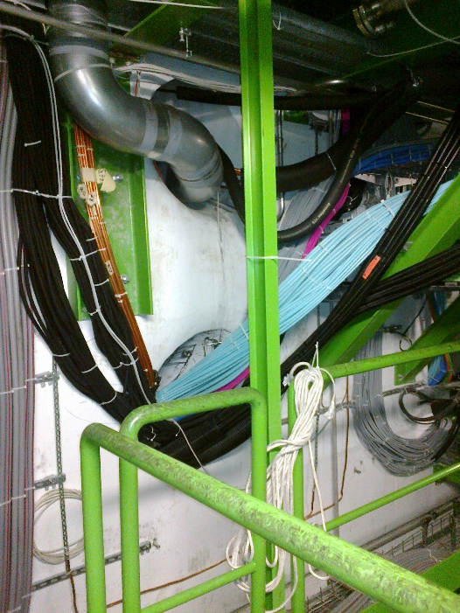
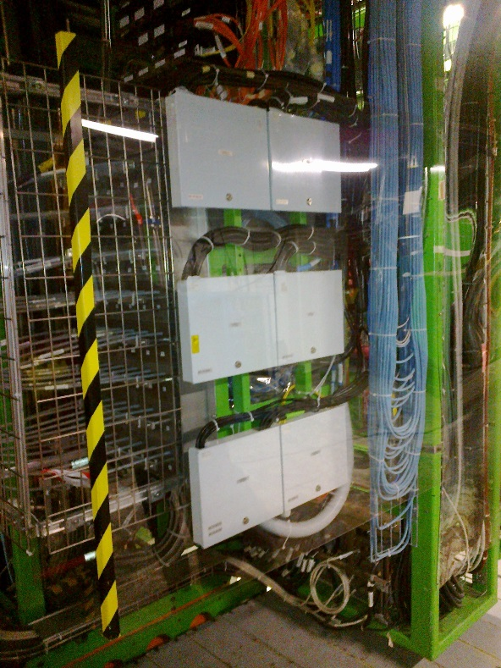
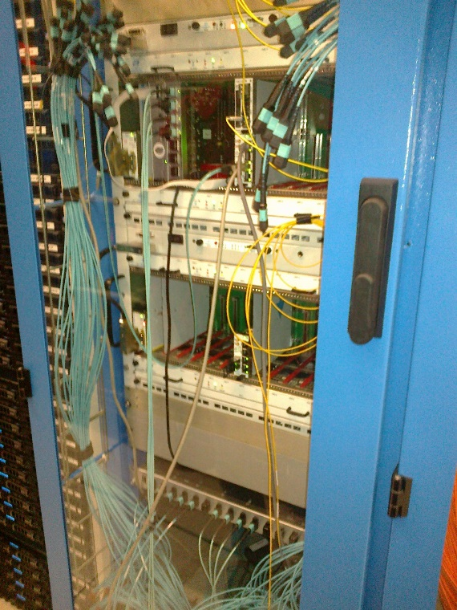
Fibre passage/path
Blow fibres from PP to Trigger Rack
YE1 Fibre PP UXC. Requires new installation for GE1/1
GE1/1
Trigger Racks in USC
Patch cords between Chamber and PP ?
Reserved Fibre passage through wall separating UXC & USC
Alignment fibres ?

Slide 12
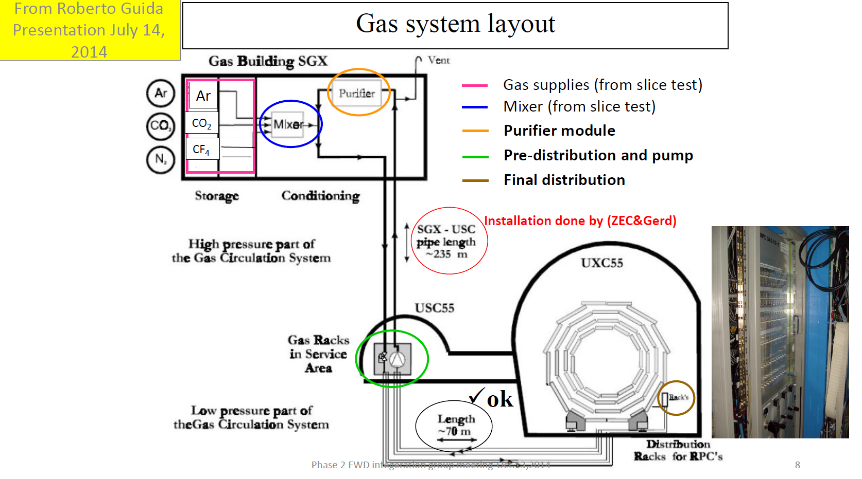
Gas
The RE1/1 gas system installed in the UXC will be used up to the chambers. Circuits are 60deg ie 6 chambers in series

Slide 13
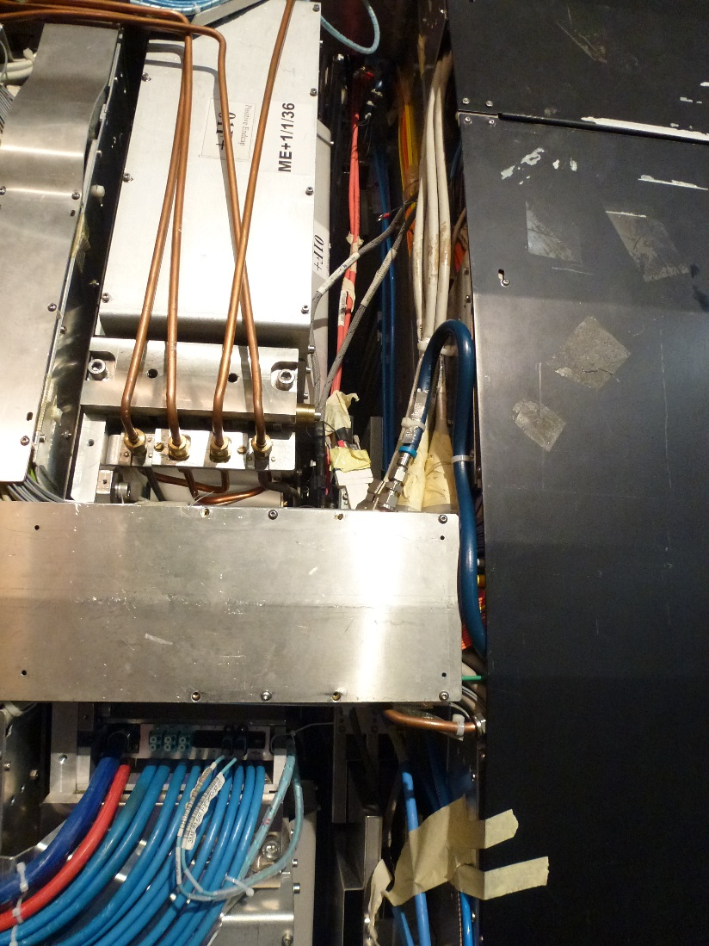
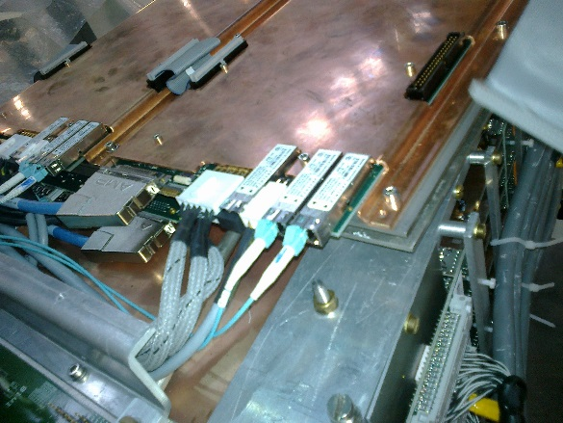
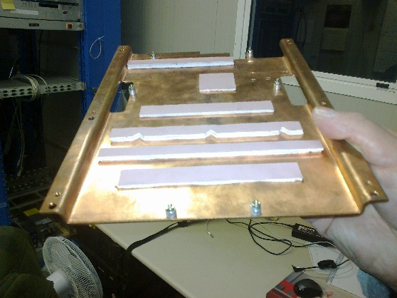
Cooling
Cooling circuits are 20deg with RBX
Use ME1/1 cooling pads as inspiration

Slide 14
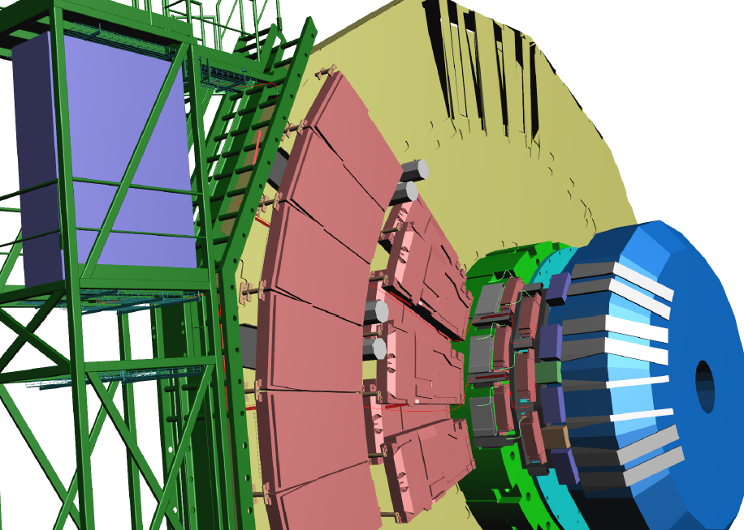
An example of integration work for all the services
16 Signal Cables dia 10mm
4 DCS cables dia 5mm
Choice of Rack access from bottom or top
2 paths to reduce cable section over CSCs

Slide 15
Conclusion
All cables for slice test(except radmon) are installed between USV & UXC. The cables at each end have to be installed or modified (HV).
We will draw our conclusions as the WS proceeds today
It is really time to setup and ensure that we have all available material ready for installation both for the Slice test and 72 GE1/1 installation as soon as possible.
All Installation work in should go through the Integration office.
Work to be done to integrate the Services with Integration in 904

Slide 16
Thanks for the many contributions

