Slide 1
Proposed cooling study on GE1/1
Ian Crotty & Saleh Muhammad
26 Sept 2014

Slide 2
3 Stages
Worst case scenario with all heat going into the cooling medium, creating greatest temperature differences across a 20deg circuit
Detailed study of real VFAT & OH heat load and thermal path resistance to cooling circuit.
Build a full model of the HE nose of CMS with 4 models of GE1/1 installed to study environmental conditions and services.

Slide 3
Worst case
Flow Rate [kg/s]
This first activity is to get the ball rolling in this thermal study in 904
Cooling station
T1
GEM type 8mm Cu pipe L=2.6m
With Resistive Loads & Insulation
T2
The expected temp increase for the CMS 20deg Cooling sector is 1.5degC .

Slide 4
Detailed study with VFAT & OH
Study the thermal resistances (θ_{JA})in each step from the junction temperature to the cooling mediums.
Optimisation of the highest values to keep the Junction temperatures (T_{J}) as low as possible for reliable operation.
Optimisation of the amount of heat getting to the cooling water. Reduce losses to the environment.
We will use a fully equipped GE1/1 equipped with onboard temp sensors and IR viewing instrumentation.
Result in a design of the GE1/1 cooled electronics suitable for installation in CMS.

Slide 5
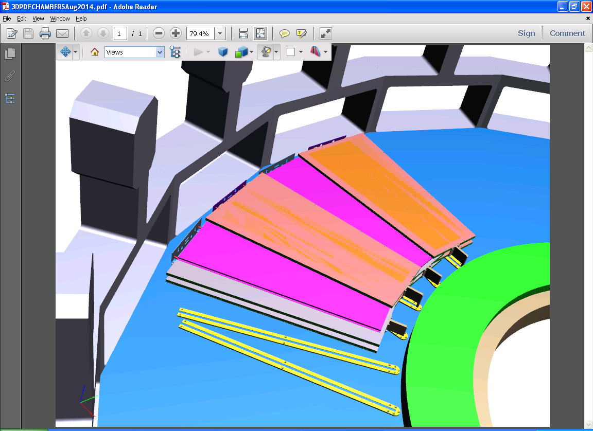
Mock up of the HE location
Brackets supporting the HE nose
The CSCs sit adjacent to the GE1/1s ( not shown)
Full size mockup to be built in 904
Mounting plane with rails

Slide 6
Mockup
To study all the services in their technical details in preparation for the slice test and beyond.
  Cooling pipes/hoses and unions
  HV, LV, FO, etc
  Gas pipes and unions.
Attempt to replicate the thermal conditions and understand the impact on the environment , HE and ME.
Prepare method for Chamber insertion

Slide 7
Conclusions
A detailed technical document proposing the method and material necessary is in preparation.
Large amount of work to achieve the aims.
Resources of manpower and finance required.
Time to achieve this.
These elements to be discussed.

