Slide 1
First Trials with Fluke Ti32 and a RPC FEB

Slide 2
First questions
What is the thermal and spacial resolution ?
Is the claimed thermal sensitivity of 45mK attainable ?
How to offset temperature precision error?
How to correctly use the device for good results.
Emmissivity values & correction
Thermal band width 7.5 – 14micrometers
Ambient disturbance
    Reflected back light
    Thermal input from external sources
How to insulate the target from the ambient and yet still have access with camera !
Can transients be used, number of frames/sec

Slide 3
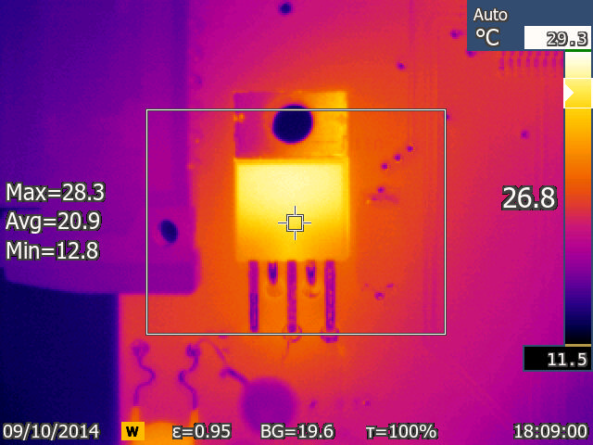
Voltage regulator

Slide 4
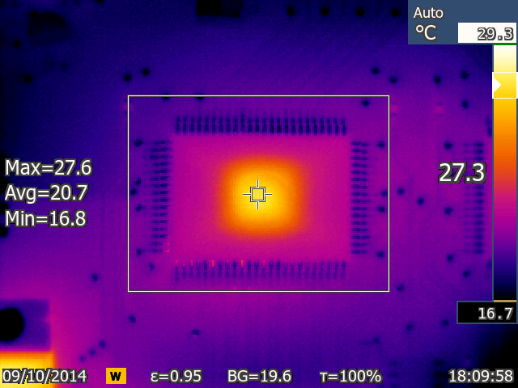
Chip of FEB

Slide 5
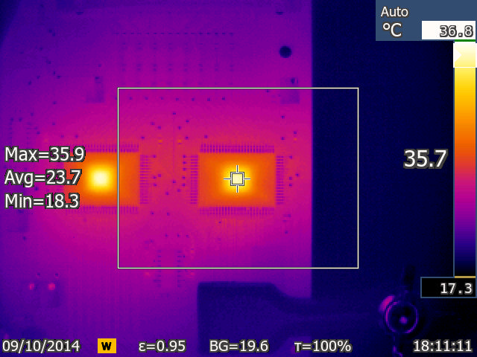
2 of the 4 FEB chips

Slide 6
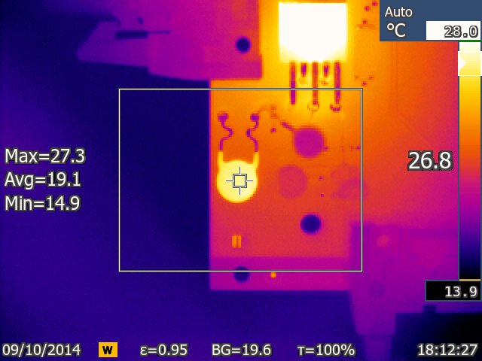
Capacitor, one hot and one cold

Slide 7
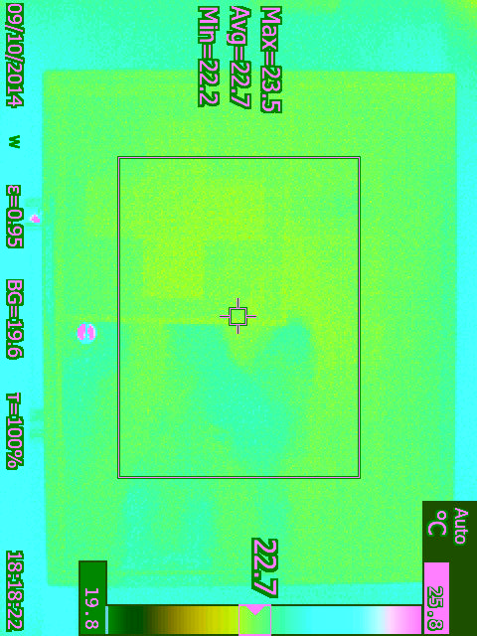
Reflected backlight

Slide 8
Conclusions so far
Spacial resolution is good enough 77k pixels
The 0.1 degC resolution may be good if the claimed 45mK is true
Emmissivity values can be changed both on the camera and the object.
The thermal band width is narrow but covers the range 200-~1000K
Ambient light will be cut out as it contains IR.
Thin mylar 10s of microns is transparent to IR

Slide 9
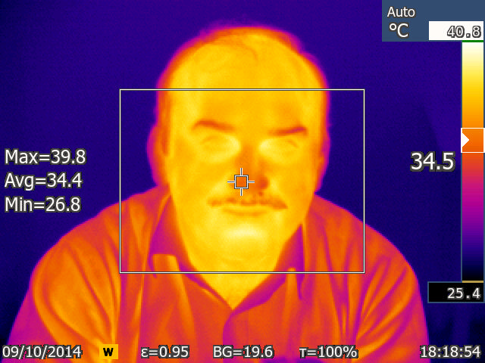
Are our colleagues in good health ?

