Slide 1
Cooling GE1/1 so far
Ian Crotty on behalf of numerous GEM colleagues.
5 Nov 2014

Slide 2
Activities & Questions
Parameters
Design so far
Proposed tests
              Full heat load to circuit
              Realistic test with full GE1/1
              Installed conditions simulation
Open questions
Conclusions

Slide 3
Some parameters
One opto Hybride 25W
24 VFATs 24W
1 HV divider 3-4W
One super Chamber 100W
Water flow (CMS present conditions) 2l/min
Delta P ( dia 6 or 8mm)

Slide 4
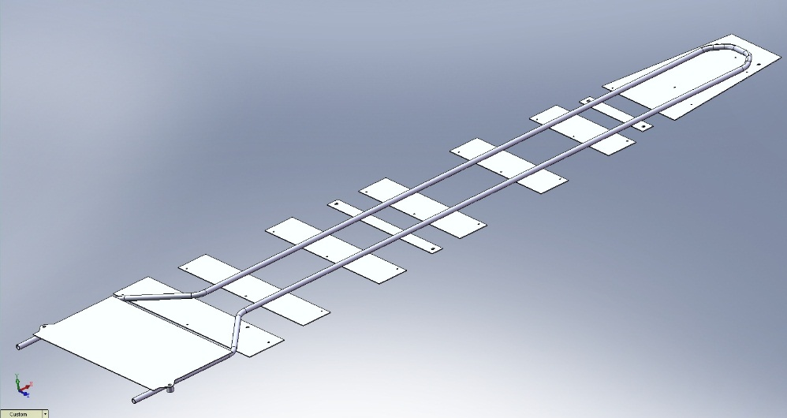
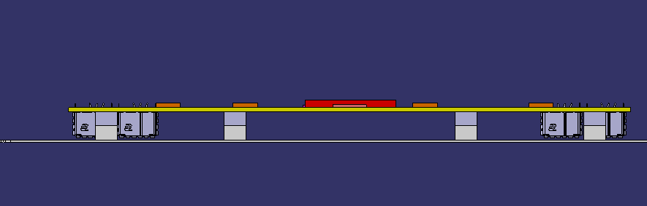
Design
Top Cu cover plate not shown
The design from Georgi is being integrated into the GE1/1 mechanics by Antonio

Slide 5
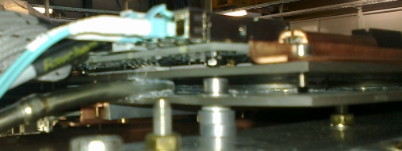
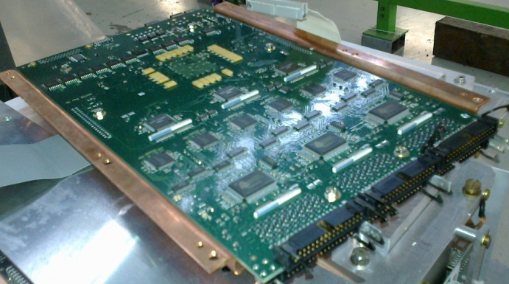
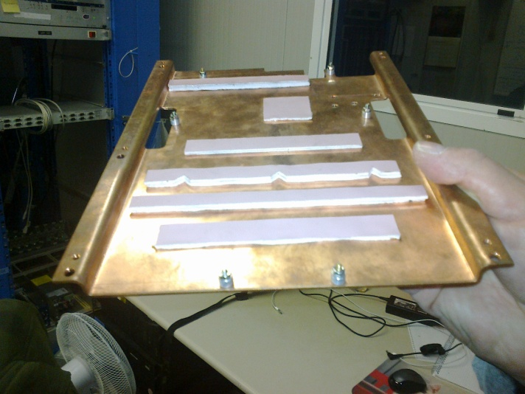
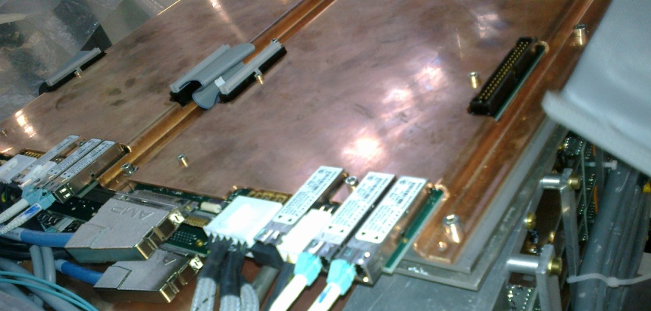
Lessons learned from CSCs ME1/1
Cooling pipe sandwiched between 2 Cu sheets
Cu cover with thermal pads
SFPs uncooled

Slide 6
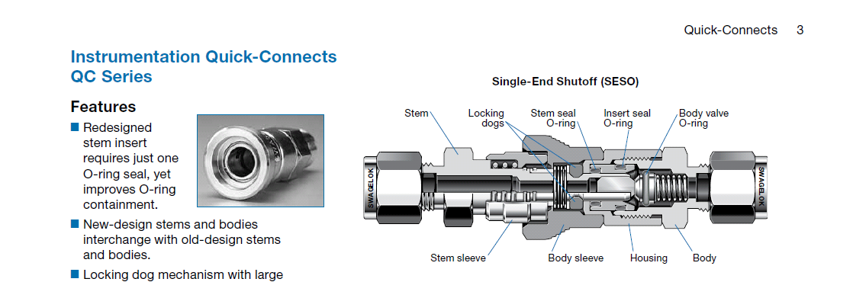
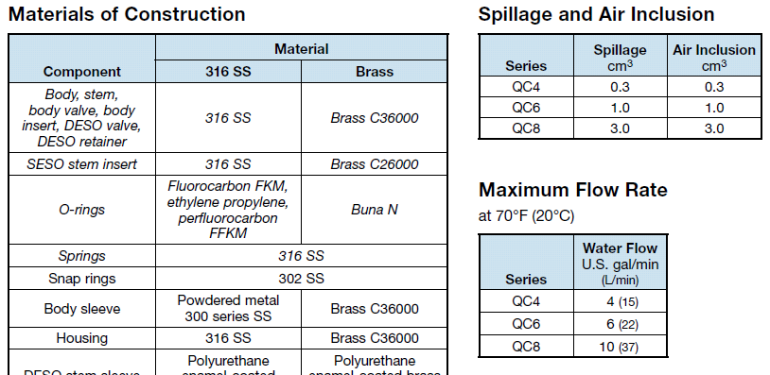
Cooling assembly and maintenance
Rapid connectors make the cooling assembly easy in the difficult access zone at P5. However they are a long extension in front of and behind the PP
They do not completely stop water lose during circuit purging
Can we adopt a smaller , simpler and cheaper solution, to be tested in the mock-up.
There are 8 connections to be made on each 20deg sector, no inversions ! No way to see errors !

Slide 7
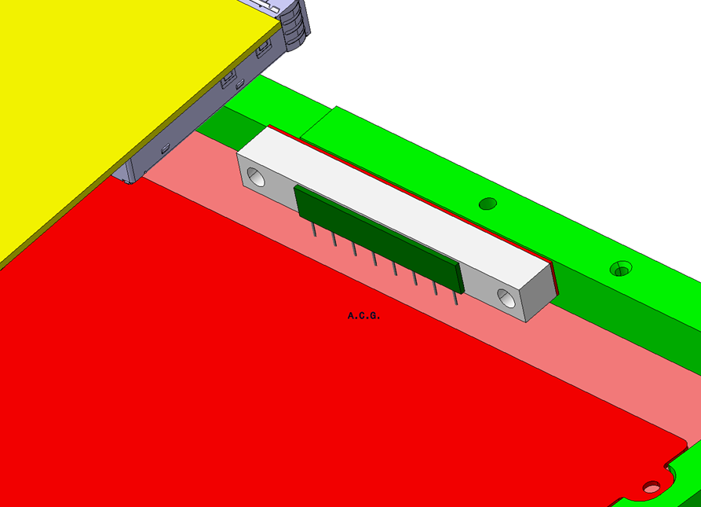
HV Divider to cool or not
3.2W of dissipated power from the divider.
GEM Frame
HV divider
Ceramic electrical insulator
A test will be repeated to establish if the heat can be evacuated through the GEM frame, if not Antonio is sure he has a solution to bring the Cu cover down to the HV divider and make good contact.

Slide 8
Calculated Delta P through the 20deg Sector without Rapid connectors, bends etc
3.5Bar
Almost an order of magnitude difference in Delta P between 6 and 8mm piping

Slide 9
3 Stages
Worst case scenario with all heat going into the cooling medium, creating greatest temperature differences across a 20deg circuit
Detailed study of real VFAT & OH heat load and thermal path resistance to cooling circuit.
Build a full model of the HE nose of CMS with 4 models of GE1/1 installed to study environmental conditions and services.

Slide 10
Worst case
Flow Rate [kg/s]
This first activity is to get the ball rolling in this thermal study in 904
Cooling station
T1
Measure Delta P with rapid connectors
GEM type 8mm Cu pipe L=2.6m
With Resistive Loads & Insulation
T2
The expected temp increase for the CMS 20deg Cooling sector is 1.5degC .
Mohsin is building this circuit

Slide 11
Detailed study with VFAT & OH
Study the thermal resistances (θ_{JA})in each step from the junction temperature to the cooling mediums.
Optimisation of the highest values to keep the Junction temperatures (T_{J}) as low as possible for reliable operation.
Optimisation of the amount of heat getting to the cooling water. Reduce losses to the environment.
We will use a fully equipped GE1/1 equipped with onboard temp sensors and IR viewing instrumentation.
Result in a design of the GE1/1 cooled electronics suitable for installation in CMS.

Slide 12
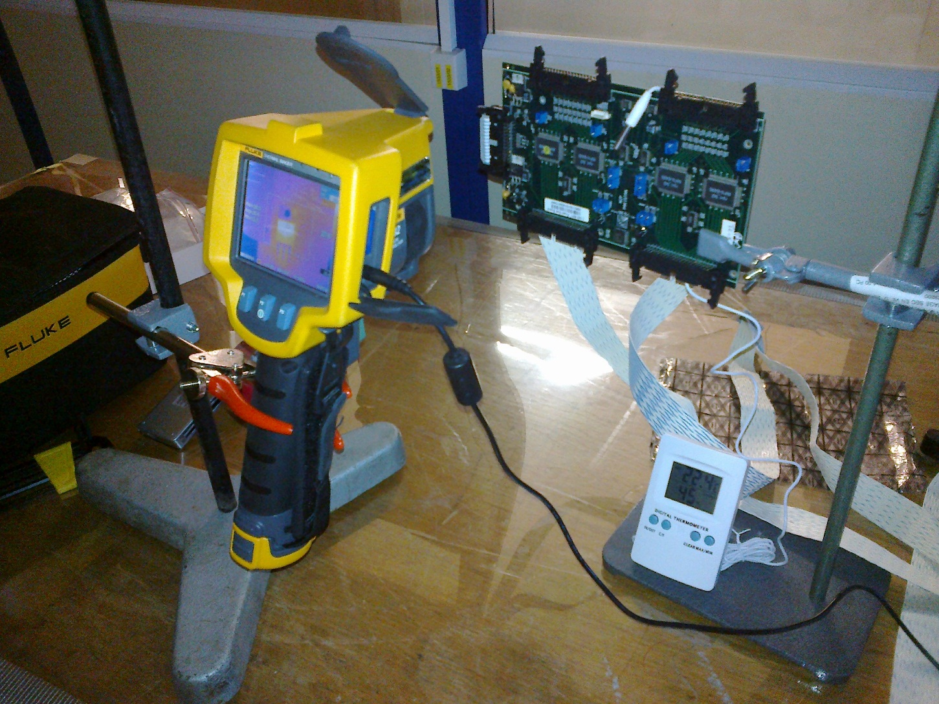
The IR imager on loan in 904
Fluke Ti 32
Thermal Sensitivity 40mK

Slide 13
Thermal path from junction to cooling medium
The aim is to keep the junction temperatures as low as possible for reasons of reliability and electrical noise. In addition losses to the environmental air including the surrounding detectors and structure should be as small as possible.

Slide 14
A good initial guide
From a study done by Da Riva we have a good idea of what is needed for the VFATs. A greater challenge will be the OH and perhaps the SFPs

Slide 15
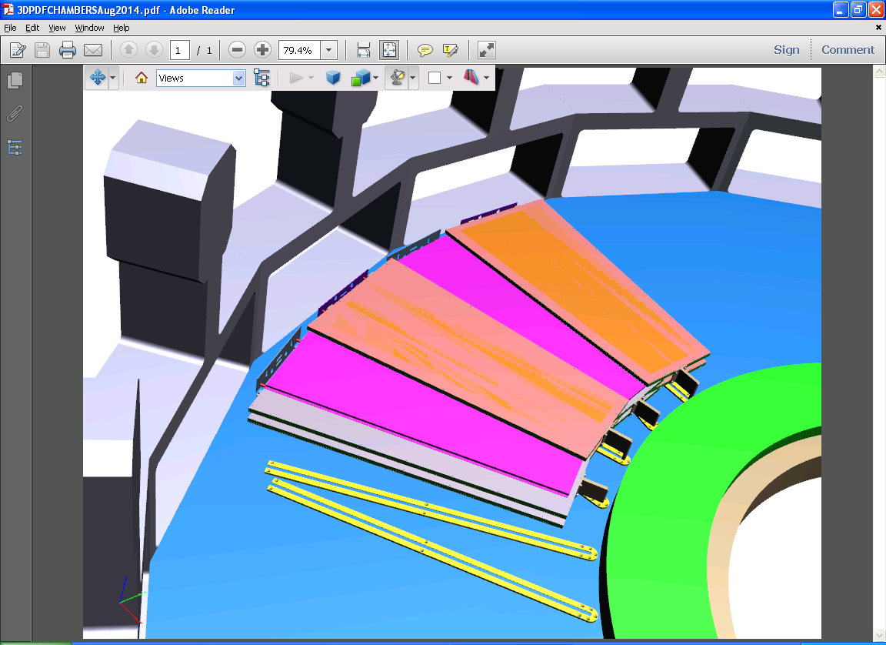
Mock up of the HE location
Brackets supporting the HE nose
The CSCs sit adjacent to the GE1/1s ( not shown)
Full size mockup to be built in 904
Mounting plane with rails

Slide 16
Mockup
To study all the services in their technical details in preparation for the slice test and beyond.
  Cooling pipes/hoses and unions
  HV, LV, FO, etc
  Gas pipes and unions.
Attempt to replicate the thermal conditions and understand the impact on the environment , HE and ME.
Prepare method for Chamber insertion

Slide 17
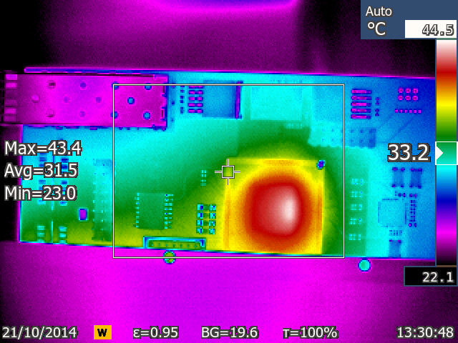
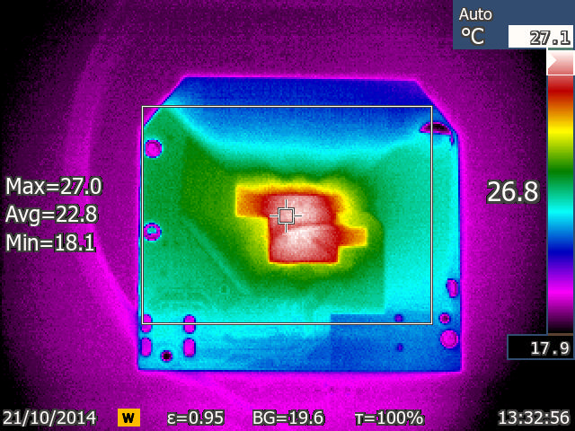
A first look with an IR imager
OH drawing 4.7W
With help from Aysen
A VFAT drawing 0.65W
Aysen reports that with the OH under load SFP temperatures rise from 30-35degC in 160-170s independant of the firmware
Test under full load will be done soon with emissivity correction of the SFPs

Slide 18
Questions
The final temperature rise and pressure drop across a 20deg Section
Impact on GEM performance
Purging the system & Rapid connectors
HV divider cooling
Large amount of work requiring resources
The schedule

