Slide 1
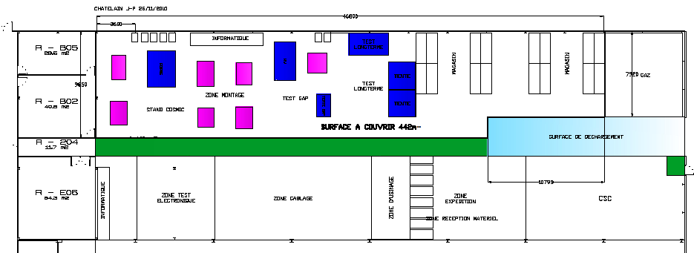
RPC lab & Upscope 904
Building 904 is on the Prevessin site
Total space of approx 1000m2allocted to CMS RPCs .
AC is requested for 450m2. At present we have approx 1500m2 in the ISR
CSC production facility and present Electronic test area not shown

Slide 2
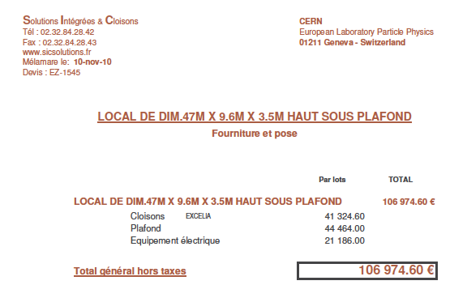
Status
The floor of the RPC and CSC space is newly covered in epoxy flooring.
PH Dept has been requested to cover a space of 450m2 to be AC for temperature and humidity
CERN has been approached to supply and fit the AC.

Slide 3
People activating this project
The 904 Integration team, namely Jean Bos, Guy Duthion, J.P. Chatelain and Sandro di Vincenzo.
Led by Archana and now David Hay.
We can thank Austin if all this comes to fruition

