Slide 1
PS LV modules small carte 3U (128.5mm)type
Ian
8 Jan 2024

Slide 2
LFE
LFE Laboratoire Francais D’electronique (44ans d’experience)
l'entreprise IOTA ELECTRONIQUE et Nagib YAHCHOUCHI sont administrateurs de la société LABORATOIRE FRANCAIS D'ELECTRONIQUE.
78 RUE GUTENBERG 91120 PALAISEAU
Date création entreprise
01-01-1900
il y a 124 ans
Radiée depuis le 26/04/2018
VERO
Still operational

Slide 3

https://www.verotec.co.uk/tech-downloads/Section%2011%20-%20Vero%20Power%20Supplies.pdf
Verotec Limited
Unit 4 Bottings Industrial Estate,
Hillsons Road
Curdridge
Southampton
Hampshire
SO30 2DY
Tel: +44 2380 246900
Email: info@verotec.co.uk
Sales: sales@verotec.co.uk

Slide 4
Name model V/A Type Number
VERO BICC Electronics PK60 Bivolt 12V-15V/2A 136-44426E
VERO BICC Electronics PK50 Monovolt ?/?
LFE 09/02/1994 V1 24V/1.6A AM2412K230+P CERN 477737
LFE 03/11/1993 V1 & V2 15V/2.2A AMD151k230+p CERN 467002
LFE 24/02/1993 V1 5V/3.6A AM53K230+P CERN+FA 434619
LFE V1 AM53K230+P CERN 516960
LFE = Laboratoire Francais d’electronique

Slide 5
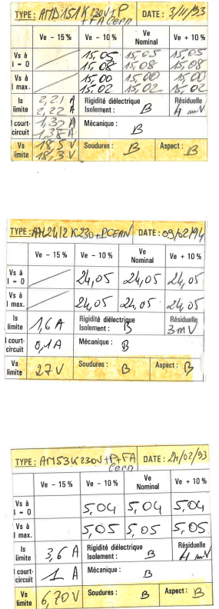
Attached cards to the LFE PSs
One is missing.

Slide 6
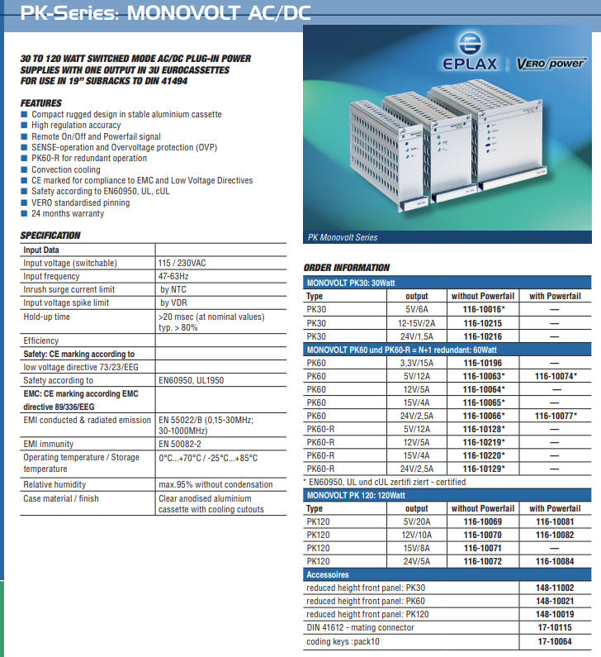

Slide 7
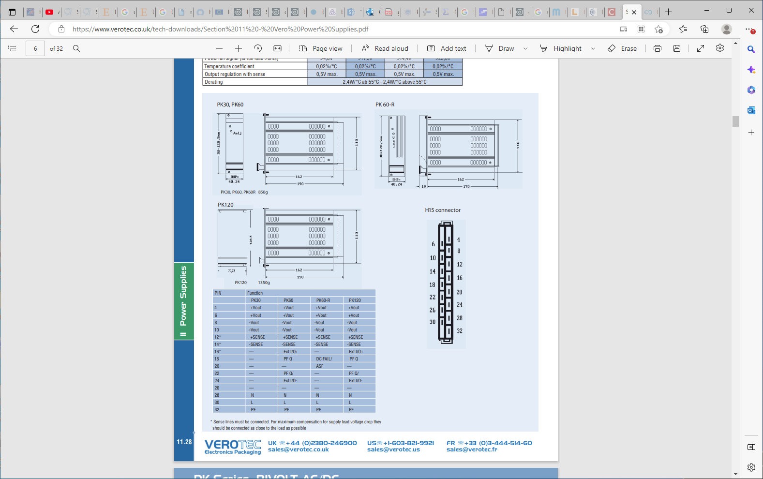

Slide 9
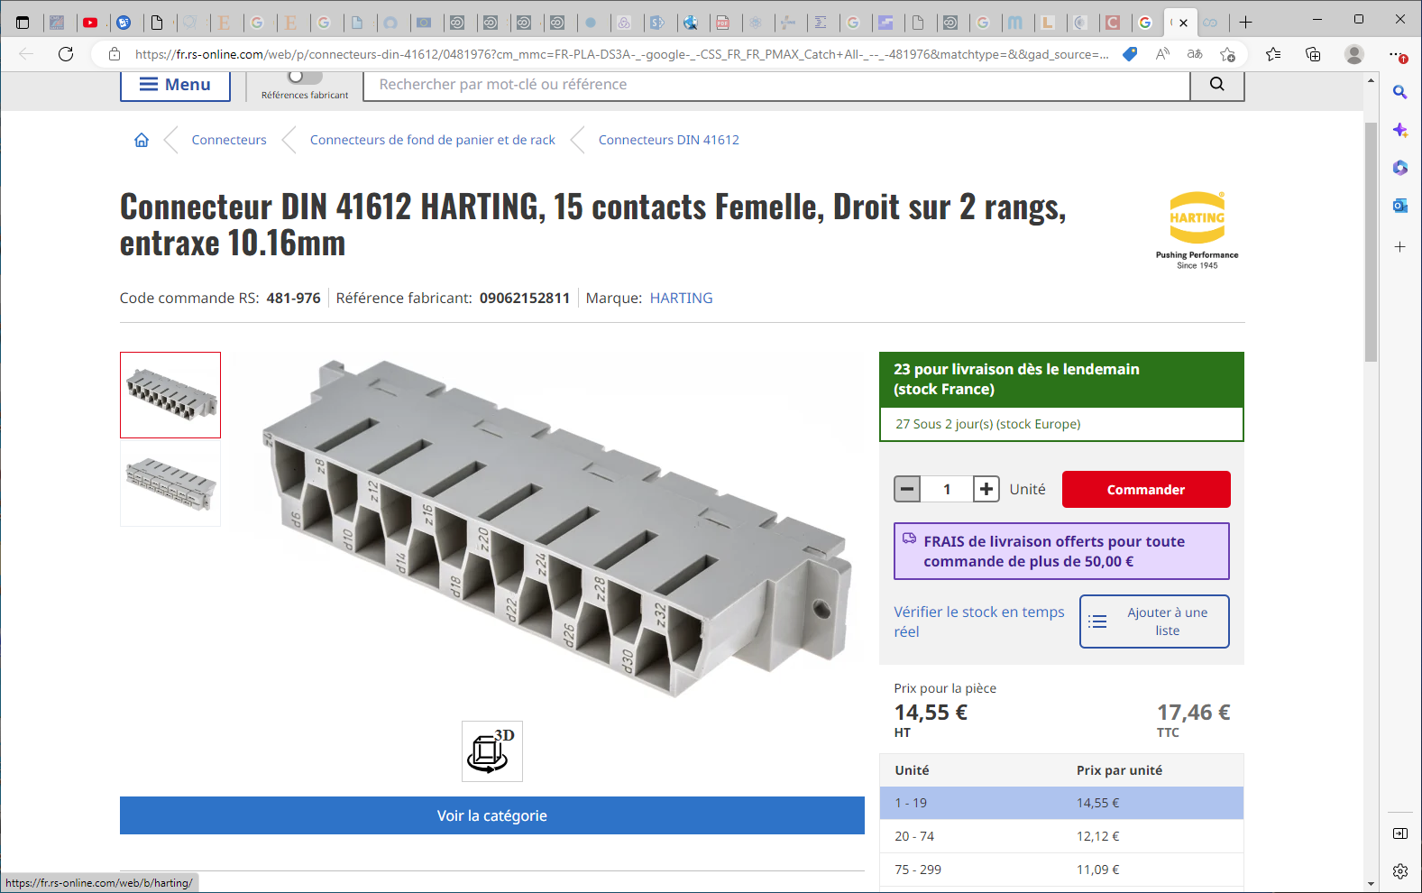
09062152811 | Connecteur DIN 41612 HARTING, 15 contacts Femelle, Droit sur 2 rangs, entraxe 10.16mm | RS (rs-online.com)
Référence fabricant:
09062152811
Marque:
HARTING
DIN-Power H015FT-4,0C1-1

Slide 10
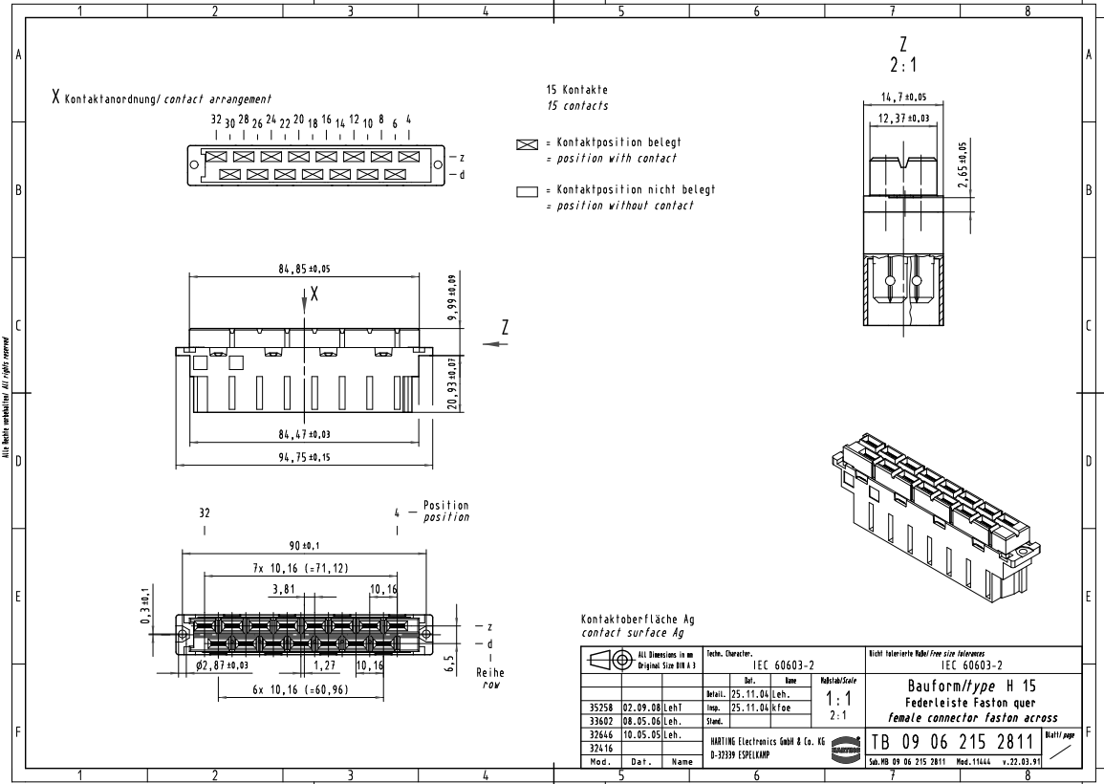
https://docs.rs-online.com/6565/0900766b81361b59.pdf

Slide 11
https://docs.rs-online.com/23aa/A700000006673797.pdf

Slide 12
https://cds.cern.ch/record/2827689/files/PS-PO-Note-96-15.pdf
2.8 Auxiliary power supplies
The crate must include Europe Cassette power supplies with Hl5 or Hl 1 (see
next point) connectors as required. They will be shared by both electronic. The crate
has a ON/OFF switch on the back panel for the incoming AC supply. The AC supply
will pass an EMC filter located in the crate.
A preliminary list of power supplies is given:
* 5V 6A and +/-15V 1A. H15 connector.
* +/-24V IA for the DCCT electronic card. H1 1 connector.
24V IA for the relay unit. Hl 1 connector
3. MECHANICAL CONSTRUCTION AND LAYOUT
The crate must be a 6U (2x3U), 19” Europe Crate DIN 41494 (EEC 297-3) with
handles. The dimensions are 445 x 430 x 265.9 mm (W x D x H). Including the rear connectors and cables the depth spans to 550 mm.
The cards must follow Europe Card standard: 160 x 100 or 220 x 100 mm (D x H).Preferably the short type.
The power supplies must follow Europe Cassette standard (DIN 41494).
The cards’ connectors must follow the norm DIN 41612 Type B or C.
The auxiliary power supplies’ connectors must follow the norm DIN 41612
TypeHll or Hl5.

Slide 13
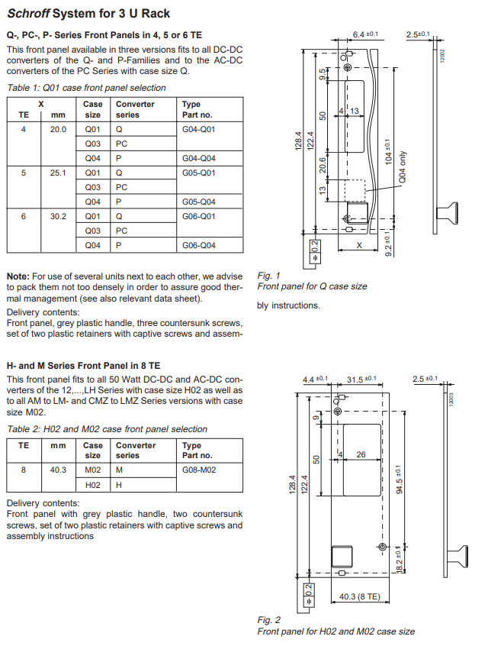
https://datasheet.octopart.com/G08-M02-Power-One-datasheet-37184023.pdf
Europe Cassette standard (DIN 41494).
3U Eurocrate CERN

Slide 17
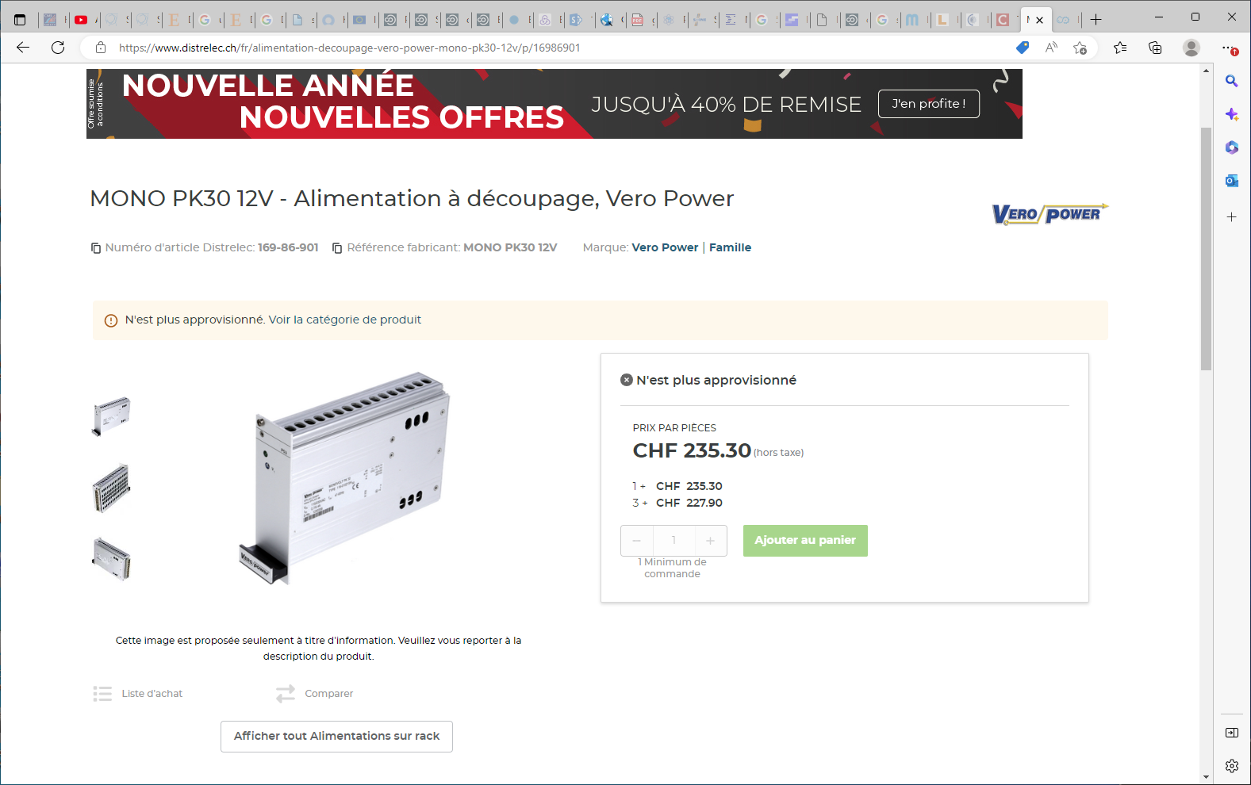

Slide 18
