Slide 1
HV >10kV modules
Ian

Slide 2
https://www.analogtechnologies.com/high_voltage_power_supply_24v_input_voltage.html

Slide 3
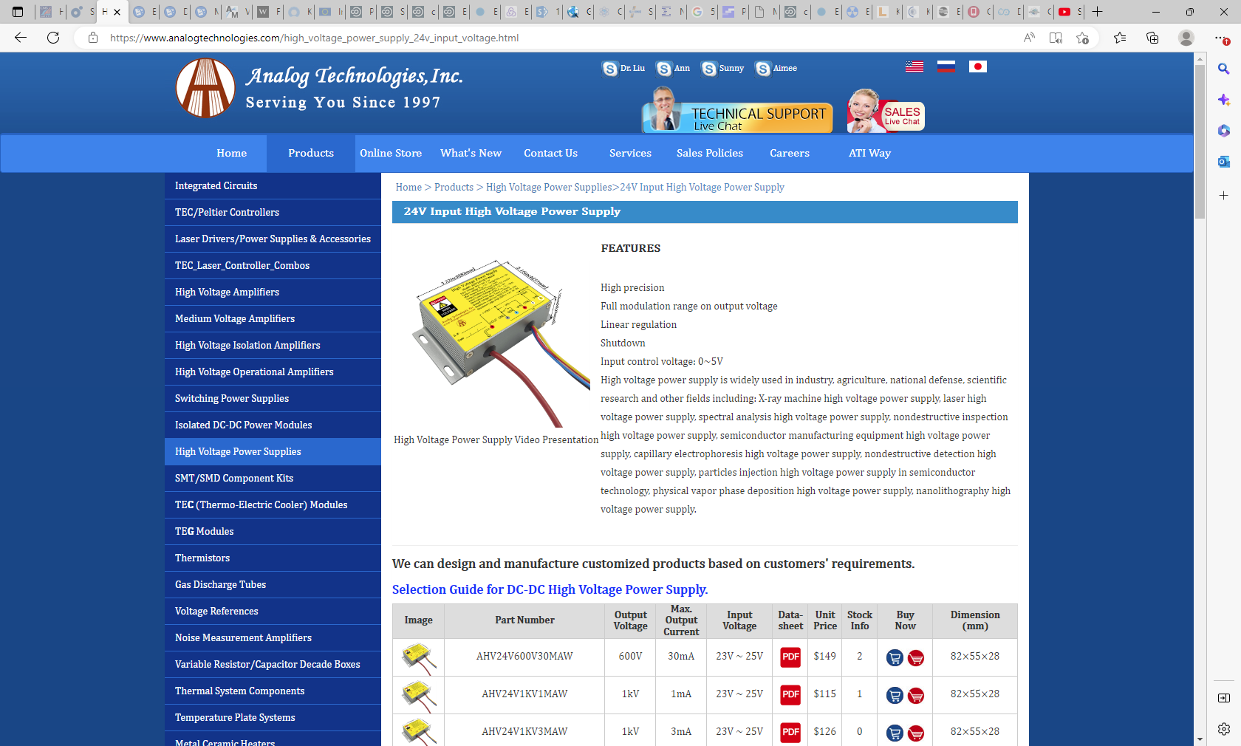

Slide 4
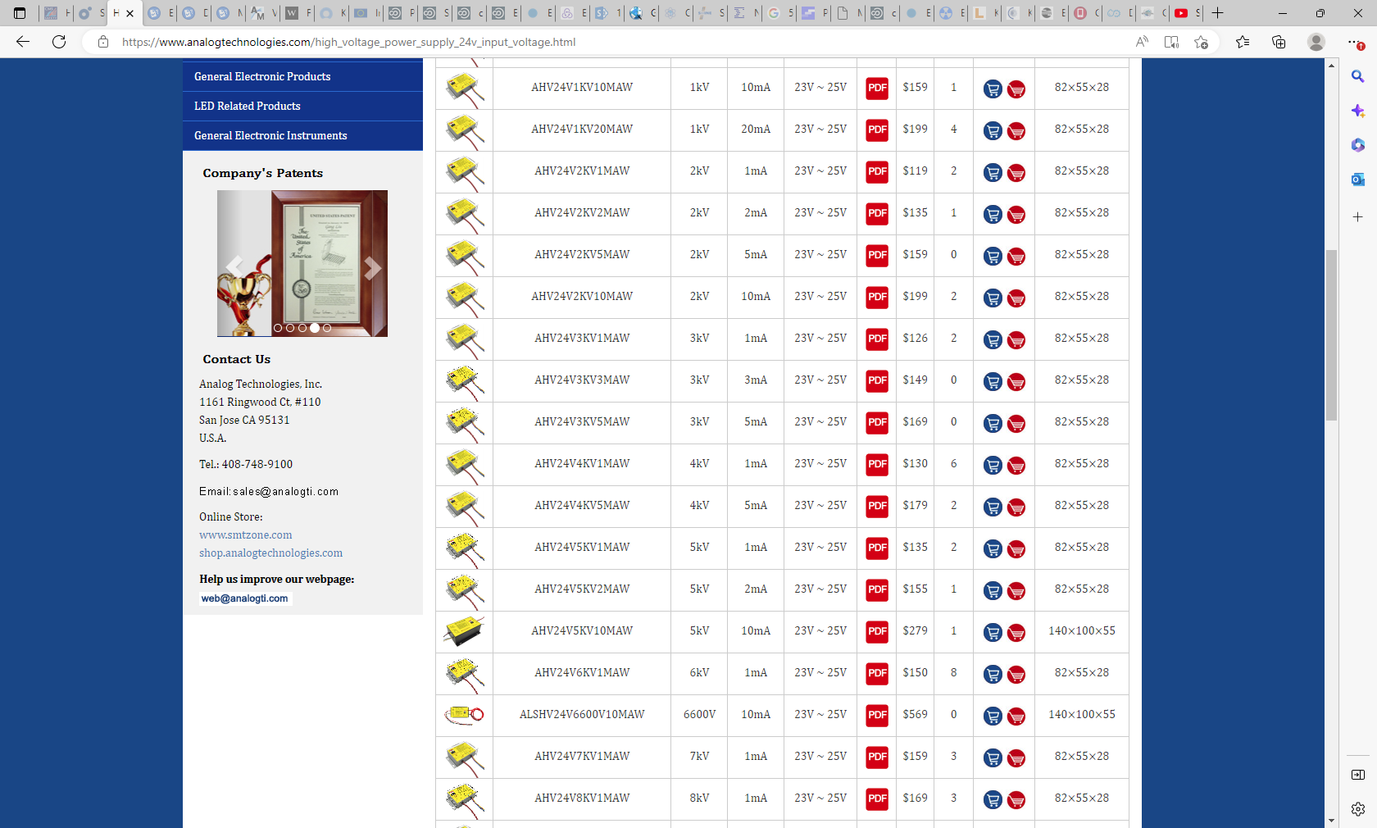

Slide 5
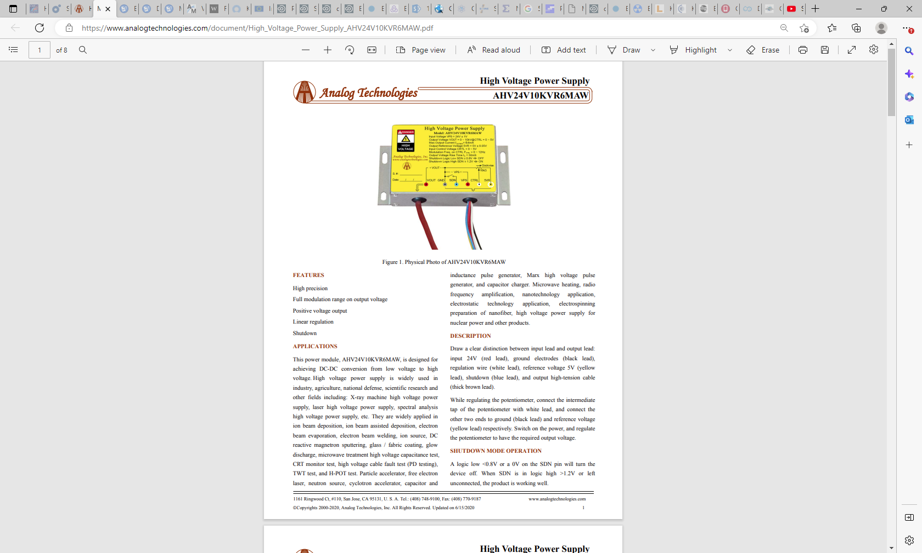

Slide 7
Convertisseur DC-DC XP Power, A, Montage traversant, 1W, 1 sortie, 1kV c.c., 1mA

Slide 8
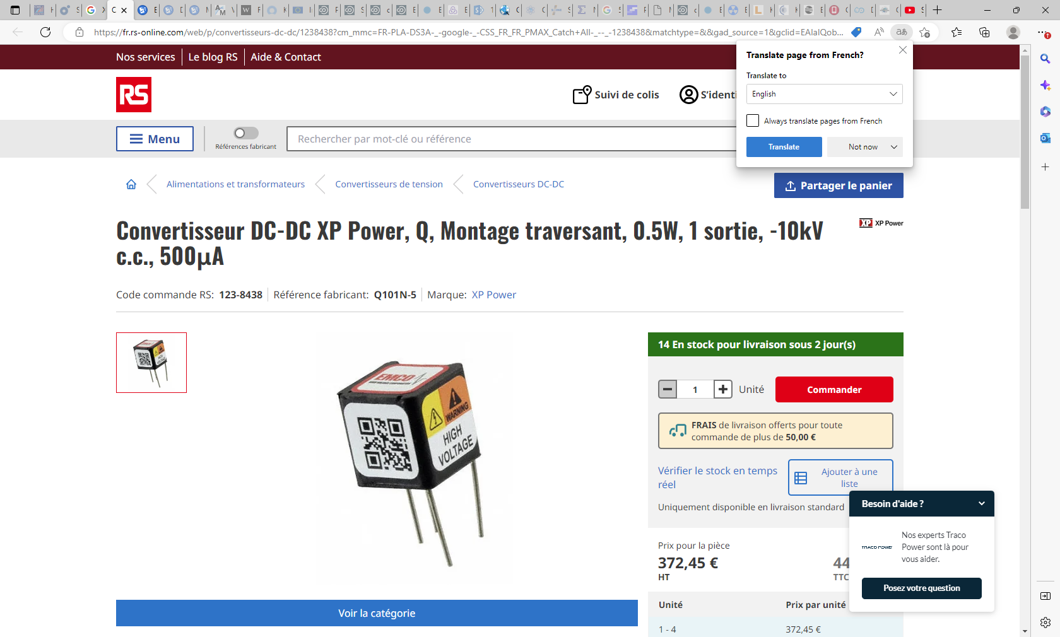

Slide 9
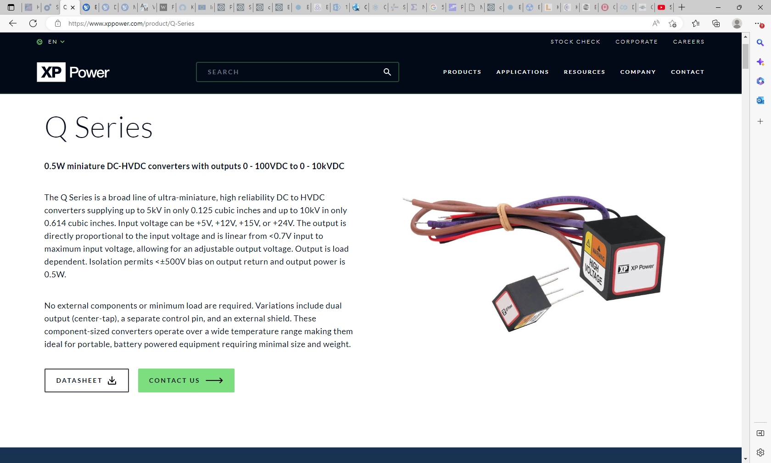

Slide 10
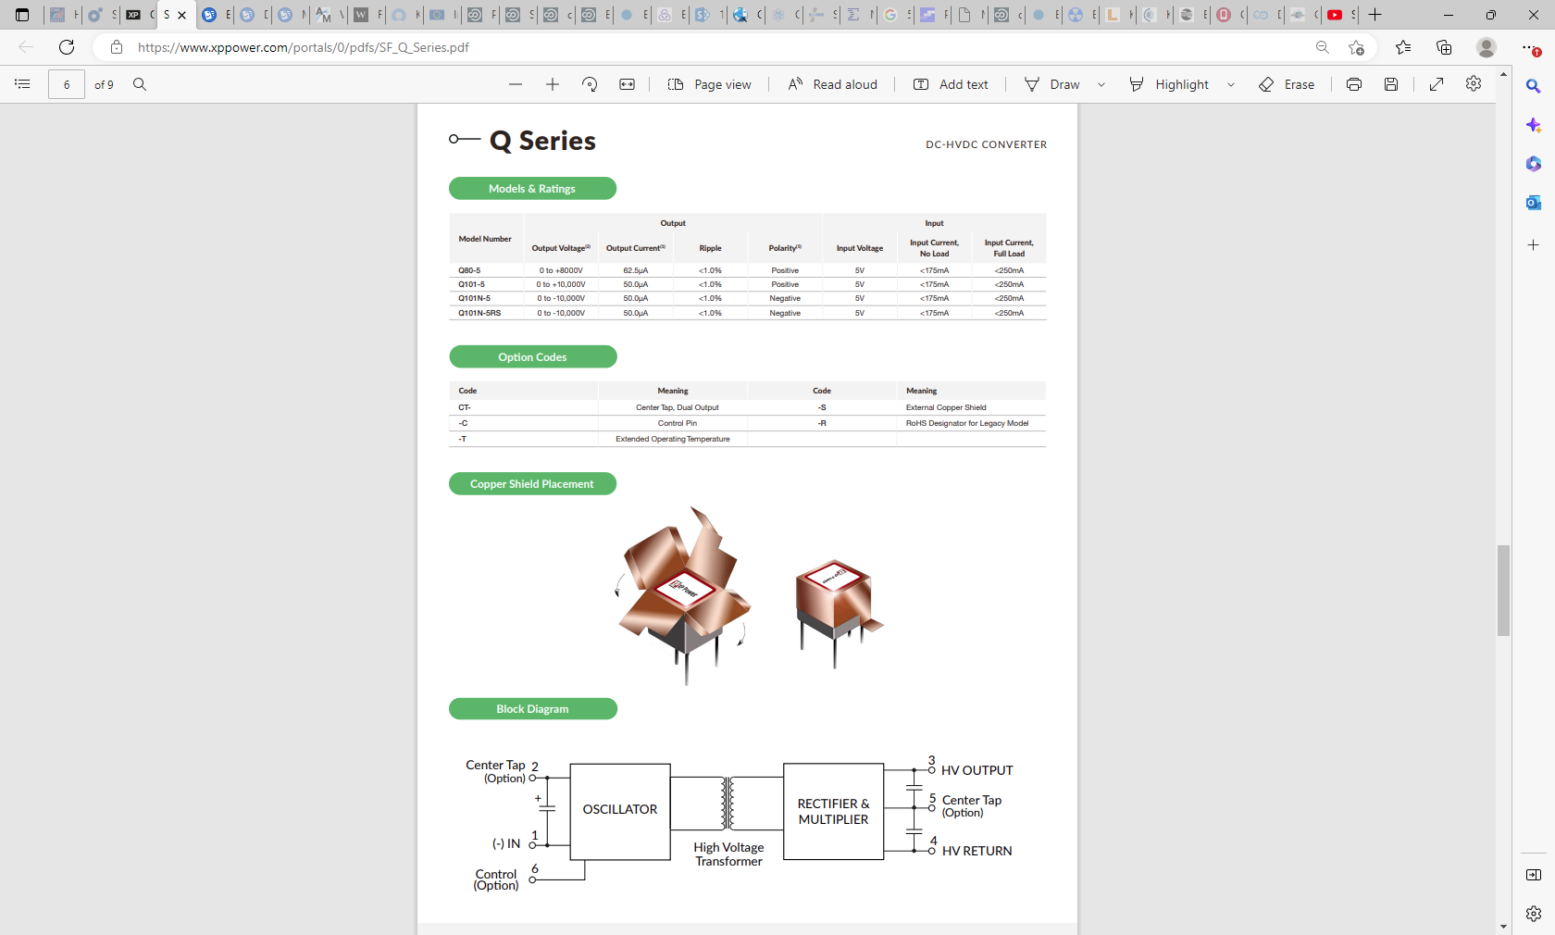

Slide 12
