Slide 1
Services and Detector Integration
S. Lusin
University of Wisconsin

Slide 2
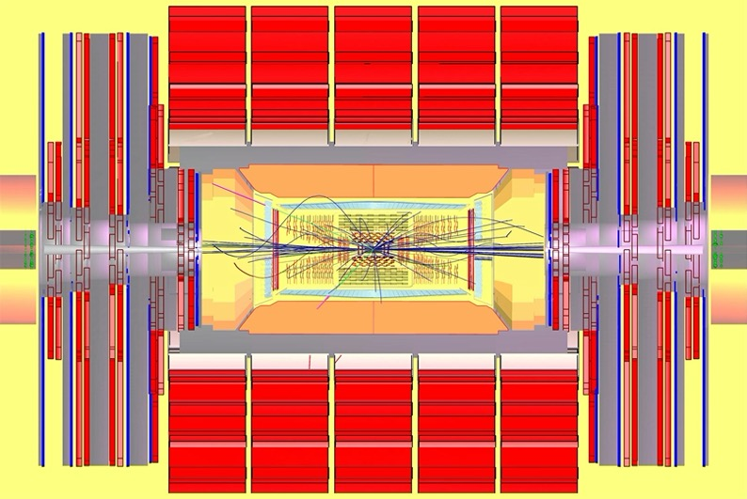
How Detectors Get Made …
Three-phase process
  Modeling
  Integration
  Implementation
HEP detector design starts with MC modeling
  Design optimization driven by choice of target processes
  Choice of detector technologies heavily influenced by performance targets, costs
Higgs to 4-muon decay simulation in CMS detector

Slide 3
Making It Work …
Practical details of detector construction are addressed at a later stage
Conflicts inevitable -> Detector integration phase
  Harmonize cable routing, cooling systems, power dissipation and interaction between subdetectors
  Design changes can propagate back to subdetectors themselves
  Can result in a further cycle of detector simulation
Services added later by different teams
Explicit:
Implicit:
Detector Readout
Cooling & Heating
Hydraulics & Pneumatics
Controls & Safety
Alignment
Radiation Shielding
Mechanical Support
Maintenance Access
Survey
Sealing & Isolation
Lighting
Ventilation

Slide 4
Services …
Very common to find detector-centric views during the design phase
  Most coordination activities involve integration of subdetectors with one another
Services are added as a parallel activity once global requirements become clearer
  Services are “standard” in the sense that they use common industrial hardware
  This common industrial hardware is then installed in an environment that is anything but standard
Process of harmonizing detector subsystems with infrastructure is usually empirical and iterative
  Typically initiated by the emergence of problems with detector operations
    Our awareness of these problems is not always immediate

Slide 5
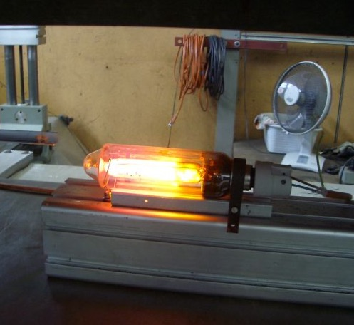
Lights …
Observed trigger rate bursts in CMS muon RPCs during cosmic-ray running
  Would last for minutes
  Trigger rate of 1 kHz and above, nominal had been 200 Hz
Trigger rate bursts would begin when CMS magnetic field was turned on
  Only small group of chambers was affected
  Affected chambers were in same area
Trigger rate bursts traced to mercury-vapor projector lights that had become unstable in the magnetic field
LPS lamp undergoing magnetic-field testing

Slide 6
Lights in a Magnetic Field
Immediate problem was resolved by agreeing to turn off projector lights in experimental cavern when CMS was running
Further investigated magnetic-field effects on lights used in cavern
  Local field can exceed 1 Kilogauss
  Found unstable lights in these regions
Found two different modes of failure
  Fluorescent lights: ballast saturation
    Lamp current increases until voltage drop across lamp triggers starter, lamp power cycles
    Lamp aging dramatically accelerated
    Use of electronic ballast is not a cure, has inductive components. Also, switches at 40 kHz
  Mercury-vapor & low-pressure sodium lights
    Lamp itself is sensitive to magnetic field
    Sensitivity is direction-dependent
    Can mitigate effects by selective orientation of lamp in magnetic field

Slide 7
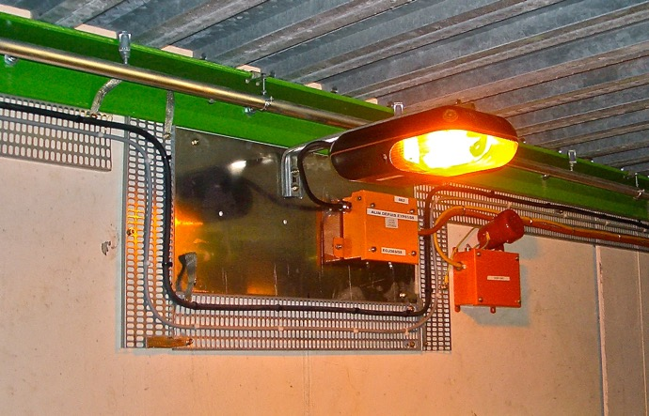
Reorientation of LPS Lights
LPS lights in service galleries underneath the CMS detector were also unstable & flickering
  These are safety lights. Turning them off is not an option.
  Results of testing showed that selective orientation could provide stable operation up to 1.2 KG
Reorienting the tube axes parallel to the magnetic field resolved instability problem completely
Reoriented LPS light in CMS X0 zone in stable operation in magnetic field

Slide 8
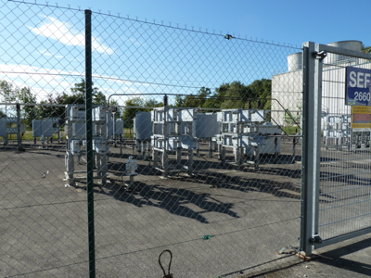
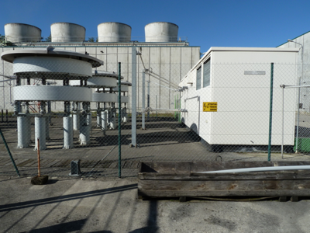
Power …
09 Feb 10: Electrical services group announced plans to switch VAR compensator onto machine network on morning of 12 Feb 10
  Believed this operation would not affect CMS
  Motivation was that similar switchovers had occurred multiple times in the past, unannounced, with no Ill effects to the knowledge of electrical services
    In fact, CMS has been having unexplained electrical failures, at a low rate, consistent with transient-induced upsets
  Installed transient recorders for monitoring electrical conditions on the CMS distribution network
Harmonic filters at LHC Point 6
Thyristor-Controlled Reactor at LHC Point 6

Slide 9
Results of Switchover …
Observed three electrical incidents at CMS, coincident with VAR compensator switchover at PA6:
  ECAL HV: HV trip on 12 supermodules in EB+ and EB-
  HCAL and RPC controls computers in service cavern: several tripped in-rack circuit breakers
  DAQ: 4 DAQ FRL computers in service cavern found in hung state
What did the transient recorders show?
  CMS front-end electronics: no transients reported
    Protected by UPS
  CMS general services network: no transients reported
    Not fed from Point 6
  CMS underground counting rooms: significant transients observed on all 3 phases
Have observed multiple SVC-related transients at CMS since then
  Have established early-warning system with LHC electrical group to allow us to power down sensitive systems
  Will not protect us when the compensator switches itself out of the network due to overload

Slide 10
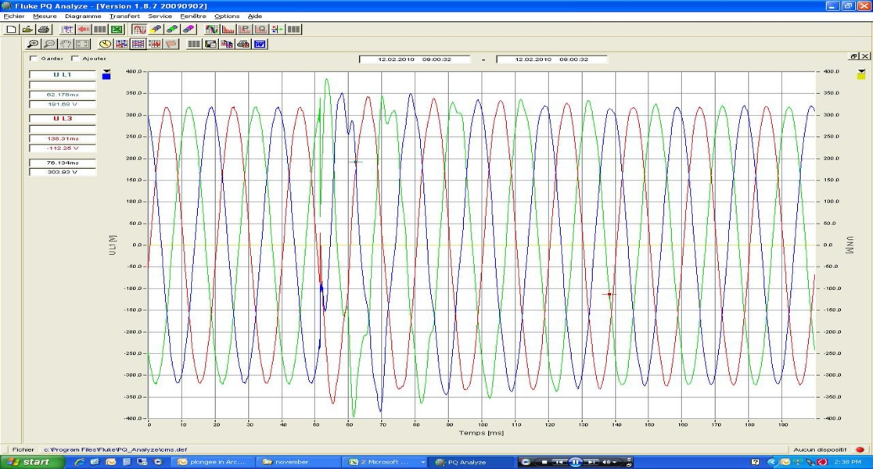
Event on powering network in CMS on Friday, Feb 12th
From EN/EL 15 Feb 10 :
60 V
~100 ms
Voltage glitch down to 50 V
80 V
~80 ms

Slide 11
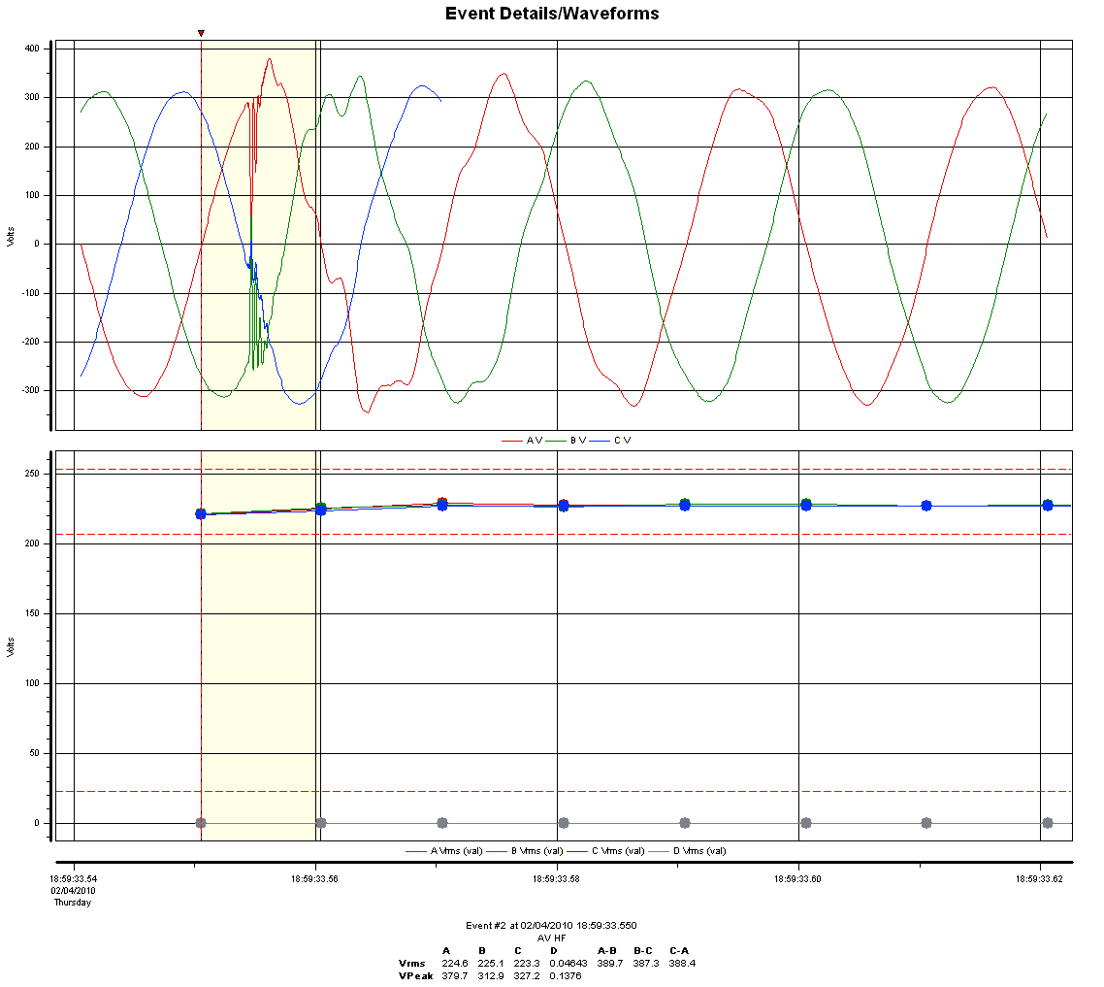
SVC Transients at ATLAS
Similar incident, observed at ATLAS during switchover of a different static VAR compensator (SVC)
Envelope of voltage waveform is minimally affected, but transients are sharp, and up to 300V magnitude
Glitch (voltage dip to almost zero, followed by overvoltage) at 18H00 on 04/feb/2010
Glitch to zero
Peak voltage goes from 320V to 380V on one cycle.
Courtesy of W. Iwanski

Slide 12
Magnet Power Converter …
During monitoring of voltage across solenoid busbars in CMS service cavern, noticed some anomalies:
  Objective had been to search for correlations with PLC communication failures
    Had been noted earlier as a problem that appearing during ramping
  No PLC communication failures occurred during this study
  Instead, noted significant AC component at output of magnet power converter
    Approx 500mV p-p on top of 1.4 VDC supply voltage
Casual contact with magnet busbars discouraged, made modifications to add diagnostic ports

Slide 13
Power Converter Spectra
Measurements on power converter are available from earlier study
  Study focused on effects of adding capacitance across power converter output
  Test was performed in 2005
  Power converter was run at 20KA into short circuit
  Spectra with and without additional capacitors shown for positive polarity converter

Slide 14
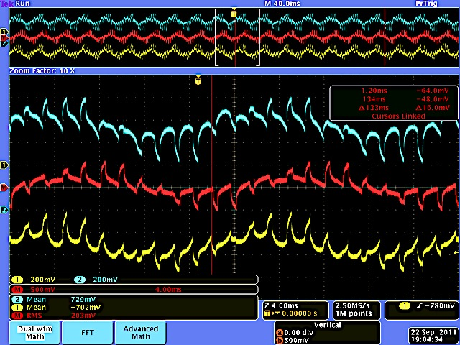
CMS Magnet Common-Mode Voltage
Ch.1 (yellow): Negative polarity output, 200 mV/div
Ch.2 (Blue): Positive polarity output, 200 mV/div
Red trace: sum of channels 1 & 2 at 500 mV/div
  203 mV rms
  Large 50 Hz component

Slide 15
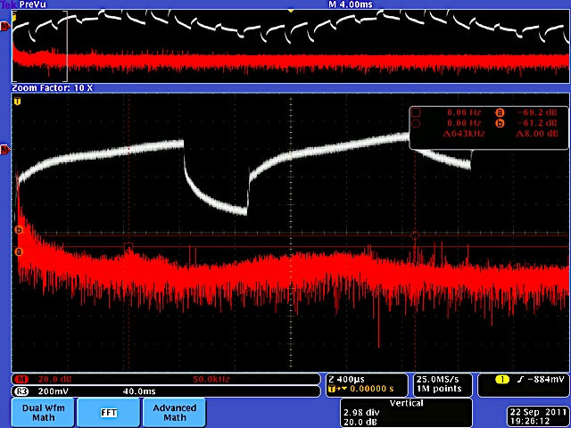
Common-Mode Spectrum
Spectrum: 20 dB/div vertical, 0-500 kHz
  Expanded trace out to 5 MHz
  Can see 100KHz enhancement from 2005 study
  But enhancements are -62, -69 dB
Most of energy is below 10 kHz

Slide 16
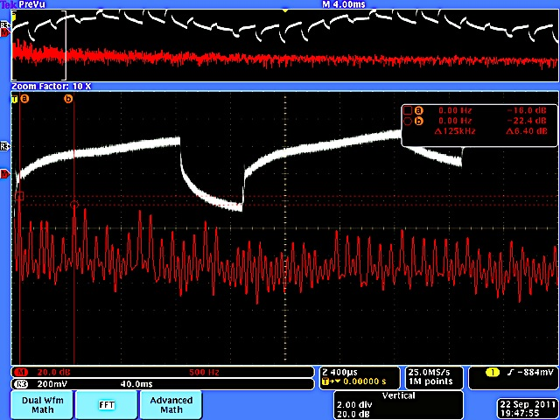
LF View of CM Spectrum
Horiz: 500 Hz/div
  Harmonics of 50 Hz extending past 5 kHz
  Strongest contributions from 1st, 11th harmonics at -16, -22 dB respectively
Will not affect magnetic field
  But concern is that CM currents couple through CMS yoke

Slide 17
Motor Drives …
Late 2010: CMS Tracker group proposed to power motors of C6F14 pumps inside experimental hall using variable-frequency drives
  Motivation was to reduce pressure excursions in the coolant
Noted experience of another LHC experiment with VFDs:
  Noise appearing in multiple detector systems was traced to a ventilation unit powered by motor with a commercial speed control

Slide 18
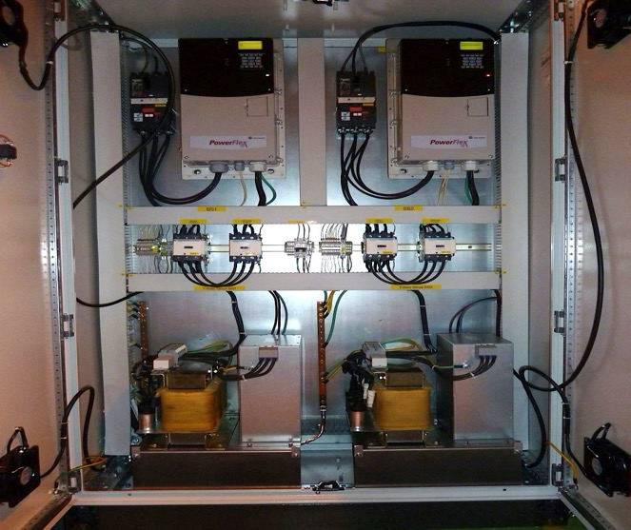
CMS VFD Installation
Concerns taken into account, VFDs were installed with extensive filtering on outputs
Based on Allen-Bradley PowerFlex 70 VFD
Cabinet is supported on concrete
  No galvanic connection through cabinet structure to any other cabinet or service cavern steel framework
  Connections to outside world consist of:
    2 incoming cables from 18KV/400V transformer
    2 outgoing power cables to pump motors
    1 protective earth cable connecting to service cavern earth

Slide 19
VFD Connections to Cooling Plant

Slide 20
Shaft Currents
Variation in flux enclosing the shaft can drive currents down the shaft and through the bearings

Slide 21
Common-Mode Currents

Slide 22
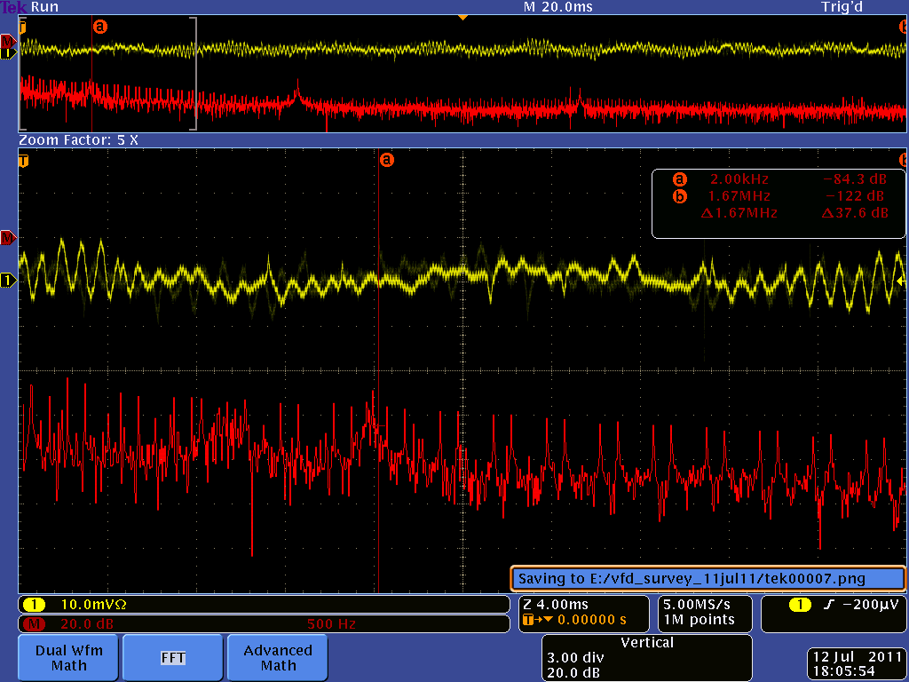
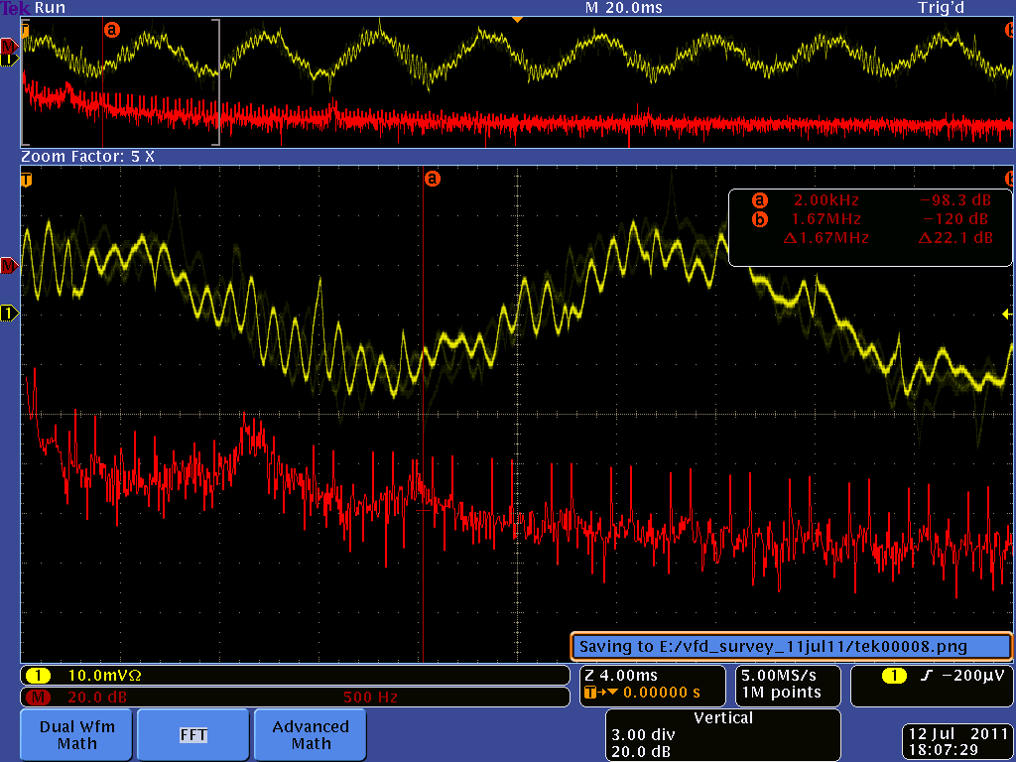
Cable Shield & P.E. …
Input cable shield (point C)@ 500 mA/Div
Protective earth (point A) @ 500 mA/Div
1A p-p current flowing on PE of power cable

Slide 23
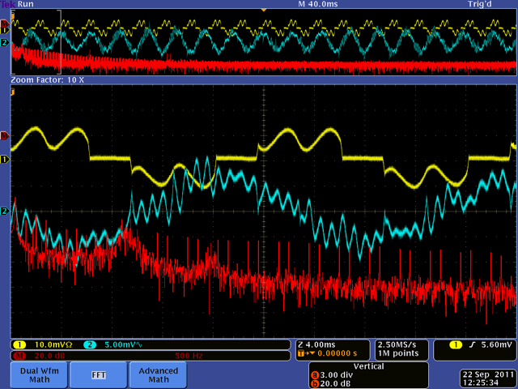
What is Origin of Earth Current ?
Ch. 1: One phase of input to VFD at 50 A/div
Ch. 2: Current in protective earth wire to pump motor at 500 ma/div
Spectrum from 0 to 5 kHz, expanded scale to 50 kHz

Slide 24
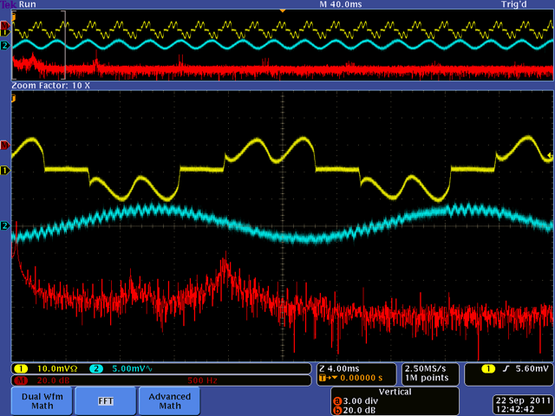
- Not Common-Mode from VFD
Ch. 1: One phase of input to VFD at 50 A/div
Ch.2: Point L common- mode current at 500 ma/div
43.8 Hz component is 8 dB down
Cannot account for observed earth current on PE conductor

Slide 25
VFD Summary …
VFD tests showed:
  Significant earth currents flowing through motor drive cabling
    Source of currents not understood
    But linked to motor operation- not external
  Interaction (“beating”) between VFDs running at different frequencies
  HF noise from VFD switching present on input and output cabling
Earth currents caused the most concern, since this was evidence of possible bearing currents in motors
  Both motors had already been replaced once
  Both had been observed to run with elevated shaft & bearing temperatures
  Bearing currents are well-known effect exacerbated by use of VFDs, but this was something else

Slide 26
HF Bearing Currents
HF emissions from VFD can couple capacitively between stator windings and rotor, driving currents through bearings

Slide 27
Currents Through Motor Load
Currents can also circulate through load bearing via the motor shaft
Found evidence of bearing damage in both motor and pump bearings

Slide 28
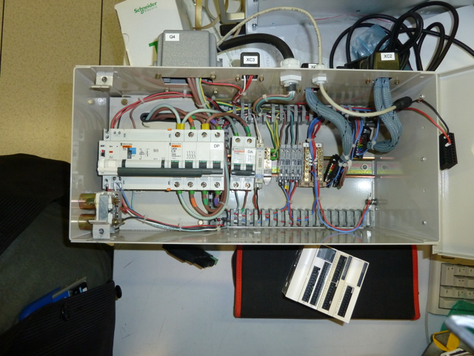
PLCs …
Programmable Logic Controller (PLC) used for controlling rack power distribution unit, being replaced for second time in same unit
  PLCs have replaced hard-wired logic throughout infrastructure
Would like to understand more about failure mode
  But standard industrial components simply get replaced …

Slide 29
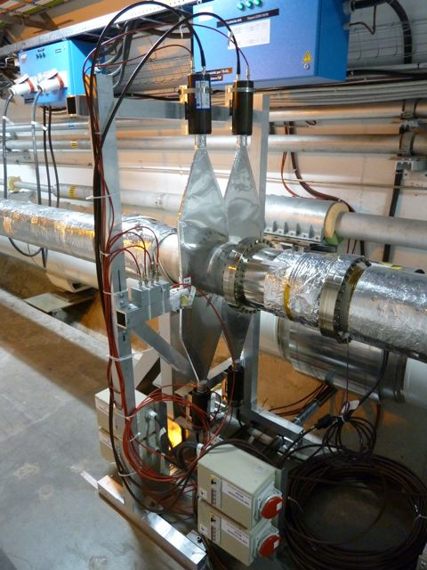
Late Additions …
In mid-2011, a provisional system of scintillation counters was installed in the LHC tunnel on the two sides of CMS
  Objective was study the timing of showers propagating down the tunnel from CMS
System design was straightforward
  Tunnel-based components were passive
  Signal cables were properly isolated
  However, as the result of some last-minute modifications, (common) HV cable shields became galvanically connected to CMS service cavern ground

Slide 30
Potential Current Paths
HV cable shields would allow multiple paths for currents between CMS & LHC local grounds

Slide 31
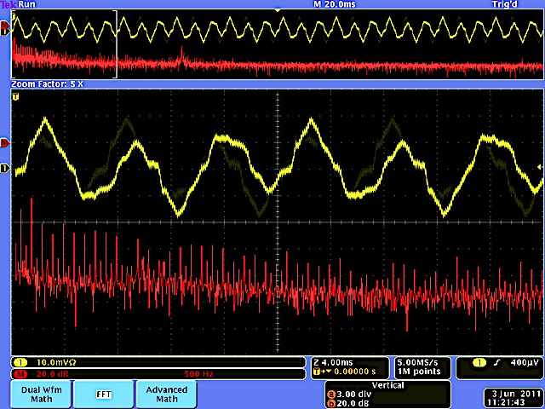
Current into CMS Service Cavern
Measuring net ground current from LHC tunnels into CMS service via HV cable shields
  Ch.1: common-mode current of all 6 HV cables, 100 ma/div
  Current is 300 ma p-p
  Spectrum shows strong 50 Hz harmonics, characteristic of magnet power converters
HV supply to be replaced by unit with floating outputs

Slide 32
Lessons Learned …
Services are not engineered in ..
  Necessary to validate them over time for compatibility with detector operation
  Consider instrumenting services for monitoring & assessment
    Infrastructure groups may not be accustomed to this
    Not a criticism, compatibility is something only the experiment can assess
Services may be very different once they’re installed in the experimental environment
  Witness lights and motors in magnetic field
Experiments are not always the prime customer of services
  Compensators are oriented toward the LHC
    Figures of merit set limits on envelope of voltage waveform
  Power converters are specified for magnets
  Standards specifications may not protect the secondary customer
    They specify a primary customer’s requirement

Slide 33
Lessons 2 …
Services change over time
  VFDs proliferating
    Requested cooling & ventilation group to stop adding VFDs
    Otherwise installations would have proceeded without request on our part
Not all effects are immediately apparent
  We have to anticipate them based on experience
    Have to gauge potential for disruption
    Assessment is informed by knowledge of the detector
  ECAL heater is case in point
    50 KW load turning on & off at 0.5 Hz was not anticipated in original design
    Has this led to problems? Under investigation …
Experiment changes over time
  Late additions are arriving regularly
  Reviews have generally been effective at anticipating problems
  But need for verification and testing is constant

