Slide 1
LS2 Electrical Services Upgrade: GE
S. Lusin

Slide 2
GE Power Cabling: Run3 Configuration
GEM subdetector will have racks on near side only,
on levels X2 & X5
GEMs will add 3 MAOs to each of 4 racks. Will require 4 LV power cables (230 VAC 3-phase)
Each rack contains two independent power systems, one for GE1/1 and one for GE2/1
GEM power system is based on CAEN power supplies
Will need to fabricate 6 new power distribution boxes for GEM, not shared with other subdetectors
Cables will connect via new X4 cable chains on near side
Cable installation should be done as part of common installation effort

Slide 3
GE LV Distribution Boxes
X5
X2
Plus Side
Minus Side

Slide 4
GE Service Power Cabling: Run3 Configuration
48V service power will come through near-side YE1 patch panels
Service power from USC allocated only to MAOs
On-detector service power cabling is a subdetector responsibility
Will need 2 independent pairs of conductors, one for GE1/1, one for GE2/1
Common service power cabling ends at YE1 patch panels

Slide 5
YE+1 Patch Panel: Run3 Configuration
YE1 patch panels supply service power to GE, and nothing else
Will need one new cable routed via YE+1near cable chain
Power & DCS cables to GE go through new X4 cable chain
Service power supplied to subdetectors via pair of Anderson PP45 contacts at rear of patch panel
Service power cabling downstream of YE1 patch panels is subdetector responsibility

Slide 6
YE-1 Patch Panel: Run3 Configuration
Will repurpose power and DCS connections currently being used for GE1/1 demonstrator
Will allocate 2 additional pairs in existing service power cable to serve upgraded GE & RE

Slide 7
GE DCS Cabling: Run3 Configuration
GE DCS cabling will arrive via new X4 cable chains
Will need 4 branch drivers in GE CAEN mainframe in S4F
GE1/1 and GE2/1 will use separate DCS chains
Each branch driver needs its own 50-conductor DCS cable between S4F and UXC

Slide 8
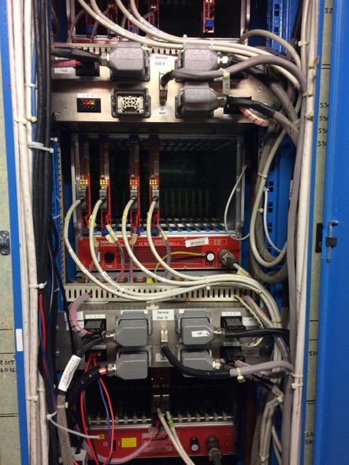
Service Power Distribution in S4
Located space for 3 connections via existing hardware, but will need to add 1 new cable for YE+1 near
GE CAEN mainframe in S4F to hold total of 4 branch drivers
Service power relay box provides DSS functionality in addition to cable interfacing

Slide 9
S4F Zone
Power delivered from armoire EXD10/55 in S4F zone of USC
Will need space for 4 circuit breakers in EXD10/55
Need 1 new USC-UXC service power cable installed

