Slide 1
Cooling wate rhose
Ian
15 Sept 2022

Slide 2
Terst 2 different barb fitting
Radial expansion and failure mode

Slide 3
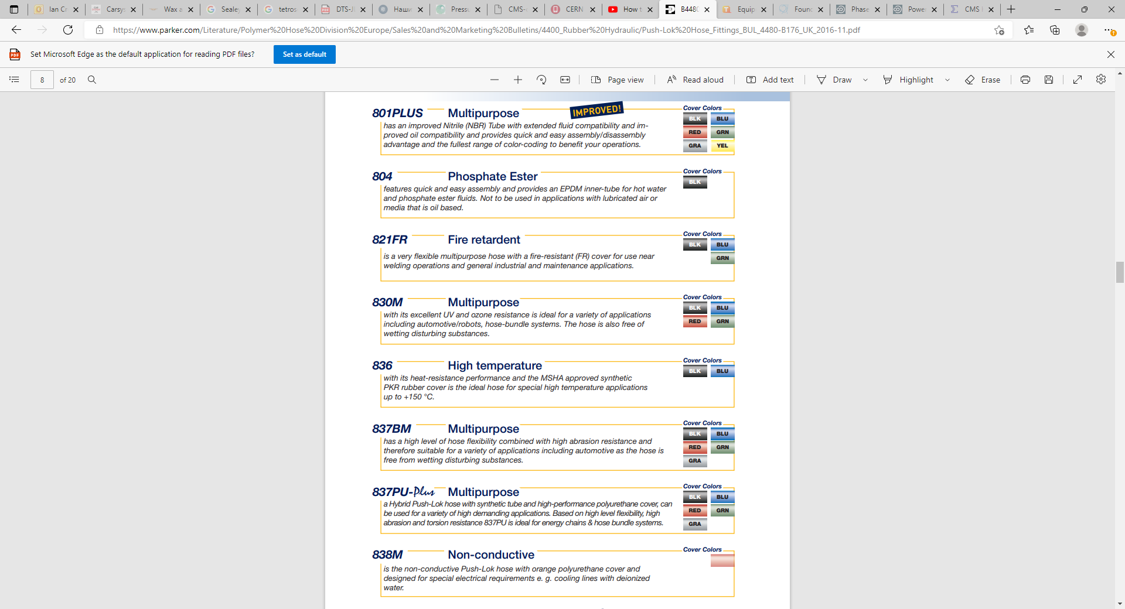
https://www.parker.com/Literature/Polymer%20Hose%20Division%20Europe/Sales%20and%20Marketing%20Bulletins/4400_Rubber%20Hydraulic/Push-Lok%20Hose_Fittings_BUL_4480-B176_UK_2016-11.pdf

Slide 4
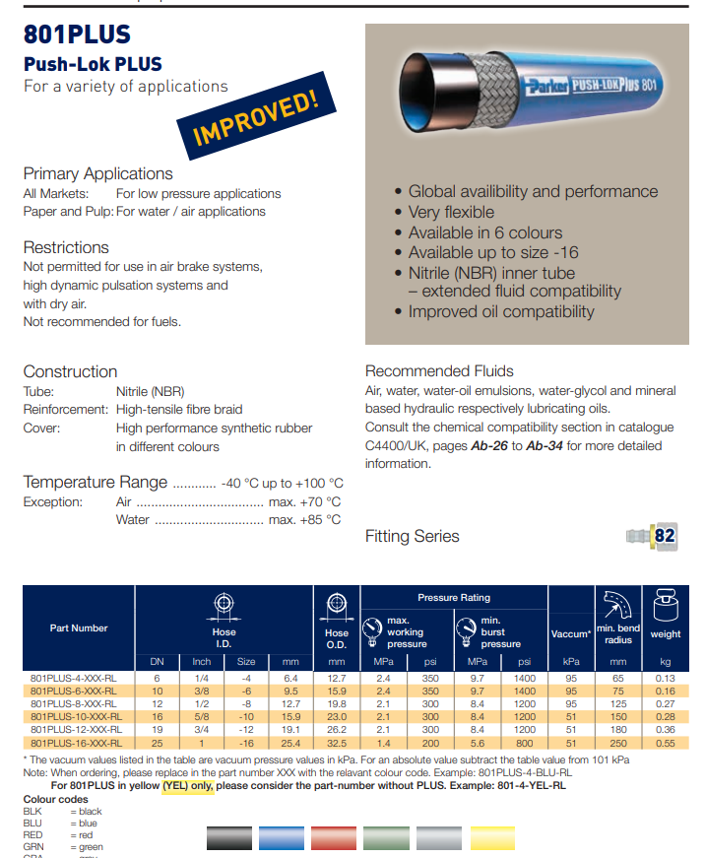
https://www.parker.com/Literature/Polymer%20Hose%20Division%20Europe/Sales%20and%20Marketing%20Bulletins/4400_Rubber%20Hydraulic/Push-Lok%20Hose_Fittings_BUL_4480-B176_UK_2016-11.pdf
Notice that there seems to be a universal factor to the minimum burst pressure from the max working pressure of 4.
So in the case of 1/4inch hoses given for 24Bar max operational pressure this is a minimum burst pressure at 96 bar.

Slide 5
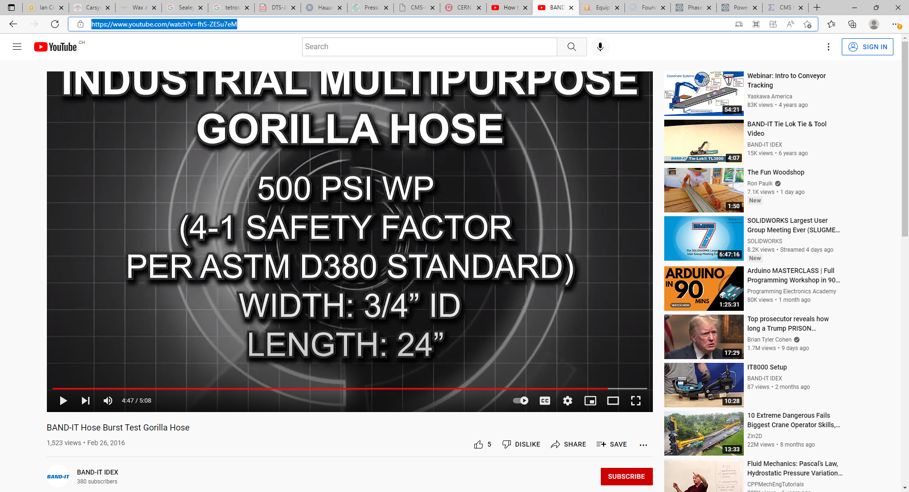
https://www.youtube.com/watch?v=fhS-ZESu7eM

Slide 6
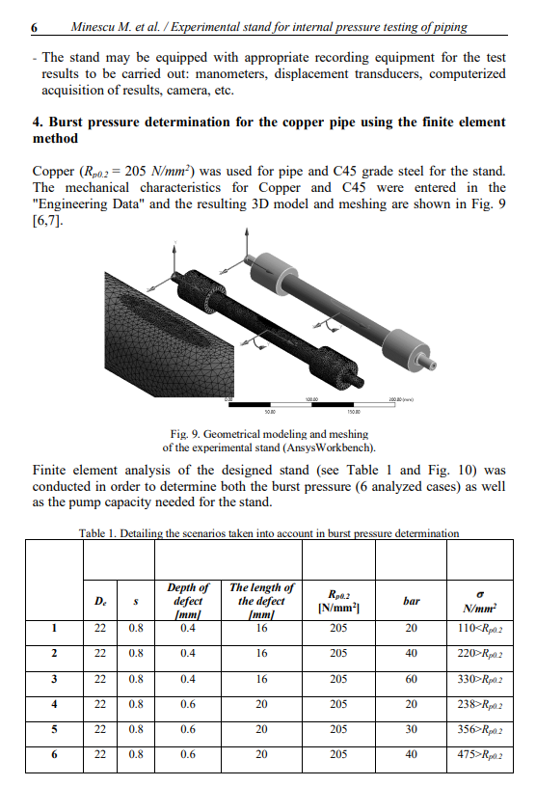
https://www.researchgate.net/publication/354683882_Experimental_Stand_for_Internal_Pressure_Testing_of_Pipes

