Slide 1
RPC RE1 new cabling
Ian
12 March 2023

Slide 2
Template from TC
Service Type (HV/LV/Fiber/…)
  Technical Specifications available: Yes/No (On EDMS? Link?)
  Procurement Path: CERN/In-kind/To be defined
  Supplier known: Yes/No (From EU? US? Other Country)
  CPR (Fire) and R.I. (Radiation) certification, or similar, available: Yes/No
  Connectorization strategy: At the supplier premise /At CERN/To be defined
  (Connector type/Connectorization Instruction /QA-QC, on EDMS?)
  Routing path defined: Yes/No (On EDMS?)
  Cables quantities: # of cables / length / diameter / weigh(/m) / bending radius
  Space request: Storage (m³), Assembly/Test (m²)
  Timeline: Material arrival / Cables assembly/tests (if at CERN)

Slide 3
Service Type HV 3 polar CPE connector
  Technical Specifications: 1x(2x0.22 + 2x 0.22mm²) H2M1 15kV CC IEC 60332-1
  Procurement Path: EDH External purchase
  Supplier known: Novacavi
  CPR (Fire) and R.I. (Radiation) certification, requires verification with supplier
  Connectorisation strategy: at the connector supplier, already done , re-checked at CERN
  Routing path defined: defined, as before but new lengths to be calculated to reduce slack storage
  Cables quantities: 144 pieces, avg. 15m, tot. length 2.2km.
  Space request: Storage (m³), Assembly/Test in 904 rack area (m²)
  Timeline: Material arrival / Cables assembly/tests at CERN and labels

Slide 4
Service Type HV Jupitor connector
  Technical Specifications: Prev 3864L LSZH sheath See CPE spec sheet
  Procurement Path: EDH External purchase
  Supplier known: CPE, Italy
  CPR (Fire) and R.I. (Radiation) certification, requires verification with supplier
  Connectorisation strategy: at the connector supplier, already done , re-checked at CERN
  Routing path defined: defined, as before as before but new lengths to be calculated to reduce slack storage
  Cables quantities: 144 pieces, avg. 15m, tot. length 2.2km.
  Space request: Storage (m³), Assembly/Test in 904 rack area (m²)
  Timeline: Material arrival / Cables assembly/tests at CERN and labels

Slide 5
Service Type LV Molex / Powerpole connector
  Technical Specifications: 8 x 0.75mm² screened FMUH2M4 300V LSOH IEC 60332-3-25
  Procurement Path: EDH External purchase
  Supplier known: Novacavi, Italy
  CPR (Fire) and R.I. (Radiation) certification, requires verification with supplier
  Connectorisation strategy: Cavitech, Suisse or CERN
  Routing path defined: defined, as before as before but new lengths to be calculated to reduce slack storage
  Cables quantities: 72 pieces, avg. 15m, tot. length 1.1km.
  Space request: Storage (m³), Assembly/Test (m²)
  Timeline: Material arrival / Cables assembly/sample tests at CERN and labels

Slide 6
Service Type Signal 3M IDC flat cable connector 40c
  Technical Specifications: TWISTED PAIR ROUND CABLE FE[5x(4*2*AWG28)N]N/SN/ST/M
  CERN 04.71.06.400.0 LSZH IEC 60332-1-11
  Procurement Path: EDH External purchase
  Supplier known: Technikabel, Plastcavi or , Italy
  CPR (Fire) and R.I. (Radiation) certification, requires verification with supplier
  Connectorisation strategy: Cavitech en Suisse , already done , quote obtained 2022, re-checked at CERN
  Routing path defined: defined, as before as before but new lengths to be calculated to reduce slack storage
  Cables quantities: 864 pieces, avg. 15m, tot. length 13km.
  Space request: Storage 40m³, Assembly/Test 30m²
  Timeline: Material arrival / Cables assembly 2-3 weeks. Skew tests at CERN BEFORE procurement amongst (5) suppliers and retested at CERN

Slide 7
Service Type DCS 3M IDC flat cable connector 10c
  Technical Specifications: Cat 5 Ethernet ( or better)
  Procurement Path: EDH External purchase
  Supplier known: wide choice
  CPR (Fire) and R.I. (Radiation) certification, requires verification with supplier
  Connectorisation strategy: Cavitech, already done, quote obtained 2022, re-checked at CERN
  Routing path defined: defined, as before
  Cables quantities: 144 pieces, avg. 15m, tot. length 2.2km.
  Space request: Storage (m³), Assembly/Test (m²)
  Timeline: Material arrival / Cables assembly/tests (if at CERN)

Slide 8
Service Type Temperature sensor (Pt100) with connector 2c
  Technical Specification: ? screened
  Procurement Path: EDH External purchase
  Supplier known: wide choice
  CPR (Fire) and R.I. (Radiation) certification, requires verification with supplier
  Connectorisation strategy: At CERN , already done , checked at CERN
  Routing path defined: defined, as before
  Cables quantities: 24 (or 144) pieces, avg. 15m, tot. length 360m.
  Space request: Storage (m³), Assembly/Test (m²)
  Timeline: Material arrival / Cables assembly/tests (if at CERN)

Slide 9
Service Type Fibre Optic from each Link board ( Up grade)
  Technical Specification: ?
  Procurement Path: EDH External purchase
  Supplier known: wide choice
  CPR (Fire) and R.I. (Radiation) certification, requires verification with supplier
  Connectorisation strategy: At suppier, already done , checked at CERN
  Routing path defined: defined, as before
  Cables quantities: pieces, avg. Xm, tot. length XXm.
  Space request: Storage (m³), Assembly/Test (m²)
  Timeline: Material arrival / Cables assembly/tests (if at CERN)

Slide 10
Conclusions
Basic info available on dfs project web site.
Skew test jig has to be rebuilt from scratch
Increase number of temp sensors to one per chamber
Requires up dating to meet CARE and new prices/delay
Do the cables this year so that everybody is on the starting line in 2027 (?) If RPC need assistance now to be sure that there are no last minute mess-ups.

Slide 11
Notes
https://cpr.europacable.eu/en/cpr/understanding-cpr-cable-classification-and-certification
https://efreddi.web.cern.ch/webtools/CERN-cables-codification
CPE catalogues inc HV
file:///G:/Websites/r/rpc-cms-re4-upscope/RPC/Services/HV/CPE/DownLoadHVCatalogue.htm#
4c HV cable
https://project-cms-rpc-endcap.web.cern.ch/rpc/Services/Services2000/Hv/HVcable/H2M115KVCCIEC332-1.doc
Signal cables
Skew test jig
http://rpc-cms-re4-upscope.web.cern.ch/RPC/Services/SignalDCS/SkewTestJig/
DCS
Cat. 5 04.21.70.104.6 Kerpen mega Line 727 Flex 4P LSFROH 3503789

Slide 12
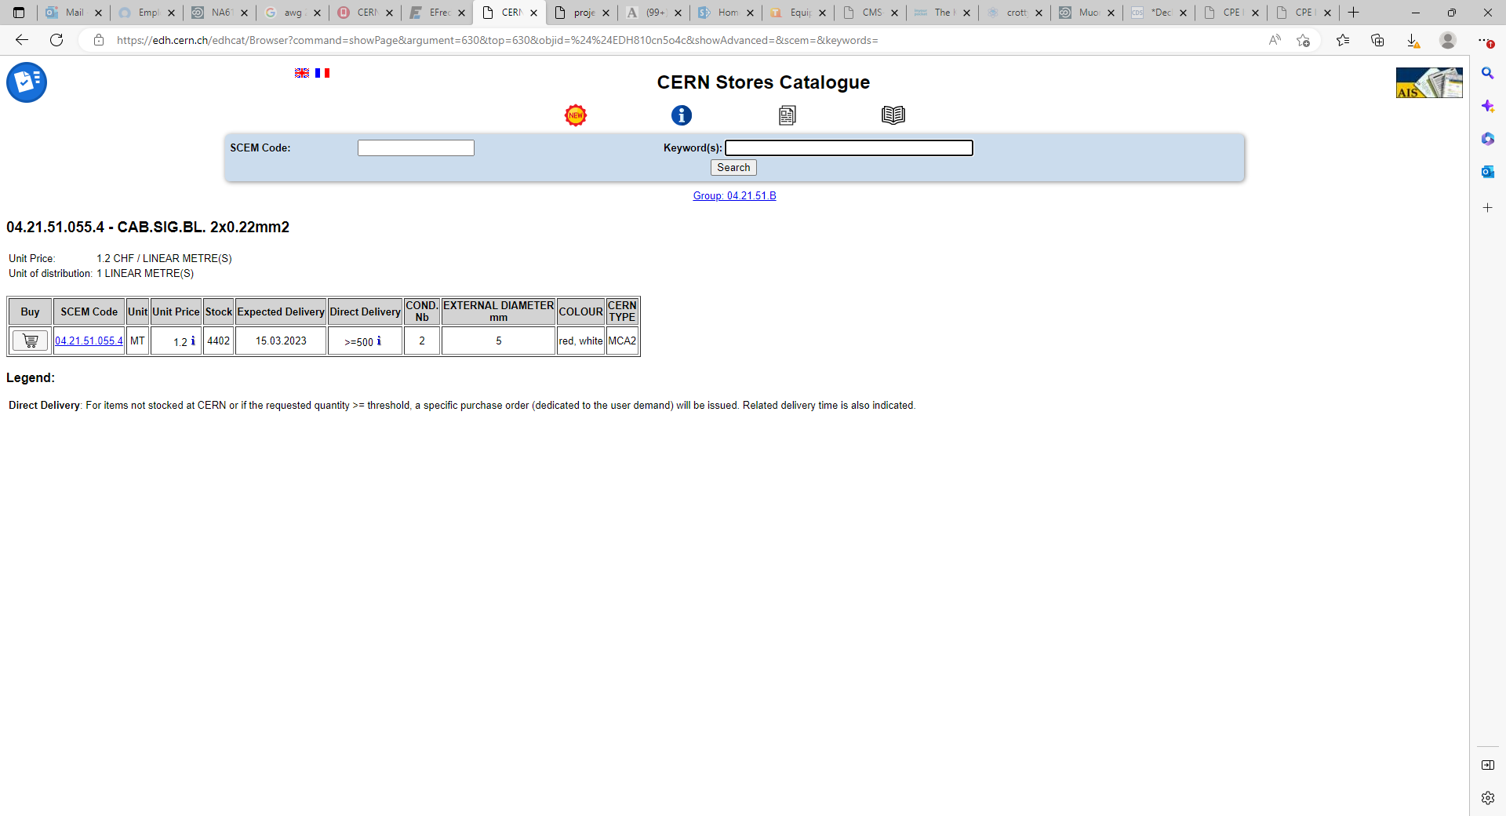
Temp sensor cable ?
Technikabel 08WH CERN Type MCA2 IEC 60332-1 ZH
See EDH 2715408
RE1/1 temp cable

