Slide 1
New Signal cable for phase 3
RE1 and RE2
Ian
3 Sept 2021

Slide 2
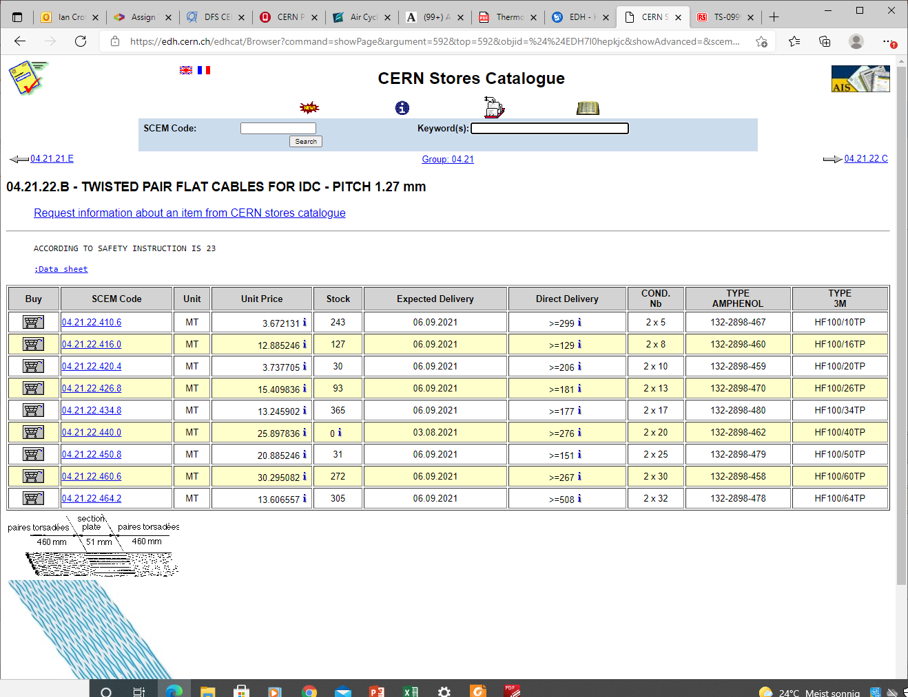

Slide 3
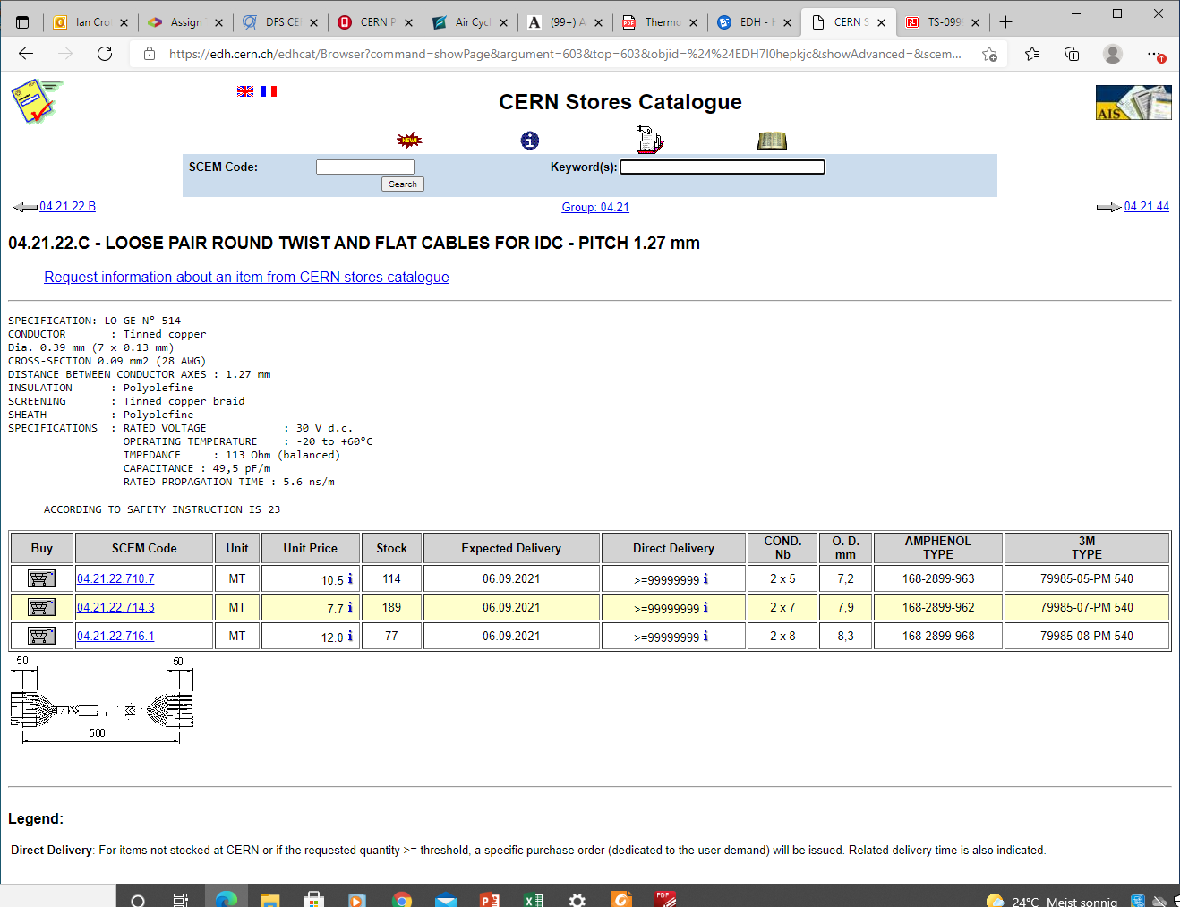

Slide 4
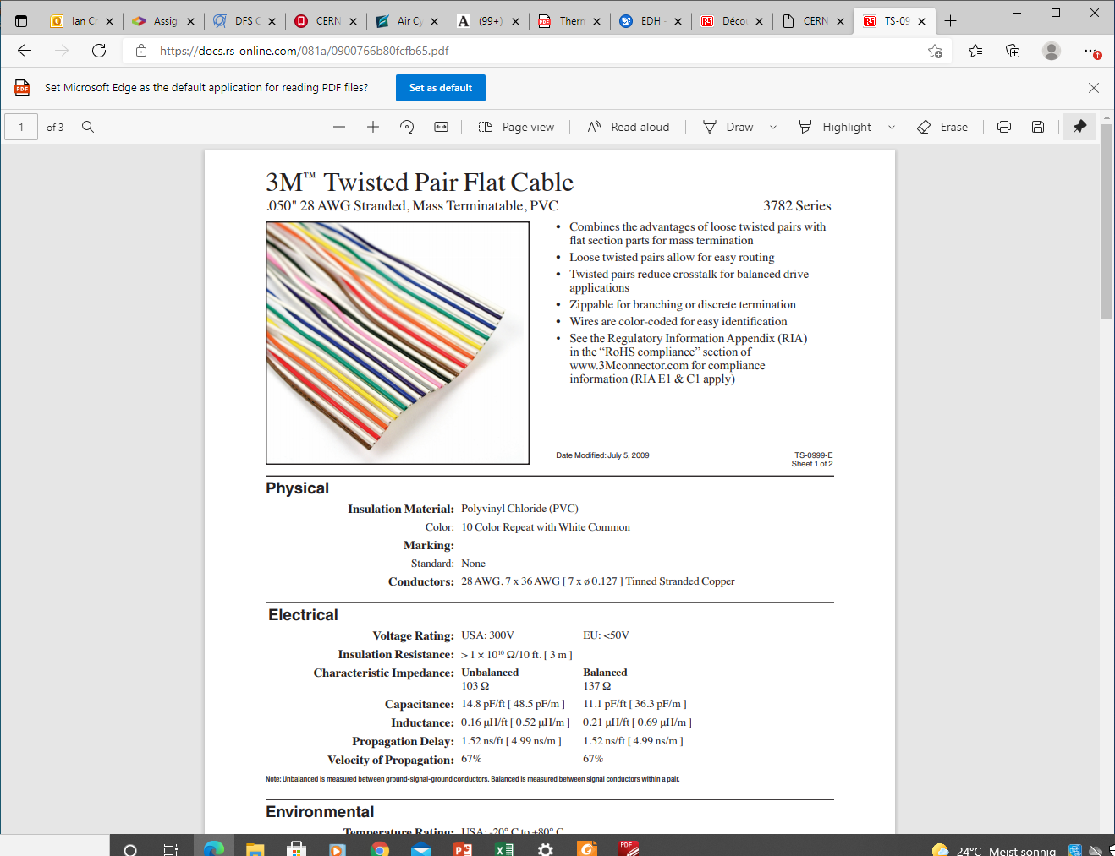
https://docs.rs-online.com/081a/0900766b80fcfb65.pdf

Slide 6
Connectors 40c IDC flat cable (3M)

Slide 8
