Slide 1
RE1/2 & RE1/3 Signal Cable Assembly
Ian Crotty
Taken from original 2005 version (in word)
24 March 2022

Slide 2
2 pages , 1 one for each end of the cable
Note the cable lengths for RE1/3 & RE1/2 are NOT the same.
Chamber End
Enlever la gaine L= 150mm
Replace with Poly braid
Heat Shrink Tube
Diam 10
With internal hot melt
Poly Braid
L= 40mm
Ground wire 0.5mm²
L= 280mm
40 pin Scotch Flex (3M)
Cosse dia.
6 x 10mm
Ian Crotty
28 Oct 05
Updated
29 March 2022

Slide 3
Link Board Box End
Enlever la gaine L= 400mm
Replace with poly braid
Heat Shrink Tube
Diam 10
With internal hot melt
Heat Shrink tube
Dia. 12 L = 60mm
NE PAS CHAUFFER
SCEM 04.86.62.130.9
Poly Braid
Ground wire 0.5mm²
L= 200mm
L= 40mm
40 pin Scotch Flex (3M)
Cosse dia.
6 x 10mm
Ian Crotty
28 Oct 05
Up-dated 29 March 2022
2 pages , 1 one for each end of the cable
Note the cable lengths for RE1/3 & RE1/2 are NOT the same.

Slide 4
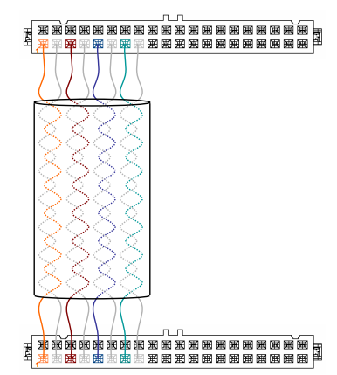
Pin out schema
In correct for DCS and Signal !

