Slide 1
New Signal & DCS cable for phase 2
RE1 and RE2
Ian Crotty
3 Sept 2021

Slide 2
 | Signal & DCS cables Phase II
 |  |  |  | Ian, 3 Sept 2021
 | Nos cable/chamber | RE1/2 | RE1/3 | RE2/2 | RE2/3
Signal | 6 | 36 | 36 | 36 | 36
 | Cable per ch type | 216 | 216 | 216 | 216
DCS | 1
 | Cable per ch type | 36 | 36 | 36 | 36
Signal | Total cables per Endcap |  |  |  | 864
DCS | Total cables per Endcap |  |  |  | 144
Signal | Both Endcaps |  |  |  | 1728
DCS | Both Endcaps |  |  |  | 288
Signal | No spares except for Tests Lab installation = 20 of 10m |  |  |  |  | 1748
DCS | No spares except for Tests Lab installation = 20/6 of 10m |  |  |  |  | 292

Slide 3
Signal cables and DCS cables
Signal cables
Approx. length for 1 station = 4722m.
There are 4 stations
Total length approx. 20km
Lengths vary from 7 – 15m
DCS cables
Approx. length for 1 station =
348 + 438 = 787m.
There are 4 stations
Total length approx. 3.5km
Lengths vary from 7 – 15m
EXAMPLE NOT FOR PRODUCTION

Slide 4
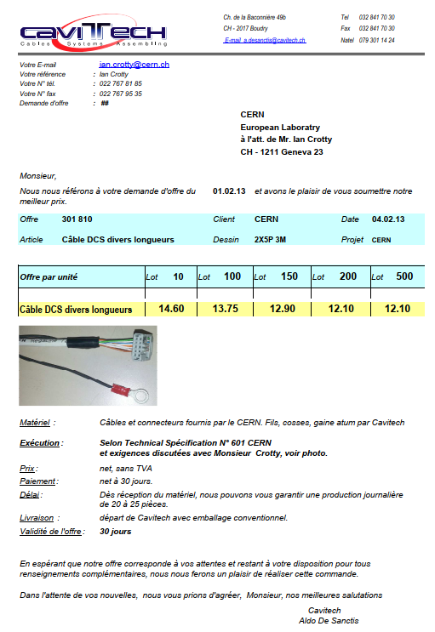
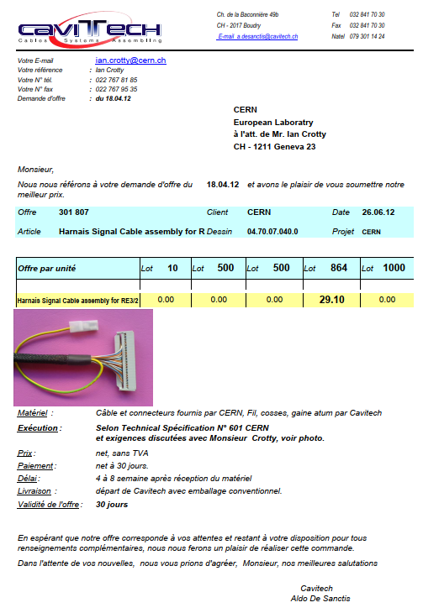
10c IDC
40c IDC

Slide 5
Possible Signal cable solutions
Halogen free
AWG28, 40c, Twisted pair, shielded
NOT PVC

Slide 6
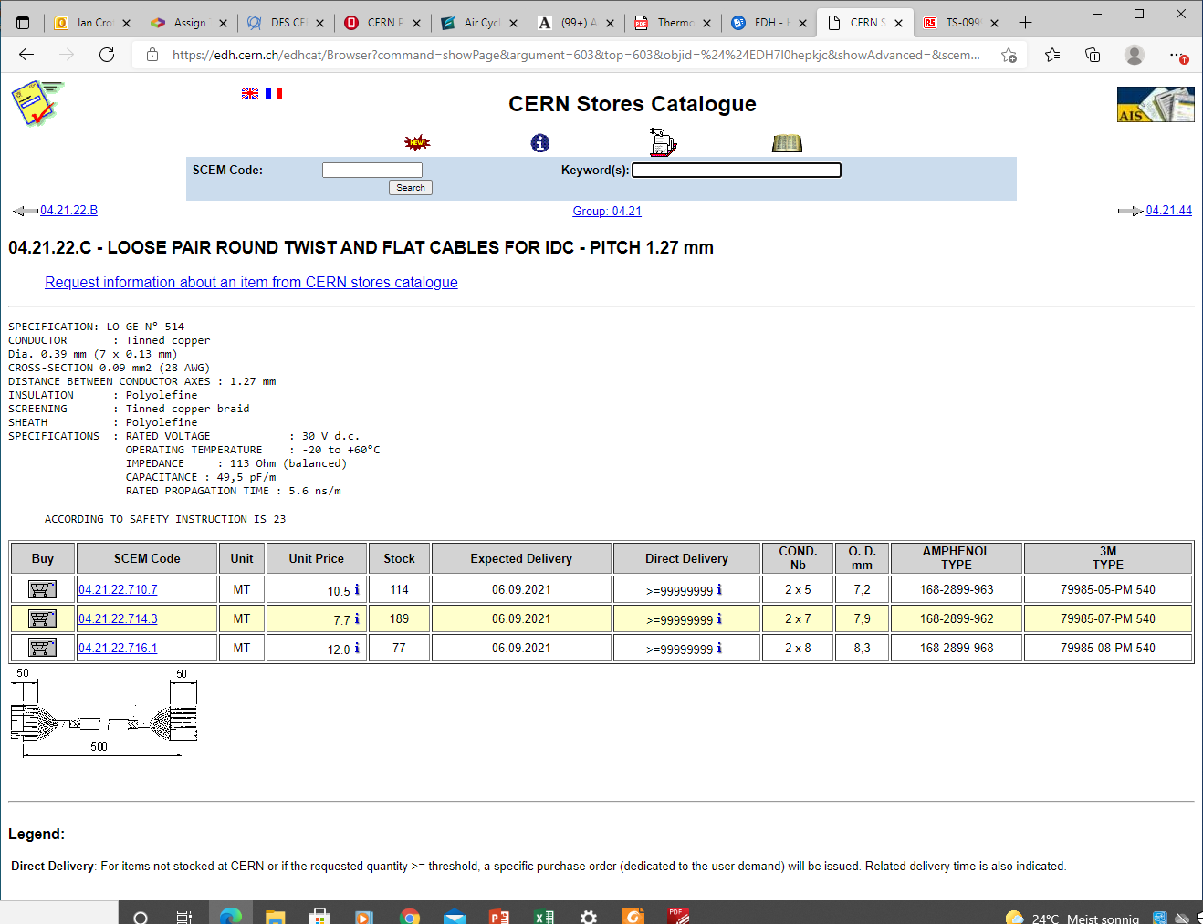

Slide 7
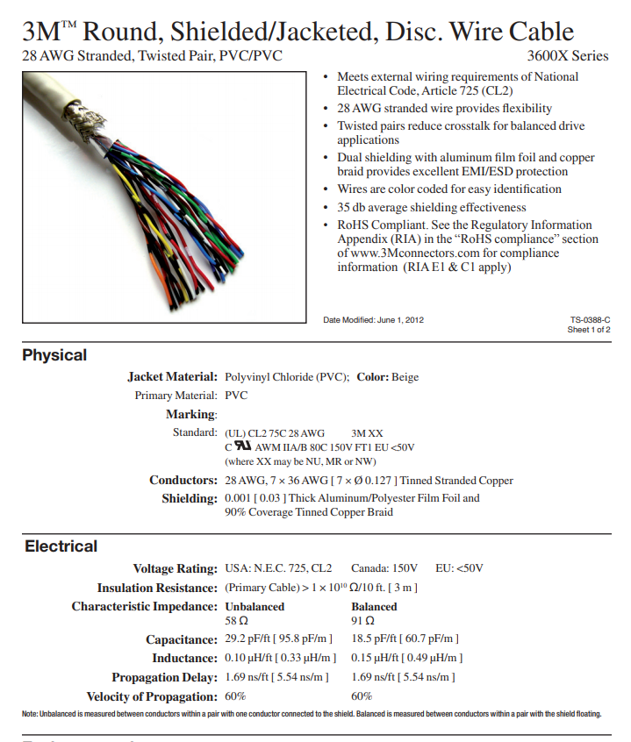
79985-20-PM 540

Slide 8
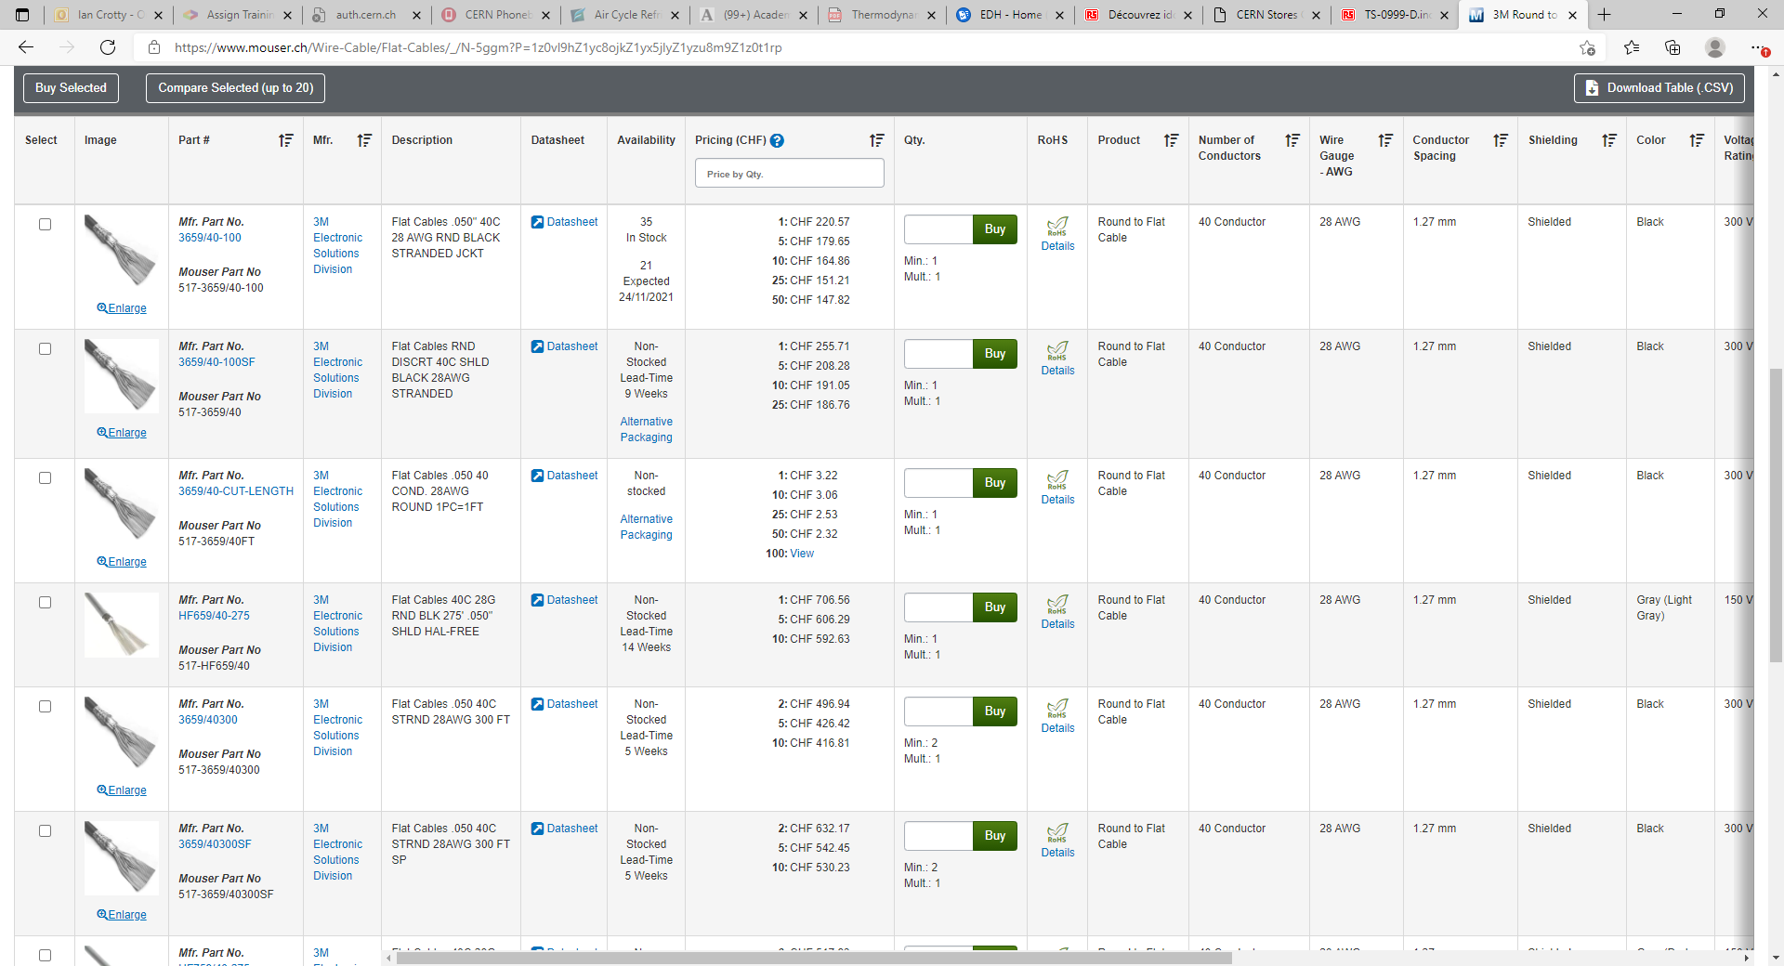
https://www.mouser.ch/Wire-Cable/Flat-Cables/_/N-5ggm?P=1z0vl9hZ1yc8ojkZ1yx5jlyZ1yzu8m9Z1z0t1rp

Slide 9
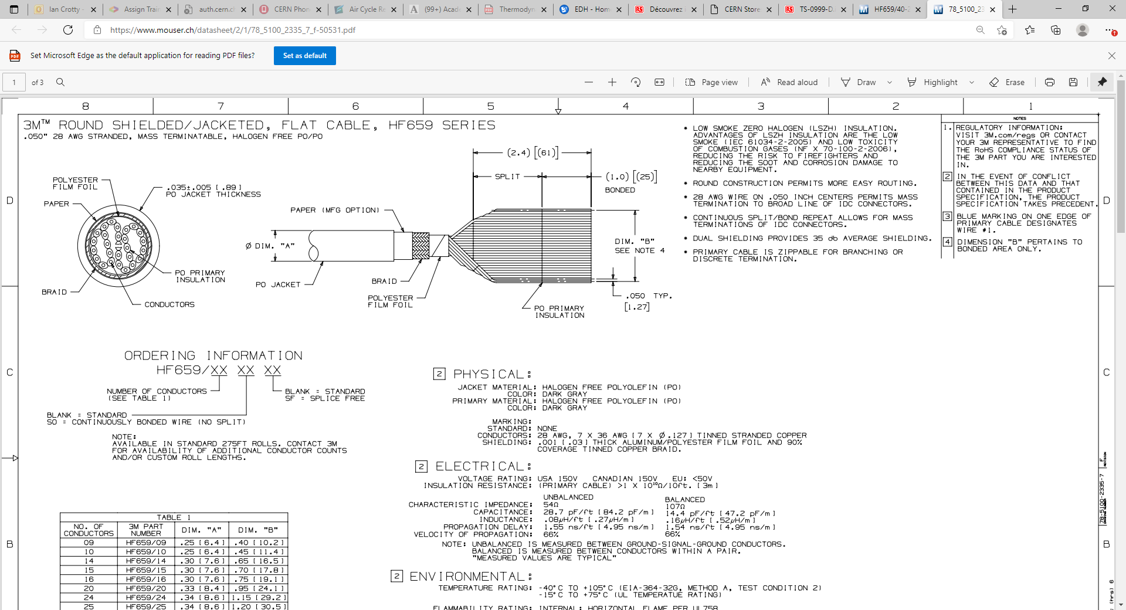
78_5100_2335_7_f-50531.pdf (mouser.ch)
HF659/40-275 3M Electronic Solutions Division | Mouser Switzerland

Slide 10
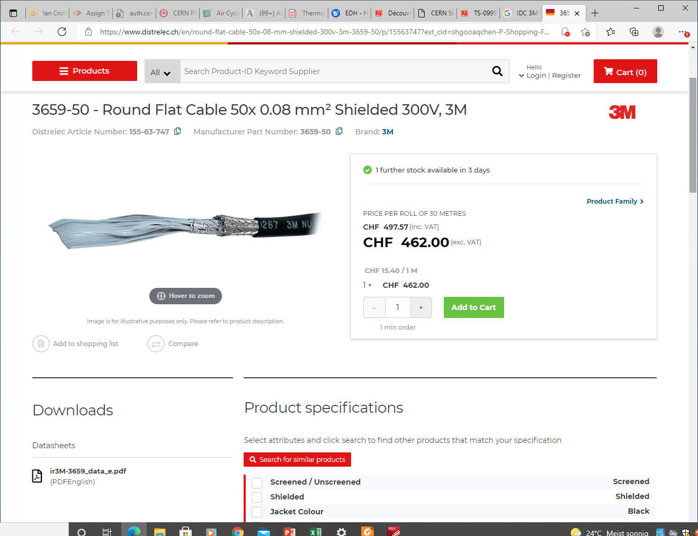
https://www.distrelec.ch/en/round-flat-cable-50x-08-mm-shielded-300v-3m-3659-50/p/15563747?ext_cid=shgooaqchen-P-Shopping-Fallback&pi=15563747&gclid=EAIaIQobChMI2tLFutXi8gIVCOh3Ch2KxAIkEAQYASABEgLNU_D_BwE

Slide 11
Possible DCS cable solutions
Halogen free
AWG22, 8c, Twisted pair, shielded
NOT PVC

Slide 12
Mega flex xxxxx

Slide 13
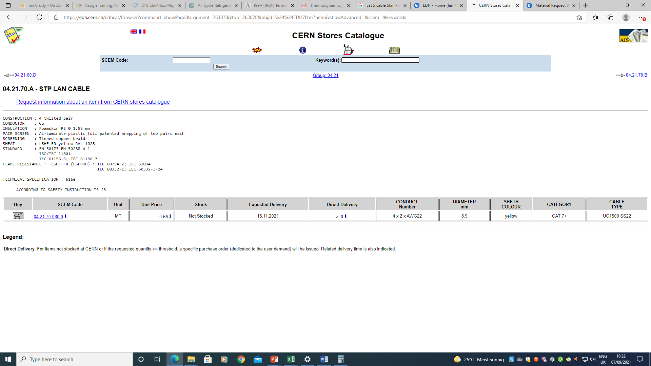

Slide 14
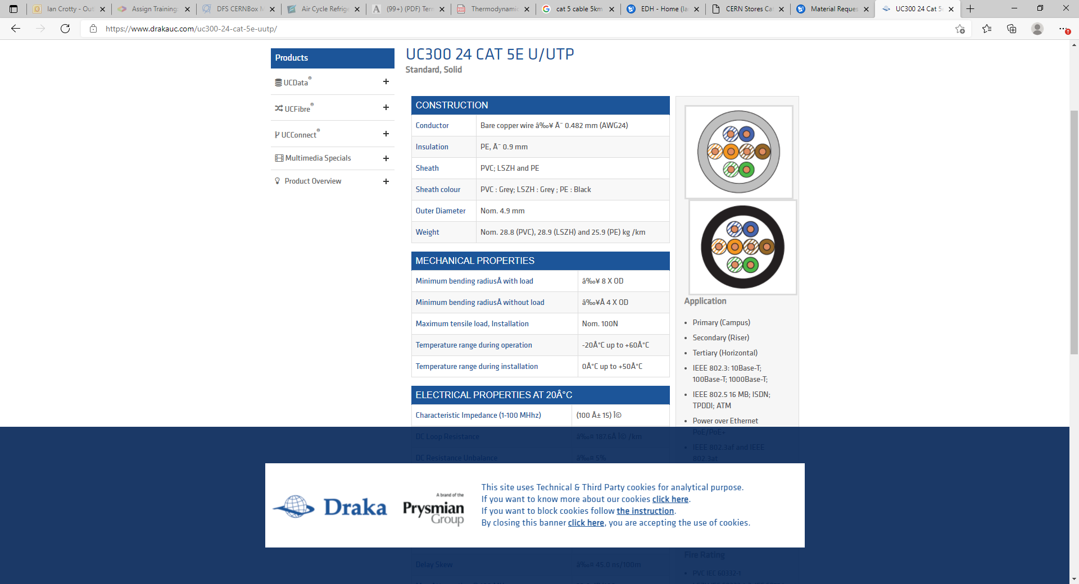
https://www.drakauc.com/uc300-24-cat-5e-uutp/

Slide 15
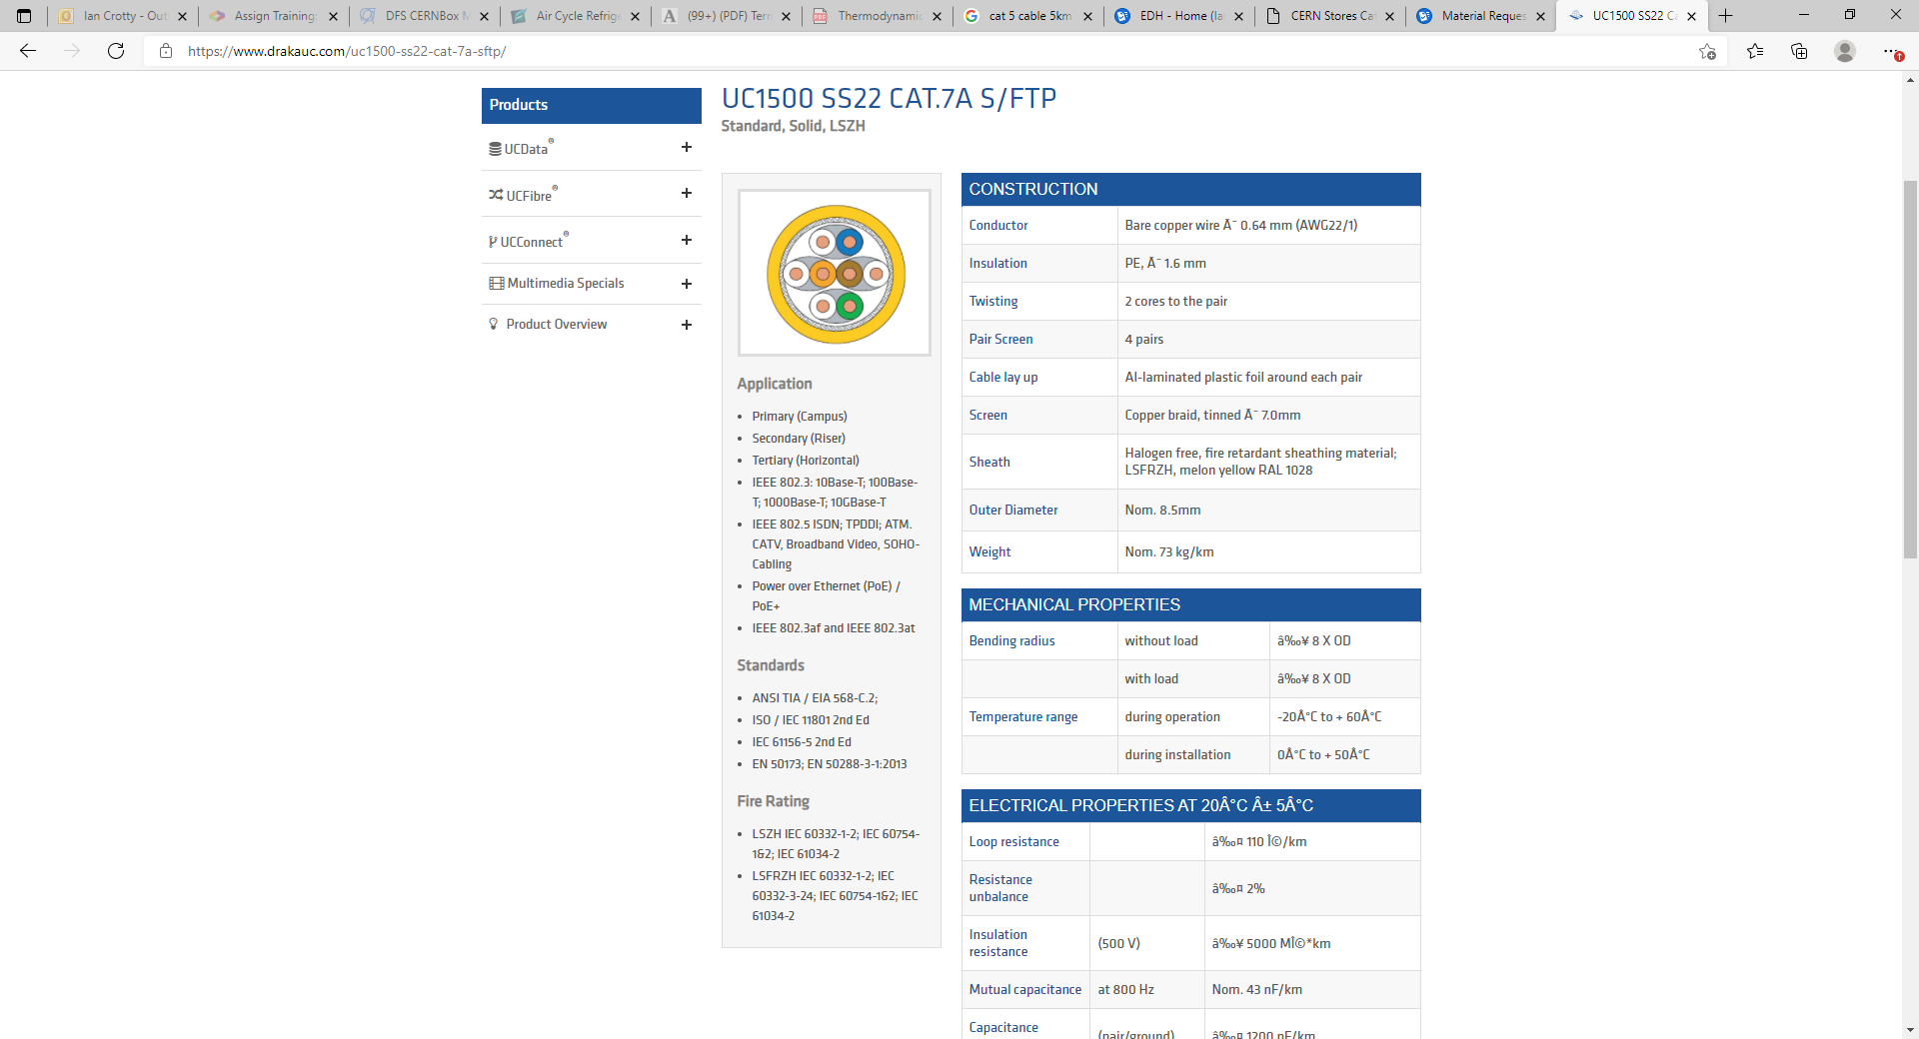

Slide 16
Connectors 40c & 10c
IDC flat cable (3M)

Slide 17
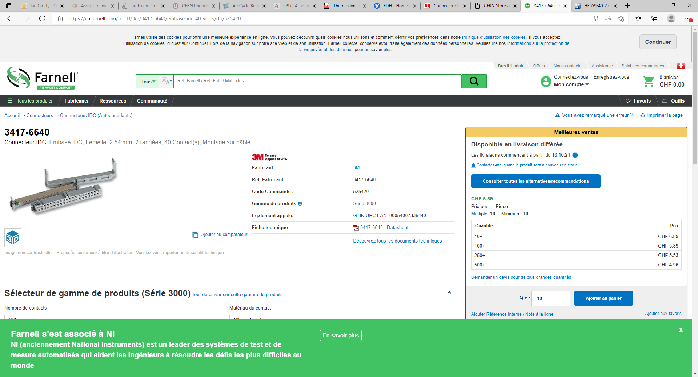
https://ch.farnell.com/fr-CH/3m/3417-6640/embase-idc-40-voies/dp/525420
3417-6640
Preferred connector

Slide 18
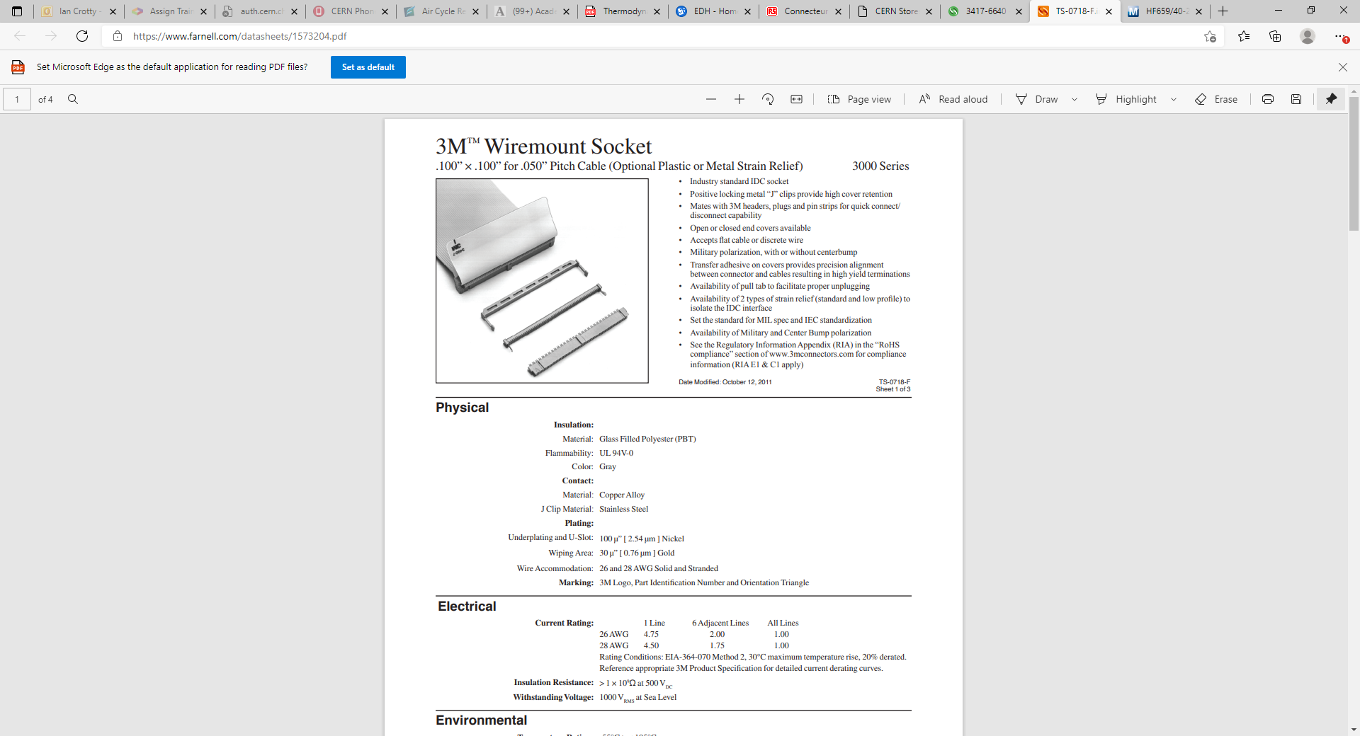
https://www.farnell.com/datasheets/1573204.pdf

Slide 19
These connectors are second choice

Slide 20
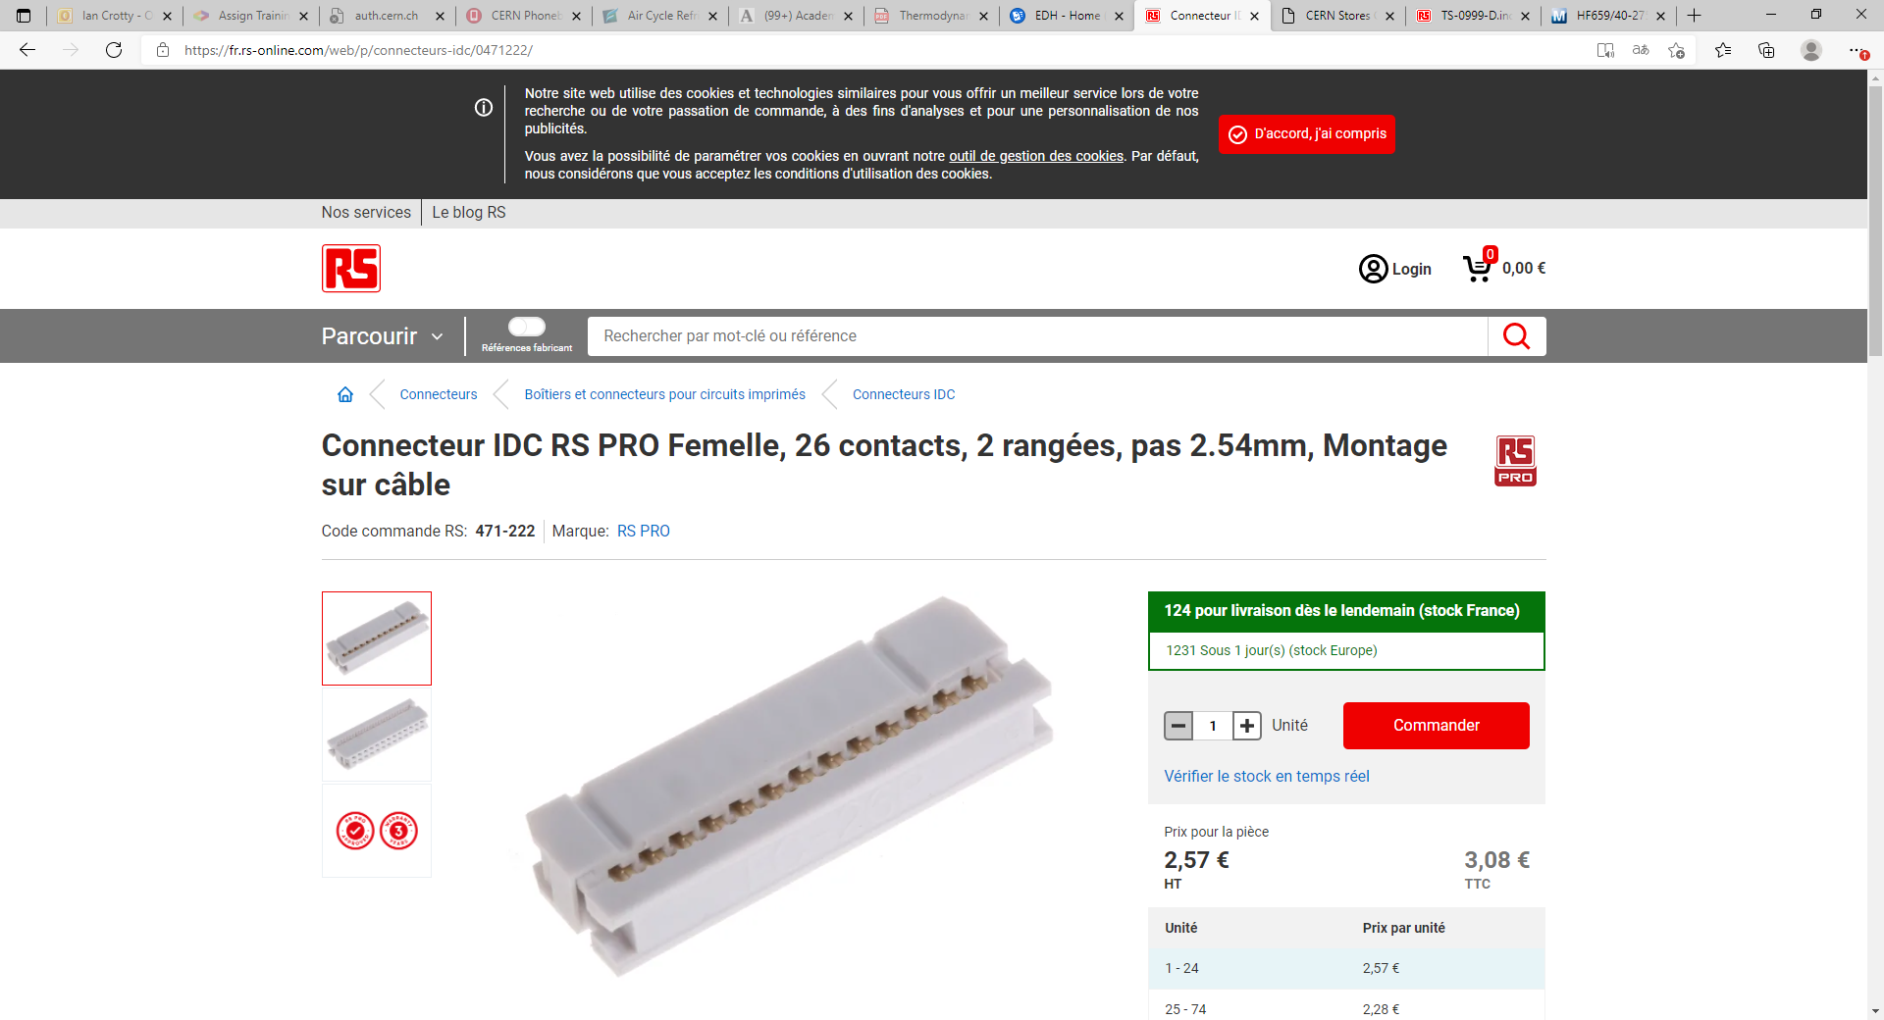
https://fr.rs-online.com/web/p/connecteurs-idc/0471222/

Slide 21
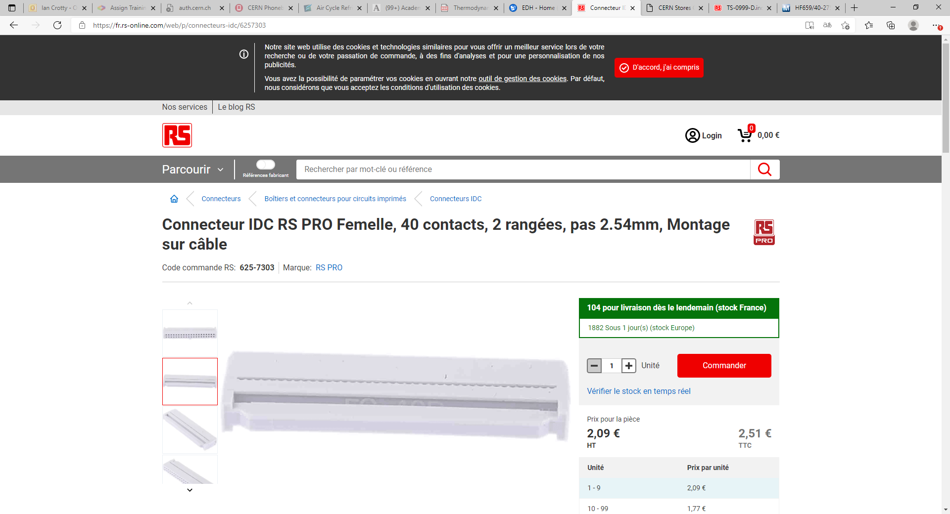
https://fr.rs-online.com/web/p/connecteurs-idc/6257303

Slide 22
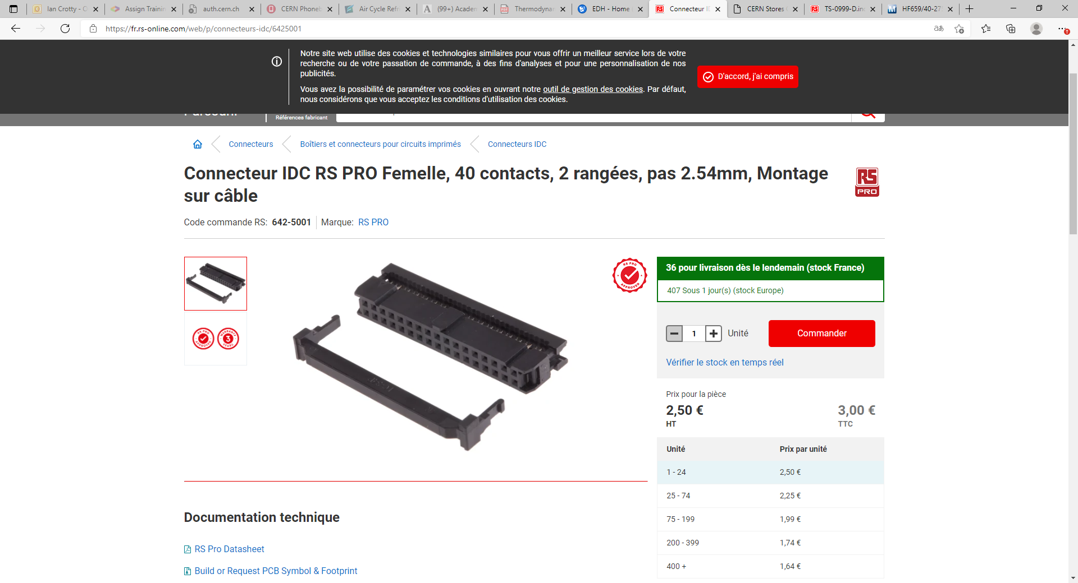
https://fr.rs-online.com/web/p/connecteurs-idc/6425001

