Slide 1
New Signal & DCS cable for phase 2
RE1 and RE2
Ian Crotty
3 Sept 2021

Slide 2
 | Signal & DCS cables Phase II
 |  |  |  | Ian, 3 Sept 2021
 | Nos cable/chamber | RE1/2 | RE1/3 | RE2/2 | RE2/3
Signal | 6 | 36 | 36 | 36 | 36
 | Cable per ch type | 216 | 216 | 216 | 216
DCS | 1
 | Cable per ch type | 36 | 36 | 36 | 36
Signal | Total cables per Endcap |  |  |  | 864
DCS | Total cables per Endcap |  |  |  | 144
Signal | Both Endcaps |  |  |  | 1728
DCS | Both Endcaps |  |  |  | 288
Signal | No spares except for Tests Lab installation = 20 of 10m |  |  |  |  | 1748
DCS | No spares except for Tests Lab installation = 20/6 of 10m |  |  |  |  | 292

Slide 3
Signal cables and DCS cables
Signal cables
Approx. length for 1 station = 4722m.
There are 4 stations
Total length approx. 20km
Lengths vary from 7 – 15m
DCS cables
Approx. length for 1 station =
348 + 438 = 787m.
There are 4 stations
Total length approx. 3.5km
Lengths vary from 7 – 15m
EXAMPLE NOT FOR PRODUCTION

Slide 4
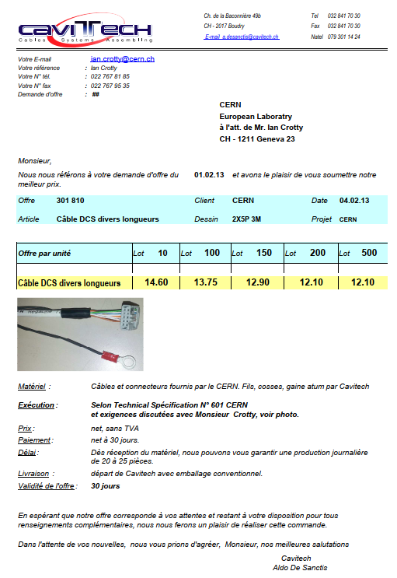
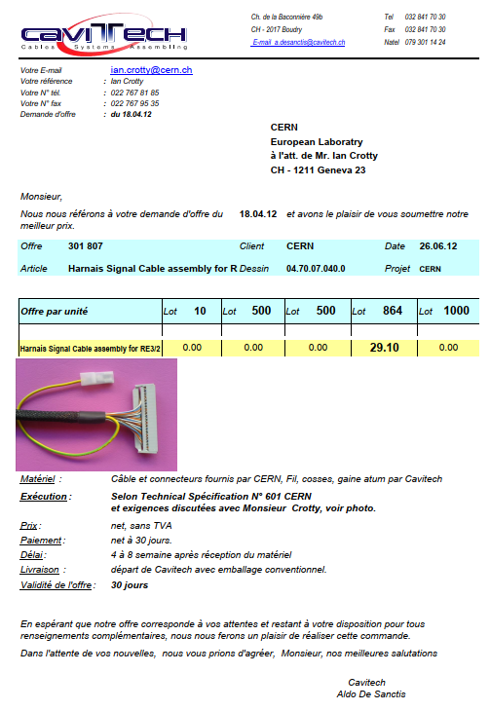
10c IDC
40c IDC

Slide 5
Possible Signal cable solutions
Halogen free
28AWG, 40c, Twisted pair, shielded
NOT PVC

Slide 6
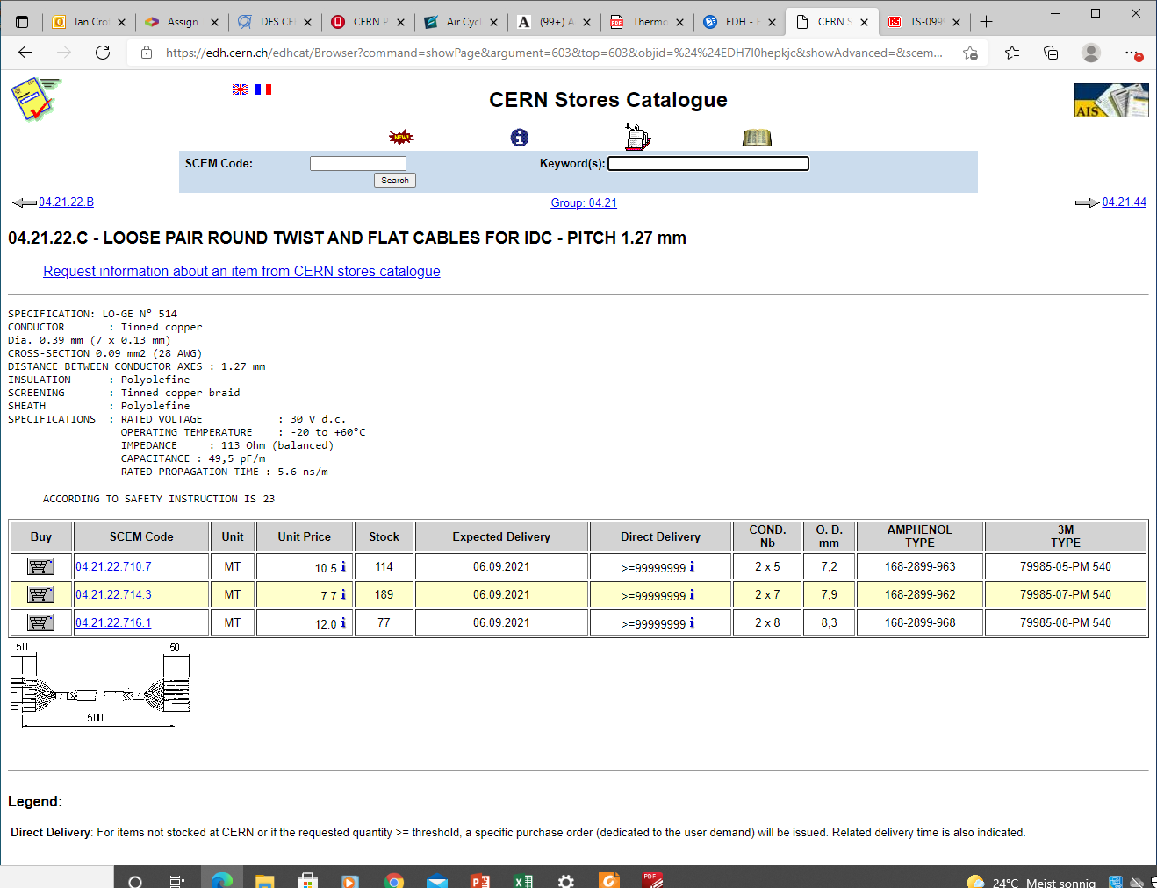

Slide 7
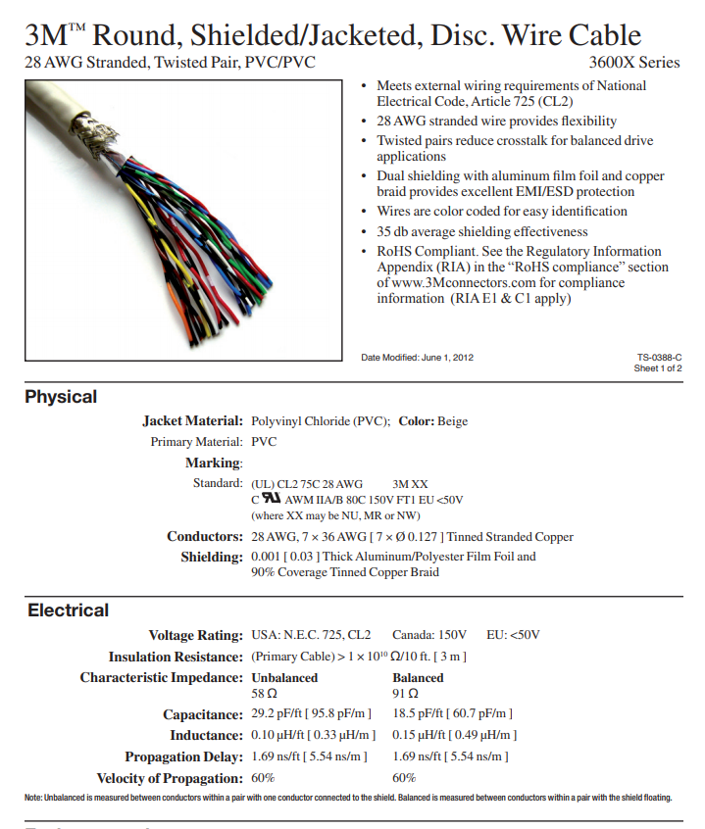
79985-20-PM 540

Slide 8
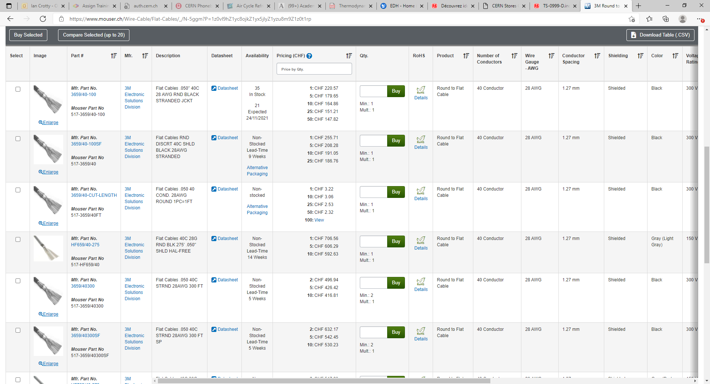
https://www.mouser.ch/Wire-Cable/Flat-Cables/_/N-5ggm?P=1z0vl9hZ1yc8ojkZ1yx5jlyZ1yzu8m9Z1z0t1rp

Slide 9
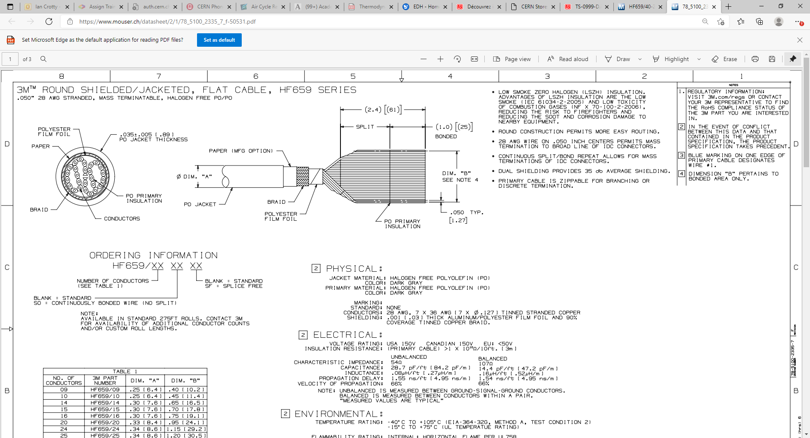
78_5100_2335_7_f-50531.pdf (mouser.ch)
HF659/40-275 3M Electronic Solutions Division | Mouser Switzerland

Slide 10
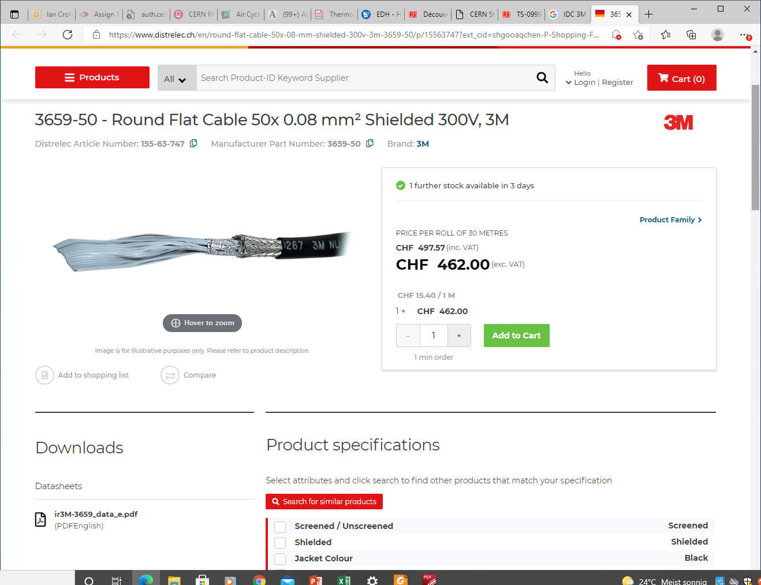
https://www.distrelec.ch/en/round-flat-cable-50x-08-mm-shielded-300v-3m-3659-50/p/15563747?ext_cid=shgooaqchen-P-Shopping-Fallback&pi=15563747&gclid=EAIaIQobChMI2tLFutXi8gIVCOh3Ch2KxAIkEAQYASABEgLNU_D_BwE

Slide 12
Possible DCS cable solutions
Halogen free
28AWG, 40c, Twisted pair, shielded
NOT PVC

Slide 13
Mega flex xxxxx

Slide 16
Connectors 40c IDC flat cable (3M)

Slide 17
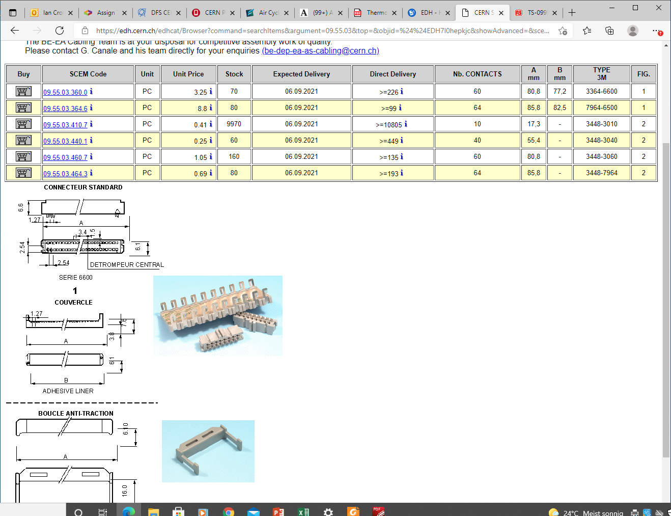

Slide 18
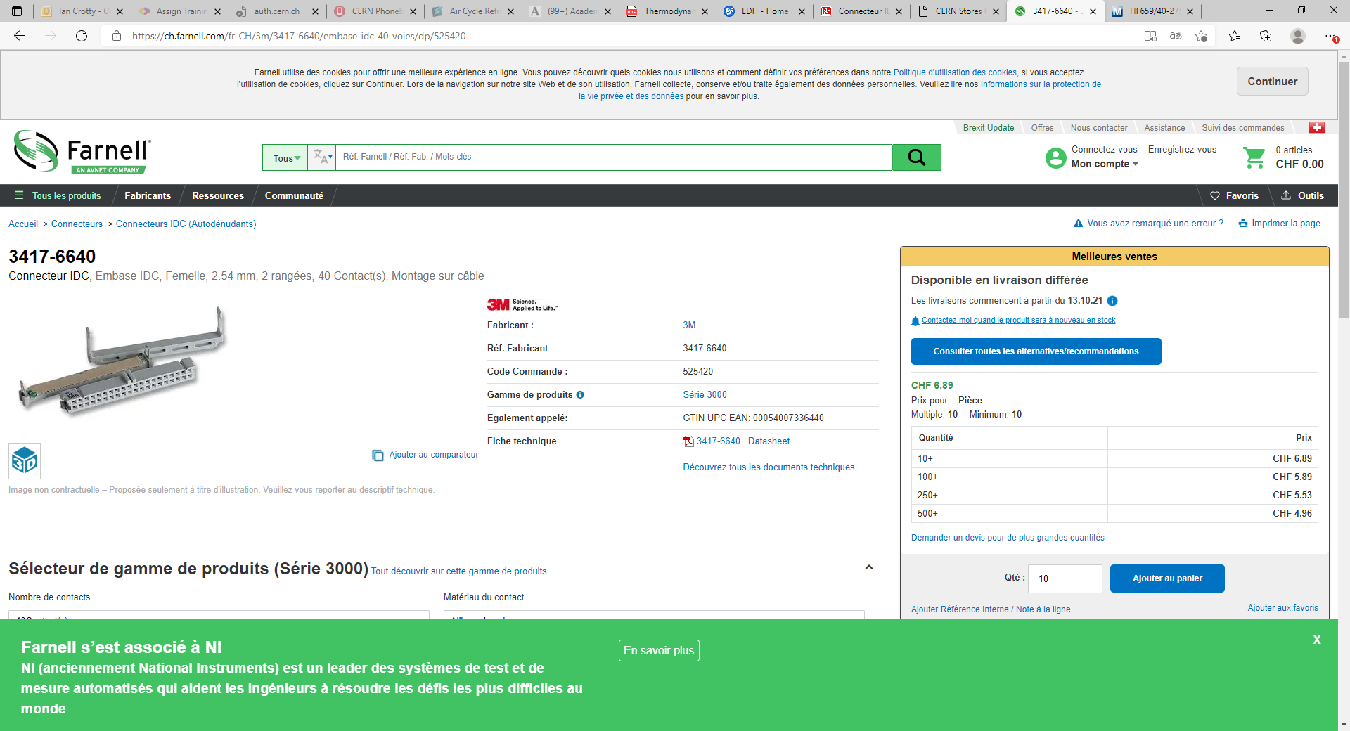
https://ch.farnell.com/fr-CH/3m/3417-6640/embase-idc-40-voies/dp/525420
3417-6640
Preferred connector

Slide 19
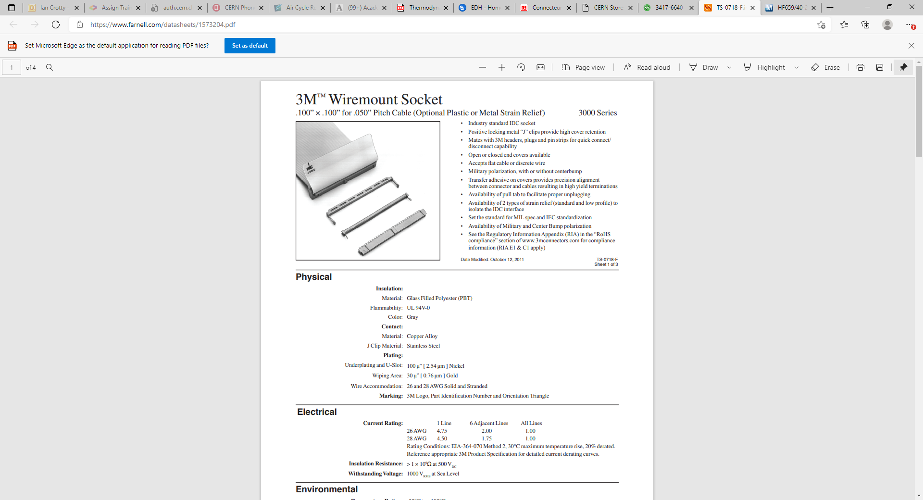
https://www.farnell.com/datasheets/1573204.pdf

Slide 20
These connectors are second choice

Slide 21
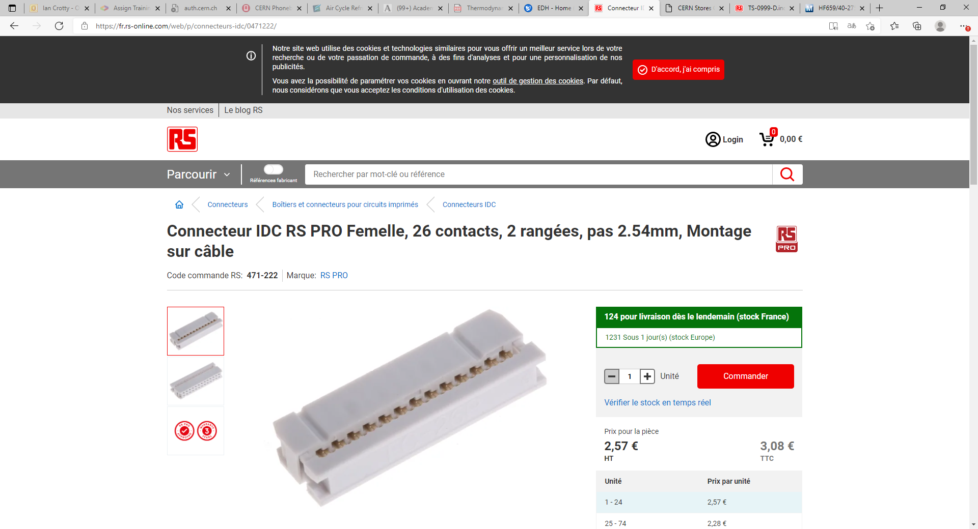
https://fr.rs-online.com/web/p/connecteurs-idc/0471222/

Slide 22
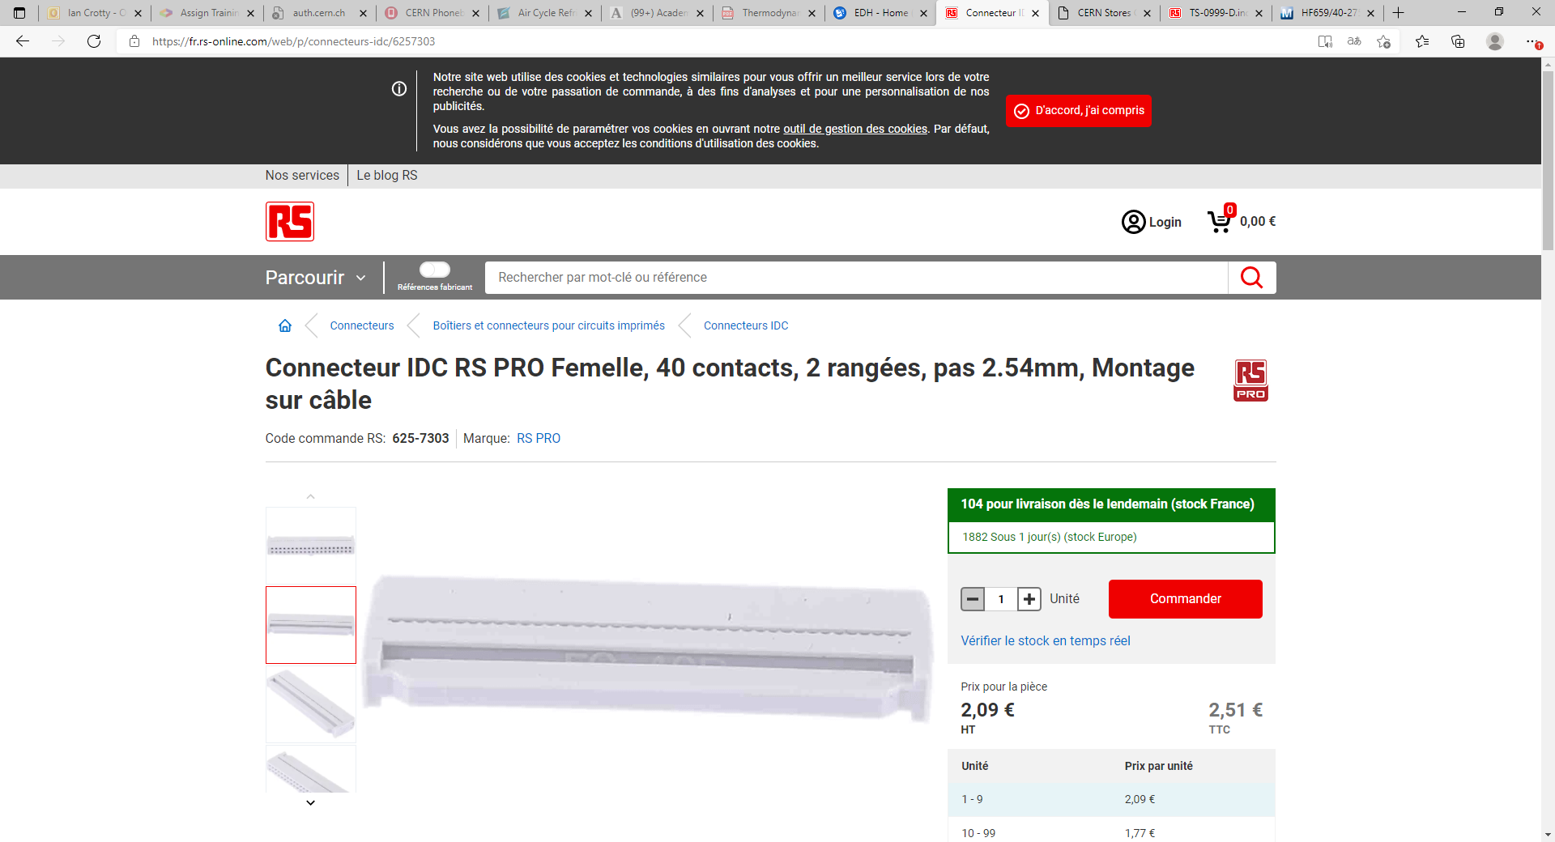
https://fr.rs-online.com/web/p/connecteurs-idc/6257303

Slide 23
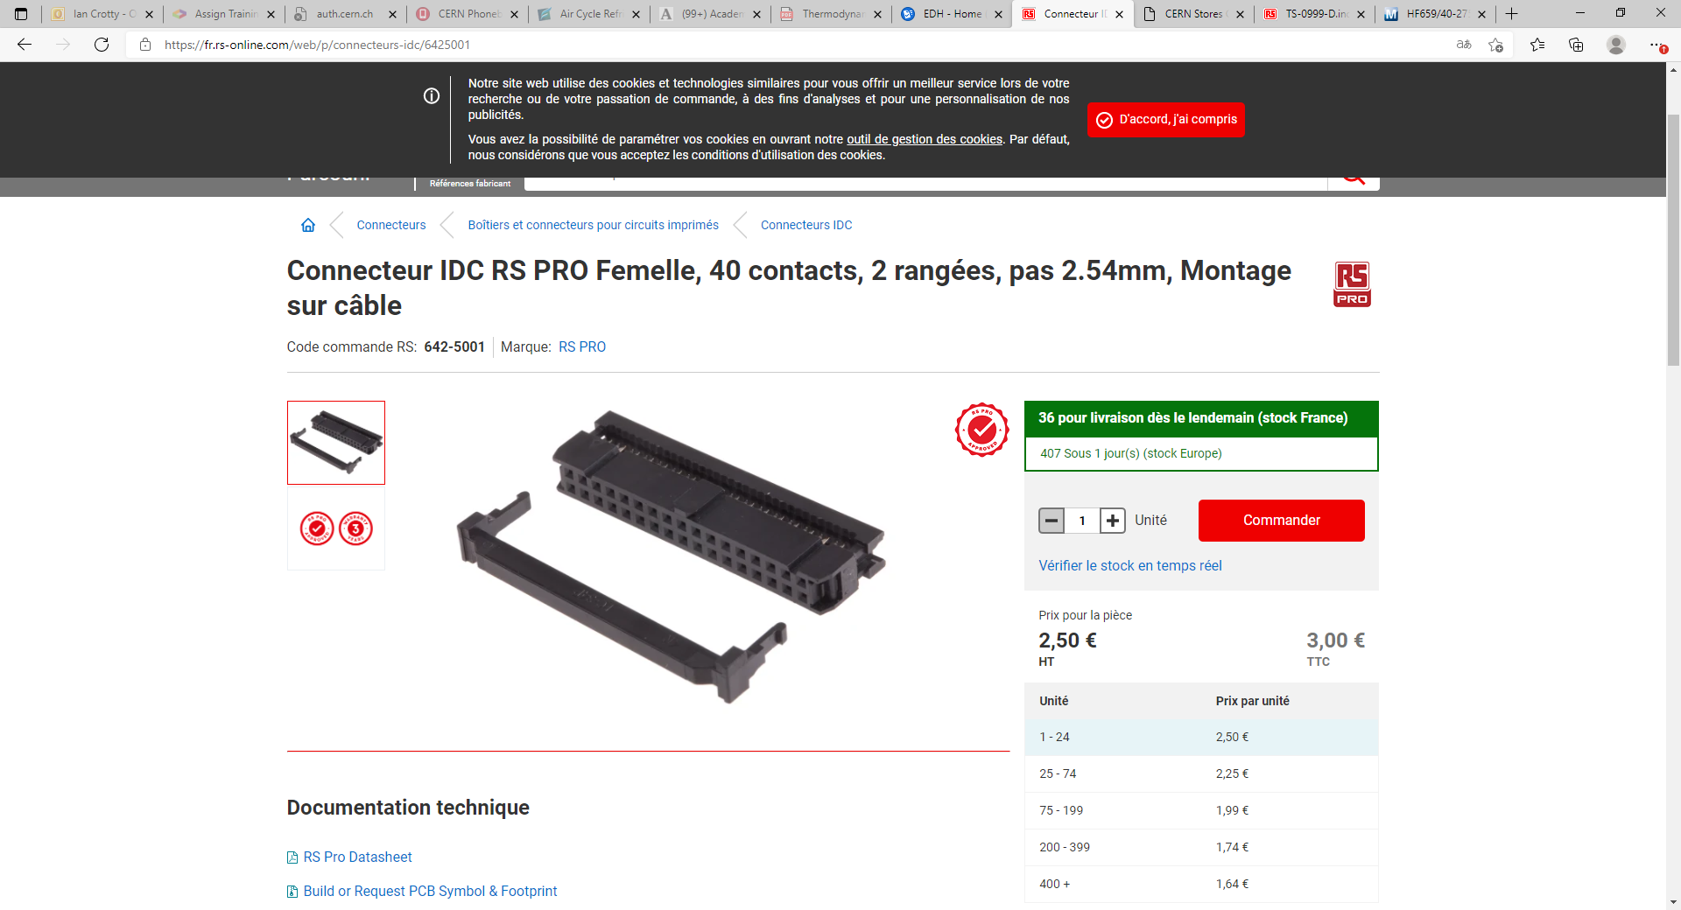
https://fr.rs-online.com/web/p/connecteurs-idc/6425001

