Slide 1
Cable test and Standards
Ian
13 March 2023

Slide 2
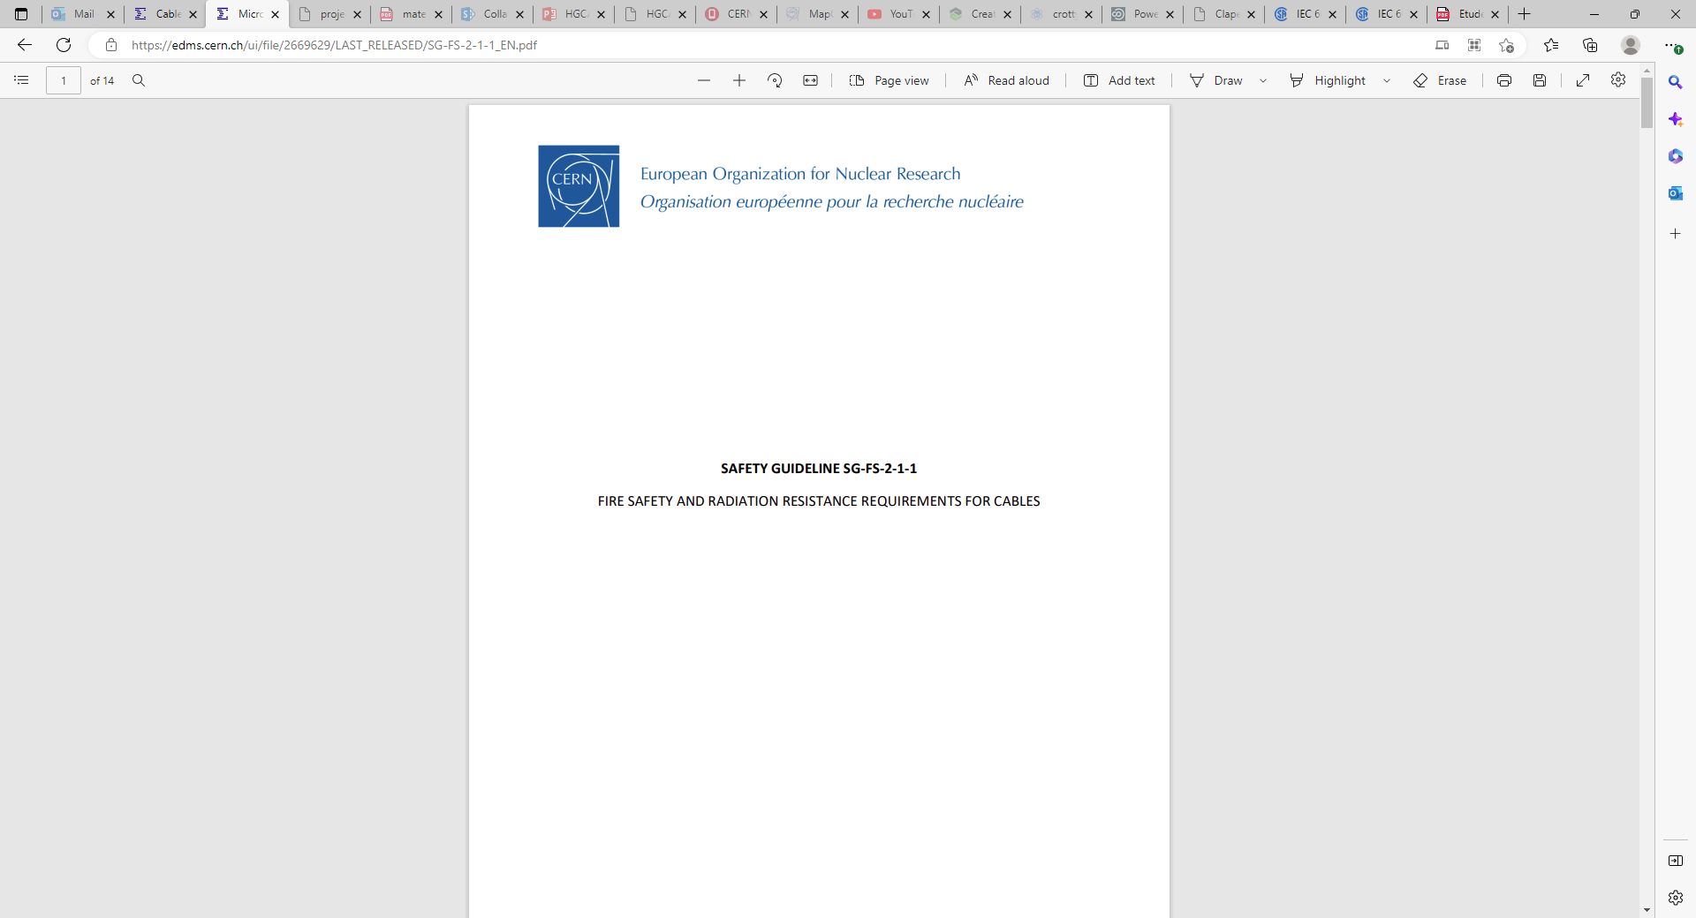
https://edms.cern.ch/ui/file/2669629/LAST_RELEASED/SG-FS-2-1-1_EN.pdf

Slide 3
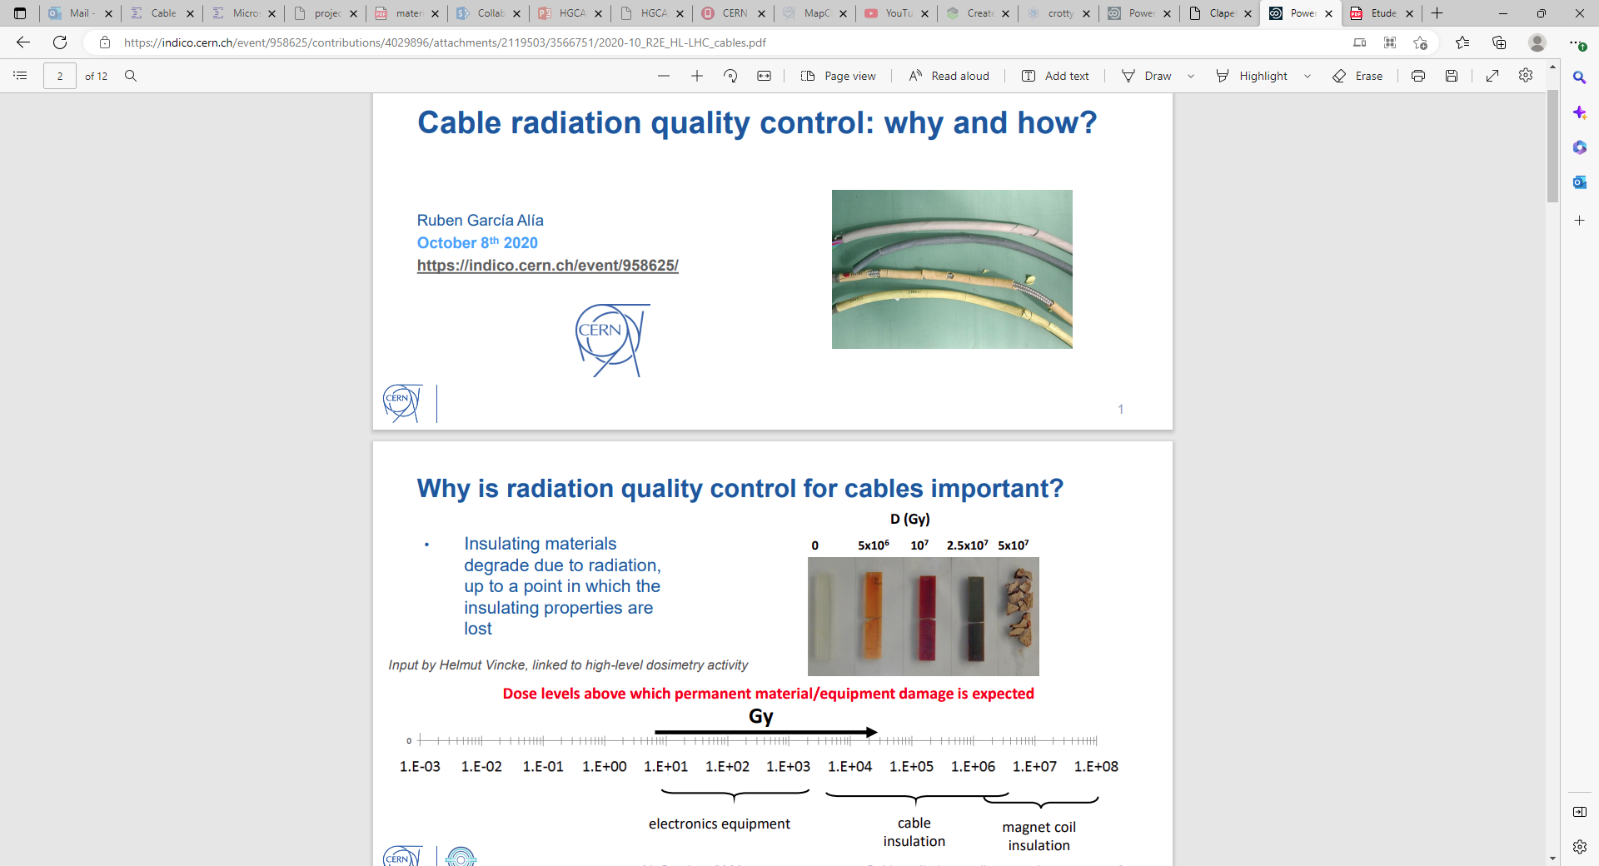
https://indico.cern.ch/event/958625/contributions/4029896/attachments/2119503/3566751/2020-10_R2E_HL-LHC_cables.pdf

Slide 4
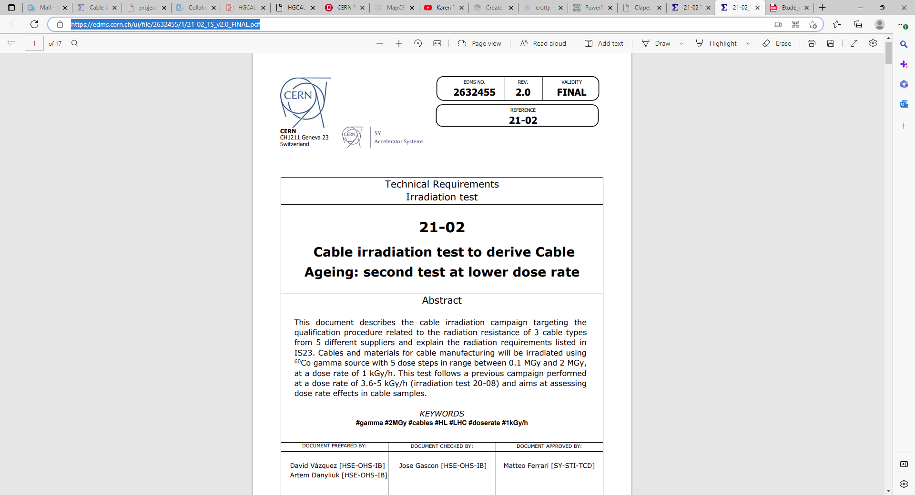
https://edms.cern.ch/ui/file/2632455/1/21-02_TS_v2.0_FINAL.pdf
https://edms.cern.ch/ui/#!master/navigator/document?D:100946237:100946237:subDocs

Slide 5
iec 60544 pdf

Slide 6
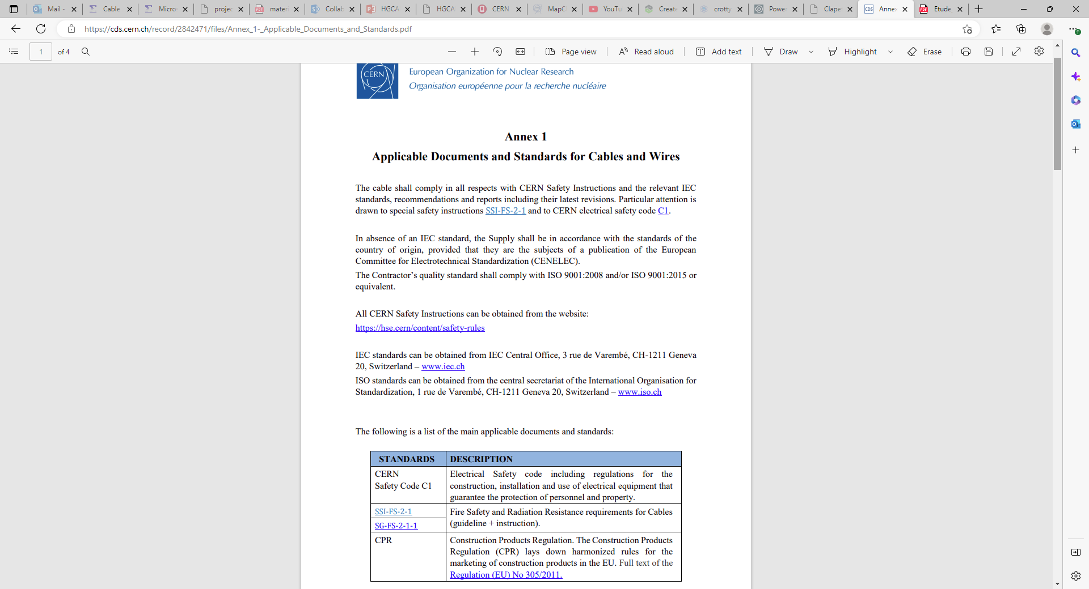
https://cds.cern.ch/record/2842471/files/Annex_1-_Applicable_Documents_and_Standards.pdf

Slide 7
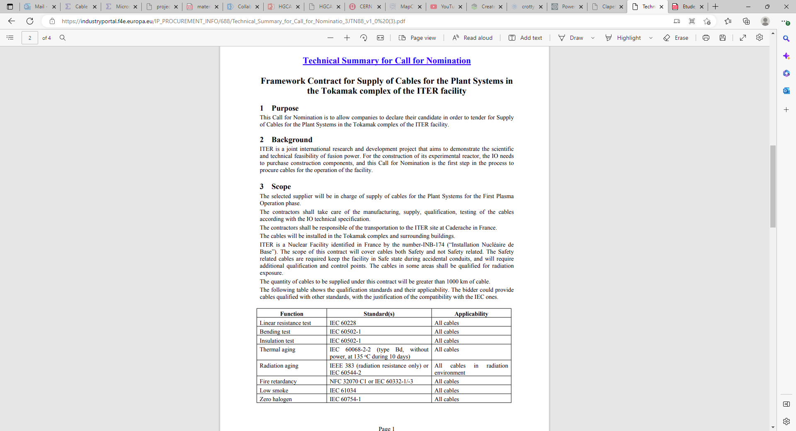
Tokomak spec
https://industryportal.f4e.europa.eu/IP_PROCUREMENT_INFO/688/Technical_Summary_for_Call_for_Nominatio_3JTN88_v1_0%20(3).pdf

Slide 8
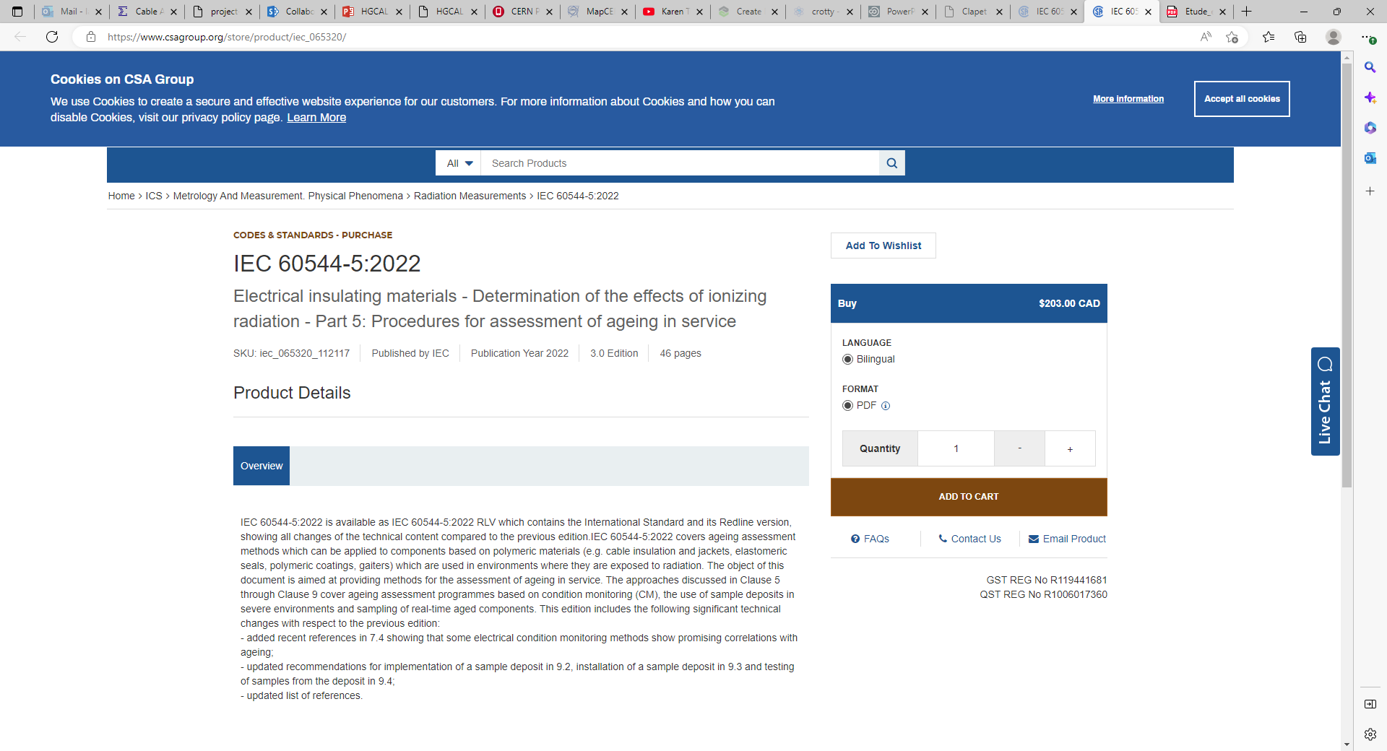
https://www.csagroup.org/store/product/iec_065320/

Slide 9
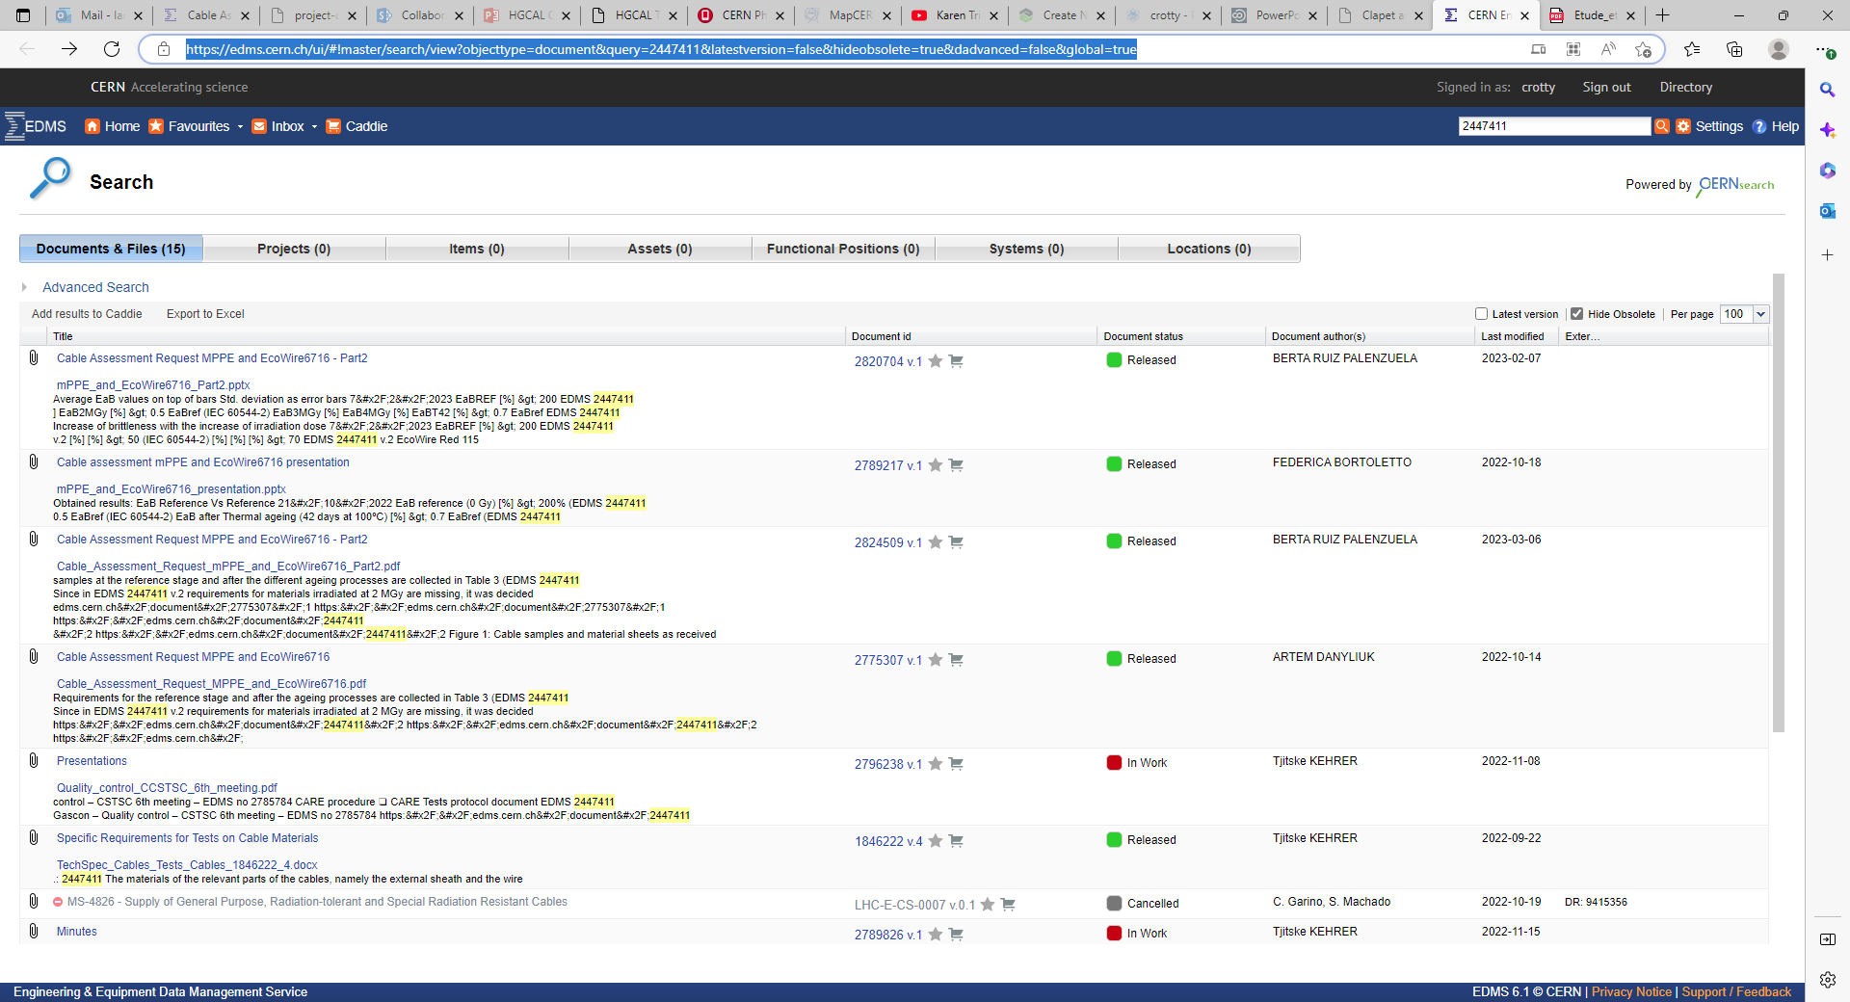
https://edms.cern.ch/ui/#!master/search/view?objecttype=document&query=2447411&latestversion=false&hideobsolete=true&dadvanced=false&global=true
mPPE tests

Slide 10
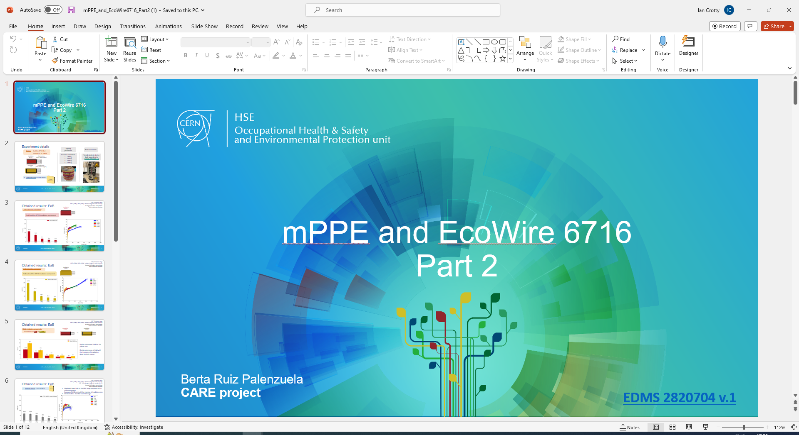
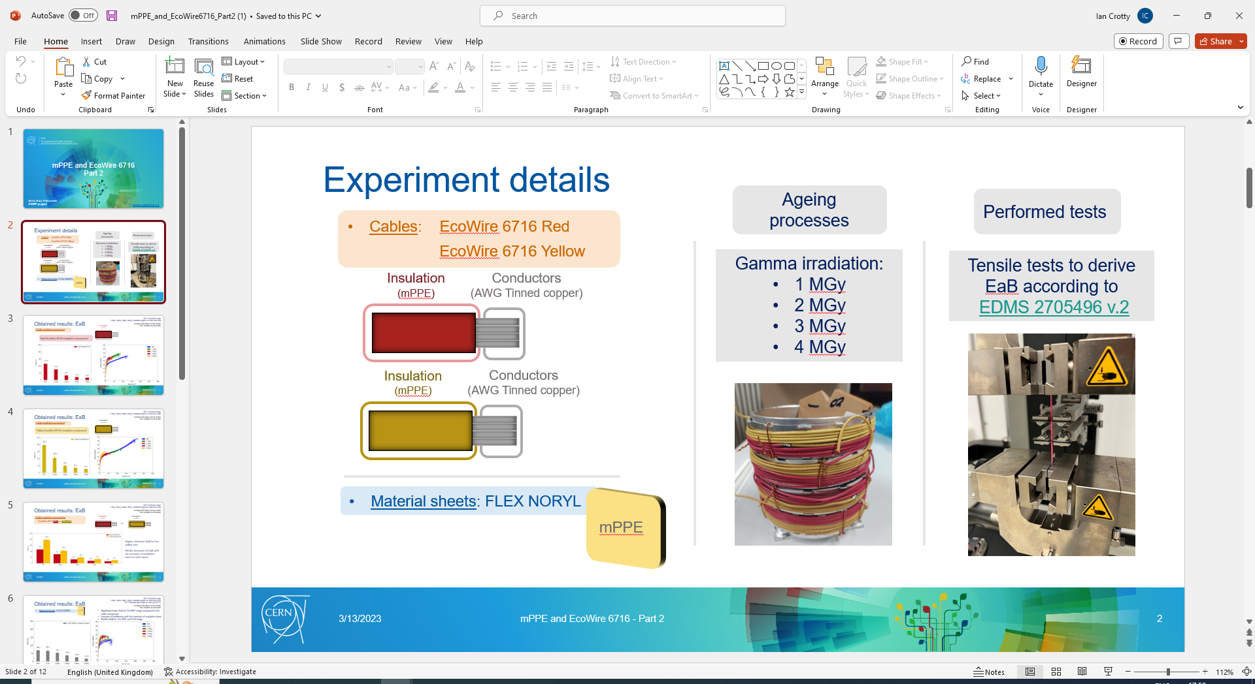
https://edms.cern.ch/ui/#!master/navigator/document?D:101201551:101201551:subDocs

