Slide 1
Reduction Legris

Slide 2
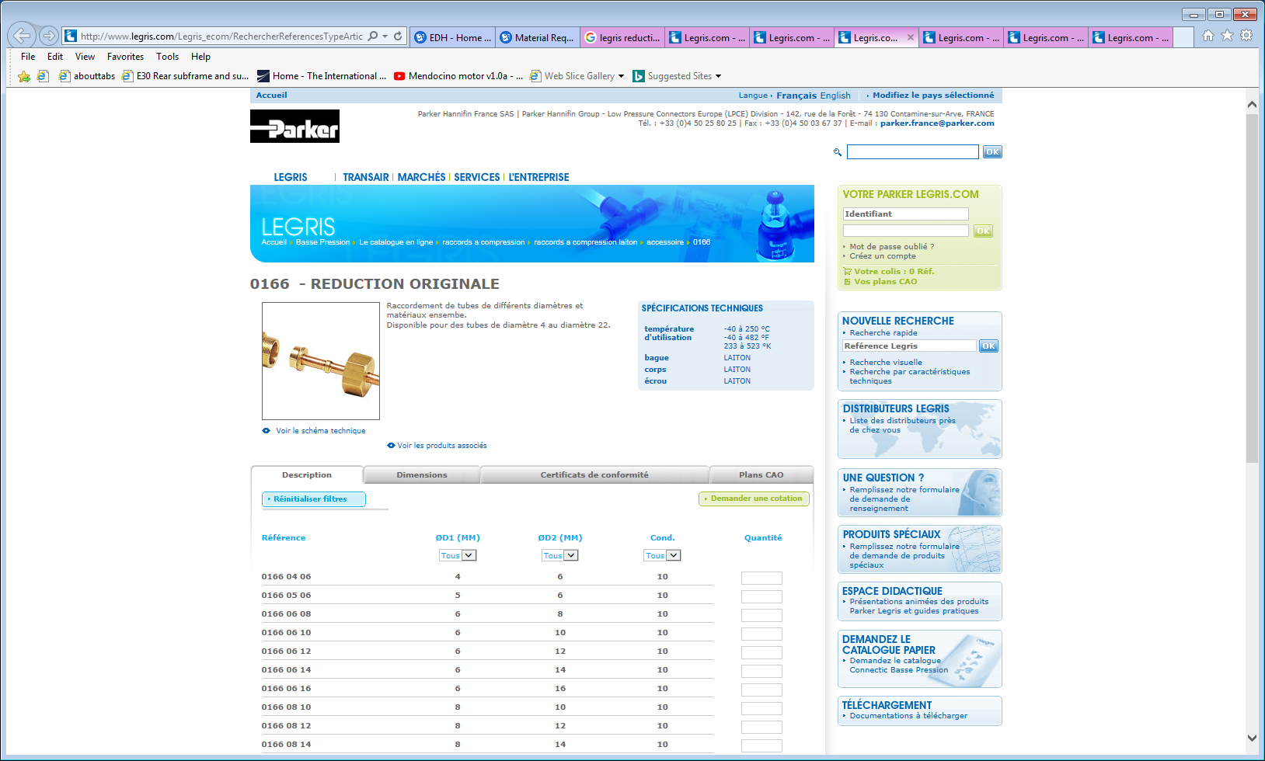
http://www.legris.com/Legris_ecom/RechercherReferencesTypeArticle.do;jsessionid=BD8D7D77A192688288095FEAD7CAE742?codeActivite=BP&codeGroupe=01&codeFamille=01&codeSousFamille=98&codeTypeArticle=0166&codeFiliale=france&codeLangue=fr

Slide 3
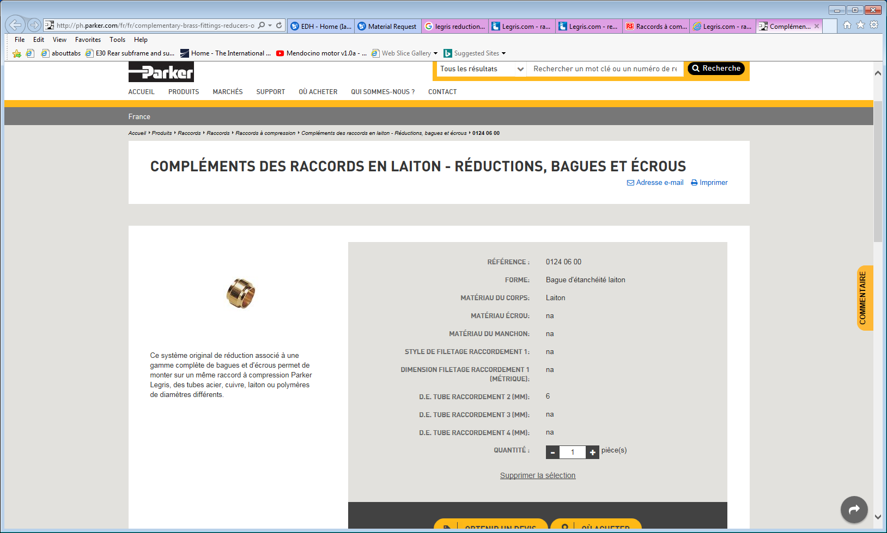
http://ph.parker.com/fr/fr/complementary-brass-fittings-reducers-olives-and-nuts/0124-06-00

Slide 4
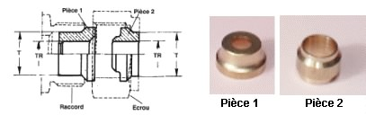
New Legris (Parker) reductions
It appears that the sealing is only done on one side and not 2 as in the standard compression fitting

Slide 5
